Slide 1
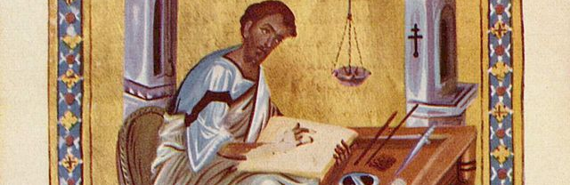
How do We Interpret the Bible?
Insights for Ministry in the 21st Century

Slide 2

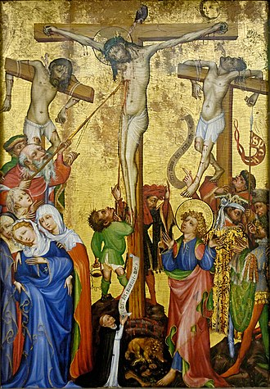
Views of Biblical Theology
Biblical Theology as Historical Description
Biblical Theology as History of Redemption
Biblical Theology as Worldview Story
Biblical Theology Canonical Approach
Biblical Theology as Theological Construction

Slide 3
Redemptive-Historical View of Biblical Theology

Slide 4
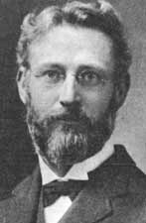
Geerhard Vos
“It is certainly not without significance that God has embodied the contents of revelation, not in a dogmatic system, but in a book of history, the parallel to which in dramatic interest and simple eloquence is nowhere to be found” (Vos 2001, 23)
“The Bible is not a dogmatic handbook but a historical book full of dramatic interest” (Vos 1975, 26).

Slide 5
Redemptive-historical hermeneutics recognizes that the Bible throughout is Christian Scripture. All of Scripture, whether it is in the Old or New Testament, not only points to but also reveals and applies Jesus Christ. Just as the full tree is present in the acorn, so also is the gospel present in the Old Testament in embryonic form. Without this assumption, our understanding of any text in any part of the canon will be, at root, a misunderstanding.

Slide 6
The Covenantal Funnel
Abrahamic
Re-Creation
Noahic
Mosaic
Davidic (a)
New Covenant
Davidic (b)
Incarnational
The Progress of Revelation

Slide 7
Begin with exegesis of Passage to identify theology theme
Explore historical Antecedent and Subsequent treatments of the Theme as understood within covenantal settings
Center Column References
Topical Bible
Theological Wordbooks
Commentary
Study Bible
OT/NT Theology Texts

Slide 8
Redemptive-Historical View of Temple/Tabernacle Typology

Slide 9
Exodus 25:8-9
8 And let them make me a sanctuary, that I may dwell in their midst. 9 Exactly as I show you concerning the pattern of the tabernacle, and of all its furniture, so you shall make it.

Slide 10
בֵּית יהוה
The House of the LORD

Slide 11
The Covenantal Funnel
Abrahamic
Re-Creation
Noahic
Mosaic
Davidic (a)
New Covenant
Davidic (b)
Incarnational
Garden

Slide 12
Garden
Genesis 3:8
And they heard the sound of the LORD God walking in the garden in the cool of the day, and the man and his wife hid themselves from the presence of the LORD God among the trees of the garden.
Conceptual Unfolding
Man Made for His Presence
Universal
Unhindered
Broken by sin

Slide 13
The Covenantal Funnel
Abrahamic
Re-Creation
Noahic
Mosaic
Davidic (a)
New Covenant
Davidic (b)
Incarnational
Tabernacle

Slide 14
Tabernacle
Exodus 25:8-9
8 And let them make me a sanctuary, that I may dwell in their midst. 9 Exactly as I show you concerning the pattern of the tabernacle, and of all its furniture, so you shall make it.
Leviticus 15:31
31 “Thus you shall keep the people of Israel separate from their uncleanness, lest they die in their uncleanness by defiling my tabernacle that is in their midst.”
Leviticus 26:11-12
11 I will make my dwelling among you, and my soul shall not abhor you. 12 And I will walk among you and will be your God, and you shall be my people.
Conceptual Unfolding
Divinely Initiated
Limited Access
Particular
Dangerous

Slide 15
The Covenantal Funnel
Abrahamic
Re-Creation
Noahic
Mosaic
Davidic (a)
New Covenant
Davidic (b)
Incarnational
Solomonic Temple

Slide 16
Solomonic Temple
2 Samuel 7
4 But that same night the word of the Lord came to Nathan, 5 “Go and tell my servant David, ‘Thus says the Lord: Would you build me a house to dwell in?
11c Moreover, the Lord declares to you that the Lord will make you a house. 12 When your days are fulfilled and you lie down with your fathers, I will raise up your offspring after you, who shall come from your body, and I will establish his kingdom. 13 He shall build a house for my name, and I will establish the throne of his kingdom forever. 14 I will be to him a father, and he shall be to me a son.
1 Kings 8:27
27 “But will God indeed dwell on the earth? Behold, heaven and the highest heaven cannot contain you; how much less this house that I have built!
Conceptual Unfolding
Divine Initiative
David’s Son
Physical Insufficiency

Slide 17
The Covenantal Funnel
Abrahamic
Re-Creation
Noahic
Mosaic
Davidic (a)
New Covenant
Davidic (b)
Incarnational
Restoration Temple

Slide 18
Restoration Temple
Jeremiah 7:12
12 Go now to my place that was in Shiloh, where I made my name dwell at first, and see what I did to it because of the evil of my people Israel. 13 And now, because you have done all these things, declares the Lord, and when I spoke to you persistently you did not listen, and when I called you, you did not answer, 14 therefore I will do to the house that is called by my name, and in which you trust, and to the place that I gave to you and to your fathers, as I did to Shiloh.
Haggai 2:9
9 The latter glory of this house shall be greater than the former, says the Lord of hosts. And in this place I will give peace, declares the Lord of hosts.’ ”
Conceptual Unfolding
Not a talisman
Greater glory to come
Everlasting Temple
The Nations

Slide 19
Restoration Temple
Ezekiel 37:26-28
26 I will make a covenant of peace with them. It shall be an everlasting covenant with them. And I will set them in their land and multiply them, and will set my sanctuary in their midst forevermore. 27 My dwelling place shall be with them, and I will be their God, and they shall be my people. 28 Then the nations will know that I am the Lord who sanctifies Israel, when my sanctuary is in their midst forevermore.”
Micah 4:1-2
It shall come to pass in the latter days that the mountain of the house of the Lord shall be established as the highest of the mountains, and it shall be lifted up above the hills; and peoples shall flow to it, 2 and many nations shall come, and say: “Come, let us go up to the mountain of the Lord, to the house of the God of Jacob, that he may teach us his ways and that we may walk in his paths.” For out of Zion shall go forth the law, and the word of the Lord from Jerusalem.
Conceptual Unfolding
Not a talisman
Greater glory to come
Everlasting Temple
The Nations

Slide 20
The Covenantal Funnel
Abrahamic
Re-Creation
Noahic
Mosaic
Davidic (a)
New Covenant
Davidic (b)
Incarnational
Jesus as the Temple

Slide 21
Jesus as the Temple
Matthew 12:6
6 I tell you, something greater than the temple is here.
John 2:19-22
19 Jesus answered them, “Destroy this temple, and in three days I will raise it up.” 20 The Jews then said, “It has taken forty-six years to build this temple, and will you raise it up in three days?” 21 But he was speaking about the temple of his body. 22 When therefore he was raised from the dead, his disciples remembered that he had said this, and they believed the Scripture and the word that Jesus had spoken.
Conceptual Unfolding
Jesus is the True Temple
He is the approachable presence of God

Slide 22
The Covenantal Funnel
Abrahamic
Re-Creation
Noahic
Mosaic
Davidic (a)
New Covenant
Davidic (b)
Incarnational
Church and Believers Built into the Temple

Slide 23
Believers and the Church as the Temple
1 Corinthians 3:16-17
16 Do you not know that you are God’s temple and that God’s Spirit dwells in you? 17 If anyone destroys God’s temple, God will destroy him. For God’s temple is holy, and you are that temple.
1 Corinthians 6:19-20
9 Or do you not know that your body is a temple of the Holy Spirit within you, whom you have from God? You are not your own, 20 for you were bought with a price. So glorify God in your body.
Conceptual Unfolding
In Christ
Both corporate and individual
Liminal

Slide 24
The Covenantal Funnel
Abrahamic
Re-Creation
Noahic
Mosaic
Davidic (a)
New Covenant
Davidic (b)
Incarnational
No Temple but the Lord God and the Lamb

Slide 25
Re-Creation
Revelation 21:22
22 And I saw no temple in the city, for its temple is the Lord God the Almighty and the Lamb.
Conceptual Unfolding
Universal
Spiritual
Eternal
Unhindered (the result of full redemption

