Slide 1
14
Files and Streams

Slide 2
I can only assume that a “Do Not File” document is filed in a “Do Not File” file.
  Senator Frank Church
  Senate Intelligence Subcommittee Hearing, 1975
Consciousness does not appear to itself chopped up in bits. A “river” or a “stream” are the metaphors by which it is most naturally described.
  William James
I read part of it all the way through.
  Samuel Goldwyn
A great memory does not make a philosopher, any more than a dictionary can be called grammar.
  John Henry, Cardinal Newman

Slide 3
OBJECTIVES
In this chapter you will learn:
To create, read, write and update files.
To use class File to retrieve information about files and directories.
The Java input/output stream class hierarchy.
The differences between text files and binary files.
Sequential-access and random-access file processing.
To use classes Scanner and Formatter to process text files.
To use the FileInputStream and FileOutputStream classes.
To use a JFileChooser dialog.
To use the ObjectInputStream and ObjectOutputStream classes.
To use class RandomAccessFile.

Slide 4
14.1 Introduction
14.2 Data Hierarchy
14.3 Files and Streams
14.4 Class File
14.5 Sequential-Access Text Files
14.5.1 Creating a Sequential-Access Text File
14.5.2 Reading Data from a Sequential-Access Text File
14.5.3 Case Study: A Credit-Inquiry Program
14.5.4 Updating Sequential-Access Files

Slide 5
14.6 Object Serialization
14.6.1 Creating a Sequential-Access File Using Object Serialization
14.6.2 Reading and Deserializing Data from a Sequential- Access File
14.7 Random-Access Files
14.7.1 Creating a Random-Access File
14.7.2 Writing Data Randomly to a Random-Access File
14.7.3 Reading Data Sequentially from a Random-Access File
14.7.4 Case Study: A Transaction-Processing Program
14.8 Additional java.io Classes
14.9 Opening Files with JFileChooser
14.10 Wrap-Up

Slide 6
14.1 Introduction
Storage of data in variables and arrays is temporary
Files used for long-term retention of large amounts of data, even after the programs that created the data terminate
Persistent data – exists beyond the duration of program execution
Files stored on secondary storage devices
Stream – ordered data that is read from or written to a file

Slide 7
14.2 Data Hierarchy
Computers process all data items as combinations of zeros and ones
Bit – smallest data item on a computer, can have values 0 or 1
Byte – 8 bits
Characters – larger data item
  Consists of decimal digits, letters and special symbols
  Character set – set of all characters used to write programs and represent data items
    Unicode – characters composed of two bytes
    ASCII

Slide 8
14.2 Data Hierarchy
Fields – a group of characters or bytes that conveys meaning
Record – a group of related fields
File – a group of related records
Data items processed by computers form a data hierarchy that becomes larger and more complex from bits to files
Record key – identifies a record as belonging to a particular person or entity – used for easy retrieval of specific records
Sequential file – file in which records are stored in order by the record-key field
Database – a group of related files
Database Management System – a collection of programs designed to create and manage databases

Slide 9
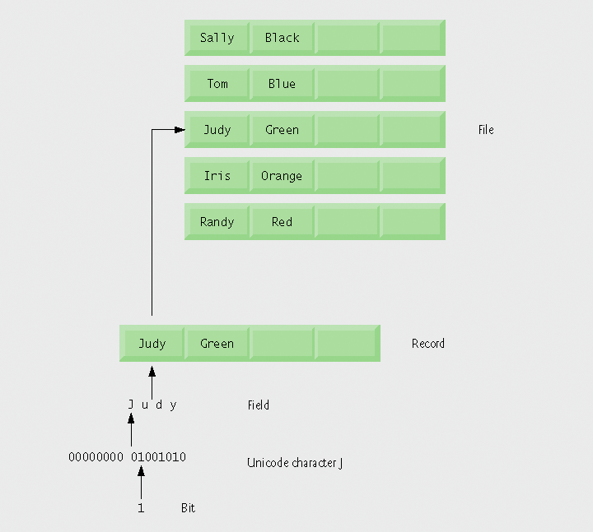
Fig. 14.1 | Data hierarchy.

Slide 10
14.3 Files and Streams
Java views each files as a sequential stream of bytes
Operating system provides mechanism to determine end of file
  End-of-file marker
  Count of total bytes in file
  Java program processing a stream of bytes receives an indication from the operating system when program reaches end of stream

Slide 11
14.3 Files and Streams
File streams
  Byte-based streams – stores data in binary format
    Binary files – created from byte-based streams, read by a program that converts data to human-readable format
  Character-based streams – stores data as a sequence of characters
    Text files – created from character-based streams, can be read by text editors
Java opens file by creating an object and associating a stream with it
Standard streams – each stream can be redirected
  System.in – standard input stream object, can be redirected with method setIn
  System.out – standard output stream object, can be redirected with method setOut
  System.err – standard error stream object, can be redirected with method setErr

Slide 12
14.3 Files and Streams
java.io classes
  FileInputStream and FileOutputStream – byte-based I/O
  FileReader and FileWriter – character-based I/O
  ObjectInputStream and ObjectOutputStream – used for input and output of objects or variables of primitive data types
  File – useful for obtaining information about files and directories
Classes Scanner and Formatter
  Scanner – can be used to easily read data from a file
  Formatter – can be used to easily write data to a file

Slide 13

Fig. 14.2 | Java’s view of a file of n bytes.

Slide 14
14.4 Class File
Class File useful for retrieving information about files and directories from disk
Objects of class File do not open files or provide any file-processing capabilities

Slide 15
Creating File Objects
Class File provides four constructors:
  Takes String specifying name and path (location of file on disk)
  Takes two Strings, first specifying path and second specifying name of file
  Takes File object specifying path and String specifying name of file
  Takes URI object specifying name and location of file
Different kinds of paths
  Absolute path – contains all directories, starting with the root directory, that lead to a specific file or directory
  Relative path – normally starts from the directory in which the application began executing

Slide 16
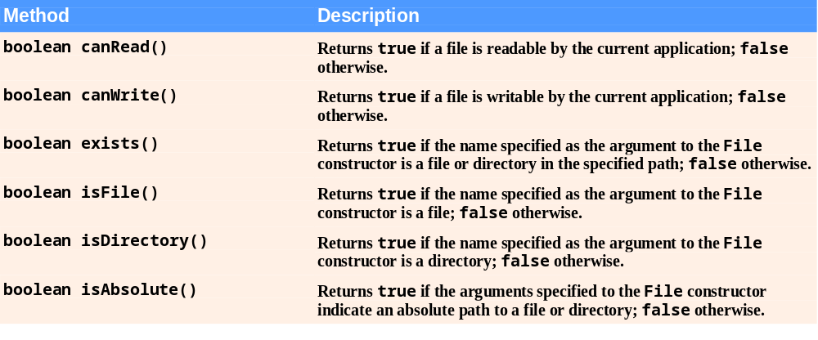
Fig. 14.3 | File methods.
(Part 1 of 2)

Slide 17
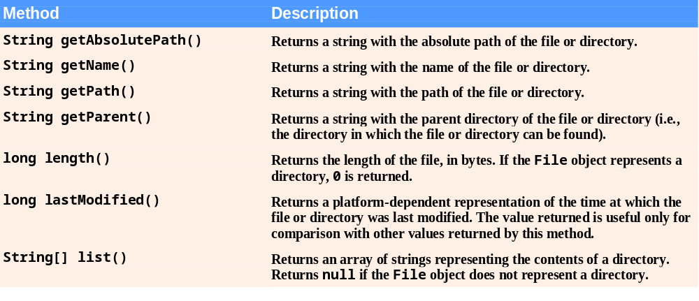
Fig.14.3 | File methods.
(Part 2 of 2)

Slide 18
Error-Prevention Tip 14.1
Use File method isFile to determine whether a File object represents a file (not a directory) before attempting to open the file.

Slide 19
Demonstrating Class File
Common File methods
  exists – return true if file exists where it is specified
  isFile – returns true if File is a file, not a directory
  isDirectory – returns true if File is a directory
  getPath – return file path as a string
  list – retrieve contents of a directory
Separator character – used to separate directories and files in a path
  Windows uses \
  UNIX uses /
  Java process both characters, File.pathSeparator can be used to obtain the local computer’s proper separator character

Slide 20
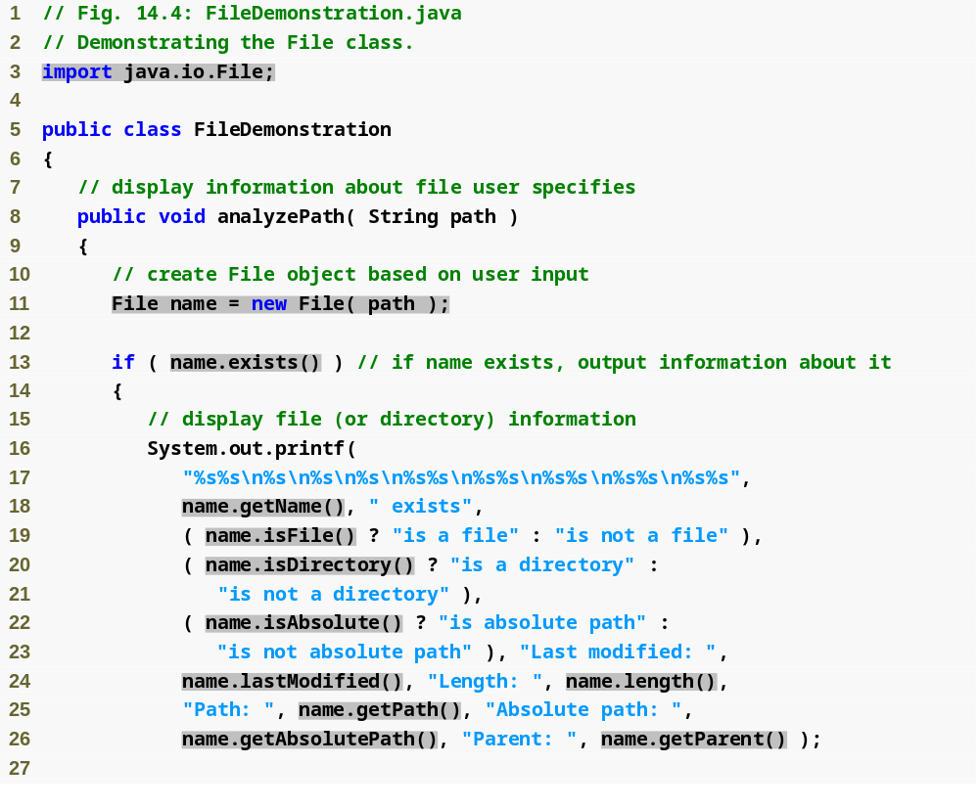
Outline
FileDemonstration
.java
(1 of 2)
Create new File object; user specifies file name and path
Returns true if file or directory specified exists
Retrieve name of file or directory
Returns true if name is a file, not a directory
Returns true if name is a directory, not a file
Returns true if path was an absolute path
Retrieve time file or directory was last modified (system-dependent value)
Retrieve length of file in bytes
Retrieve path entered as a string
Retrieve absolute path of file or directory
Retrieve parent directory (path where File object’s file or directory can be found)

Slide 21
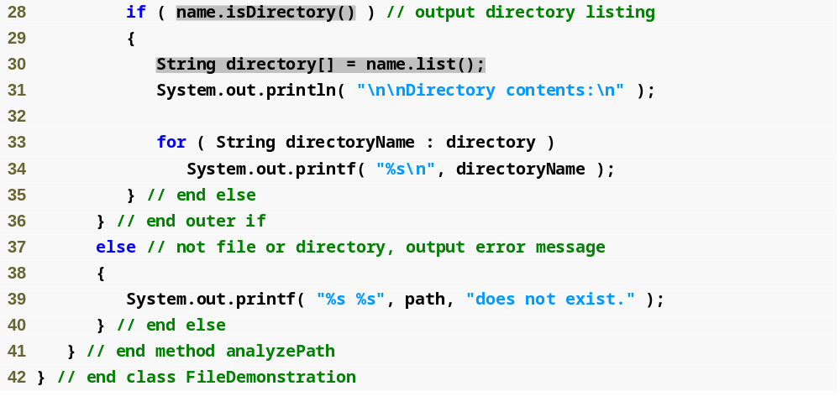
Outline
Returns true if File is a directory, not a file
FileDemonstration
.java
(2 of 2)
Retrieve and display contents of directory

Slide 22
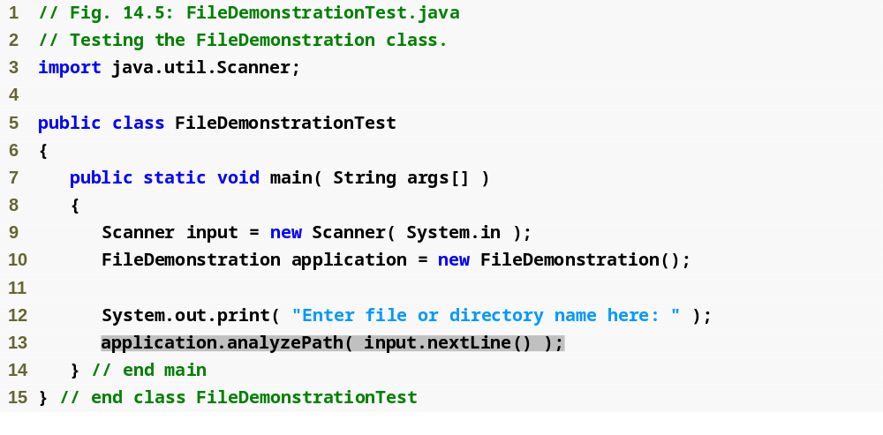
Outline
FileDemonstration
Test.java
(1 of 3)

Slide 23
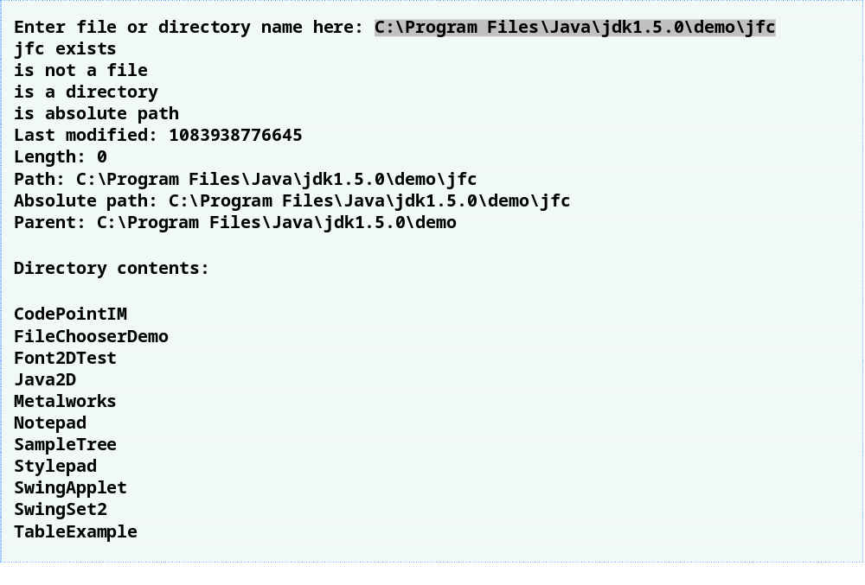
Outline
FileDemonstration
Test.java
(2 of 3)

Slide 24
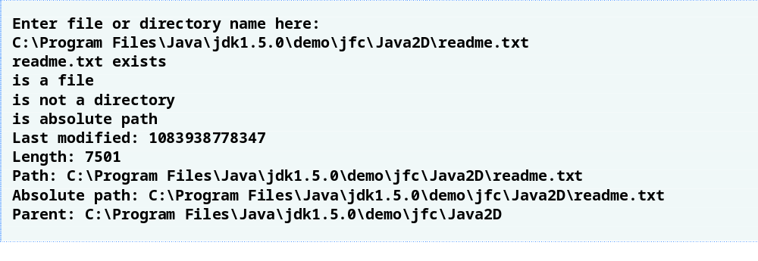
Outline
FileDemonstration
Test.java
(3 of 3)

Slide 25
Common Programming Error 14.1
Using \ as a directory separator rather than \\ in a string literal is a logic error. A single \ indicates that the \ followed by the next character represents an escape sequence. Use \\ to insert a \ in a string literal.

Slide 26
14.5 Sequential-Access Text Files
Records are stored in order by record-key field
Can be created as text files or binary files

Slide 27
14.5.1 Creating a Sequential-Access Text File
Java imposes no structure on a file, records do not exist as part of the Java language
Programmer must structure files
Formatter class can be used to open a text file for writing
  Pass name of file to constructor
  If file does not exist, will be created
  If file already exists, contents are truncated (discarded)
  Use method format to write formatted text to file
  Use method close to close the Formatter object (if method not called, OS normally closes file when program exits)

Slide 28
14.5.1 Creating a Sequential-Access Text File
Possible exceptions
  SecurityException – occurs when opening file using Formatter object, if user does not have permission to write data to file
  FileNotFoundException – occurs when opening file using Formatter object, if file cannot be found and new file cannot be created
  NoSuchElementException – occurs when invalid input is read in by a Scanner object
  FormatterClosedException – occurs when an attempt is made to write to a file using an already closed Formatter object

Slide 29
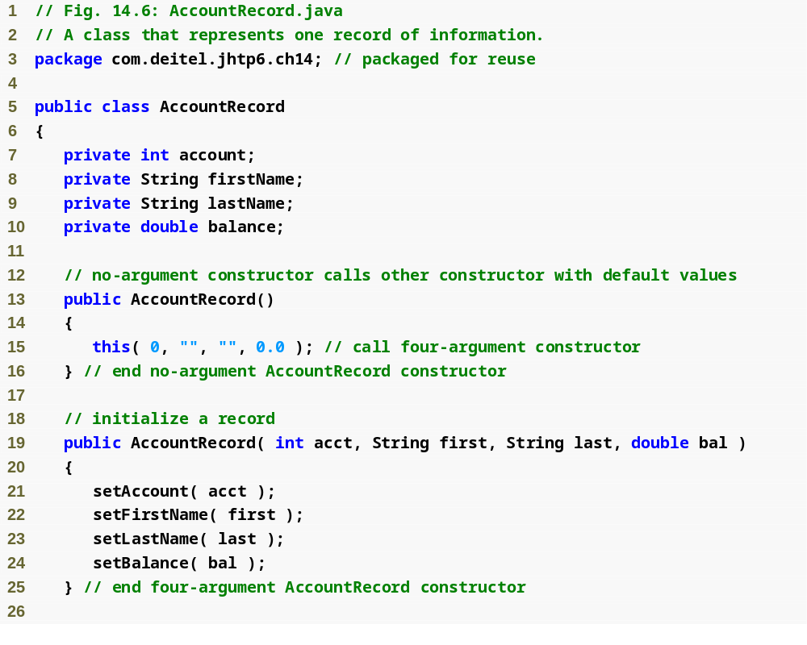
Outline
AccountRecord.java
(1 of 3)

Slide 30
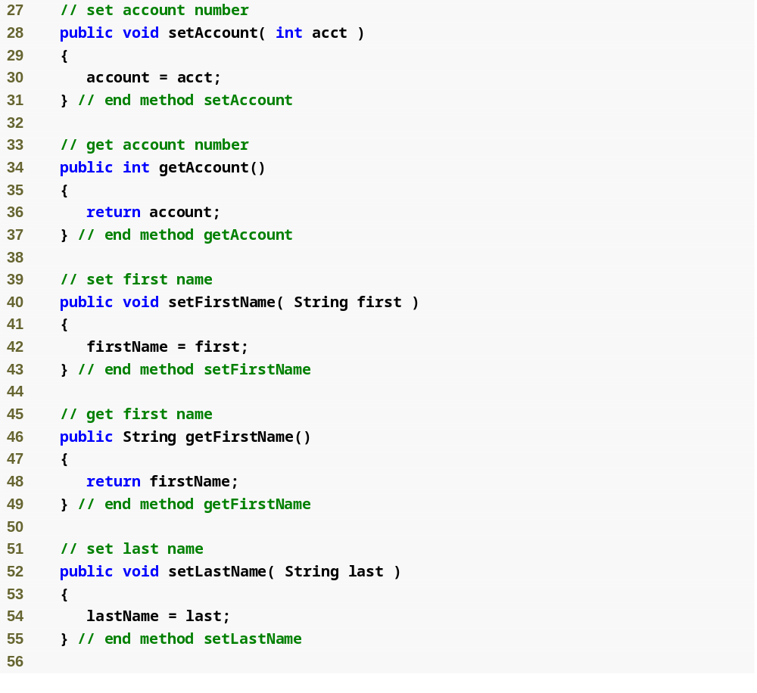
Outline
AccountRecord.java
(2 of 3)

Slide 31
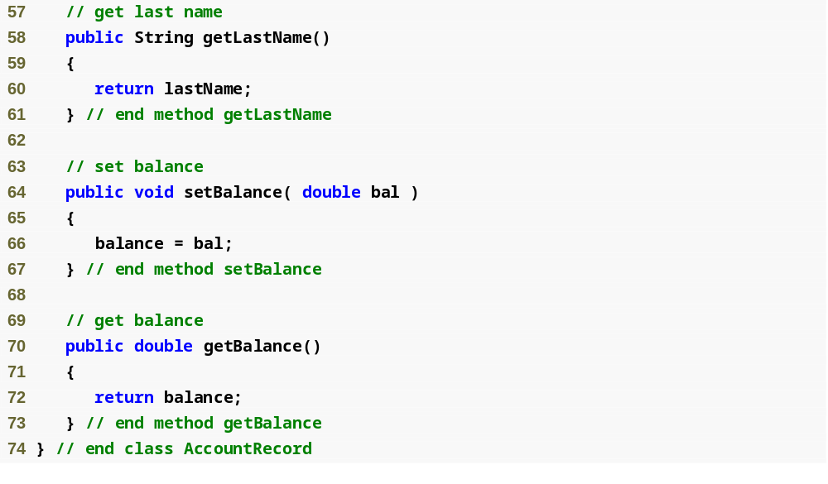
Outline
AccountRecord.java
(3 of 3)

Slide 32
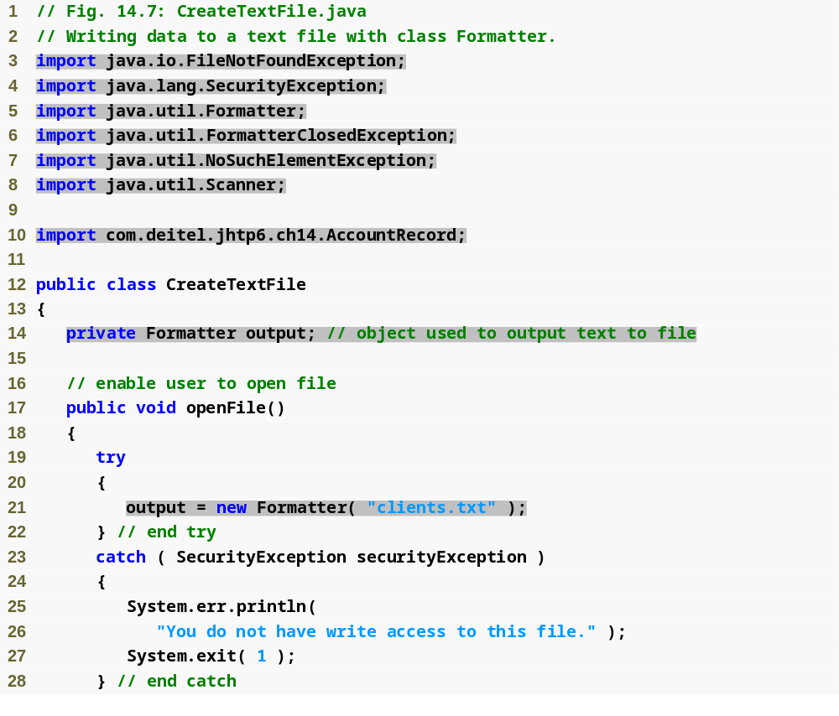
Outline
Used for writing data to file
CreateTextFile
.java
(1 of 4)
Used for retrieving input from user
Object used to output data to file
Open file clients.txt for writing

Slide 33
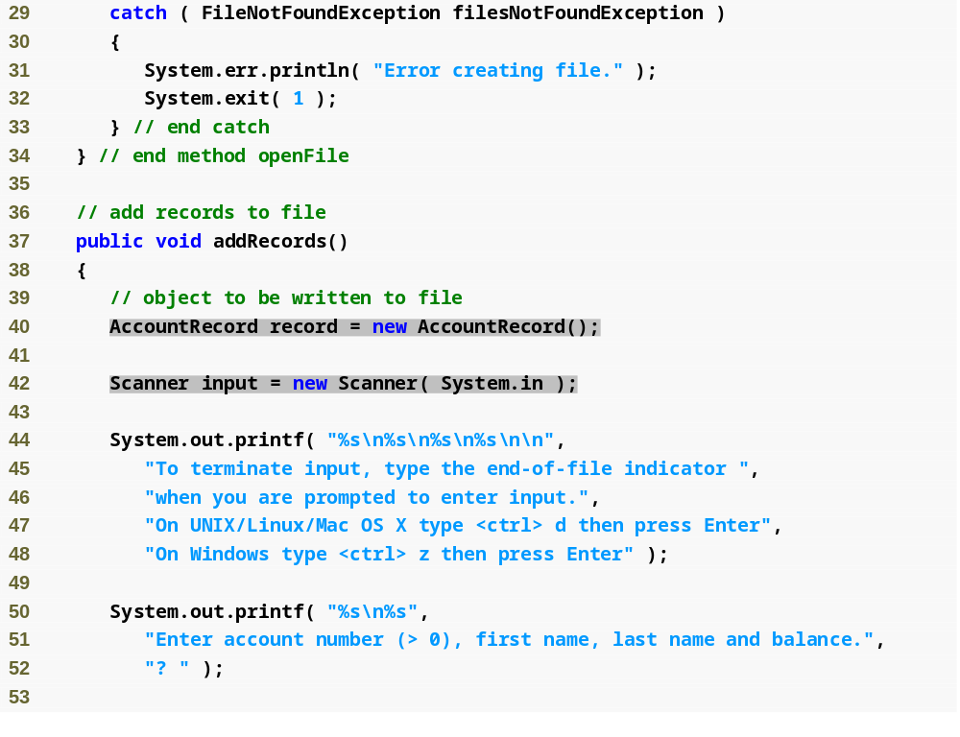
Outline
CreateTextFile
.java
(2 of 4)
Create AccountRecord to be filled with user input
Create Scanner to retrieve input from user

Slide 34
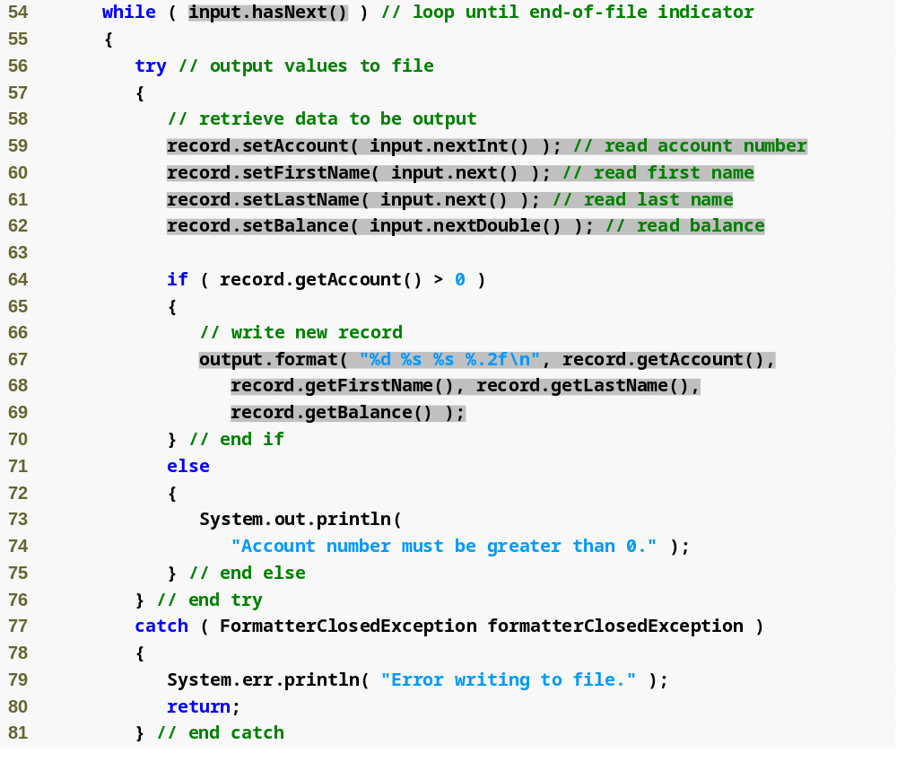
Outline
Loop while user is entering input
CreateTextFile
.java
(3 of 4)
Retrieve input, store data in AccountRecord
Write AccountRecord information to file
File closed while trying to write to it

Slide 35
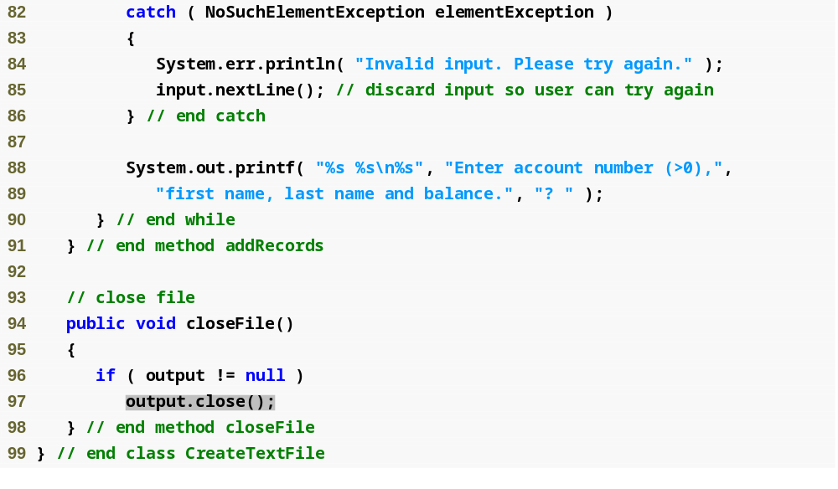
Outline
Error with input entered by user
CreateTextFile
.java
(4 of 4)
Close file

Slide 36
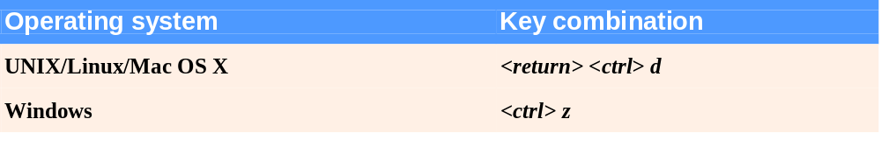
Fig.14.8 | End-of-file key combinations for various popular operating systems.

Slide 37
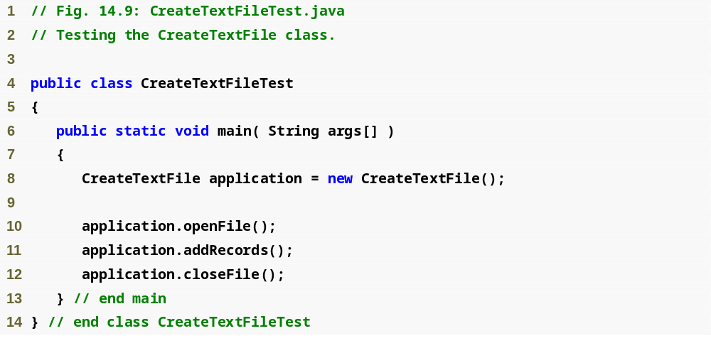
Outline
CreateTextFileTest
.java
(1 of 2)

Slide 38
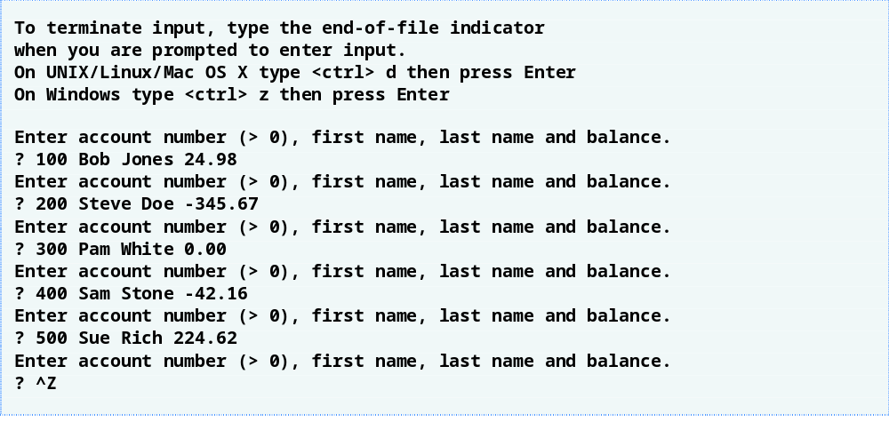
Outline
CreateTextFileTest
.java
(2 of 2)

Slide 39
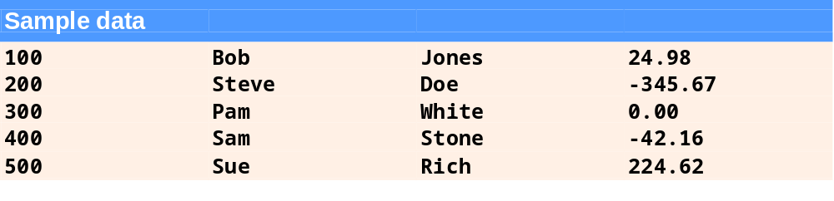
Fig.14.10 | Sample data for the program in Fig. 14.7.

Slide 40
14.5.2 Reading Data from a Sequential-Access Text File
Data is stored in files so that it may be retrieved for processing when needed
Scanner object can be used to read data sequentially from a text file
  Pass File object representing file to be read to Scanner constructor
  FileNotFoundException occurs if file cannot be found
  Data read from file using same methods as for keyboard input – nextInt, nextDouble, next, etc.
  IllegalStateException occurs if attempt is made to read from closed Scanner object

Slide 41
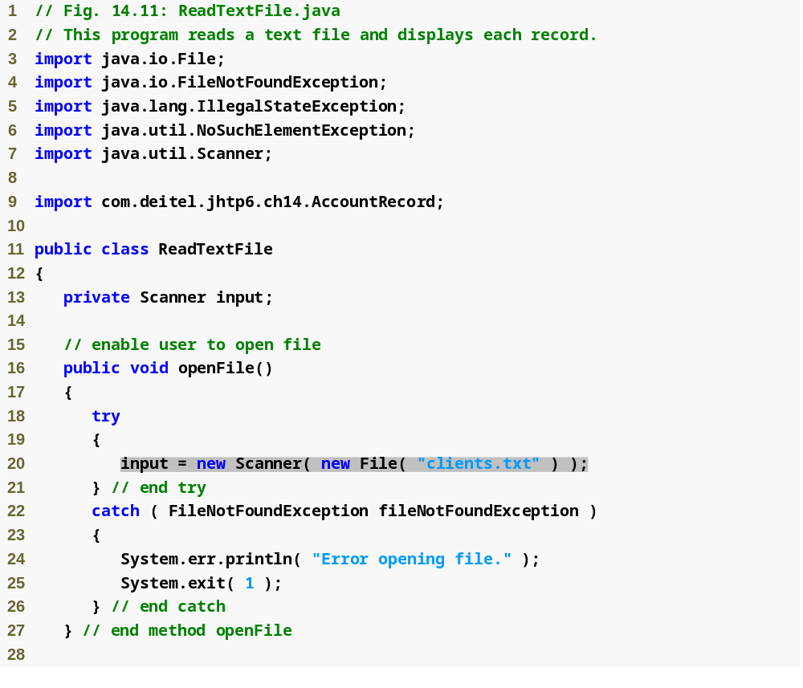
Outline
ReadTextFile.java
(1 of 3)
Open file clients.txt for reading

Slide 42
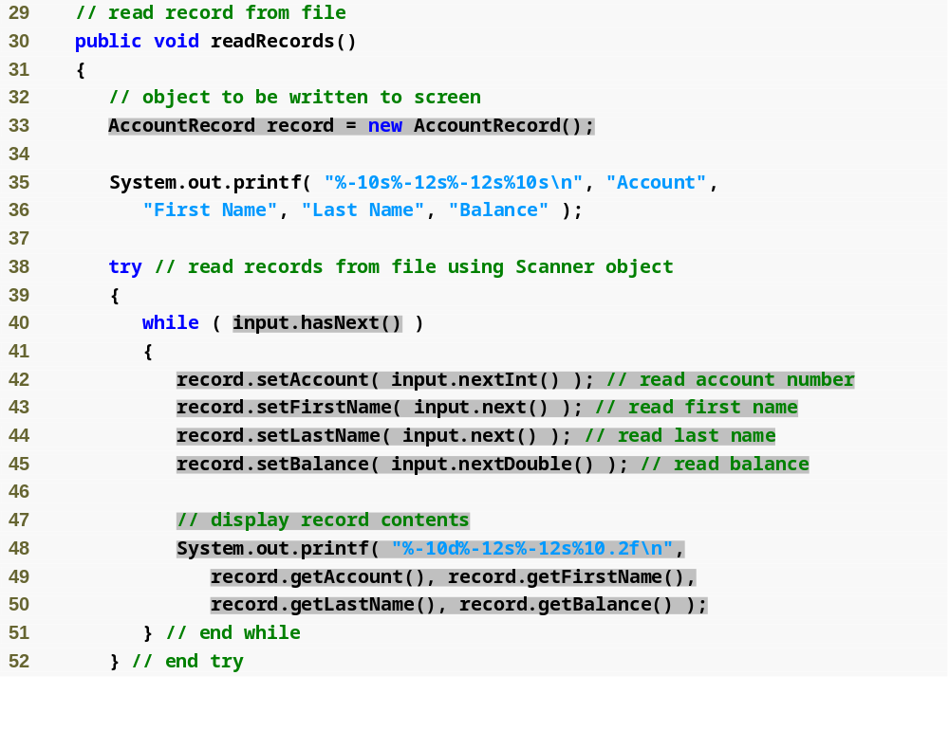
Outline
ReadTextFile.java
(2 of 3)
Create AccountRecord to store input from file
While there is data to be read from file
Read data from file, store in AccountRecord
Display AccountRecord contents

Slide 43
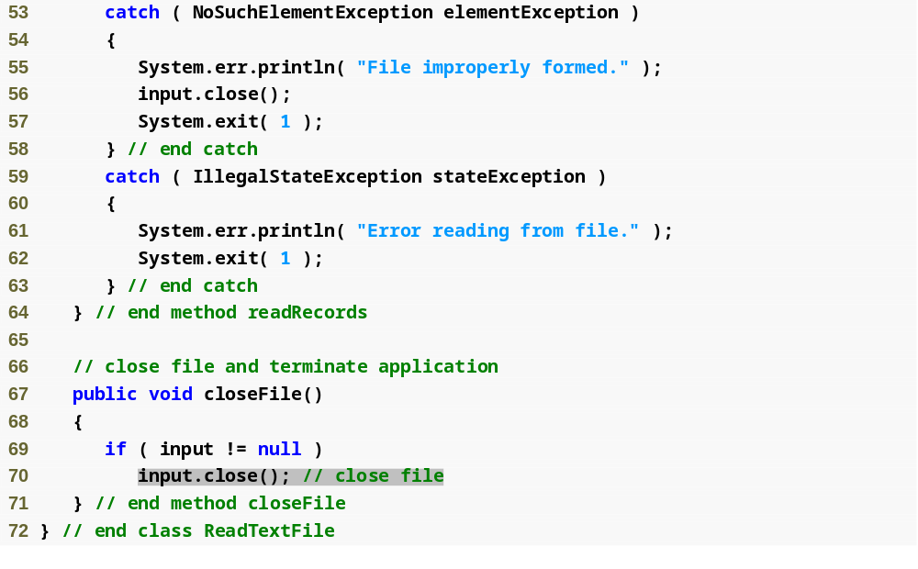
Outline
ReadTextFile.java
(3 of 3)
Close file

Slide 44
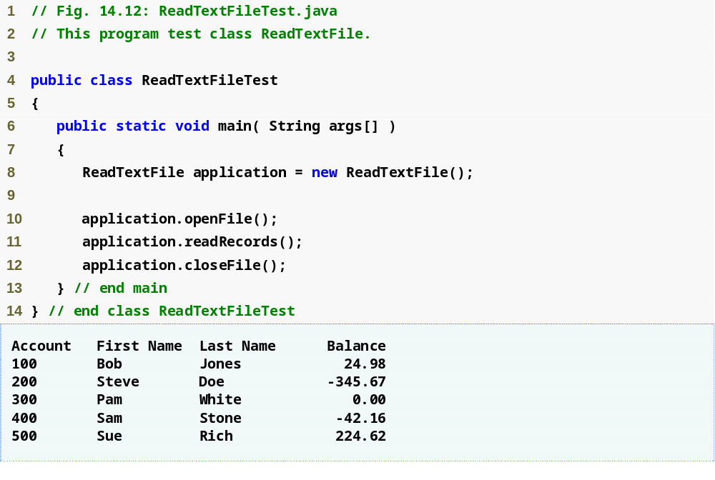
Outline
ReadTextFileTest
.java

Slide 45
14.5.3 Case Study: A Credit-Inquiry Program
To retrieve data sequentially from a file, programs normally start reading from beginning of the file and read all the data consecutively until desired information is found
Class Scanner provides no way to reposition to beginning of file
Instead, file is closed and reopened

Slide 46
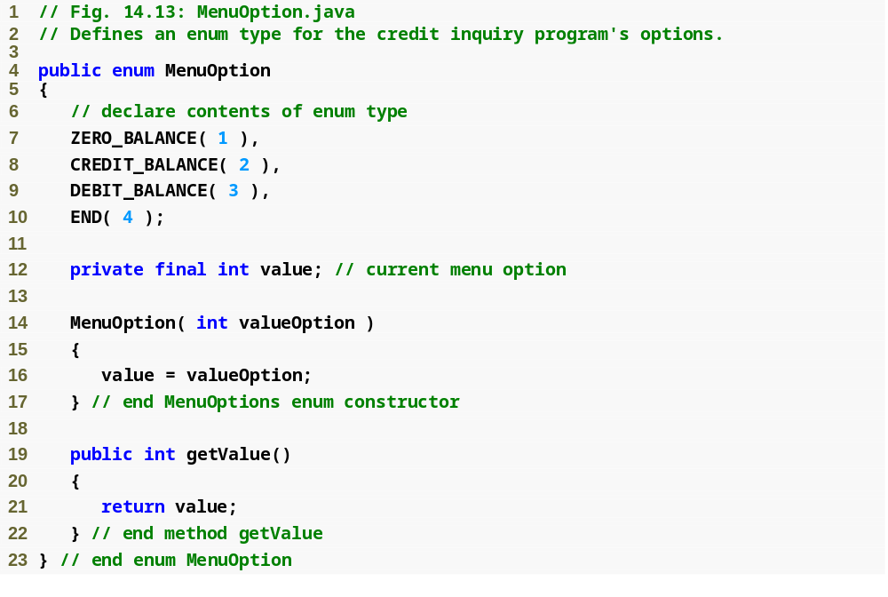
Outline
MenuOption.java

Slide 47
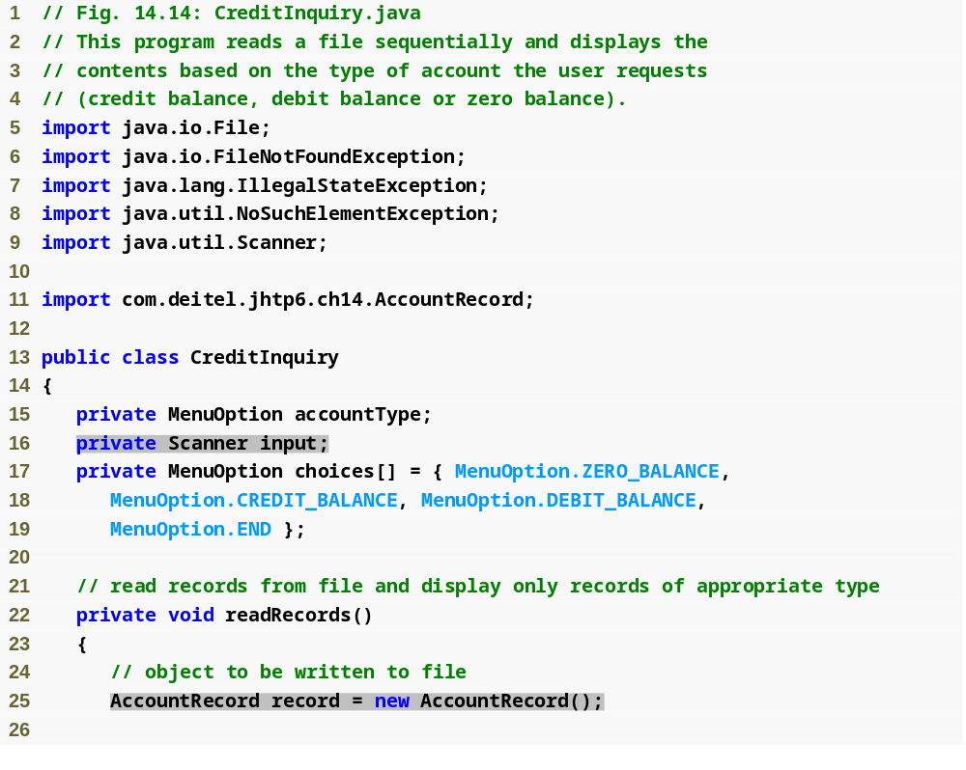
Outline
CreditInquiry.java
(1 of 6)
Scanner used to read data from file
AccountRecord stores record being read from file

Slide 48
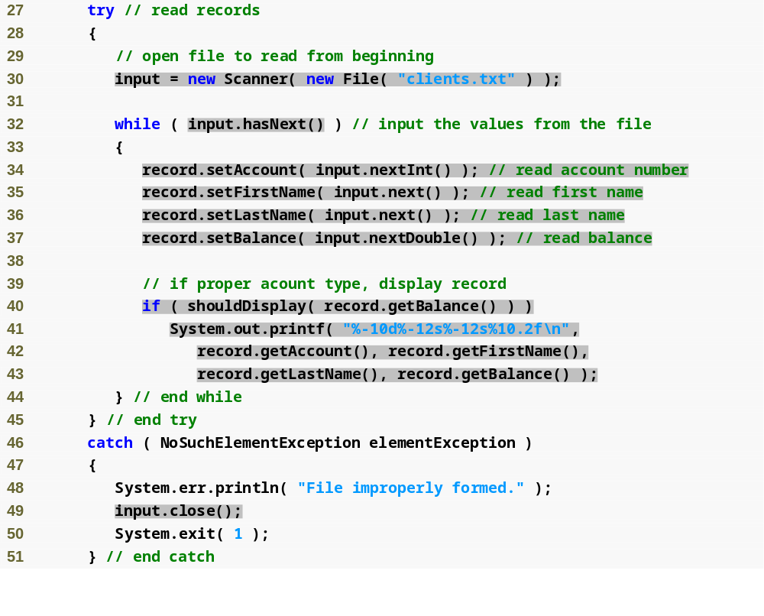
Outline
Open file clients.txt for reading
While there is data to read from file
CreditInquiry.java
(2 of 6)
Check if record is of requested type
Retrieve input, store data in AccountRecord
Display record data to screen
Close Scanner

Slide 49
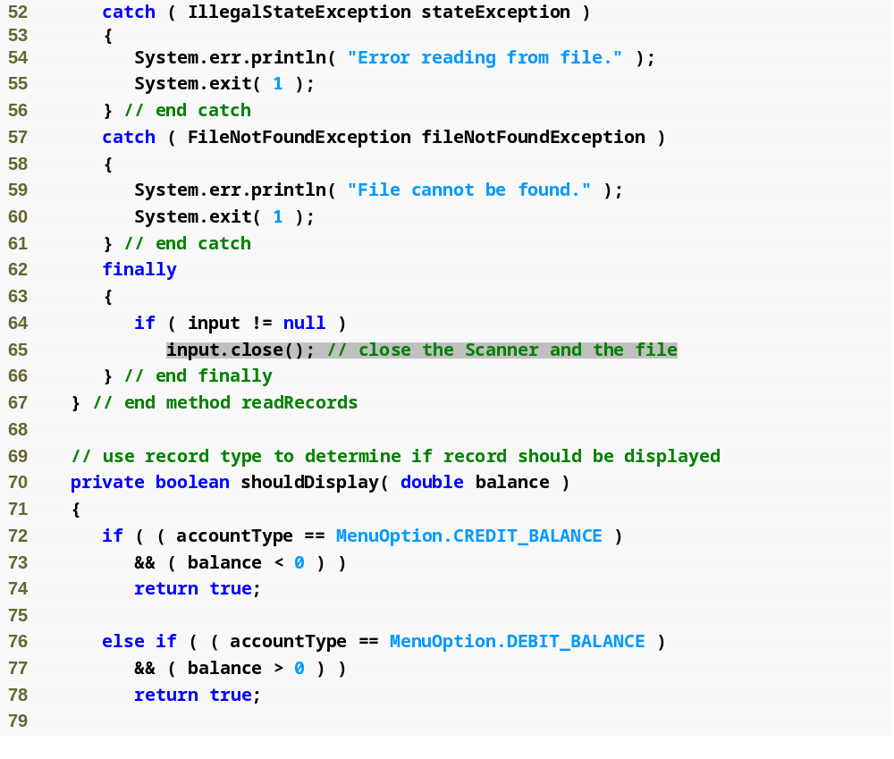
Outline
CreditInquiry.java
(3 of 6)
Close file
Method determines if record is of proper type

Slide 50
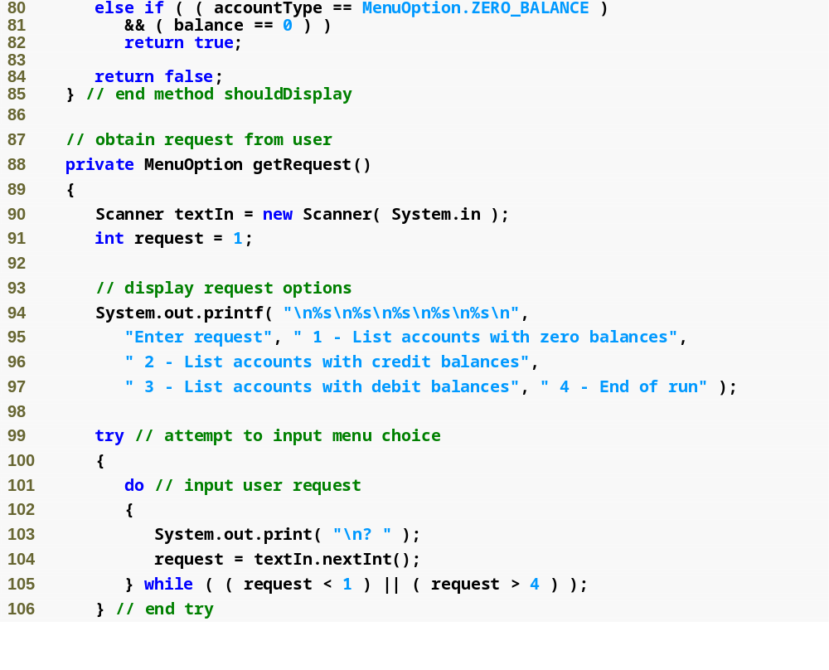
Outline
CreditInquiry.java
(4 of 6)
Loop until user enters valid request
Retrieve request entered

Slide 51
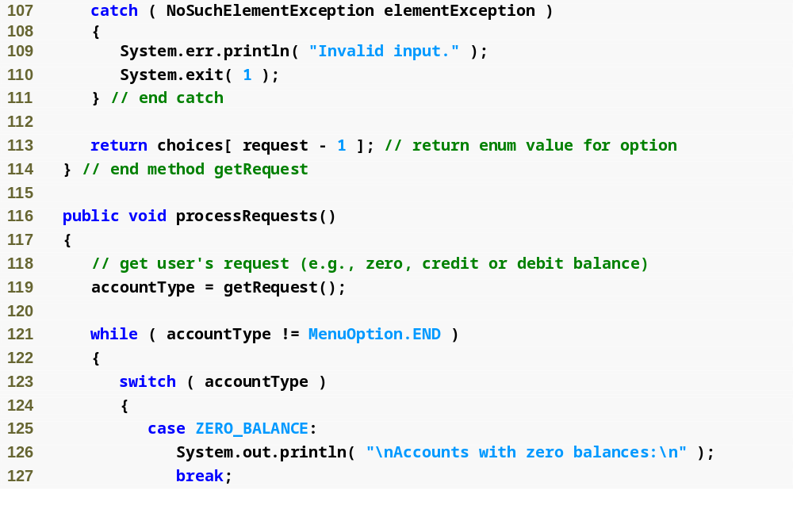
Outline
CreditInquiry.java
(5 of 6)

Slide 52
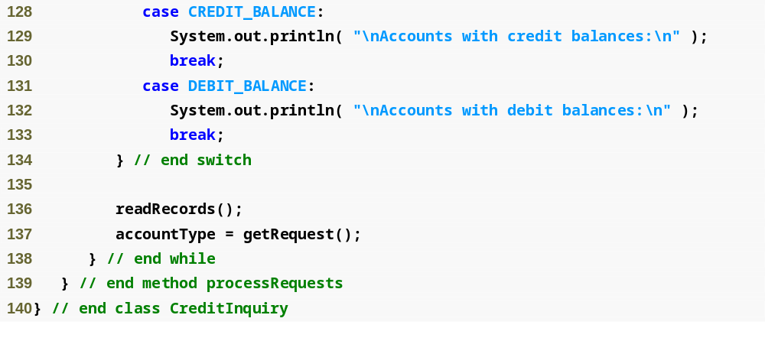
Outline
CreditInquiry.java
(6 of 6)
Read file, display proper records

Slide 53
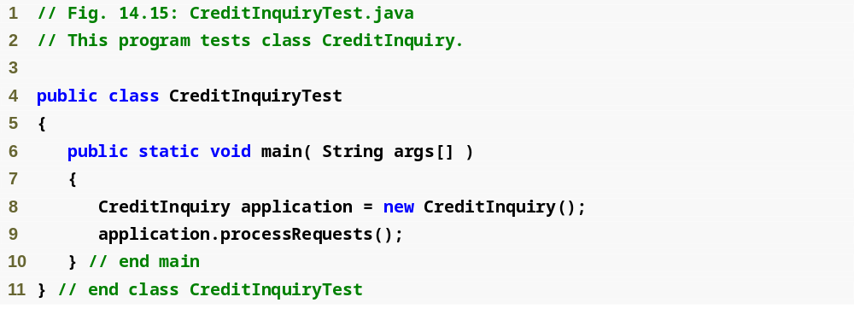
Outline
CreditInquiryTest
.java

Slide 54
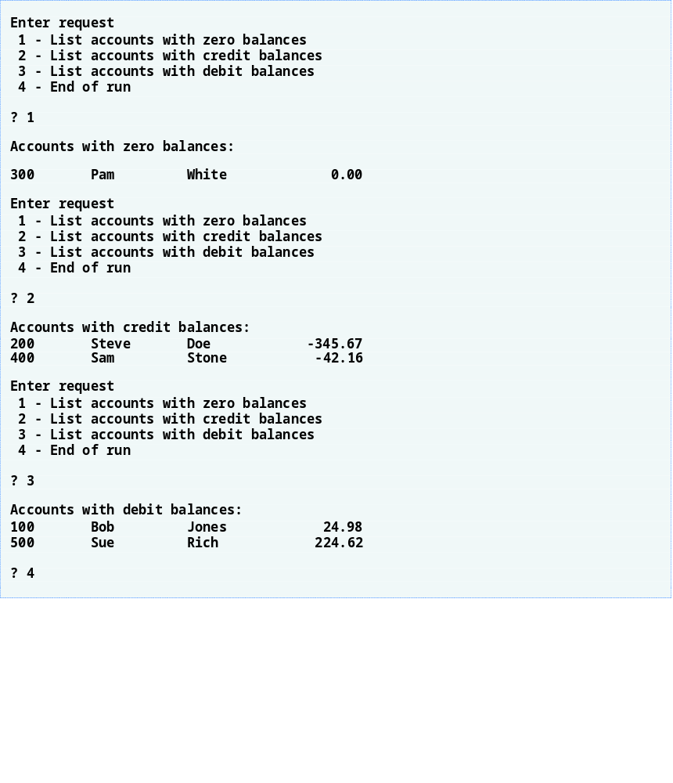
Outline

Slide 55
14.5.4 Updating Sequential-Access Files
Data in many sequential files cannot be modified without risk of destroying other data in file
Old data cannot be overwritten if new data is not same size
Records in sequential-access files are not usually updated in place. Instead, entire file is usually rewritten.

Slide 56
14.6 Object Serialization
With text files, data type information lost
Object serialization – mechanism to read or write an entire object from a file
Serialized object – object represented as sequence of bytes, includes object’s data and type information about object
Deserialization – recreate object in memory from data in file
Serialization and deserialization performed with classes ObjectInputStream and ObjectOutputStream, methods readObject and writeObject

Slide 57
14.6.1 Creating a Sequential-Access File Using Object Serialization:
Defining the AccountRecordSerializable Class
Serializable interface – programmers must declare a class to implement the Serializable interface, or objects of that class cannot be written to a file
To open a file for writing objects, create a FileOutputStream wrapped by an ObjectOutputStream
  FileOutputStream provides methods for writing byte-based output to a file
  ObjectOutputStream uses FileOutputStream to write objects to file
  ObjectOutputStream method writeObject writes object to output file
  ObjectOutputStream method close closes both objects

Slide 58
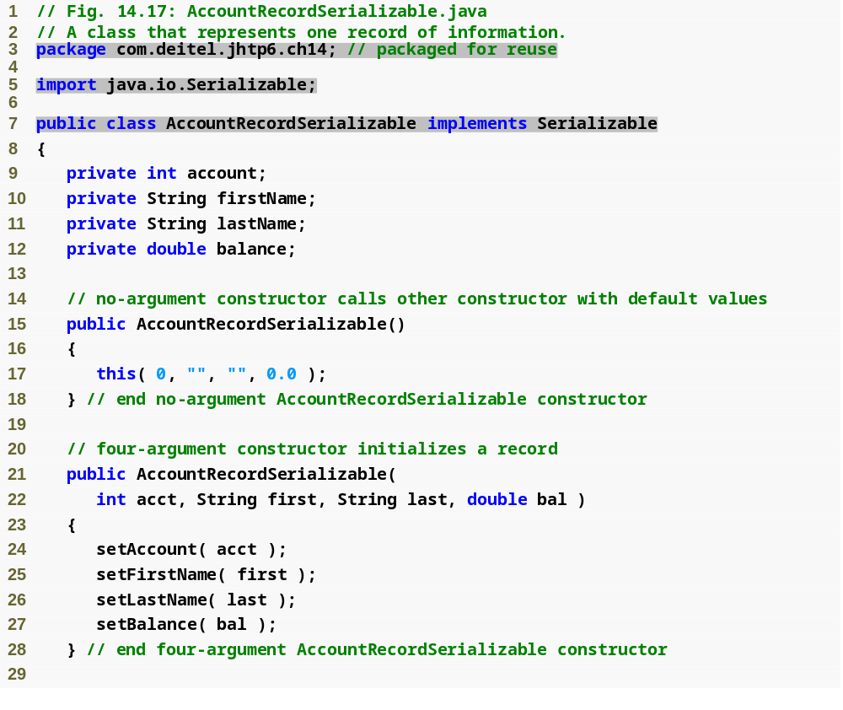
Outline
AccountRecord
Serializable.java
(1 of 3)
Interface Serializable specifies that AccountRecordSerializable objects can be written to file

Slide 59
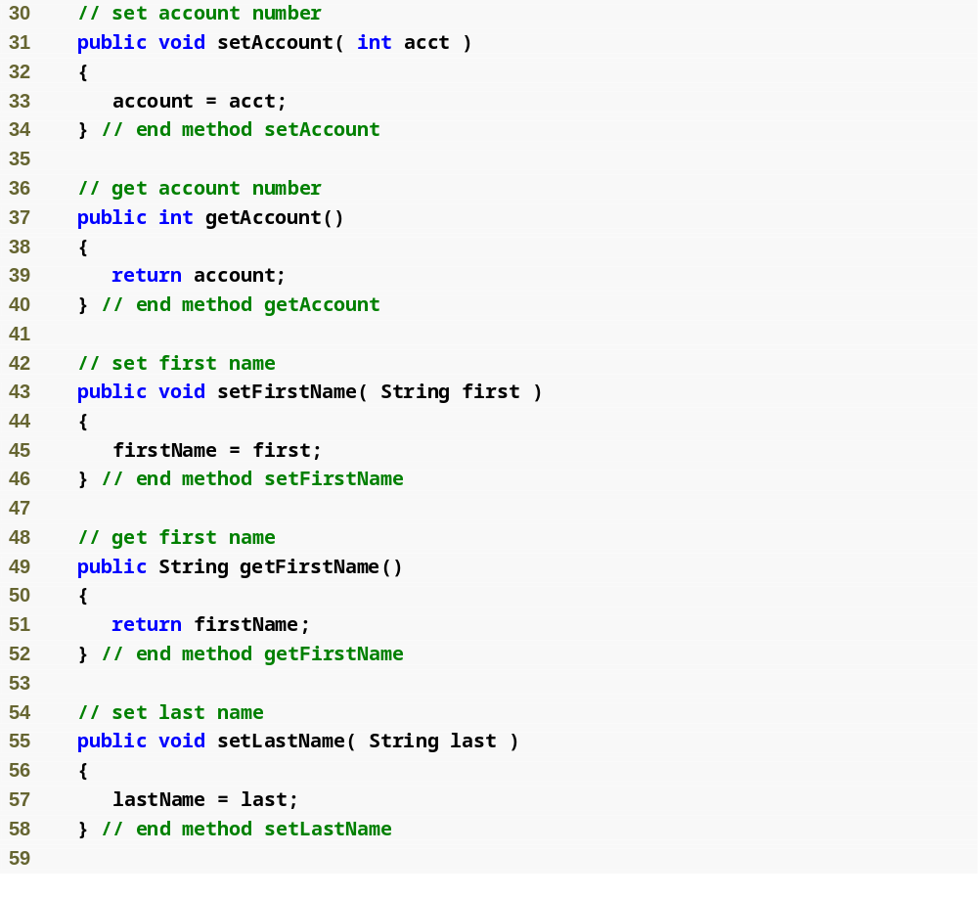
Outline
AccountRecord
Serializable.java
(2 of 3)

Slide 60
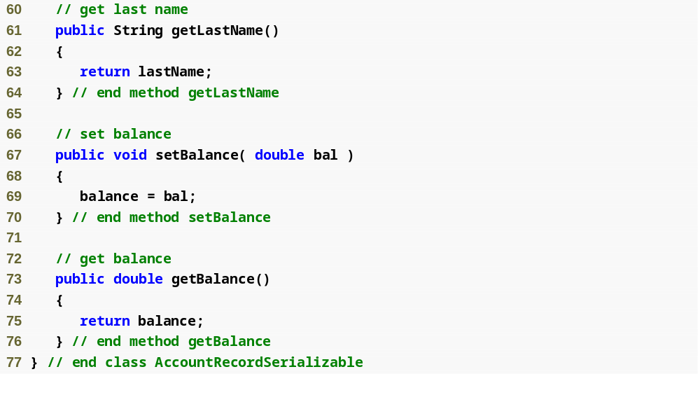
Outline
AccountRecord
Serializable.java
(3 of 3)

Slide 61
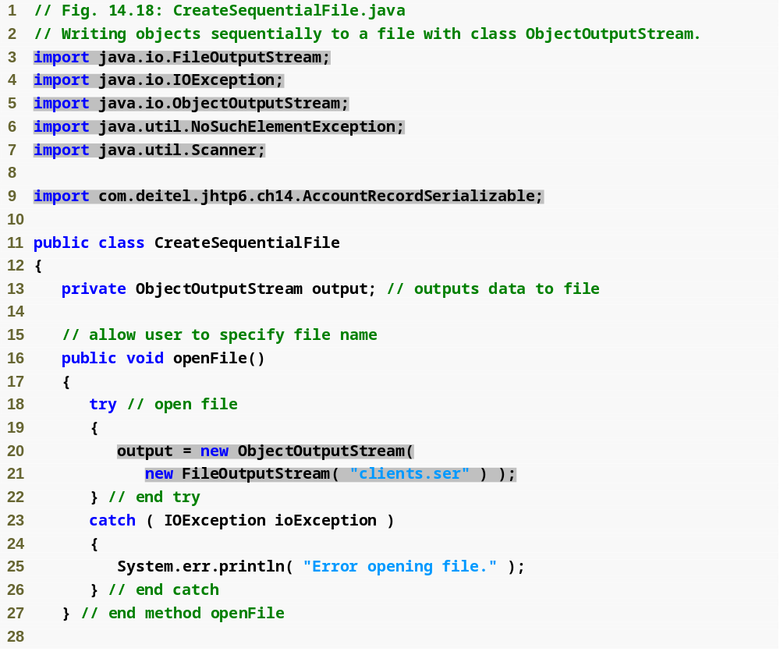
Outline
Class used to create byte-based output stream
Class used to create output object data to byte-based stream
CreateSequential
File.java
(1 of 4)
Open file clients.ser for writing

Slide 62
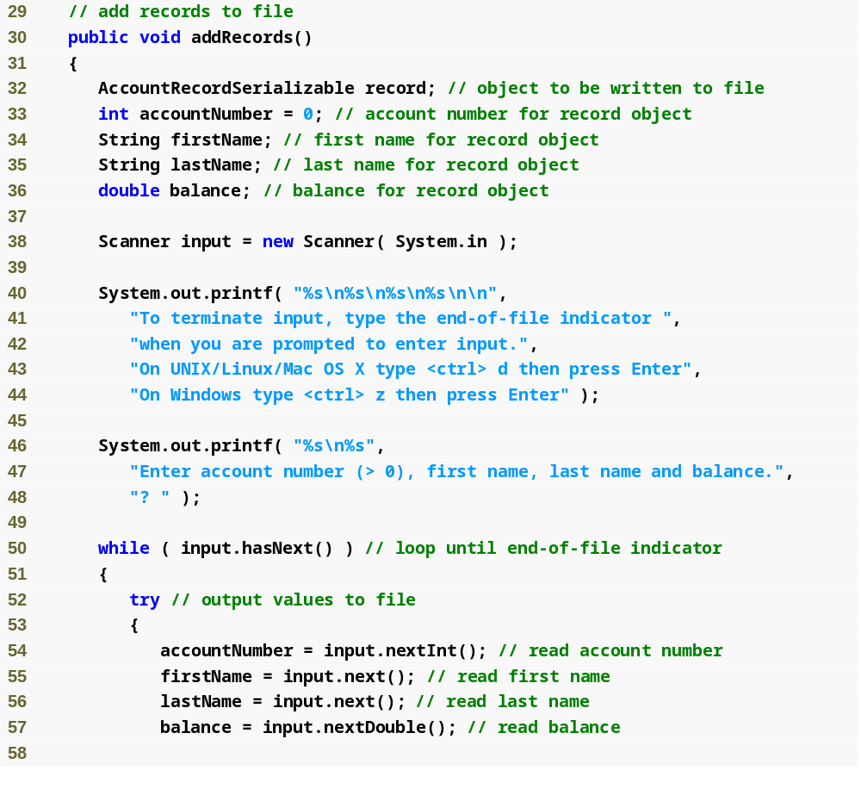
Outline
CreateSequential
File.java
(2 of 4)

Slide 63
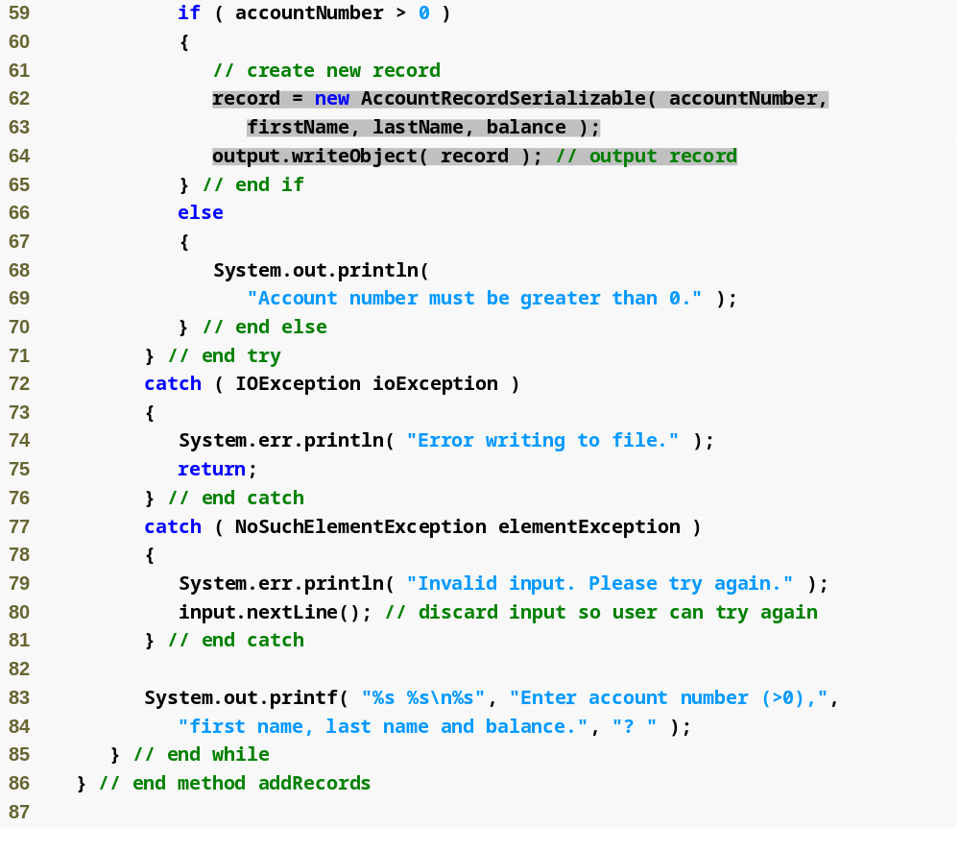
Outline
Write record object to file
Create AccountRecord based on user input
CreateSequential
File.java
(3 of 4)

Slide 64
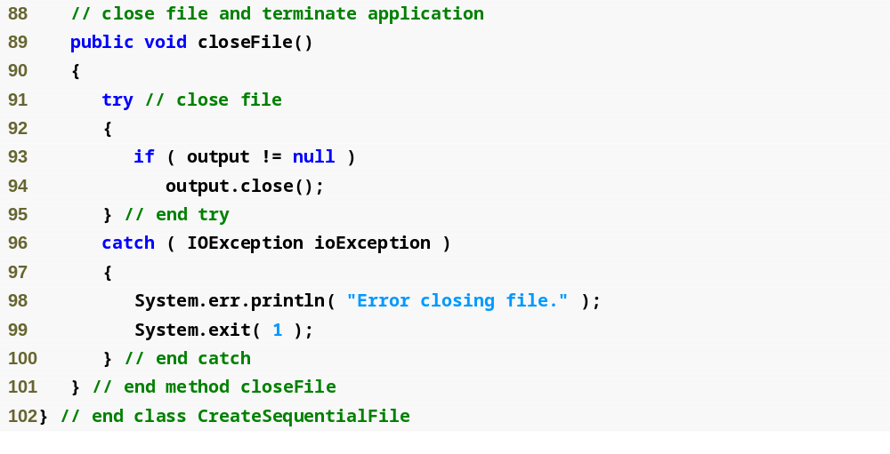
Outline
CreateSequential
File.java
(4 of 4)

Slide 65
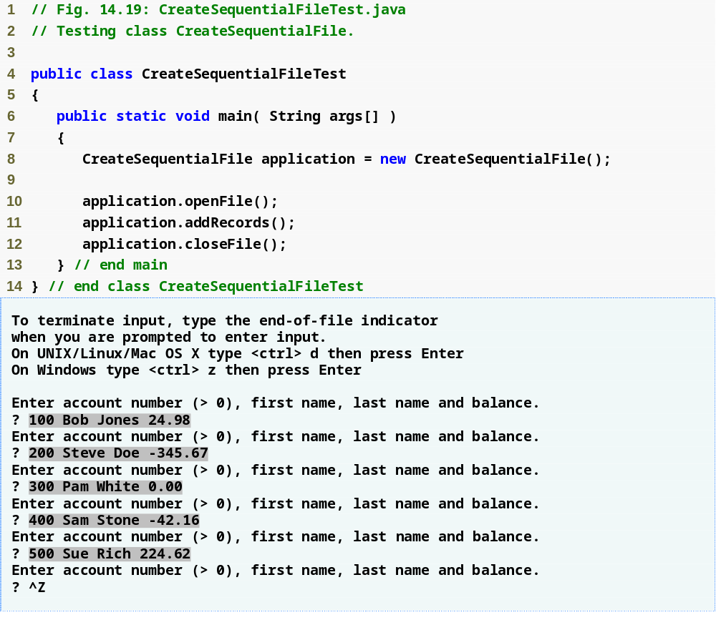
Outline
CreateSequential
FileTest.java

Slide 66
Common Programming Error 14.2
It is a logic error to open an existing file for output when, in fact, the user wishes to preserve the file.

Slide 67
14.6.2 Reading and Deserializing Data from a Sequential-Access File
To open a file for reading objects, create a FileInputStream wrapped by an ObjectInputStream
  FileInputStream provides methods for reading byte-based input from a file
  ObjectInputStream uses FileInputStream to read objects from file
  ObjectInputStream method readObject reads in object, which is then downcast to proper type
    EOFException occurs if attempt made to read past end of file
    ClassNotFoundException occurs if the class for the object being read cannot be located
  ObjectInputStream method close closes both objects

Slide 68
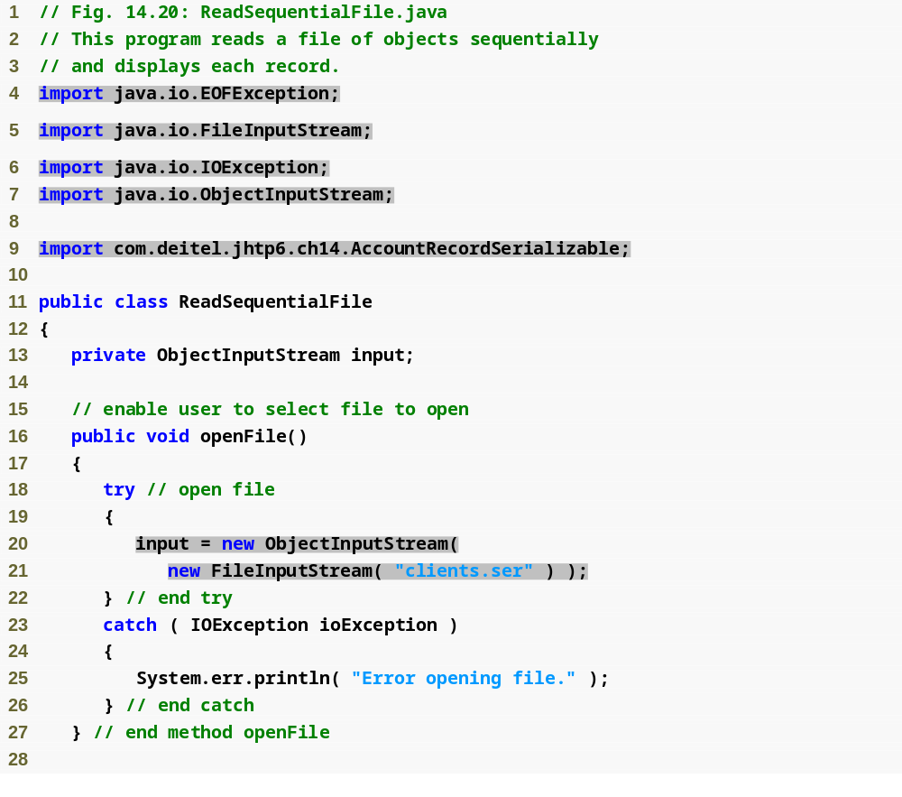
Outline
Class used to create byte-based input stream
ReadSequentialFile.java
(1 of 3)
Class used to read input object data to byte-based stream
Open file clients.ser for reading

Slide 69
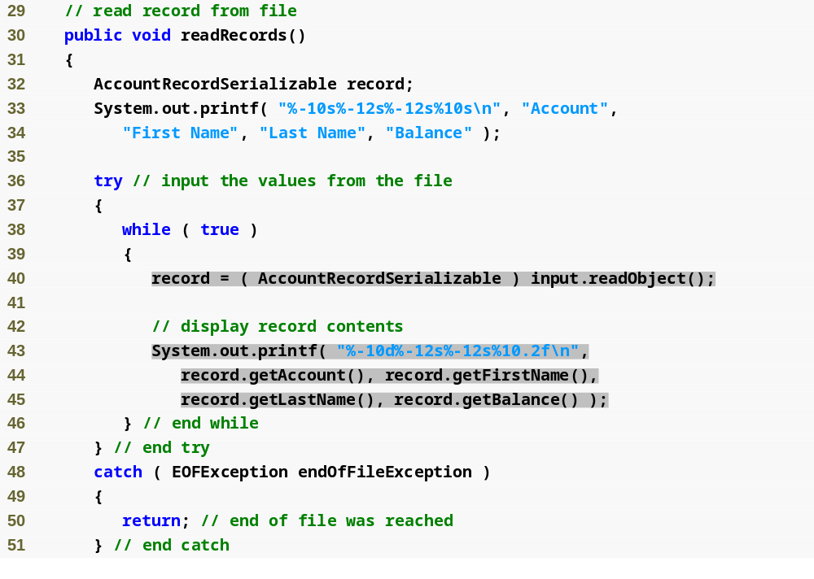
Outline
ReadSequentialFile.java
(2 of 3)
Read record from file
Output record information to screen

Slide 70
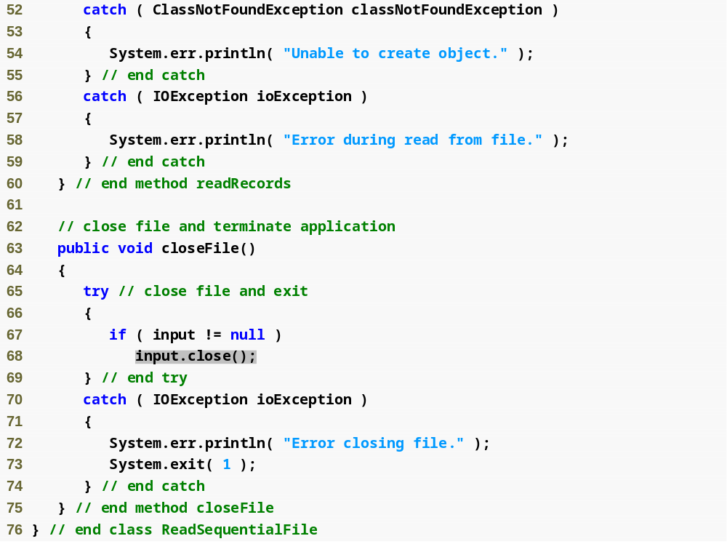
Outline
ReadSequentialFile.java
(3 of 3)
Close file

Slide 71
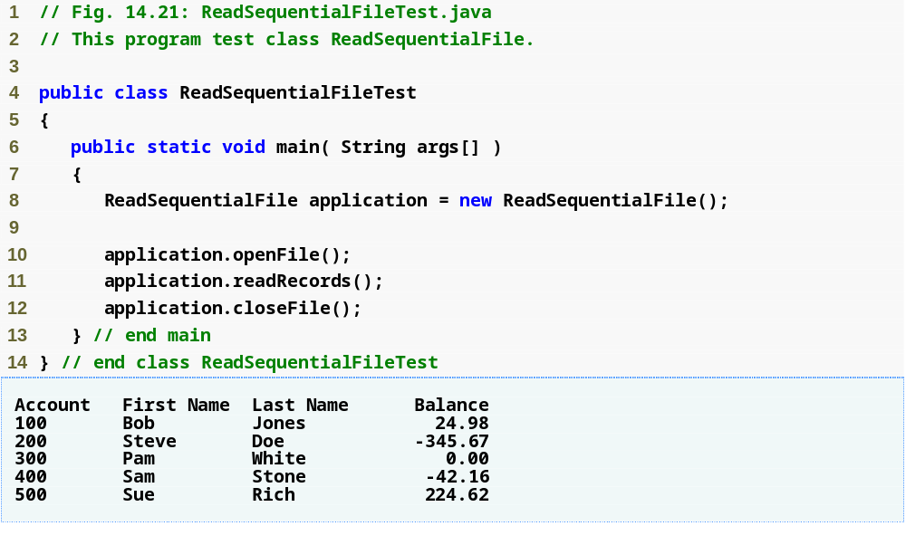
Outline
ReadSequentialFileTest.java

Slide 72
14.7 Random-Access Files
Sequential-access files inappropriate for instant-access applications
Instant-access applications are applications in which desired information must be located immediately
Instant access possible with random-access files (also called direct-access files) and databases
Data can be inserted in random-access file without destroying other data
Different techniques for creating random-access files
  Simplest: Require that all records in file be same fixed length
    Easy to calculate (as a function of record size and record key) exact location of any record relative to beginning of file

Slide 73
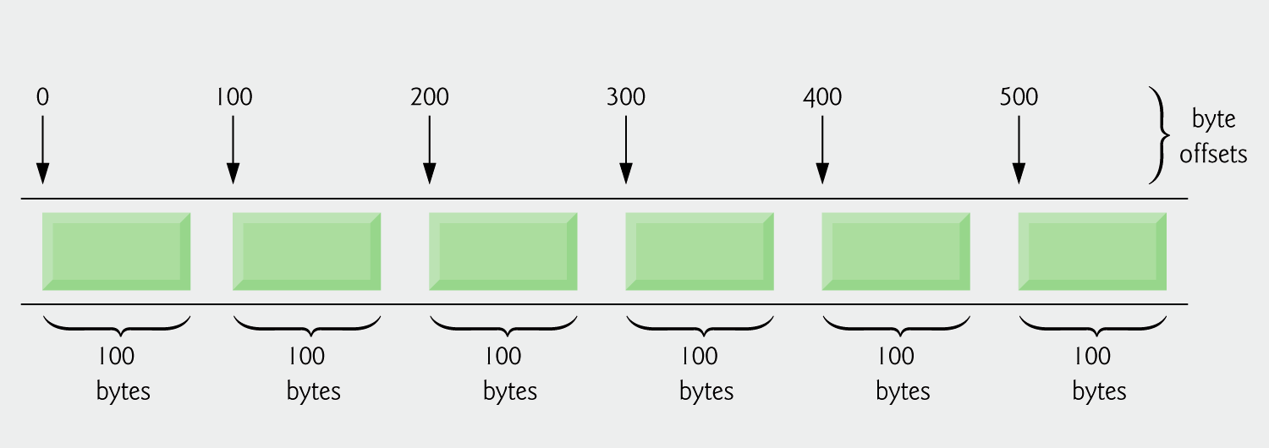
Fig. 14.22 | Java’s view of a random-access file.

Slide 74
14.7.1 Creating a Random-Access File
RandomAccessFile class
  Includes all capabilities of FileInputStream and FileOutputStream
  Includes capabilities for reading and writing primitive-type values, byte arrays and strings
  Using RandomAccessFile, program can read or write data beginning at location specified by file-position pointer
  Manipulates all data as primitive types
  Methods readInt, readDouble, readChar used to read integer, double and character data from file
  Methods writeInt, writeDouble, writeChars used to write integer, double and string data to file
  File-open mode – specifies whether file is opened for reading (“r”), or for both reading and writing (“rw”). File-open mode specified as second argument to RandomAccessFile constructor

Slide 75
14.7.1 Creating a Random-Access File
StringBuffer class – allows us to dynamically manipulate strings
  String objects are immutable, StringBuffer used so strings can be changed dynamically
  Can store a number of characters specified by capacity
  If the capacity is exceeded, the capacity is expanded
  Number of characters in StringBuffer set with method setLength
Create random access file by writing blank or empty records to file for amount of records that will be needed

Slide 76
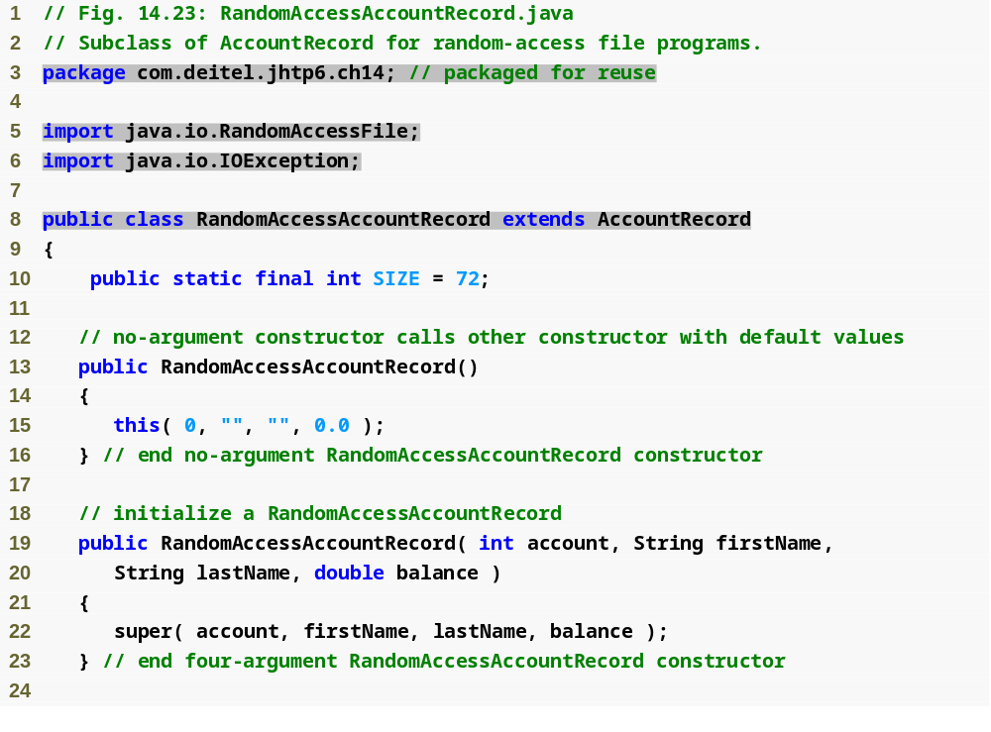
Outline
Used to write to and read from random-access files
RandomAccess
AccountRecord.java
(1 of 3)

Slide 77
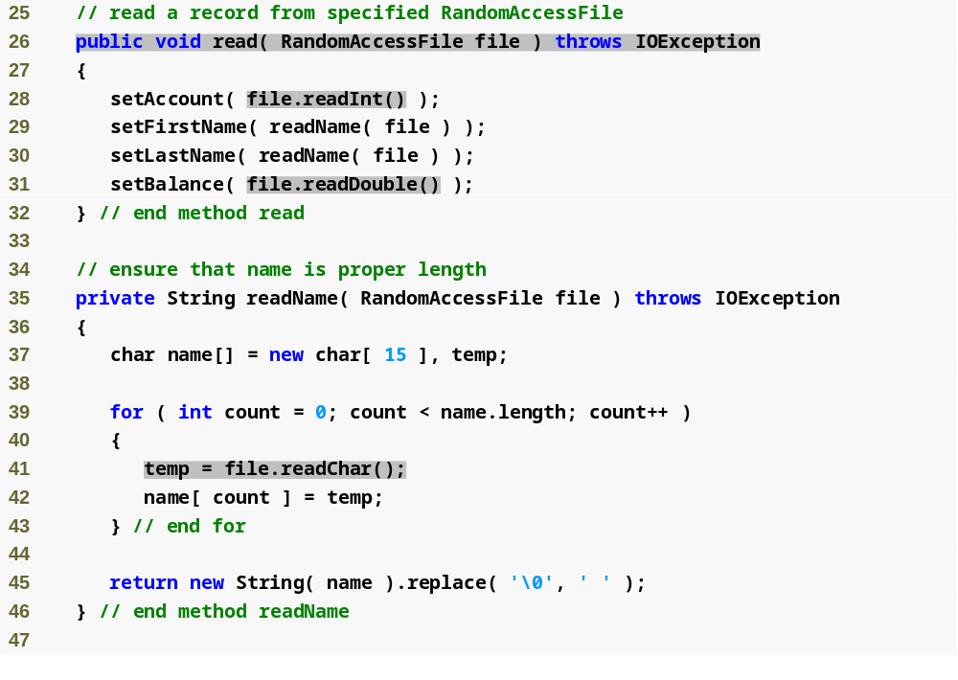
Outline
Method reads primitive-type data, stores in RandomAccessAccountRecord object
RandomAccess
AccountRecord.java
(2 of 3)
Read characters, aggregate into string

Slide 78
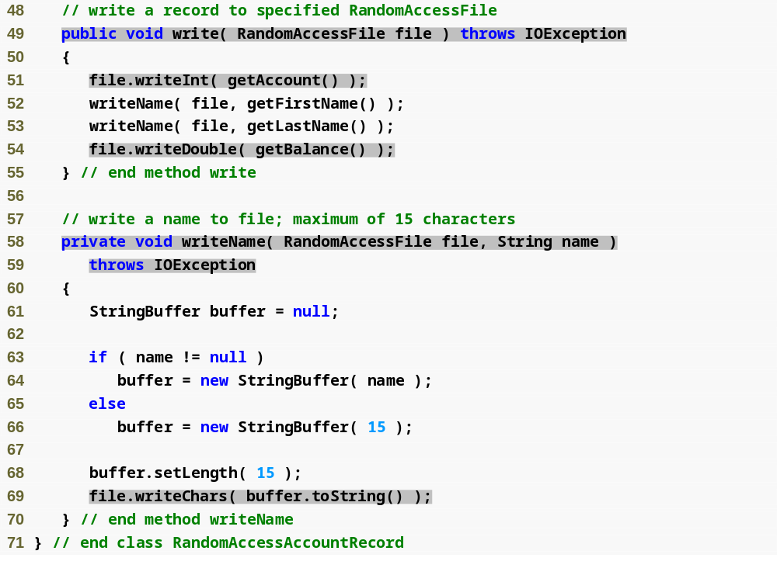
Outline
Method writes primitive-type data based on data from RandomAccessAccountRecord object
RandomAccess
AccountRecord.java
(3 of 3)
Writes first and last names to file, make sure each has 15 characters

Slide 79
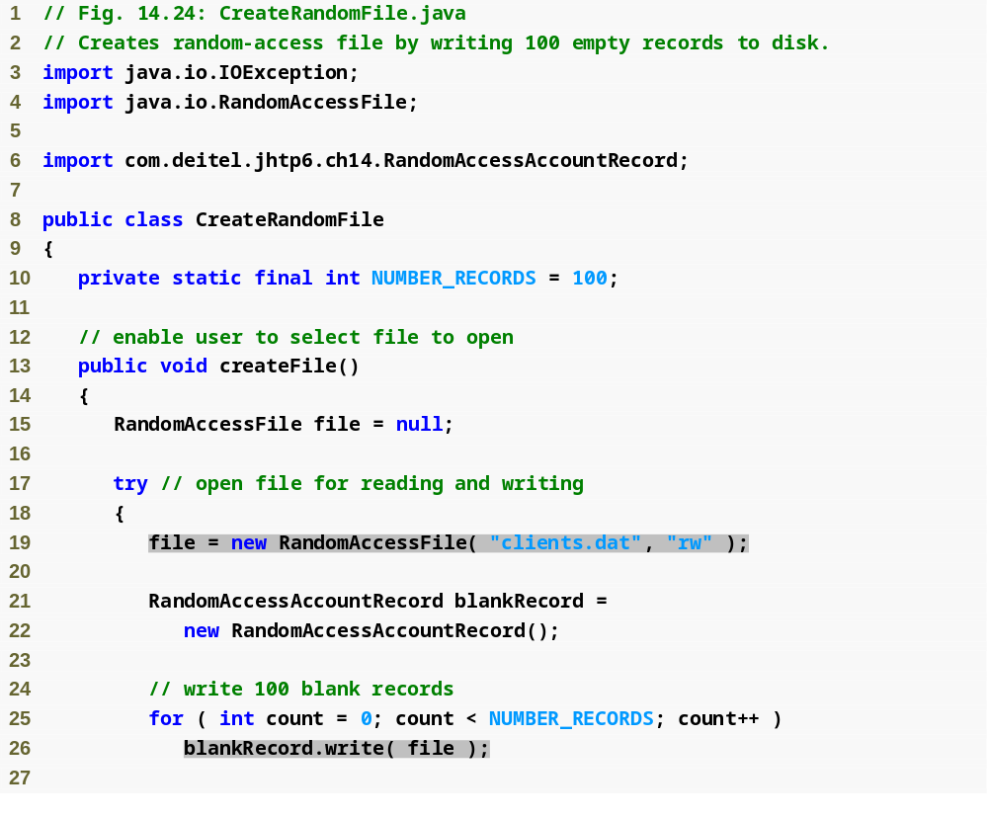
Outline
CreateRandomFile
.java
(1 of 2)
Open file for reading and writing
Create a blank record
Output blank record 100 times, for each possible account

Slide 80
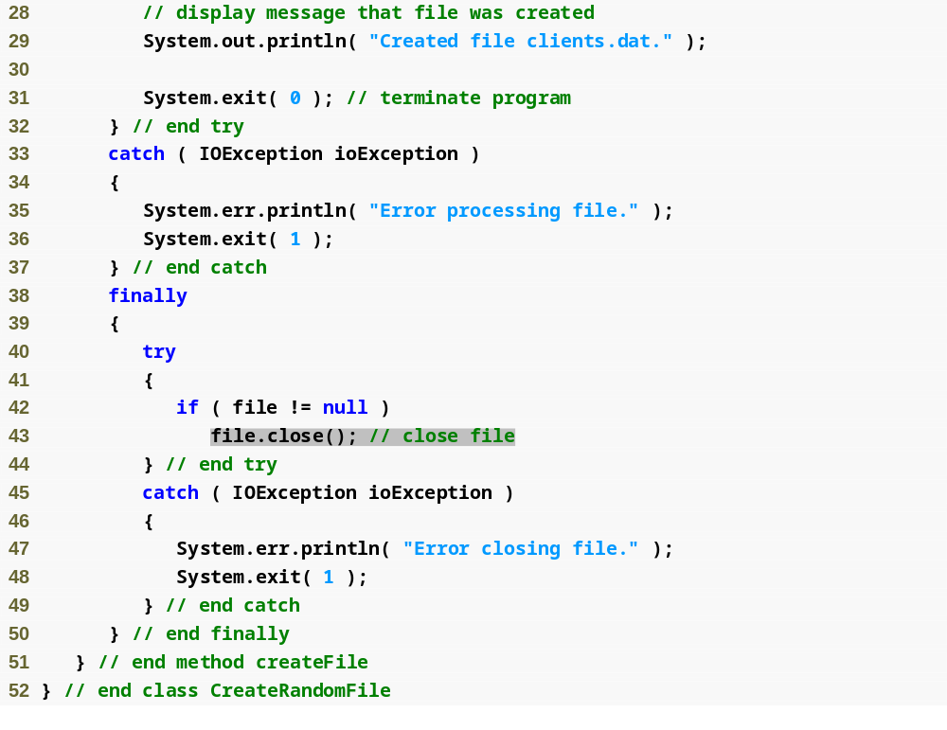
Outline
CreateRandomFile
.java
(2 of 2)
Close file

Slide 81

Outline
CreateRandomFile
Test.java

Slide 82
14.7.2 Writing Data Randomly to a Random-Access File
RandomAccessFile method seek positions file-position pointer to a specific location in a file relative to beginning of file
Size of each record is known, so location in file of a specific record can be found by multiplying size of record with number of record
Once location known, new record data can be written without worrying about rest of file, as each record is always same size

Slide 83

Outline
WriteRandomFile
.java
(1 of 4)
Open file for reading and writing

Slide 84

Outline
WriteRandomFile
.java
(2 of 4)

Slide 85

Outline
WriteRandomFile
.java
(3 of 4)
Store input data in RandomAccessAccountRecord

Slide 86

Outline
Calculate location of new record
Output new record to file
WriteRandomFile
.java
(4 of 4)

Slide 87

Outline
WriteRandomFile
Test.java

Slide 88
14.7.3 Reading Data Sequentially from a Random-Access File
Open file with “r” file-open mode for reading
Ignore empty records (usually those with account number of zero) when reading from file
Records stored by account number in random-access files have added bonus of being sorted, as each record’s data can only be placed in specific portion of file
Sorting with direct-access techniques is blazingly fast—speed achieved by making file large enough to hold every possible record
  Space/time trade-off

Slide 89
Good Programming Practice 14.1
Open a file with the “r” file-open mode for input if the contents should not be modi­fied. This practice prevents unintentional modification of the file’s contents. This is another example of the principle of least privilege.

Slide 90

Outline
ReadRandomFile
.java
(1 of 3)
Open file for reading

Slide 91

Outline
ReadRandomFile
.java
(2 of 3)
Read until non-blank record found
Exception occurs when end of file reached

Slide 92

Outline
ReadRandomFile
.java
(3 of 3)

Slide 93

Outline
ReadRandomFileTest
.java

Slide 94
14.7.4 Case Study: A Transaction-Processing Program
Example of instant-access processing
User can:
  Display records – read from beginning to end, ignore empty records
  Update records – ask for account number, only allow user to update if record is not empty
  Add new records – ask for account number, only allow user to add account if record is empty
  Delete records – ask for account number, only delete existing records (i.e., replace record with an empty record)

Slide 95

Outline
Transaction Processor: Display accounts

Slide 96

Outline
Transaction Processor: Update accounts

Slide 97

Outline
Transaction Processor: Inserting account

Slide 98

Outline
MenuOption.java

Slide 99

Outline
FileEditor.java
(1 of 5)
Open file for reading and writing
Close file

Slide 100

Outline
Retrieve record based on account number
FileEditor.java
(2 of 5)
Position file-position pointer to record
Read record from file
Retrieve record based on account number
Position file-position pointer to record

Slide 101

Outline
Modify record based on input
Write new record to file
FileEditor.java
(3 of 5)
Retrieve record based on account number
Position file-position pointer to record
Create new record based on input
Write new record to file

Slide 102

Outline
Retrieve record based on account number
FileEditor.java
(4 of 5)
Position file-position pointer to record
Write blank record to file

Slide 103

Outline
Return to beginning of file, to read all records
FileEditor.java
(5 of 5)
Read until non-blank record is found
Display record

Slide 104

Outline
Transaction
Processor.java
(1 of 7)

Slide 105

Outline
Transaction
Processor.java
(2 of 7)

Slide 106

Outline
Transaction
Processor.java
(3 of 7)
Read and display all records
Prompt user for new record data
Retrieve new record data

Slide 107

Outline
Write new record to file
Transaction
Processor.java
(4 of 7)
Retrieve transaction amount
Update record in file

Slide 108

Outline
Transaction
Processor.java
(5 of 7)
Retrieve account number of record to be deleted
Delete record

Slide 109

Outline
Transaction
Processor.java
(6 of 7)

Slide 110

Outline
Transaction
Processor.java
(7 of 7)
Edit file based on menu option selected by user

Slide 111

Outline
Transaction
ProcessorTest.java

Slide 112
14.8 Additional java.io Classes: Interfaces and Classes for Byte-Based Input and Output
InputStream and OutputStream classes
  abstract classes that declare methods for performing byte-based input and output
PipedInputStream and PipedOutputStream classes
  Establish pipes between two threads in a program
  Pipes are synchronized communication channels between threads
FilterInputStream and FilterOutputStream classes
  Provides additional functionality to stream, such as aggregating data byte into meaningful primitive-type units
PrintStream class
  Performs text output to a specified stream
DataInput and DataOutput interfaces
  For reading and writing primitive types to a file
  DataInput implemented by classes RandomAccessFile and DataInputStream, DataOutput implemented by RandomAccessFile and DataOuputStream
SequenceInputStream class enables concatenation of several InputStreams – program sees group as one continuous InputStream

Slide 113
Interfaces and Classes for Byte-Based Input and Output
Buffering is an I/O-performance-enhancement technique
  Greatly increases efficiency of an application
  Output (uses BufferedOutputStream class)
    Each output statement does not necessarily result in an actual physical transfer of data to the output device – data is directed to a region of memory called a buffer (faster than writing to file)
    When buffer is full, actual transfer to output device is performed in one large physical output operation (also called logical output operations)
    Partially filled buffer can be forced out with method flush
  Input (uses BufferedInputStream class)
    Many logical chunks of data from a file are read as one physical input operation (also called logical input operation)
    When buffer is empty, next physical input operation is performed
ByteArrayInputStream and ByteArrayOutputStream classes used for inputting from byte arrays in memory and outputting to byte arrays in memory

Slide 114
Performance Tip 14.1
Buffered I/O can yield significant performance improvements over unbuffered I/O.

Slide 115
Interfaces and Classes for Character-Based Input and Output
Reader and Writer abstract classes
  Unicode two-byte, character-based streams
BufferedReader and BufferedWriter classes
  Enable buffering for character-based streams
CharArrayReader and CharArrayWriter classes
  Read and write streams of characters to character arrays
LineNumberReader class
  Buffered character stream that keeps track of number of lines read
PipedReader and PipedWriter classes
  Implement piped-character streams that can be used to transfer information between threads
StringReader and StringWriter classes
  Read characters from and write characters to Strings

Slide 116
14.9 Opening Files with JFileChooser
JFileChooser – class used to display a dialog that enables users to easily select files
  Method setFileSelectionMode specifies what user can select from JFileChooser
    FILES_AND_DIRECTORIES constant indicates files and directories
    FILES_ONLY constant indicates files only
    DIRECTORIES_ONLY constant indicates directories only
  Method showOpenDialog displays JFileChooser dialog titled Open, with Open and Cancel buttons (to open a file/directory or dismiss the dialog, respectively)
    CANCEL_OPTION constant specifies that user click Cancel button
  Method getSelectedFile retrieves file or directory user selected

Slide 117

Outline
FileDemonstration
.java
(1 of 4)
Class for display JFileChooser dialog

Slide 118

Outline
FileDemonstration
.java
(2 of 4)
Create JFileChooser
Allow user to select both files and directories
Display dialog
User clicked Cancel
Retrieve file or directory selected by user

Slide 119

Outline
FileDemonstration
.java
(3 of 4)
Display information about file

Slide 120

Outline
FileDemonstration
.java
(4 of 4)

Slide 121


Outline
FileDemonstration
Test.java
(1 of 2)
Select location for file here
Click Open to submit new file name to program
Files and directories are displayed here

Slide 122


Outline
FileDemonstration
Test.java
(2 of 2)

