Slide 2
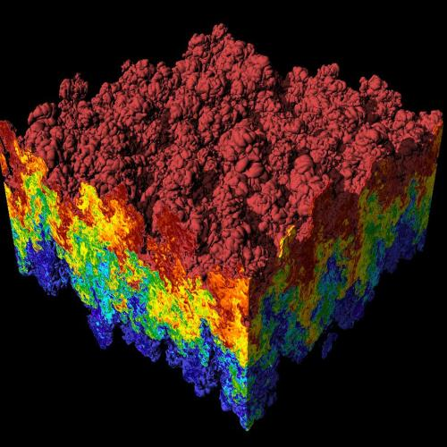
Introduction to Data Wrangling

Slide 3
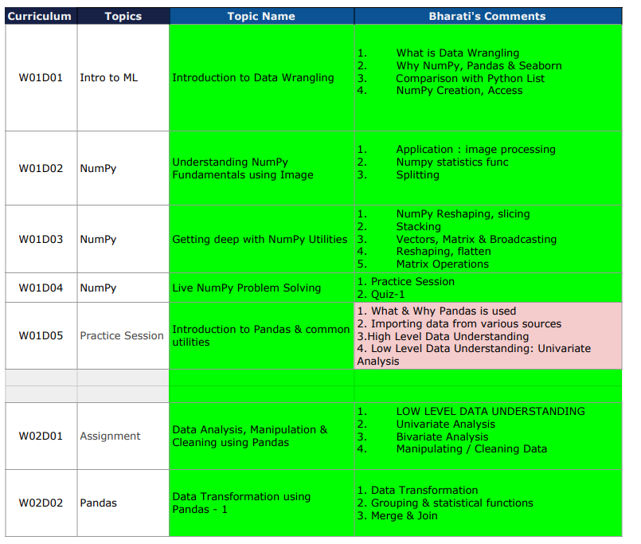
What will we cover

Slide 4
What is Data Analysis
Data analysis is a process of inspecting, cleansing, transforming, and modeling data with the goal of discovering useful information, informing conclusions, and supporting decision-making.

Slide 5
Why python for data analysis ?

Slide 6
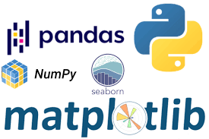
Simple and intuitive to learn
Open Source
powerful libraries with community support

Slide 7
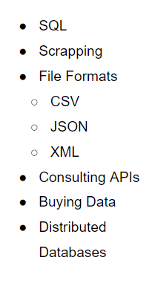
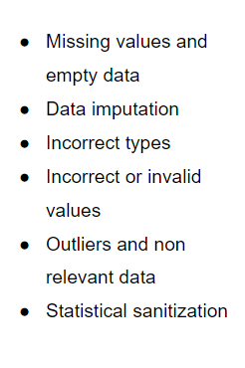
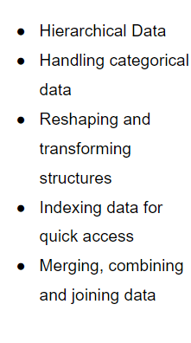
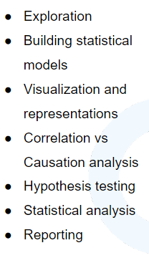
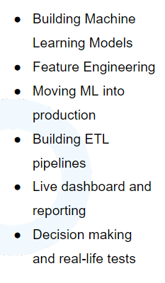
Data Extraction
Data Cleaning
Action
Data Wrangling
Analysis

Slide 8
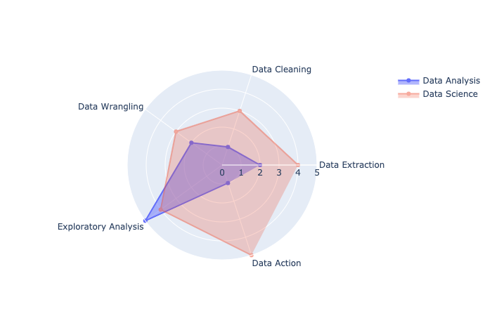
Data Analysis v/s Data Science

Slide 9
Libraries:
pandas: The cornerstone of our Data Analysis job with Python
matplotlib: The foundational library for visualizations. Other libraries we’ll use will be built on top of matplotlib.
numpy: The numeric library that serves as the foundation of all calculations in Python.
seaborn: A statistical visualization tool built on top of matplotlib.
statsmodels: A library with many advanced statistical functions.
scipy: Advanced scientific computing, including functions for optimization, linear algebra, image processing and much more.
scikit-learn: The most popular machine learning library for Python (not deep learning)

Slide 10
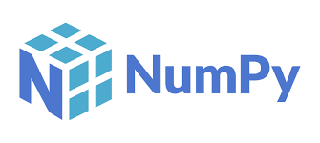
Numpy
The fundamental package for scientific computing with Python
https://numpy.org/

Slide 11
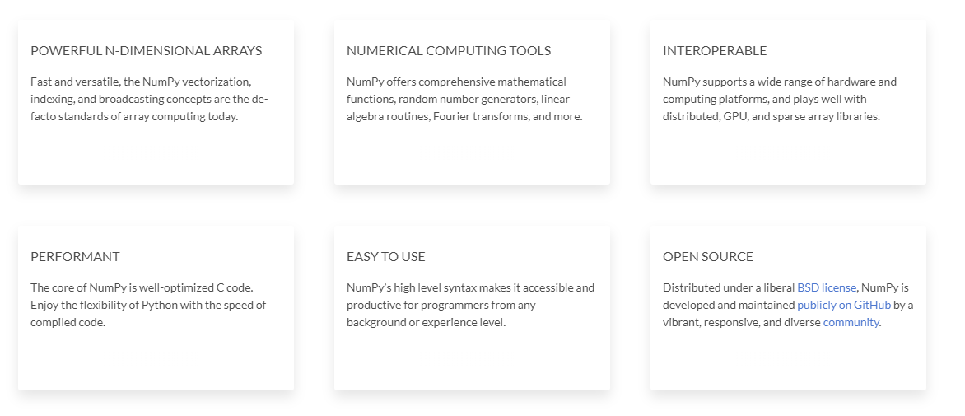
Sample Data

Slide 12
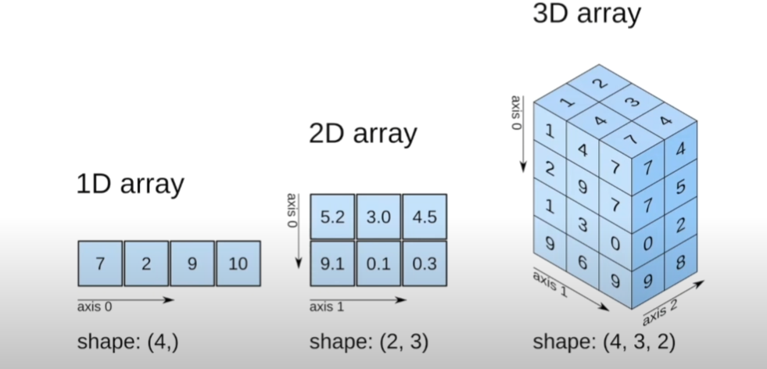

Slide 13
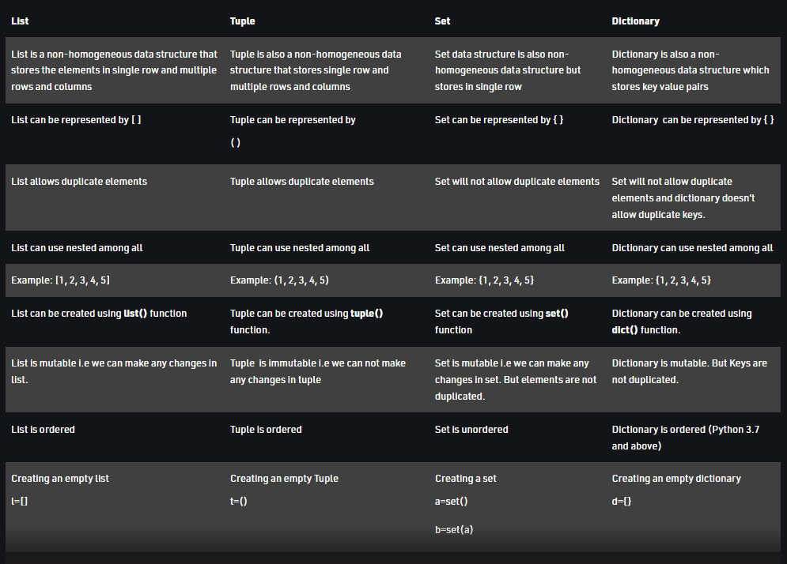
Notes:
Tuples are stored in a single block of memory. Tuples are immutable so, It doesn't require extra space to store new objects. Lists are allocated in two blocks: the fixed one with all the Python object information and a variable-sized block for the data. It is the reason creating a tuple is faster than List

Slide 14
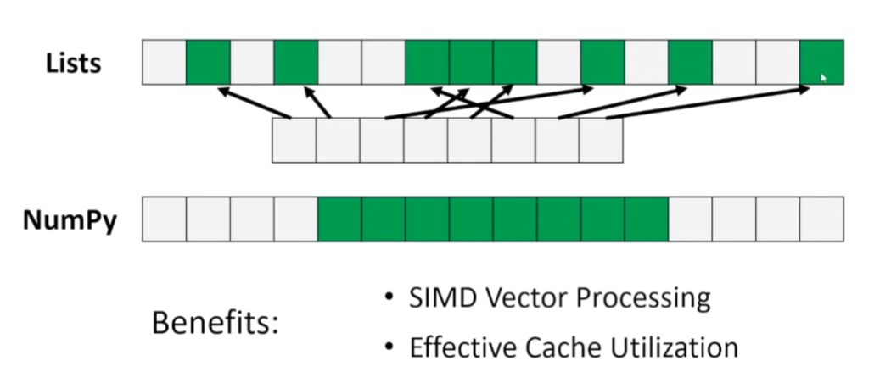
Advantages of using Numpy array vs lists
Consumes less memory.
Fast as compared to the python List.
Convenient to use.

Slide 15
Numpy and its Image Application

Slide 16
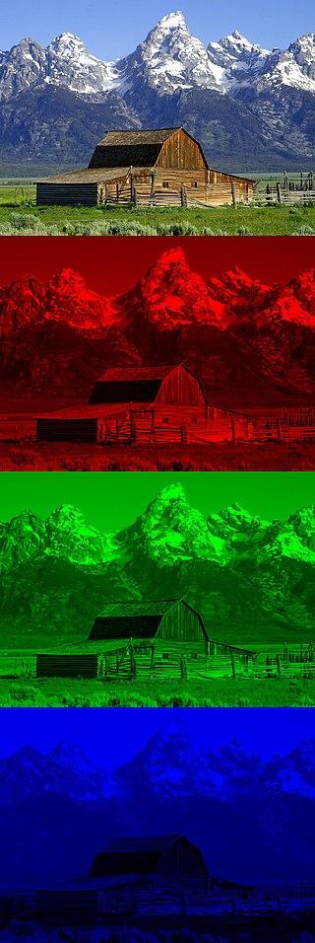
RGB Image

Slide 17
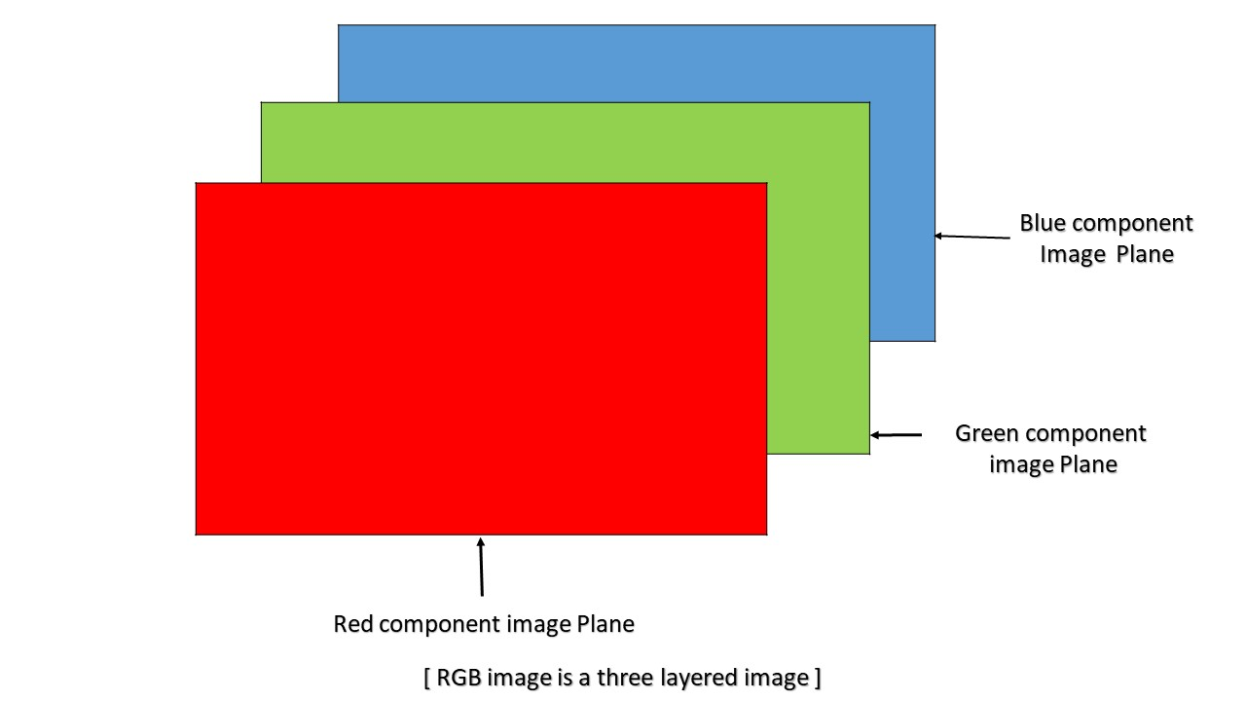
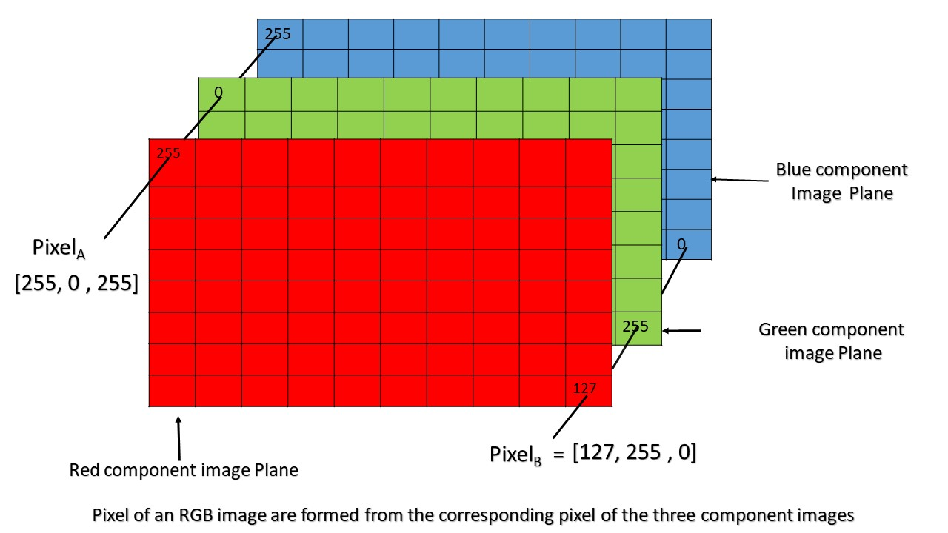
3 D representation
A pixel value has just a single number ranging from 0 to 255 (both inclusive). The pixel value 0 represents black and the pixel value 255 represents white

Slide 18
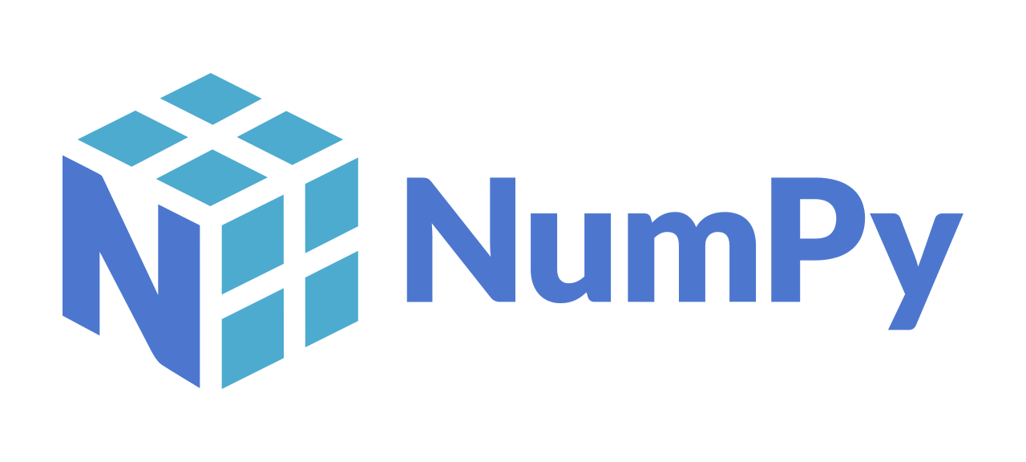
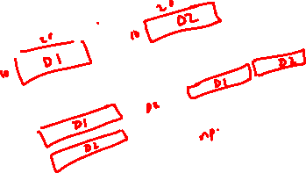
Notebook Walkthrough

Slide 19

Introduction to Pandas

Slide 20
Pandas is a fast, powerful, flexible and easy to use open source data analysis and manipulation tool, built on top of the Python programming language.

Slide 21
Difference between Numpy and Pandas
Pandas
Tabular Data
1D- Series and 2D – Dataframe
Load, manipulate and model the data
Numpy
Numerical Calculations
Multidimension
More memory efficient

Slide 22
iloc = integer position of the index value
loc = name of the index value

Slide 23
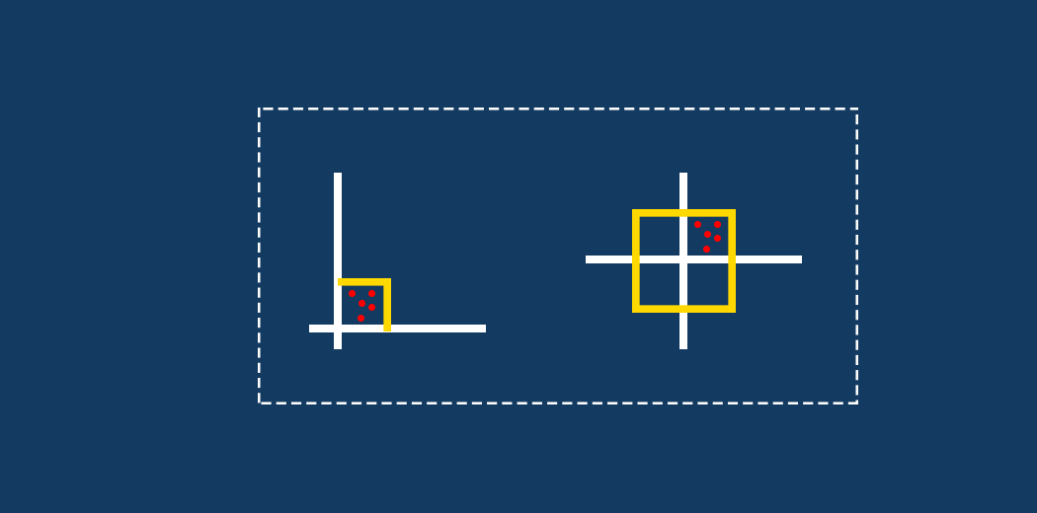
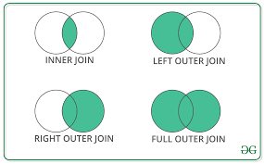
Feature Transformation Concat, Merge/Join

Slide 24
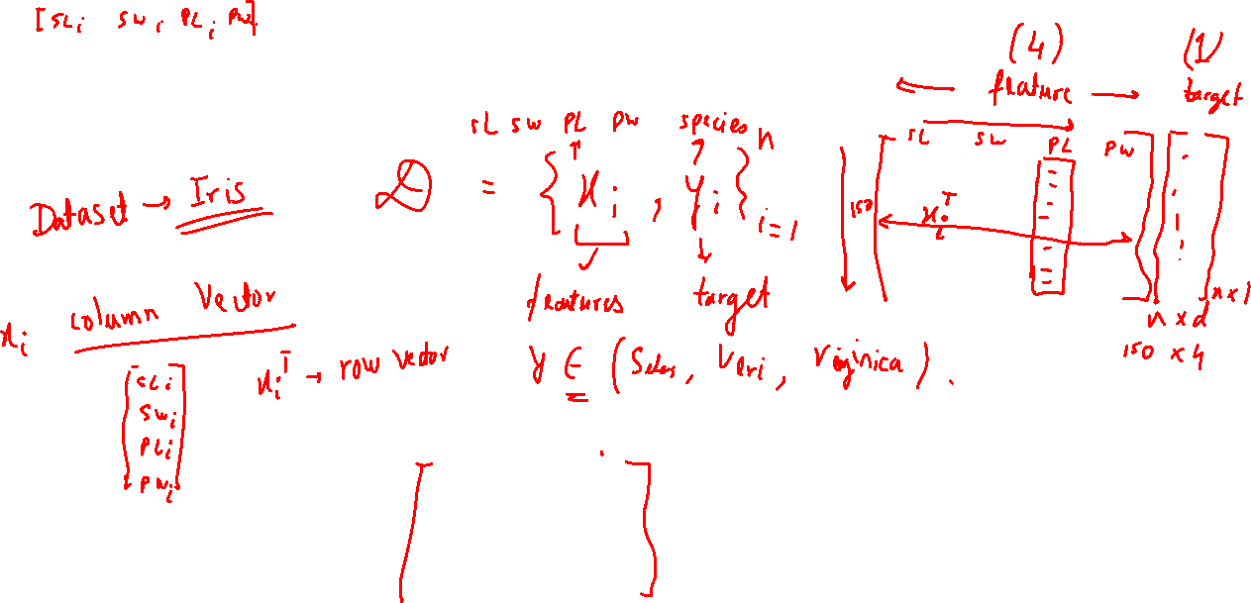
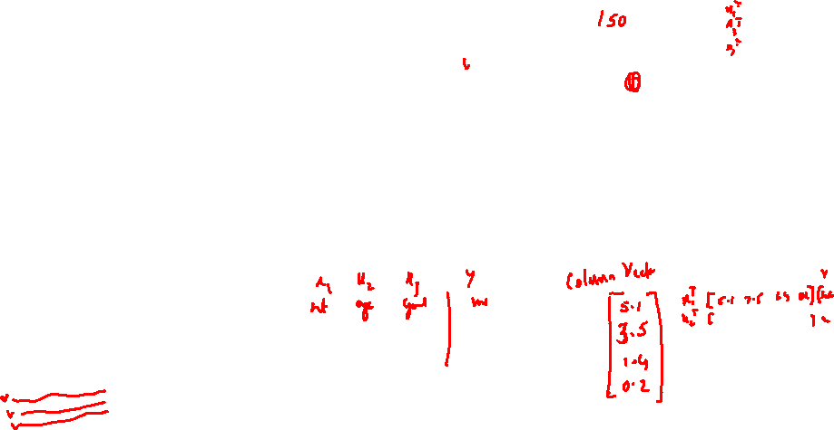
Understanding of Column and Row vector

Slide 25
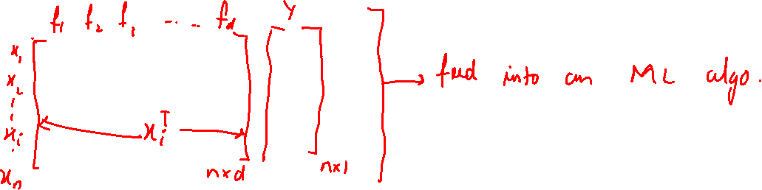
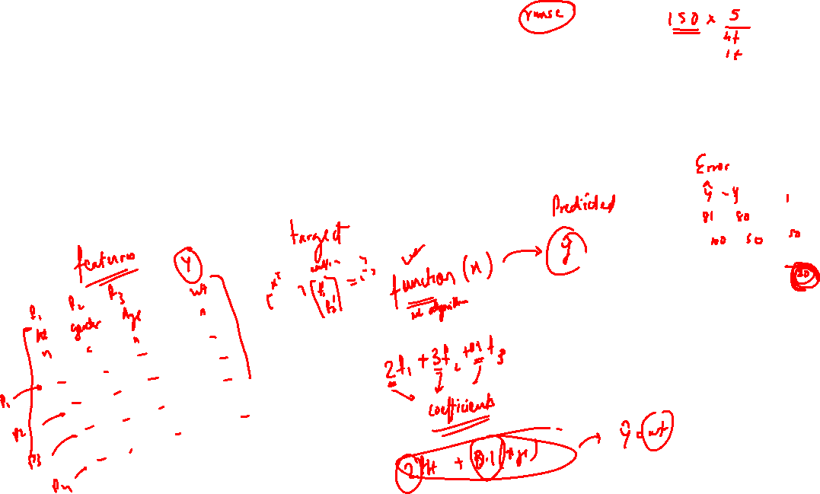

Slide 26
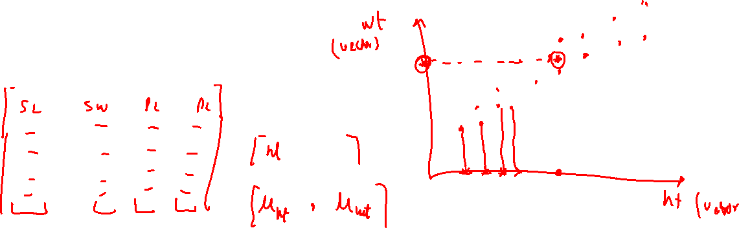
Mean of a Vector

Slide 27
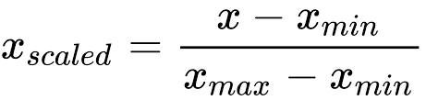
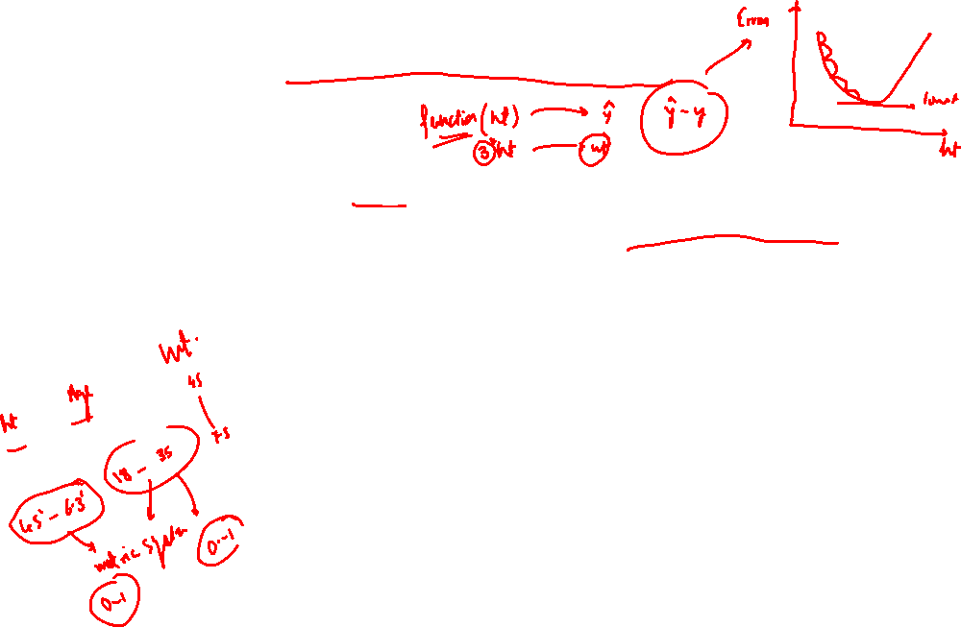
What is Normalization?
Normalization is a scaling technique in which values are shifted and rescaled so that they end up ranging between 0 and 1. It is also known as Min-Max scaling.

Slide 28
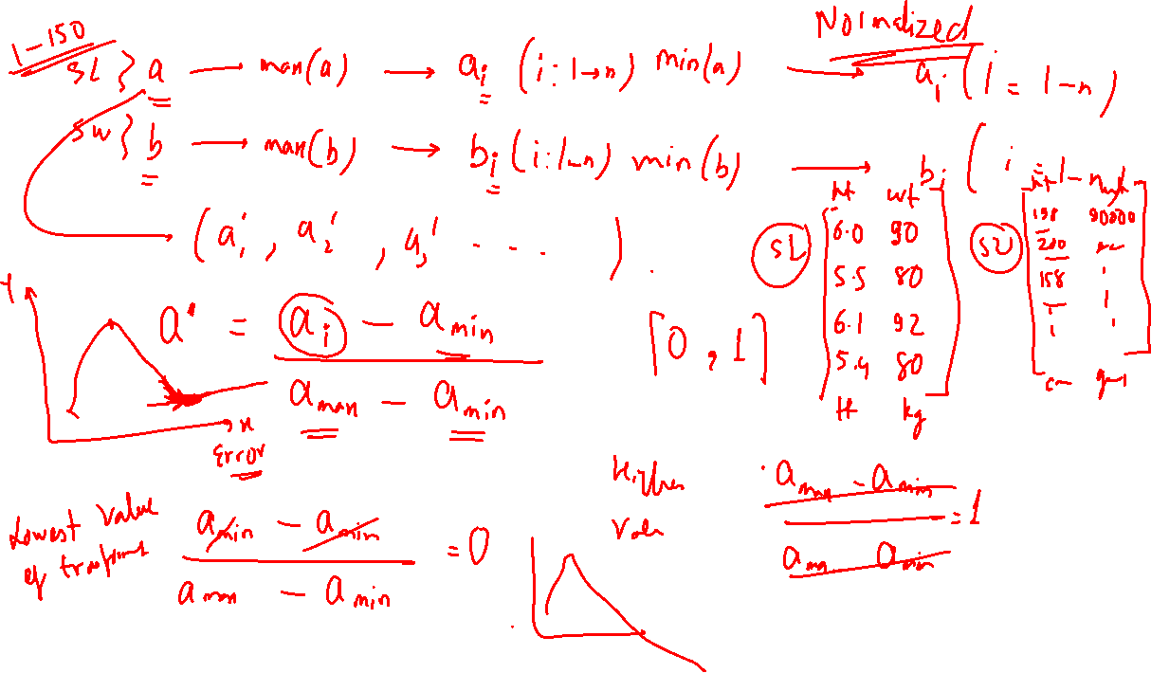

Slide 29
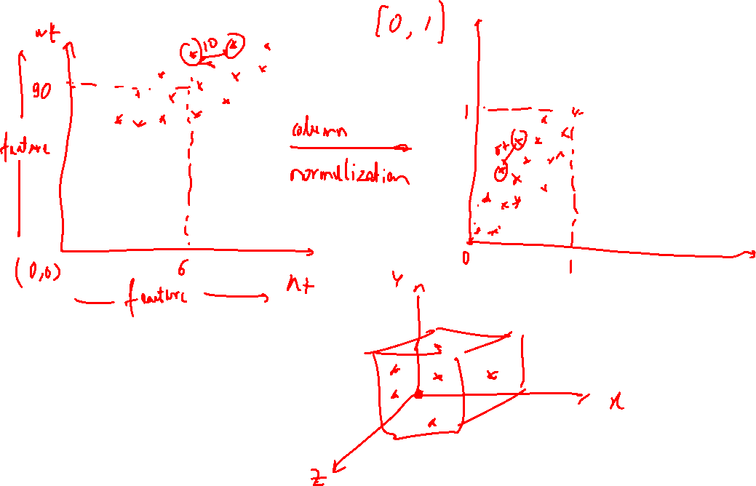

Slide 30
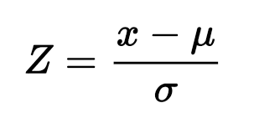
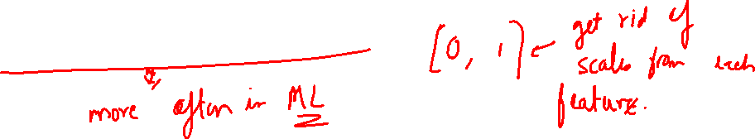
What is Standardization?
Standardization is another scaling technique where the values are centered around the mean with a unit standard deviation. This means that the mean of the attribute becomes zero and the resultant distribution has a unit standard deviation..

Slide 31
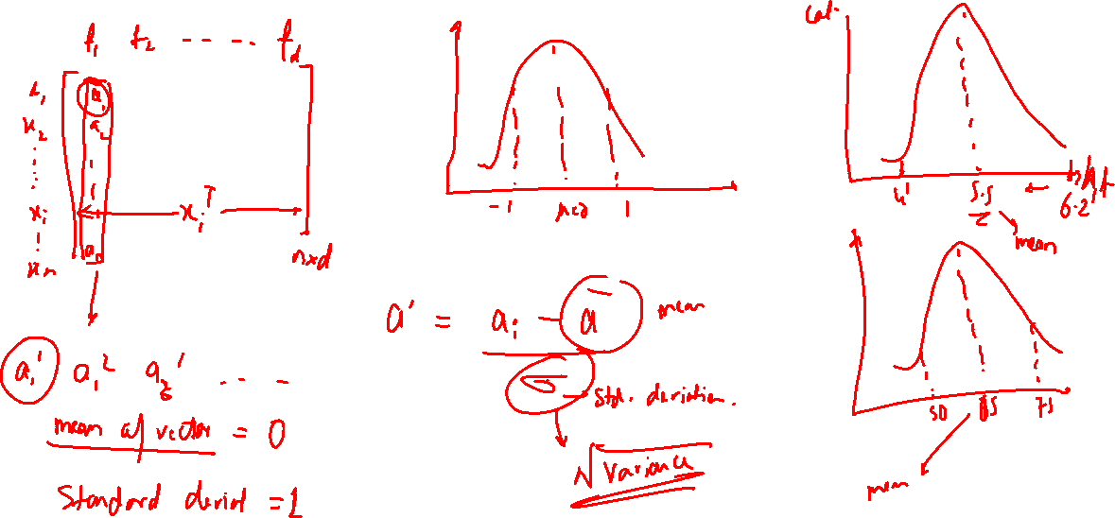

Slide 32
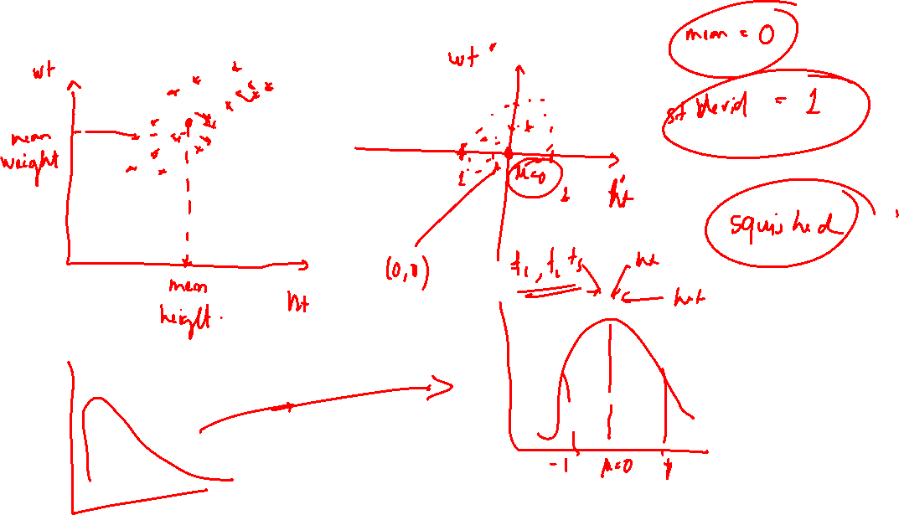

Slide 33
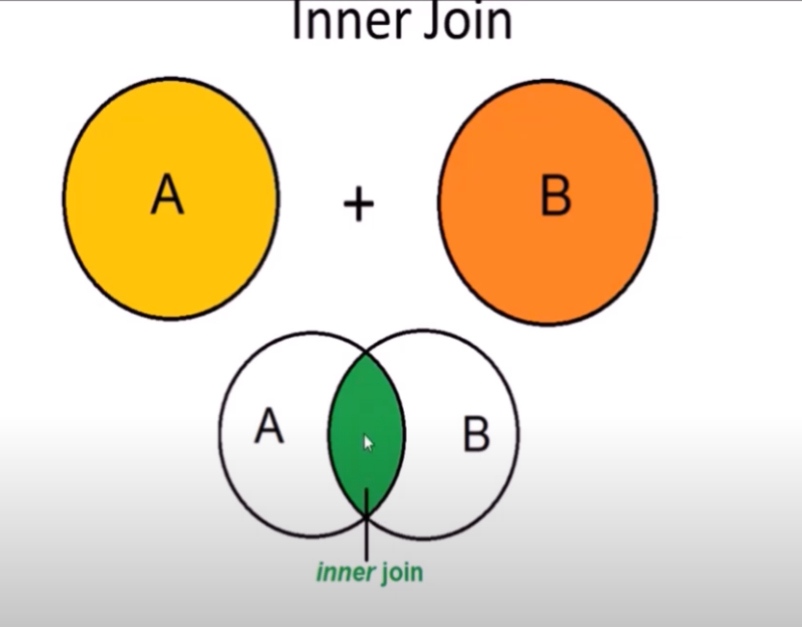
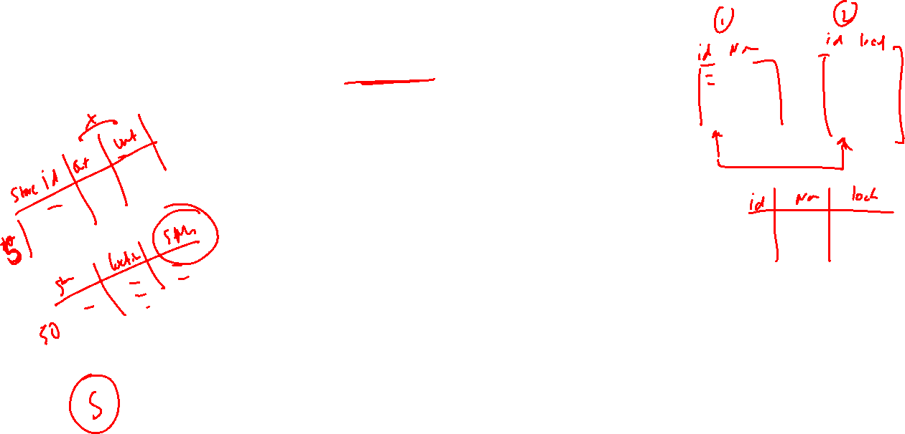
Understanding of joins

Slide 34
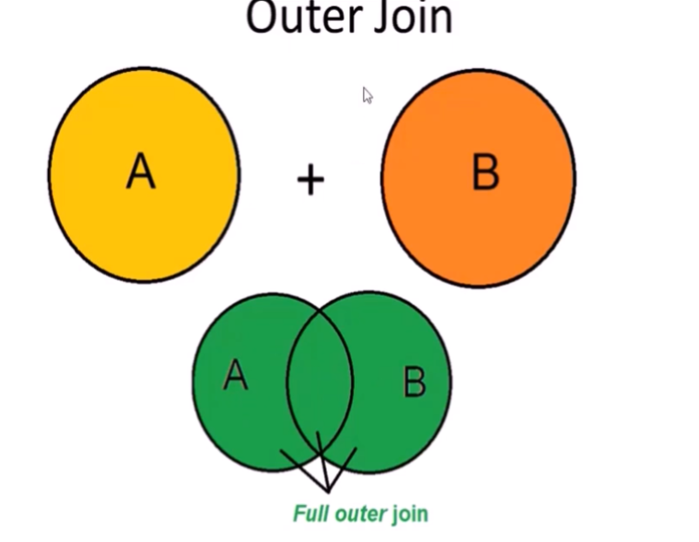
Understanding of joins

Slide 35
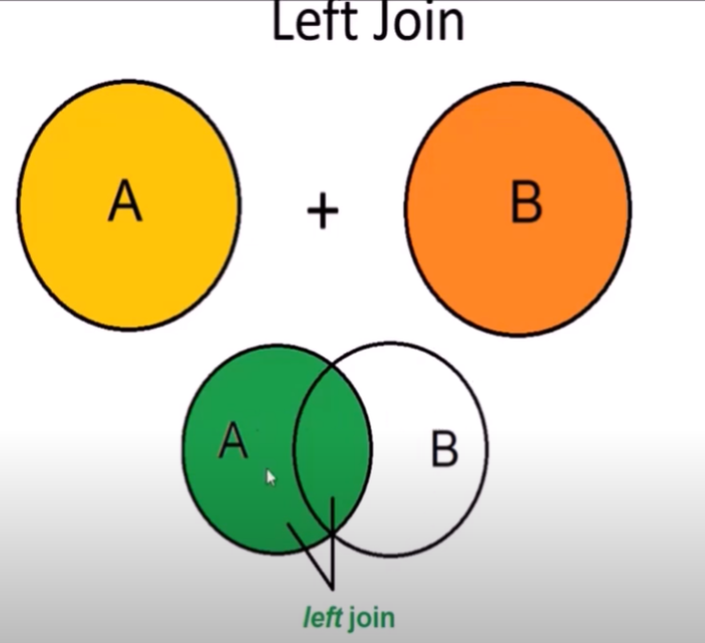
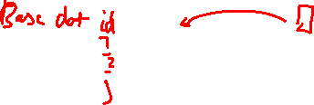
Understanding of joins

Slide 36
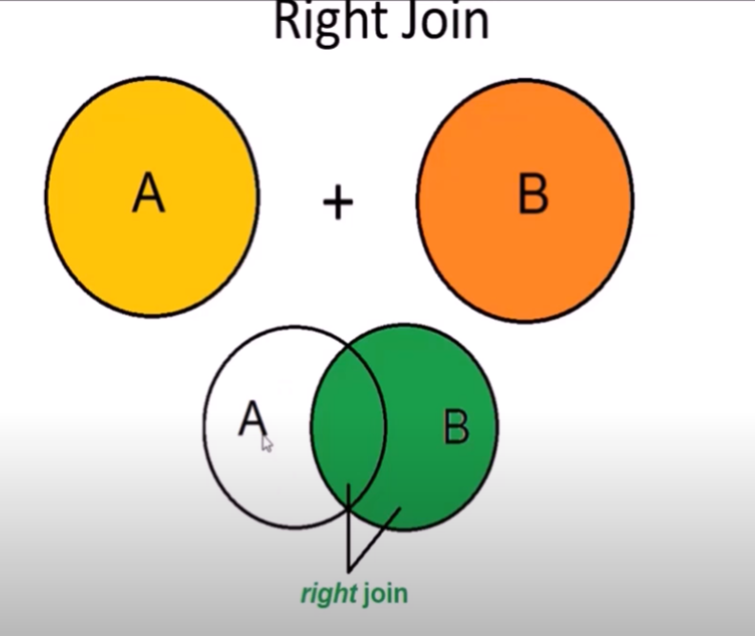
Understanding of joins

Slide 37
