Slide 1
Introduction to JS
Turn your passion into Website

Slide 2
Today’s Topics
Web Storage
What is a backend?
What is an HTTP request?
What is JSON?
What is AJAX?
Handling AJAX Response + OnReadyStateChangeProperty
Render HTML elements dynamically

Slide 3
Web Storage API
Two storage types of HTML5 are:
Session Storage: It stores data of current session only. It means that the data stored in session storage clear automatically when the browser is closed.
Local Storage: Local storage is another type of HTML5 Web Storage. In local storage, data is not deleted automatically when the current browser window is closed.
Two main benefits of HTML5 Web Storage:
It can store up to 10 MB data which is certainly more than what cookies have.
Web storage data cannot be transferred with the HTTP request. It helps to increase the performance of the application.
EdYoda - Frontend Developer Program
https://www.edyoda.com

Slide 4
WHAT IS BACK-END DEVELOPMENT?
The back end refers to parts of a computer application or a program's code that allow it to operate and that cannot be accessed by a user. Most data and operating syntax are stored and accessed in the back end of a computer system. Typically the code is comprised of one or more programming languages. It consists of Servers and Database.
Programming and scripting languages like NodeJs, ExpressJs, MongoDB, Relational Database, PHP.
EdYoda - Frontend Developer Program
https://www.edyoda.com

Slide 5
What is HTTP request?
An HTTP request is made by a client, to a named host, which is located on a server. The aim of the request is to access a resource on the server. To make the request, the client uses components of a URL (Uniform Resource Locator), which includes the information needed to access the resource.
HTTP methods: get, post, update, delete
HTTP status code: https://developer.mozilla.org/en-US/docs/Web/HTTP/Status
An HTTP header is a field of an HTTP request or response that passes additional context and metadata about the request or response. For example, a request message can use headers to indicate it's preferred media formats, while a response can use header to indicate the media format of the returned body
EdYoda - Frontend Developer Program
https://www.edyoda.com

Slide 6
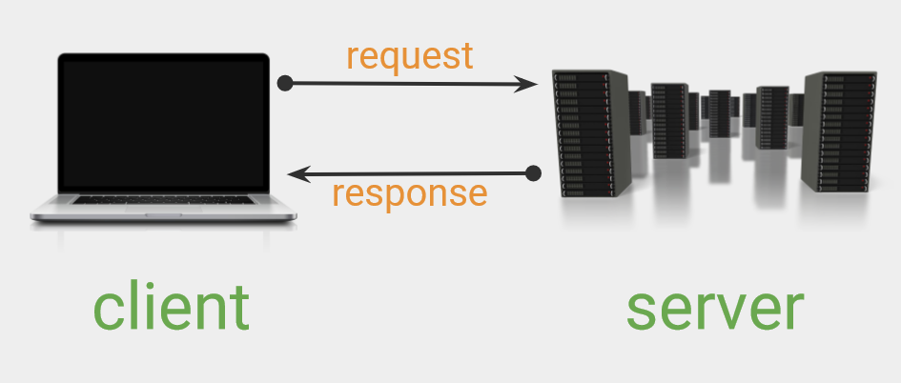
EdYoda - Frontend Developer Program
https://www.edyoda.com

Slide 7
What is AJAX?
AJAX stands for Asynchronous JavaScript And XML. AJAX allows web pages to be updated asynchronously by exchanging data with a web server behind the scenes. This means that it is possible to update parts of a web page, without reloading the whole page.
AJAX is not a programming language.
AJAX just uses a combination of:
A browser built-in XMLHttpRequest object (to request data from a web server)
JavaScript and HTML DOM (to display or use the data)
EdYoda - Frontend Developer Program
https://www.edyoda.com

Slide 8
Why Ajax?
Update a web page without reloading the page
Request data from a server - after the page has loaded
Receive data from a server - after the page has loaded
Send data to a server - in the background
EdYoda - Frontend Developer Program
https://www.edyoda.com

Slide 9
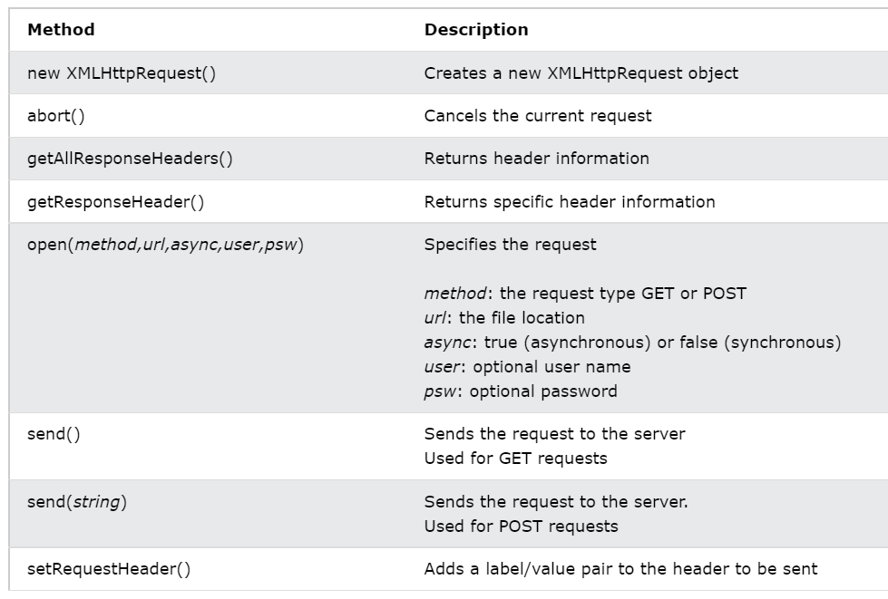
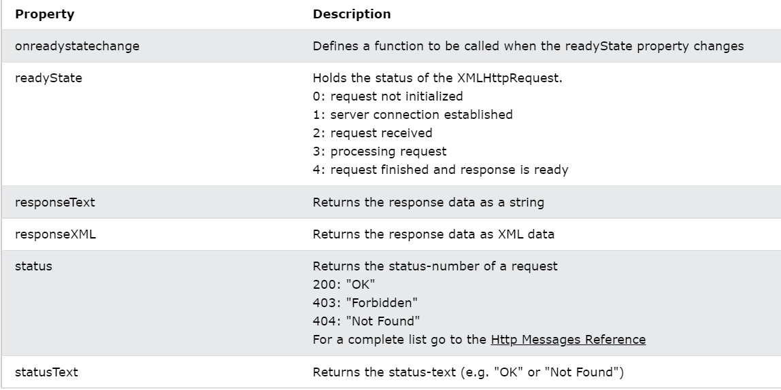
XMLHttpRequest Object
All modern browsers support the XMLHttpRequest object.
The XMLHttpRequest object can be used to exchange data with a server behind the scenes. This means that it is possible to update parts of a web page, without reloading the whole page.
EdYoda - Frontend Developer Program
https://www.edyoda.com

Slide 10
Ajax Request
With the XMLHttpRequest object you can define a function to be executed when the request receives an answer. The function is defined in the onreadystatechange property of the XMLHttpResponse object:
Making AJAX Requests – GET
Handling AJAX Response + OnReadyStateChangeProperty
EdYoda - Frontend Developer Program
https://www.edyoda.com

Slide 11
Ajax Response
Handling AJAX Response with OnReadyStateChangeProperty.
The readyState property holds the status of the XMLHttpRequest.
The onreadystatechange property defines a function to be executed when the readyState changes.
The status property and the statusText property holds the status of the XMLHttpRequest object.
Render HTML elements dynamically
EdYoda - Frontend Developer Program
https://www.edyoda.com

Slide 12
JSON
JSON stands for JavaScript Object Notation
JSON is a lightweight data-interchange format
JSON is plain text written in JavaScript object notation
JSON is used to send data between computers
JSON is language independent
EdYoda - Frontend Developer Program
https://www.edyoda.com

Slide 13
Thank You!
KEEP LEARNING!!

