Slide 1
Introduction to JS
Turn your passion into Website

Slide 2
Today’s Topics
Intro to Events + Event Listeners + Event Handlers
Mouse Events
Keyboard Events
Form Events

Slide 3
JavaScript- Events
An HTML event can be something the browser does, or something a user does.
Event handlers and Event Listener.
To assign events to HTML elements you can use event attributes.
Event handlers can be used to handle and verify user input, user actions, and browser actions.
DOM Event Property + addEventListener
EdYoda - Frontend Developer Program
https://www.edyoda.com

Slide 4
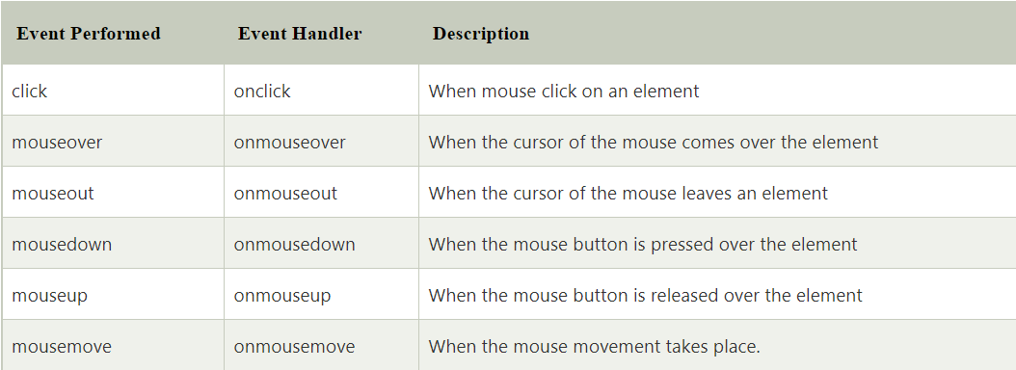
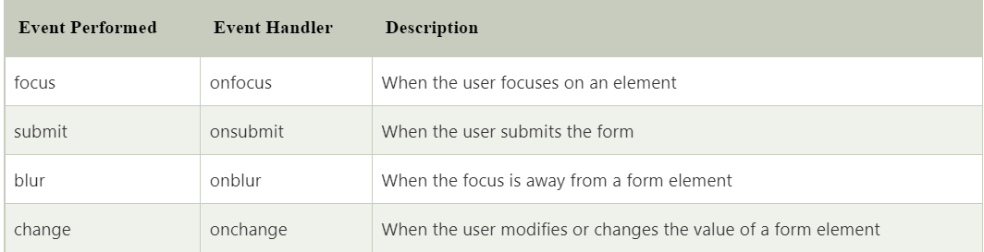
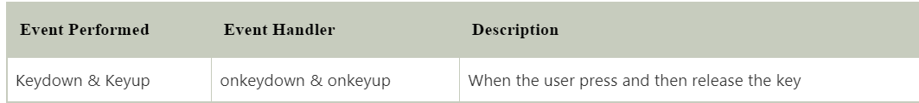
JavaScript- Events
EdYoda - Frontend Developer Program
https://www.edyoda.com

Slide 5
JavaScript- Events
Mouse Events
Keyboard Events: keyup, keydown, keypressed.
Form Events: onChange, onInput, onFocus, onBlur, onSubmit.
Default Behaviour, e.preventDefault()
EdYoda - Frontend Developer Program
https://www.edyoda.com

Slide 6
Create a TODO Application
Add a new element: Create an input box (add data once user click on submit button and display it below).
EdYoda - Frontend Developer Program
https://www.edyoda.com

Slide 7
Thank You!
KEEP LEARNING!!

