Slide 1
Introduction to HTML
Turn your passion into Website

Slide 2
Today’s Topics
Tables
More CSS properties

Slide 3
Tables
HTML tables allow us to organize data into rows and columns.
tr: define each row
td: define each table cell/ they are data containers
th: define the table header
caption: Use the HTML <caption> element to define a table caption
EdYoda - Frontend Developer Program
https://www.edyoda.com

Slide 4
CSS properties
Font Family
Font Weight
Border
Margin
Padding
Box Model
Border Radius
EdYoda - Frontend Developer Program
https://www.edyoda.com

Slide 5
Font
Choosing the right font has a huge impact on how the readers experience a website.
The right font can create a strong identity for your brand.
Using a font that is easy to read is important. The font adds value to your text. It is also important to choose the correct color and text size for the font.
Font-family
Font-weight
EdYoda - Frontend Developer Program
https://www.edyoda.com

Slide 6
Borders
The CSS border properties allow you to specify the style, width, and color of an element's border.
border-color
border-style
border-width
border shorthand
border radius
EdYoda - Frontend Developer Program
https://www.edyoda.com

Slide 7
Margin
Margins are used to create space around elements, outside of any defined borders.
margin-top
margin-right
margin-bottom
margin-left
EdYoda - Frontend Developer Program
https://www.edyoda.com

Slide 8
Padding
Padding is used to create space around an element's content, inside of any defined borders.
padding-top
padding-right
padding-bottom
padding-left
EdYoda - Frontend Developer Program
https://www.edyoda.com

Slide 9
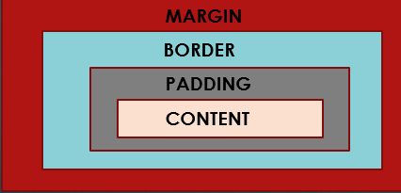
Box Model
In CSS, the term "box model" is used when talking about design and layout.
The CSS box model is essentially a box that wraps around every HTML element.
It consists of: margins, borders, padding, and the content.
EdYoda - Frontend Developer Program
https://www.edyoda.com

Slide 10
Thank You!
KEEP LEARNING!!

