Slide 1
Introduction to HTML
Turn your passion into Website

Slide 2
Today’s Topics
What is HTML5?
Semantic & Non-Semantic

Slide 3
What is HTML5?
HTML5 is the improved HTML version released in 2014 by the World Wide Web consortium.
New features added to HTML 5.
In HTML5, several semantic elements were introduced , which is to say elements that convey meaning. Some of the new semantic elements are <header>, <footer>, <section>, and <article> . They are semantic in that they are not just simple containers, but they tell the browser more about their contents.
There are additional form element types, like "number", "date", "calendar" and "range". Video and audio elements have also been added, as well as new graphic elements, such as <svg> and <canvas>.
EdYoda - Frontend Developer Program
https://www.edyoda.com

Slide 4
Semantic & Non-Semantic
Semantic elements describe the meaning of the element and content. e.g.
<header>: Introductory content e.g. set of navigation links
<footer>: Define the footer section containing copyright, social media links, sitemap, etc.
<section>: Defines a section of a document.
<nav>: It define the navigation links.
Non-Semantic elements define nothing about the content. e.g.
div: tag is used to define division/section in an HTML document. It is used as a container for HTML elements. Any sort of content can be added in the div tag.
span: tag is an inline container to mark up a part of the text of document.
EdYoda - Frontend Developer Program
https://www.edyoda.com

Slide 5
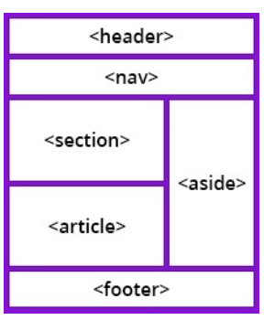
Layout
Websites often display content in multiple columns (like a magazine or a newspaper).
HTML has several semantic elements that define the different parts of a web page:
Header: Defines a header for a document or a section.
Nav: Defines a set of navigation links.
Section: Defines a section in a document.
Footer: Defines a footer for a document or a section.
Aside: Defines content aside from the content (like a sidebar).
EdYoda - Frontend Developer Program
https://www.edyoda.com

Slide 6
Thank You!
KEEP LEARNING!!

