Slide 1
Introduction to JS
Turn your passion into Website

Slide 2
Today’s Topics
Intro to Time Complexity
Big O, Omega and Theta Notation
Types of Time Complexity Functions
Maths behind Time Complexity and Comparison
Practice on Time Complexity
Best, Worst and Average Cases

Slide 3
Intro to Time Complexity
The time complexity is the number of operations an algorithm performs to complete its task (considering that each operation takes the same amount of time). The algorithm that performs the task in the smallest number of operations is considered the most efficient one in terms of the time complexity
EdYoda - Frontend Developer Program
https://www.edyoda.com

Slide 4
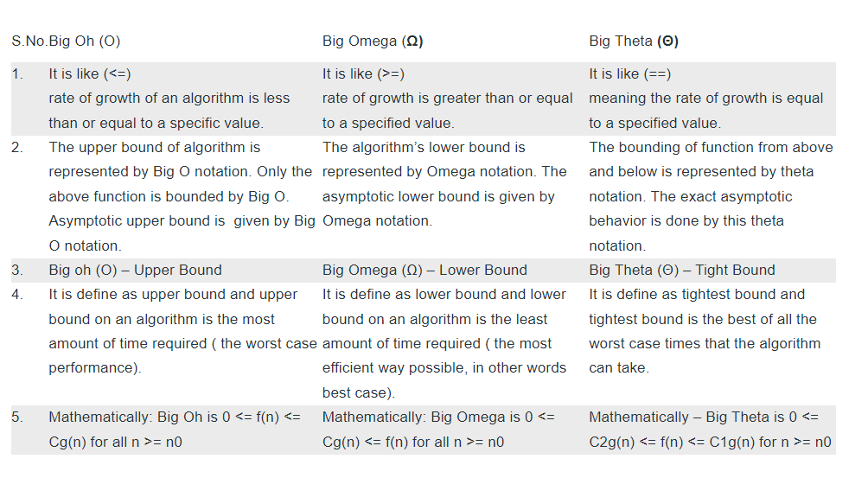
Big O, Omega and Theta Notation
EdYoda - Frontend Developer Program
https://www.edyoda.com

Slide 5
Types of Time Complexity Functions
There are different types of time complexities:
Constant Time Complexity: O(1)
Linear Time Complexity: O(n)
Logarithmic Time Complexity: O(log n)
Quadratic Time Complexity: O(n²)
Exponential Time Complexity: O(2^n)
EdYoda - Frontend Developer Program
https://www.edyoda.com

Slide 6
The time complexity of Insertion Sort in the best case is O(n). In the worst case, the time complexity is O(n^2).
This sorting technique is for all kinds of cases. Merge Sort in the best case is O(nlogn). In the worst case, the time complexity is O(nlogn). This is because Merge Sort implements the same number of sorting steps for all kinds of cases.
EdYoda - Frontend Developer Program
https://www.edyoda.com

Slide 7
The time complexity of Bubble Sort in the best case is O(n). In the worst case, the time complexity is O(n^2).
Quick Sort in the best case is O(nlogn). In the worst case, the time complexity is O(n^2). Quicksort is considered to be the fastest of the sorting algorithms due to its performance of O(nlogn) in best and average cases.
EdYoda - Frontend Developer Program
https://www.edyoda.com

Slide 8
Linear Search follows sequential access. The time complexity of Linear Search in the best case is O(1). In the worst case, the time complexity is O(n).
Binary Search is the faster of the two searching algorithms. However, for smaller arrays, linear search does a better job. The time complexity of Binary Search in the best case is O(1). In the worst case, the time complexity is O(log n).
Time complexity for the deletion of a node from the end of the link list is O(n).
Time complexity when we enqueue data in the queue is O(1)
Time complexity of deleting a node from the middle of the linked link is O(n)
EdYoda - Frontend Developer Program
https://www.edyoda.com

Slide 9
External Resources for Study on Time Complexity
https://www.geeksforgeeks.org/practice-questions-time-complexity-analysis/
https://towardsdatascience.com/the-math-behind-big-o-and-other-asymptotic-notations-64487889f33f
https://www.geeksforgeeks.org/understanding-time-complexity-simple-examples/
EdYoda - Frontend Developer Program
https://www.edyoda.com

Slide 10
External Resources for Study on Data Structure
https://builtin.com/software-engineering-perspectives/javascript-data-structures
https://www.freecodecamp.org/news/data-structures-in-javascript-with-examples/#arrays
https://www.geeksforgeeks.org/introduction-to-data-structures/?ref=lbp
https://www.youtube.com/watch?v=41GSinwoMYA
External Resources for Interview Questions
https://www.educative.io/blog/javascript-data-structures#questions
https://www.interviewbit.com/data-structure-interview-questions/
https://www.simplilearn.com/data-structure-interview-questions-and-answers-article
EdYoda - Frontend Developer Program
https://www.edyoda.com

Slide 11
External Resources for Study on Algorithm
https://dev.to/swastikyadav/algorithms-in-javascript-with-visual-examples-gh3
https://javascript.plainenglish.io/top-5-javascript-algorithms-that-you-should-solve-92c34448fbbb
External Resources for Interview Questions
https://www.thatjsdude.com/interview/js1.html
https://betterprogramming.pub/common-javascript-algorithm-interview-questions-explained-68d8c4186270
https://shinjukudev.medium.com/algorithm-interview-questions-and-answers-js-c44f0872b9b2
EdYoda - Frontend Developer Program
https://www.edyoda.com

Slide 12
Thank You!
KEEP LEARNING!!

