Slide 1
Introduction to HTML
Turn your passion into Website

Slide 2
Today’s Topics
HTML5 - Introduction, Fundamentals
HTML5 - Basic Elements
Semantic, Attributes, Headings, Paragraph

Slide 3
WHAT IS HTML?
HTML stands for Hyper text Markup Language.
It is used to define structure of Web Pages.
With HTML, you can create your own website.
It is a Tag based language.
e.g. <h1>add some title course</h1>
EdYoda - Frontend Developer Program
https://www.edyoda.com

Slide 4
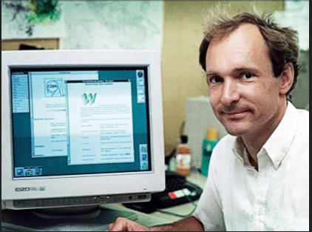
History
HTML was introduced by Sir Tim Berners-Lee.
This first web page was created by Sir Tim Berners-Lee.
First web page went live in the year 1991.
EdYoda - Frontend Developer Program
https://www.edyoda.com

Slide 5
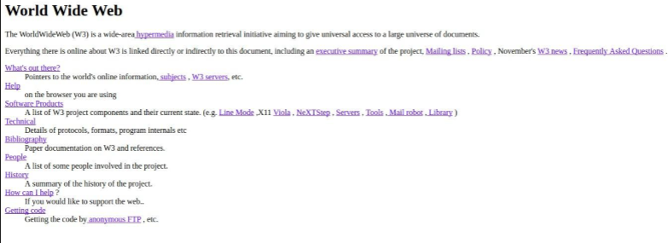
THE FIRST WEB PAGE
EdYoda - Frontend Developer Program
https://www.edyoda.com

Slide 6


LET'S HAVE A LOOK AT WHAT'S INVOLVED WITH THE WHOLE IDEA OF WEB
Client Side
Server Side
EdYoda - Frontend Developer Program
https://www.edyoda.com

Slide 7
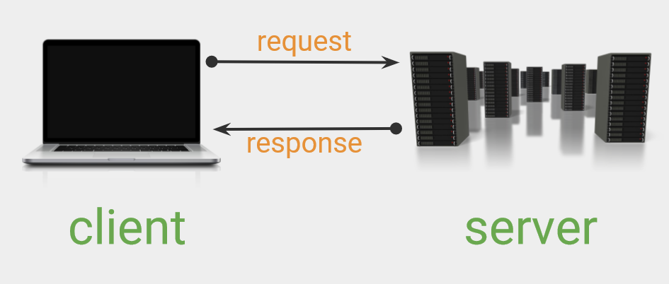
Architecture
EdYoda - Frontend Developer Program
https://www.edyoda.com

Slide 8
HTML5 - Basic Elements
Structure of HTML Document
Basic Elements: Heading, Paragraph, Links, Image.
Create First HTML Webpage.
How to View HTML Source.
EdYoda - Frontend Developer Program
https://www.edyoda.com

Slide 9
HTML Head
HTML metadata is data about the HTML document. Metadata is not displayed. Metadata typically define the document title, character set, styles, script.
metaData: The html element is a container for the following elements: title, style, meta, link, script. title: Defines a title in the browser toolbar provides a title for the page when it is added to favorites displays a title for the page in search engine-results
style: The <style> element is used to define style information for a single HTML page
link: tag defines the relationship between the current document and an external resource.
EdYoda - Frontend Developer Program
https://www.edyoda.com

Slide 10
Tags, Attributes, Headings, Paragraph
Tag: Types of tags: paired, unpaired/empty, self-closing tag, utility tag.
Elements & Attributes
Heading: HTML headings are titles or subtitles that you want to display on a webpage.
Paragraph: A paragraph always starts on a new line, and is usually a block of text.
EdYoda - Frontend Developer Program
https://www.edyoda.com

Slide 11
Thank You!
KEEP LEARNING!!

