Slide 1
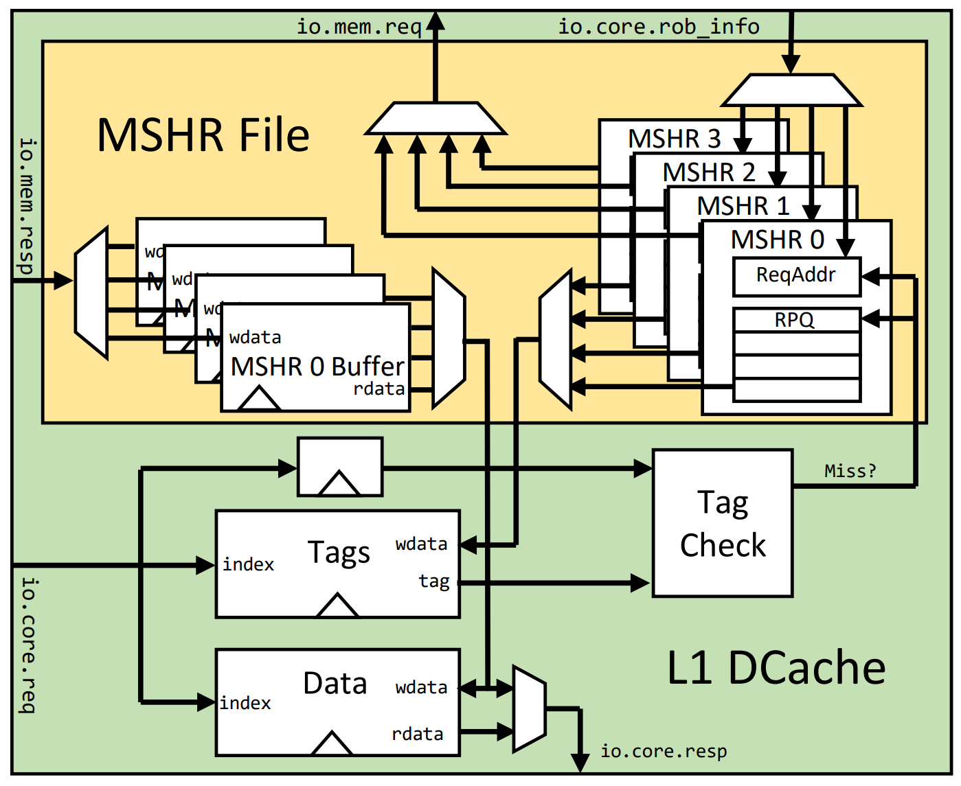
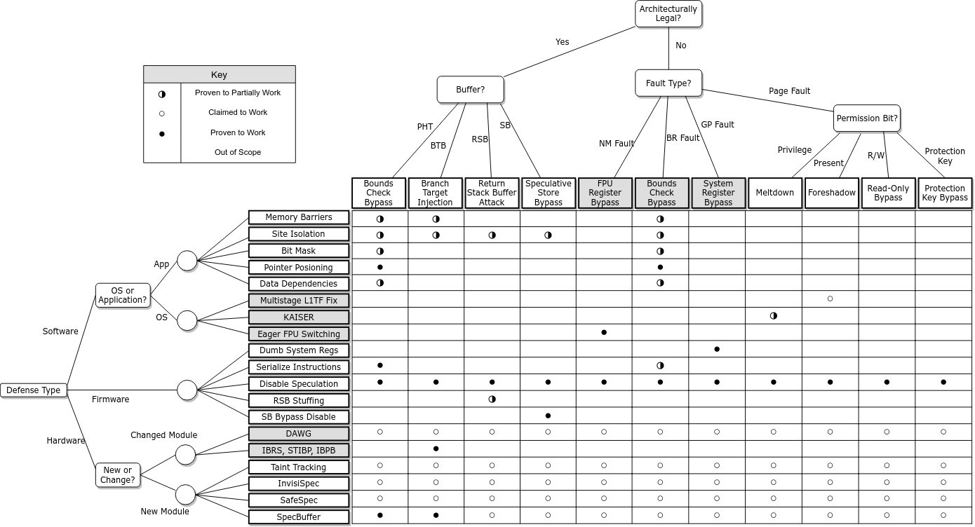
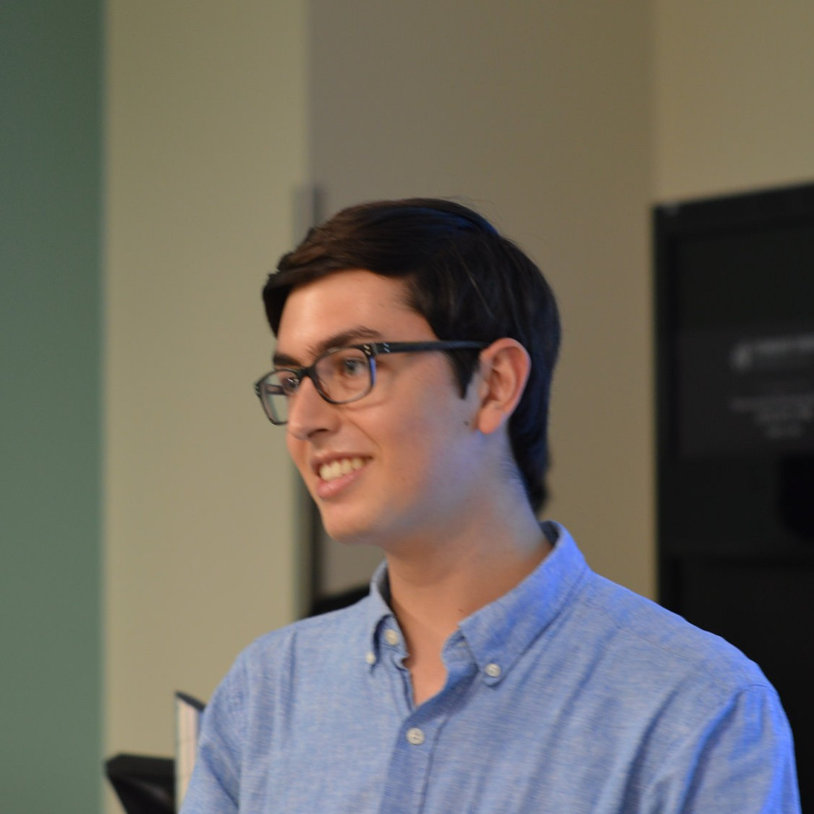
Spectrum: Classifying, Replicating and Mitigating Spectre Attacks
Use BOOM as a model
Taxonomy of single core attacks
Replicated Spectre v1/v2
Prototype L1D$ Speculative Buffer
Abraham Gonzalez
Notes:
Please put in notes here to explain poster so that someone else could summarize what your poster is about
<number>

