Slide 1
S.O.L.I.D Object Oriented Design

Slide 2
WHAT IS THAT?
S.O.L.I.D is an acronym for the first five object-oriented design(OOD) principles.
These principles, when combined together, make it easy for a programmer to develop software that are easy to maintain and extend.

Slide 3
MEANING
S = Single-responsibility Principle
O = Open-closed Principle
L = Liskov substitution principle
I = Interface segregation principle
D = Dependency Inversion principle

Slide 4
S:Single-responsibility
A class should have one and only one reason to change, meaning that a class should have only one job.

Slide 5
The Single Responsibility Principle is the key software engineering principle which determines how we should modularize code in object oriented programming.

Slide 6
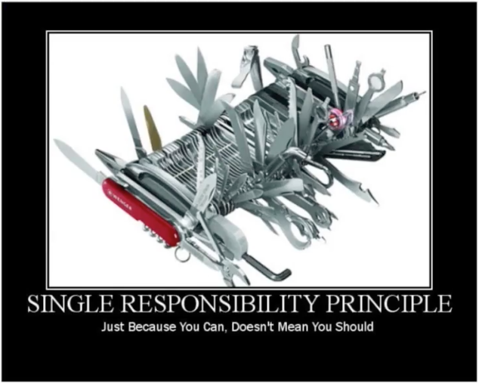

Slide 7
O:Open-closed
Objects or entities should be open for extension, but closed for modification.

Slide 8
Open for extension means that we should be able to add new features or components to the application without breaking existing code.
Closed for modification means that we should not introduce breaking changes to existing functionality, because that would force you to refactor a lot of existing code.
In simpler words, means that a class or factory function in our case, should be easily extendable without modifying the class or function itself.

Slide 9
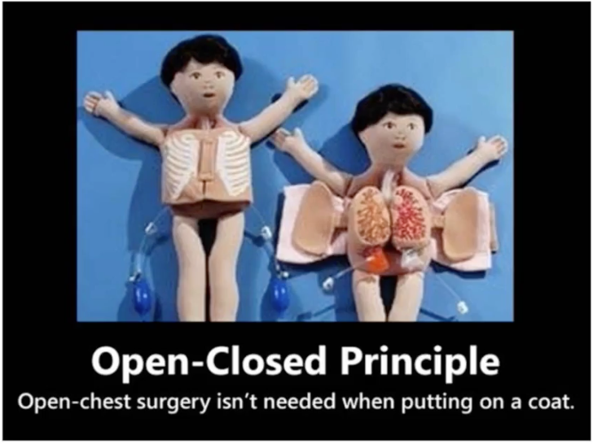
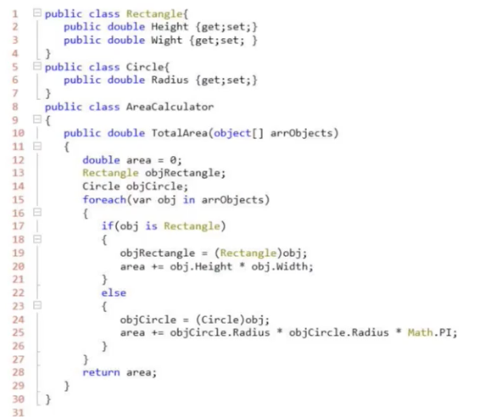

Slide 10
L:Liskov substitution
Let q(x) be a property provable about objects of x of type T. Then q(y) should be provable for objects y of type S where S is a subtype of T.

Slide 11
All this is stating is that every subclass/derived class should be substitutable for their base/parent class.

Slide 12
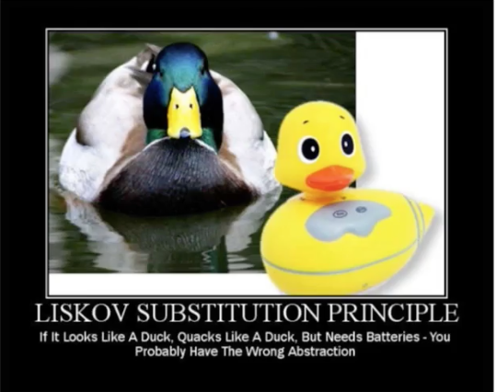

Slide 13
I:Interface segregation
A client should never be forced to implement an interface that it doesn't use or clients shouldn't be forced to depend on methods they do not use.

Slide 14
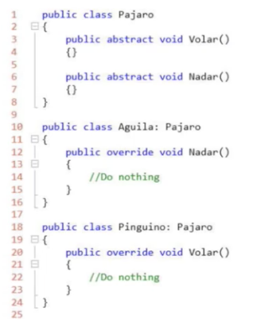
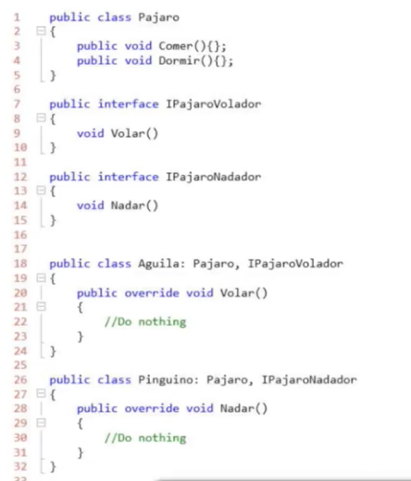
Incorrect
Correct

Slide 15
D:Dependency inversion
Entities must depend on abstractions not on concretions. It states that the high level module must not depend on the low level module, but they should depend on abstractions.

Slide 16
Character
Fighter Junior
Fighter
Pro
Fighter Junior
Fighter
Pro
IFighter
Character
IFighter

Slide 17
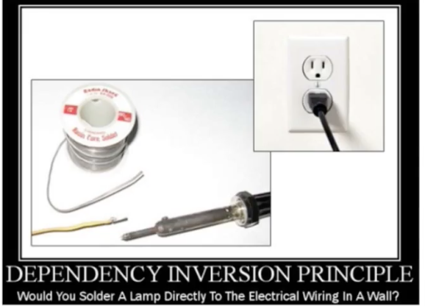
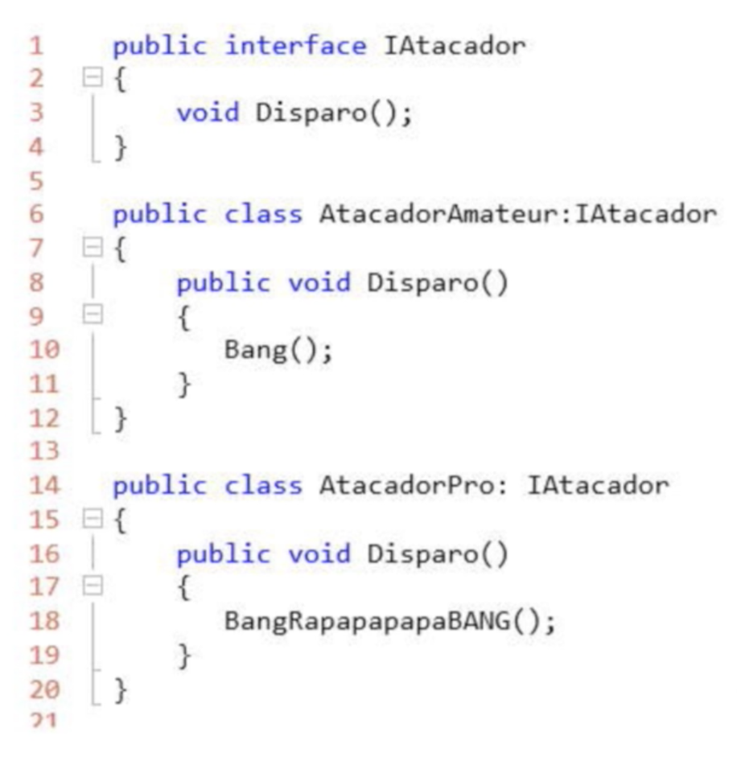
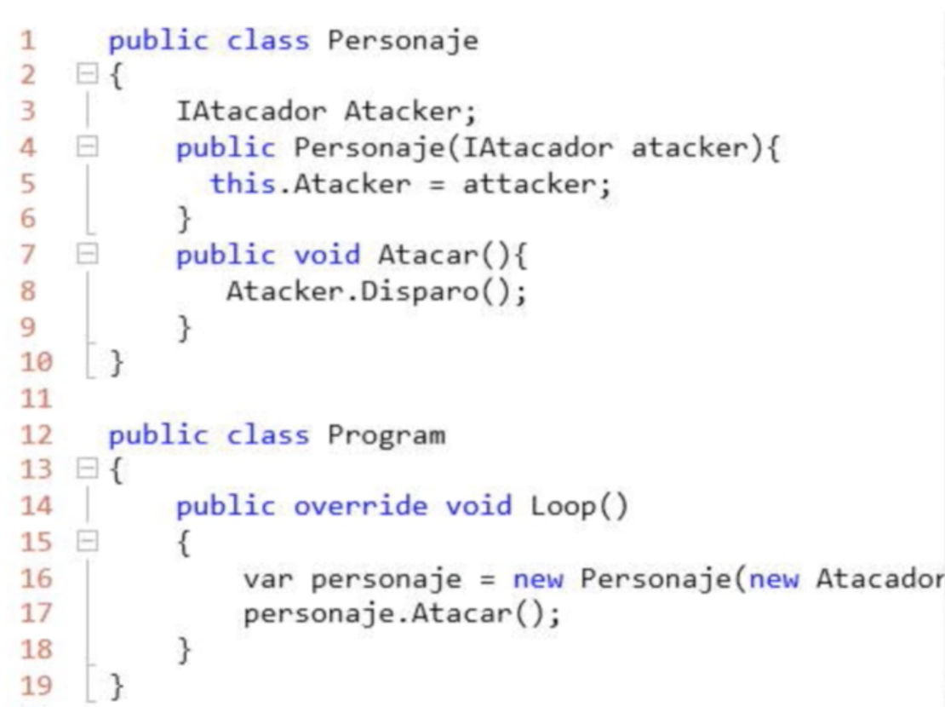

Slide 18
Thanks!
Any questions?

