Slide 1

Eda Wagyu
Buyer's Guide 2026
Antibiotic-free, hormone-free Japanese Black Wagyu
Direct from Miyazaki, Japan
CONFIDENTIAL — EDA LIVESTOCK CO., LTD.

Slide 2
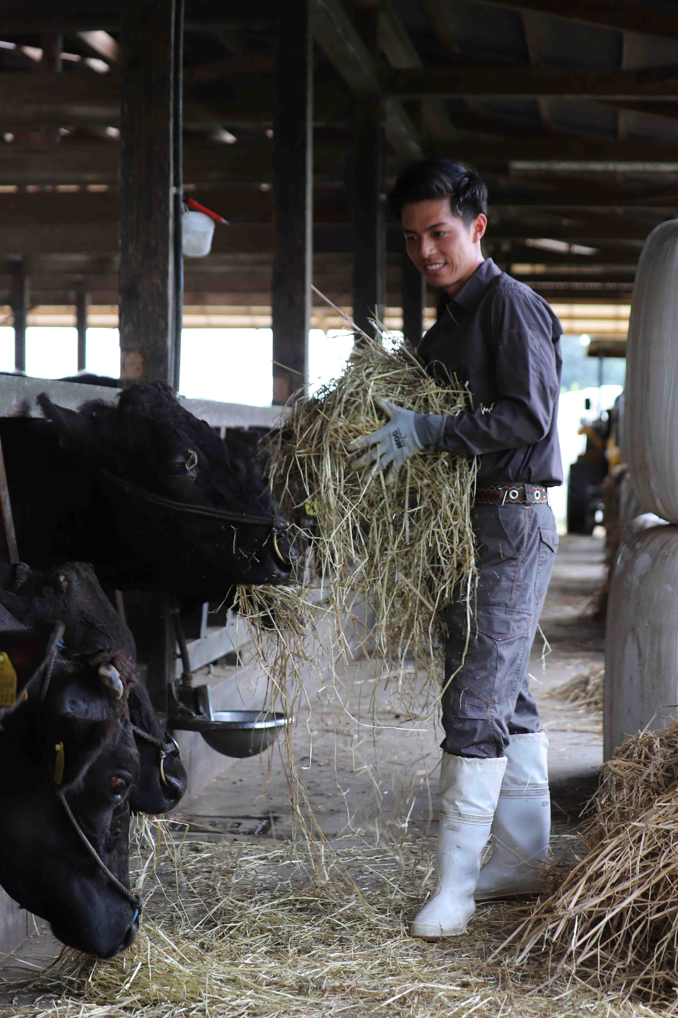
— ABOUT US —
Eda Livestock
Co., Ltd.
Founded in 2023 by Tomoki Eda, the 4th-generation successor of Eda Livestock — a 70-year cattle-farming heritage in Miyazaki, Japan.
We raise Japanese Black Wagyu using circular feeding, zero antibiotics, and complete farm-to-table traceability — pioneering the world's first organic-certified Wagyu beef.
"Not the rank, but how they're raised. We believe true quality comes from the feed, the care, and the methods behind the meat."
Tomoki Eda
2023
CEO · 4TH GENERATION REPRESENTATIVE
FOUNDED
EDA WAGYU — BUYER'S GUIDE
02

Slide 3
Antibiotic & Hormone Free
— WHY EDA WAGYU —
Zero antibiotics, growth promoters, or hormones throughout the entire lifecycle.
What Makes Us
Different.
Circular Feed System
Feed produced from our own compost cycle — not imported. Structural cost advantage.
Unlike conventional Wagyu brands defined by region (Kobe, Matsusaka, Omi), Eda Wagyu is defined by how the cattle are raised — our feed and farming practices.
Grade A3+ · 28 Months+
Minimum A3 grade, 28+ months fattening. Grade and region specification available.
This means your customers get a consistent, transparent product with a story they can verify — not just a geographic label.
World's Only Organic Wagyu
Premium EdaWagyu holds JAS Organic + EU Leaf equivalence — first and only in the world.
ONLY 1% OF JAPANESE FARMS ARE ADDITIVE-FREE
Direct Export · JPY Settlement
No trading house intermediaries. Direct from farm, settled in Japanese Yen.
EDA WAGYU — BUYER'S GUIDE
03

Slide 4
— EXPORT CUT LINEUP —
Six Primal Cuts — Chilled or Frozen, Vacuum-Packed
All cuts available chilled (0–4°C) or frozen (-18°C). Vacuum-pack or skin-pack. Custom portioning on request.
01
Striploin
BEST SELLER
02
Ribeye
POPULAR
サーロイン
リブロース / リブアイ
Rich marbling in a fine web pattern. The king of steaks.
Generous marbling with buttery flavor. Excellent for roasting.
03
Tenderloin / Fillet
PREMIUM
04
Round (Momo)
VERSATILE
ヒレ / フィレ
モモ（ウチモモ · ランプ · イチボ）
Only ~3kg per head. The most tender cut — perfect for chateaubriand.
Lean with concentrated umami. Versatile — roast, steak, shabu-shabu.
05
Tomahawk
SHOWPIECE
06
Skin Pack Portions
RETAIL READY
トマホーク（骨付きリブロース）
スキンパック（個包装）
Bone-in ribeye with long rib bone. Dramatic presentation cut.
Pre-portioned 150g–300g. Retail-ready for high-end supermarkets.
EDA WAGYU — BUYER'S GUIDE
04

Slide 5
— PRODUCT SPECIFICATION —
Two Brands, One Standard of Excellence
Specification
Eda Wagyu
Premium EdaWagyu
Conventional Wagyu
Breed
Japanese Black (Kuroge)
Japanese Black (Kuroge)
Japanese Black
Antibiotics / Hormones
✓ Zero
✓ Zero
Used
Feed
Circular (domestic)
100% Organic-certified
Imported compound
Minimum Grade
A3+
A3+
Varies
Fattening Period
28+ months
31+ months
24–26 months
Regions
Miyazaki · Kagoshima · Tohoku
Miyazaki only (Eda Farm)
Single prefecture
Organic Certification
—
✓ JAS + EU Leaf + USDA
—
HALAL
✓ Available
Not available
Limited
Animal Welfare
✓ Compliant
✓ Organic standard
No standard
Traceability
✓ Full (birth–table)
✓ Full (birth–table)
Partial
PREMIUM EDAWAGYU IS AVAILABLE EXCLUSIVELY TO EXISTING EDA WAGYU CUSTOMERS
EDA WAGYU — BUYER'S GUIDE
05

Slide 6
— LOGISTICS & SHIPPING —
Farm to Your Designated Port in ~1 Month
Chilled or frozen — you choose. We handle export documents, customs clearance, and freight to your designated port.
PHASE 1 — ORDER
PHASE 2 — PREPARATION
PHASE 3 — DELIVERY
Order Confirmation
Documents & Shipping
Shipment & Arrival
→ Purchase order confirmed
→ Health Certificate issued
→ AWB (Air Waybill) issued
→ Invoice issued (JPY)
→ Packing List prepared
→ EQC (Export Quarantine Cert)
→ 30% deposit received
→ Commercial Invoice finalized
→ Certificate of Origin
→ Slaughter scheduled
→ HALAL cert (if applicable)
→ Freight to designated port
→ 70% balance payment received
→ Arrival confirmation
TEMPERATURE
PACKAGING
SHELF LIFE
Chilled: 0–4°C or Frozen: -18°C. Buyer specifies at order.
Vacuum-pack (standard) or skin-pack (retail). Styrofoam box with gel ice / dry ice.
110 days from production. Approx. 90 days remaining at arrival.
EDA WAGYU — BUYER'S GUIDE
06

Slide 7
— COMMERCIAL TERMS —
Transparent Terms, Built for Long-Term Partnership
Order & Payment
Shipping & Delivery
CURRENCY
Japanese Yen (JPY) — all invoices in ¥
INCOTERMS
FOB or CIF — buyer's choice
PAYMENT
Deposit 30% at order confirmation Balance 70% before shipping This rule applies to all clients without exception
FREIGHT
Air freight, chilled or frozen
LEAD TIME
Approx. 4 weeks from deposit to port delivery
DELIVERY
Approx. 4 weeks to designated port Customs clearance by buyer
SHELF LIFE
110 days from production ~90 days remaining at arrival
MOQ
200 kg per order
CUSTOM CUT
Thickness, portioning, and trim to spec.
PRICING
Based on JPY/kg · Grade and region affect price
GRADE SELECT
A3/A4/A5 specification available. Region lock = price premium.
EXCLUSIVITY
Currently exclusive in 3 countries. Inquire separately for distribution rights.
EDA WAGYU — BUYER'S GUIDE
07

Slide 8

— CERTIFICATIONS —
Trust, Verified by International Standards
Eda Wagyu
HALAL
USDA Organic
EU Leaf
JAS Organic
BOTH BRANDS
EDA WAGYU ONLY
PREMIUM ONLY
PREMIUM ONLY
PREMIUM ONLY
Proprietary brand cert. Antibiotic-free, hormone-free.
Certified for Malaysia, Indonesia, and Islamic markets.
Application in progress. Targeting US organic market.
Approved. Organic-labeled export to all EU states.
World's first organic-certified Kuroge Wagyu. Jan 2026.
FOR YOUR MENU
FOR YOUR BRAND
FOR YOUR COMPLIANCE
"Antibiotic-free," "Hormone-free," "Organic-certified" — menu claims your guests actively seek.
Sustainability, traceability, and animal welfare are expected by luxury consumers.
EU import regulations, HALAL requirements, organic labeling — we handle the paperwork.
EDA WAGYU — BUYER'S GUIDE
08

Slide 9
— WHERE EDA WAGYU IS SERVED —
Trusted by The World's Finest Hotels
THE RITZ-CARLTON
FOUR SEASONS
THE PENINSULA
MANDARIN ORIENTAL
Tokyo · Fukuoka · Hong Kong · New York
Tokyo at Otemachi
Tokyo
Tokyo
TOKYO STATION HOTEL
EDITION GINZA
CITY'SUPER
MITSUKOSHI · KEIO
National Heritage · Tokyo
Marriott Luxury · Ginza
All stores · Hong Kong
Ginza · Nihonbashi · Shinjuku
21
13
4
Also served at ANA International First Class, Tokyo DisneySea, WITH THE STYLE Fukuoka, and fine-dining restaurants across Europe and Southeast Asia.
LOCATIONS
COUNTRIES
CONTINENTS
EDA WAGYU — BUYER'S GUIDE
09

Slide 10
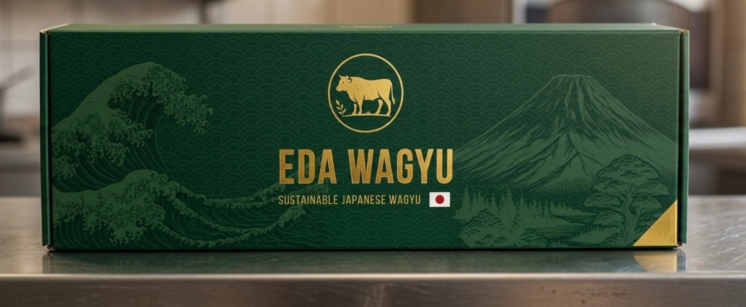
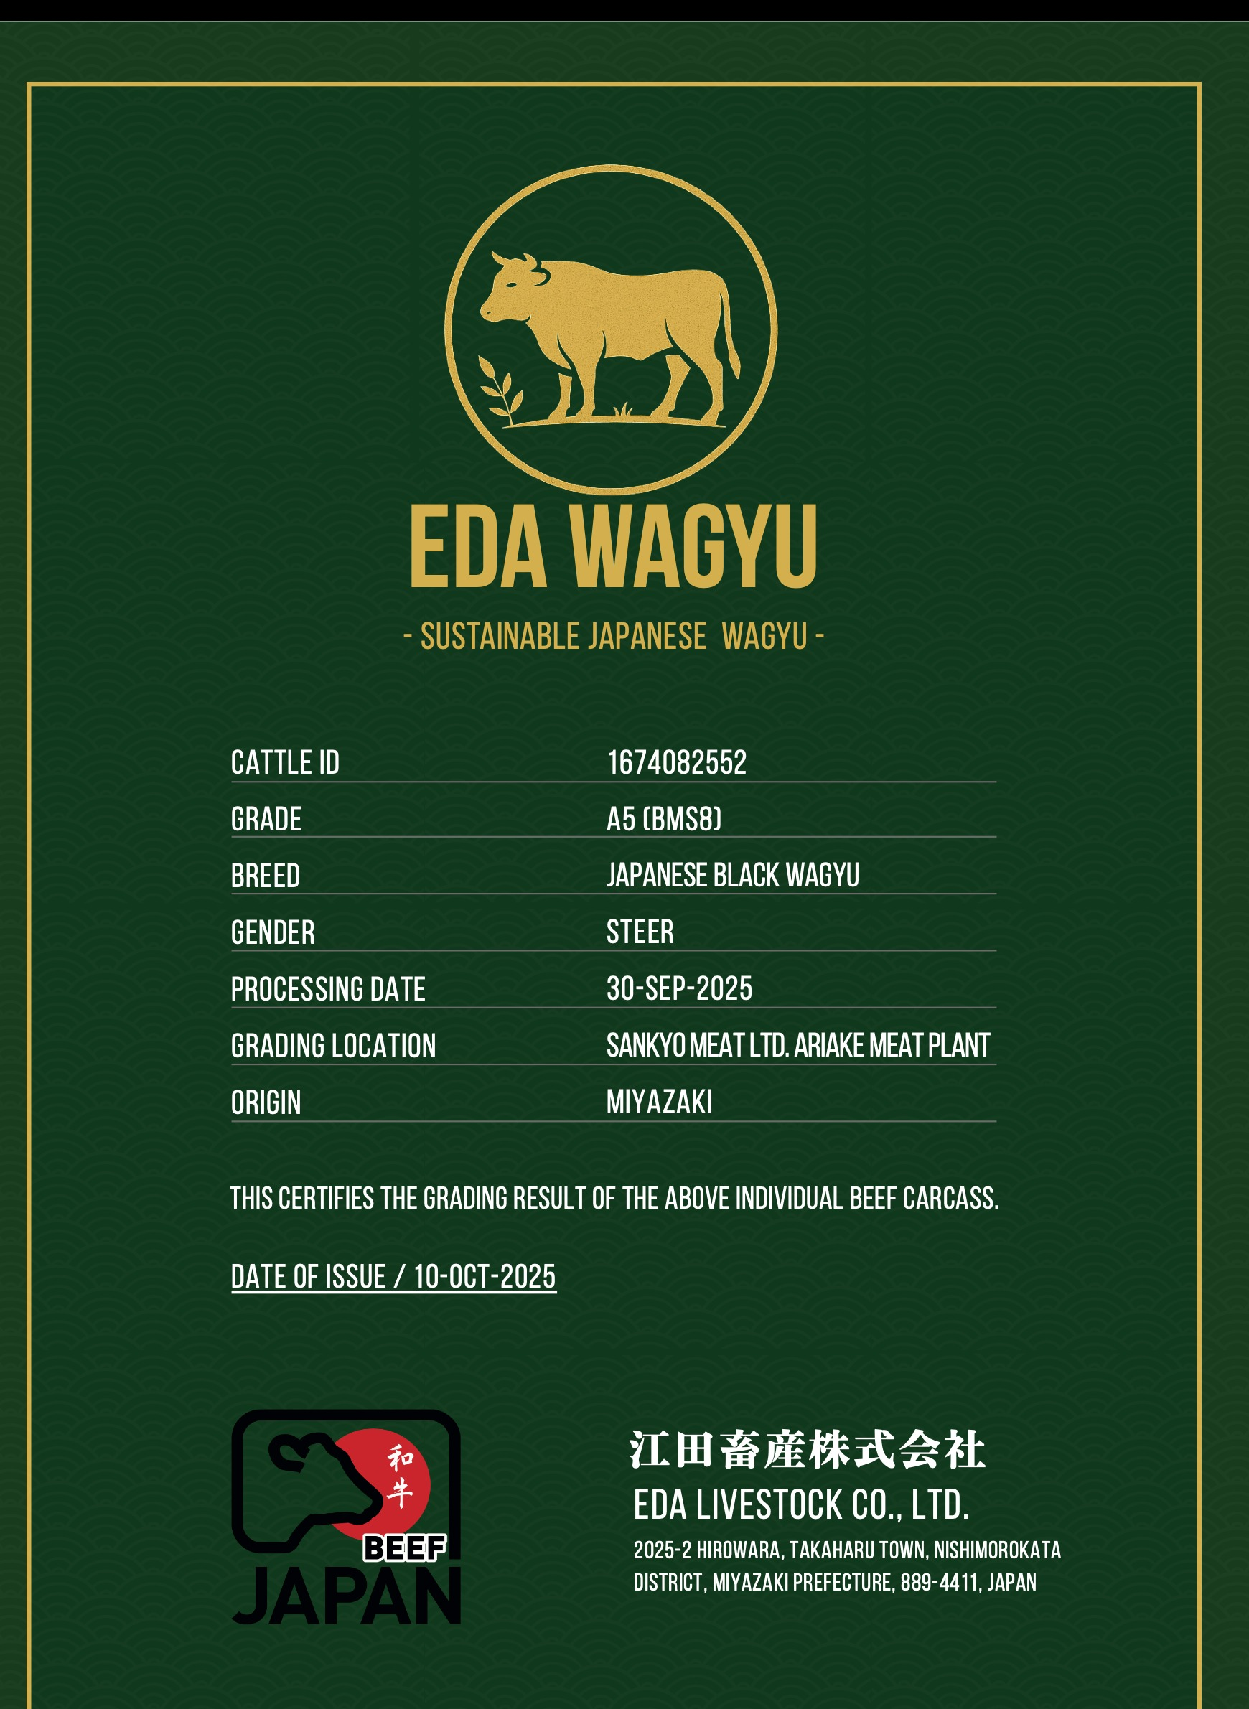
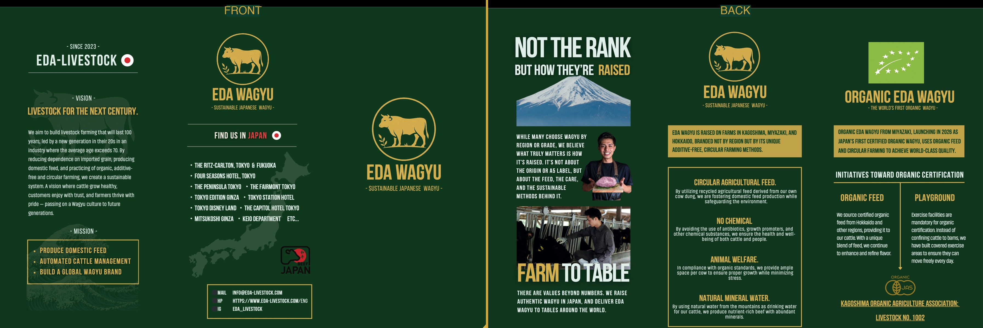

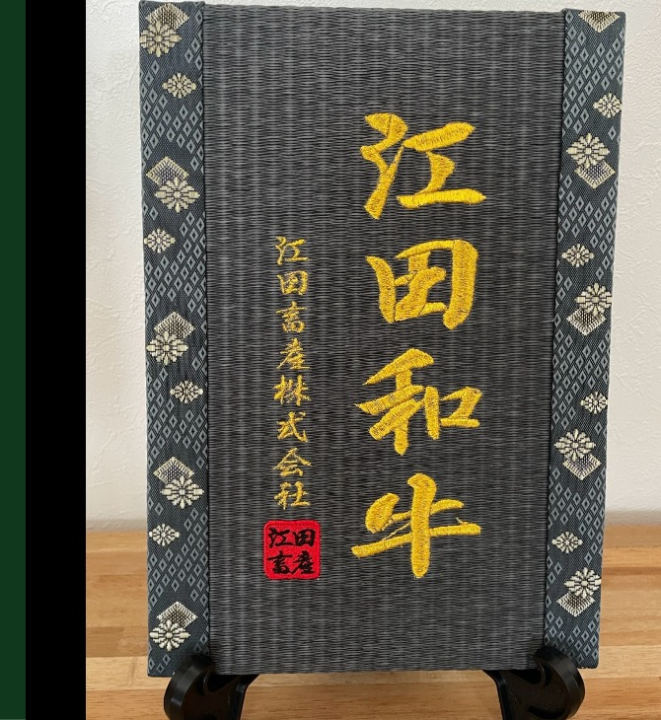
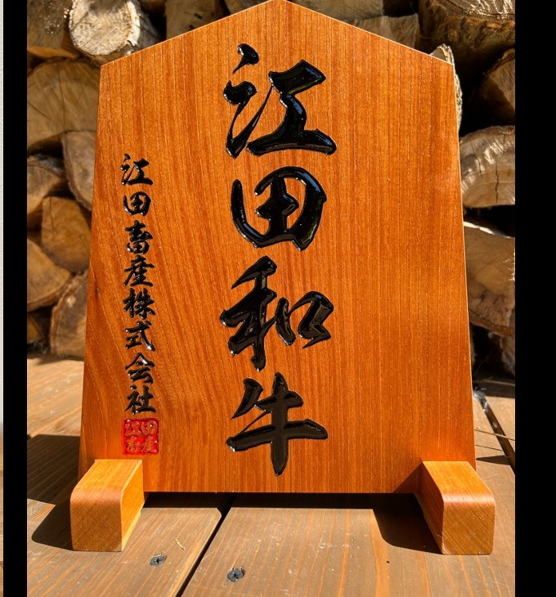
— BRANDED MATERIALS · SOLD SEPARATELY —
Elevate Your Presentation with Eda Wagyu Originals
Optional brand materials available for purchase. Strengthen the in-store and dining experience with authentic, hand-crafted Eda Wagyu items.
SIGNATURE
EN / JP
AUTHENTIC
Original Branded Box
Brand Pamphlet
Eda Wagyu Certificate
江田和牛 オリジナル 化粧箱
3つ折りパンフレット（表・裏）
江田和牛 証明書
¥1,100 / BOX
¥440 / PIECE
¥550 / SHEET
Premium green & gold-foil packaging with Hokusai-inspired wave and Mt. Fuji motif.
Bilingual 3-fold brochure (2 sides) detailing philosophy, farming, and certifications.
Individual carcass certificate (Cattle ID, Grade, Farm, Origin).
SET OF 24
HANDMADE
PREMIUM
Brand Sticker Set
Display Plate (Tatami)
Display Plate (Wood)
江田和牛 ロゴシール
立て札 — 畳バージョン
立て札 — 木製バージョン
¥980 / SET
¥38,000 / PLATE
¥77,000 / PLATE
Forest-green and gold seal stickers for packaging, gift wrap, and retail.
Traditional tatami-textured display with embroidered "江田和牛" gold branding.
Premium solid wood with engraved "江田和牛" — luxury statement piece.
EDA WAGYU — BUYER'S GUIDE
10

Slide 11
— HOW TO ORDER —
From Inquiry to Delivery — Simple & Direct
01
02
03
04
Contact Us
Quotation
Deposit 30%
Balance & Ship
Email your interest, preferred cuts, volume, and destination. We reply within 24 hours.
We send a JPY price list tailored to your order. Custom cuts and grades available.
Sign purchase order and send 30% deposit. Slaughter is scheduled upon receipt.
Pay remaining 70% before shipping. Documents + freight arranged to your designated port.
FIRST ORDER?
REGULAR BUYER?
DISTRIBUTOR?
We accommodate smaller first orders so you can test with your kitchen team before scaling.
Established accounts receive priority scheduling and access to Premium EdaWagyu (organic).
We partner with local importers and distributors. Exclusive territory rights negotiable.
EDA WAGYU — BUYER'S GUIDE
11

Slide 12
Ready to Taste the Difference?
Request a price list or schedule a call with our export team.
EXPORT INQUIRIES
HEADQUARTERS
Tomoki Eda — CEO / 4th Generation Representative
international.sales@eda-livestock.com
We respond within 24 hours.
Eda Livestock Co., Ltd.
2025-2 Hirohara, Takaharu-cho
Miyazaki 889-4411, Japan
backoffice@eda-livestock.com
eda-livestock.com · @eda_livestock
© 2026 EDA-LIVESTOCK CO., LTD. — CONFIDENTIAL

