Slide 1
POWER BI CASE STUDY
THE ANALYTICAL STORY
DEMAND
INTELLIGENCE
01
OVERVIEW
What happened to demand?
Historical trends, growth, seasonality
02
PERFORMANCE
What is driving demand?
Store & product contributors, concentration
Retail Demand Analysis
& Forecasting
03
FORECAST
January 2013 – December 2017 · 10 Stores · 50 Products
What might happen next?
12-month outlook, confidence intervals
Power BI · SQL Server · DAX · Data Modeling
Edward Jon Arquiza · 2026
Simulated portfolio case study.
Notes:
Three connected pages, one analytical question: understand the past, identify the drivers, prepare for the future. January 2013 to December 2017, 10 stores, 50 products, 47.70M total demand.

Slide 2
01 · THE BUSINESS QUESTION
A retail business needs more than a headline sales number.
Total sales data is available — but decision-makers need to understand how demand changed over time, which stores and products contribute most, and what demand patterns may be expected in the future.
ANALYTICAL FLOW
FOUR KEY BUSINESS QUESTIONS
OVERVIEW
Understand historical demand, growth, and seasonal patterns.
1
How has demand changed over time — and is growth accelerating or slowing?
2
Which stores and products contribute most to overall demand?
PERFORMANCE
Identify the stores and products contributing to demand.
3
Is demand concentrated among a few contributors, or broadly distributed?
4
What demand patterns can be expected over the next 12 months?
FORECAST
Examine expected future demand and forecast uncertainty.
Understand the Past → Identify the Drivers → Prepare for the Future
Demand Intelligence · Retail Demand Analysis & Forecasting · 2
Notes:
The analytical brief in one line: total sales alone does not tell management whether growth is accelerating or slowing, who the key contributors are, or what to expect next.

Slide 3
02 · DEMAND OVERVIEW
47.70M in total demand across 10 stores and 50 products, 2013–2017.
47.70M
3.64%
26.13K
10
50
TOTAL DEMAND
YoY GROWTH
AVG DAILY DEMAND
STORES
PRODUCTS
Jan 2013 – Dec 2017
2017 (latest year)
Per day across period
All contributing
Broad portfolio
DEMAND SIGNALS
STRONGEST GROWTH: 2014
GROWTH MODERATED: 2017
YoY growth peaked at 15.04% — the highest annual growth in the period.
YoY growth slowed to 3.64%, indicating moderating momentum despite continued growth.
SEASONAL PATTERN
BROAD-BASED DEMAND
Higher demand observed in Q3 and Q4 every year, with July peaking at ~1.0M.
Consistent growth observed across all stores and products — no single dominant driver.
Demand Intelligence · Retail Demand Analysis & Forecasting · 3
Notes:
Scale first. Five numbers that frame the rest of the analysis. Then the four demand signals — these mirror exactly what the dashboard's Demand Signals panel shows.

Slide 4
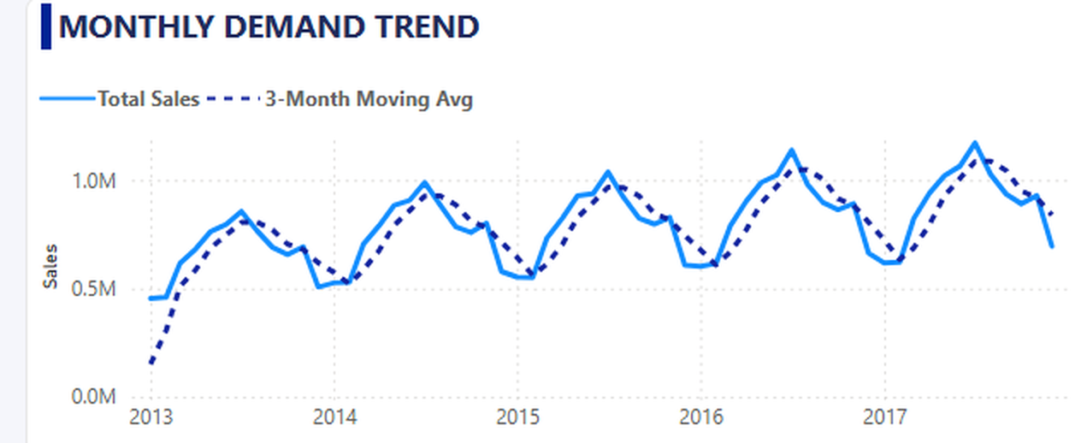
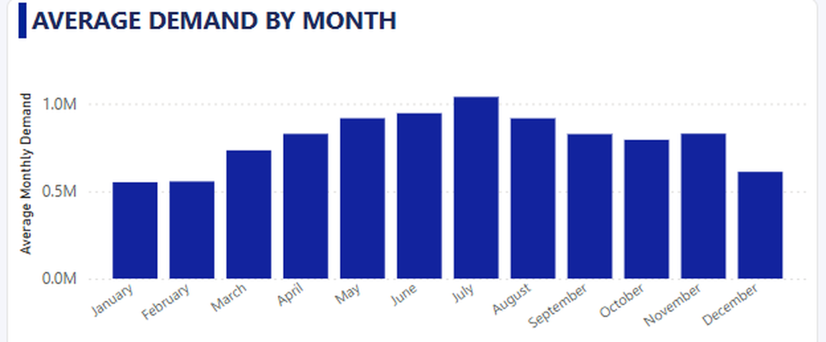
03 · DEMAND OVERVIEW
Demand grew consistently — with clear seasonal patterns every year.
UPWARD TRAJECTORY
Demand rose from ~0.4M to above 1.0M over 5 years.
RECURRING PEAKS
Each year shows a visible mid-year peak followed by a seasonal dip — demand is not uniform.
Monthly demand with 3-month moving average — the smoothed line reduces short-term noise to reveal the broader trend.
Average monthly demand — July peaks at ~1.0M.
Demand Intelligence · Retail Demand Analysis & Forecasting · 4
Notes:
The trend line and the 3-month moving average tell different things: the trend shows the upward trajectory, the MA reveals that month-to-month demand is noisy but directionally consistent. The seasonal bar chart on the right makes the July peak concrete.

Slide 5
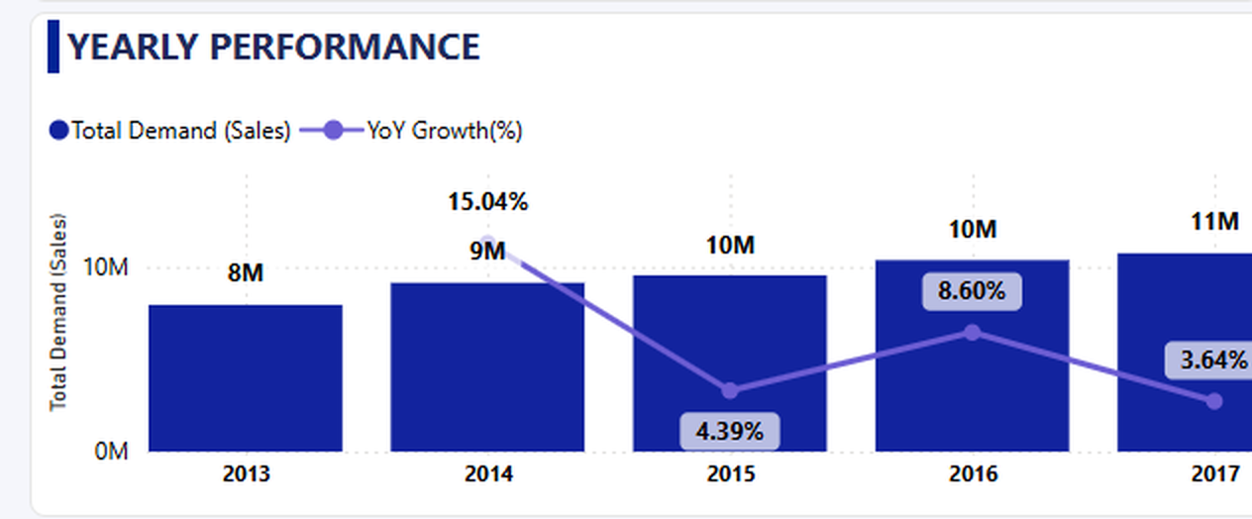
04 · DEMAND OVERVIEW
Demand grew every year — but the rate of growth is slowing.
Annual demand (bars) with year-over-year growth rate (purple line) — Dashboard 1 of 3.
2013
2014
2015
2016
2017
8M
9M
10M
10M
11M
YoY: 15.04%
YoY: 4.39%
YoY: 8.60%
YoY: 3.64%
Strong demand levels do not always mean strong growth momentum — both metrics should be tracked together.
Demand Intelligence · Retail Demand Analysis & Forecasting · 5
Notes:
This is the moderation story. Demand is at its highest level ever in 2017 at 11M, but the YoY growth rate is at its lowest at 3.64%. A management team watching only the total number would miss the slowdown. Both measures are needed.

Slide 6
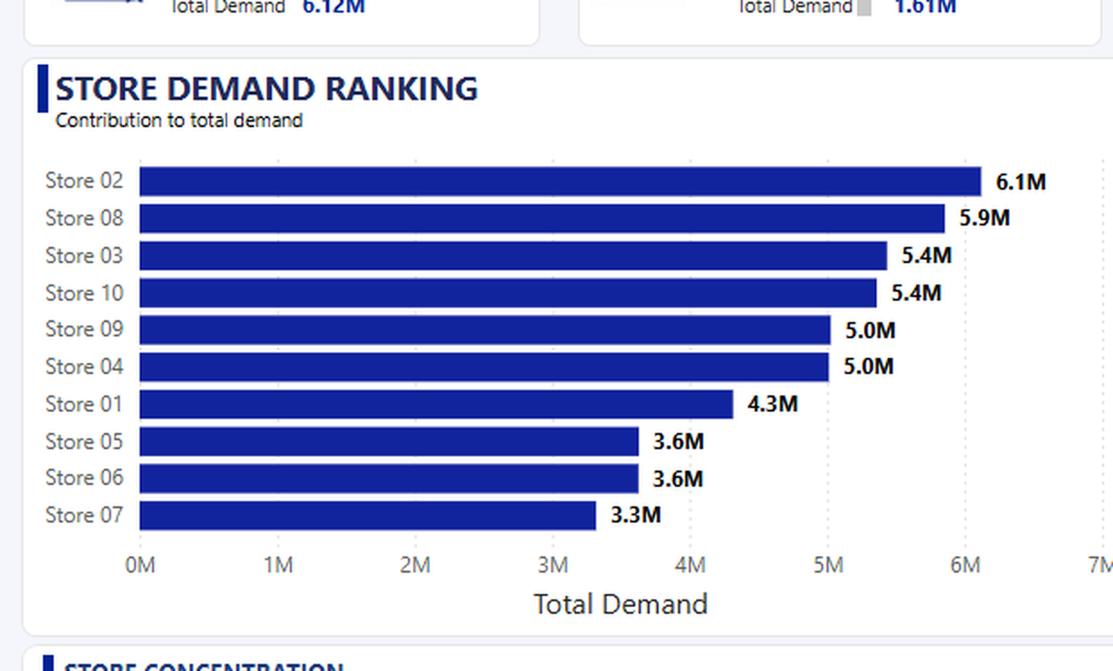
05 · PERFORMANCE ANALYSIS
Store 02 and Product 15 lead — but demand is broadly distributed.
Store 02
Product 15
36.5%
31.4%
TOP STORE
TOP PRODUCT
TOP 3 STORES
TOP 10 PRODUCTS
6.12M total demand
1.61M total demand
of total demand
of total demand
WHAT THE RANKING TELLS US
Store 02 leads at 6.1M
Top performer, but accounts for roughly 12.8% of total demand.
The ranking is competitive
Stores 02 through 10 are within a 3M range — no outlier dominance.
Remaining 7 stores: 63.5%
The majority of demand comes from outside the top 3.
Business resilience
No single store is large enough to threaten total demand stability.
Store demand ranking — Dashboard 2 of 3.
Demand Intelligence · Retail Demand Analysis & Forecasting · 6
Notes:
The headline numbers: Store 02 at 6.12M and Product 15 at 1.61M. But the more important numbers are 36.5% and 31.4% — the concentration metrics. Both show demand is broadly supported, not dominated by one or two contributors.

Slide 7
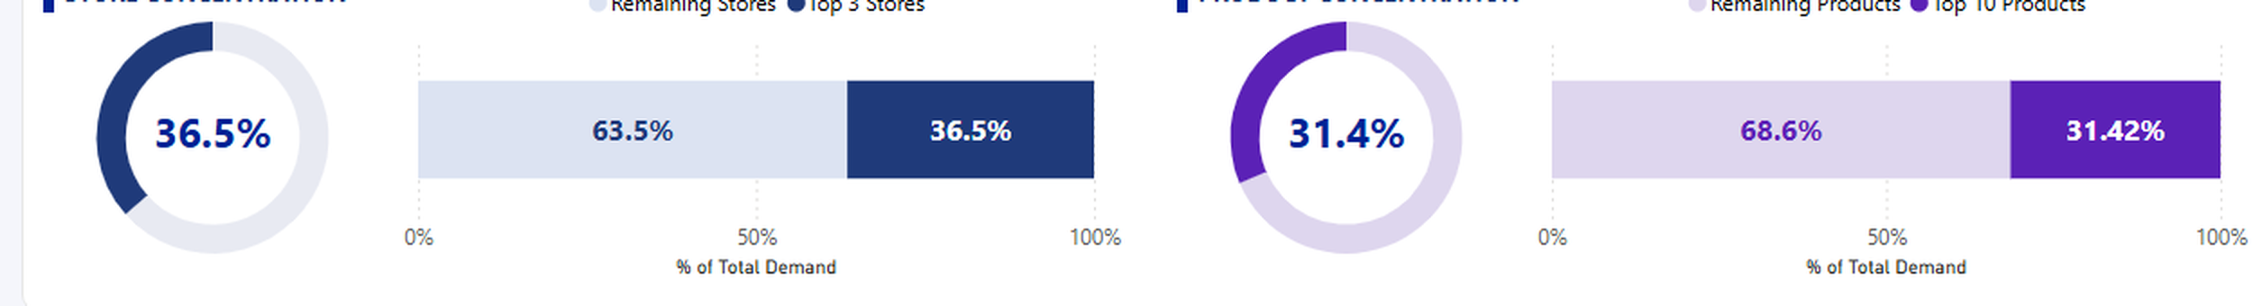
06 · PERFORMANCE ANALYSIS
Demand is diversified — no single contributor dominates.
Store and product concentration analysis — top contributors vs remaining business. Dashboard 2 of 3.
STORE CONCENTRATION
PRODUCT CONCENTRATION
36.5%
Top 3 Stores
31.4%
Top 10 Products
63.5% Remaining 7 Stores
68.6% Remaining 40 Products
The top three stores — Store 02, Store 08, Store 03 — together account for just over a third of total demand. The broader store network generates the majority.
Even the top 10 products, from a portfolio of 50, contribute less than a third of demand. The product base is genuinely broad — no single item is disproportionately critical.
Diversified demand = greater resilience. No single store closure or product failure would critically disrupt overall demand.
Demand Intelligence · Retail Demand Analysis & Forecasting · 7
Notes:
This is the concentration slide — the second most important analytical finding after the growth moderation story. The business is resilient by construction. 63.5% of demand from stores outside the top 3, 68.6% from products outside the top 10.

Slide 8
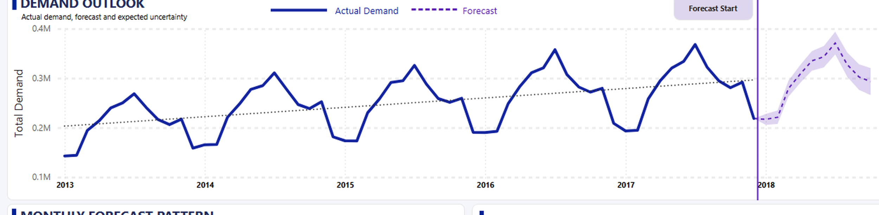
07 · DEMAND FORECAST
The forecast continues the historical trajectory — with widening uncertainty.
26.4K
838.39K
12 Months
95%
LATEST DEMAND
3-MONTH AVG
FORECAST HORIZON
CONFIDENCE LEVEL
Dec 2017
Oct – Dec 2017
2018 Outlook
Forecast interval
Demand Outlook — actual demand (navy), forecast (purple dashed), and confidence interval (shaded band). Dashboard 3 of 3.
Demand Intelligence · Retail Demand Analysis & Forecasting · 8
Notes:
The forecast KPIs frame the chart: the latest actual demand, the 3-month trend, and the 12-month horizon. The shaded band is critical — it communicates uncertainty directly to the management audience. Note that the band widens toward the right of the chart.

Slide 9
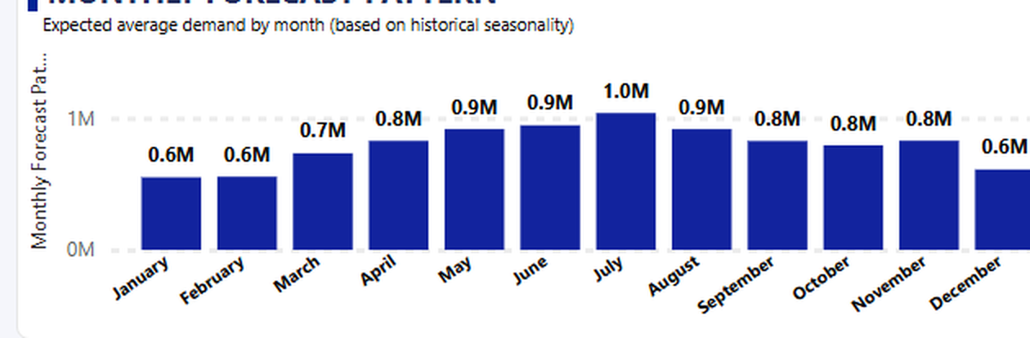
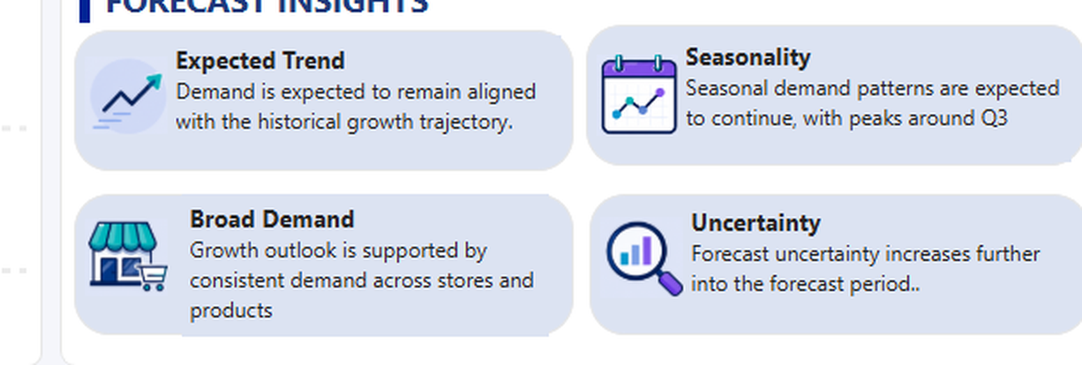
08 · DEMAND FORECAST
Seasonality continues into the forecast — peaks expected in Q3.
Monthly forecast pattern based on historical seasonality. Expected average demand by month.
Forecast Insights panel from Dashboard 3.
Jan–Feb:
~0.6M
Lowest expected demand
IMPORTANT: INTERPRETING THE FORECAST
Mar–Apr:
~0.7–0.8M
Building toward mid-year
The forecast reflects historical seasonal patterns — it is not a guaranteed outcome.
May–Jul:
~0.9–1.0M
Peak demand period
Confidence intervals widen further into the forecast period.
External factors (promotions, pricing, market conditions) are not in the model.
Aug–Dec:
~0.6–0.8M
Gradual moderation
Use as planning guidance, not as a prediction.
Demand Intelligence · Retail Demand Analysis & Forecasting · 9
Notes:
The monthly pattern is where seasonality becomes actionable — inventory preparation, staffing, promotions. The important caveat is on the right: this is a pattern-based estimate with widening uncertainty. The model has no awareness of promotions, pricing changes, or external events.

Slide 10
09 · KEY FINDINGS
Five findings from the analysis.
01
02
03
TOTAL DEMAND
GROWTH MODERATED
JULY PEAKS EVERY YEAR
47.70M
3.64% (2017)
~1.0M avg
Historical demand across 10 stores and 50 products, January 2013 to December 2017. The business generated substantial and growing demand over the period.
Strongest growth was 15.04% in 2014. By 2017 growth had slowed to 3.64% — demand remained positive but expansion moderated.
A recurring mid-year seasonal peak occurs annually. This consistent pattern is the foundation of the forecast model.
04
05
STORE CONCENTRATION
PRODUCT CONCENTRATION
36.5%
31.4%
Top 3 stores contribute 36.5%. The remaining 7 stores generate 63.5% — demand is broadly distributed, not dominated by a few locations.
Top 10 products contribute 31.4%. The remaining 40 generate 68.6% — the portfolio is genuinely broad.
Demand Intelligence · Retail Demand Analysis & Forecasting · 10
Notes:
Five self-contained findings. The two concentration findings together tell the diversification story — both show that the remaining business (outside the top contributors) generates the majority of demand.

Slide 11
10 · RECOMMENDATIONS
Four actions emerge from the analysis.
HIGH
01 PLAN FOR SEASONAL DEMAND
July peaks at ~1.0M every year · Q3 highest demand period
Use historical seasonal patterns to prepare inventory, staffing, and operational resources ahead of the mid-year peak rather than reacting after demand increases.
HIGH
02 MONITOR GROWTH ALONGSIDE TOTAL DEMAND
YoY growth fell from 15.04% to 3.64% over 4 years
Track both total demand and year-over-year growth rate. Strong demand levels do not always indicate strong growth momentum — the two metrics together tell a more complete story.
MEDIUM
03 MAINTAIN VISIBILITY ACROSS THE FULL NETWORK
63.5% of demand from stores outside the top 3
Monitor all 10 stores — not just the top performers. The broader store network generates the majority of demand; changes there could significantly affect overall performance.
ONGOING
04 USE FORECASTS AS PLANNING GUIDANCE
95% confidence interval · Uncertainty widens over time
Compare actual demand against forecasts regularly. Use short-term forecasts for operational decisions; treat longer-term forecasts as scenario planning inputs, not guarantees.
Every recommendation traces directly to an observed finding. Forecasts support planning — they should not be treated as guaranteed outcomes.
Demand Intelligence · Retail Demand Analysis & Forecasting · 11
Notes:
Four traceable recommendations — every one cites the finding that generated it. The fourth covers forecast limitations directly, which is analytically honest and demonstrates maturity.

Slide 12
11 · ANALYST TAKEAWAY
THE COMPLETE ANALYTICAL STORY
The goal is not
just to describe
what happened.
47.70M
Strong overall demand
Growing across all 5 years
↓
3.64%
Moderating growth
Lowest YoY rate in 2017
↓
It is to identify the signals that should drive
future planning decisions.
July = 1.0M
Seasonal peak
Recurring every year
↓
36.5%
Diversified stores
WHAT THE DATA DOES NOT PROVE
Top 3 = minority of demand
The forecast does not guarantee future demand.
↓
Concentration analysis does not identify root causes of performance differences.
31.4%
Diversified products
Top 10 = minority of demand
The model excludes promotions, pricing, inventory, and external factors.
Understand the Past → Identify the Drivers → Prepare for the Future
Power BI · SQL Server · DAX · Data Modeling
Edward Jon Arquiza
Notes:
Close on the analytical framework, not on thanks. The five-step chain tells the complete story in sequence. The limitations on the left are not apologies — they are demonstrations of analytical maturity.

