Slide 1

POWER BI PORTFOLIO CASE STUDY
E-Commerce
Performance Analysis
THE DASHBOARD
01
Executive Overview
02
Delivery & Customer Experience
03
Commercial & Geographic Performance
Sales, Delivery, Customer Experience & Geographic Performance
Olist Brazilian E-Commerce Public Dataset · January 2017 – August 2018
Power BI · Power Query · DAX · Data Modeling
Edward Jon Arquiza · 2026
A simulated business case for portfolio purposes.
Notes:
This is a simulated business case built on the Olist public dataset, covering January 2017 to August 2018. Three dashboard pages, one question: how is the business performing, and where should management look?

Slide 2
01 THE BUSINESS QUESTION
A strong commercial base — but where should attention go?
Management has transaction, customer, product, seller, payment, review and delivery data — but no consolidated view of how the business is actually performing.
THE CENTRAL QUESTION
Where are the strongest opportunities for improvement and growth?
WHAT MANAGEMENT NEEDS TO UNDERSTAND
1
How sales are performing over time
2
Where revenue is coming from
3
How reliable delivery is
4
Whether delivery performance relates to customer satisfaction
Every slide that follows answers one part of this question.
5
Which markets and categories deserve attention
E-Commerce Performance Analysis · Olist Marketplace · 2
Notes:
Frame the problem, not the dataset. The business has plenty of data and no consolidated read on performance. One question drives the whole analysis.

Slide 3
02 THE BUSINESS AT A GLANCE
The business generated ₱13.54M across 99.1K orders.
TOTAL REVENUE
99.1K
₱136.66
₱13.54M
TOTAL ORDERS
REVENUE / ORDER
Distinct order IDs
Revenue ÷ orders
Product revenue across the analysis period,
January 2017 – August 2018.
91.87%
4.11 / 5
ON-TIME DELIVERY
AVG REVIEW SCORE
95.8K unique customers
Of delivered orders
Overall average
The commercial base is strong, but operational performance and customer experience warrant closer investigation.
E-Commerce Performance Analysis · Olist Marketplace · 3
Notes:
Scale first. Nearly a hundred thousand orders and 13.54 million in revenue — a real commercial base. Two of these five numbers are operational, and those are the ones that open up the rest of the analysis.

Slide 4
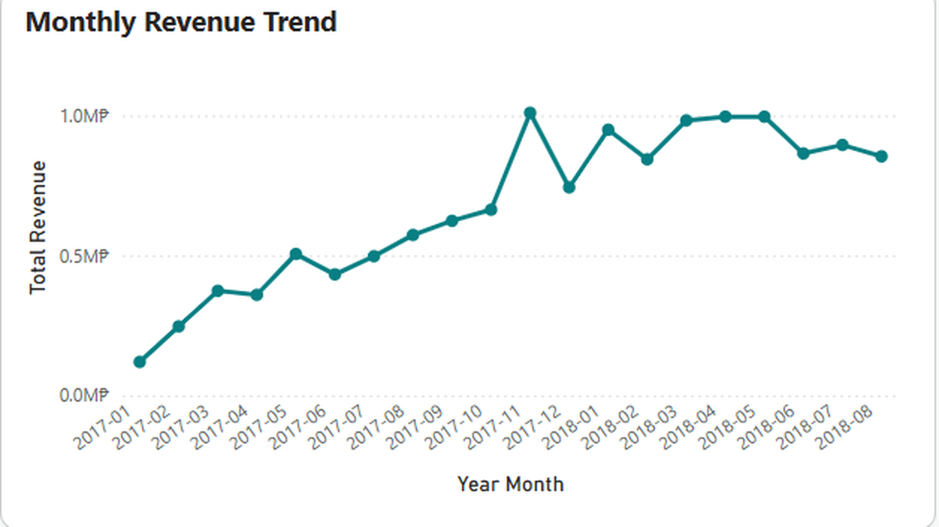
03 SALES PERFORMANCE
Revenue grew substantially — then became more volatile.
Growth through 2017
Revenue climbed steadily across 2017, peaking in November.
Volatility through 2018
Monthly revenue moves up and down within a narrower band rather than continuing to climb.
Category concentration
Health & Beauty was the highest-revenue category in the analysed dashboard context.
Growth alone doesn't tell us whether the business is healthy.
Monthly revenue, January 2017 – August 2018 — Executive Overview.
E-Commerce Performance Analysis · Olist Marketplace · 4
Notes:
2017 is a growth story. 2018 flattens and gets choppier. That shift is the reason the analysis doesn't stop at revenue — a flat top line with an operational problem underneath looks very different from a flat top line without one.

Slide 5
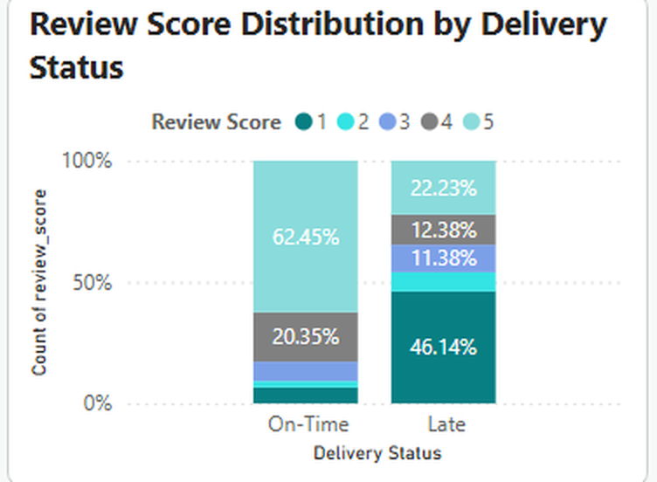
04 CUSTOMER EXPERIENCE
Late deliveries are associated with a 1.72-point lower review score.
ON-TIME
4.29 / 5
LATE
2.57 / 5
Average review score by delivery status. Scale 0–5.
The gap is not just a shift in the average — the whole rating mix differs. 46.14% of late deliveries scored 1 star, against 62.45% of on-time deliveries scoring 5.
1.72
91.87%
on-time delivery
ASSOCIATION — NOT CAUSATION
POINT GAP
8.13%
late delivery
Late deliveries are associated with substantially lower review scores. The data does not establish that lateness caused them — product issues, seller performance and customer expectations may also be at work.
E-Commerce Performance Analysis · Olist Marketplace · 5
Notes:
This is the strongest finding in the project. Late orders average 2.57 against 4.29 for on-time — a 1.72-point gap. The distribution matters as much as the average: nearly half of late deliveries score a single star. I describe this as an association deliberately; the dataset has no field explaining why an order was late.

Slide 6
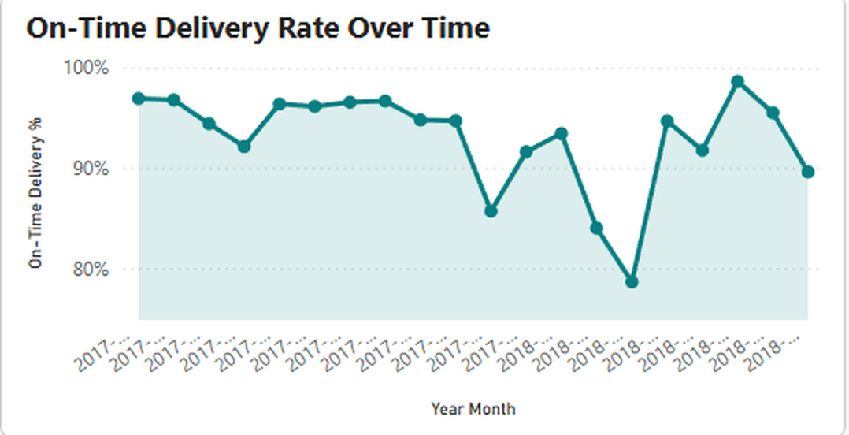
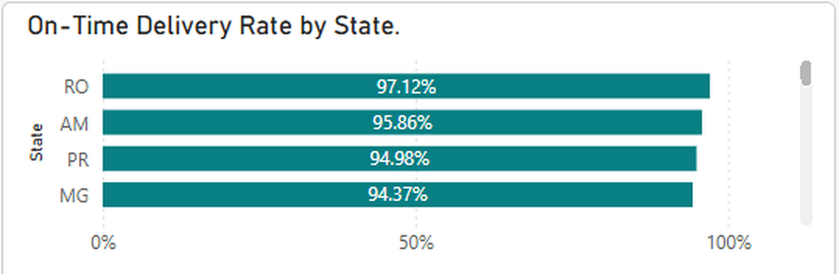
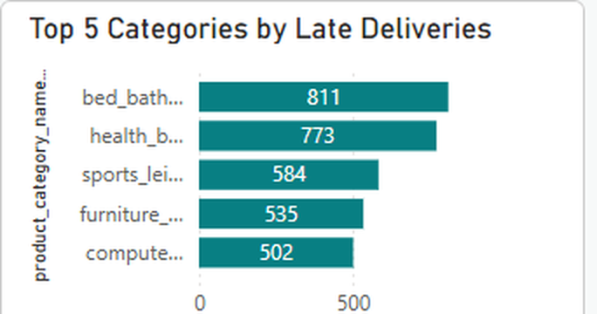
05 DELIVERY PERFORMANCE
Delivery performance is strong overall — but not uniform.
Rate by state
Late volume by category
Performance varies across states, categories and time periods.
Variation identifies where further investigation may be useful. The dataset records whether an order was late, not why — so weaker states and high-late-volume categories are areas to investigate, not identified causes.
On-time delivery rate by month — the rate dips well below the overall average in several periods.
91.87%
of delivered orders arrived on time — but the rate is not uniform.
On-Time = actual delivery date ≤ estimated delivery date. Orders without a customer delivery date are excluded from delivered orders.
E-Commerce Performance Analysis · Olist Marketplace · 6
Notes:
A single company-wide number hides the variation. Monthly performance swings, some states run several points above the average, and late deliveries cluster in particular categories. None of that identifies a cause — the dataset has no delay-reason field — but it tells operations where to point an investigation.

Slide 7
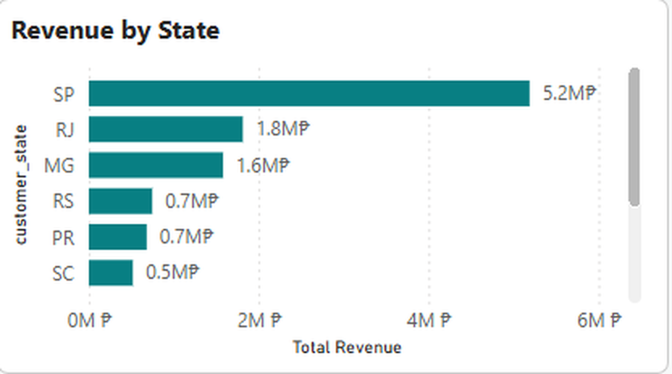
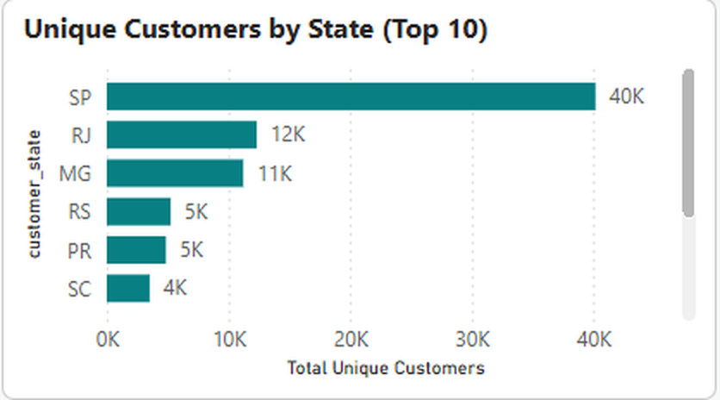
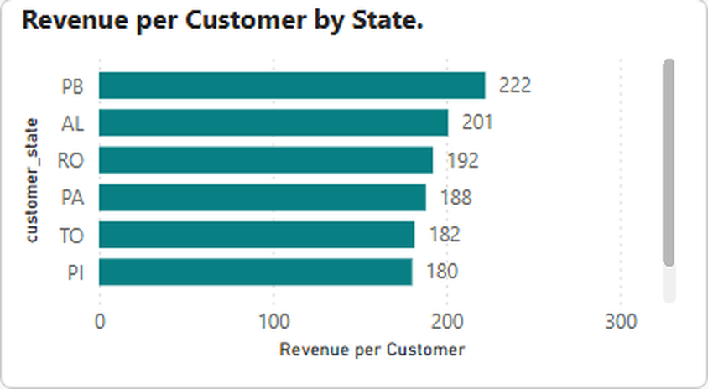
06 GEOGRAPHIC PERFORMANCE
Revenue concentration creates both strength and opportunity.
38.3%
São Paulo is the core market. Concentration is a strength and a dependency — but it does not mean São Paulo is underperforming.
Revenue alone does not tell us whether a market is attractive. The analysis reads every state on three dimensions instead.
of total revenue comes from São Paulo
MARKET VALUE
MARKET SIZE
CUSTOMER VALUE
Revenue by state
Unique customers by state
Revenue per customer by state
E-Commerce Performance Analysis · Olist Marketplace · 7
Notes:
São Paulo leads revenue and customer count by a wide margin — but it does not lead revenue per customer. Several smaller states generate more value per customer. That is the whole argument for not ranking markets by revenue alone.

Slide 8
07 PRIORITIZATION
Revenue alone is not enough to decide where to focus.
Market size
+
FOUR MARKET PROFILES IN THE STATE ANALYSIS
Revenue
+
High volume + high revenue
Core markets — protect and maintain.
Revenue / customer
+
High volume + lower customer value
Delivery performance
+
Potential value opportunity.
Customer experience
Lower volume + high revenue per customer
Higher-value niche markets.
BETTER PRIORITIZATION
Low volume + low revenue
The strongest opportunity is not necessarily the market with the highest revenue.
Lower immediate priority.
E-Commerce Performance Analysis · Olist Marketplace · 8
Notes:
This is the decision framework the dashboard is built to support. A state with high revenue but weak delivery needs a different response from a smaller state with strong customer value and reliable delivery. Optimising any one of these measures alone will point management at the wrong market.

Slide 9
08 KEY FINDINGS
Three signals stand out.
01
02
03
DELIVERY
CUSTOMER EXPERIENCE
MARKET CONCENTRATION
8.13%
2.57 vs 4.29
38.3%
of delivered orders were late.
average review score, late versus on-time deliveries.
of revenue came from São Paulo.
Together, these suggest that operational reliability and geographic diversification deserve attention.
E-Commerce Performance Analysis · Olist Marketplace · 9
Notes:
Three numbers carry the story: how often delivery fails, what that failure looks like to the customer, and how concentrated the revenue is. Everything I recommend traces back to one of these.

Slide 10
09 RECOMMENDATIONS
Four actions emerge from the analysis.
01
IMPROVE DELIVERY RELIABILITY
Investigate weaker-performing states, categories with higher late-delivery volumes, and periods consistently below the benchmark.
8.13% late · 1.72-point review gap
02
DIVERSIFY GEOGRAPHIC REVENUE
Maintain São Paulo's strength while developing revenue contribution from other states.
38.3% of revenue from São Paulo
03
TARGET HIGH-VALUE MARKETS
Evaluate customer base, revenue, revenue per customer and delivery performance together — not revenue alone.
Revenue per customer varies by state
04
FOCUS ON HIGH-VALUE CATEGORIES
Evaluate categories with stronger revenue-per-order performance for targeted commercial strategies.
Category revenue per order varies widely
Each action traces to an observed finding.
E-Commerce Performance Analysis · Olist Marketplace · 10
Notes:
Delivery reliability comes first because it has the clearest link to customer experience. Diversification is second — it is a dependency question, not a São Paulo problem. Three and four are commercial growth, and both depend on reading several measures together.

Slide 11
10 ANALYST TAKEAWAY
The opportunity is not just to sell more — it is to understand where performance can improve.
→
→
→
STRONG COMMERCIAL BASE
OPERATIONAL SIGNAL
CUSTOMER EXPERIENCE SIGNAL
GEOGRAPHIC CONCENTRATION
₱13.54M
8.13% late
1.72-point gap
38.3% from SP
ACTION · Improve delivery reliability while using geographic and category analysis to guide targeted growth.
WHAT THE DATA DOES NOT PROVE
Correlation does not prove causation.
High late-delivery volume does not identify the root cause.
São Paulo's revenue concentration does not mean São Paulo is underperforming.
Revenue does not equal profitability.
Power BI · Power Query · DAX · Data Modeling
Edward Jon Arquiza
Notes:
Close on the reasoning, not a thank-you. A strong commercial base, one operational signal, one customer-experience signal, one concentration risk — and an action that follows from all four. And an honest boundary: this identifies where to look, it does not prove why.

