Slide 1

POWER BI PORTFOLIO CASE STUDY
Incident Performance
& Operational Analysis
Using Power BI to identify SLA pressure, resolution inefficiency,
and operational workload.
IT Service Management · Power BI Portfolio Case Study
Edward Jon Arquiza · 2026
Simulated business scenario using a historical IT service management incident dataset.
Notes:
Opening frame: this is a simulated ITSM business case built in Power BI. The point of the next ten minutes is not the dashboard — it is where the operation is under pressure and what leadership should look at first.

Slide 2
THE BUSINESS QUESTION
Where is the IT operation under pressure?
The organization handles a large incident workload — but only 63.42% of incidents meet SLA against a 70% target.
Incident volume alone doesn't tell management where operational pressure is occurring.
01
02
03
Are we meeting service expectations?
Where is resolution becoming inefficient?
Where is operational effort concentrated?
The analysis connects workload, SLA performance, resolution efficiency, priority, and operational behavior.
HOW THE ANALYSIS PROGRESSED
QUESTION
›
PROFILE
›
MODEL
›
MEASURE
›
VALIDATE
›
ANALYZE
›
RECOMMEND
The dashboard was not the starting point — the business question and the data profile were.
Incident Performance & Operational Analysis · 2
Notes:
Set the tension. Volume by itself is not a management problem — the gap between 63.42% and the 70% target is. Everything that follows answers one question: where is that pressure coming from? Note the sequence at the bottom: the dashboard came last, after profiling, modelling, measuring and validating.

Slide 3
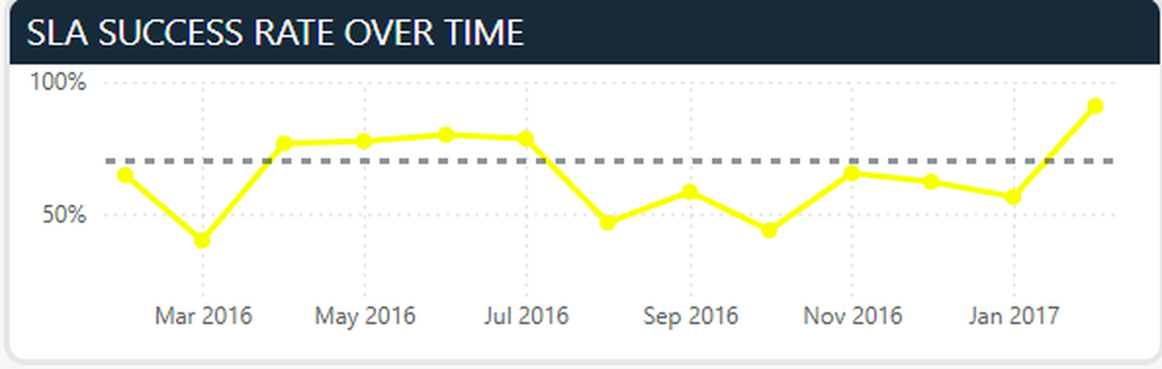
THE OVERALL PICTURE
The operation handles significant demand — but SLA performance is below target.
24,918
63.42%
36.58%
TOTAL INCIDENTS
SLA SUCCESS
MISSED SLA
SLA SUCCESS AGAINST THE 70% TARGET
70% TARGET
63.42% MET SLA
36.58% missed SLA — a gap of 6.58 points below the defined target.
More incidents met SLA than missed it, but overall performance remains below the defined 70% target — and monthly performance moves either side of it rather than settling above.
Monthly SLA success against the 70% reference line — Incident Command Center.
Incident Performance & Operational Analysis · 3
Notes:
Scale first: 24,918 incidents. Then the gap: 63.42% success, 36.58% missed, against a 70% target. The trend on the right matters more than the single number — performance crosses the target line repeatedly rather than sitting above it, so this is a consistency problem, not a one-month dip.

Slide 4
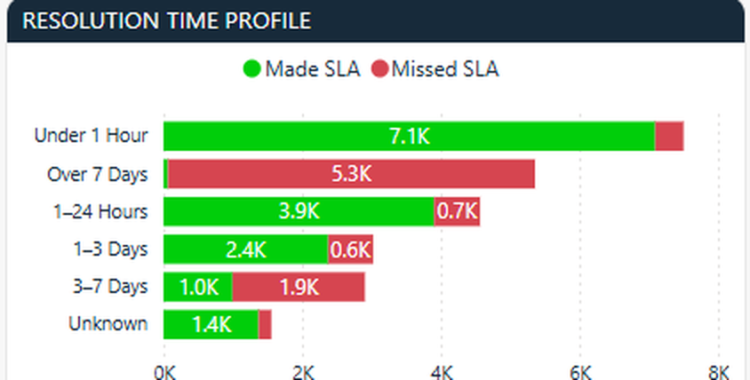
RESOLUTION EFFICIENCY
The average resolution time hides a long-running tail.
AVERAGE (MEAN)
178.17 hrs
TYPICAL (MEDIAN)
22.10 hrs
Bars drawn to the same scale.
Why is the average so high?
Resolution-time bands, met vs missed SLA — Service Performance Deep Dive.
A smaller number of long-running incidents materially influence the mean. Both measures are kept in the dashboard rather than relying on the average alone.
Resolution duration is an important part of the SLA story, particularly among longer-running incidents — which is why resolution time is analysed in bands as well as averages.
Mean resolution time alone does not represent the typical incident experience.
Incident Performance & Operational Analysis · 4
Notes:
This is the interpretation moment. An eight-fold gap between mean and median says the distribution is skewed, not that the operation is slow. The typical incident closes in about a day; a smaller population of long-running incidents pulls the average out to 178 hours. Reporting the mean alone would misrepresent the service experience.

Slide 5
PRIORITY PERFORMANCE
SLA pressure varies sharply across priority levels.
PRIORITY
INCIDENTS
SLA SUCCESS RATE
AN UNEXPECTED RESULT TRIGGERED AN INVESTIGATION
Critical
270 incidents
1.85%
UNEXPECTED RESULT
High
408 incidents
0.49%
↓
CHECK UNDERLYING COUNTS
↓
VALIDATE CALCULATION
Moderate
23,466 incidents
64.54%
↓
ACCEPT RESULT
Low
774 incidents
84.11%
↓
INTERPRET CAREFULLY
The unusually low High and Critical results were checked against the underlying incident and SLA counts — and confirmed.
Moderate accounts for roughly 94% of all incidents. The High and Critical populations are much smaller, so their rates should not be read the same way as the dominant Moderate population.
Validated result · cause not established
Incident Performance & Operational Analysis · 5
Notes:
The numbers on the left looked wrong the first time I saw them. Rather than assuming a broken measure, I checked the incident and SLA counts underneath and confirmed the results. Two caveats go with them: the cause is not established here, and the High and Critical populations are small relative to Moderate, which is about 94% of the dataset.

Slide 6
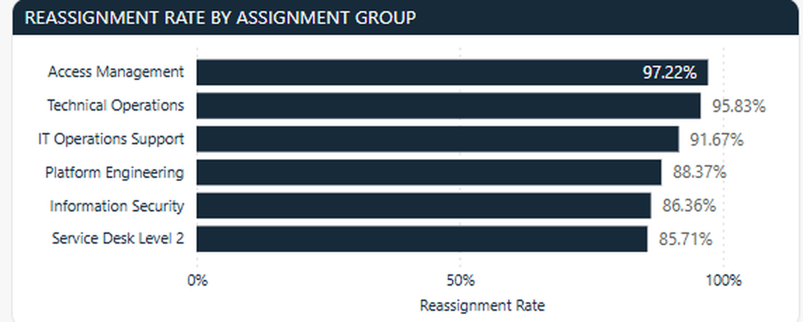
OPERATIONAL FRICTION
What does a 45.63% reassignment rate actually tell us?
45.63%
A POTENTIAL OPERATIONAL SIGNAL — INVESTIGATE:
Initial routing
of incidents were reassigned at least once
Ownership
275
Skill alignment
Highest reassignment rates by assignment group — Incident Root Cause & Workload Analysis.
reopened incidents — repeat activity after an incident was considered resolved
Escalation
ANALYTICAL SAFEGUARD
Reassigned = reassignment_count > 0
Extreme percentages are not always meaningful.
Reassignment does not prove poor service or establish causation. It shows where work changed hands.
Dynamic DAX measure, evaluated within the report's date and assignment-group filter context.
A small group with few incidents can reach 100%. The ranking applies a minimum incident-volume threshold so groups are compared on a stable base.
Incident Performance & Operational Analysis · 6
Notes:
Nearly half the workload changes hands before it is resolved. That is a signal worth investigating — routing, ownership, skill alignment, escalation — not evidence of poor service. Note the safeguard: a group with six incidents can show 100% reassignment, so the ranking only includes groups above a minimum volume.

Slide 7
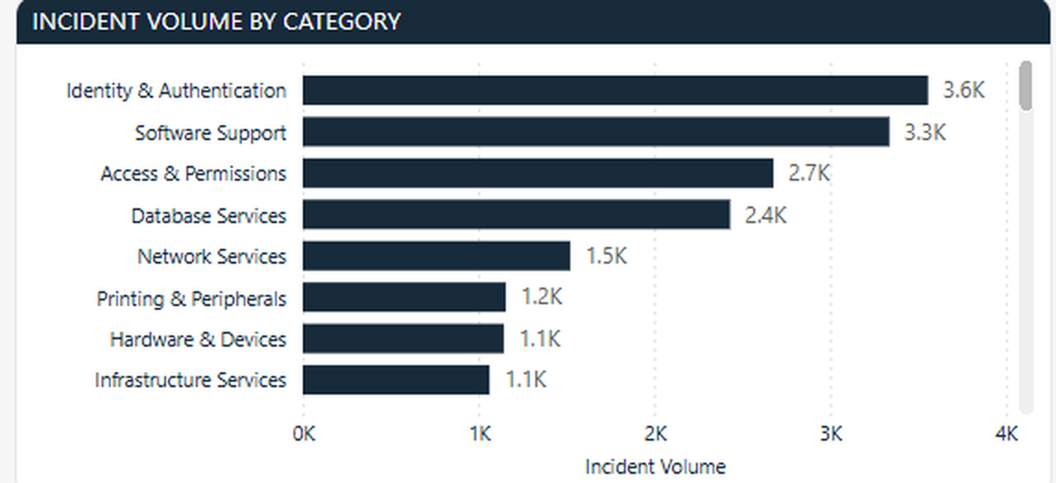
WORKLOAD CONCENTRATION
Where could improvement effort affect the most demand?
Four categories — Identity & Authentication, Software Support, Access & Permissions and Database Services — account for the largest share of incident demand.
High-volume categories represent potential opportunities for targeted prevention, self-service, documentation, or process improvement.
High volume alone does not indicate poor performance.
WORKLOAD VOLUME + SERVICE PERFORMANCE + OPERATIONAL SIGNALS
Incident volume by category — Incident Root Cause & Workload Analysis. Category names are simulated business-friendly labels created for portfolio presentation.
must be considered together before a category is called a problem.
Subcategory analysis narrows this further: Password & Account Issues is the single largest source of demand.
Incident Performance & Operational Analysis · 7
Notes:
Demand is concentrated, which makes it a prioritisation opportunity rather than a problem statement. A large category is where prevention or self-service would reach the most incidents — but volume on its own says nothing about whether that category is performing badly. Subcategory analysis is where this becomes actionable: password and account issues is the single biggest source.

Slide 8
ANALYTICAL PRINCIPLE
No single KPI explains where to act.
READ TOGETHER, NOT IN ISOLATION
WHAT THE DATA DOES NOT PROVE
SLA PERFORMANCE
Reassignment causes SLA failure.
High-priority incidents are the cause of SLA problems.
Reopened incidents automatically indicate poor service.
High-volume categories are necessarily inefficient.
RESOLUTION TIME
INCIDENT VOLUME
PRIORITY
REASSIGNMENT
CATEGORY & ASSIGNMENT GROUP
WHAT THE ANALYSIS DOES PROVIDE
= BETTER OPERATIONAL CONTEXT
Patterns · Comparisons · Outliers · Operational signals · Areas for further investigation
A group with poor SLA performance is not necessarily the same operational problem as a group with poor SLA performance AND slow resolution AND high workload.
Association is not causation — the dashboard points to where to look.
Incident Performance & Operational Analysis · 8
Notes:
This is the principle behind the whole report. Optimising one KPI in isolation will move the wrong thing. And to be explicit about the limits: none of this establishes cause. What it does give leadership is a defensible shortlist of where to investigate.

Slide 9
FROM FINDINGS TO ACTION
Where should management focus first?
FINDING
WHY IT MATTERS
ACTION
HIGH
63.42% SLA success against a 70% target
6.58 points below the defined target
Investigate SLA exposure by priority, assignment group and resolution-time band.
HIGH
1.85% Critical and 0.49% High SLA success — validated
The most severe incidents show the weakest SLA outcomes
Review escalation, SLA definitions, workload and resolution bottlenecks for these priorities.
HIGH
178.17 hr mean vs 22.10 hr median
A smaller population of long-running incidents influences the average
Identify and investigate long-running incidents as a separate population.
MEDIUM
45.63% reassignment rate
Potential routing and ownership friction
Review high-reassignment groups that clear the minimum volume threshold.
MEDIUM
Four categories lead volume (3.6K down to 2.4K)
Demand is concentrated in a small number of categories
Target recurring categories for prevention, self-service and documentation.
ONGOING
70% SLA target
Monthly performance moves either side of the target
Monitor SLA performance against the 70% target.
Incident Performance & Operational Analysis · 9
Notes:
Every action here traces back to a specific number on the earlier slides — nothing generic. The three HIGH items are where I would start: overall SLA exposure, the High and Critical population, and the long-running tail. Reassignment and category work are real but second-order. The last row is the standing measure, not a project.

Slide 10
THE TAKEAWAY
The goal is better operational decisions, not just better reporting.
01
02
03
SLA performance is below the 70% target.
A smaller population of long-running incidents materially affects average resolution time.
Workload concentration and reassignment provide additional signals for prioritizing investigation.
Where should we focus operational effort — and why?
SLA PERFORMANCE + RESOLUTION EFFICIENCY + WORKLOAD + OPERATIONAL BEHAVIOR
Together, these provide a stronger basis for prioritizing operational investigation than any single KPI.
The dashboard helps management identify where to investigate first — without assuming that the dashboard alone proves root cause.
BUILT WITH Power BI · Power Query · DAX · Data Modeling
Edward Jon Arquiza
Notes:
Close on the question, not on thanks. The value of this work is that it turns a large incident dataset into a defensible shortlist of where to look first — and it is honest about what it cannot prove.

