Slide 1

NORTHSTAR
WHAT THIS COVERS
Distribution Group
01
Pipeline Architecture & Flow
Automated Finance
Data Pipeline
02
Data Validation & Quality
03
Duplicate Prevention
04
Power BI Finance Dashboards
End-to-end automated processing of finance CSV files into
reporting-ready datasets and Power BI analytics.
05
Pipeline Health Monitoring
Python · PostgreSQL · SQL · Windows Task Scheduler · Power BI
Edward Jon Arquiza · 2026
Notes:
Opening frame: set the context for the audience. This is a complete, automated data engineering and analytics project — not just a dashboard. The five topics on the right mirror the five main presentation sections.

Slide 2
THE PROBLEM
Finance data sitting in CSV files doesn't become insight by itself.
Manual effort
No audit trail
Reactive reporting
Finance teams download, rename, and import CSV files by hand — an error-prone and time-consuming process.
When a file gets loaded twice, or fails silently, there is no record of what happened or why.
Reports are built after data arrives, not triggered by it — meaning decisions are always slightly behind.
THE SOLUTION
An automated pipeline that detects, validates, deduplicates, and loads CSV files every 15 minutes — with a full audit trail and Power BI reporting layer.
Python ETL Pipeline
PostgreSQL Storage
SHA-256 Deduplication
Windows Task Scheduler
SQL Reporting Views
Power BI Analytics
Northstar Distribution Group · Automated Finance Data Pipeline · 2
Notes:
Frame the problem before showing the solution. Three clear pain points that any finance or data-aware stakeholder will recognise immediately. Then the solution as one sentence, supported by the six technology pillars.

Slide 3
ARCHITECTURE
One clear flow: CSV files in, business insights out.
CSV Files
Task Scheduler
Python Pipeline
PostgreSQL
SQL Views
Power BI
→
→
→
→
→
customers · invoices · payments
Every 15 minutes
Validate · Transform · Load
4 core tables · Audit trail
6 reporting views
4 dashboard pages
PIPELINE STEPS
1
2
3
4
5
6
7
Detect & Classify
Validate
Deduplicate
Transform
Load to DB
Record History
Report
Identifies CSV files by filename pattern
Columns, nulls, types, business rules
SHA-256 hash check against prior loads
Clean and convert data to required formats
Transactional insert into PostgreSQL
SUCCESS · FAILED · SKIPPED logged
SQL views → Power BI ready
Northstar Distribution Group · Automated Finance Data Pipeline · 3
Notes:
Architecture in one row, then the seven pipeline steps below. Each step is genuinely distinct — this is not padding. Note step 3 is the SHA-256 deduplication which is a key differentiator of the design.

Slide 4
DATA QUALITY
Every file is validated before a single record reaches the database.
VALIDATION CHECKS
FILE LIFECYCLE OUTCOMES
Required Columns
SUCCESS
Passed all validation. Loaded into PostgreSQL.
All expected columns must be present before validation proceeds.
data/processed/
Missing Values
Required fields are checked for null or empty values.
Duplicate IDs
FAILED
Failed validation or encountered a processing error. No data loaded.
CustomerID, InvoiceID, and PaymentID duplicates within a file are caught.
data/failed/
Numeric Validation
Payment terms and amounts must contain valid numeric values.
Date Validation
SKIPPED
SHA-256 hash matched a prior successful load. No duplicate inserted.
Invoice, due, and payment dates must be parseable.
data/skipped/
Business Rules
Positive amounts, valid payment terms, due date ≥ invoice date.
SHA-256 hash-based deduplication makes every pipeline run safe and idempotent.
Northstar Distribution Group · Automated Finance Data Pipeline · 4
Notes:
Two-column layout. Left shows the six validation checks in order of execution. Right shows the three lifecycle outcomes with their folder destinations. The SHA-256 callout at the bottom right is the idempotency guarantee.

Slide 5
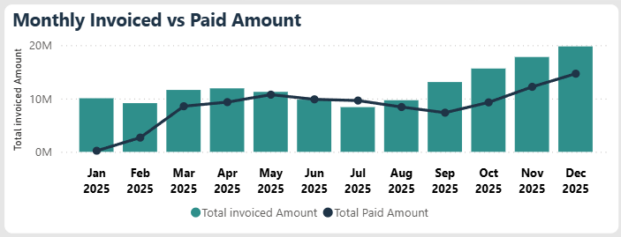
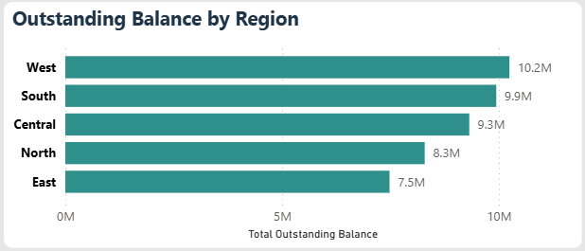
DASHBOARD · PAGE 1
Executive Finance Overview — the financial pulse at a glance.
148.08M
Total Invoiced
Full portfolio invoiced across the analysis period.
69.41%
Collection Rate
Active payment collection — 102.79M received.
45.29M
Outstanding
Total balance awaiting collection.
15.78M
Overdue
Balance past due date requiring active follow-up.
Northstar Distribution Group · Automated Finance Data Pipeline · 5
Notes:
Page 1 of the Power BI dashboard. The five KPI cards at the top give the headline numbers. The trend chart shows monthly invoiced vs paid (the gap is the outstanding receivables). Region bar chart on the right shows where the balance sits.

Slide 6
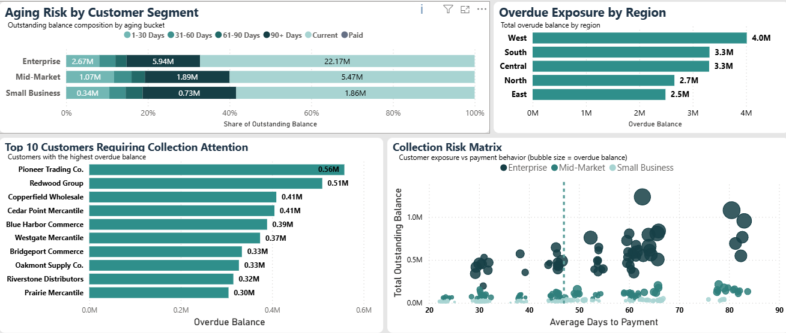
DASHBOARD · PAGE 2
Receivables Risk — knowing who owes what, and how urgently.
45.29M outstanding · 15.78M overdue (34.8%) · 299 customers with 90+ day exposure · 8.56M in 90+ day aging bucket
Northstar Distribution Group · Automated Finance Data Pipeline · 6
Notes:
Page 2 shows where the risk sits. The top-left stacked bar breaks outstanding balance by customer segment and aging bucket. Enterprise has the largest exposure. The scatter matrix bottom-right plots customers by average days to payment vs outstanding balance — bubble size = overdue balance.

Slide 7
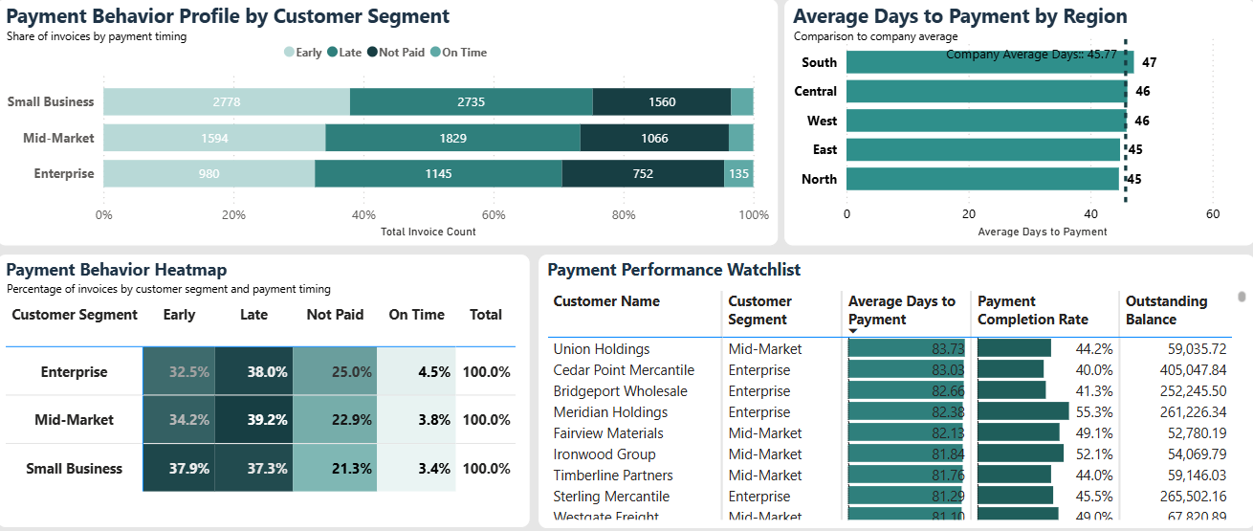
DASHBOARD · PAGE 3
Payment & Customer Performance — how reliably customers pay.
45.8 days avg to payment · 64.0% completion rate · Small Business leads on early payment at 37.9% · Enterprise leads on late payment at 38%
Northstar Distribution Group · Automated Finance Data Pipeline · 7
Notes:
Page 3. Top visual shows payment behaviour profile (early / late / not paid / on time) by customer segment. Bottom-left is the payment heatmap showing percentages — Enterprise 25% not paid is a flag. Bottom-right is the watchlist: customers with the worst average days to payment and lowest completion rates.

Slide 8
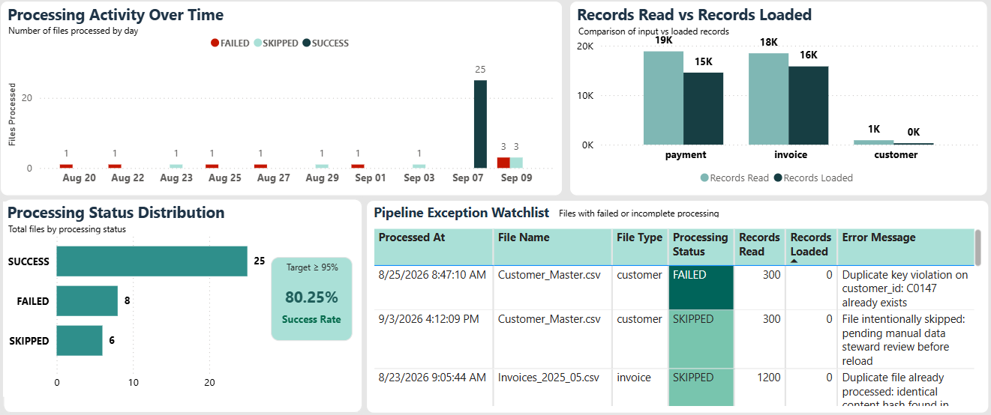
DASHBOARD · PAGE 4
Pipeline Health — every run tracked, every failure visible.
Northstar Distribution Group · Automated Finance Data Pipeline · 8
43 files processed · 29 successful · 8 failed · 80.26% load success rate · 31K records loaded · Exception watchlist for failed and skipped files
Notes:
Page 4 is the operational monitoring page. Processing activity over time shows SUCCESS/FAILED/SKIPPED per day. Records Read vs Records Loaded bar shows the input-to-output ratio by file type. Status distribution shows the 80.26% success rate against a ≥95% target. Exception watchlist shows the specific files that failed or were skipped with error messages.

Slide 9
TECHNOLOGY
The stack behind the pipeline.
Python
PIPELINE
pandas
PIPELINE
PostgreSQL
DATABASE
SQLAlchemy
DATABASE
Core ETL pipeline — file detection, validation, transformation, hashing, database loading.
CSV processing, column validation, data type checking, and transformation logic.
Historical data storage across customers, invoices, payments, and processing history.
Database connection management and transactional data loading.
SQL Views
REPORTING
Power BI
ANALYTICS
Task Scheduler
AUTOMATION
python-dotenv
PIPELINE
Six reporting views expose curated, analytics-ready datasets for Power BI.
Four-page finance analytics and pipeline health monitoring dashboard.
Triggers the pipeline every 15 minutes — no human action required.
Manages database credentials and environment configuration securely.
Northstar Distribution Group · Automated Finance Data Pipeline · 9
Notes:
Eight technology components in a 4×2 grid. Each shows its category badge, name, and exactly what it does in this project — not a generic description.

Slide 10
NORTHSTAR
Distribution Group
CSV Files arrive
From raw CSV files
to business insight —
automatically.
incoming/ folder
↓
Pipeline runs
Every 15 minutes
↓
Validate & deduplicate
SHA-256 + 6 quality checks
↓
Load to PostgreSQL
Transactional · Audited
↓
SQL views prepare data
6 reporting views
↓
Power BI surfaces insights
Python · pandas · PostgreSQL · SQLAlchemy · SQL · Windows Task Scheduler · Power BI
4 dashboard pages
Edward Jon Arquiza · 2026
Notes:
Close on the value proposition, not on thanks. The chain on the right is the full pipeline story in six steps — the same journey the audience just walked through. The statement on the left is what differentiates this from a simple reporting project.

