Slide 1
TABLEAU · PORTFOLIO CASE STUDY
Workforce Retention
& Career Progression
Analysis
THREE DASHBOARDS
01
Workforce Stability
02
Retention Pressure
03
Career Development & Progression
Identifying Workforce Stability, Retention Pressure,
and Career Development Patterns
HR Analytics Dataset · Tableau · Multi-Table Data Model
Edward Jon Arquiza · 2026
Simulated business case for portfolio purposes.
Notes:
This is a simulated HR analytics case study using a multi-table dataset. Three Tableau dashboards, one question: where is retention pressure concentrated across the workforce — and what does it tell us about where to investigate?

Slide 2
01 THE BUSINESS QUESTION
The overall termination rate hides where the problem is.
An overall termination rate tells HR that turnover is happening.
It does not tell HR where, among whom, or why.
THE APPROACH
Rather than relying on a single workforce-wide metric, the analysis segments the workforce by tenure, career level, and performance to identify where retention pressure is concentrated.
HR LEADERSHIP NEEDS TO UNDERSTAND
1
Which tenure groups have the highest termination rates?
2
Which career levels show elevated turnover?
3
Does performance explain retention pressure — or is it broader?
01 Workforce Stability
How is the active workforce distributed across tenure and career level?
02 Retention Pressure
4
03 Career Development
The findings identify patterns, not causes.
Workforce Retention & Career Progression · HR Analytics Dataset · 2
Notes:
The central argument is segmentation. A single 28.4% termination rate across 1,562 employees is not actionable. Segment by tenure, career level and performance and suddenly you can see where the pressure is 50% versus 19% — and that is where investigation should begin.

Slide 3
02 WORKFORCE OVERVIEW
1,562 employees. 28.4% overall termination rate.
1,562
1,118
444
28.4%
TOTAL EMPLOYEES
ACTIVE EMPLOYEES
TERMINATED
TERMINATION RATE
TENURE SNAPSHOT
< 1 Year
1–2 Years
2–5 Years
5+ Years
73 total
69 total
164 total
812 total
38.7%
38.9%
50.0% ◄ HIGHEST
19.0%
The 2–5 year tenure group stands out immediately — both as a strategic risk and as the primary focus for further investigation.
Workforce Retention & Career Progression · HR Analytics Dataset · 3
Notes:
Scale the audience. 1,562 employees, 444 terminated, 28.4% overall rate. Then show the tenure split immediately — the 2–5 year group at 50% against 19% for 5+ year employees is the headline number that everything else explains.

Slide 4
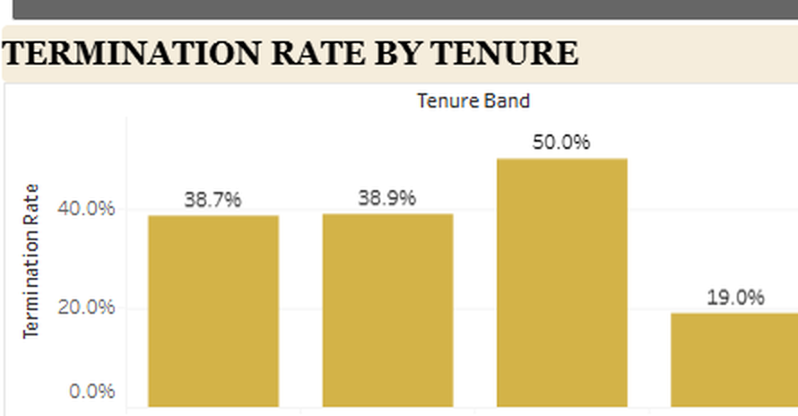
03 WORKFORCE STABILITY
Mid-tenure employees show the highest termination rate at 50%.
50.0%
termination rate
among 2–5 year employees
19.0% among 5+ year employees
WHY THE GAP MATTERS
Termination rate by tenure band — Dashboard 1 of 3.
Employees who survive their first two years and reach the 2–5 year stage are exiting at twice the rate of the long-tenured workforce. This is the window where retention intervention may have the greatest potential impact.
Workforce Retention & Career Progression · HR Analytics Dataset · 4
Notes:
The 50% vs 19% comparison is the clearest number in the project. Employees who make it to 2–5 years are the most at risk. That gap is 31 percentage points — and it persists across performance ratings, which the next slide shows.

Slide 5
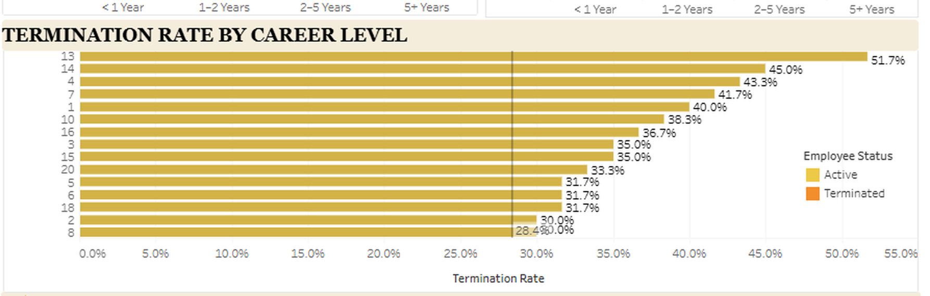
04 WORKFORCE STABILITY
Termination rates vary substantially across career levels.
RANGE
28.4%
overall
51.7%
highest
career level
Termination rate by career level — 28.4% overall reference line shown. Dashboard 1 of 3.
Relying on an organisation-wide rate conceals this variation. Several career levels show termination rates above 40% — nearly double the overall benchmark.
Career-level segmentation provides HR with specific targets for further investigation.
Workforce Retention & Career Progression · HR Analytics Dataset · 5
Notes:
The reference line at 28.4% shows that many individual career levels sit substantially above the average. This is the argument for segmentation: a company-wide number cannot guide action. Career levels above 40% termination rate need individual attention.

Slide 6
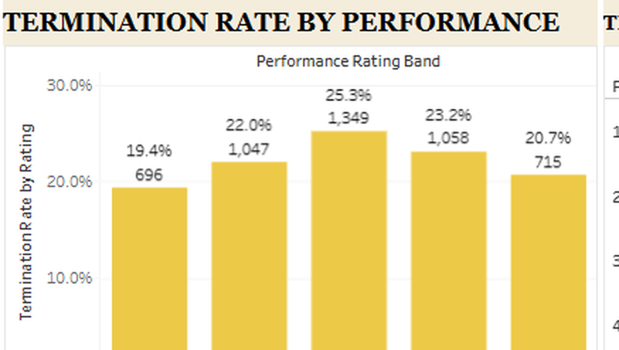
05 RETENTION PRESSURE
Termination is not concentrated among low performers alone.
WHAT THE PERFORMANCE DATA SHOWS
Average rating (3)
25.3%
Highest termination rate by rating
Above Average (4)
23.2%
Second highest
High rating (5)
20.7%
Still meaningful
Low rating (1)
19.4%
Actually the lowest
Termination rate by performance rating — Dashboard 2 of 3.
Performance rating does not predict who leaves.
Retention pressure is distributed across ratings.
Workforce Retention & Career Progression · HR Analytics Dataset · 6
Notes:
This is a counter-intuitive finding that makes the analysis stronger. Low performers have the lowest termination rate (19.4%). Average performers have the highest (25.3%). If a stakeholder assumed we only needed to retain high performers, this slide challenges that assumption.

Slide 7
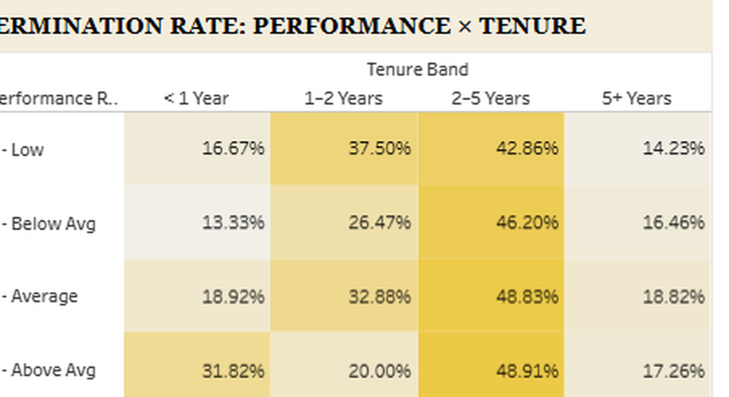
06 RETENTION PRESSURE
The 2–5 year group shows elevated termination across every performance rating.
THE KEY PATTERN
Look across the 2–5 Years column:
Low:
42.86%
Below Avg:
46.20%
Average:
48.83%
Above Avg:
48.91%
High:
46.23%
Elevated across ALL ratings — this is a tenure problem, not a performance problem.
Termination rate: performance × tenure — heat map highlights concentrations. Dashboard 2 of 3.
Workforce Retention & Career Progression · HR Analytics Dataset · 7
Notes:
This is the most analytically rich slide. Every performance rating in the 2–5 year column shows 42–49% termination. That consistency across ratings means this cannot be explained by performance. The problem is tenure-stage, not performance level — which completely changes what HR should investigate.

Slide 8
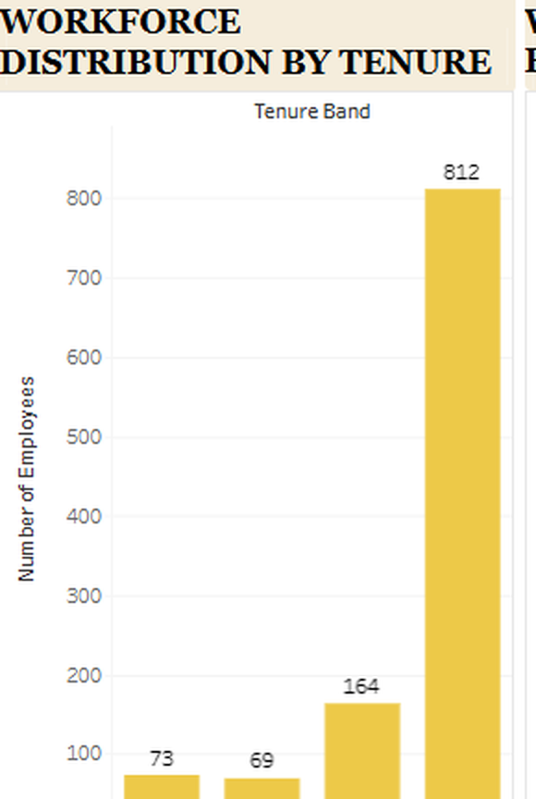
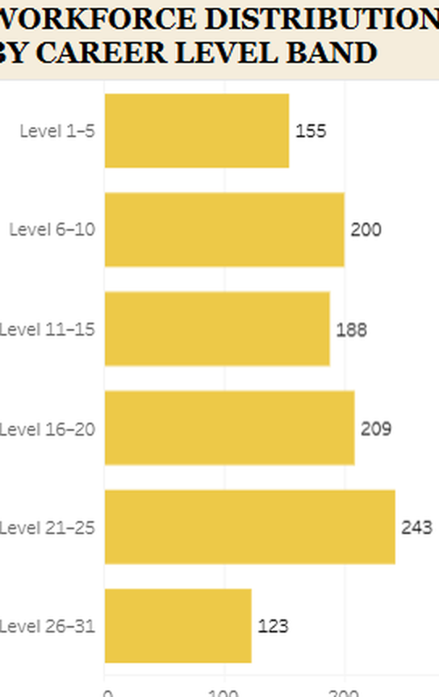
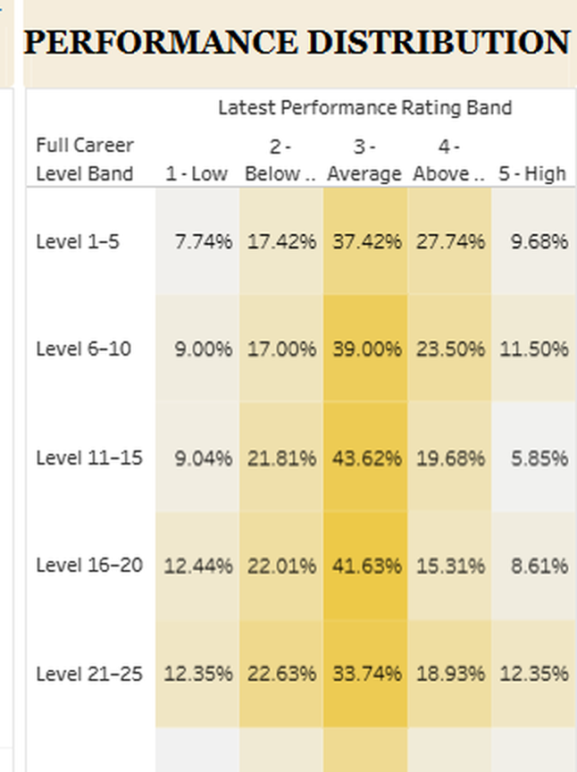
07 CAREER DEVELOPMENT & PROGRESSION
The active workforce is concentrated among long-tenured, mid-career employees.
ACTIVE WORKFORCE
5.97
3.01 / 5
812
AVG TENURE
AVG PERFORMANCE
IN 5+ YR GROUP
Tenure
Career Band
Performance × Career Level
Workforce Retention & Career Progression · HR Analytics Dataset · 8
Notes:
Dashboard 3 focuses on the active workforce only. 812 of 1,118 active employees have 5+ years of tenure. The most populated career band is Level 21–25. Performance centres around Average (3). This is the stability picture — and it also shows where experienced workforce depth sits.

Slide 9
08 KEY FINDINGS
Four workforce signals stand out.
01
02
MID-TENURE RISK
CAREER LEVEL VARIATION
50.0%
Up to 51.7%
Employees with 2–5 years of tenure show the highest termination rate — 31 points above the 5+ year group.
Termination rates vary substantially across career levels, with some well above the 28.4% overall rate.
03
04
PERFORMANCE DOESN'T PREDICT LEAVING
TENURE IS THE DOMINANT SIGNAL
25.3% highest
42–49%
Average performers show the highest termination rate. Low performers show the lowest. Retention pressure is not concentrated among low performers.
The 2–5 year column in the performance × tenure matrix shows elevated rates across all five performance ratings.
Workforce Retention & Career Progression · HR Analytics Dataset · 9
Notes:
The four findings build on each other. Finding 1 names the group. Finding 2 adds career-level nuance. Finding 3 challenges the performance assumption. Finding 4 seals it — the 2–5 year pattern is not a performance story, it is a tenure-stage story.

Slide 10
09 RECOMMENDATIONS
Four actions emerge from the analysis.
HIGH
01 INVESTIGATE THE 2–5 YEAR SEGMENT
50.0% termination rate · elevated across all performance ratings
HR should prioritise this group for deeper investigation: career development opportunities, compensation, promotion pathways, engagement, workload, and manager relationships.
HIGH
02 REVIEW HIGH-TERMINATION CAREER LEVELS
Rates up to 51.7% — nearly double the overall benchmark
Identify which career levels consistently show elevated termination and investigate whether specific workforce conditions are contributing.
MEDIUM
03 MONITOR RETENTION BEYOND PERFORMANCE
Elevated mid-tenure rates appear across all five performance groups
Retention strategies should not focus only on low performers. Monitoring should span the broader workforce.
ONGOING
04 USE THE DASHBOARD FOR ONGOING MONITORING
Patterns identified, not causes — further data required
Track termination trends by tenure, career level and performance regularly to detect emerging retention risks early.
Every recommendation traces back to a pattern in the data. Additional qualitative data — engagement surveys, exit interviews, promotion history — would be required before implementing specific interventions.
Workforce Retention & Career Progression · HR Analytics Dataset · 10
Notes:
The first two recommendations have evidence directly in the data. The third challenges a common assumption. The fourth is the standing instruction. Note the caveat at the bottom: this analysis identifies where to look, not what the intervention should be.

Slide 11
10 ANALYST TAKEAWAY
The question is not how many employees leave —
it is where, and among whom.
28.4%
→
50.0%
→
Across ratings
→
Investigate
overall termination rate
in the 2–5 yr group
not a performance story
tenure stage first
WHAT THE DATA DOES NOT ESTABLISH
The dashboard shows HR where to investigate first — not why employees leave, but which workforce segment should be investigated next.
Higher termination rates do not prove why employees leave.
Performance groups with elevated rates are areas to investigate, not confirmed causes.
Career levels with high rates may reflect size, pay, or role characteristics not in this dataset.
Additional data — engagement, compensation, promotion, exit interviews — is required before acting.
Tableau · Multi-Table Data Model · COUNTD(EmpID) · Calculated Fields · Latest Performance Record Logic
Edward Jon Arquiza
Notes:
Close on the reasoning. The 2–5 year tenure group is the primary target. But the analysis is honest about what it cannot do — it cannot explain why employees leave. That requires engagement data, compensation records, exit interviews, promotion history. The dashboard is the start of that conversation, not the end.

