Slide 1
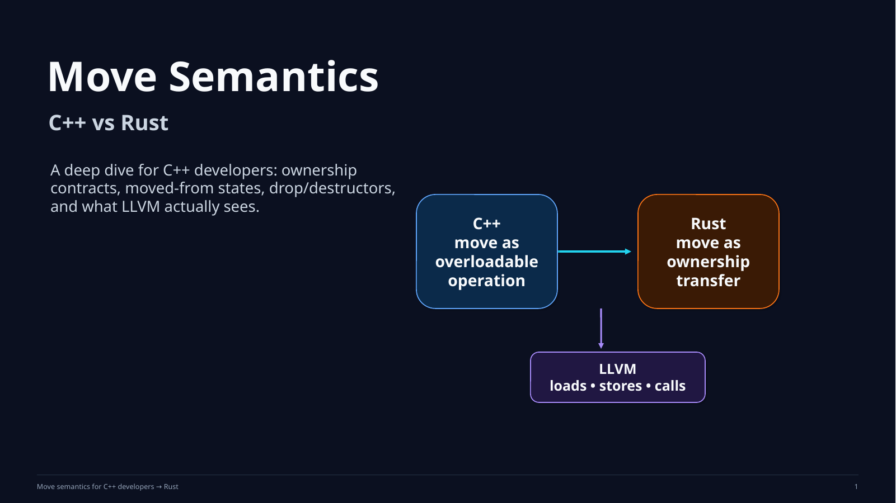
Notes:
Sources / teaching notes:
Original course slide retained as a rendered slide background from the previous generated deck.

Slide 2
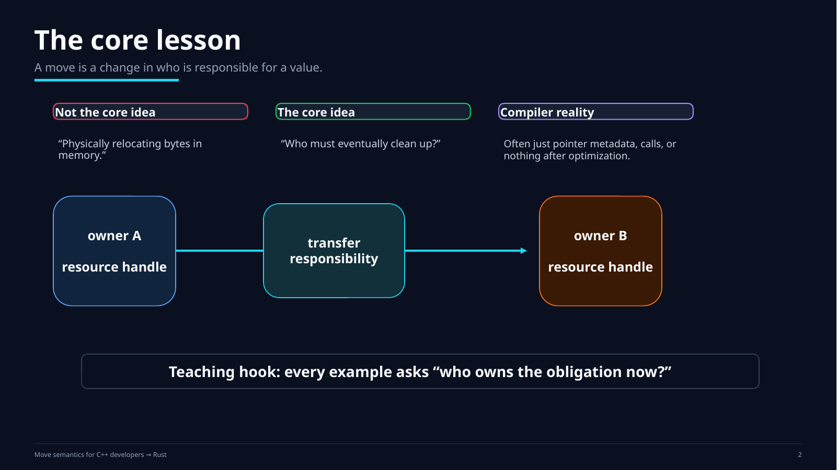
Notes:
Sources / teaching notes:
Original course slide retained as a rendered slide background from the previous generated deck.

Slide 3

Notes:
Sources / teaching notes:
Original course slide retained as a rendered slide background from the previous generated deck.

Slide 4
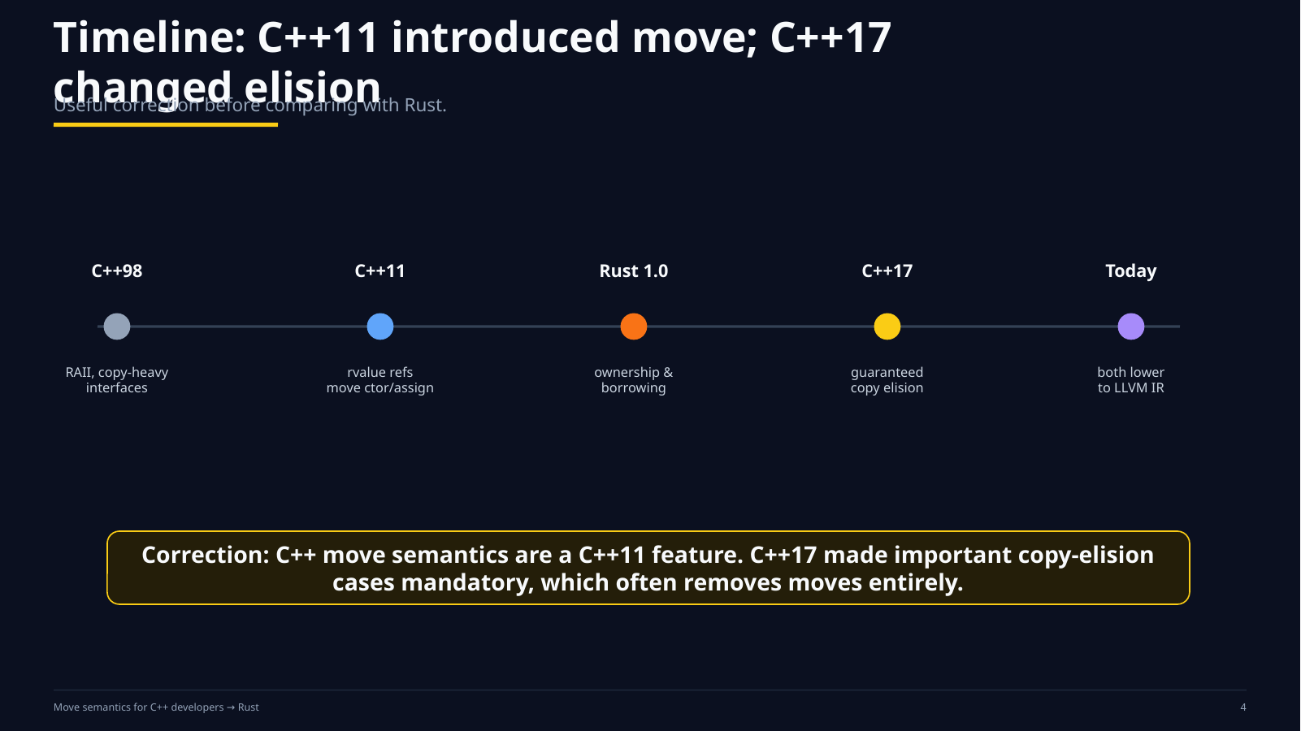
Notes:
Sources / teaching notes:
Original course slide retained as a rendered slide background from the previous generated deck.

Slide 5
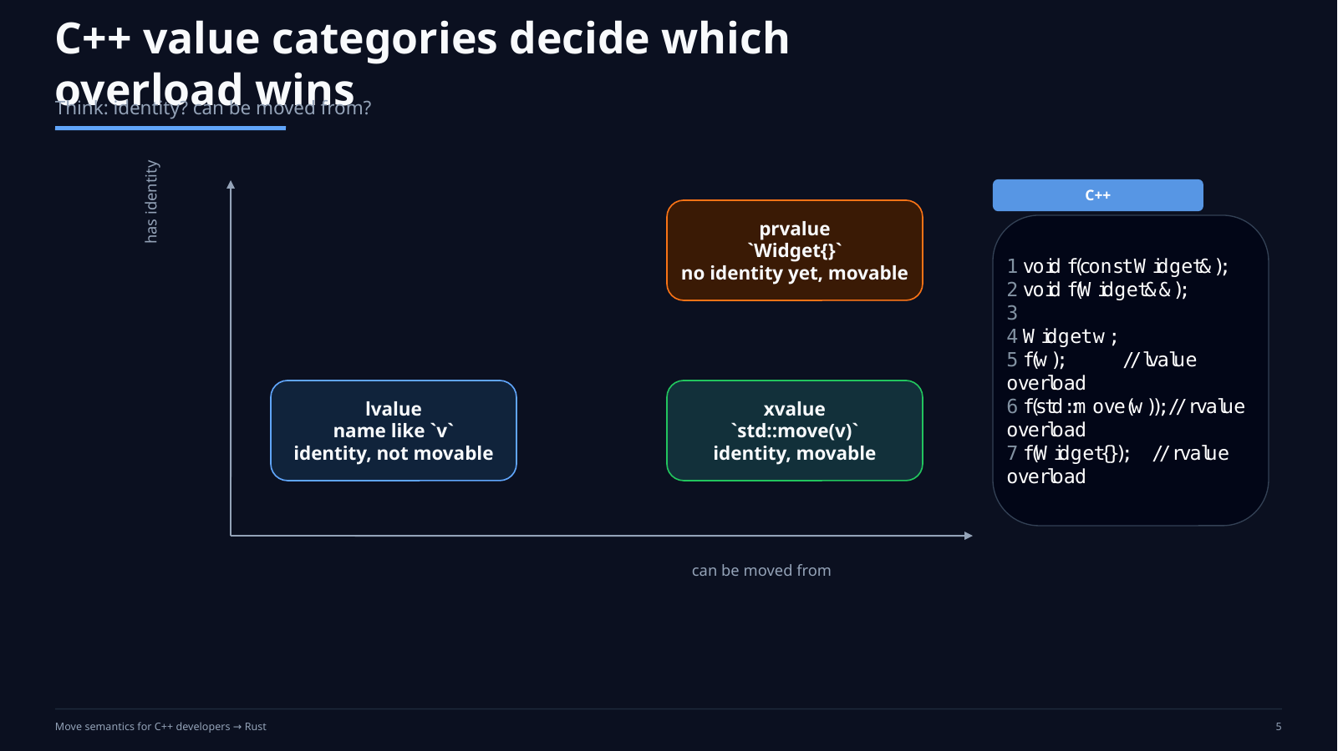
Notes:
Sources / teaching notes:
Original course slide retained as a rendered slide background from the previous generated deck.

Slide 6
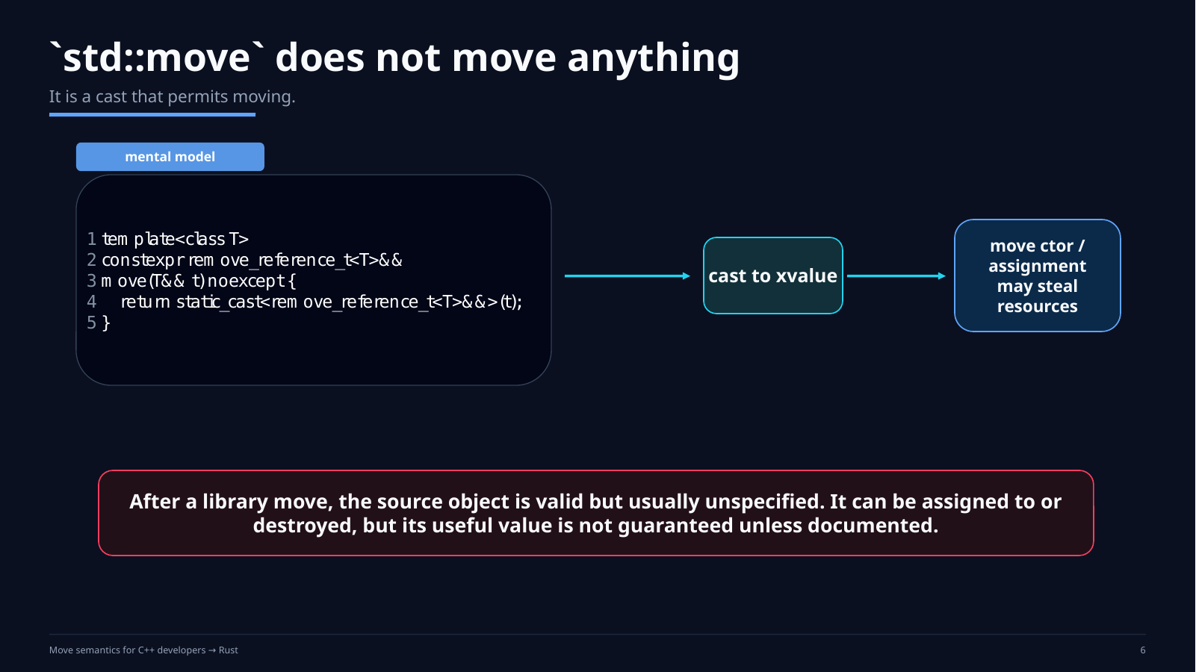
Notes:
Sources / teaching notes:
Original course slide retained as a rendered slide background from the previous generated deck.

Slide 7
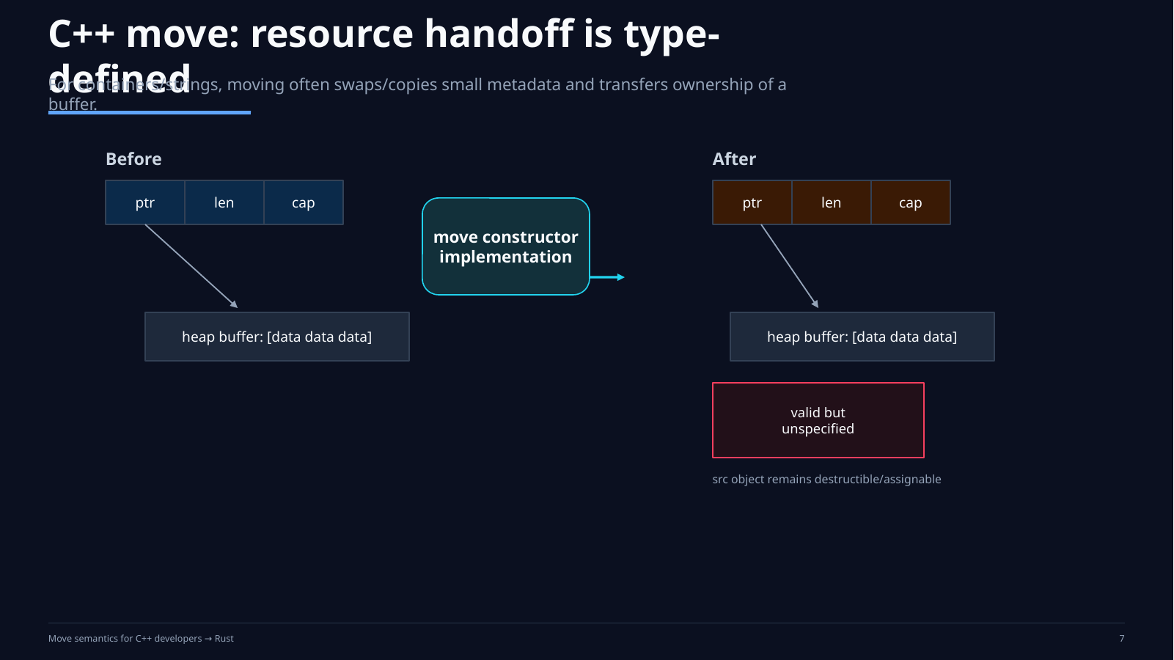
Notes:
Sources / teaching notes:
Original course slide retained as a rendered slide background from the previous generated deck.

Slide 8
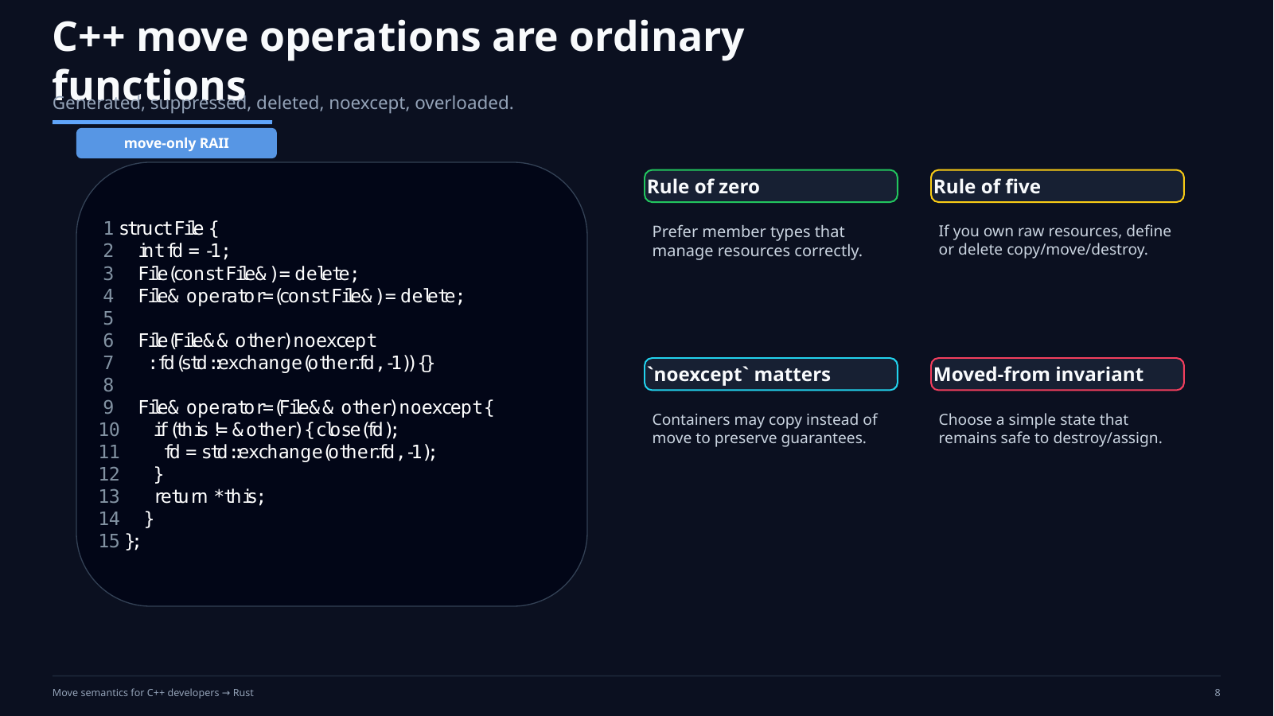
Notes:
Sources / teaching notes:
Original course slide retained as a rendered slide background from the previous generated deck.

Slide 9
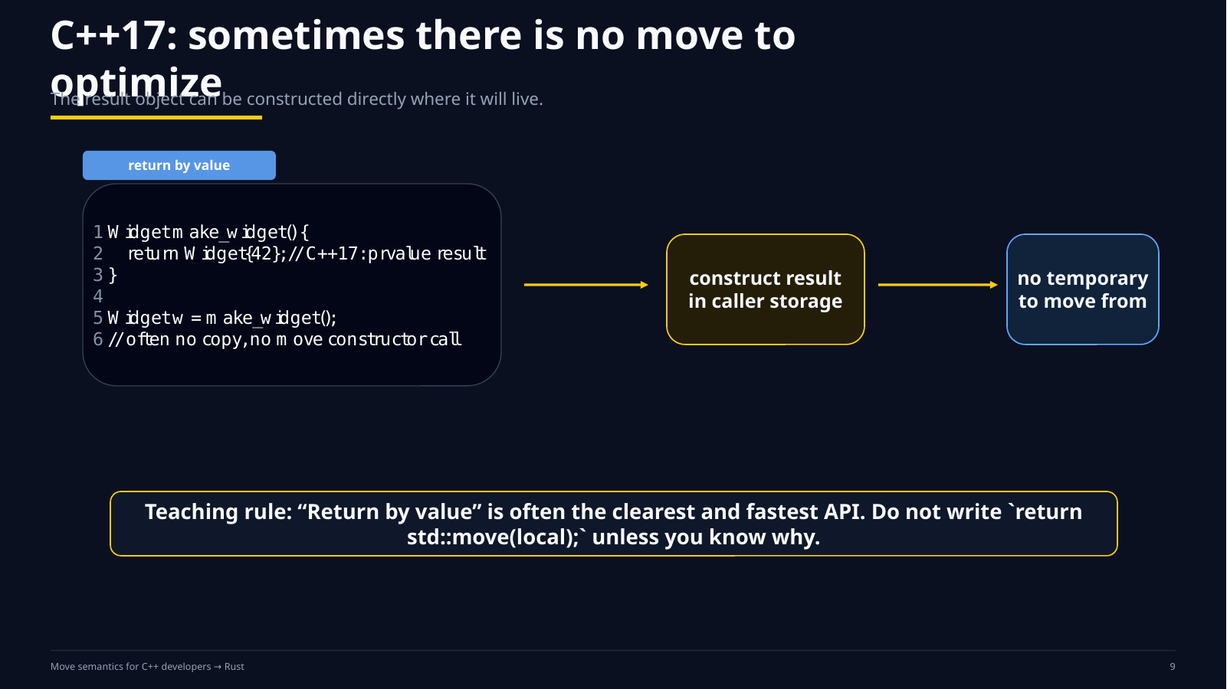
Notes:
Sources / teaching notes:
Original course slide retained as a rendered slide background from the previous generated deck.

Slide 10
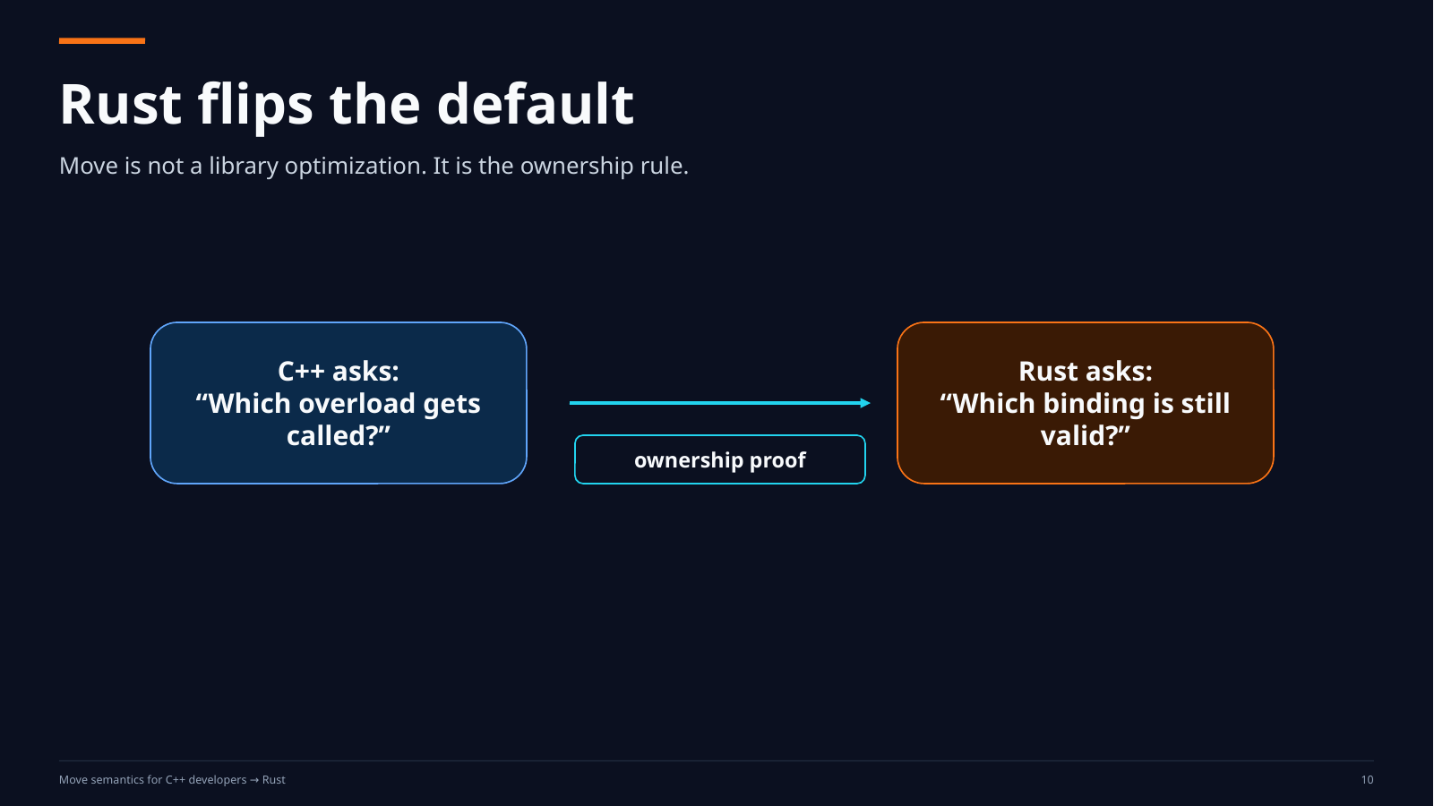
Notes:
Sources / teaching notes:
Original course slide retained as a rendered slide background from the previous generated deck.

Slide 11
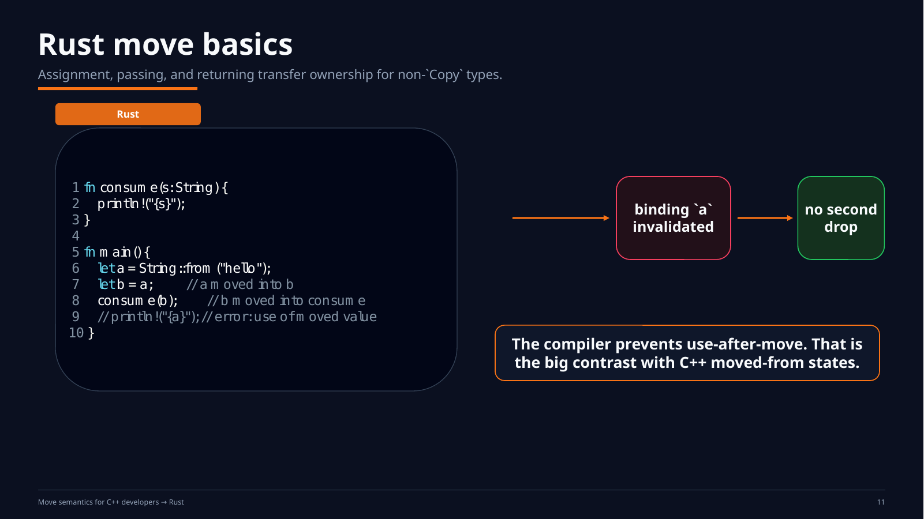
Notes:
Sources / teaching notes:
Original course slide retained as a rendered slide background from the previous generated deck.

Slide 12
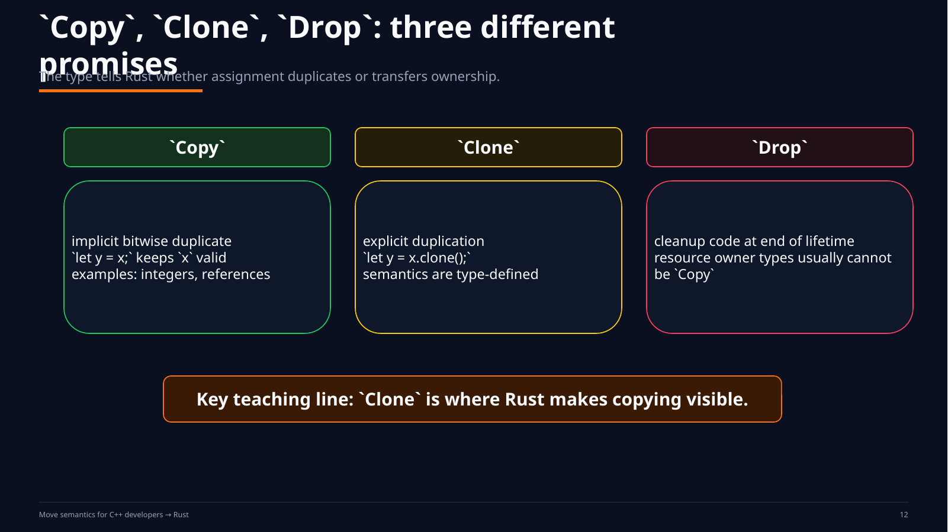
Notes:
Sources / teaching notes:
Original course slide retained as a rendered slide background from the previous generated deck.

Slide 13
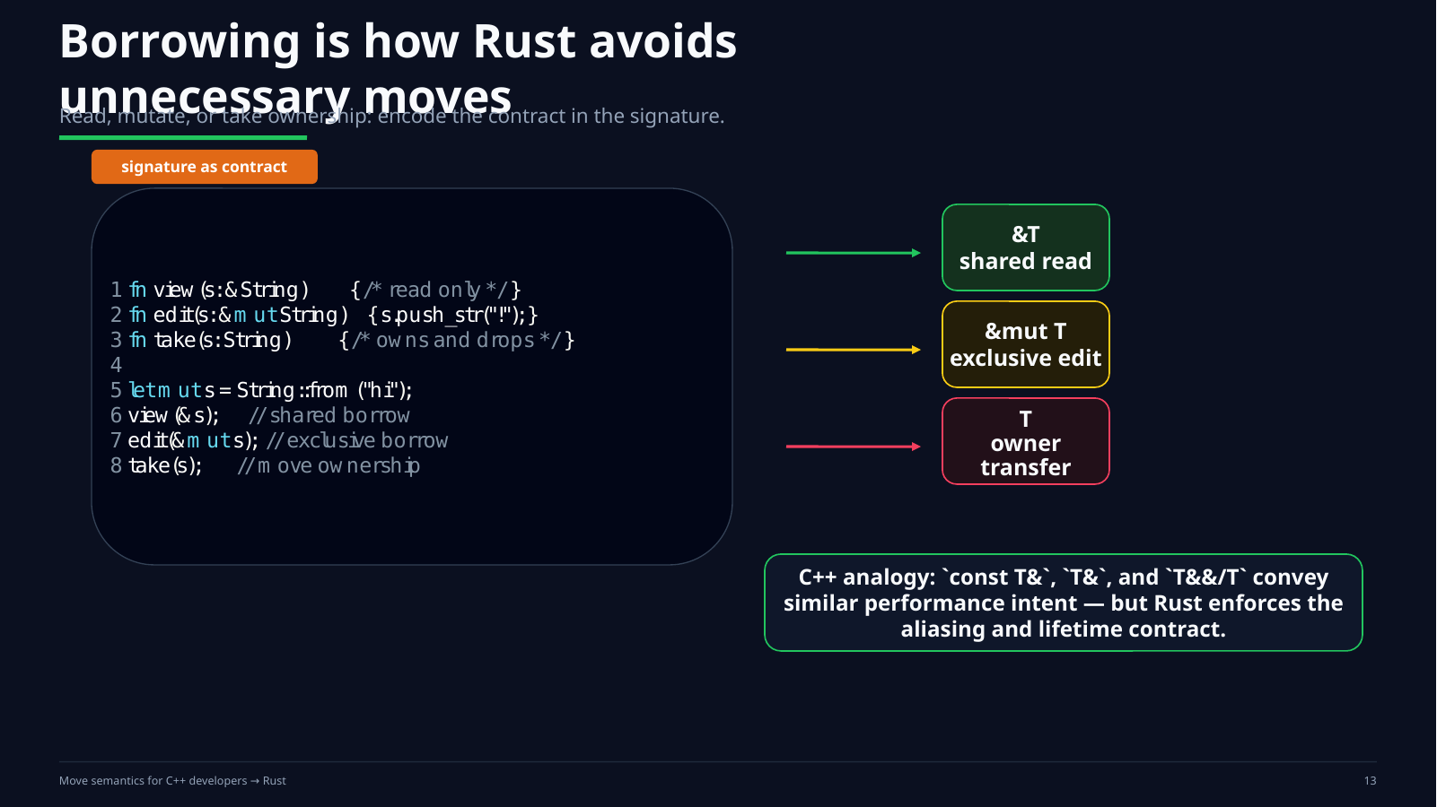
Notes:
Sources / teaching notes:
Original course slide retained as a rendered slide background from the previous generated deck.

Slide 14
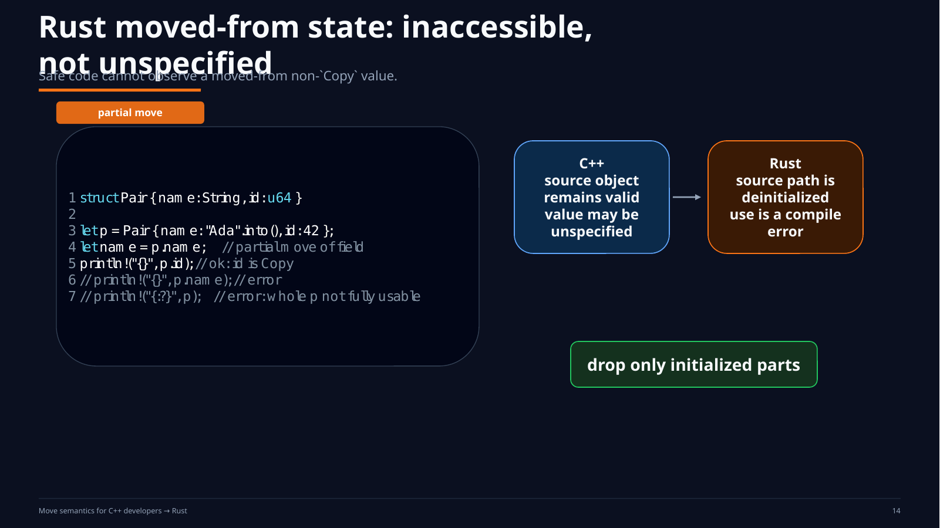
Notes:
Sources / teaching notes:
Original course slide retained as a rendered slide background from the previous generated deck.

Slide 15
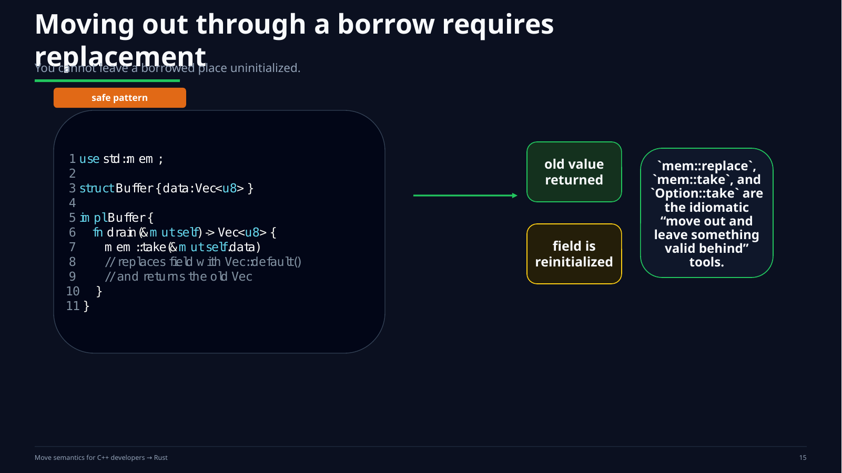
Notes:
Sources / teaching notes:
Original course slide retained as a rendered slide background from the previous generated deck.

Slide 16
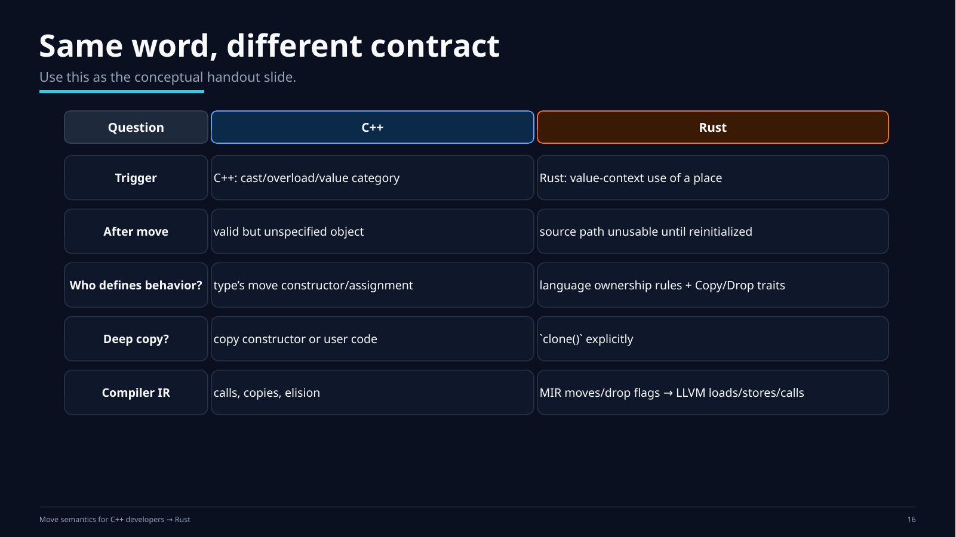
Notes:
Sources / teaching notes:
Original course slide retained as a rendered slide background from the previous generated deck.

Slide 17
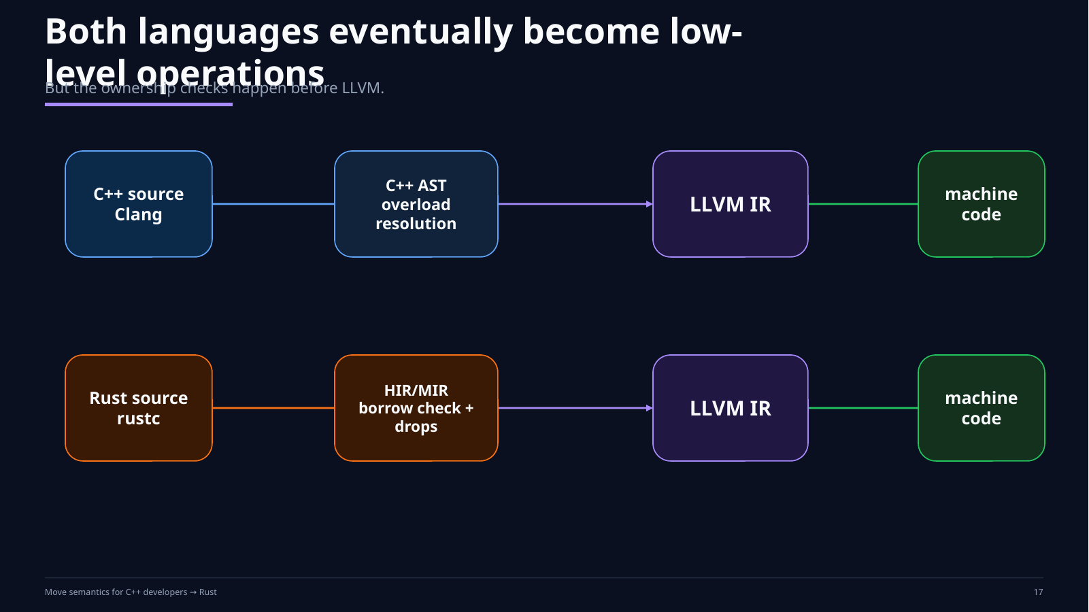
Notes:
Sources / teaching notes:
Original course slide retained as a rendered slide background from the previous generated deck.

Slide 18
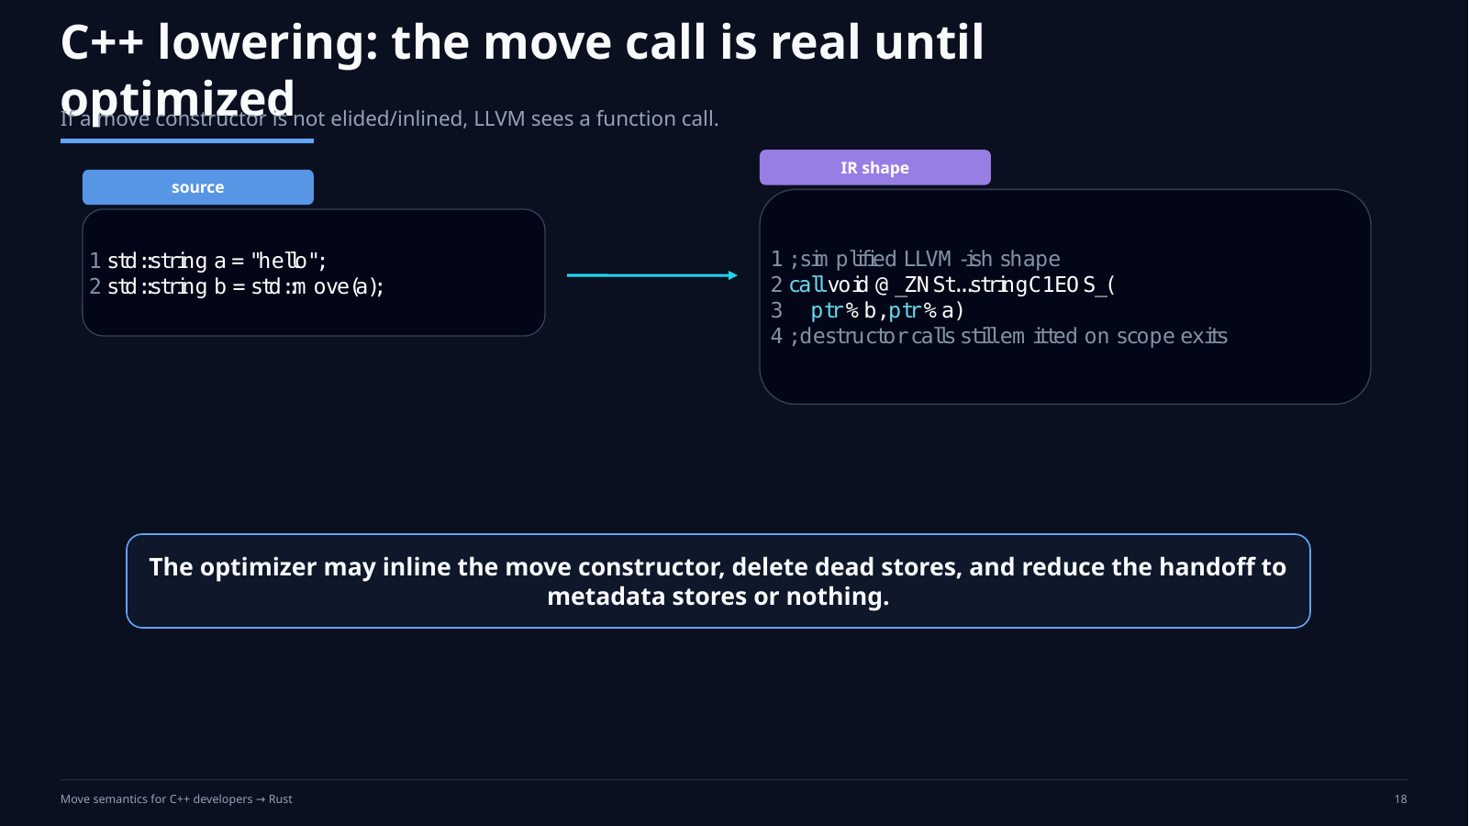
Notes:
Sources / teaching notes:
Original course slide retained as a rendered slide background from the previous generated deck.

Slide 19
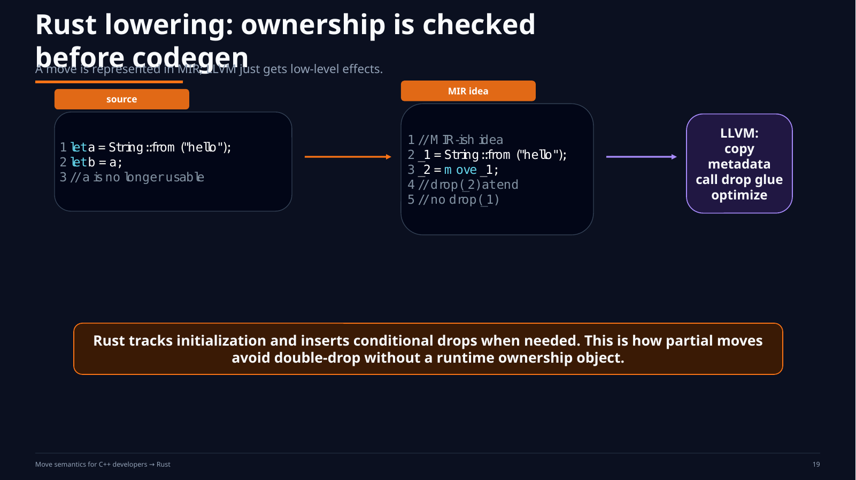
Notes:
Sources / teaching notes:
Original course slide retained as a rendered slide background from the previous generated deck.

Slide 20
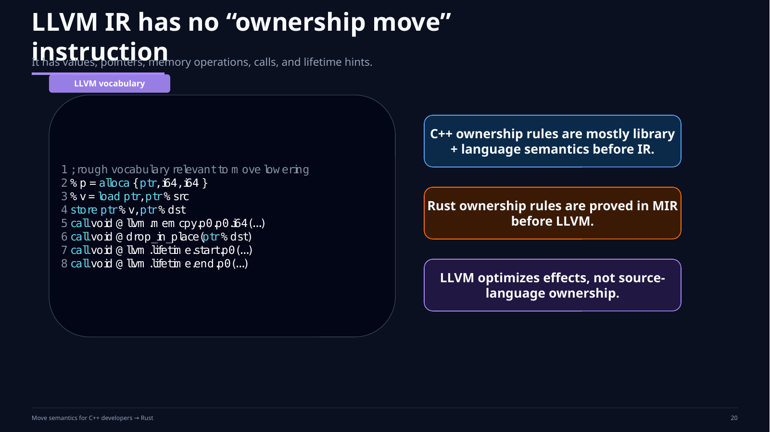
Notes:
Sources / teaching notes:
Original course slide retained as a rendered slide background from the previous generated deck.

Slide 21
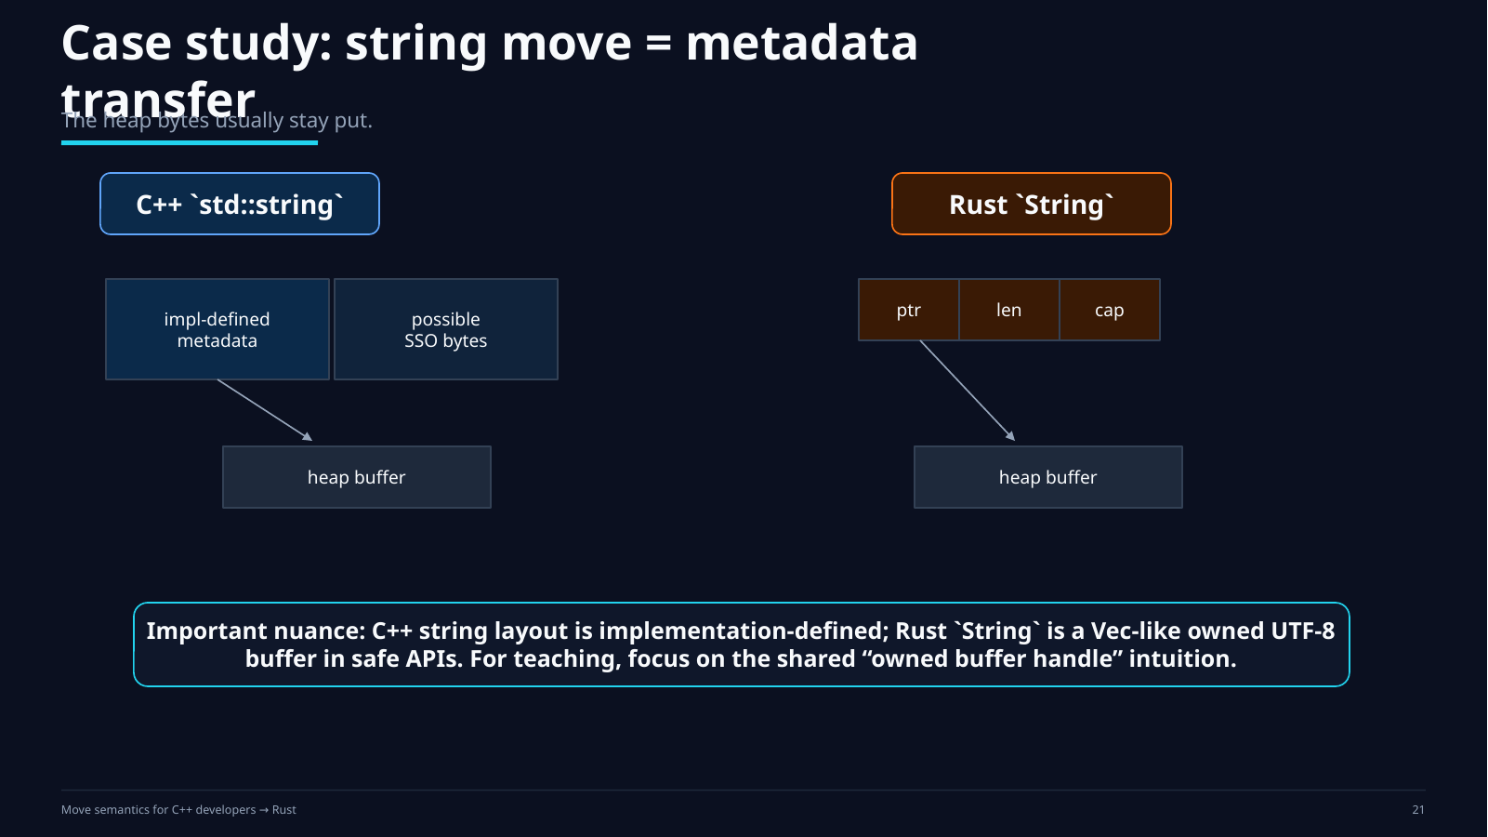
Notes:
Sources / teaching notes:
Original course slide retained as a rendered slide background from the previous generated deck.

Slide 22
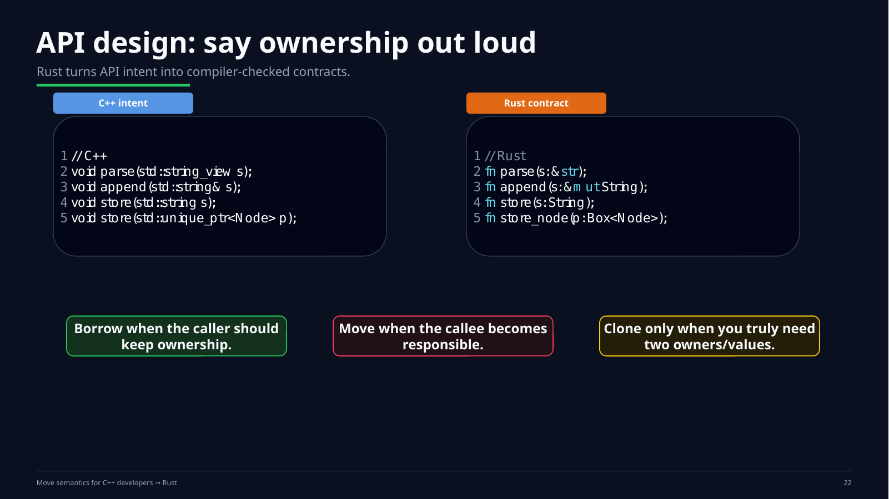
Notes:
Sources / teaching notes:
Original course slide retained as a rendered slide background from the previous generated deck.

Slide 23
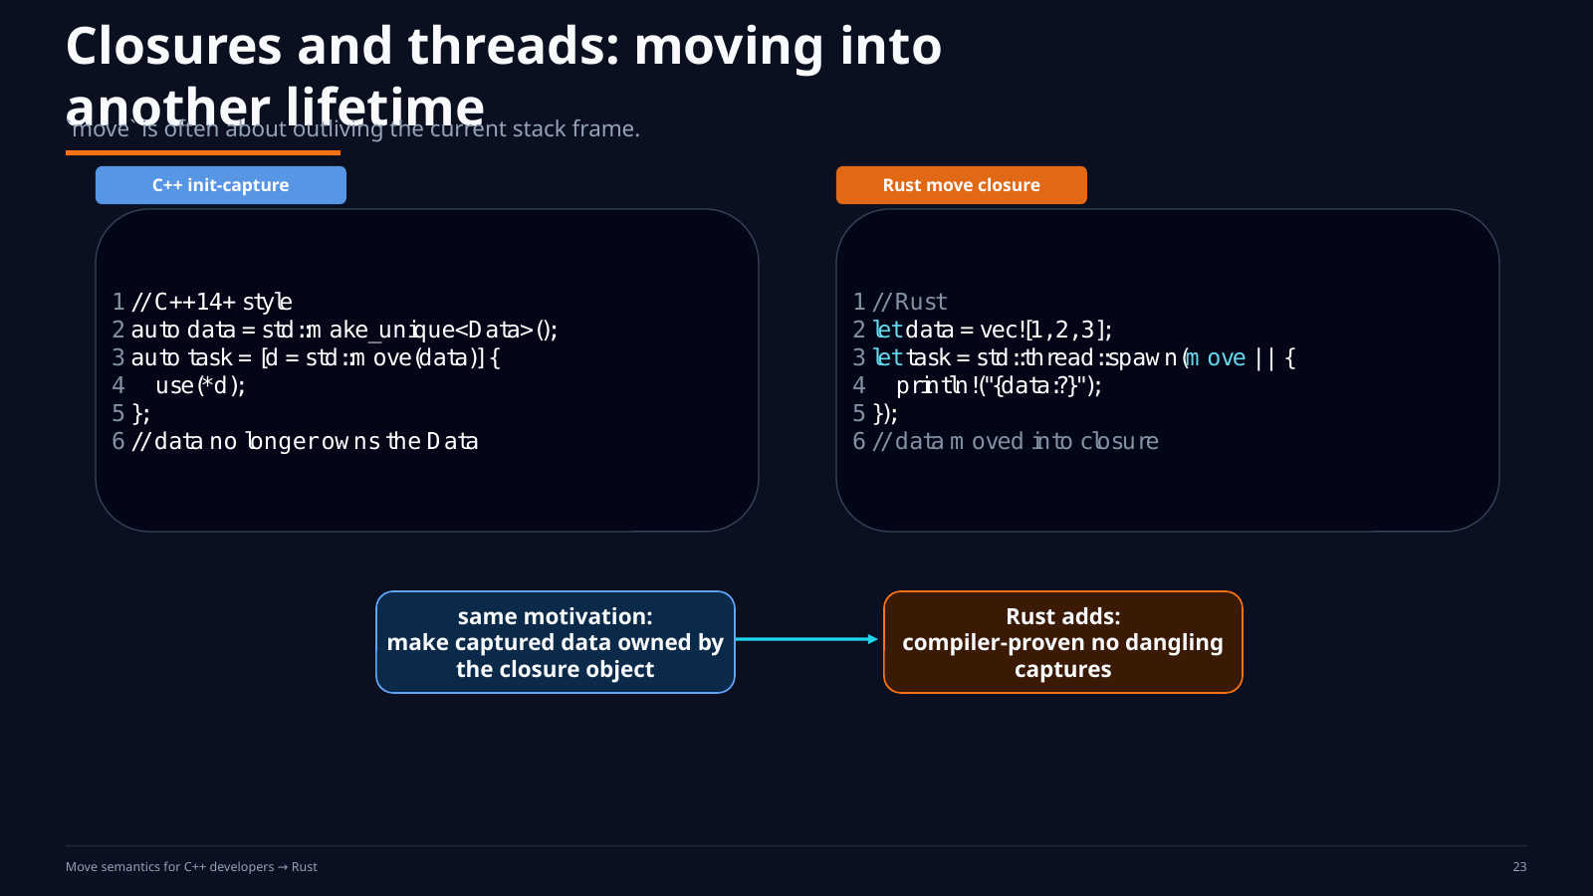
Notes:
Sources / teaching notes:
Original course slide retained as a rendered slide background from the previous generated deck.

Slide 24
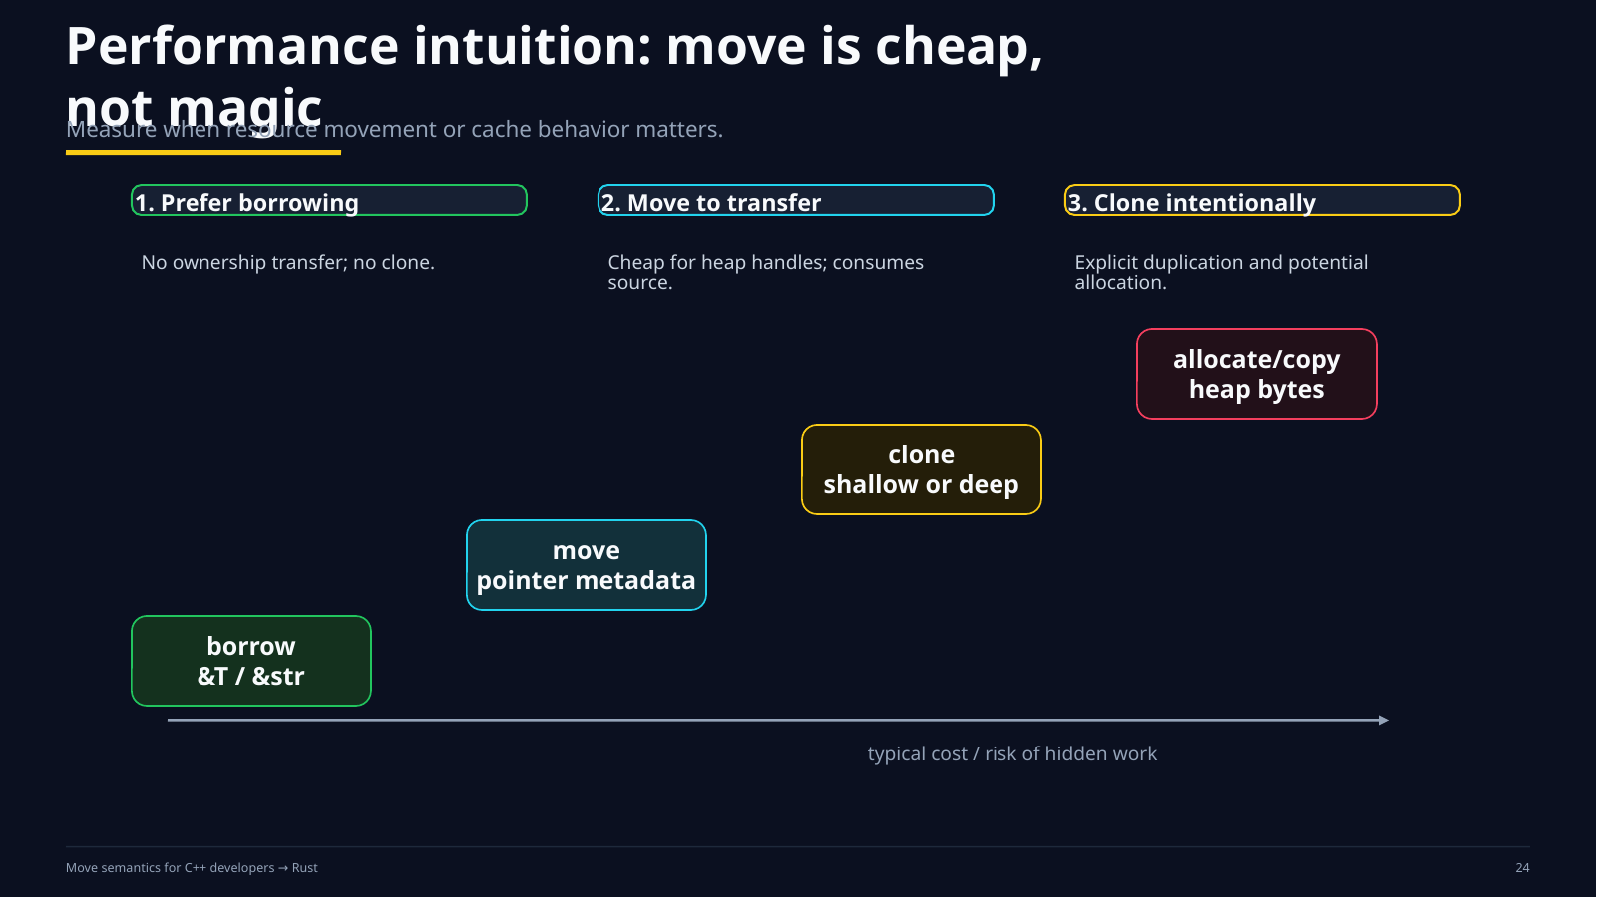
Notes:
Sources / teaching notes:
Original course slide retained as a rendered slide background from the previous generated deck.

Slide 25
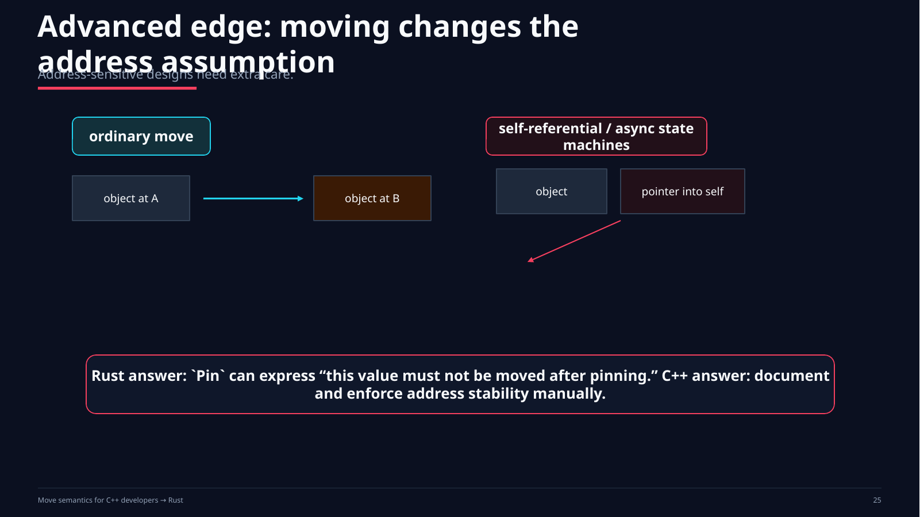
Notes:
Sources / teaching notes:
Original course slide retained as a rendered slide background from the previous generated deck.

Slide 26
Hands-on Lab: make moves visible
A 40–55 minute lab for C++ developers learning Rust ownership
lab
You will predict, run, and explain one ownership transfer in both languages.
1. Trace C++
Instrument copy / move / destructor calls.
Toggle std::move and copy elision.
Explain the moved-from object.
2. Port to Rust
Move a String-owning type.
Break the program, read E0382, then fix it by borrow, move, or clone.
3. Inspect IR
Generate LLVM IR at O0 and O3.
Find what remains: loads, stores, calls, metadata, or nothing.
→
→
Instructor prompt: “Where is the ownership obligation now?”
Move semantics: C++ vs Rust — hands-on lab and quiz
26
Notes:
Sources / teaching notes:
Rust ownership/move model: https://doc.rust-lang.org/book/ch04-01-what-is-ownership.html
C++ std::move helper semantics: https://eel.is/c++draft/forward
LLVM IR reference: https://llvm.org/docs/LangRef.html

Slide 27
Lab logistics and deliverables
Students work in pairs; one person predicts while the other runs the experiment
Timebox
• 5 min: copy starter files
• 12 min: C++ trace experiment
• 15 min: Rust ownership port
• 10 min: LLVM IR inspection
• 5 min: pair share-out
Turn in
• Prediction table: copy, move, drop counts
• One Rust compiler error and explanation
• One “before / after” fix using borrow or clone
• A sentence explaining what disappeared in O3 IR
• One API rule you will use at work
Pair rule: do not edit before making a prediction.
Move semantics: C++ vs Rust — hands-on lab and quiz
27
Notes:
Sources / teaching notes:
No external sources beyond the language references cited on neighboring slides. This slide defines a classroom process and deliverables.

Slide 28
Starter files: one story in two languages
The point is not syntax; the point is ownership transfer and cleanup responsibility
lab/
cpp/trace.cpp
cpp/tiny.cpp
rust/src/main.rs
rust/tiny.rs
worksheet.md
C++ experiment
Trace actual constructor calls.
Ask: “Which overload did overload resolution choose?”
Then ask: “Did the optimizer remove it?”
Rust experiment
Trace compile-time ownership.
Ask: “Who may use the value now?”
Then ask: “Which destructor still runs?”
# Useful commands
clang++ -std=c++20 -O0 -fno-elide-constructors trace.cpp && ./a.out
clang++ -std=c++20 -O3 -S -emit-llvm tiny.cpp -o cpp.ll
rustc -C opt-level=0 src/main.rs && ./main
rustc -O --emit=llvm-ir tiny.rs -o rust.ll
Use clang++ if available; g++ also works for the tracing part.
Move semantics: C++ vs Rust — hands-on lab and quiz
28
Notes:
Sources / teaching notes:
Clang -S -emit-llvm produces textual LLVM IR: https://releases.llvm.org/18.1.4/tools/clang/docs/Toolchain.html
rustc --emit=llvm-ir emits LLVM IR: https://doc.rust-lang.org/stable/rustc/command-line-arguments.html
LLVM IR reference: https://llvm.org/docs/LangRef.html

Slide 29
Task 1: C++ move trace
Before running, predict the log lines and the state of each object
// include <iostream>, <string>
struct Trace {
std::string name;
explicit Trace(std::string n)
: name(std::move(n)) { log("ctor"); }
Trace(const Trace& o)
: name(o.name + ".copy") { log("copy"); }
Trace(Trace&& o) noexcept
: name(std::move(o.name)) { log("move"); }
~Trace() { log("dtor"); }
void log(const char* op) const { /* print op + name */ }
};
Trace make() { Trace t{"made"}; return t; }
void consume(Trace t) { t.log("consume"); }
Your prediction
1. Which lines are moves?
2. What happens to the source object?
3. Does `std::move` itself move anything?
4. What changes if copy elision is disabled?
5. What changes at `-O3`?
int main() {
Trace a{"A"};
Trace b = std::move(a);
consume(std::move(b));
Trace c = make();
}
Move semantics: C++ vs Rust — hands-on lab and quiz
29
Notes:
Sources / teaching notes:
C++ draft specifies std::move returns static_cast<remove_reference_t<T>&&>(t): https://eel.is/c++draft/forward
The lab intentionally uses -fno-elide-constructors to make non-elided moves visible.

Slide 30
Task 1 worksheet: change one line at a time
Each edit tests a different misconception from C++ move semantics
Experiment A
Run exactly as written.
Record ctor / move / copy / dtor counts.
Experiment B
Remove `std::move(a)`.
Which overload is selected now?
Experiment C
Change move ctor to not be `noexcept`.
Discuss what containers may prefer.
Worksheet table
Case
Prediction
Observed
Explanation
A: as written
B: no std::move(a)
C: move not noexcept
D: return std::move(t)
Do not use the moved-from object except to destroy it or assign a new value unless you know the type’s contract.
Move semantics: C++ vs Rust — hands-on lab and quiz
30
Notes:
Sources / teaching notes:
C++ standard library moved-from objects are generally valid but have type-specific states and contracts; for the std::move helper see https://eel.is/c++draft/forward. This slide is a student worksheet.

Slide 31
Task 2: Rust ownership port
First make the compiler complain, then fix the design intentionally
#[derive(Debug)]
struct Token(String);
impl Drop for Token {
fn drop(&mut self) { println!("drop {}", self.0); }
}
fn consume(t: Token) { println!("consume {}", t.0); }
fn main() {
let a = Token("A".to_string());
let b = a;
println!("{a:?}"); // predict error E0382
consume(b);
}
Your task
1. Predict the compiler error.
2. Fix it by borrowing.
3. Fix it by transferring ownership.
4. Add explicit cloning and explain the cost.
5. Explain why `Copy` is not allowed here.
Instructor hint
Do not “fight” the compiler.
Ask which line wants ownership, which line only wants to observe, and which line should pay for duplication.
Move semantics: C++ vs Rust — hands-on lab and quiz
31
Notes:
Sources / teaching notes:
Rust Book ownership chapter shows that assigning a non-Copy value moves it and the old binding cannot be used: https://doc.rust-lang.org/book/ch04-01-what-is-ownership.html
Rust Copy docs state that types implementing Drop cannot be Copy: https://doc.rust-lang.org/std/marker/trait.Copy.html
Rust Reference drop behavior: https://doc.rust-lang.org/reference/destructors.html

Slide 32
Task 2 worksheet: three legal fixes
Same program intent, three different ownership contracts
// Borrowing: observe without taking ownership
fn observe(t: &Token) {
println!("observe {}", t.0);
}
let a = Token("A".to_string());
observe(&a);
println!("still usable: {:?}", a);
// Moving: callee consumes the value
fn consume(t: Token) {
println!("consume {}", t.0);
}
let a = Token("A".to_string());
consume(a);
// println!("{:?}", a); // not legal
// Cloning: explicit duplicate
#[derive(Debug, Clone)]
struct Token(String);
let a = Token("A".to_string());
let b = a.clone();
consume(b);
println!("original: {:?}", a);
Fill in the contract
Borrowing says: “I only need to read.”
Moving says: “I take cleanup responsibility.”
Cloning says: “I explicitly pay for another value.”
Compare with C++
`const T&`, `T&&`, and copy construction are all available in C++; Rust makes the ownership choice explicit at the use site and checks use-after-move.
Move semantics: C++ vs Rust — hands-on lab and quiz
32
Notes:
Sources / teaching notes:
Rust references allow using a value without transferring ownership, per The Rust Book: https://doc.rust-lang.org/book/ch04-01-what-is-ownership.html
Clone and Copy semantics: https://doc.rust-lang.org/std/marker/trait.Copy.html

Slide 33
Task 3: inspect the lowering
Look for what survives after source-level ownership has been checked
// cpp/tiny.cpp
#include <string>
std::string pass(std::string s) {
return s;
}
int len(std::string s) {
return static_cast<int>(s.size());
}
// rust/tiny.rs
#[no_mangle]
pub fn pass(s: String) -> String {
s
}
#[no_mangle]
pub fn len(s: String) -> usize {
s.len()
}
Commands
clang++ -std=c++20 -O3 -S -emit-llvm tiny.cpp -o cpp.ll
rustc -O --emit=llvm-ir tiny.rs -o rust.ll
What to find
• Is there an LLVM “move” instruction?
• Is String data copied, or just metadata?
• Which drops/destructors remain at O0?
• Which checks disappear after O3?
• Which calls are ABI/runtime calls rather than ownership operations?
Move semantics: C++ vs Rust — hands-on lab and quiz
33
Notes:
Sources / teaching notes:
Clang emits textual LLVM IR with -S -emit-llvm: https://releases.llvm.org/18.1.4/tools/clang/docs/Toolchain.html
rustc --emit=llvm-ir emits .ll output: https://doc.rust-lang.org/stable/rustc/command-line-arguments.html
LLVM IR is a low-level, typed SSA IR; instructions include loads, stores, calls, aggregate ops, and memory intrinsics: https://llvm.org/docs/LangRef.html

Slide 34
Lab debrief: what should students discover?
The desired answer is conceptual, not a perfect instruction count
C++
`std::move` is a cast to an rvalue expression.
The move operation happens only if an overload or constructor actually uses that value category.
Rust
A move transfers the right to use and later drop the value.
The compiler removes access to the old binding for non-Copy types.
LLVM
After type checking and borrow checking, ownership is already resolved.
IR mostly sees memory, values, calls, and optimizer metadata.
Bridge sentence students should be able to say
“Move is not a magical byte-copy operation. It is a change in who owns the obligation to clean up, expressed differently by C++ and Rust.”
Move semantics: C++ vs Rust — hands-on lab and quiz
34
Notes:
Sources / teaching notes:
C++ std::move return expression specification: https://eel.is/c++draft/forward
Rust ownership chapter: https://doc.rust-lang.org/book/ch04-01-what-is-ownership.html
LLVM LangRef: https://llvm.org/docs/LangRef.html

Slide 35
Quiz: multiple choice
Use after the lab; 12 questions, 8–10 minutes, closed notes
How to run it
• Ask students to answer individually first.
• Then discuss in pairs.
• Finally reveal the answer key.
• Award credit for the explanation, not only the letter.
What it tests
• C++ value categories and moved-from state
• Rust ownership, Copy, Clone, Drop
• LLVM lowering and optimizer intuition
• API design: borrow vs own
do not show answer key yet
Move semantics: C++ vs Rust — hands-on lab and quiz
35
Notes:
Sources / teaching notes:
Questions are authored for the course and are based on the language documentation cited in the answer slides.

Slide 36
Quiz Part A: C++ move semantics
Choose the best answer
1. What does std::move(x) do by itself?
A. Frees x's resources
B. Casts x to an rvalue expression
C. Copies x into a temporary
D. Calls the move constructor immediately
2. After moving from a standard-library object, the object is usually…
A. destroyed
B. valid but unspecified
C. undefined to touch at all
D. guaranteed empty
3. Why are many move constructors marked noexcept?
A. It makes them faster at runtime
B. It forbids all exceptions in the program
C. Containers can prefer moving during reallocation
D. It disables copy elision
4. Inside a move constructor, the parameter named other is…
A. an xvalue
B. an lvalue expression
C. always const
D. already destroyed
5. Why is return std::move(local) often a pessimization?
A. It turns into a deep copy
B. It can prevent NRVO/copy elision
C. It makes local const
D. It prevents destruction
Move semantics: C++ vs Rust — hands-on lab and quiz
36
Notes:
Sources / teaching notes:
C++ draft std::move specification: https://eel.is/c++draft/forward
Questions 1 and 4 test the difference between value category and actual moving operation.

Slide 37
Quiz Part B: Rust ownership
Choose the best answer
6. For let b = a; where a: String, what happens?
A. a and b both own the buffer
B. a is moved; b owns the String
C. a is copied byte-for-byte
D. a becomes a borrowed reference
7. Which trait makes implicit bitwise duplication legal?
A. Clone
B. Drop
C. Copy
D. Deref
8. Can a type that implements Drop also implement Copy?
A. Yes, always
B. Yes, only if it owns heap memory
C. No
D. Only in unsafe code
9. What is the cheapest way to let a function inspect a value?
A. Pass ownership
B. Clone first
C. Pass a shared reference
D. Use Box<T>
10. What does Clone communicate?
A. Implicit copy at every assignment
B. Explicit duplication chosen by the programmer
C. Guaranteed zero-cost move
D. A destructor has already run
Move semantics: C++ vs Rust — hands-on lab and quiz
37
Notes:
Sources / teaching notes:
Rust Book ownership and move examples: https://doc.rust-lang.org/book/ch04-01-what-is-ownership.html
Rust Copy trait docs: https://doc.rust-lang.org/std/marker/trait.Copy.html
Rust Reference destructors/drop: https://doc.rust-lang.org/reference/destructors.html

Slide 38
Quiz Part C: lowering and API design
Choose the best answer
11. Does LLVM IR have a first-class “ownership move” instruction?
A. Yes: move
B. Yes: transfer
C. No; it has ordinary low-level operations
D. Only for Rust
12. A Rust String move usually copies…
A. all heap bytes
B. only stack metadata such as pointer/len/cap
C. nothing at all, even registers
D. the allocator object only
13. An API should take ownership when the callee…
A. stores, consumes, or becomes responsible for cleanup
B. only reads the value once
C. wants to avoid typing &
D. wants automatic cloning
14. Best C++/Rust translation of “read without owning” is…
A. T&& / T
B. const T& / &T
C. T* / Box<T>
D. std::move / clone()
15. The biggest safety difference after a move is…
A. Rust keeps the old binding usable
B. C++ forbids all moved-from use
C. Rust rejects use-after-move statically
D. LLVM checks use-after-move
Move semantics: C++ vs Rust — hands-on lab and quiz
38
Notes:
Sources / teaching notes:
LLVM LangRef describes LLVM IR as low-level typed SSA with loads/stores/calls/memory intrinsics, not language-level ownership: https://llvm.org/docs/LangRef.html
Rust ownership use-after-move checking: https://doc.rust-lang.org/book/ch04-01-what-is-ownership.html

Slide 39
Suggested Lab Solution 1: C++ trace
The exact log can vary with elision, flags, and library implementation; the reasoning should not
Expected reasoning
• `std::move(a)` changes the value category; overload resolution then selects move operations where available.
• The moved-from `a` remains alive and will be destroyed.
• In this example, `a.name` is typically empty after `std::string` move, but do not rely on a specific value unless the type promises it.
Key variations
• Removing `std::move(a)` selects copy construction for `b`.
• `return t;` allows copy elision / move from local.
• `return std::move(t);` often blocks NRVO and can add a move.
• `noexcept` matters for containers that choose between move and copy for strong exception guarantees.
Trace b = std::move(a); // move constructs b; a is still a live object
consume(std::move(b)); // move constructs the parameter
Trace c = make(); // usually elided; visible with -fno-elide-constructors
Scoring rubric: students get full credit if they separate “cast to rvalue” from “actual move constructor/assignment selected.”
Move semantics: C++ vs Rust — hands-on lab and quiz
39
Notes:
Sources / teaching notes:
C++ draft: std::move returns static_cast<remove_reference_t<T>&&>(t): https://eel.is/c++draft/forward
This solution intentionally states implementation-dependent output as reasoning, not as a guaranteed byte-for-byte log.

Slide 40
Suggested Lab Solution 2: Rust ownership fixes
The compiler error is the lesson: the old owner is no longer usable
// Borrowing solution
fn observe(t: &Token) { println!("{}", t.0); }
let a = Token("A".to_string());
observe(&a);
println!("still usable: {:?}", a);
// Move solution
fn consume(t: Token) { println!("{}", t.0); }
let a = Token("A".to_string());
consume(a);
// a is intentionally gone here
// Clone solution
#[derive(Debug, Clone)]
struct Token(String);
let a = Token("A".to_string());
consume(a.clone());
println!("original: {:?}", a);
Answer explanation
The line `let b = a;` moves ownership of the Token. Because Token owns a String and implements Drop, it cannot be Copy. `clone()` is explicit duplication; borrowing leaves ownership with the caller.
Move semantics: C++ vs Rust — hands-on lab and quiz
40
Notes:
Sources / teaching notes:
Rust Book shows non-Copy values move on assignment and previous binding cannot be used: https://doc.rust-lang.org/book/ch04-01-what-is-ownership.html
Rust Copy trait docs state that any type implementing Drop cannot be Copy: https://doc.rust-lang.org/std/marker/trait.Copy.html
Rust destructors/drop behavior: https://doc.rust-lang.org/reference/destructors.html

Slide 41
Suggested Lab Solution 3: LLVM IR findings
A move is a source-level ownership event; LLVM mostly sees ordinary low-level operations
What students should see
• No universal LLVM “move ownership” instruction.
• Small values may become registers or disappear completely.
• `String`/`std::string` moves are mostly metadata transfer plus destructor/runtime calls.
• Drop flags and cleanup paths are visible more often at O0.
• O3 removes dead transfers and inlines aggressively.
Instructor phrasing
“Rust’s borrow checker does not emit runtime ownership checks for ordinary moves. It proves the ownership story before LLVM sees the program. C++ expresses move by overloads and library code; LLVM optimizes the resulting operations.”
Do not grade on exact IR text. Grade on the absence of source-language magic.
Move semantics: C++ vs Rust — hands-on lab and quiz
41
Notes:
Sources / teaching notes:
LLVM LangRef describes the IR and low-level instructions: https://llvm.org/docs/LangRef.html
Clang LLVM emission: https://releases.llvm.org/18.1.4/tools/clang/docs/Toolchain.html
rustc LLVM IR emission: https://doc.rust-lang.org/stable/rustc/command-line-arguments.html

Slide 42
Quiz answer key
Reveal only after students commit to an answer
1. B
std::move casts to rvalue; it does not move by itself.
9. C
&T observes without taking ownership.
2. B
Moved-from standard-library objects are valid, but their value is type-specific / unspecified.
10. B
Clone is explicit duplication.
3. C
noexcept enables containers to move while preserving exception guarantees.
11. C
LLVM has low-level operations, not a universal ownership move.
4. B
A named rvalue-reference parameter is an lvalue expression.
12. B
String move transfers metadata/ownership, not heap bytes.
5. B
return std::move(local) can block NRVO.
13. A
Take ownership when the callee consumes or stores.
6. B
String moves; the old binding is no longer usable.
14. B
const T& and &T read without owning.
7. C
Copy enables implicit duplication.
15. C
Rust statically rejects use-after-move.
8. C
Drop types cannot be Copy.
Grade the explanation
Best answers mention ownership, validity, and when duplication is explicit.
Move semantics: C++ vs Rust — hands-on lab and quiz
42
Notes:
Sources / teaching notes:
Answer key source basis: C++ std::move specification https://eel.is/c++draft/forward; Rust ownership chapter https://doc.rust-lang.org/book/ch04-01-what-is-ownership.html; Rust Copy trait docs https://doc.rust-lang.org/std/marker/trait.Copy.html; Rust destructors https://doc.rust-lang.org/reference/destructors.html; LLVM LangRef https://llvm.org/docs/LangRef.html

Slide 43
Final teaching move: translate API intent
End the session by having each student rewrite one function signature
C++ vocabulary
const T&
T&& / T by value
std::move
copy constructor
move constructor
Rust vocabulary
&T
&mut T
T
.clone()
Drop / Copy / Clone
Design question
Does this function only observe, temporarily borrow mutably, or consume ownership?
↔
↔
Best closing exercise: take one API from your C++ codebase and write the Rust ownership contract beside it.
Move semantics: C++ vs Rust — hands-on lab and quiz
43
Notes:
Sources / teaching notes:
This slide is an instructor wrap-up. Conceptual sources: Rust Book ownership chapter https://doc.rust-lang.org/book/ch04-01-what-is-ownership.html and C++ std::move helper specification https://eel.is/c++draft/forward.

