Slide 1
Dataset mention extraction from AI-Related publications
Qi Zhang & Zhuoan Zhou

Slide 2
Overview
Background & Dataset
Explore Questions & Result
Conclusion & Discussion

Slide 3
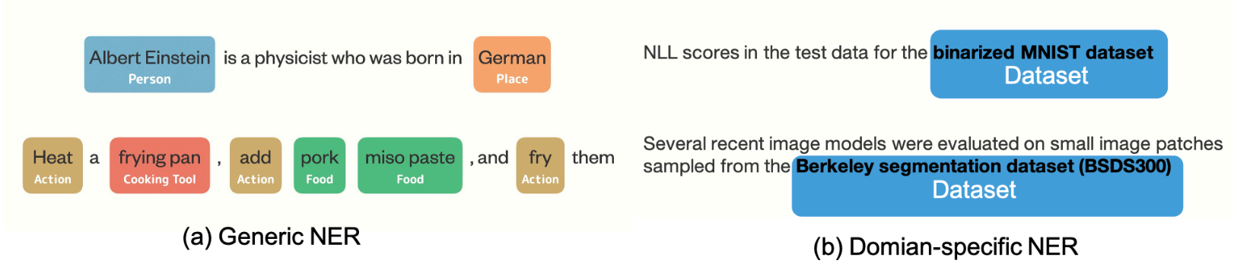
Background & Dataset
Study the task of recognizing named dataset in AI-related papers as the NER problem
Named entity recognition: seeks to locate and classify named entities mentioned in unstructured text into pre-defined categories likes person, location and date. The most basic task of NLP.
Extracting the named dataset is a domain-specific NER problem

Slide 4


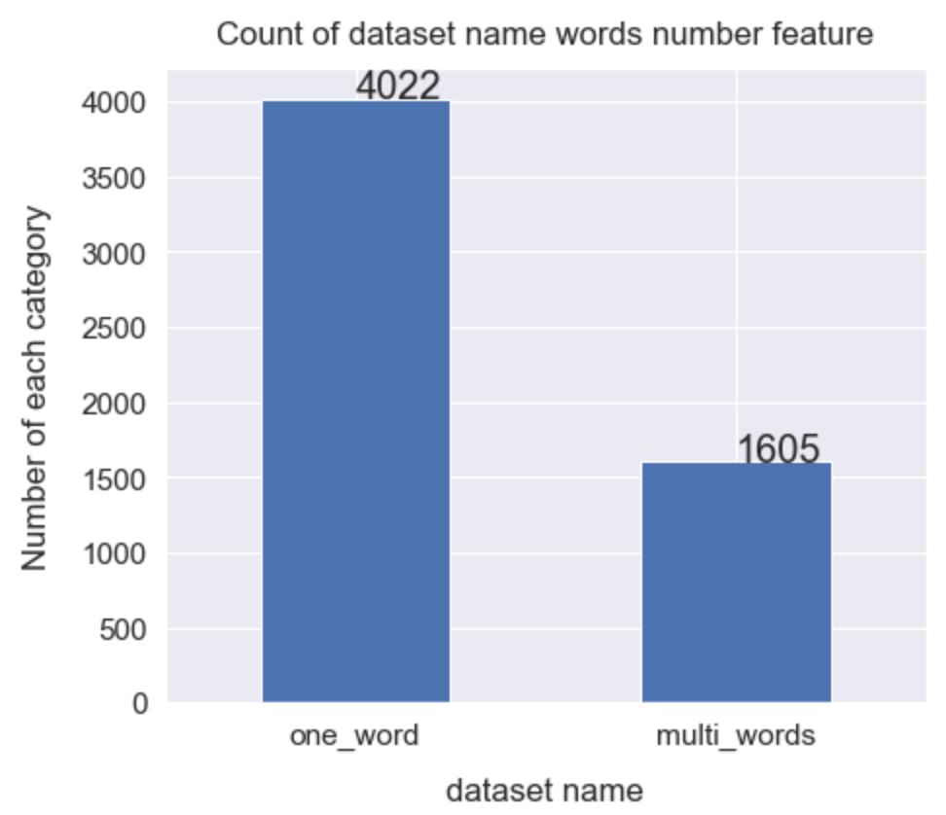
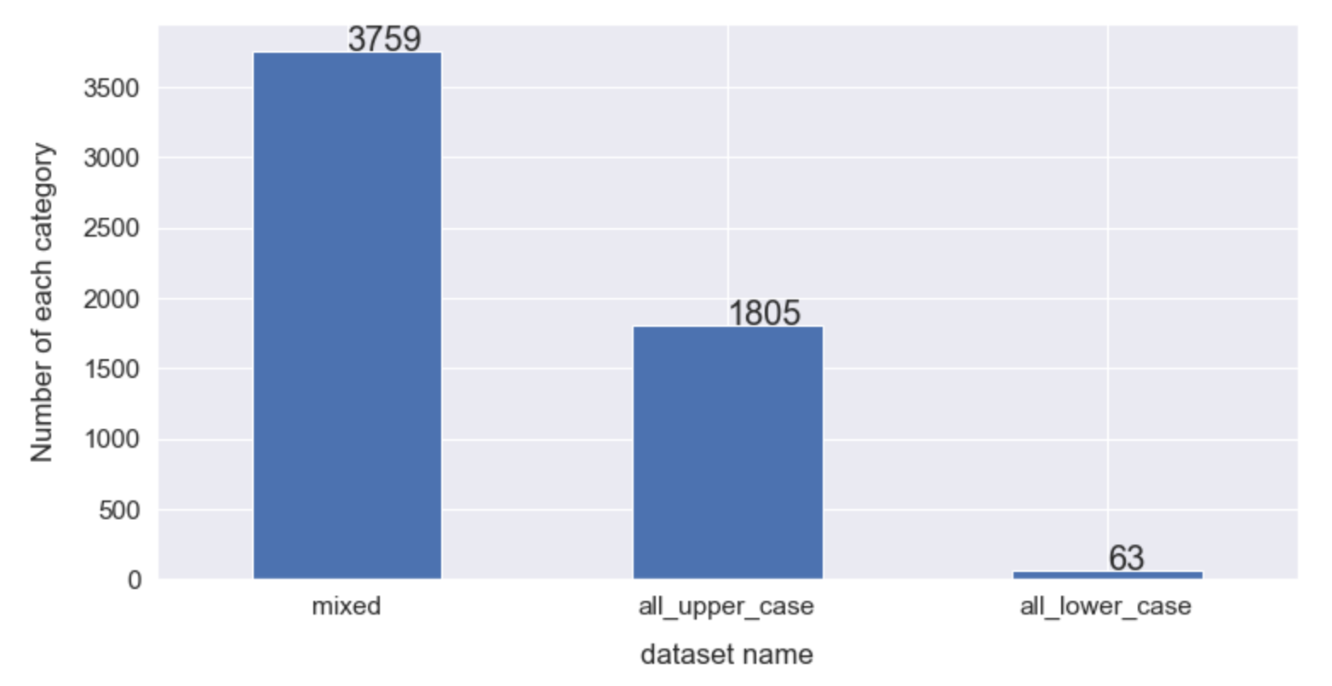
Background & Dataset
Generated from paperswithcode and S2ROC(~5700 dataset, ~20k papers form CVPR, ArXiv, ICCV, ACL, AAAI, etc.)
Our “Dataset” contains ~22k sentences with BIO tagging.
Dataset Names used in papers are usually acronyms, containing numbers and punctuation(like “-”)
Dataset name feature – letter type
All uppercase letters: 1805 ex: MNIST, JFT-300M, GLUE
All lowercase letters: 63 ex: freefield1010, word2word, 20000 utterances
mixed : 3759 ex: CelebA, ImageNet, Penn Treebank
Dataset name feature – # of words
one word: 4022 ex: MINIST, IMDB-Clean
Multi words: 1605 ex:WSJ Dow Jones Stock Data

Slide 5
Background & Dataset
Dataset Split
# of examples for training, validation and test: 210,185
Train = 146,580 (69.74%)
Valid=21,217 (10.09%)
Test=42,388 (20.17%)
Zero-shot set: 7,608 (3.62%)
Sentences with datasets that do not occur in the Train, Valid or Test set

Slide 6
Explore Questions & Result
Explore Question 1: Which NER model is best suited for the dataset name recognition task in AI-related papers?
CRF
BiLSTM(word2vec embedding: GloVe and google word2vec)
BERT and Sci-BERT
Explore Question 2: How does the amount of training data impact the models’ performance?
Look at the major cost factor: the size of the training set.
Context-aware: Do these models the structure of a dataset mention in papers?
Zero-shot test set: the test sentences with dataset are not occur in the train or test set.
Vary amounts of training sentences, test in zero-shot test set.

Slide 7
EQ1: Test different models
CRF: Conditional Random Fields is a probabilistic model for labeling sequential data. The SOTA model of NER around the year 2007. Widely used in information extraction like GROBID.
We used the sklearn_crfsuite form the scikit-learn library
BiLSTM
Recurrent Neural Network
Bi-directional Long Short Term Memory
Embedding
Word2vec embedding
Predictive based
GloVe embedding
Count-based
Co-occurrence probabilities matrix
All the BiLSTM methods are keras based. No parameter optimization was performed. The used parameters were taken from the “Depends on the definition NER series”[1].
[1] https://www.depends-on-the-definition.com/guide-sequence-tagging-neural-networks-python/

Slide 8


EQ1: Test different models
BERT and SciBERT
Based on transformer network, which is praised for its context-aware word representations improving the prediction ability. BERT has revolutionized classical NLP.
SciBERT is extended from BERT: unlike the BERT model, which is trained on general texts, SciBERT is trained on 1.14M scientific papers from Semantic Scholar, consisting of 18% computer science papers.
We use a scikit-learn wrapper to finetune Google's BERT model for text and token sequence tasks based on the huggingface pytorch port.

Slide 9
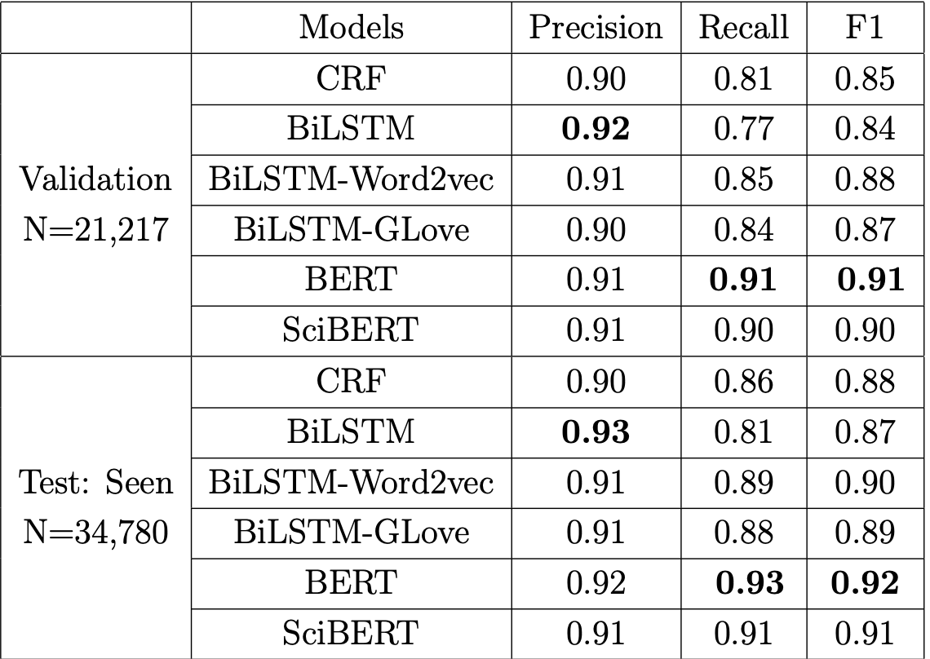
EQ1: Overall Performances
BERTs have the best performances. No difference between them.

Slide 10
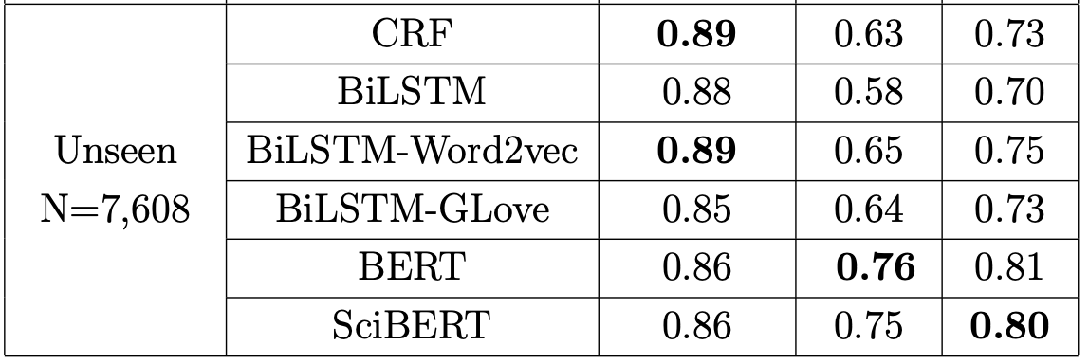
EQ2: Overall Performances on zero-shot set
When these models meet the dataset that they never see, Can they find them?
This experiment show the the context-aware of these models. Do them learn the structure of a dataset mention in papers?
BERT has the best overall performances on zero-shot set

Slide 11
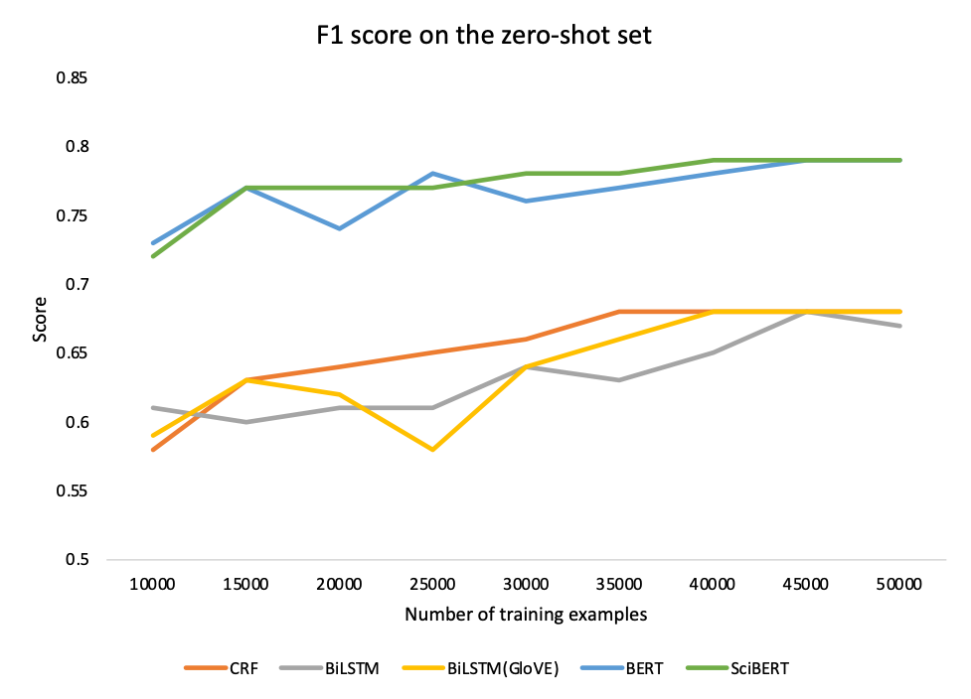
EQ2: Test on zero-shot set with different training examples
Clear difference between two BERTS and other models;
BiLSTM is most affected by the amount of training data.
BERTs and CRF and BiLSTM(GloVE ) show their robust behavior: only slight influence of the amount of training examples;

Slide 12
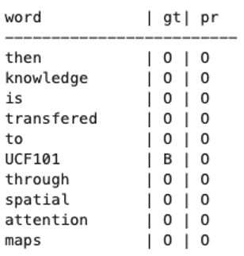
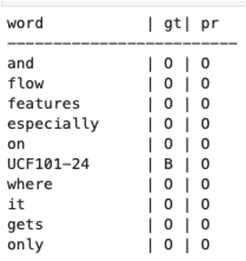
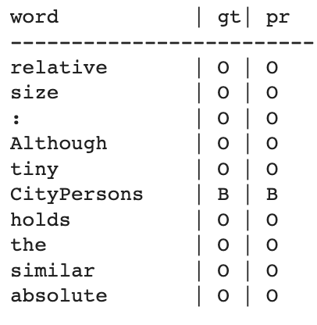
EQ: Test Examples: based on SciBERT
Fail in this case
Fail in this case

Slide 13
Conclusion & Discussion
Conclusion:
EQ1: BERTs have the best performances in dataset name extraction task;
EQ2: Zero-shot set test show that BERTs and BiLSTM(GloVE) learn the structure of a dataset mention well and do not overfit on the dataset names themselves. (context-aware)
Problems & Limitation
Training steps are very time-consuming and “expensive”
Train one BERT cost at least 3 hours. We trained near 15 times.
Other models also time-consuming: BiLSTM costs ~2.5 hours/time; CRF costs ~2 hours/time.
We cannot finish this project in our own computer; we use the Temple HPC.
Disambiguation
task name == Data set name: Visual Question Answering (VQA) dataset, VQA is also one task in AI.
Dataset name is common word： raindrop and raindrop dataset; BotNet dataset and botnet
Abbreviation
Visual Question Answering and VQA;
Dataset version
DAVIS, DAVIS 2016, DAVIS 2017
Places, Places365, Places205, Places2?, Places365-Standard
Future work:
Exploring more about the embedding influence of the BiLSTM…
Doing more experiments on zero-shot set and test set and compare their performance.

Slide 14
Reference
Lu, Meiyu, et al. "A dataset search engine for the research document corpus." 2012 IEEE 28th International Conference on Data Engineering. IEEE, 2012.
Färber, Michael, Alexander Albers, and Felix Schüber. "Identifying Used Methods and Datasets in Scientific Publications." SDU@ AAAI (2021).
Kolyada, Nikolay, Martin Potthast, and Benno Stein. "Beyond Metadata: What Paper Authors Say About Corpora They Use." Findings of the Association for Computational Linguistics: ACL-IJCNLP 2021 (2021): 5085-5090.
Prasad, Animesh, Chenglei Si, and Min-Yen Kan. "Dataset mention extraction and classification." Proceedings of the Workshop on Extracting Structured Knowledge from Scientific Publications. 2019.
Lafia, Sara, et al. "Detecting Informal Data References in Academic Literature." (2021).
Ikeda, Daisuke, Kota Nagamizo, and Yuta Taniguchi. "Automatic Identification of Dataset Names in Scholarly Articles of Various Disciplines." International Journal of Institutional Research and Management 4.1 (2020): 17-30.
Arora, Jatin, et al. "Extracting entities of interest from comparative product reviews." Proceedings of the 2017 ACM on Conference on Information and Knowledge Management. 2017.
Li, Jing, et al. "A survey on deep learning for named entity recognition." IEEE Transactions on Knowledge and Data Engineering 34.1 (2020): 50-70.
Ghavimi, Behnam, et al. "A semi-automatic approach for detecting dataset references in social science texts." Information Services & Use 36.3-4 (2016): 171-187.

Slide 15

Thanks for your listening!!!

