Slide 1
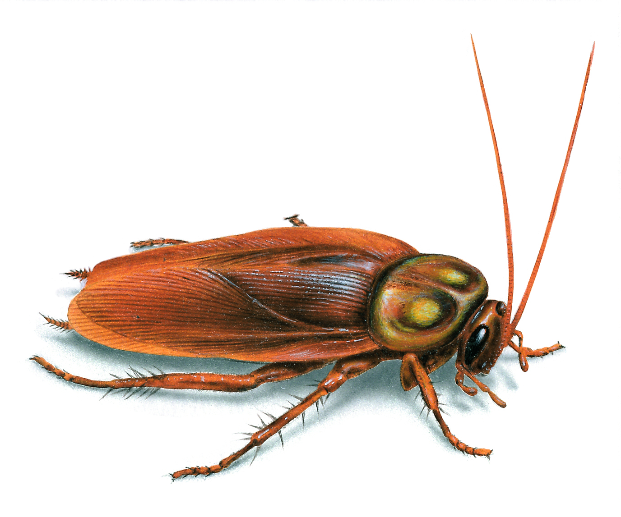

Slide 2
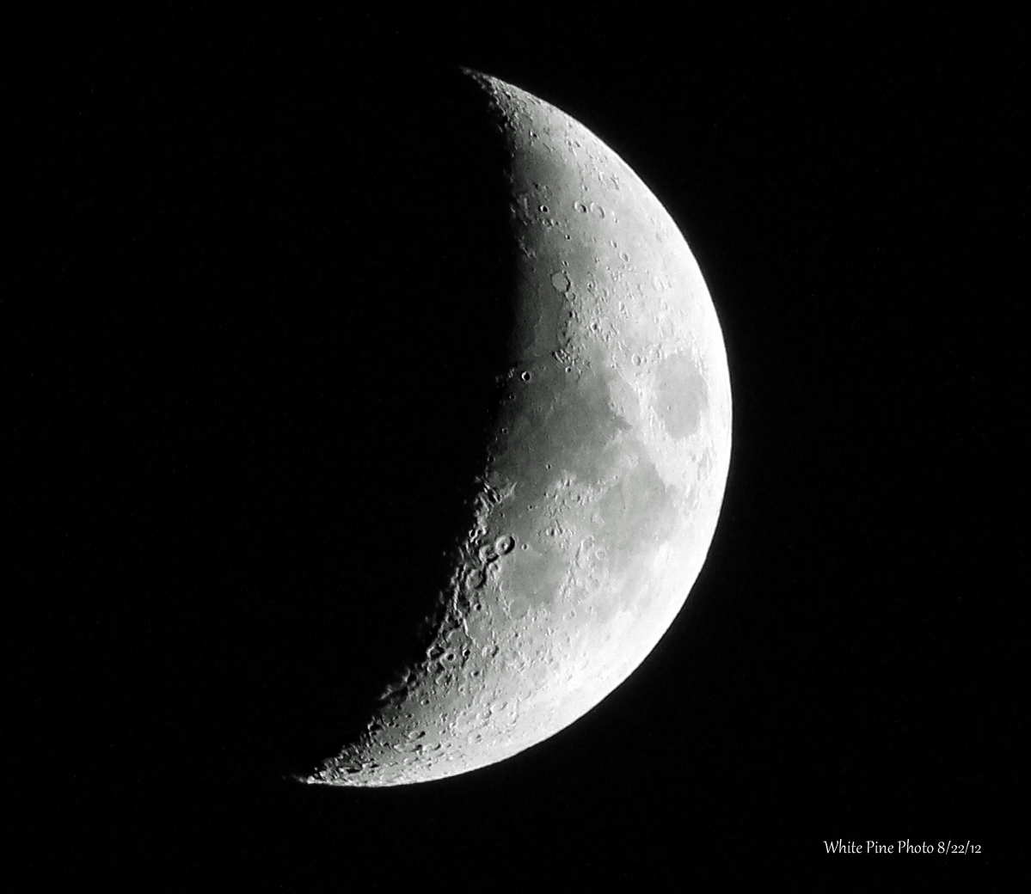
iEat

Slide 3
iEat 6
iEat 6 Plus
Eat more than more

Slide 4
￥99,999

Slide 5
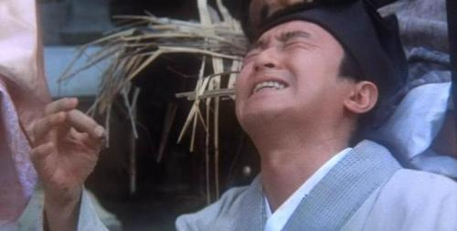
唐伯虎点秋香之哭小强

Slide 6


444-444-4444
cheatu.taobao.com

