Slide 1
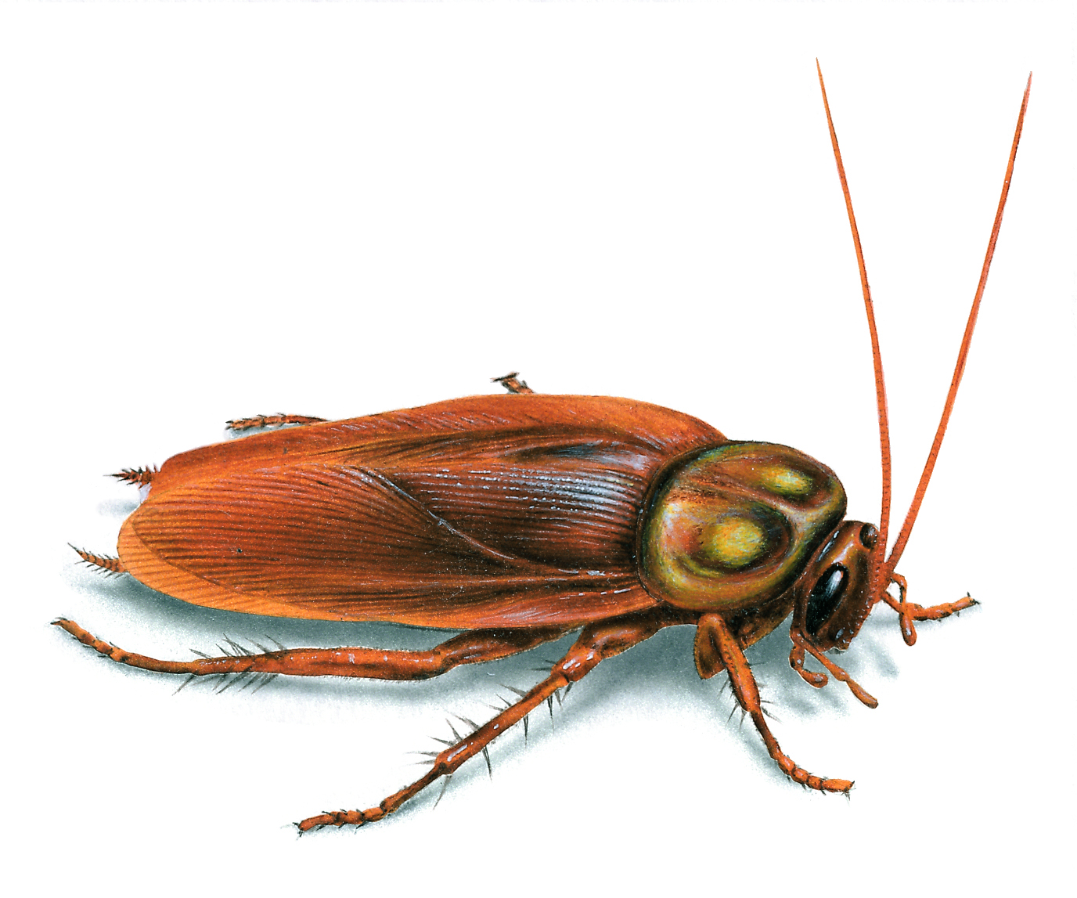
Cockroach

Slide 2
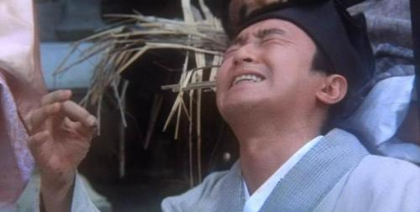
唐伯虎点秋香之哭小强

Slide 3
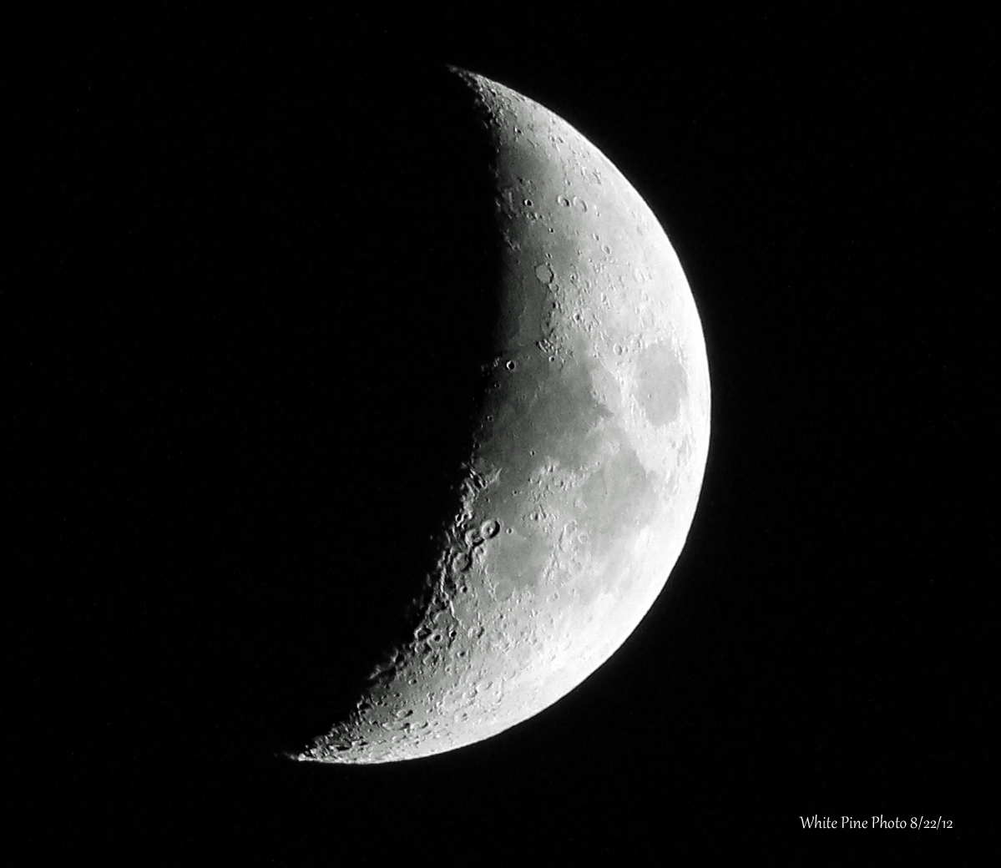
iEat

Slide 4
iEat 6
iEat 6 Plus
Eat more than more

Slide 5

Cockroach King
George.Edward.William VI

Slide 6
￥99,999

Slide 7


444-444-4444
cheatu.taobao.com

