Slide 1
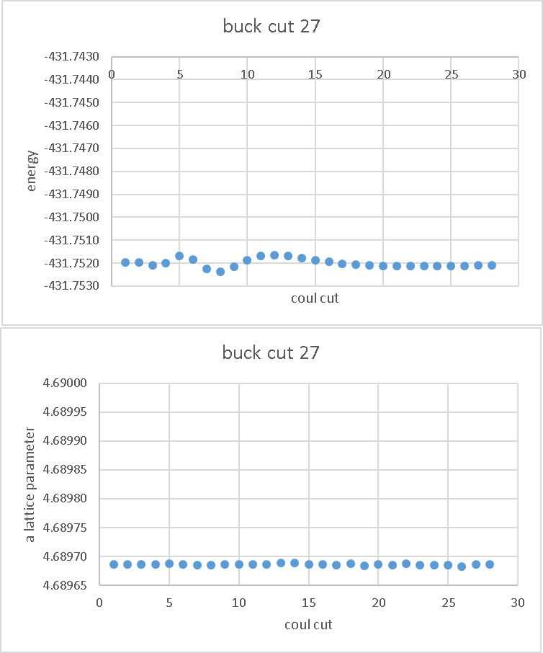

Slide 2
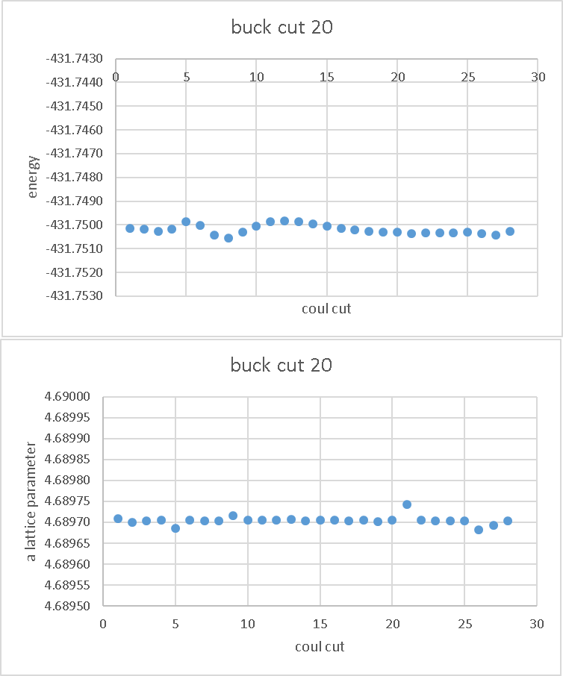

Slide 3
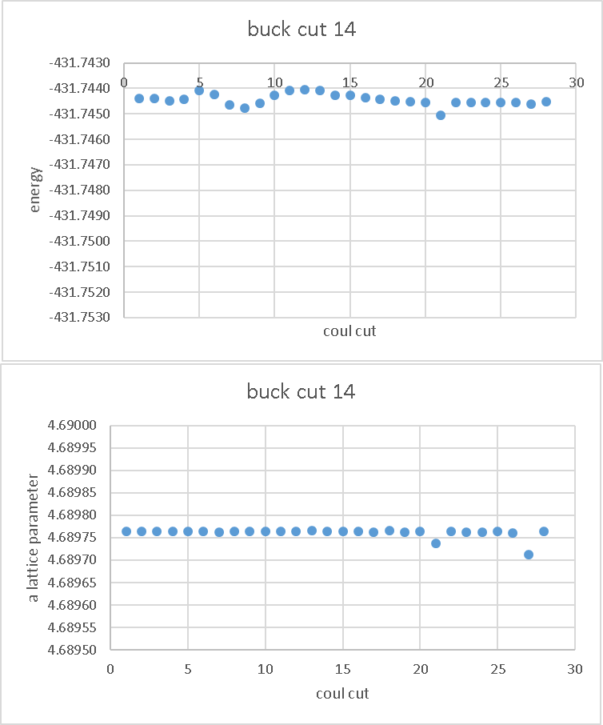

Slide 4
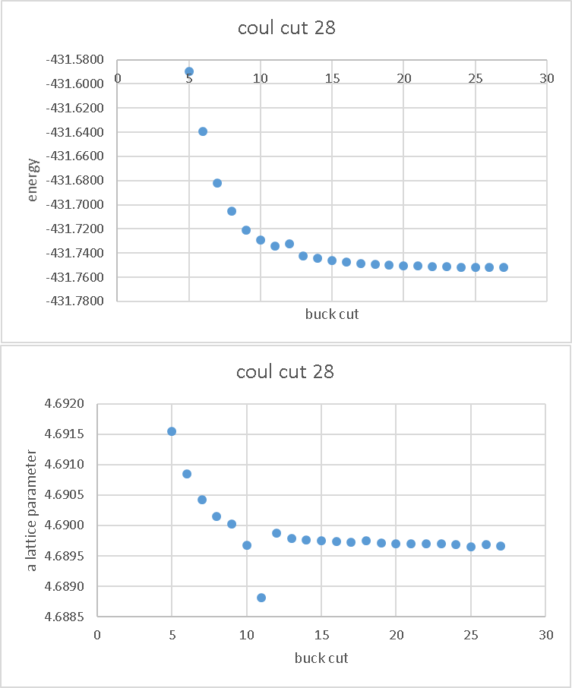

Slide 5
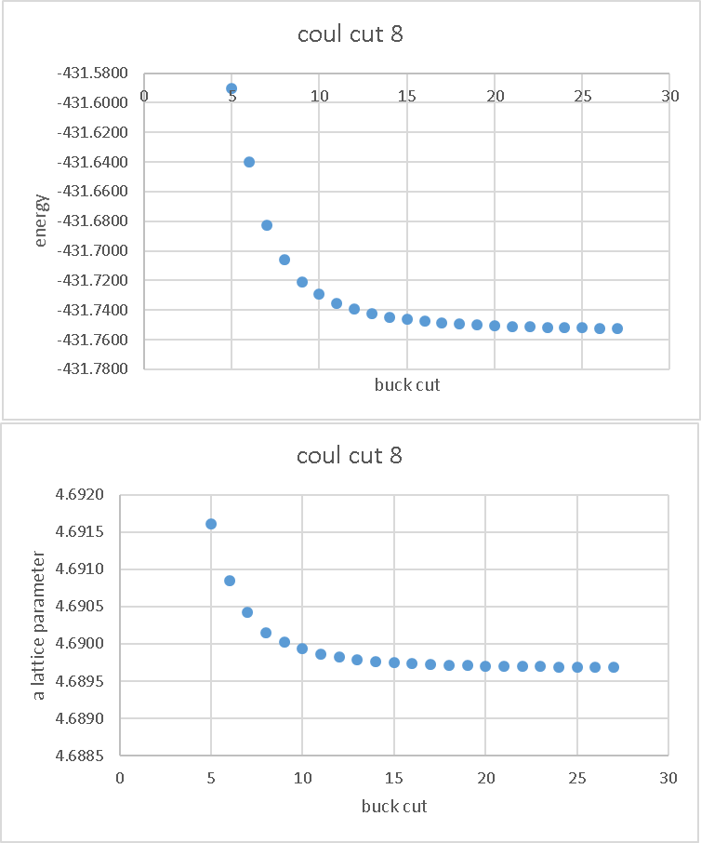

Slide 6
Cutoffs make little difference
My choices influenced by literature
Kept small to minimise computation cost
Variations on picometer scale

Slide 7
