Slide 1
EE16B Prelab Instructions (Have open when students enter)
Form a 2-student team (same as last week!)
Find a station to seat (16B stations are 1 - 22)
Download the lab material (course website)
Download the presentation file http://bit.ly/1SDY7oe
Open question&checkoff queue http://bit.ly/1PToyYj
Open the ipynb file and read the instruction
Lab introduction starts at {Hour}:12!!
VERY IMPORTANT: Each team has to have at least 1 MSP from 16A
If not, email gerke@berkeley.edu with subject "Need MSP"

Slide 2
EE16B Lab 2
Session XXX
2016. 2. XX
<TA NAME>

Slide 3
Lab Policies Reminder
NO FOOD OR DRINK IN THE LAB!!
Respect the lab equipment
Clean up your work station at the end of lab
Respect your GSI and the Lab Assistants
Be patient with checkoffs; there are 20 groups and two GSI
Clean up starts 5 minute before lab ends
125 Cory is completely booked – other classes need the space
Remember, participation counts toward your grade!
Ask questions
Help your neighbor

Slide 4
Unofficial Suggestions
20-minute rule : BEFORE spending more than 20 minutes on a single problem and making no progress, ask questions
No show? : If you can’t attend a session, please let Alyssa know before the fact
Even after the fact, let us know ASAP
Participation : Please help us & your friends if you finish early
Not showing your answers ☺

Slide 5
Let’s start!!
For question & checkoffs <GOOGLEDOC URL>

Slide 6
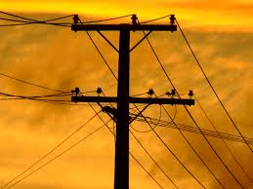
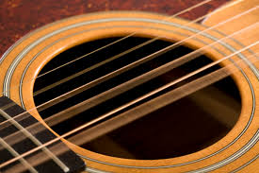
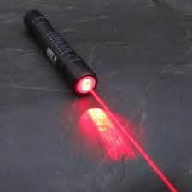
Why frequency domain?
60 Hz
~100 Hz – 1 KHz
~460 THz (red)
Across all disciplines, you can describe repetitive phenomena more concisely in frequency domain
and that’s what we’ll do in this lab today with BRAINS
(brains are repetitive)

Slide 7
Task 1
Remember your terms:
Fourier Transform:
abstract conversion of a signal into frequency domain
Discrete Fourier Transform (DFT):
A Fourier transform when your signal is represented by a list of measurements evenly spaced in time
Fast Fourier Transform (FFT):
Fast, awesome, history-changing method to do a DFT
Goal here:
Get comfortable with the result of a DFT
Carefully label it in frequency domain

Slide 8
Task 2 & 3
Given real brain signals vs. time that looks like nonesense, switch to frequency domain to look for insight
Task 3: you’ll need to make a judgement call and defend it to your TA

