Slide 1
Github - Setting
EE209A
Miryeong Kwon

Slide 2

Step1: Sing up Github
Enter https://github.com/
Click the Sign up button

Slide 3
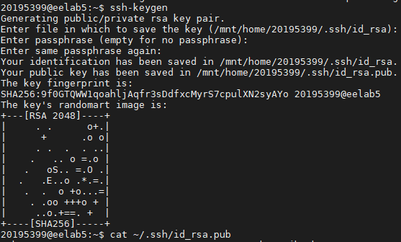
Step2: Generate SSH Key
Access the lab machine or your local machine and generate the SSH key with ssh-keygen command.
Then just keep hitting the “ENTER” button on keyboard.
Then print the generated key with command cat ~/.ssh/id_rsa.pub

Slide 4
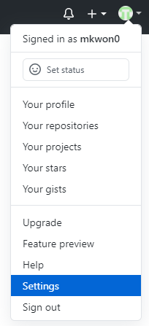
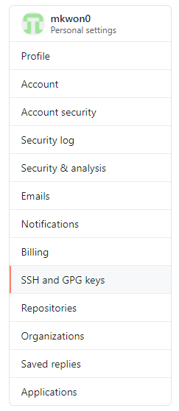
Step3: Register SSH Key
We have to establish the connection between our machine and Github account!

Slide 5
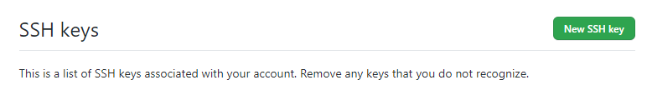
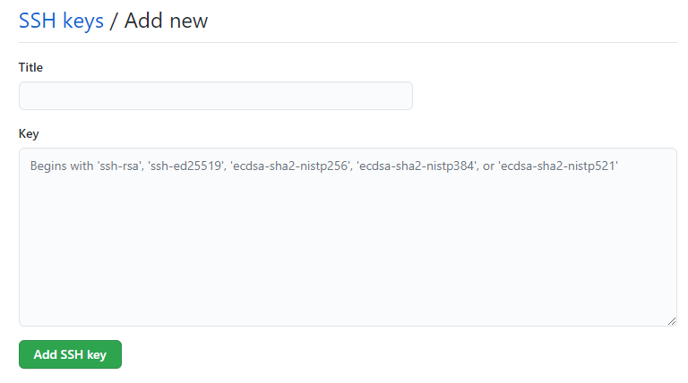
Step3: Register SSH Key
We have to establish the connection between our machine and Github account!
❶ name your ssh key (example: lab-machine)
❷ copy the generated ssh key
❸ DONE!

Slide 6
Step4: Initialize Git account
Set your name and email with below commands

Slide 7
Github – Example (Project3)
EE209A
Miryeong Kwon

Slide 8
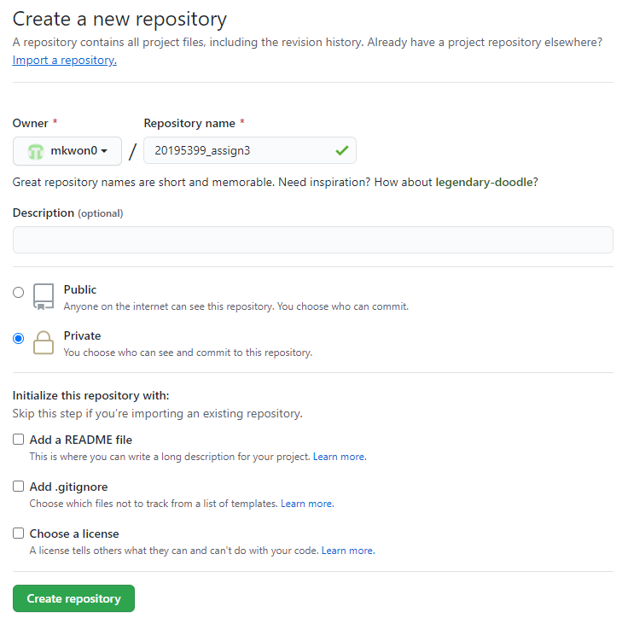
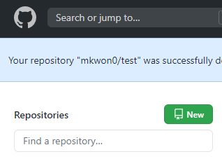

Step1: Generate Github Repository
❷ set your repository name
❸ you must choose PRIVATE!
If you make your repository as a public, then everyone can see what you did
VIOLATION
❶ click
❹ DONE

Slide 9
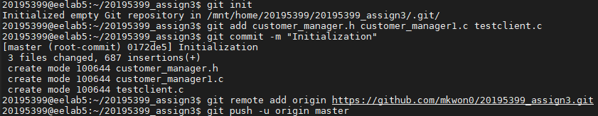
Step2: Setting the Project3
Download the source code from EE209 website
Initialize Git repository
You should change below URL as yours
git init : make directory as a Git repository
git add : add new files to the Git repository
git commit : type message with –m option
git remote add : link our project3 directory to Git repository
git push : “PUSH” our machine files to Github

Slide 10
Simple Explanation of Git command
❶ git init I’m now a candidate of Git repository
❹ git push Apply my files to the remote Github repository
Lab machine (local)
Github (remote)
❷ git add What I want to do is add new files or modified files to the remote server
❸ git commit And I’d like to tagging my “git add” behavior with some message with –m option

Slide 11
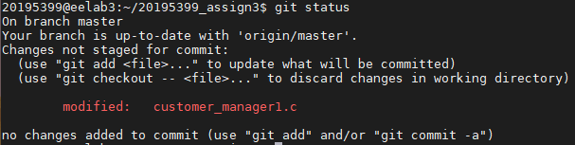
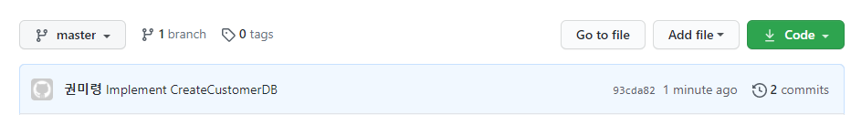
Step3: Implement Project3
check what I modify with git status command
git add & git commit & git push
If you check the Github, then our commit is applied!

Slide 12
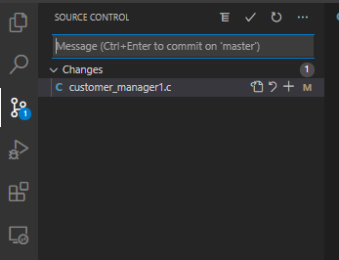

If you are using vscode
❹ git commit
❸ Type message
❶ Click
❷ Click (git add)
❺ Click (git push)

Slide 13
Github – When eelab5 does not work
EE209A
Miryeong Kwon

Slide 14
Step1: Fine Alive Lab Machine
By using the command “ping”, we can check whether the machine is alive or not
If machine is alive, then the output will be as below
If machine is down, then the output will be as below

Slide 15
Step2: Go to Alive Lab Machine
Access alive lab machine (e.g., eelab3), with ssh command
We have to generate ssh key of eelab3 machine (please refer Github initialization process again)

Slide 16
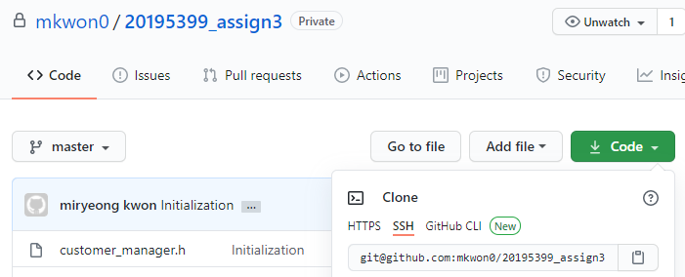
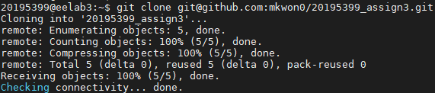
Step3: Clone your Git Repository
WOW, we can now implement project3 regardless of lab machine!
❶ click
❷ click, then it will be copied
❸ use git clone command

