Slide 1
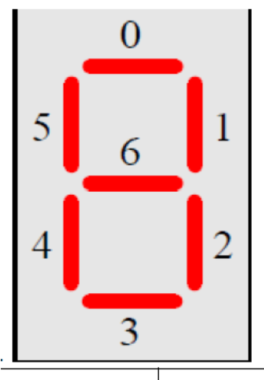
bcd2_display.vhd
(Part 1 design)
z
bcd_disp[6..0]
0
v[3..0]
disp_out[6..0]
1
hex_display.vhd
seg_led1
hex_disp[6..0]
s

