Slide 1
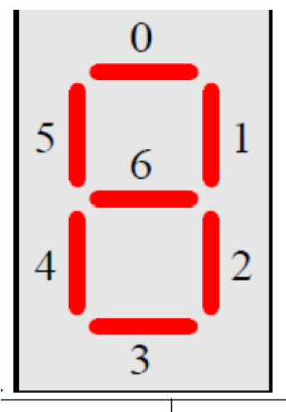
io_swt_a[3..0]
a_in[3..0]
top_4bit_adder.vhd
s_out[3..0]
Led[3..0]
co_out
Led[4]
io_swt_b[3..0]
b_in[3..0]
seg_ledmux_out[6..0]
io_swt_b[7]
ci_in
seg_led1_en
seg_led1

