Slide 1
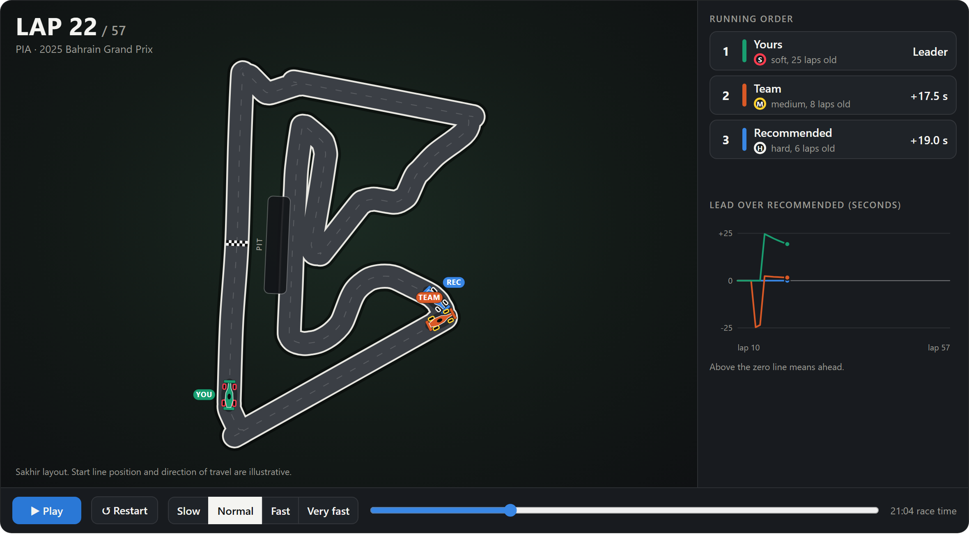

PREDICTIVE MODELLING · COURSE PROJECT
Can a model call the pit stop?
A statistical model of lap time, the optimisation built on it, and whether its error allows a decision
Notes:
The project has two mathematical parts. First a regression problem: predict how a driver's lap time changes through a race. Second an optimisation: choose the pit strategy that minimises predicted race time. The question is whether the error of the first part is small enough for the second part to mean anything.

Slide 2




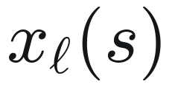
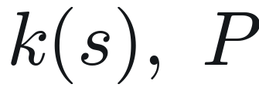

PROBLEM
Pit strategy as an optimisation over a learned function
OBJECTIVE
NOTATION
strategy: pit laps and tyre compounds
baseline pace of the driver, seconds
PREDICTED RACE TIME
learned model: % change in pace
inputs on lap ℓ under strategy s
number of stops, time lost per stop
feasible strategies (tyre rules)
Statistics: how accurate is the estimate?
Decision: is the minimiser stable?
1
2
Race time within 0.57% on an unseen season.
No. The recommended pit lap is 8 laps from the team's on average.
F1 Race Strategy Simulator
2
Notes:
A strategy s is a list of pit laps and tyre compounds. Its predicted race time is the sum of predicted lap times plus a fixed pit loss per stop. Each lap time is the driver's baseline pace B scaled by a learned function f-hat of the inputs on that lap, and those inputs depend on the strategy through tyre compound and tyre age. We want the strategy in the feasible set that minimises this. That raises two separate questions, at the bottom: how accurate is f-hat, and is the minimiser stable under its error. The answers differ.

Slide 3
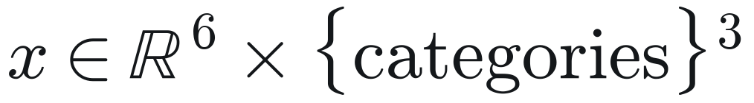


TARGET AND DATA
The response is a ratio, so the circuit and car scale cancel
RESPONSE
Tyre age a (laps)
Fuel burned since baseline / N
Race progress ℓ / N
Race length N
Baseline tyre age
Baseline track temperature
Compound c: soft, medium, hard
Baseline compound
Circuit
BASELINE
MODEL AND ITS INVERSE
Split | Seasons | Dry races | Laps n
Train | 2022, 2023 | 35 | 24,039
Validation | 2024 | 19 | 15,332
Test | 2025 | 21 | 15,844
B is fixed a few laps into the race, so predicting later laps from it uses no future information.
Split by season, not at random: errors within one race are correlated (ρ ≈ 0.33, slide 7), so a random split would leak.
F1 Race Strategy Simulator
3
Notes:
Absolute lap time is dominated by the circuit and the car. Dividing by the driver's own baseline removes that multiplicative scale and leaves the quantity a strategy depends on: the percentage change in pace. The baseline is the median of up to eight clean laps between laps 2 and 12, so it is known early and no future information enters. The model is additive on this scale: y equals f of x plus an error. All nine inputs are known in advance for any hypothetical strategy, which is what allows the model to be used as a simulator. Data are real race laps from FastF1, split by season.

Slide 4
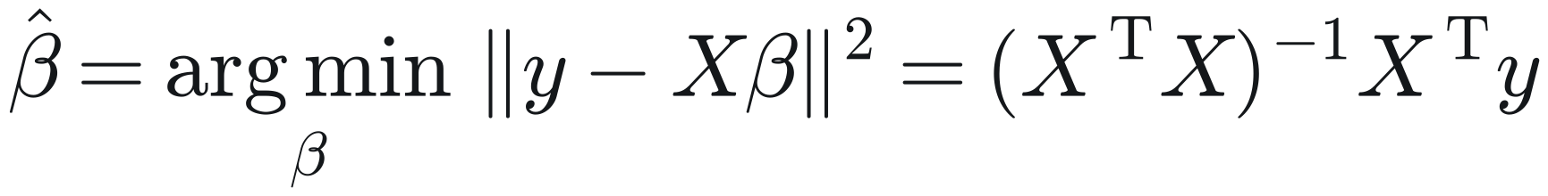
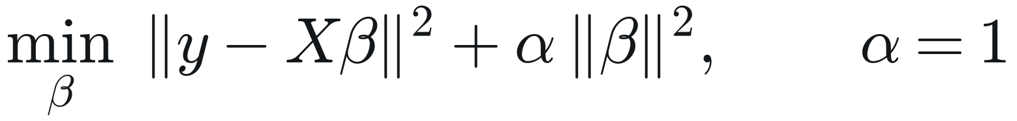
REFERENCE AND LINEAR MODELS
Constant pace is biased; a linear model fixes most of it
NO CHANGE (PREDICT ZERO)
Validation season 2024
Model | RMSE % | RMSE s | R²
Gradient boosting | 0.902 | 0.798 | 0.454
Boosting, monotone wear | 0.909 | 0.803 | 0.445
Linear regression | 0.930 | 0.822 | 0.419
Linear, wear per compound | 0.938 | 0.828 | 0.410
Mean change (ŷ = ȳ) | 1.222 | 1.084 | −0.002
No change (ŷ = 0) | 1.698 | 1.550 | −0.936
Fuel burn makes cars faster: mean change 1.18% down. That bias gives R² = −0.94.
LINEAR REGRESSION (LEAST SQUARES)
13 coefficients. RMSE: training 0.913%, validation 0.930%. Almost no gap: low variance.
WEAR CURVE PER COMPOUND (RIDGE)
RMSE in % of baseline pace and in seconds per lap. Models were fitted on 2022–2023 and compared here; 2025 was not touched.
Adds a² and a × compound terms. Validation 0.938%: the extra terms do not help.
F1 Race Strategy Simulator
4
Notes:
Three steps. The naive reference predicts zero change. Its mean squared error decomposes exactly into squared bias plus variance of the response: cars get faster as fuel burns, the mean change is minus 1.18 percent, and that bias is why its R squared is negative. Ordinary least squares with six standardised numeric inputs and indicator variables for compound gives 0.930 on validation with almost no gap to training error, so it is a low-variance model. Adding a quadratic in tyre age and compound interactions, with a ridge penalty, does not help.

Slide 5
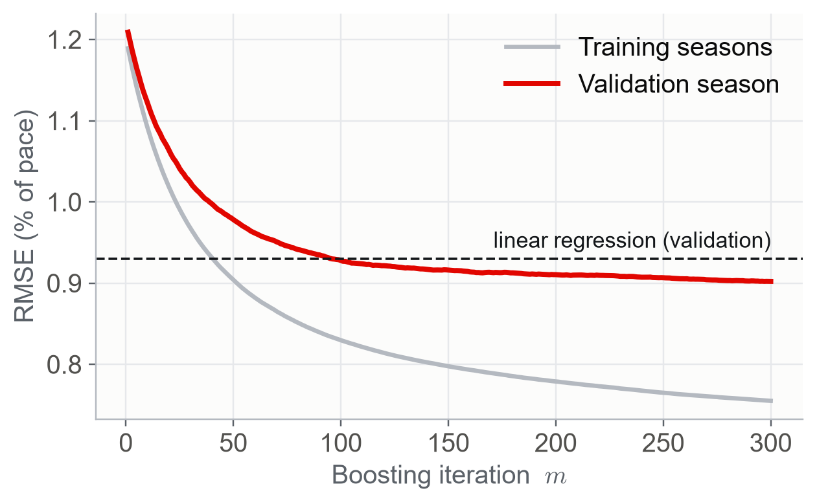


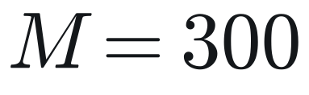
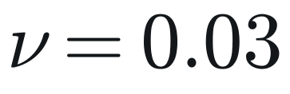
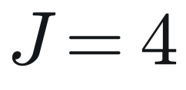
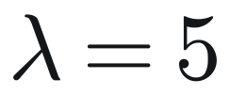
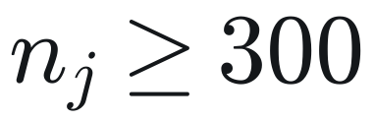
GRADIENT BOOSTING
Boosting: gradient descent in function space
ADDITIVE MODEL
PSEUDO-RESIDUALS FOR SQUARED LOSS
LEAF VALUE
SPLIT GAIN
Trees, learning rate, leaves per tree, L2 penalty, minimum leaf size. The chart is the error after each tree.
F1 Race Strategy Simulator
5
Notes:
Gradient boosting builds the predictor as a sum of small regression trees. Start from the mean. At each step compute the negative gradient of the loss at the current fit; for squared loss that is just the residual. Fit a tree with J leaves to those residuals and add a fraction nu of it. Each leaf value is a shrunken mean of the residuals in the leaf, with an L2 penalty lambda in the denominator, and splits are chosen to maximise the gain shown. The chart is the fit stage by stage: validation error falls below linear regression after roughly a hundred trees and then flattens. Ten percent of training laps were held out internally for early stopping; it never triggered, so all 300 trees are used.

Slide 6
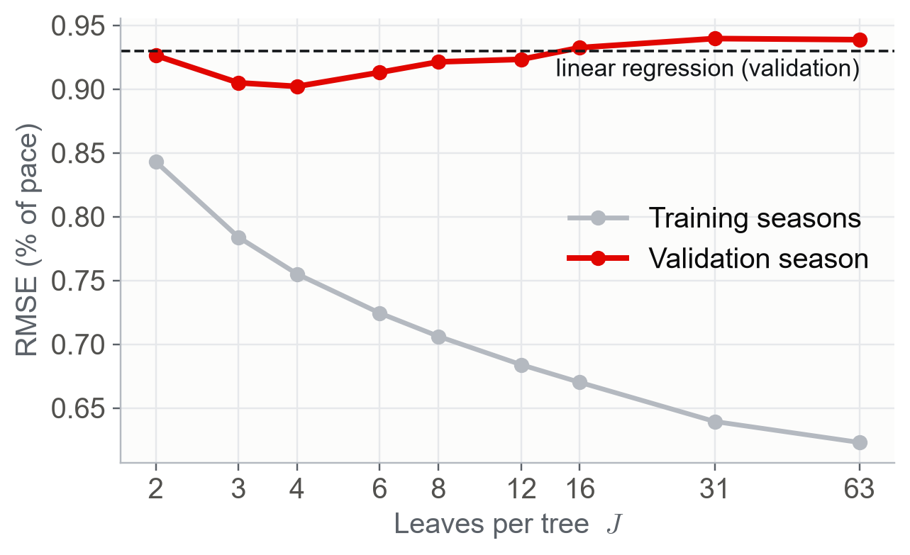
MODEL SELECTION
Tree size is chosen by the bias–variance trade-off
RMSE, % of baseline pace
Leaves J | Training | Validation | Gap
2 | 0.843 | 0.926 | 0.083
4 | 0.755 | 0.902 | 0.147
8 | 0.706 | 0.921 | 0.215
31 | 0.639 | 0.940 | 0.300
Linear | 0.913 | 0.930 | 0.017
Training error falls with J; validation error is lowest at J = 4. The growing gap is variance.
Test season 2025, used once
0.835 s
1.558 s
0.44
RMSE per lap
constant pace
R²
F1 Race Strategy Simulator
6
Notes:
Expected squared error splits into squared bias, variance and irreducible noise. Leaves per tree control the trade. As J grows, training error keeps falling, but validation error is lowest at J equals 4 and then rises: with 31 leaves the boosted model is worse than linear regression. The reason is on the next slide: the data have far fewer independent observations than laps. The selected model was refitted on 2022 to 2024 and applied once to 2025: 0.835 seconds per lap against 1.558 for constant pace, R squared 0.44.

Slide 7
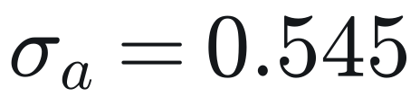

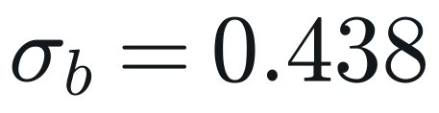
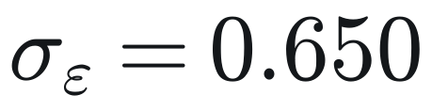
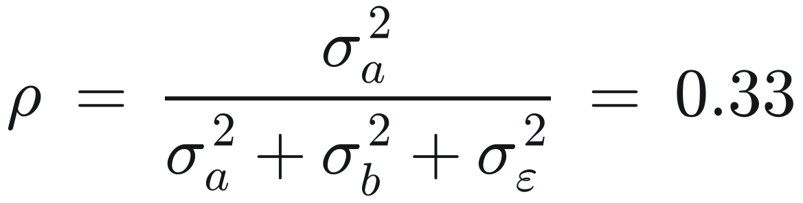
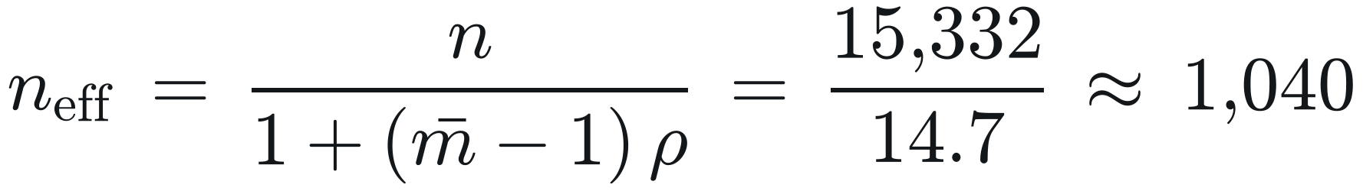
ERROR STRUCTURE
The errors are not independent: a three-level decomposition
VALIDATION RESIDUAL, BY LEVEL
Driver over a race
A misjudged baseline. The same for every strategy.
Stint within a race
The part that separates strategies.
Lap within a stint
d: driver-race, j: stint, ℓ: lap. Mutually independent, mean zero.
Averages out over a stint.
Share of error variance (in % of pace, squared)
Race 33%
Stint 21%
Lap 46%
INTRACLASS CORRELATION
EFFECTIVE SAMPLE SIZE
F1 Race Strategy Simulator
7
Notes:
This is the central modelling step. The validation residual of driver-race d, stint j, lap l is split into a term shared by the whole race, a term shared by the stint, and a lap term. About a third of the error variance is the race-level term, which is mostly a misjudged baseline. The intraclass correlation is therefore 0.33. With 43 laps per driver-race the design effect is about 15, so 15 thousand validation laps carry the information of roughly one thousand independent ones. That is why the split must be by season and why small trees win. The three terms also behave differently in a strategy comparison, which the next slides use. The components are standard deviations of group means; they sum to slightly more than the pooled mean squared error.

Slide 8
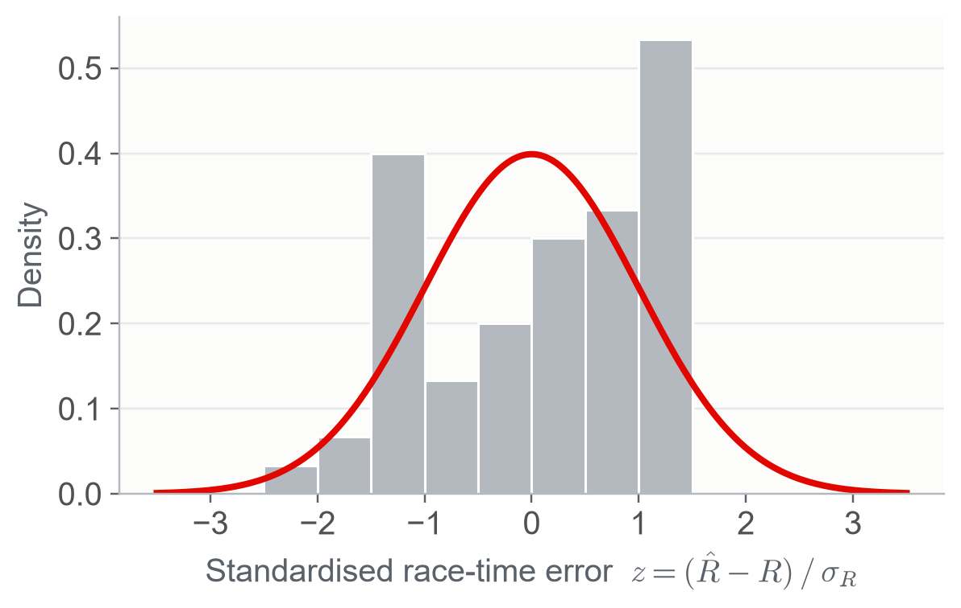


FROM LAPS TO RACES
Propagating the error predicts the race-time error
RACE-TIME ERROR FOR A GIVEN STRATEGY
ITS VARIANCE
Share of race-time variance (N = 50 laps, two stints of 25)
60 green-flag driver-races, 2025. Curve: standard normal. The spread matches; the shape is rough.
Race 74%
Stint 24%
28.0 s
27.9 s
1.03
Lap noise is 46% of the lap-level variance but 2% of race-time variance: it averages out. The race-level term adds up coherently and dominates.
predicted SD, from 2024 variances
observed RMSE, 2025
SD of z (1 if the model holds)
F1 Race Strategy Simulator
8
Notes:
Race time is baseline times the sum of one plus y over a hundred, so the race-time error is B over a hundred times the sum of lap errors. Under the three-level model its variance has three terms. The race-level term is perfectly correlated across laps and grows with N squared; lap noise grows only with N. So lap noise, 46 percent of lap variance, is 2 percent of race-time variance, and the race-level term is three quarters. Now the check: the variances were estimated on 2024. Applied to the 60 green-flag driver-races of 2025, the formula predicts a standard deviation of 28.0 seconds. The observed root mean squared error is 27.9. The standardised errors have standard deviation 1.03, where 1 is what the model implies. The histogram is rough rather than bell-shaped: sixty driver-races from a limited number of events, and drivers in the same race share conditions. So the size of the error is predicted out of sample; its exact shape is not established.

Slide 9
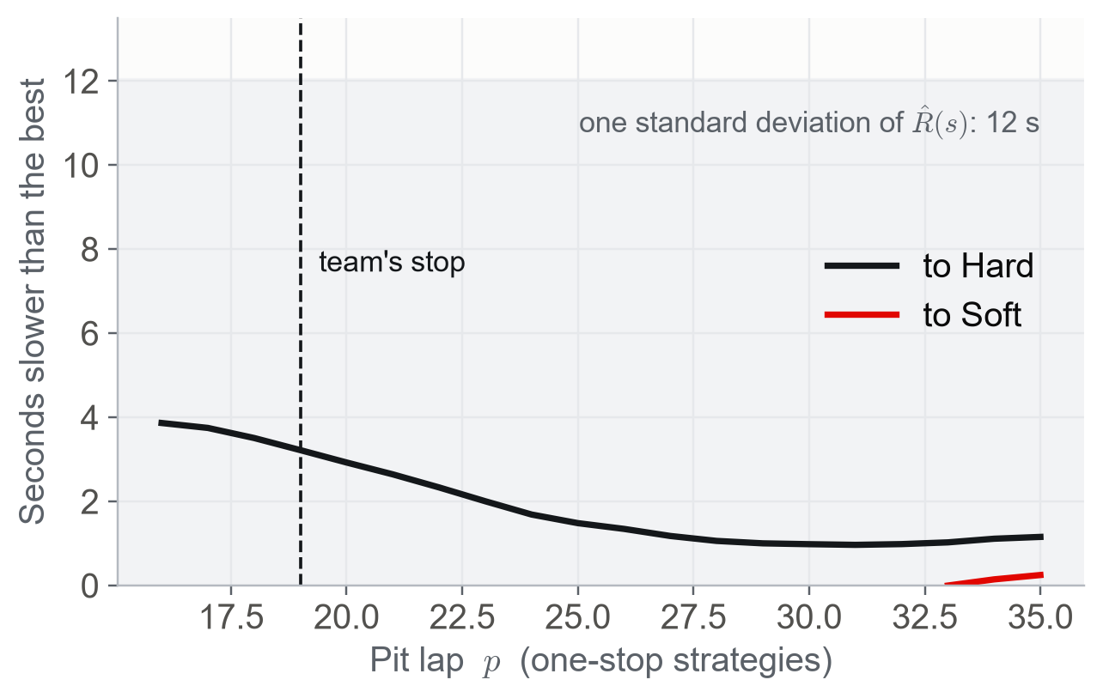
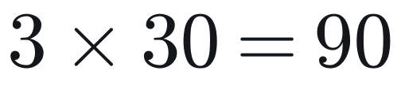
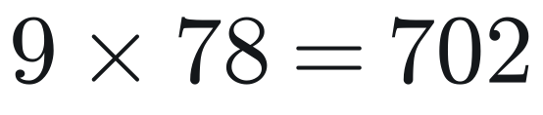
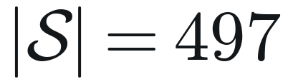
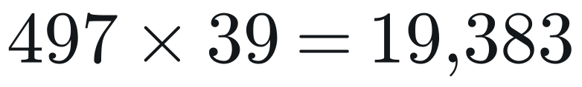
OPTIMISATION
A small constrained search, solved exactly by enumeration
FEASIBLE SET
n: stint length. c: compound. a: tyre age at the end of the stint.
Example: 2025 Saudi Arabian Grand Prix, winner
one-stop candidates, 3 compounds
two-stop candidates, pit-lap step 2
feasible: 23 one-stop, 474 two-stop
The objective is flat near its minimum: 15 strategies are within 2 s of the best. The grey band is one standard deviation of a predicted race time (12 s).
lap predictions, one model call
Enumeration is exact, so the only error in the recommendation is the error in the predicted race time.
F1 Race Strategy Simulator
9
Notes:
The feasible set has three constraints: every stint at least five laps, at least two different compounds as the rules require, and no stint beyond the 98th percentile of tyre age seen on that compound at that circuit, because trees cannot extrapolate. The set is small enough to enumerate. For the example, the 2025 Saudi Arabian Grand Prix winner, there are 90 one-stop and 702 two-stop candidates, 497 feasible, evaluated in one batched model call. So the minimiser is exact for the model: any error in the recommendation comes from R-hat, not from the search. The chart shows the problem. The objective is flat: 15 strategies are within two seconds of the best, while one standard deviation of the predicted time is 12 seconds.

Slide 10

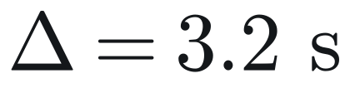
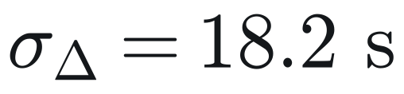
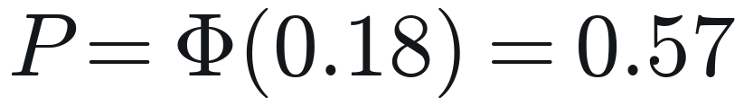
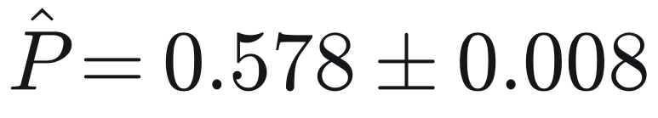
DECISION UNDER UNCERTAINTY
The minimiser is not stable: the signal is a fifth of the noise
Example: 2025 Saudi Arabian Grand Prix, winner
NOISE SEPARATING TWO STRATEGIES (RACE TERM CANCELS)
predicted gain
its standard deviation
PROBABILITY THE RECOMMENDATION IS REALLY FASTER
from the formula
Monte Carlo, M = 4000 races
All 182 driver-races of 2025: recommendation against the team's choice
65%
8.0 laps
26%
2.2 s
same number of stops
mean distance of first pit lap
within 3 laps
median predicted gain Δ
The standard deviation of Δ treats the two races as independent draws. Sharing the error on the laps both strategies have in common gives 16 s instead of 18 s.
F1 Race Strategy Simulator
10
Notes:
When two strategies for the same driver are compared, the race-level error a cancels, because it shifts both equally. What remains is stint and lap error. For the example the recommended strategy is predicted 3.2 seconds faster than the team's, but the standard deviation of that difference is 18 seconds, treating the two races as independent draws; if the laps the two strategies have in common share their error it is 16 seconds, which changes nothing. The probability that the recommendation is really faster is Phi of 0.18, which is 0.57. A Monte Carlo of four thousand simulated races gives 0.578 with standard error 0.008, so simulation and formula agree. Barely better than a coin. Across all 182 driver-races the same thing shows up as disagreement with the teams: same number of stops in 65 percent, but the first pit lap is 8 laps away on average.

Slide 11
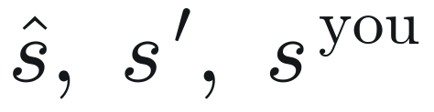
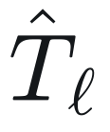
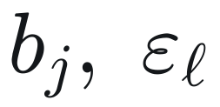
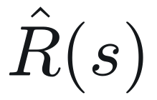
DEMO
The same mathematics as an animated race
Three strategies race
The minimiser, the team's, and your own
Every lap is a prediction
Baseline pace scaled by the model
Random races
One Monte Carlo draw of stint and lap error
Live running order
Cumulative predicted time, gap to the leader
Circuit outlines are real. Start-line position and direction of travel are illustrative.
F1 Race Strategy Simulator
11
Notes:
This is the app. The same driver runs three strategies at once on the real circuit outline: the minimiser s-hat, the team's real strategy, and one the user sets. Each lap is the model's prediction. With random variation switched on, each run draws one stint offset b per stint and one lap noise term per lap from the estimated distributions, so it is one Monte Carlo draw played out, and the finishing order changes between runs. Switch to the live app here.

Slide 12
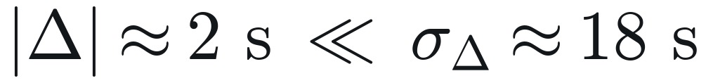
LIMITATIONS
Where the assumptions fail
1
Selection in tyre data
2
Omitted variables
Old tyres are seen only when they lasted. Stops come out later than the team's in 66% of cases, by 4.3 laps on average.
Traffic and track position are not in the data (R² = 0.44). Teams stop early to gain position; the model sees clean air only.
3
A regime that is not modelled
4
Resolution of the decision
Safety cars make a stop cheaper and decide many races. Race time could be checked on 60 of 182 driver-races only.
Differences between good strategies are far inside the error. The team's choice is a reference, not a proven optimum.
Next: a survival model for stint length, a safety-car scenario with its own pit loss, and a traffic term.
F1 Race Strategy Simulator
12
Notes:
Four failures, each stated as mathematics. First, selection: a lap at tyre age a is observed only if the stint lasted that long, and stints last when tyres hold up. So the observed mean at high age is below the true mean, f-hat is too optimistic about old tyres, and recommendations are later than the teams' in two thirds of cases, by 4.3 laps on average. Second, omitted variables: traffic and track position are not observed, which is why R squared is 0.44, and teams optimise for them. Third, safety cars change the pit loss and are not modelled; race time could only be checked on 60 of 182 driver-races. Fourth, resolution: the gains are far inside the error.

Slide 13

CONCLUSION
An accurate model is not yet a decision
1
Lap
Unseen season. Constant pace: 1.558 s.
2
Race
The error model holds out of sample.
3
Decision
The minimiser is not identified.
Validate a model at the level of the decision it will be used for.
Notes:
Three levels, three answers. At lap level the model halves the error of constant pace. At race level the variance model predicts the size of the error almost exactly on a new season. At decision level the predicted gain is a fifth of its standard deviation, so the argmin is not identified by the data. Accuracy has to be judged at the level of the decision. Questions.

