Slide 1
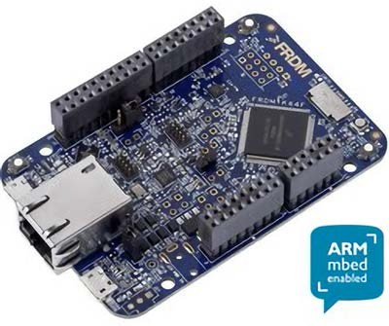
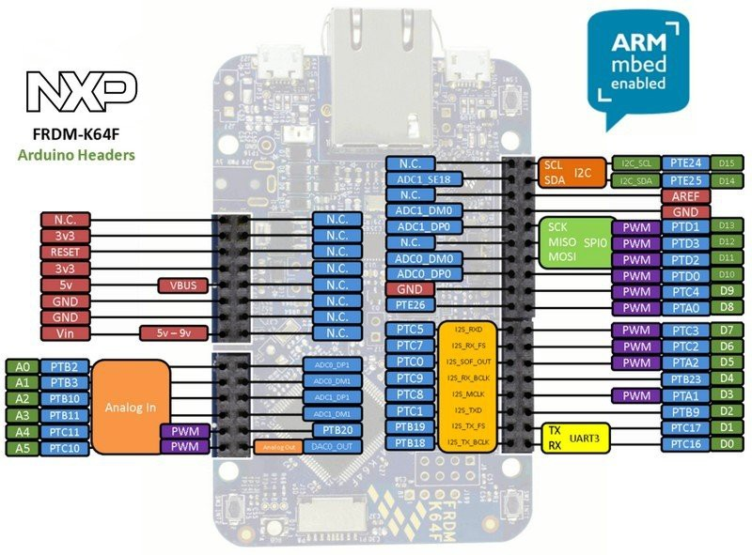
Chapter 12:
Internet Communication and Control
If you use or reference these slides or the associated textbook, please cite the original authors’ work as follows:
Toulson, R. & Wilmshurst, T. (2016). Fast and Effective Embedded Systems Design - Applying the ARM mbed (2nd edition), Newnes, Oxford, ISBN: 978-0-08-100880-5.
www.embedded-knowhow.co.uk

Slide 2
Introduction to Internet Communications
Computers and devices connect to the Internet through the Ethernet communications protocol, or through wireless (wi-fi) communications.
Public data, stored on servers as web pages, can be accessed by client devices that
are connected to the Internet.
It could also be an embedded system that accesses and utilises data stored on the server and responds to control messages sent by the server.
The Internet nowadays facilitates advanced interactive applications. The mbed compiler for example is accessed entirely through the Internet, which means that no additional software needs to be installed for a developer to work with the mbed.
The Internet nowadays allows for machines and devices to communicate with each other autonomously, i.e. with no (or limited) human interaction.
The concept of connecting literally billions of devices and sensors to the Internet is
referred to as the Internet of Things.

Slide 3
Introducing Ethernet
Ethernet is a serial protocol which is designed to facilitate network communications. Any device successfully connected to the Ethernet can potentially communicate with any other device connected to the network.
Networks are often described as one of two types:
Local area network (LAN) – usually for devices connected together in close proximity, perhaps in the same building and often without internet access.
Wide area network (WAN) – which describes a network of devices over a greater geographic area, usually connected by the internet.
Ethernet communications are defined by the IEEE 802.3 standard and supports data rates up to 100 Gigabits per second.
Ethernet uses differential send (Tx) and receive (Rx) signals, resulting in 4 wires labelled
RX+, RX-, TX+ and TX-.
Ethernet messages are communicated as serial data packets referred to as frames. Using frames allows a single message to hold a number of data values including a value defining the length of the data packet as well as the data itself.

Slide 4
Introducing Ethernet
The Ethernet frame defines its own size, which means that only the necessary amount of data is communicated with no wasted or empty data bytes.
Ethernet communications need to pass a large quantity of data at high rates, so data
efficiency is a very important aspect.
The use of frames allows an efficient method. Each frame also includes a unique source and destination MAC address.
The frame is wrapped within a set of preamble and start of frame (SOF) bytes and a frame check sequence (FCS) which enables devices on the network to understand the function of each communicated data element. The standard 802.3 Ethernet frame is constructed as shown below.
Preamble | Start of frame delimiter | Destination MAC address | Source MAC Address | Length | Data | Frame Check Sequence | Interframe gap
7 bytes of 10101010 | 1 byte of 10101011 | 6 bytes | 6 bytes | 2 bytes | 46 – 1500 bytes | 4 bytes

Slide 5
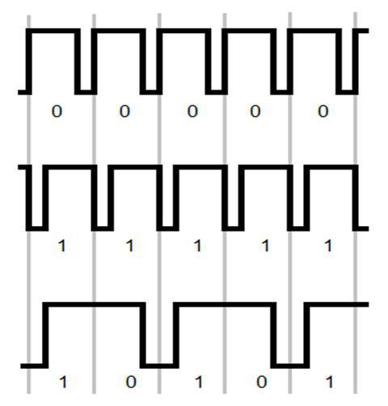
Introducing Ethernet
The Ethernet data takes the form of the Manchester encoding method, which relies on the direction of the edge transition within the timing window.
If the edge transition within the timing frame is high-to-low, the coded bit is a 0
If the transition is low-to-high then the bit is a 1
The Manchester protocol is very simple to implement in integrated circuit hardware
As there is always a switch from 0 to 1 or 1 to 0 for every data value, the clock signal is effectively embedded within the data.
Even when a stream of zeros (or ones for that matter) is being transmitted, the digital signal still shows transitions between high and low states.

Slide 6
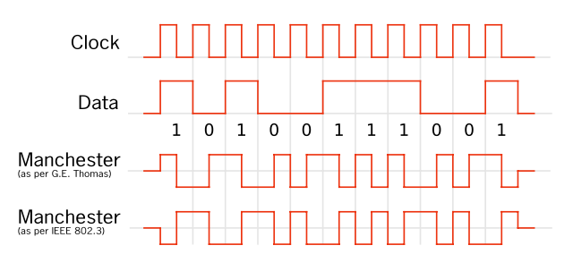
An Example of Manchester Encoding
https://en.wikipedia.org/wiki/Manchester_code

Slide 7
Implementing simple mbed Ethernet communications
Function | Usage
Ethernet | Create an Ethernet interface.
write | Writes into an outgoing Ethernet packet.
send | Send an outgoing Ethernet packet.
receive | Receives an arrived Ethernet packet.
read | Read from a received Ethernet packet.
address | Gives the Ethernet address of the mbed.
link | Returns the value 1 if an Ethernet link is present and 0 if no link is present.
set_link | Sets the speed and duplex parameters of an Ethernet link.

Slide 8
Program Example 12.1: Ethernet write
#include "mbed.h"
#include "EthernetInterface.h"
const int PORT = 7;
static const char* SERVER_IP = "192.168.1.101"; //IP of server board
static const char* CLIENT_IP = "192.168.1.102"; //IP of client board
static const char* MASK = "255.255.255.0"; //mask
static const char* GATEWAY = "192.168.1.1"; //gateway
Serial pc(USBTX, USBRX); //create PC interface
EthernetInterface eth; //create ethernet
UDPSocket sock; //creat Ethernet socket
Endpoint server; //create endpoint
DigitalOut red(LED_RED); //debug led
DigitalOut green(LED_GREEN); //debug led
int n; //size of received message
char in_buffer[1]; //create receive buffer
char counter[1] = {0}; //sample send buffer
void init_usb(void); //initializes pc.printf if required
void init_eth(void); //initializes Ethernet

Slide 9
Program Example 12.1: Ethernet write
void init_usb(void)
{
pc.baud(9600); //baud
}
void init_eth(void)
{
eth.init(CLIENT_IP, MASK, GATEWAY); //set up IP
eth.connect(); //connect ethernet
pc.printf(“\nCLIENT - Client IP Address is %s\r\n”, eth.getIPAddress()); //get client IP address
sock.init(); //initialize socket
server.set_address(SERVER_IP, PORT); //set address of server
}
void end_eth(void)
{
sock.close(); //close socket
eth.disconnect(); //close Ethernet
}

Slide 10
Program Example 12.1: Ethernet write
int main(void)
{
red = 0; //client
green = 1;
init_usb(); //initialize the PC interface
init_eth(); //initialize the Ethernet connection
while(true) //repeat forever
{
pc.printf("\nCLIENT - Sending '%i' to server %s\r\n", counter[0], SERVER_IP);
sock.sendTo(server, counter, sizeof(counter)); //send message
pc.printf("CLIENT - Waiting for UDP packet...\r\n");
n = sock.receiveFrom(server, in_buffer, sizeof(in_buffer));
in_buffer[n] = '\0'; //add \0 to end of message
pc.printf(“CLIENT - Received ‘%i’ from server %s\r\n”, in_buffer[0], SERVER_IP);
counter[0] = (counter[0] + 1)%11;//only count up to 10, then reset to 0
wait(1); //wait 1 second
}

Slide 11
Program Example 12.2: Ethernet read
#include "mbed.h"
#include "EthernetInterface.h"
const int PORT = 7; //arbitrary port
static const char* SERVER_IP = "192.168.1.101"; //IP of server board
static const char* MASK = "255.255.255.0"; //mask
static const char* GATEWAY = "192.168.1.1"; //gateway
Serial pc(USBTX, USBRX); //create PC interface
EthernetInterface eth; //create ethernet
UDPSocket server; //creat server
Endpoint client; //create endpoint
DigitalOut red(LED_RED); //debug led
DigitalOut green(LED_GREEN); //debug led
int n; //size of received message
char counter[1] = {0}; //sample receive/send buffer
void init_usb(void); //initializes pc.printf if required
void init_eth(void); //initializes Ethernet
void receive(void); //receives packets

Slide 12
Program Example 12.2: Ethernet read
void init_usb(void)
{
pc.baud(9600); //baud
} //end init_usb()
void init_eth(void)
{
eth.init(SERVER_IP, MASK, GATEWAY); //set up IP
eth.connect(); //connect ethernet
pc.printf("\nSERVER - Server IP Address is %s\r\n", eth.getIPAddress());
server.bind(PORT); //bind server
}
void receive(void)
{
pc.printf("\nSERVER - Waiting for UDP packet...\r\n"); //wait for packet
n = server.receiveFrom(client, counter, sizeof(counter));
counter[n] = '\0'; //add \0 to end of message
pc.printf("SERVER - Received '%i' from client %s\r\n", counter[0], client.get_address());
pc.printf("SERVER - Sending '%i' back to client %s\r\n", counter[0], client.get_address());
server.sendTo(client, counter, n); //send message
}

Slide 13
Ethernet communication between mbeds
Program Example 12.2: Ethernet read
int main(void)
{
red = 1;
green = 0; //server
init_usb(); //initialize the PC interface
init_eth(); //initialize the Ethernet connection
while (true) //repeat forever
{
receive(); //wait for message
}
}
Note that the Ethernet read program first defines a large data buffer to store incoming data. The program then continuously evaluates the size of any Ethernet data traffic.
If the data packet has a size greater than zero the display loop is entered. The size of the data package along with the data is then displayed to the host terminal.

Slide 14
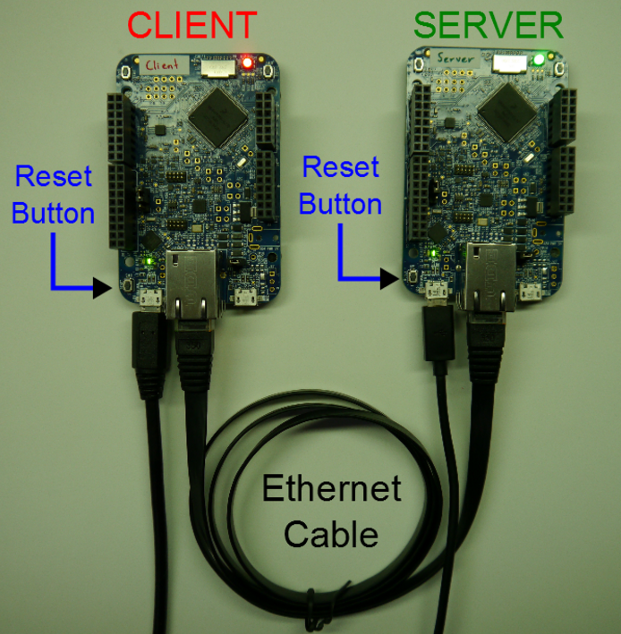
Ethernet communication between mbeds
To successfully communicate between the two mbeds, a crossed signal connection is required, as shown

Slide 15
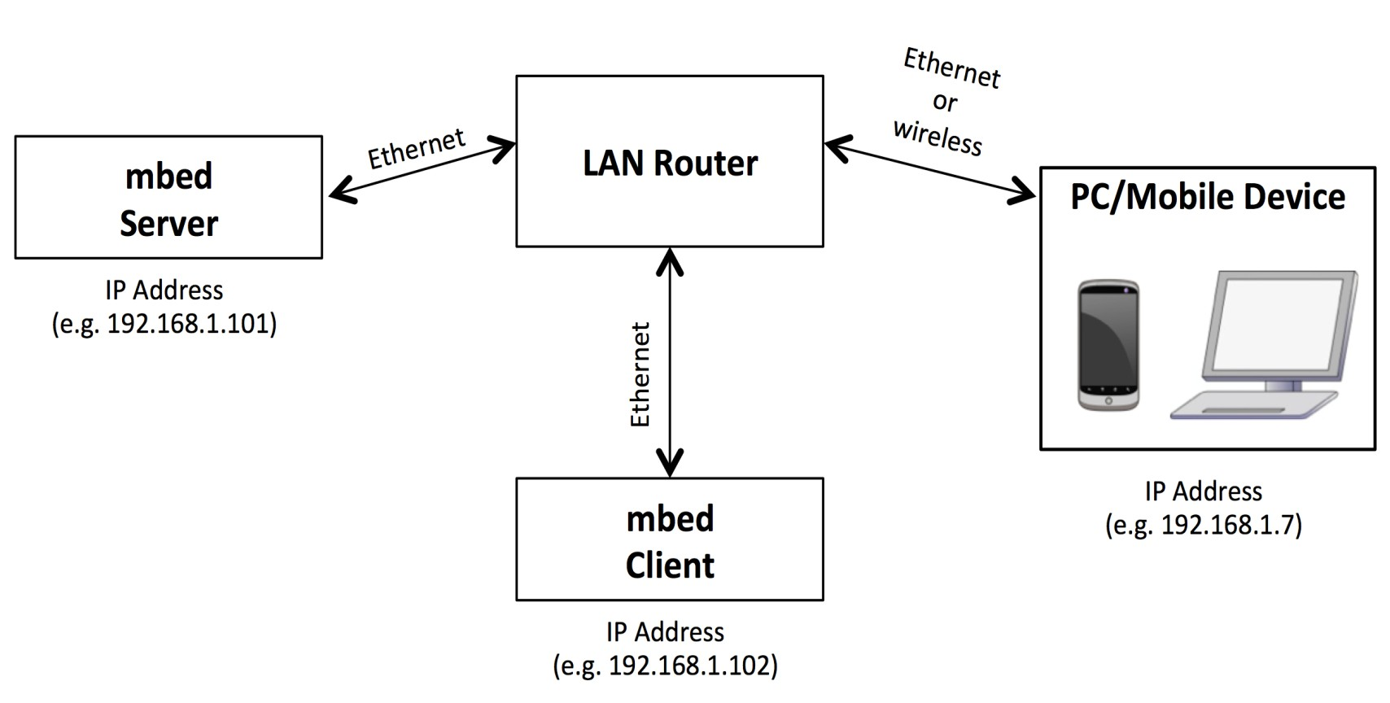
Local Area Network communications with the mbed
Within the LAN shown, it is possible for the PC or mobile device to remotely access files stored on the mbed server. Equally, it is possible for the mbed client to access files and data stored on the mbed server, as well as for the mbed server to control the mbed client through remote control protocols.
The PC client can also request the mbed server to send control messages to the mbed client, hence allowing the PC client to indirectly control the mbed client. This communication can all be implemented as long as the local 32-bit IP address - sometimes referred to as the private IP address
- of each device is known.

Slide 16
Initiating a simple LAN connection with the mbed
A standard Ethernet socket (RJ45) is required to connect the mbed Ethernet port to a network hub or router. If using the mbed application board, it is simple to use the built in Ethernet socket.
Utilising the mbed EthernetInterface and mbed-rtos libraries, Program Example 12.3 creates an Ethernet communications interface and requests the router to automatically assign an IP address to the mbed. The program then prints the assigned IP address to a host terminal.
#include "mbed.h"
#include "EthernetInterface.h"
EthernetInterface eth; // create ethernetinterface
int main() {
eth.init(); // initialise interface with DCHP
eth.connect(); // connect and open communications
printf("IP Address is %s\r\n", eth.getIPAddress() ); // display IP address
eth.disconnect(); // disconnect
}

Slide 17
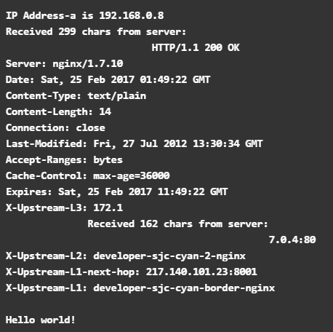
Using the mbed with Wide Area Networks
It is possible to use the mbed as a HTTP client in order to access data from the Internet. To do this we rely on another network interface library called EthernetInterface.
Program Example 12.4 enables the mbed to connect as an HTTP client to a remote online server and access and display a text string from within a text file held on the server. The test file we use in this example is stored online at: https://developer.mbed.org/media/uploads/mbed_official/hello.txt

Slide 18
Program Example 12.4: mbed HTTP Client Test
#include "mbed.h"
#include "EthernetInterface.h"
int main() {
EthernetInterface eth;
eth.init(); //Use DHCP
eth.connect();
printf("IP Address-a is %s\r\n", eth.getIPAddress());
TCPSocketConnection sock;
sock.connect("mbed.org", 80);
char http_cmd[] = "GET /media/uploads/mbed_official/hello.txt HTTP/1.0\n\n";
sock.send_all(http_cmd, sizeof(http_cmd)-1);
char buffer[300];
int ret;
while (true) {
ret = sock.receive(buffer, sizeof(buffer)-1);
if (ret <= 0)
break;
buffer[ret] = '\0';
printf("Received %d chars from server:\n%s\n", ret, buffer);
}
sock.close();
eth.disconnect();
}

Slide 19
The Internet of Things
It is therefore possible to make data that the mbed gathers accessible to the outside world, as well as enabling mbed systems to be controlled remotely through the Internet.
The concepts discused are the fundamental building blocks for a global Internet of Things, which is a phrase that has evolved to refer to a worldwide network of everyday objects and sensors that are connected to the Internet, allowing remote access to information that can be used to control and enhance everyday activities, whilst interacting with the mobile Internet devices which people are now carrying regularly, for example smartphones.
IoT data includes billions of sensors and databases that are made available for monitoring through the Internet, from travel and transport data, to environmental data, sports results and status data of mechanical devices.
The IoT concept includes reference to the term cloud computing, which utilises servers and data memory storage locations that are only accessed through the Internet. Companies such as Google, Microsoft, Apple and Dropbox all provide their own cloud-based services and one day it is anticipated that most of our personal and professional data (and programs) will be stored in the cloud.
More recently the IoT concept has expanded to include everyday objects attached to the Internet. Examples include the washing machine that can alert the repair man to an impending fault, the vending machine that can tell the Head Office it is empty, the manufacturer who can download a new version of firmware to an installed burglar alarm, or the home owner who can switch on the oven from the office or check that the garage door is closed.

Slide 20
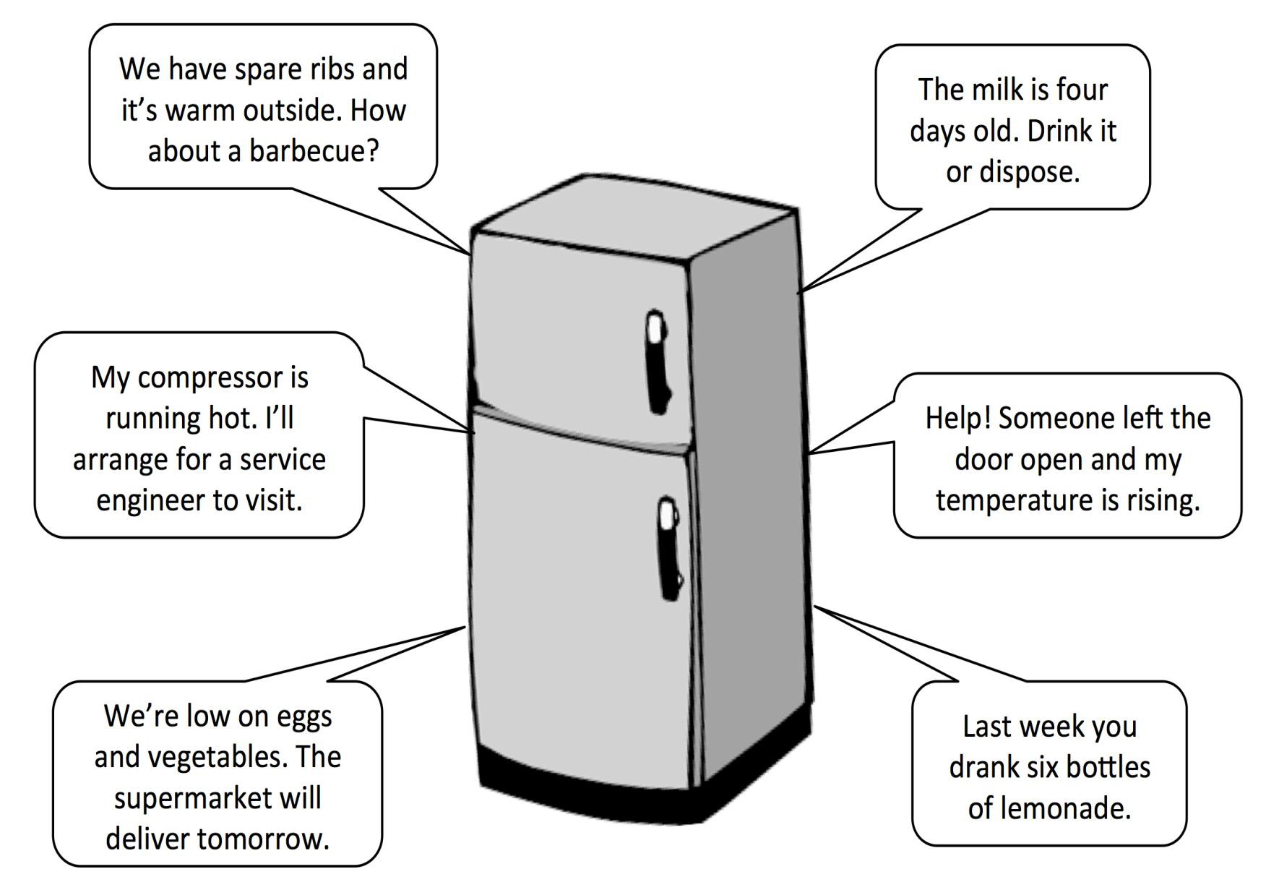
An Internet of Things fridge

Slide 21
The Global Internet of Things
The potential anticipated power of IoT can be realised when Internet ‘things’ start to interact
automatically and intelligently with other Internet ‘things’.
Some things, such as computers and smart phones can connect directly to the Internet through Ethernet or standard mobile communications protocols, whereas other devices will connect to the Internet through a local gateway or router.
For example, electronic textiles and personal healthcare devices are becoming more widely available and it is not difficult to imagine a person who wears clothes (including wristbands and shoes) that can measure and record data about the person’s location, heart rate, body temperature, posture, perspiration levels, exercise routines and potentially even their emotional state.
This data can be measured by small, low-energy devices that are built into the clothes we wear and transmit information over Bluetooth, or another wireless communications protocol, to the user’s Internet-connected smartphone or watch.
The data is continuously sent to the cloud and can be accessed by the user and other people (or devices) that the data owner wishes to share their data with, such as family members, healthcare organisations, or home automation systems.
The IoT concept extends further to represent smart cities, which are made up of houses and communities using home automation and smart transport systems. The smart home has a number of IoT devices – not only the IoT fridge - but also Internet-connected heating systems, lighting and automatic windows that can be controlled through mobile devices, Internet- connected security systems, and smart renewable energy systems.

Slide 22
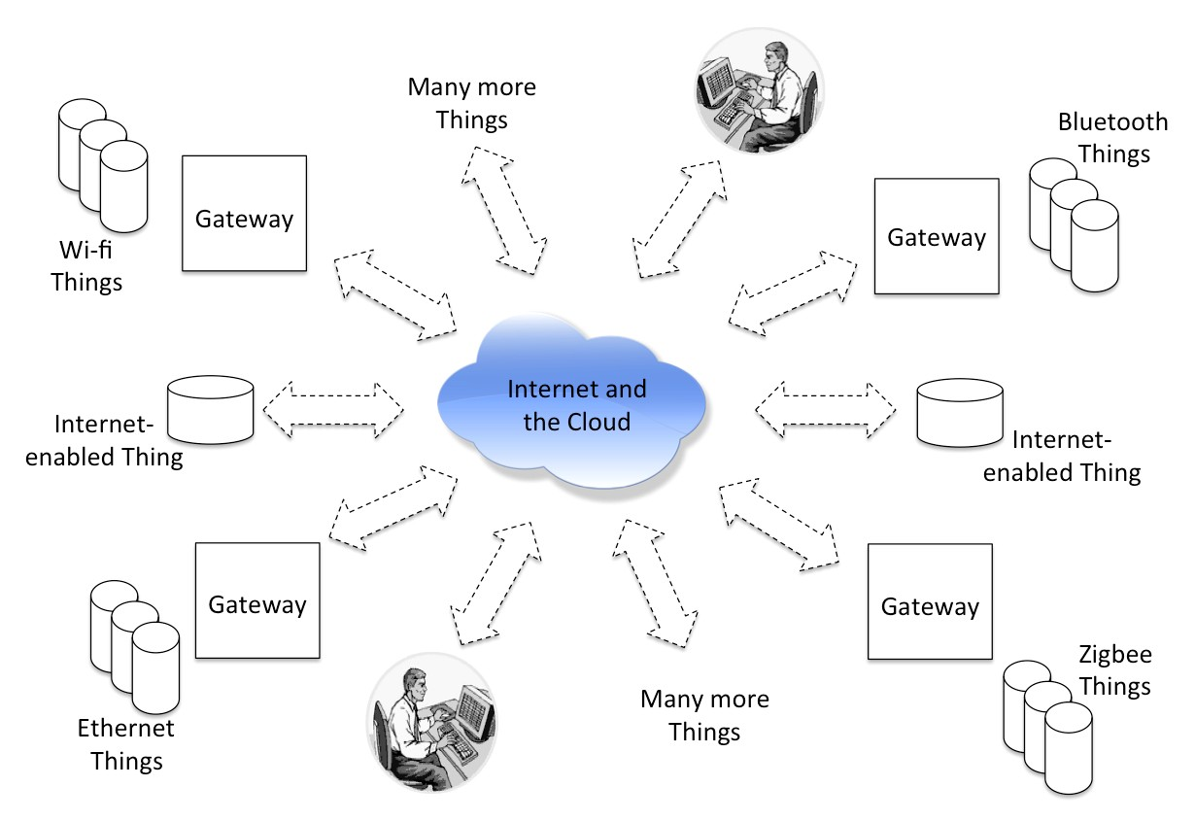
The Global Internet of Things

Slide 23
Opportunities and challenges for the Internet of Things
IoT Opportunity | IoT Challenge
Remote Control of Hardware Systems enables devices that would normally be controlled by physical switches and potentiometers to be controlled remotely through graphical user interfaces. | Security of IoT devices is a major concern. When devices are connected to the Internet it is feasibly possible for unauthorised persons to access the data and to interfere with control systems.
Real-Time Status Monitoring allows any IoT enabled device to be monitored remotely and historical charts of performance and functionality to be gathered. | Reliability is a challenge because continuous Internet connectivity is required, yet it can be sporadic and unreliable in some locations.
Intelligent Connected Functionality can be realised by the sharing of data between devices; meaning the status of one device can inform the action of another device. | Robustness of IoT products is a challenge because they are potentially exposed to more unexpected use, environmental conditions and accidents.
Remote Diagnostic Analysis allows users and manufacturers to constantly monitor the performance of their products after sale. | Online Services are required to enable IoT customers to register their products and access data associated with those products, bringing additional development costs.
Remote Firmware Updates allow functionality to be enhanced or modified remotely, enabling errors to be corrected or new features to be included. | Graphical Interface Development skills will be required for organisations to create bespoke user interfaces and mobile applications for accessing and controlling IoT devices.
User Data Gathering enables product developers to evaluate how customers use their products and use those statistics for future product development. | Bespoke Designs mean that potentially many different approaches to IoT design will be implemented over the coming years, making some devices compatible with each other and others unable to communicate.
Improved Consumer Experiences through graphical interfaces, plug-and-play products and improved customer support and education features. | Standardisation and Legislation is a significant challenge – when billions of devices are connected to the Internet, who will ensure they are all performing correctly and ethically?

Slide 24
mbed and the Internet of Things
In the previous network examples, we have always configured the mbed as a HTTP server that manages its own data traffic. The mbed needs to continuously poll (i.e. continuously check) for messages and a browser needs to regularly poll for changes in mbed status data in return.
This setup causes demand on the mbed, particularly if data is to be sent and received at the same time, if data is sent rapidly and continuously, and if data connections are initiated by more than one client at once.
As a result the RPC and HTTP server examples shown before are functional, but are prone to fail when overloaded.
The IoT concept relies on continuous reliability and fast data transfer rates, so it is clear that a different solution is required for more advanced IoT applications with the mbed
One method is to use a dedicated and robust IoT server that is connected to the Internet and handles all messaging traffic between clients. This is a particularly advantageous method for using the mbed as an IoT device, as all mbed devices can be configured as clients and avoid the complex processing responsibilities of the server.
The server in this setup can be built with substantial processing power and housed in a remote industrial location, where it can be as large and powerful as is necessary to manage all the clients that may wish to communicate with it.
ARM have implemented this application of mbed IoT by using the open source HTML5 WebSockets protocol, which allows bidirectional communications between a server and client devices or browsers.

Slide 25
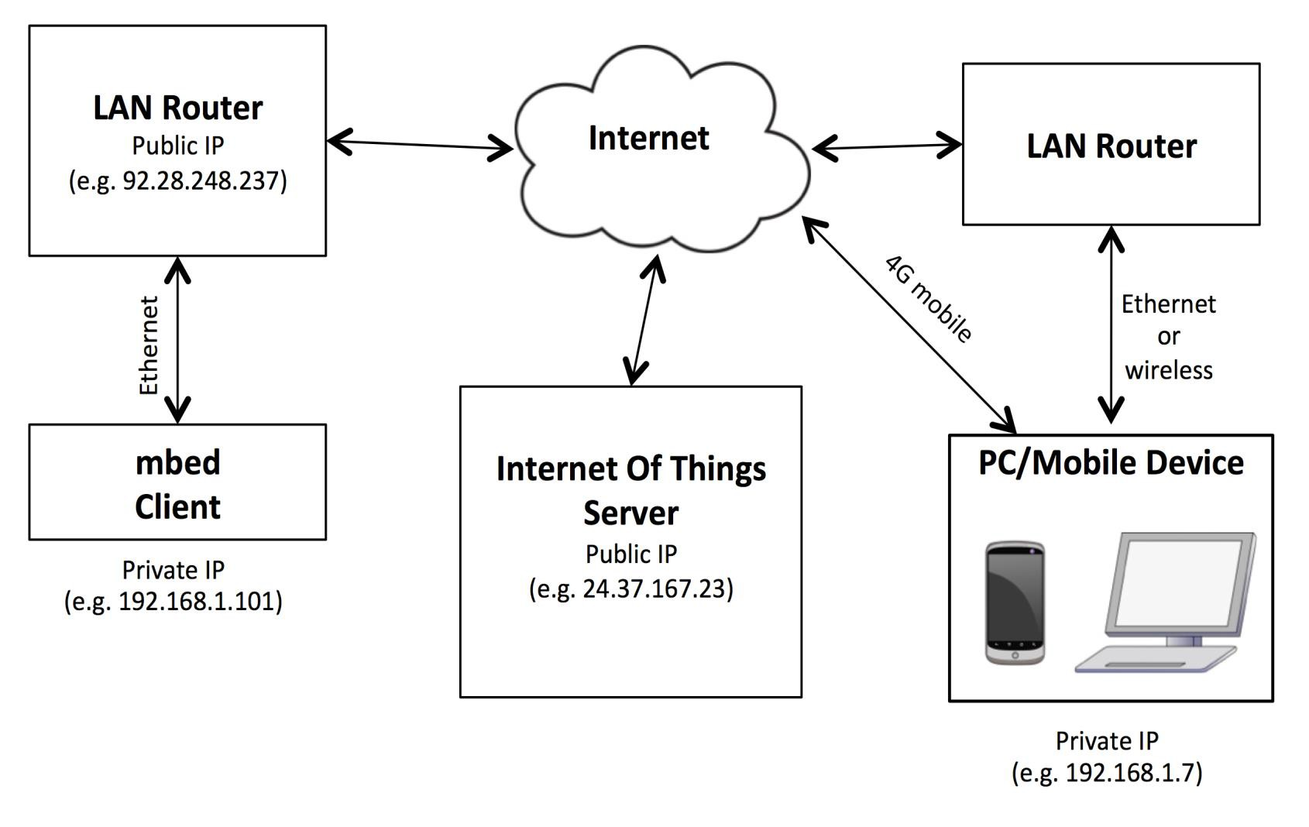
mbed and the Internet of Things

Slide 26
mbed and the Internet of Things
The WebSocket approach for implementing mbed IoT projects is still susceptible to security breaches. It is important that would-be criminals cannot hijack IoT communications, access confidential information and data, or take control of physical devices that are IoT enabled.
One solution is to ensure that all data communication packets over the IoT network are encrypted with advanced algorithms that mean only the intended recipients can access and utilise the contained information.
This needs to be handled by both the server and the client for encryption and decryption, meaning that every IoT device has to be programmed with encryption software within. Given that most embedded systems developers are not encryption experts, this causes a significant headache and is a barrier for innovation around IoT.
Moving forwards, ARM have chosen the mbed to be their flagship IoT development platform for the future. They intend to use the mbed RTOS as a low-level software platform that can manage all encryption and decryption tasks without the programmer needing to become an expert.
The mbed RTOS therefore adds this to its list of multithreading responsibilities. In the coming years they are planning to launch new suites of mbed IoT development frameworks, tools and services.
The commercial mbed website (www.mbed.com) explains how they foresee the future of the mbed for IoT applications, ensuring that the platform will have a significant role to play in the ‘world of connected everything’.

Slide 27
Chapter quiz questions
Describe the ‘Manchester’ digital communication format for Ethernet signals.
Sketch the following Ethernet data streams, as they would appear on an analog oscilloscope, labelling all points of interest:
o 0000
o 0101
o 1110
What are the minimum and maximum Ethernet data packet sizes, in bytes?
What does the terms ‘Gateway Address’ and ‘Network Mask’ refer to?
What is the differences between a public IP address and a private IP address?
What does the term RPC refer to? Give a brief explanation of the use of RPC in embedded systems.
What does the concept of the Internet of Things (IoT) refer to? Give two examples of IoT devices.
Name three opportunities and three challenges associated with Internet of Things systems.
Describe three IoT systems that might be found in a ‘smart home’ and explain the benefits that each system brings to the household.
Draw a wide area network diagram of an mbed IoT application that serves three remote mbed devices and can be accessed by a mobile device or Internet connected PC.

Slide 28
Chapter review
Ethernet is a high-speed serial protocol which facilitates networked systems and communications
between computers, either within a local network or through the World Wide Web.
LANs and WANS use Ethernet and wireless communications to connect Internet servers and clients through routers, allowing web pages, data and control messages to be accessed between devices.
The mbed can communicate through Ethernet to access data from files stored on a data server computer.
The mbed can be configured to act as an Ethernet file server itself, allowing data stored on the mbed to be accessed through a network.
The mbed Remote Procedure Call (RPC) interface and libraries allow mbed variables and outputs
to be manipulated from an external client through the Internet.
WebSockets allow robust data communications between a server and mbed clients, meaning that mbed devices can programmed to be controlled remotely through the Internet by accessing web pages and mobile applications.
The Internet of Things (IoT) refers to the concept of everyday objects and devices being connected to the Internet, allowing them to be controlled and analysed from anywhere in the world.
IoT concepts bring many advantages with respect to massively connected systems, local or global transfer of data, and intelligent systems on a grand scale. IoT does however bring challenges with respect to real-time data, security and reliability.

