Slide 1


Introduction to ZigBee
電機系
ZigBee簡介
清華大學電機系 劉靖家
EE2405 Embedded System Labs

Slide 2
Content
Introduction
ZigBee/IEEE 802.15.4
Physical Layer
MAC Layer
ZigBee Network Topologies
ZigBee Application Profiles
ZigBee and Bluetooth Comparison
Technology Trends

Slide 3
Sensor Network Challenges
Low computational power
Less than 10 MIPS
Low memory budget: 4-10 KB
Limited energy budget
AA batteries provide ~2850 mAh
LiIon and NiMH batteries provide 800-2500 mAh
Solar cells: around 5 mA/cm² in direct sunlight
Communication?

Slide 4
Wireless Communication
Wireless communication standards:
IEEE 802.11 a/b/g
Bluetooth
GSM
What makes them unattractive for WSN:
Power hungry (need big batteries)
Complexity (need lots of clock cycles and memory)
New protocol for WSN:
802.15.4 and Zigbee (ratified in Dec 14, 2004)

Slide 5
Basic ZigBee overview
ZigBee is a specification for a high level protocol stack using small, low-power and low-cost radios.
Based on IEEE 802.15.4 standard for Personal Area Network.
Maintained by ZigBee Alliance (www.zigbee.org)
ZigBee data transmission rate varies from 20 to 900kbits.

Slide 6






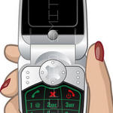
ZigBee Applications
security
HVAC
AMR
lighting control
access control
BUILDING
AUTOMATION
CONSUMER ELECTRONICS
TV
VCR
DVD/CD
remote
ZigBee
Wireless Control that
Simply Works
PERSONAL HEALTH CARE
PC & PERIPHERALS
patient monitoring
fitness monitoring
mouse
keyboard
joystick
TELECOM SERVICES
INDUSTRIAL
CONTROL
HOME CONTROL
asset mgt
process control
environmental
energy mgt
security
HVAC
lighting control
access control
irrigation
m-commerce
info services
object interaction (Internet of Things)
Notes:
Future applications include Toys and Games, like consoles controllers, portable game pads (like gameboys), educational toys like leap frog stuff, and fun toys like RC (remote control) toys, etc.

Slide 7
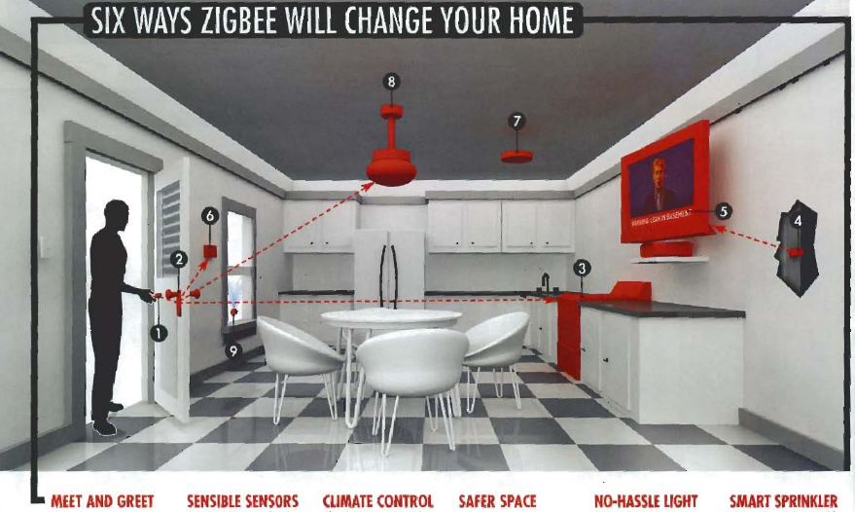
From Popular Science Magazine

Slide 8
ZigBee and Bluetooth Comparison
TEXT
GRAPHICS
INTERNET
HI-FI
AUDIO
STREAMING
VIDEO
DIGITAL
VIDEO
MULTI-CHANNEL
VIDEO
802.15.4
ZigBee
802.11b
LAN
802.11a/HL2 & 802.11g
SHORT < RANGE > LONG
802.15.1
Bluetooth 2
PAN
802.15.1
Bluetooth1
LOW < DATA RATE > HIGH

Slide 9
ZigBee and Bluetooth Comparison
Feature(s) | Bluetooth | Bluetooth Low Energy 4.0 | ZigBee | WiFi
Complexity | complex | simple | simple | high
Nodes/Master | 7 | undefined | 65535 | 255 subnet
Latency | 100 ms | <3 ms | <10 ms | <100ms
Range | 10 -100m | 10-100m | 10m-200m | 10-100m
Power | 1 as ref. | 0.01-0.5 | 0.1-2 | 10
Data Rate | 1-3 Mbps | 1 Mbps | 250 Kbps | 11M-Gbps
Network | scatter | star | star or mesh | flexible
Security | 64bit, 128bit | 128bit AES and Application Layer | 128bit AES and Application Layer | flexible
Notes:
Zigbee是一種短距離的通訊技術，理想中的傳輸距離是300公尺，實際距離約150~200公尺，資料傳輸速率從20Kbps到250Kbps，而且會隨著距離的增長而不同，為藍芽的傳輸速率是1Mbps,適合比較複雜的應用，而ZigBee的應用定位主要是在一般的資料擷取，例如環境監測、家電自動化控制、個人醫療、工業廠房監控、商務大樓自動化、保全監控...等
ZigBee其節點數可多達六萬多點，距離也因為採用Mesh架構(每個節點可以擷取資料也可傳遞來自其他節點的資料)較不受限制，因此ZigBee具有最省電、最大網路節點數及最低成本等優點，專為低成本多節點的低功耗網路所設計

Slide 10
Technology Development Trend
The main trend in Zigbee development is improving power management and stack interoperability.
Smart Energy 2.0.
The ZigBee Alliance is developing an internet protocol (IP) networking layer called ZigBee IP, which is based on the IETF-based 6LoWPAN technology.

Slide 11
802.15.4 basics
IEEE 802.15.4 specifies physical and MAC layer of low-rate WPANs.
It could be used as a basis for different protocols and standards. ZigBee, ISA100.11a, MiWi etc.
IEEE 802.15.4 specification:
802 = networking group
15 = wireless network
4 = low data rate consuming less power

Slide 12
802.15.4 Physical Layer
Applications
ZigBee
IEEE 802.15.4 MAC
Packet generation
Packet reception
Data transparency
Power Management
IEEE 802.15.4
IEEE 802.15.4
868/915 MHz
2400 MHz
PHY
PHY

Slide 13
PHY functionalities
Activation and deactivation of the radio transceiver
Energy detection within the current channel
Link quality indication for received packets
Clear channel assessment for CSMA-CA
Channel frequency selection
Data transmission and reception
Notes:
ZigBee的實體層負責啟動和停止無線電收發器、選擇通道、能量偵測以及封包的傳送和接收等功能。
CSMA-CA---→Carrier Sense Multiple Access-Collision Avoidance
實體層的功能：
1. 無線電收發的啟用與關閉
2. 從當前的channel做能源的偵測
3. 從接收到的封包當成鏈結品質指標
4. 利用CSMA-CA來評估可使用的channel
5. Channel頻率的選擇
6. 資料傳送與接收

Slide 14
IEEE 802.15.4 PHY Overview
Channel 0
Channels 1-10
868MHz / 915MHz
PHY (DSSS)
2 MHz
868.3 MHz
902 MHz
928 MHz
2.4 GHz
PHY (DSSS)
Channels 11-26
5 MHz
2.4 GHz
2.4835 GHz

Slide 15
PHY frame structure
PHY packet fields
Preamble (32 bits) – synchronization
Start of packet delimiter (8 bits) – shall be formatted as “11100101”
PHY header (8 bits) –PSDU length
PSDU (0 to 127 bytes) – data field
Sync Header
PHY Header
PHY Payload
Start of
Packet
Delimiter
Frame
Length
(7 bit)
Preamble
Reserve
(1 bit)
PHY Service
Data Unit (PSDU)
4 Octets
1 Octets
1 Octets
0-127 Bytes
Notes:
實體層資料傳輸封包格式
1. 前置位元(32bits) – 同步化時間
2. 封包定義起始(8bits) – 直接以11100101表示
3. 實體層標頭(8bits) – 表示PSDU的長度
4. PSDU(0 ~ 1016bits) – 資料欄位

Slide 16
802.15.4 Architecture
Applications
ZigBee
Channel acquisition
Contention mgt
NIC address
Error Correction
IEEE 802.15.4 MAC
IEEE 802.15.4
IEEE 802.15.4
868/915 MHz
2400 MHz
PHY
PHY
Slide 16
Joe Dvorak, Motorola
9/27/05

Slide 17
IEEE 802.15.4 MAC Layer
Traffic Type
Periodic data
e.g. sensors
Intermittent data
e.g. light switch
Repetitive low latency data
e.g. mouse
Notes:
ZigBee 的媒體存取控制層提供MAC資訊服務和管理服務，負責信標(beacon)管理、通道接取、保障時槽(guaranteed time slots, GTS)管理、訊框驗證、回覆訊框之傳輸及加盟(association)與終止加盟(disassociation)
Traffic Type
第一種：定時會傳輸資料的裝置，例如：感測器。
第二種：不定時會傳輸資料的裝置，例如：照明裝置，當人走過照明裝置，燈光亮起來的時候，照明裝置會傳輸資料，像是說有人經過。
第三種：需迅速送資料到達其他設備的裝置，例如：滑鼠，當在使用滑鼠時，滑鼠的訊號需要迅速送到電腦。
Intermittent-→間歇的，斷斷續續的
Periodic ---→週期性的
Repetitive--→重複的

Slide 18
IEEE 802.15.4 MAC Layer
Device Classes
Full function device (FFD)
Can function in any topology
Capable of being Network coordinator
Can talk to any other device (FFD/RFD)
Reduced function device (RFD)
Limited to star topology
Cannot become network coordinator
Talks only to FFDs
Address
All devices must have 64 bit IEEE addresses
Short (16 bit) addresses can be allocated to reduce packet size
Notes:
ZigBee的設備有兩種，一種是完整功能裝置(FFD)，另一種是精簡功能裝置(RFD)，
FFD可以用在ZigBee任何的網路拓墣，並且可以做為網路協調者，網路協調者就是負責建立網路、管理網路的裝置，並且可以和FFD和RFD溝通。
RFD只能用在星狀拓墣中，並且只能和FFD溝通。ZigBee的MAC位址有兩種格式，包括用在大型網路的64位元位址，以及16位元的短位址，適合用在較小型的網路
ZigBee的MAC位址有兩種格式，包括用在大型網路的64位元位址，以及16位元的短位址，適合用在較小型的網路。

Slide 19
IEEE 802.15.4 MAC Layer
Frame Types
Data Frame
used for all transfers of data
Beacon Frame
used by a coordinator to transmit beacons
Acknowledgment Frame
used for confirming successful frame reception
MAC Command Frame
used for handling all MAC peer entity control transfers
Notes:
ZigBee的frame種類有四種：
Data frame是用來傳輸資料
Beacon是用來做同步化，Beacon的功能是啟動superframe，將其他裝置同步，告訴不在這個網路裏的裝置這個有我這個coordinator形成的PAN，以及告訴裝置有資料要傳輸給他
Acknowledgment frame
Mac command frame則是用來下些指令，例如data request

Slide 20
IEEE 802.15.4 MAC Layer
Transmission Mode
Slotted (Beacon enable mode )
Periodic data and Repetitive low latency data.
Un-slotted (Non-Beacon enable mode)
Intermittent data.
Notes:
ZigBee的傳輸模式
ZigBee的傳輸模式有兩種，一種是Slotted另一種是unslotted，Slotted是指coordinator會訂時發出beacon來做同步化的動作，適合用來傳輸定時
性的資料和需要低延遲的資料
Unslotted則是指裝置要傳輸資料的話都靠csma/ca來搶頻寬傳輸資料，適合用來傳不定時的資料
而device要傳資料給coordinator則是在slotted情況下，當coordinator發出beacon後，device如果有資料要傳輸資料的話，就將資料傳給coordinator
而在unslotted模式下，device用csma/ca搶頻寬，在將資料傳給coordinator

Slide 21
ZigBee Network Topologies
Mesh
Star
Cluster Tree
PAN coordinator
Full Function Device
Reduced Function Device
Notes:
ZigBee網路層方面，ZigBee支援Star、Cluster Tree與Mesh三種網路架構，在各個節點之角色方面，可分為全功能設備（Full-Function Device；FFD）與精簡功能設備（Reduced-Function Device；RFD）。相較於FFD，RFD之電路較為簡單且記憶體較小。FFD之節點具備控制器（Controller）之功能提供資料交換，而RFD則是只能傳送資料給予FFD或是從FFD接受資料。
在星狀和樹狀網路中，coordinator會定時地發出beacon來同步化網路中其他裝置。

Slide 22
ZigBee Network Topologies
Star Topology
Advantage
Easy to synchronize
Low latency
Disadvantage
Small scale
Notes:
星狀拓樸，他的優點是容易同步化和所以有superframe，低延遲缺點是難以擴充

Slide 23
ZigBee Network Topologies
Mesh Topology
Advantage
Robust multihop communication
Network is more flexible
Lower latency
Disadvantage
Route discovery is costly
Needs storage for routing table
Notes:
Mesh優點是允許多點傳播、網路形成較具彈性和低延遲
網路拓墣，優點是允許多點傳播、網路形成較具彈性和低延遲 缺點是不具有superframe，route discovery成本過大和須另有儲存空間儲存路由表

Slide 24
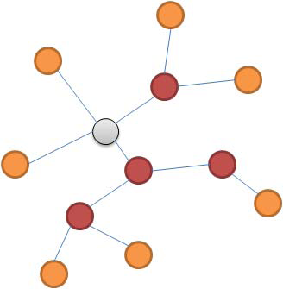
ZigBee Network Topologies
Cluster Tree
Advantage
Low routing cost
Allow multihop communication
Disadvantage
Route reconstruction is costly
Latency may be quite long
Notes:
樹狀拓樸的優點是低路由成本和可以有superframe，允許多點傳播
缺點是路由重建是成本耗費過大和延遲過長

Slide 25
IEEE 802.15.4 MAC Overview
General Frame Structure
4 Types of MAC Frames:
Data Frame
Beacon Frame
Acknowledgment Frame
MAC Command Frame

Slide 26
802.15.4 Architecture
Applications
Network Routing
Address translation
Packet Segmentation
Profiles
ZigBee
IEEE 802.15.4 MAC
IEEE 802.15.4
IEEE 802.15.4
868/915 MHz
2400 MHz
PHY
PHY
Slide 26
Joe Dvorak, Motorola
9/27/05

Slide 27
ZigBee Stack Architecture
{
Initiate and join network
Manage network
Determine device relationships
Send and receive messages
Application
Application
ZDO
SSP
App Support (APS)
Device management
Device discovery
Service discovery
Security functions
NWK
Network organization
Route discovery
Message relaying
Device binding
Messaging
Medium Access (MAC)
Physical Radio (PHY)
Notes:
want to make clear what zigbee does for the application, and what is the application’s responsibility
Cover stack
Cover app - need to decide on a network to join
Set up relationships (may be external tools)
Send/receive messages

Slide 28

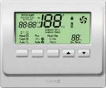
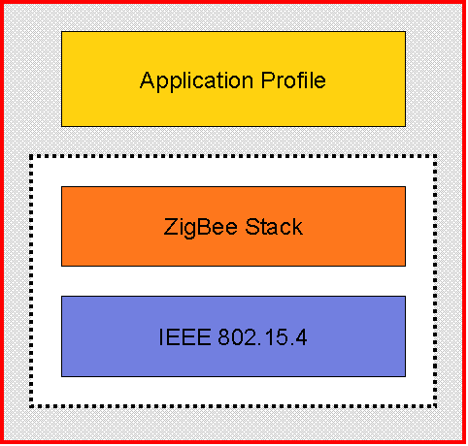
Application Profiles
Application
ZDO
SSP
App Support (APS)
NWK
Clusters
Clusters
Medium Access (MAC)
0: off
1: on
2: scene 1
3: scene 2
0: fan off
1: fan on
2: temp set
3: time set
Physical Radio (PHY)
Application profiles define what messages are sent over the air for a given application
Devices with the same application profiles interoperate end to end
ZigBee publishes a set of public profiles, but vendors may create manufacturer specific ones as well

Slide 29
Some Application Profiles
Home Automation [HA]
Defines set of devices used in home automation
Light switches
Thermostats
Window shade
Heating unit
etc.
Industrial Plant Monitoring
Consists of device definitions for sensors used in industrial control
Temperature
Pressure sensors
Infrared
etc.

Slide 30
Reference
Comparing Low-Power Wireless Technologies
https://www.digikey.com/en/articles/techzone/2017/oct/comparing-low-power-wireless-technologies

