Slide 1
DENTAL CLINIC - MIGRATION FROM RELATIONAL TO NOSQL DATABASE
Professor: MSc. Benjamin Besimi
Presented by: Era Emurli, Jona Sela
Date: 16th June 2025

Slide 2
The Challenge
What’s the problem?
Traditional relational databases are powerful, but they often struggle to adapt when systems grow larger or data becomes more interconnected. In our case, managing deeply linked patient data—like appointments, medical history, billing, and staff assignments—became complex and inefficient with multiple join operations. This complexity created performance challenges and made scaling difficult for real-world applications like dental clinic systems.

Slide 3
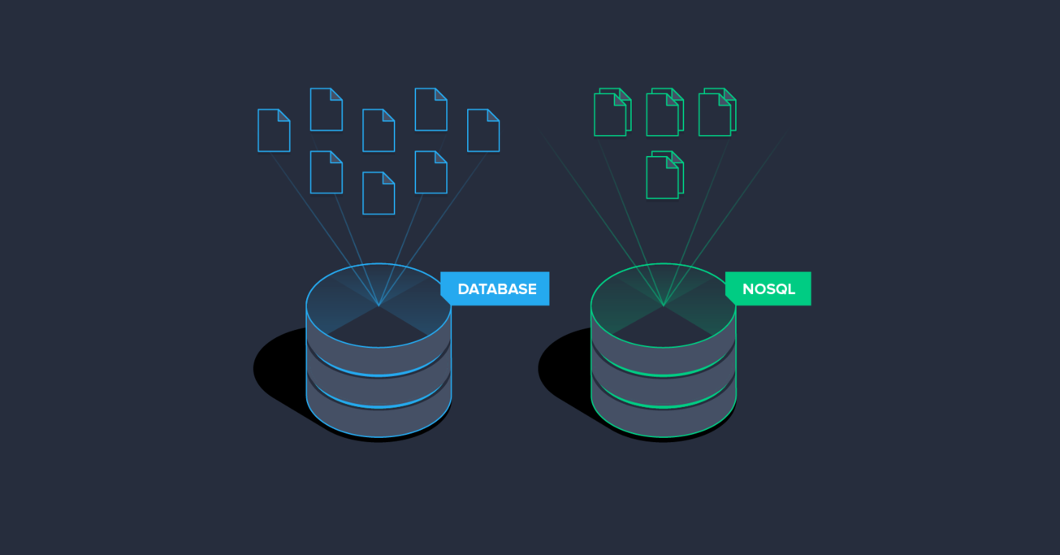
Our Solution
1. Relational Database Design in SQL Server
We designed and implemented a fully normalized relational database in SQL Server, including 8+ interconnected tables such as Patient, Appointment, Bill, and Employee. We applied constraints, relationships, and populated each table with 20+ meaningful records.
2. Python-Based Migration Script
We developed a custom Python script using pyodbc and pymongo to extract data from SQL Server, transform it, and load it into MongoDB—all with error handling and logging.
3. Document-Based Storage in MongoDB
Finally, we structured the data in MongoDB using collections like patients, employees, and dentists. Key relationships were embedded as subdocuments to optimize queries, scalability, and performance.

Slide 4
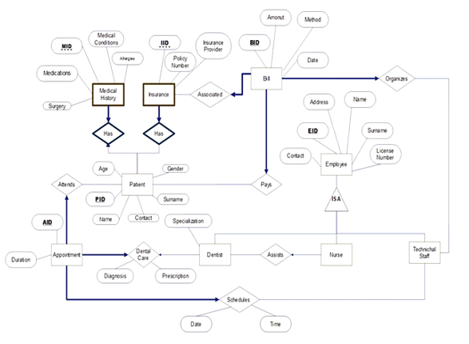
ER Diagram
This is the Entity Relationship (ER) diagram for our SQL database. Key entities include:
- Patient: core entity with appointments, bills, medical history
- Appointment: connected with patient, dentist, tech staff
- Employee: base entity for Dentist, Nurse, TechStaff
-We ensured 1:N and 1:1 mappings with appropriate foreign keys.

Slide 5
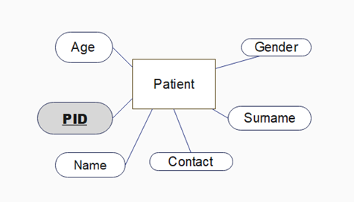
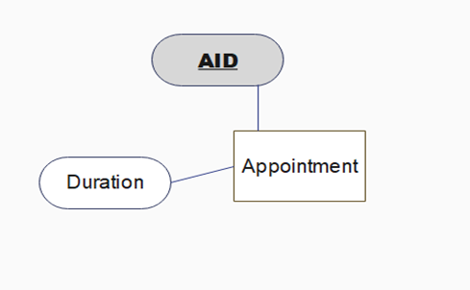
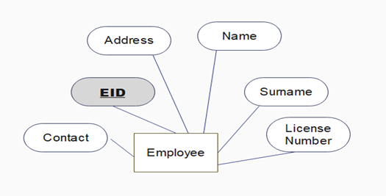
Table Structures
We created 10 relational tables. Here are a few examples:
-Patient (PID, Pname, Psurname, Ppage, Pgender, Pcontact)
-Appointment (AID, PID, TID, DID, Date, Time)
-Employee (EID, Ename, Esurname, ...)
Constraints were applied: primary keys, foreign keys, and check constraints for gender.

Slide 6
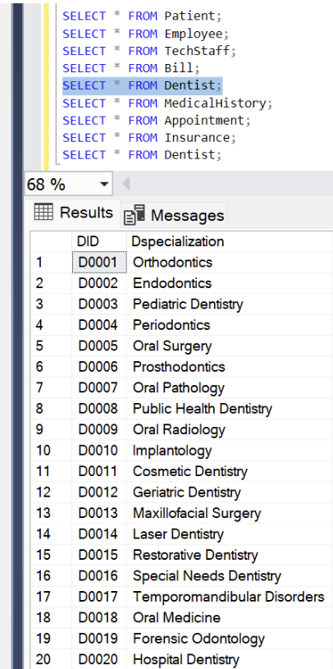
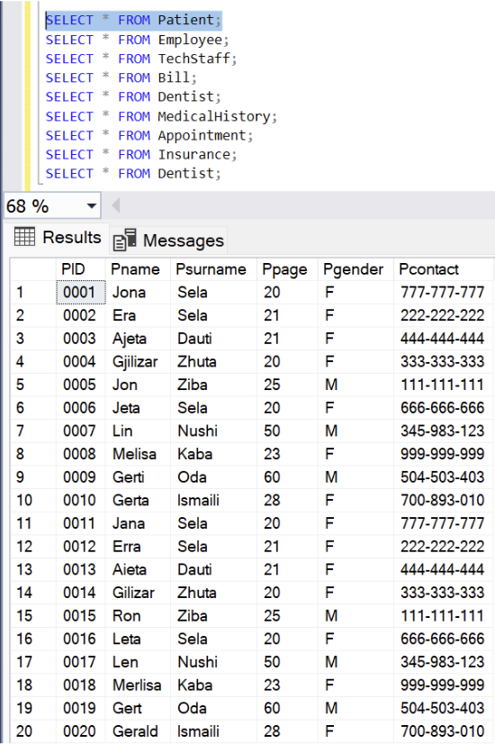
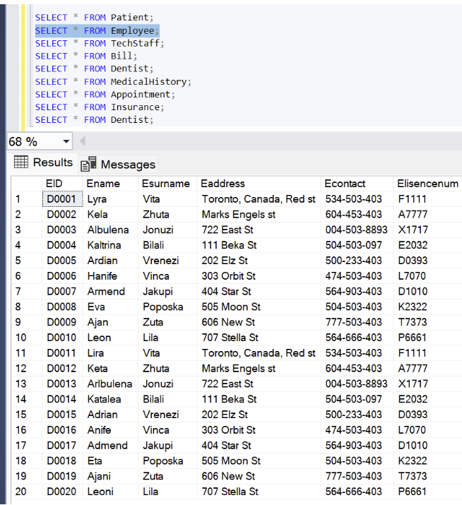
Data Population
Each table was populated with at least 20 rows. We used meaningful and realistic data to simulate a real clinic. Here you can see sample screenshots showing populated Patient and Appointment tables.
Enterprise Solutions
Custom packages for large-scale clients

Slide 7
Why MongoDB?
We chose *MongoDB* for these reasons:
- Document-based structure fits our data well (especially for embedding patient history)
- Scalable, flexible schema
- Good support for nested and dynamic documents
Compared to Redis (key-value only) and Cassandra (good for large-scale writes but column-family-based), MongoDB offered the best balance for our document-heavy case.

Slide 8
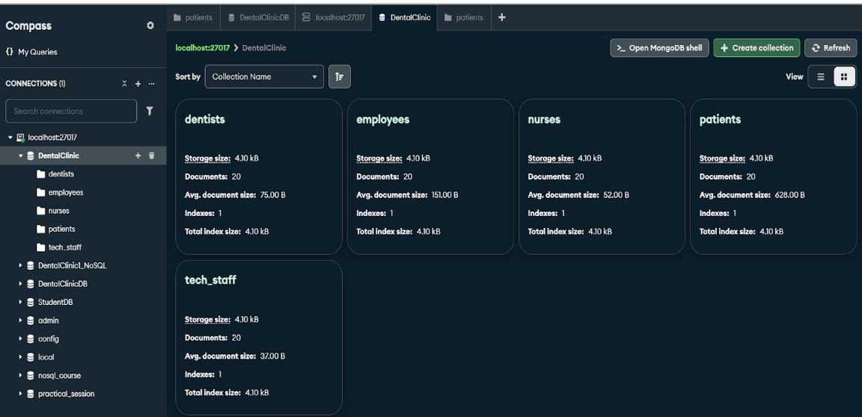
NoSQL Modeling
In MongoDB, we modeled each SQL table as a collection:
- Patient → embedded fields: appointments, bills, medical_history, insurance
- Other entities like Dentist, Nurse, TechStaff are separate collections.
This allowed us to reduce joins and improve read performance.

Slide 9
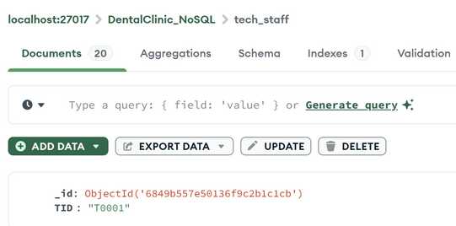
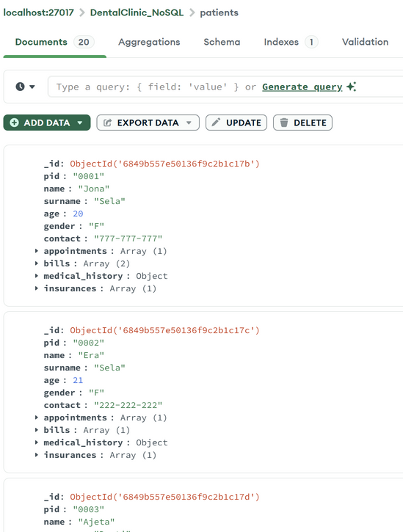
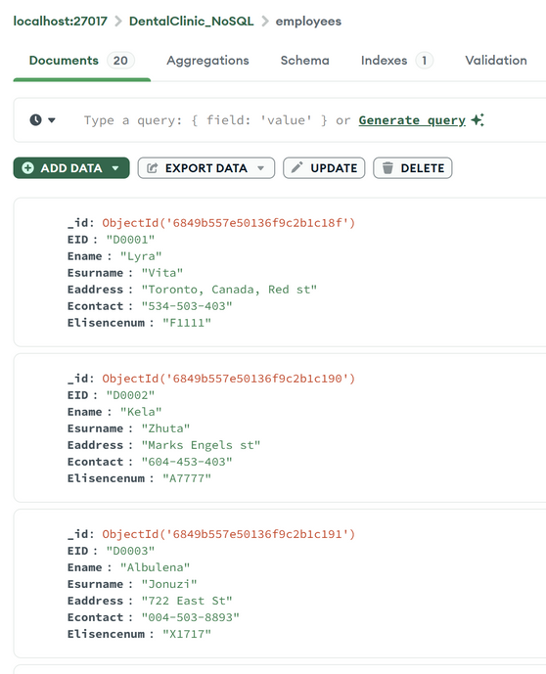
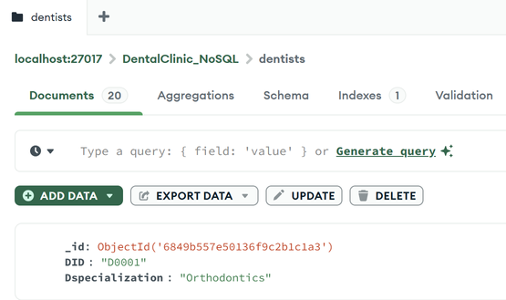
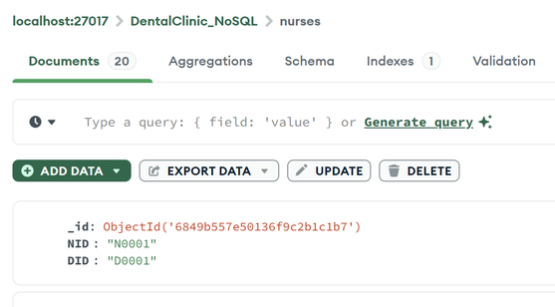
MongoDB Collections
We created the following collections:
patients: includes embedded subdocuments for appointments, bills, medical history, and insurance
employees: generic collection for all staff
dentists, nurses, techstaff: specialized roles derived from Employee
Each document follows MongoDB’s BSON format, optimized using a transformation function.

Slide 10
Data Migration Process
We used a Python script to:
C
Q
Connect to SQL Server using
Query each table and transform data types (like Decimal and Date)
I
L&E
Insert documents into MongoDB using pymongo
We included logging and error handling to track the process and ensure data consistency.

Slide 11
Challenges & Solutions
-Authentication error (Login failed): Fixed by changing database name and ensuring SQL permissions.
-Date/Decimal incompatibility: Solved with custom conversion function.
-Document nesting:
Carefully embedded arrays (bills, appointments) only when necessary.

Slide 12
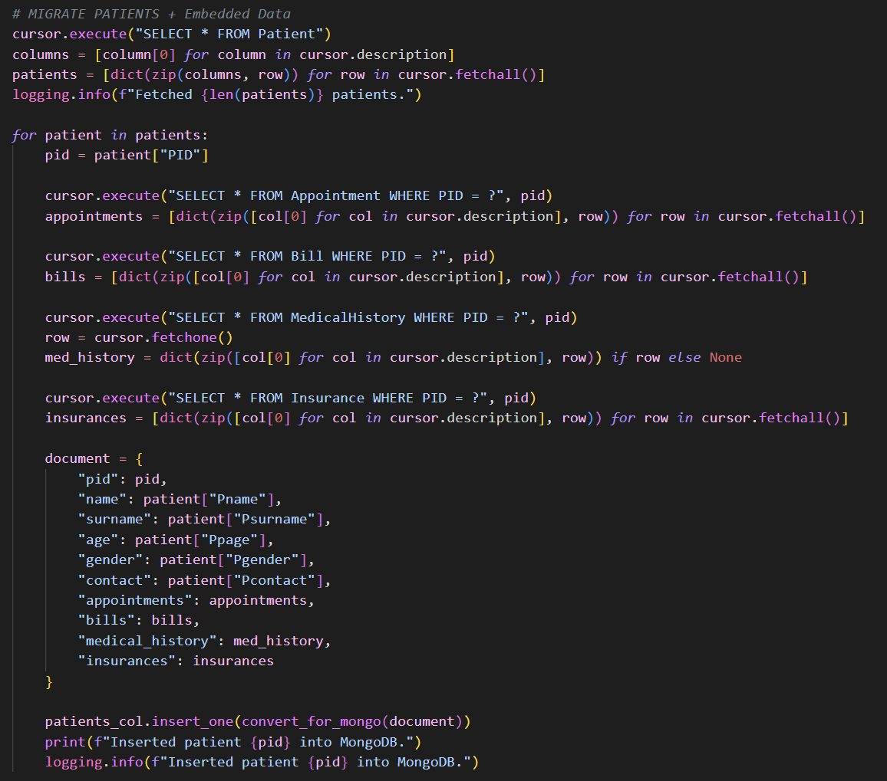
Demonstration
Here’s a demo of our script:

Slide 13

- SQL modeling taught us normalization and constraints
- MongoDB showed us flexibility with embedded documents
- We learned how to convert schemas across paradigms
- We became more confident in data migration scripting
Lessons Learned

Slide 14
Conclusion & Final Reflection
We successfully:
- Built and populated a relational DB
- Modeled equivalent NoSQL structures
- Migrated data using Python scripts
- Validated the results in MongoDB
The project gave us full-cycle experience in modern data engineering.
We truly enjoyed working on this project. It deepened our interest in databases, especially MongoDB. We’re now considering learning more in the field of data engineering or backend development, and maybe even doing internships in these areas.

Slide 15
THANK YOU!

