Slide 1
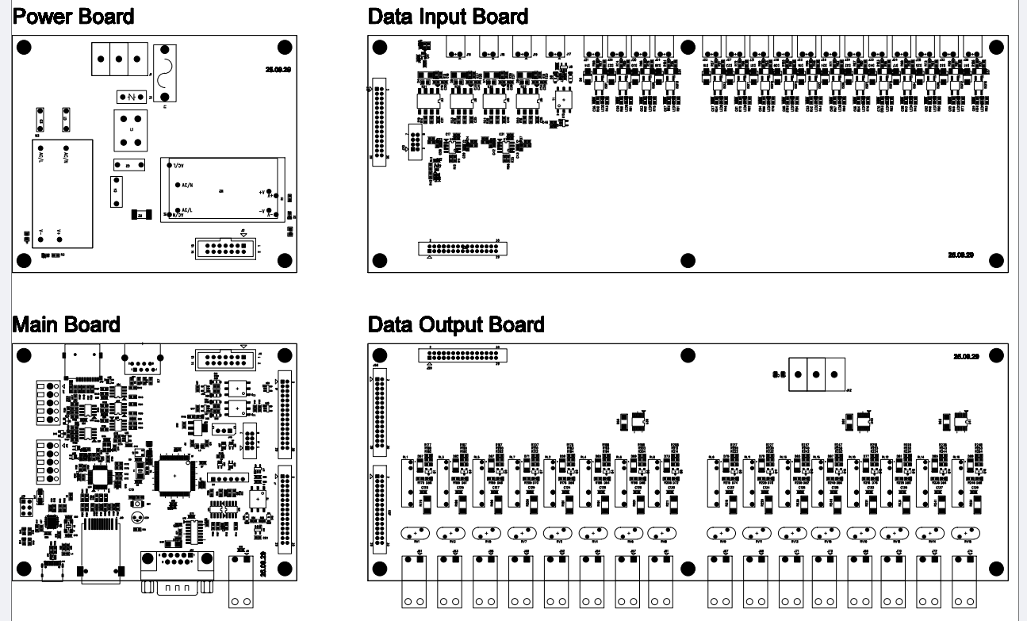
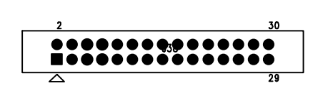
위치 변경
삭제
삭제
LED

Slide 3
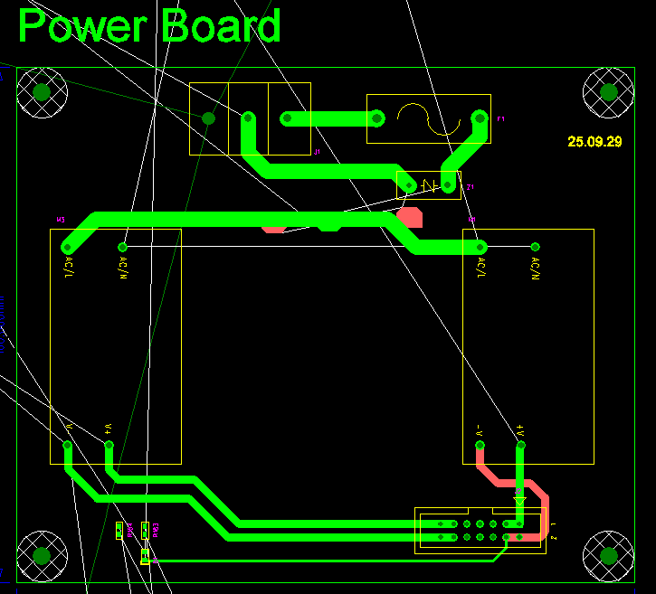
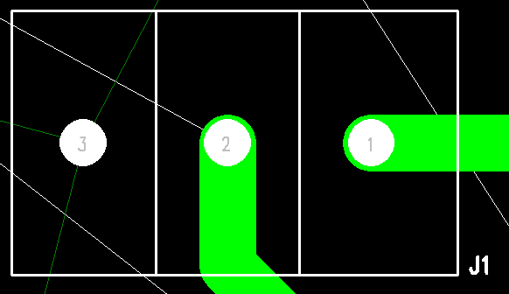
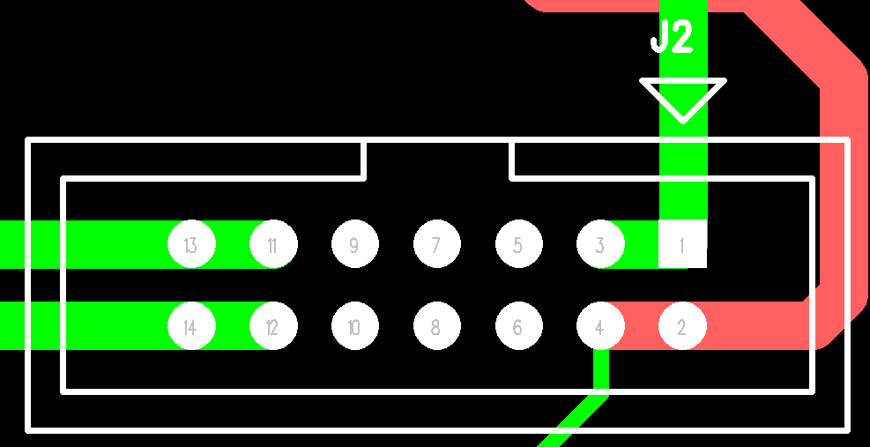
J1
J2

Slide 4
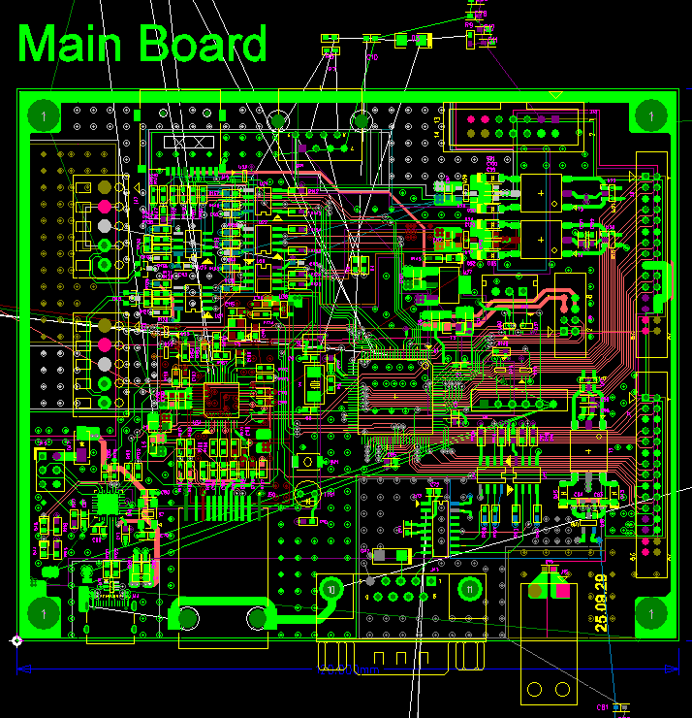
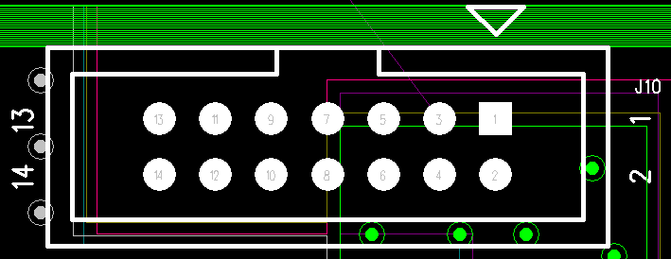
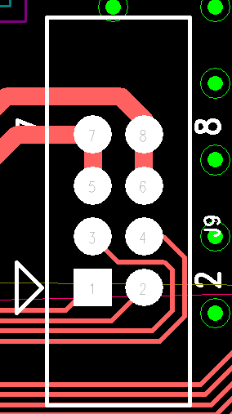
S49
SP1
J10
J46
J8
J9
J47
J7
J50
J44
J43
J15

Slide 5
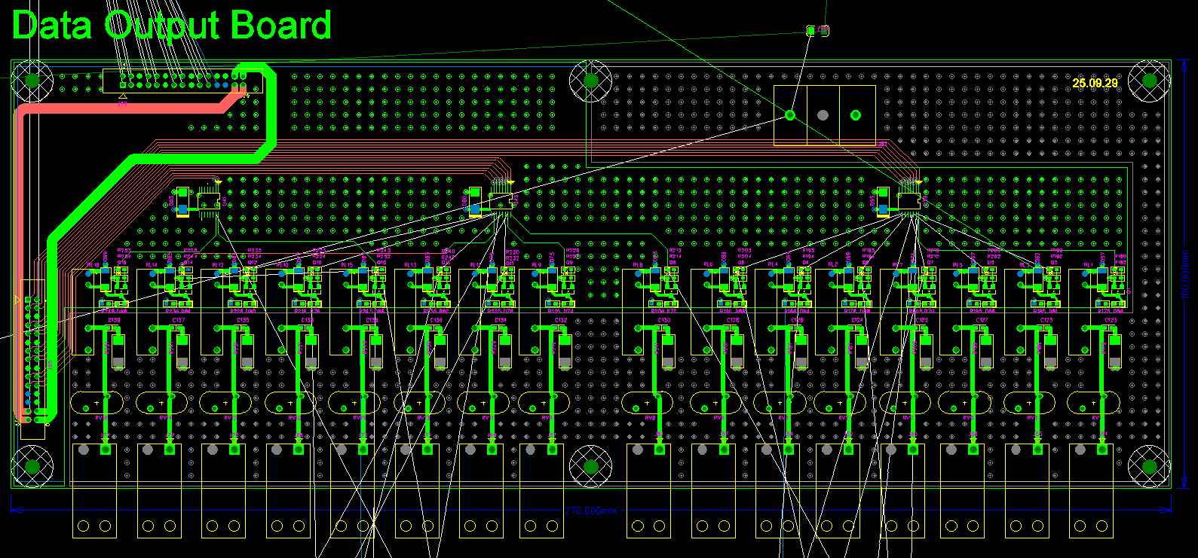
J59
J62
J58
J55
J51
J53
J56
J60
J52
J54
J57
J61
J67
J69
J71
J73
J68
J70
J72
J74

Slide 6
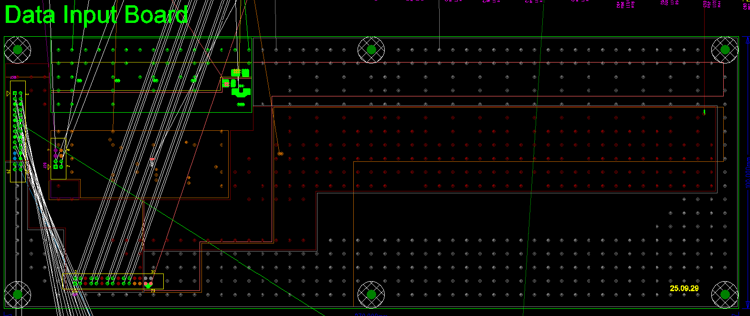
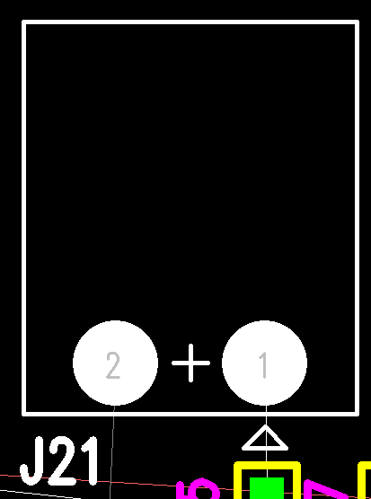
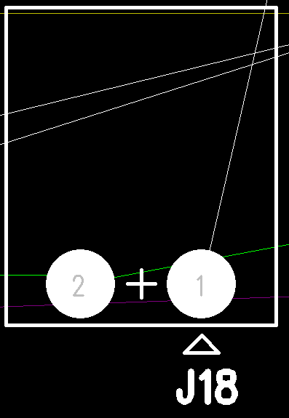
J16
J18
J17
J19
J21
J26
J30
J34
J23
J27
J31
J35
J22
J25
J29
J33
J24
J28
J32
J36
J37
J20
J38

