Slide 1



Discriminative Analysis Dictionary Learning
Jun Guo¹, Yanqing Guo¹, Xiangwei Kong¹, Man Zhang², Ran He²
¹School of Information and Communication Engineering,
Dalian University of Technology, Dalian, China
guojun@mail.dlut.edu.cn, {guoyq, kongxw}@dlut.edu.cn
²The Center for Research on Intelligent Perception and Computing,
National Laboratory of Pattern Recognition,
Institute of Automation, Chinese Academy of Sciences, Beijing, China
{zhangman, rhe}@nlpr.ia.ac.cn
AAAI 2016 - Presentation

Slide 2
Outline
Introduction
Motivation of Our Work
The Proposed Method
Optimization
Experiments
Summarization
AAAI 2016 - Presentation

Slide 3
Outline
Introduction
Motivation of Our Work
The Proposed Method
Optimization
Experiments
Summarization
AAAI 2016 - Presentation

Slide 4
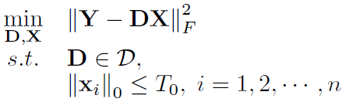
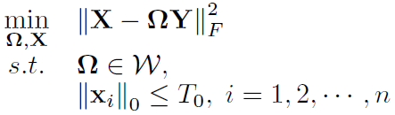
Dictionary Learning (DL)
Core idea of DL:
  Learn an optimized dictionary which can effectively represent each sample in
Two major branches of DL:
  Synthesis DL:
  Analysis DL:
AAAI 2016 - Presentation
Notes:
R. Rubinstein, A. M. Bruckstein, and M. Elad, “Dictionaries for sparse representation modeling,” Proc. IEEE, vol. 98, no. 6, pp. 1045–1057, Jun. 2010.

Slide 5



Synthesis DL
A basic framework:
  Training data:
  Coding vectors:
  Synthesis Dictionary:
  A set of constraints on :
  Sparsity level:
Emphasize representation rather than discrimination!
AAAI 2016 - Presentation

Slide 6
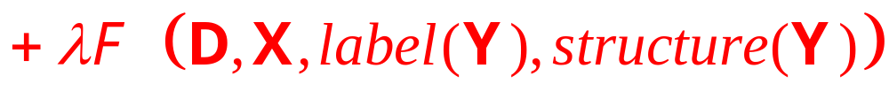
Discriminative Synthesis DL
A general formula:
  Label consistency of codes
  Transform-invariance of dictionary
  Structured incoherence of dictionary
  Joint dictionary learning and subspace clustering
  Fisher discrimination on the dictionary and codes
  ……
AAAI 2016 - Presentation
Notes:
[1] Z. Jiang, Z. Lin, and L. S. Davis, “Label consistent K-SVD: learning a discriminative dictionary for recognition,” TPAMI, vol. 35, no. 11, pp. 2651–2664, Nov. 2013.
[2] S. Zhang, M. Zhang, R. He, and Z. Sun, “Transform-invariant dictionary learning for face recognition,” in Proc. ICIP, Oct. 2014, pp. 348–352.
[3] I. Ramirez, P. Sprechmann, and G. Sapiro, “Classification and clustering via dictionary learning with structured incoherence and shared features,”in Proc. CVPR, Jun. 2010, pp. 3501–3508.
[4] G. Zhang, R. He, and L. S. Davis, “Jointly learning dictionaries and subspace structure for video-based face recognition,” in Proc. ACCV, Nov. 2014, pp. 348–352.
[5] M. Yang, L. Zhang, X. Feng, and D. Zhang, “Fisher discrimination dictionary learning for sparse representation,” in Proc. ICCV, Nov. 2011, pp. 543–550.

Slide 7

Analysis DL
A basic framework:
  Training data:
  Coding vectors:
  Analysis Dictionary:
  A set of constraints on :
  Sparsity level:
AAAI 2016 - Presentation
Notes:
The constraint set W can be matrices with either relatively small Frobenius norm or unity row-wise norm.
In our paper, we prefer W to be matrices with relatively small Frobenius norm.

Slide 8
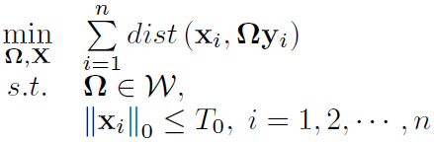
Analysis DL
A basic framework:
Rewrite:
Emphasize representation rather than discrimination!
We study how to better apply Analysis DL into pattern classification tasks.
AAAI 2016 - Presentation
Notes:
There are few works that focus on improving the classification performance of Analysis DL.
So we study how to better apply Analysis DL into pattern classification.

Slide 9
Outline
Introduction
Motivation of Our Work
The Proposed Method
Optimization
Experiments
Summarization
AAAI 2016 - Presentation

Slide 10
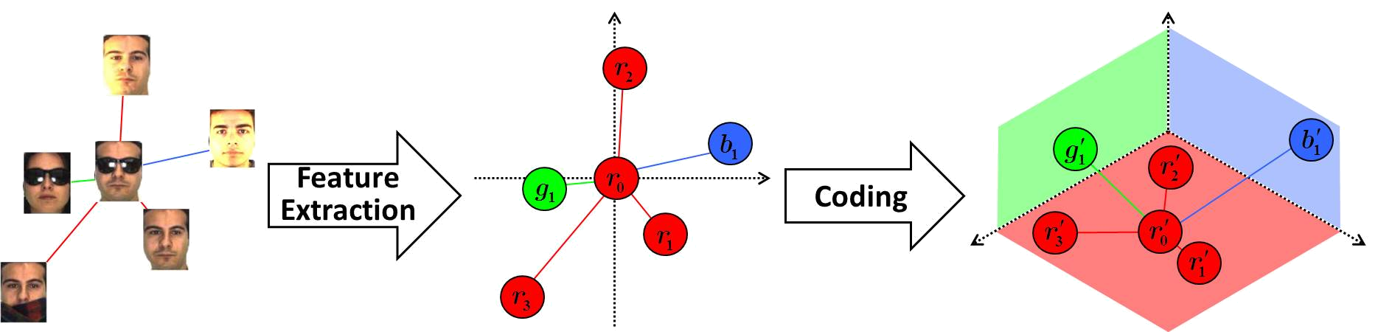
Motivation of Our Work
Illustration:
  Analysis DL + simple classifier (i.e. kNN)
  In the coding space:
  same-label neighbors are orderly preserved
  neighbors with different labels are repelled
Improve the classification performance of Analysis DL.
AAAI 2016 - Presentation

Slide 11
Motivation of Our Work
Illustration:
  Integrate two significant characters into Analysis DL
  strengthen discriminability
  preserve local topology structure
  Better control outliers and noise for classification
  employ Correntropy Induced Metric (CIM) instead of MSE
Discriminative Analysis Dictionary Learning (DADL)
AAAI 2016 - Presentation
Notes:
MSE: Mean Square Error

Slide 12
Outline
Introduction
Motivation of Our Work
The Proposed Method
Optimization
Experiments
Summarization
AAAI 2016 - Presentation

Slide 13
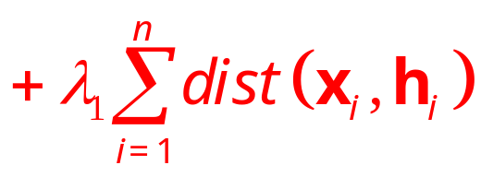
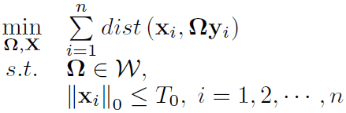
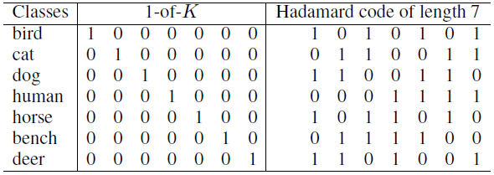
The Proposed Method
Strengthen discriminability:
  Integrate a code consistent term:
  Generate target codes (e.g., Hadamard code):
AAAI 2016 - Presentation
Notes:
[1] S. Yang, P. Luo, C. C. Loy, K. W. Shum, and X. Tang, “Deep representation learning with target coding,” in Proc. AAAI, Jan. 2015, pp. 3848–3854.

Slide 14



The Proposed Method
Preserve local topology structure:
  Definition 1: A coding process is called local topology preserving when the following condition holds: if , then
  Determining appropriate for :
  is an antisymmetric matrix.
This loss is an unsupervised type, neglecting labels.
AAAI 2016 - Presentation
Notes:
[1] D. Luo, C. Ding, F. Nie, and H. Huang, “Cauchy graph embedding,” in Proc. ICML, Jun. 2011, pp. 553-560.
[2] https://en.wikipedia.org/wiki/Rearrangement_inequality

Slide 15

The Proposed Method
Preserve local topology structure:
  Considering each sample’s label:
  Replace with that is also antisymmetric:
  So that in the coding space:
  same-label neighbors are orderly preserved
  neighbors with different labels are repelled
AAAI 2016 - Presentation
Notes:
A’_{i} is also an antisymmetric matrix.

Slide 16




The Proposed Method
Preserve local topology structure:
  Then, we obtain a supervised loss function:
  Reformulate: (please refer to Proposition 1 in our paper)
  to directly learn the analysis dictionary :
, where
AAAI 2016 - Presentation

Slide 17


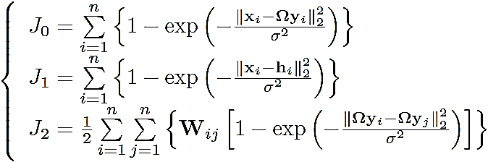
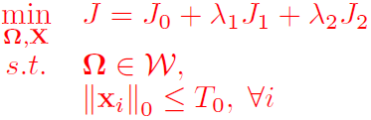
The Proposed Method
CIM induced objective function:
  Correntropy Induced Metric (CIM):
  a local measure between two variables
  obey all the properties for a distance metric
  more robust to errors (e.g., outliers and noise)
  Final objective function:
AAAI 2016 - Presentation
Notes:
[1] W. Liu, P. P. Pokharel, and J. C. Principe,“Correntropy: Properties and applications in non-gaussian signal processing,” TSP, vol. 55, no. 11, pp. 5286–5298, Nov. 2007.

Slide 18
Outline
Introduction
Motivation of Our Work
The Proposed Method
Optimization
Experiments
Summarization
AAAI 2016 - Presentation

Slide 19



Optimization
Half-quadratic (HQ) technique:
  For a fixed , there exists a dual potential function , such that
  The infimum can be reached at .
Optimize the augmented function:
  Update the analysis dictionary and sparse codes.
  Update auxiliary variables introduced by HQ.
  Alternatively minimized until convergence.
AAAI 2016 - Presentation
Notes:
[1] Y. Zhang, Z. Sun, R. He, and T. Tan,“Robust subspace clustering via half-quadratic minimization,” in Proc. ICCV, Dec. 2013, pp. 3096–3103.

Slide 20
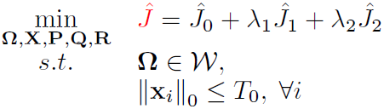
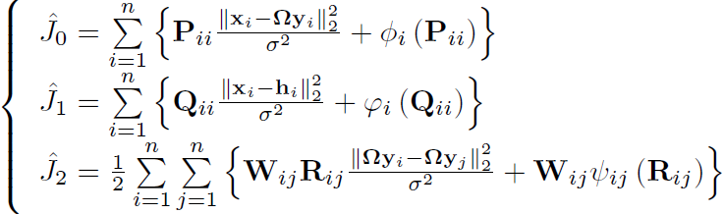
Optimization
The augmented function of our objective function based on the half-quadratic (HQ) technique:
where
AAAI 2016 - Presentation
Notes:
The n*n matrices P, Q and R store the auxiliary variables introduced by HQ. Besides, P and Q are diagonal.{\phi _i}、{\varphi _i} and {\psi _ij} are conjugate functions.

Slide 21



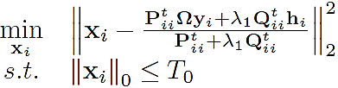
Alternating Optimization
Update dictionary and codes :
  To update with fixed , we solve
  is the Laplacian matrix of .
  Solution:
  With fixed , update in parallel by solving
  Solution: applying hard thresholding operation.
AAAI 2016 - Presentation
Notes:
We prefer the set of constraints W on {\Omega} to be matrices with relatively small Frobenius norm.
Hard thresholding: setting the smallest (m₂-T₀) elements (in magnitude) to zero.

Slide 22
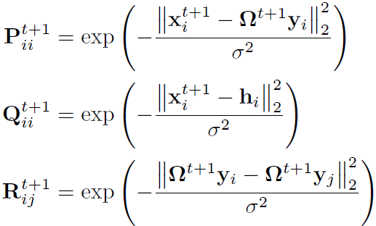
Alternating Optimization
Update auxiliary variables introduced by HQ:
Alternatively minimized until convergence.
  Please refer to our paper for more details.
AAAI 2016 - Presentation
Notes:
HQ: half-quadratic

Slide 23
Outline
Introduction
Motivation of Our Work
The Proposed Method
Optimization
Experiments
Summarization
AAAI 2016 - Presentation

Slide 24
Experimental Setup
Datasets and Features
  Extended YaleB: 504-dimensional random-face features
  AR: 540-dimensional random-face features
  Caltech 101: 3000-dimensional BoW+SPM features
  Scene 15: 3000-dimensional BoW+SPM features
  UCF 50: 5000-dimensional BoW+SPM features
Comparing Algorithms
  the baseline Analysis DL + SVM [ICIP 2014]
  the classical SRC [PAMI 2009] and CRC [ICCV 2011]
  other famous DL methods: DLSI [CVPR 2010], FDDL [ICCV 2011], LC-KSVD [PAMI 2013], DPL [NIPS 2014]
AAAI 2016 - Presentation
Notes:
BoW: Bag-of-Words; SPM: Spatial Pyramid Matching; SVM: Support Vector Machine

Slide 25
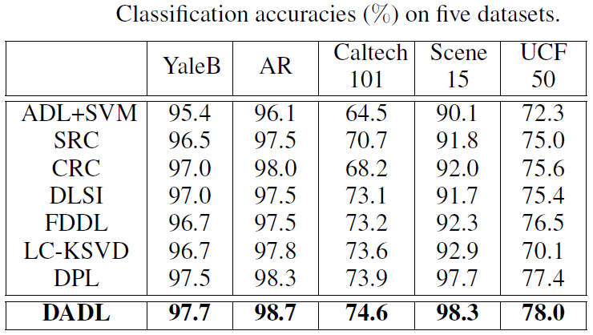
Results and Analysis
Our proposed DADL method achieves higher accuracies than other dictionary learning methods.
AAAI 2016 - Presentation
Notes:
For some datasets, all the competitors achieve over 95% accuracy, so our method’s improvement is not visibly big.

Slide 26
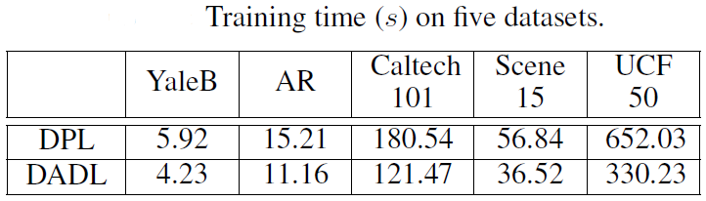
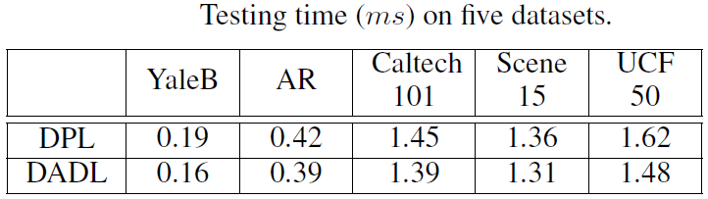
Results and Analysis
DPL markedly outperforms state-of-the-art DL methods in terms of running time. However, our proposed DADL method runs faster than DPL.
AAAI 2016 - Presentation
Notes:
[1] S. Gu, L. Zhang, W. Zuo, and X. Feng, “projective Dictionary Pair Learning for pattern classification,” in Proc. NIPS, Dec. 2014, pp. 793–801.

Slide 27
Outline
Introduction
Motivation of Our Work
The Proposed Method
Optimization
Experiments
Summarization
AAAI 2016 - Presentation

Slide 28
Summarization
Conclusions
  Our proposed DADL method performs better in pattern classification than state-of-the-art dictionary learning (DL) methods.
  The local topology preserving loss function is useful to Analysis DL + kNN classifier.
  Analysis DL models can outperform synthesis models in pattern classification tasks if discriminative information is well treated.
AAAI 2016 - Presentation

Slide 29
Summarization
Main Contributions
  A code consistent term makes analysis DL applicable for pattern classification tasks.
  A local topology preserving loss function has been developed, which can preserve neighborhood proximities in a supervised manner.
  Correntropy induced metric is utilized to improve robustness.
  Based on half-quadratic (HQ) technique, analytical solutions speed up the learning process.
AAAI 2016 - Presentation

Slide 30
Thank you! (Q&A)
Jun Guo¹, Yanqing Guo¹, Xiangwei Kong¹, Man Zhang², Ran He²
¹School of Information and Communication Engineering,
Dalian University of Technology, Dalian, China
guojun@mail.dlut.edu.cn, {guoyq, kongxw}@dlut.edu.cn
²The Center for Research on Intelligent Perception and Computing,
National Laboratory of Pattern Recognition,
Institute of Automation, Chinese Academy of Sciences, Beijing, China
{zhangman, rhe}@nlpr.ia.ac.cn
AAAI 2016 - Presentation

