Slide 1

Partial Multi-view Outlier Detection
Based on Collective Learning
Jun Guo¹ and Wenwu Zhu¹²
¹Tsinghua-Berkeley Shenzhen Institute (TBSI), Tsinghua University, China
²Department of Computer Science and Technology, Tsinghua University, China
eeguojun@outlook.com
AAAI 2018 - Presentation

Slide 2
Outline
Introduction
The proposed method
Experiments and analysis
Summary and future work
AAAI 2018 - Presentation

Slide 3
Outline
Introduction
The proposed method
Experiments and analysis
Summary and future work
AAAI 2018 - Presentation

Slide 4
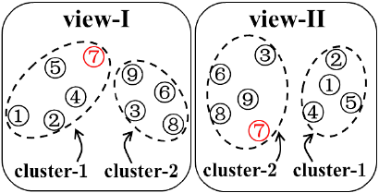
Multi-view Outlier Detection
A basic example:
  Objects {①②④⑤} stand for a group of developers working on project A.
  Objects {③⑥⑧⑨} are working on both projects A and B (e.g., in a managerial role).
  Object ⑦ is a horizontal outlier due to its inconsistent access rights.
AAAI 2018 - Presentation
Notes:
After analyzing the file accesses of users (view-I), we find that object ⑦ has the same access right as the first group {①②④⑤}. From analyzing view-II representing email interactions among users, we find two social network clusters: {①②④⑤} and {③⑥⑦⑧⑨}.

Slide 5
Multi-view Outlier Detection
Fundamental techniques:
  Cluster multi-view data via designed algorithms.
  Detect the anomalous object with inconsistent across-view clustering memberships.
Related works:
  Utilize sophisticated machine learning algorithms, e.g.,
  spectral clustering [HOAD, ICDM’11]
  consensus clustering [SPW’12]
  affinity propagation [AP, CIKM’13]
  Subspace clustering [MLRA, SDM’15]
  K-means clustering [DMOD, IJCAI’15]
  probabilistic latent variable models [NIPS’16]
AAAI 2018 - Presentation
Notes:
[1] J. Gao et al.,“A spectral framework for detecting inconsistency across multi-source object relationships,” ICDM 2011.
[2] A. Y. Liu and D. N. Lam,“Using consensus clustering for multi-view anomaly detection,” IEEE Symp. SPW 2012.
[3] A. M. Alvarez et al.,“Clustering-based anomaly detection in multi-view data,” CIKM 2013.
[4] S. Li et al.,“Multi-view low-rank analysis for outlier detection,” SDM 2015.
[5] H. Zhao and Y. Fu,“Dual-regularized multi-view outlier detection,” IJCAI 2015.
[6] T. Iwata and M. Yamada,“Multi-view anomaly detection via robust probabilistic latent variable models,” NIPS 2016.

Slide 6
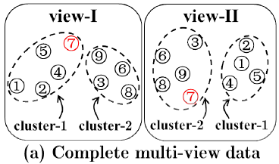
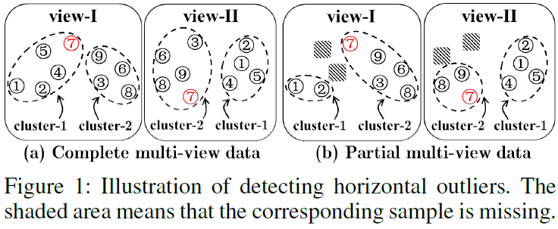
Partial Multi-view Outlier Detection
However,
  In real-world applications, each view may suffer from some missing samples, resulting in partial objects.
  All previous methods assume that all objects are present in both views, hence they may fail to detect horizontal outliers in such partial multi-view scenarios.
AAAI 2018 - Presentation
Notes:
Fig(b) shows a partial multi-view scenario. Object ③ and ⑥ do not have the corresponding samples in view II, meanwhile, object ④ and ⑤ only have the corresponding samples in view II. This situation is more practical, e.g., there may be new users without historical behaviors in a system. After clustering, the outlier (object ⑦) has been identified as an inlier owing to its consistent across-view cluster memberships.

Slide 7
Outline
Introduction
The proposed method
Experiments and analysis
Summary and future work
AAAI 2018 - Presentation

Slide 8










The Proposed Method
Challenges:
  Missing objects.
  Anomalous objects.
Motivation:
  Collective learning (CL):
  Maximize the dependency among all people’s updated knowledge.
  Each person has confidence for what he/she has contributed.
  The learning process and the update of confidence should be iteratively integrated together.
Collective Learning
……
……
……
AAAI 2018 - Presentation
Notes:
Borrowed from the realm of pedagogy, CL draws on a wide body of theories related to psychology and sociology. It is generally conceptualized as a dynamic process of knowledge production. Learning emerges due to cumulative interactions where individual knowledge is disseminated, diffused, and further shared. Therefore, CL can be conceived as an evolutionary process of perfecting collective knowledge.

Slide 9
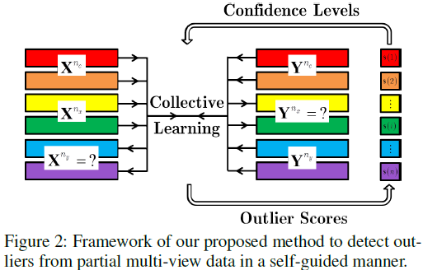


The Proposed Method
Framework:
Model:
AAAI 2018 - Presentation

Slide 10
Outline
Introduction
The proposed method
Experiments and analysis
Summary and future work
AAAI 2018 - Presentation

Slide 11
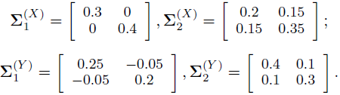

Experimental Setup
Datasets description
  Synthetic Dataset: 200 data points randomly selected from a two-component Gaussian mixture model:
  Oxford Flowers Dataset (Flowers): 17 flower classes, with 80 images per class. _x001f_χ² distance matrices of color and shape features as different views.
  USPS-MNIST Dataset: 50 images per digit from each dataset (USPS: 16×16, MNIST: 28×28)
AAAI 2018 - Presentation

Slide 12
Experimental Setup
Settings:
  Missing sample: delete samples evenly for both views according to the Partial Object Ratio (POR).
  Outlier: take two objects from different classes and swap their samples in one view but not in the others. Randomly perturb 10% of all data in that way.
Comparing algorithms
  HOAD [ICDM’11]
  MLRA [SDM’15]
  AP [CIKM’11]
  DMOD [IJCAI’15]
  *Pre-process: For each missing sample, use the linear combination (weighed by similarities) of its 5 nearest neighbors that appear in both views.
AAAI 2018 - Presentation
Notes:
[1] J. Gao et al.,“A spectral framework for detecting inconsistency across multi-source object relationships,” ICDM 2011.
[2] A. M. Alvarez et al.,“Clustering-based anomaly detection in multi-view data,” CIKM 2013.
[3] S. Li et al.,“Multi-view low-rank analysis for outlier detection,” SDM 2015.
[4] H. Zhao and Y. Fu,“Dual-regularized multi-view outlier detection,” IJCAI 2015.

Slide 13
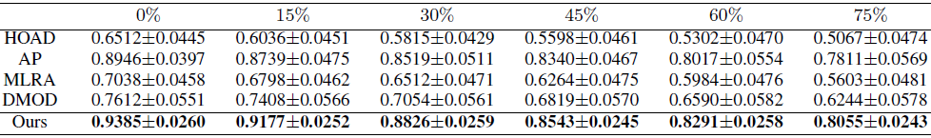
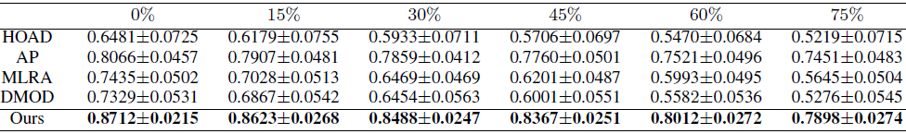
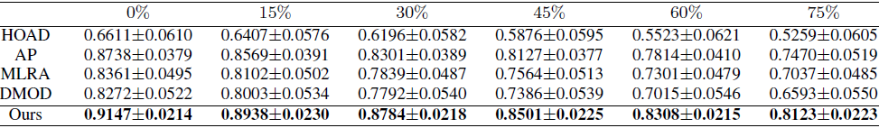
Results (AUC) and Analysis
Synthetic
Flowers
USPS-MNIST
  Our proposed method outperforms state-of-the-art methods even though Partial Object Ratio (POR) increases.
AAAI 2018 - Presentation
Notes:
Area Under ROC Curve (AUC)

Slide 14
Outline
Introduction
The proposed method
Experiments and analysis
Summary and future work
AAAI 2018 - Presentation

Slide 15
Summary and Future Work
In this paper,
  A self-guided partial multi-view outlier detection method is proposed based on collective learning.
  An effective algorithm with closed-form solutions is developed for learning-based missing samples recovery.
  Similarity-based outlier scores are designed for outlier detection, which in turn guides the process of learning.
In the future,
  Apply the strategy of collective learning into
  generative models
  combination of data & knowledge driven methods
  ……
AAAI 2018 - Presentation

Slide 16
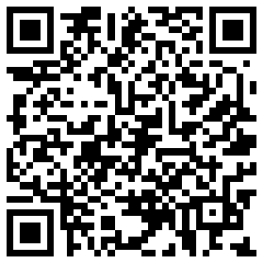
Thank you! (Q&A)
Jun Guo¹ and Wenwu Zhu¹²
¹Tsinghua-Berkeley Shenzhen Institute (TBSI), Tsinghua University, China
²Department of Computer Science and Technology, Tsinghua University, China
Email: eeguojun@outlook.com
Source code released at https://sites.google.com/site/eeguojun
QR code for Homepage
AAAI 2018 - Presentation

