Slide 1
Locality Sensitive Discriminative
Dictionary Learning (ICIP 2015)
Jun Guo*, Yanqing Guo, Yi Li, Bo Wang, Ming Li
School of Information and Communication Engineering,
Dalian University of Technology, China
guojun@mail.dlut.edu.cn
ICIP 2015 - Presentation

Slide 2
Outline
Introduction
Motivation of Our Work
The Proposed Method
Experimental Results
Summarization and Future Work
ICIP 2015 - Presentation
<number>/21

Slide 3
Outline
Introduction
Motivation of Our Work
The Proposed Method
Experimental Results
Summarization and Future Work
ICIP 2015 - Presentation
<number>/21

Slide 4
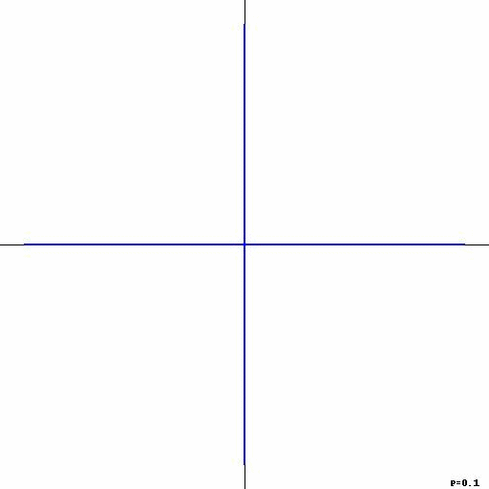






Dictionary Learning (DL)
A basic framework of DL:
  Training data:
  Dictionary:
  Coding vectors:
  Regularization parameter:
Emphasize representation rather than discrimination!
ICIP 2015 - Presentation
<number>/21

Slide 5
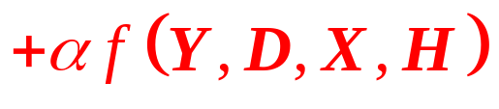
Discriminative Dictionary Learning (DDL)
A general formula of DDL:
  Structured incoherence of dictionary
  Fisher discrimination on the dictionary and codes
  Label consistency of codes
  Transform-invariance of dictionary
  Joint dictionary learning and subspace clustering
  ……
ICIP 2015 - Presentation
<number>/21

Slide 6
Outline
Introduction
Motivation of Our Work
The Proposed Method
Experimental Results
Summarization and Future Work
ICIP 2015 - Presentation
<number>/21

Slide 7
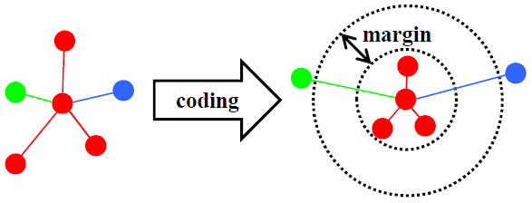
Motivation of Our Work
Illustration:
  DDL + kNN classifier
  In the coding space:
  same-label neighbors are orderly preserved
  neighbors with different labels are repelled
Maximize the local margin between different classes.
ICIP 2015 - Presentation
<number>/21

Slide 8
Motivation of Our Work
Illustration:
  Integrate two significant characters into DL
  preserve ordinal locality
  strengthen discriminability
Locality Sensitive Discriminative Dictionary Learning
(LSDDL)
ICIP 2015 - Presentation
<number>/21

Slide 9
Outline
Introduction
Motivation of Our Work
The Proposed Method
Experimental Results
Summarization and Future Work
ICIP 2015 - Presentation
<number>/21

Slide 10




The Proposed Method
Construct two graphs via Gaussian kernel:
  a within-class graph
  the corresponding weight matrix
  a between-class graph
  the corresponding weight matrix
ICIP 2015 - Presentation
<number>/21

Slide 11




The Proposed Method
Determine a “good” coding process:
  same-label neighbors are orderly preserved
  neighbors with different labels are repelled
Rewrite the objective:
ICIP 2015 - Presentation
<number>/21

Slide 12




The Proposed Method
The final objective function:
Alternating Optimization
  Compute column by column with fixed
  Update with fixed
  Alternatively minimized until convergence
ICIP 2015 - Presentation
<number>/21

Slide 13


The Proposed Method
Alternating Optimization
  Compute column by column with fixed
  First derivative:
  Second derivative:
  The objective function is convex for
  Optimal solution
ICIP 2015 - Presentation
<number>/21

Slide 14



The Proposed Method
Alternating Optimization
  Update with fixed
  First derivative:
  Second derivative:
  The objective function is convex for
  Optimal solution
ICIP 2015 - Presentation
<number>/21

Slide 15
Outline
Introduction
Motivation of Our Work
The Proposed Method
Experimental Results
Summarization and Future Work
ICIP 2015 - Presentation
<number>/21

Slide 16
Experimental Setup
Datasets and Features
  Extended YaleB: 504-dimensional random-face features
  AR: 540-dimensional random-face features
  Caltech 101: 3000-dimensional BoVW+SPM features
Comparing Algorithms
  the baseline support vector machine (SVM)
  the classical SRC [PAMI 2009] and CRC [ICCV 2011]
  the novel locality-sensitive SRC (LSRC) [PR 2013]
  the other famous DL methods: DLSI [CVPR 2010], FDDL [ICCV 2011], LC-KSVD [PAMI 2013], DDL-PC [ACCV 2012]
  the recently proposed LPDDL [ICIP 2014]
ICIP 2015 - Presentation
<number>/21

Slide 17
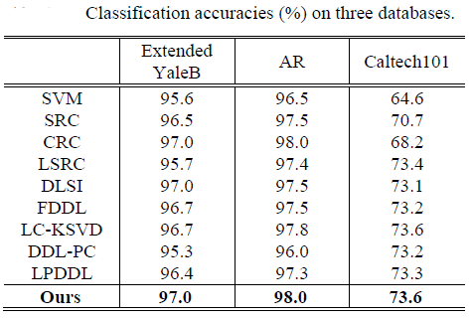
Results
ICIP 2015 - Presentation
<number>/21

Slide 18
Outline
Introduction
Motivation of Our Work
The Proposed Method
Experimental Results
Summarization and Future Work
ICIP 2015 - Presentation
<number>/21

Slide 19
Summarization
Conclusion
  Performance is competitive with previous arts.
  The locality sensitive objective function is useful to DDL + kNN classifier.
Main Contribution
  Preserve local relationship of same-label points and induce a margin between points from different classes.
  Utilize analytical solutions in both dictionary learning and coding phases.
ICIP 2015 - Presentation
<number>/21

Slide 20
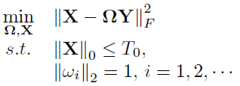
Future Work
Reducing the consumed time for cross-validation in the training phase.
Generalize our work to analysis dictionary learning framework:
R. Rubinstein, A. M. Bruckstein, and M. Elad. Dictionaries for sparse representation modeling. Proc. IEEE, 98(6):1045-1057, Jun. 2010.
ICIP 2015 - Presentation
<number>/21

Slide 21
Thank you!
Questions please?
ICIP 2015 - Presentation
<number>/21

