Slide 1





Unsupervised Feature Selection
with Ordinal Locality
Jun Guo^{1*}, Yanqing Guo², Xiangwei Kong², and Ran He³
¹Tsinghua-Berkeley Shenzhen Institute, Tsinghua University, P. R. China
²Dalian University of Technology, P. R. China
³National Laboratory of Pattern Recognition, Institute of Automation,
Chinese Academy of Sciences, P. R. China
eeguojun@outlook.com
ICME 2017 - Presentation

Slide 2
Outline
Introduction
The proposed method
Experiments and analysis
Summarization
ICME 2017 - Presentation

Slide 3
Outline
Introduction
The proposed method
Experiments and analysis
Summarization
ICME 2017 - Presentation

Slide 4
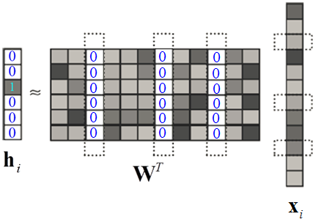
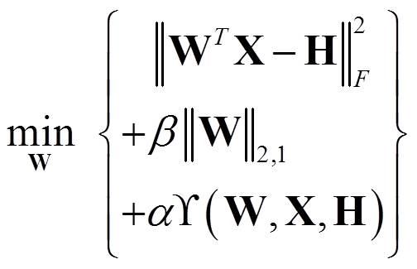



Regression Based Feature Selection
  Original data matrix:
  Target matrix:
  Feature selection matrix:
  Regularization term:
ICME 2017 - Presentation

Slide 5
Regression Based Feature Selection
In supervised scenarios:
  is usually a label matrix.
In unsupervised scenarios:
  is frequently determined by learning accurate pseudo labels through some classical machine learning algorithms, such as
  linear regression [UDFS, IJCAI’11]
  spectral clustering [NDFS, AAAI’12]
  K-means clustering [RUFS, IJCAI’13]
  bi-orthogonal semi-NMF [SOCFS, CVPR’15]
ICME 2017 - Presentation
Notes:
[1] Y. Yang, et al., “l2;1-norm regularized discriminative feature selection for unsupervised learning,” IJCAI 2011.
[2] Z. Li, et al., “Unsupervised feature selection using nonnegative spectral analysis,” AAAI 2012.
[3] M. Qian and C. Zhai, “Robust unsupervised feature selection,” IJCAI 2013.
[4] D. Han and J. Kim, “Unsupervised simultaneous orthogonal basis clustering feature selection,” CVPR 2015.

Slide 6
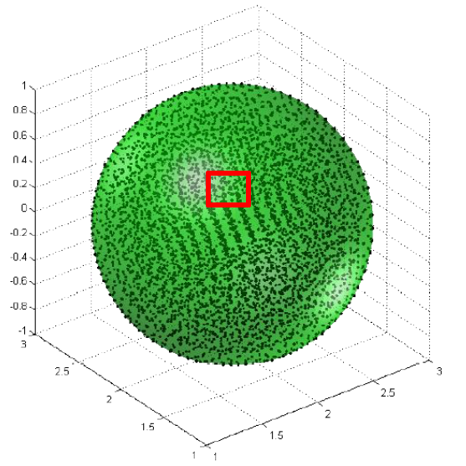
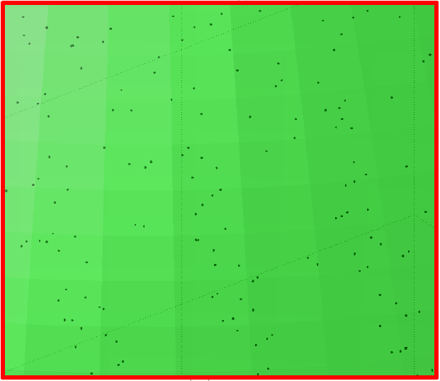





Regression Based Feature Selection
For the regularization term:
  Most existing methods focus on preserve pairwise relationship (such as locality) to help clustering.
  However, ordinal information is neglected.
ordinal locality:
1 → 2 → 3 → 4
ICME 2017 - Presentation
Notes:
Ordinal locality can be understood as the distance ranking of neighbors.

Slide 7
Outline
Introduction
The proposed method
Experiments and analysis
Summarization
ICME 2017 - Presentation

Slide 8
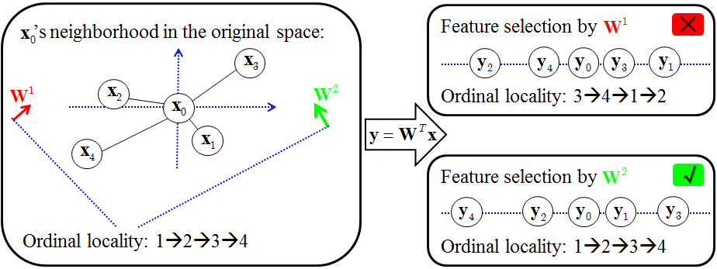

The Proposed Method
Preserve ordinal information:
  Definition 1: A feature selection process is called ordinal locality preserving when the following condition holds: if , then
ICME 2017 - Presentation

Slide 9
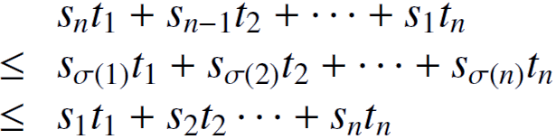






The Proposed Method
Preserve ordinal information:
  Optimize:
  is antisymmetric. =
  indicates the k nearest neighbors of .
Rearrangement Inequality
If real numbers and , then
where is the permutation of .
ICME 2017 - Presentation
Notes:
[1] https://en.wikipedia.org/wiki/Rearrangement_inequality
Note that the rearrangement inequality makes no assumptions on the signs of the real numbers.
The lower bound is attained only for the permutation which reverses the order.
The upper bound is attained only for the identity.

Slide 10

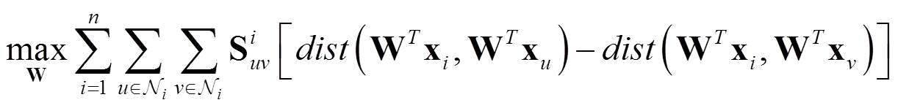
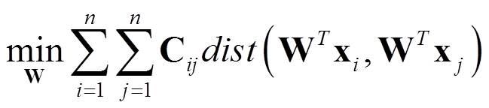


The Proposed Method
Preserve ordinal information:
  Then, we can obtain a triplet-induced loss function w.r.t. :
  Equivalent representation: (Proposition 1 in our paper)
  For simplicity, we use squared Euclidean distance, then we obtain: .
, where
ICME 2017 - Presentation
Notes:
The Cij denotes a triplet-induced weighting for graph.
L is the corresponding Laplacian matrix of C.

Slide 11
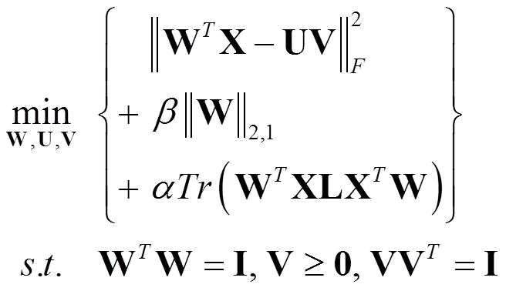
The Proposed Method
Overall objective function:
Optimization:
  Update W by half-quadratic technique [PAMI’14].
  Update U and V via K-means [KDD’06].
  Alternatively minimized until convergence.
Feature selection
W
K-means clustering
{U,V}
ICME 2017 - Presentation
Notes:
[1] R. He, et al., “Half-quadratic-based iterative minimization for robust sparse representation,” TPAMI 2014.
[2] C. Ding, et al., “Orthogonal nonnegative matrix tri-factorizations for clustering,” KDD 2006.

Slide 12
Outline
Introduction
The proposed method
Experiments and analysis
Summarization
ICME 2017 - Presentation

Slide 13
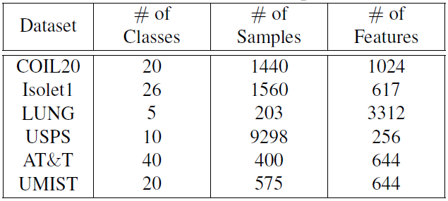
Experimental Setup
Datasets description
Comparing Algorithms
  the baseline using all feature dimensions (All Features)
  the classical Laplacian Score (LS) [NIPS’05]
  other famous methods: MCFS [KDD’10], UDFS [IJCAI’11], NDFS [AAAI’12], RUFS [IJCAI’13], SOCFS [CVPR’15]
object image dataset
spoken letter recognition dataset
cancer dataset
handwritten digit dataset
face image dataset
face image dataset
ICME 2017 - Presentation
Notes:
[1] X. He, et al., “Laplacian score for feature selection,” NIPS 2005.
[2] D. Cai, et al., “Unsupervised feature selection for multi-cluster data,” KDD 2010.

Slide 14
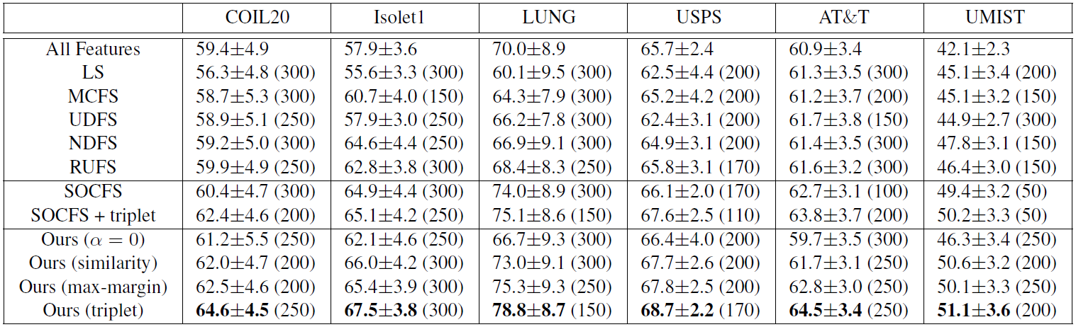
Results and Analysis
  Our proposed method achieves higher accuracies than other methods.
  Triplet is more effective than doublet for feature-selection-based clustering.
ICME 2017 - Presentation
Notes:
We also evaluate SOCFS with a triplet-induced regularization.
We also evaluate our general framework with ①alpha = 0; ②similarity-based graph; ③maximum-margin-based graph.

Slide 15
Outline
Introduction
The proposed method
Experiments and analysis
Summarization
ICME 2017 - Presentation

Slide 16
Summarization
Main contributions
  A triplet induced loss function is proposed to capture the underlying ordinal locality of data.
  A general framework is derived for simultaneous feature selection and clustering.
  An alternating minimization algorithm is developed to speed up the optimization process.
Future work
  Exploit feature-level ordinal locality.
  The i^{th} projection vector and the i^{th} dimension of feature share the one-to-one correspondence.
ICME 2017 - Presentation

Slide 17

Thank you! (Q&A)
Jun Guo^{1*}, Yanqing Guo², Xiangwei Kong², and Ran He³
¹Tsinghua-Berkeley Shenzhen Institute, Tsinghua University, P. R. China
²Dalian University of Technology, P. R. China
³National Laboratory of Pattern Recognition, Institute of Automation,
Chinese Academy of Sciences, P. R. China
Email: eeguojun@outlook.com
Source code released at https://sites.google.com/site/eeguojun
ICME 2017 - Presentation
QR code

Slide 18
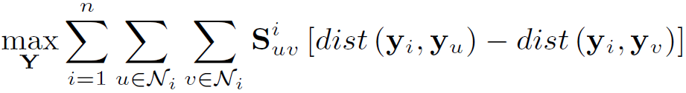

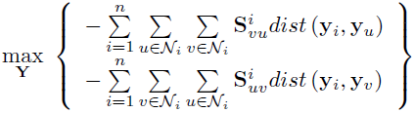
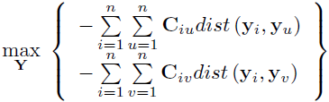
Proposition 1
The following ordinal locality preserving loss function
is equivalent to
ICME 2017 - Presentation
Notes:
Proof of proposition 1.

