Slide 1


Topology Preserving Dictionary Learning for
Pattern Classification
Jun Guo¹, Yanqing Guo^{1*}, Bo Wang¹, Xiangwei Kong¹, Ran He^{2*}
¹School of Information and Communication Engineering,
Dalian University of Technology, Dalian, China
²The Center for Research on Intelligent Perception and Computing,
National Laboratory of Pattern Recognition,
Institute of Automation, Chinese Academy of Sciences, Beijing, China
E-mail: guoyq@dlut.edu.cn, rhe@nlpr.ia.ac.cn
IJCNN 2016 - Presentation
Notes:
Hello, everyone, I’m going to introduce our work “Topology Preserving Dictionary Learning for Pattern Classification”.

Slide 2
Outline
Introduction
The Proposed Method
Experiments
Conclusions
IJCNN 2016 - Presentation

Slide 3
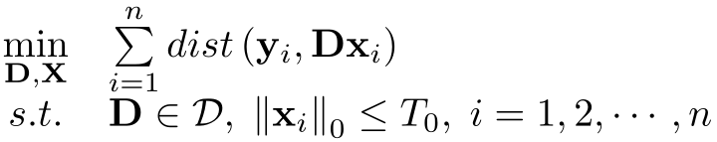
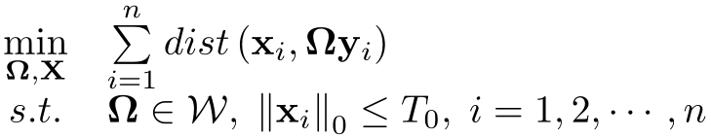
Dictionary Learning (DL)
Core idea of DL:
  Learn an optimized dictionary which can effectively represent each sample in
Two major branches of DL:
  Synthesis DL:
  Analysis DL:
IJCNN 2016 - Presentation
Notes:
Dictionary Learning (DL) has been successfully applied to various tasks in recent years.
Its core idea is to learn an optimized dictionary to effectively represent the data.
There are two major branches of DL: ①Synthesis DL; ②Analysis DL.
The function dist(·,·) is a distance metric.
There are few works that focus on improving the classification performance of Analysis DL.
So we study how to better apply Analysis DL into pattern classification in this paper.

Slide 4
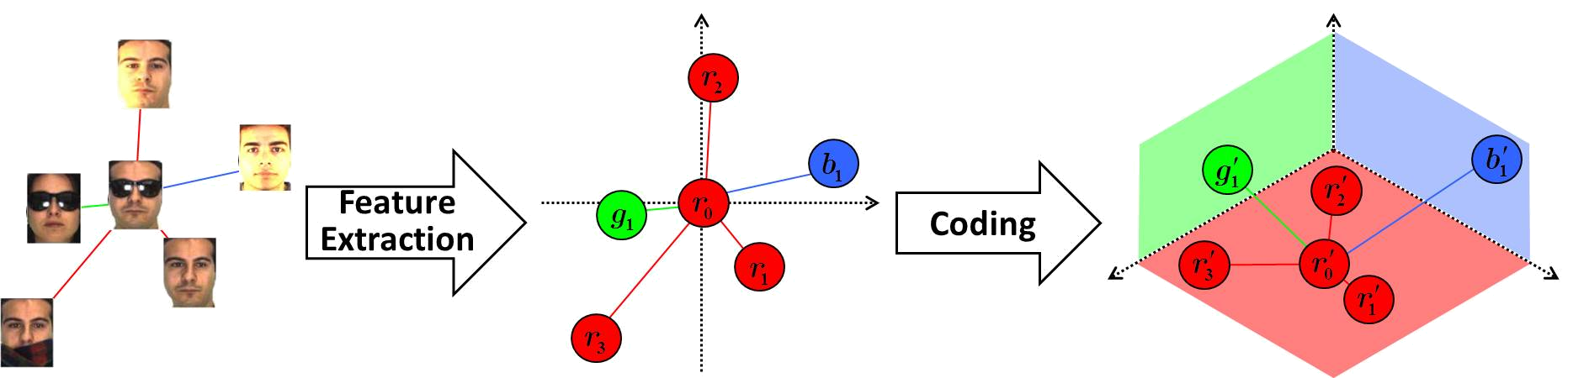
Motivation of Our Work
Illustration:
  Integrate two significant characters into Analysis DL
  ① strengthen discriminability
  ② preserve local topology structure
  Better control outliers and noise for classification
  ③ employ Huber M-estimator instead of Mean Square Error
Topology Preserving Dictionary Learning (TPDL)
IJCNN 2016 - Presentation
Notes:
To improve the classification performance of Analysis DL, we integrate two significant characters into Analysis DL.
Besides, to better control outliers and noise for classification, we employ Huber M-estimator.
In the next pages, we will introduce them in detail.

Slide 5
Outline
Introduction
The Proposed Method
Experiments
Conclusions
IJCNN 2016 - Presentation

Slide 6
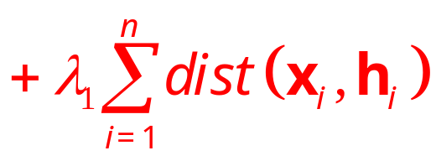
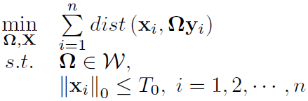
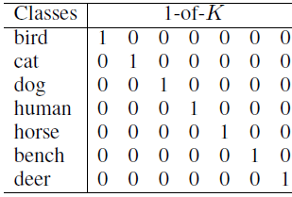


The Proposed Method
① Strengthen discriminability:
  Integrate a code consistent term:
  Generate target codes by Kronecker product , e.g.:
Kronecker product
target code
IJCNN 2016 - Presentation
Notes:
To strengthen discriminability, a code consistent term is integrated.
h₁, h₂, ..., h_{K} are target cods for K classes.
The left is an example of low-dimensional codes for a 7-class case.
To generate high-dimensional target codes, we can employ the Kronecker product.

Slide 7



The Proposed Method
② Preserve local topology structure:
  Definition 1: A coding process is called local topology preserving when the following condition holds: if , then
  Determining appropriate for :
  is an antisymmetric matrix.
This loss is an unsupervised type, neglecting labels.
IJCNN 2016 - Presentation
Notes:
To preserve local topology structure, we first give a definition of local topology preserving.
Based on this definition, we need to maximize the loss for each xi.
This loss is novel, but it neglects labels.

Slide 8




The Proposed Method
② Preserve local topology structure:
  Considering each sample’s label:
  Replace with that is also antisymmetric:
  Reformulate: (please refer to Proposition 1 in our paper)
, where
IJCNN 2016 - Presentation
Notes:
Considering each sample’s label, we replace A_{i} with a supervised type matrix.
So that in the coding space: same-label neighbors are orderly preserved and neighbors with different labels are repelled.
Then, we obtain a supervised loss function. This function can be reformulated as a compact form.
To directly learn the analysis dictionary \Omega, we replace x with \Omega*y.

Slide 9
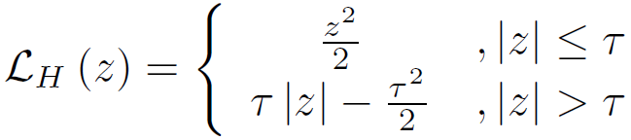
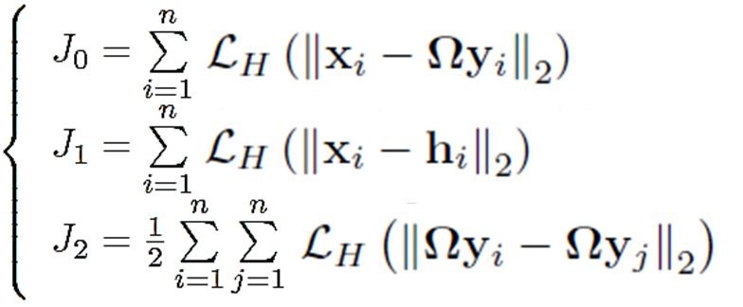
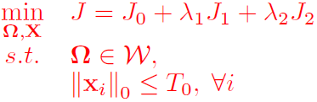
The Proposed Method
③ Employ Huber M-estimator for robustness:
  Huber loss function:
  more robust to errors (e.g., outliers and noise)
  Final objective function:
IJCNN 2016 - Presentation
Notes:
Finally, we employ Huber M-estimator as a robust measure to better control outliers and noise for classification.
The final objective function of our proposed Topology Preserving Dictionary Learning method takes the following form.

Slide 10




Optimization
Half-quadratic (HQ) technique:
  For a fixed , there exists a dual potential function , such that
  The infimum is reached at .
Optimize the augmented function:
  Update the analysis dictionary and sparse codes.
  Update auxiliary variables introduced by HQ.
  Alternatively minimized until convergence.
IJCNN 2016 - Presentation
Notes:
According to the half-quadratic technique, we have the following Lemma.
p is an auxiliary variable introduced by half-quadratic.
Based on this Lemma, we develop an iterative algorithm to optimize our objective function.

Slide 11
Outline
Introduction
The Proposed Method
Experiments
Conclusions
IJCNN 2016 - Presentation

Slide 12
Experimental Setup
Datasets and Features
  AR: 540-dimensional random-face features
  Extended YaleB: 504-dimensional random-face features
  Caltech 101: 3000-dimensional BoW+SPM features
  UCF 50: 5000-dimensional BoW+SPM features
Comparing Algorithms
  the baseline Support Vector Machine (SVM) and Nearest Subspace Classifier (NSC)
  the classical SRC [PAMI 2009] and CRC [ICCV 2011]
  other famous DL methods: DLSI [CVPR 2010], FDDL [ICCV 2011], LC-KSVD [PAMI 2013]
IJCNN 2016 - Presentation
Notes:
The features used in the two face datasets are random-face features, referring to SRC published in PAMI 2009.
The features used in the other two visual datasets are features generated by standard Bag-of-Words and Spatial Pyramid Matching.
The Comparing Algorithms are listed as follows.

Slide 13
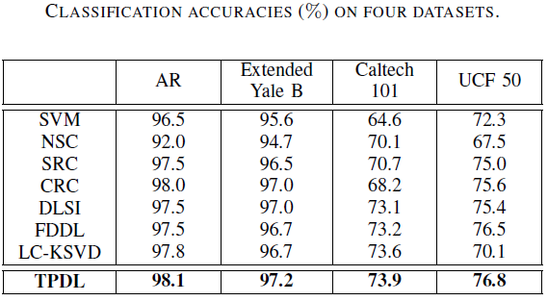
Results and Analysis
Our proposed TPDL method achieves higher accuracies than other dictionary learning methods.
IJCNN 2016 - Presentation
Notes:
From this table, we can obtain that our proposed Topology Preserving Dictionary Learning method achieves higher accuracies than other dictionary learning methods.
Note that for some datasets, all the competitors achieve over 95% accuracy, so our method’s improvement is not visibly big.

Slide 14
Outline
Introduction
The Proposed Method
Experiments
Conclusions
IJCNN 2016 - Presentation

Slide 15
Conclusions
We can conclude:
  Our proposed TPDL method performs better in pattern classification than state-of-the-art dictionary learning (DL) methods.
  The local topology preserving loss function is useful to Analysis DL + kNN classifier.
  Analysis DL models can outperform synthesis models in pattern classification tasks if discriminative information is well treated.
IJCNN 2016 - Presentation

Slide 16
Thank you! (Q&A)
Jun Guo¹, Yanqing Guo^{1*}, Bo Wang¹, Xiangwei Kong¹, Ran He^{2*}
¹School of Information and Communication Engineering,
Dalian University of Technology, Dalian, China
²The Center for Research on Intelligent Perception and Computing,
National Laboratory of Pattern Recognition,
Institute of Automation, Chinese Academy of Sciences, Beijing, China
E-mail: guoyq@dlut.edu.cn, rhe@nlpr.ia.ac.cn
IJCNN 2016 - Presentation

