Slide 1
ALiSS
Adaptive Links Suggestion Service
Antonio De Marinis (EEA)
Alec Ghica (Finsiel RO), Sasha Vinčić (Systemvaruhuset)
29 Sep 2005

Slide 2
Presentation schedule
Main concepts
ALiSS definition
ALiSS use cases
Live demo (prototype)
(System architecture and API)
Further work

Slide 3
Main concepts
Software Agent Definitions
  “In computer science, a software agent is a piece of autonomous, or semi-autonomous proactive and reactive, computer software. Many individual communicative software agents may form a multi-agent system.” (wikipedia)
Ontology Definitions
  “An explicit formal specification of how to represent the objects, concepts, and other entities that are assumed to exist in some area of interest and the relationships that hold among them.” (dli.grainger.uiuc.edu/glossary.htm)
Semantic Web Definitions
  “The web of data with meaning in the sense that a computer program can learn enough about what it means to process it.” (Tim Berners-Lee)

Slide 4
ALiSS definition and goal
ALiSS is a software agent - more precisly an adaptive web agent - which makes use of specific ontologies in order to semantically organise, adapt and relate information on the web - making one step towards the Semantic Web.
Goal:
The goal is to assist the user in navigating the web. The user will find the right information at the right time and context.
The webmaster will not have to manually create and maintain a large number of links and related information.
ALiSS will take care of this!

Slide 5
Use cases
”Live Search”
”What does it mean?”
“Related Pages”
“Auto Site Index” and “Auto Site Map”
“Web Virtual Assistant/Agent”: type your question and the virtual assistant will try to point to relevant information resources. = Live Search
“External sites monitoring / competitors monitoring”: monitor external sites for specific terms and take specific actions when such terms appears.
”Personalisation / My web alerts portal”

Slide 6
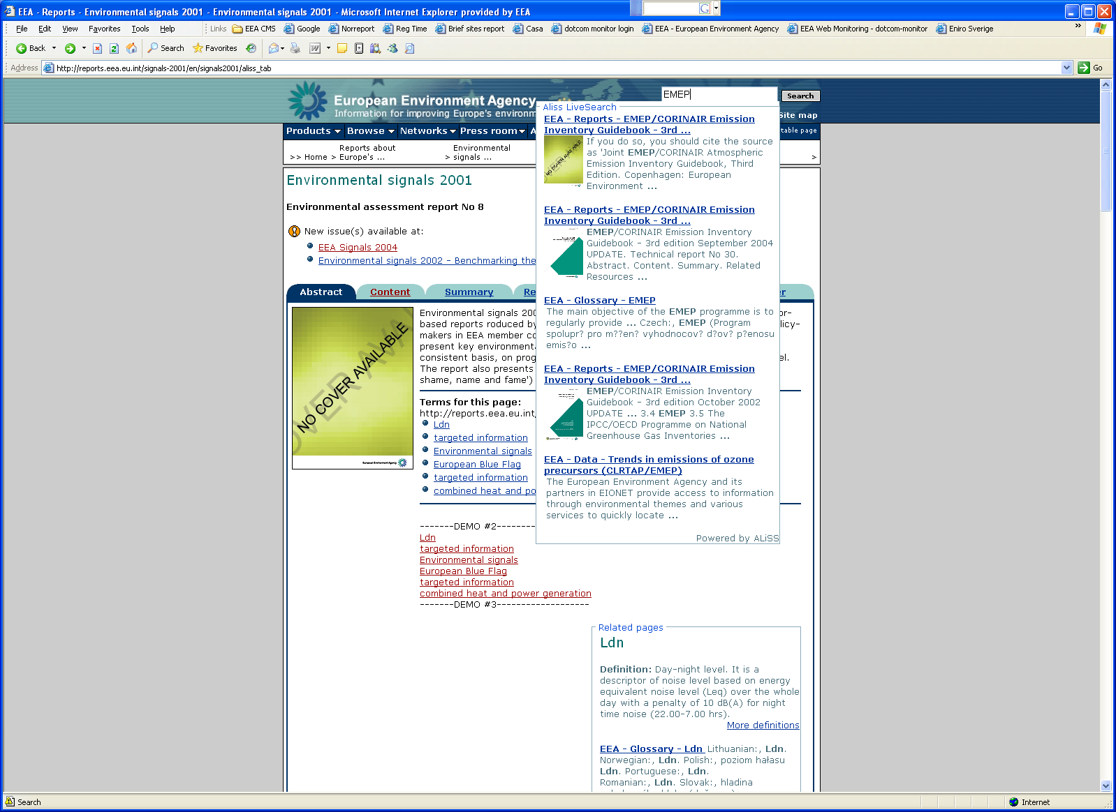
Live search
return top pages while user is typing

Slide 7
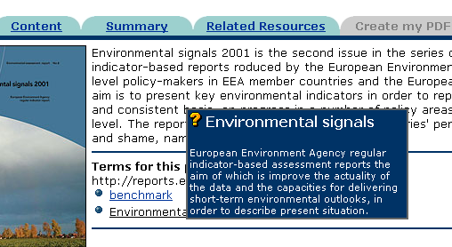
What does it mean?
(Auto Glossary/Web SmartTags)
Highlight terms, show definition about terms on mouse over (in side area or within text)

Slide 8
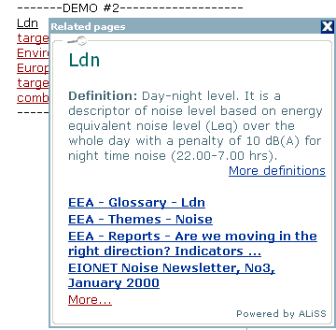
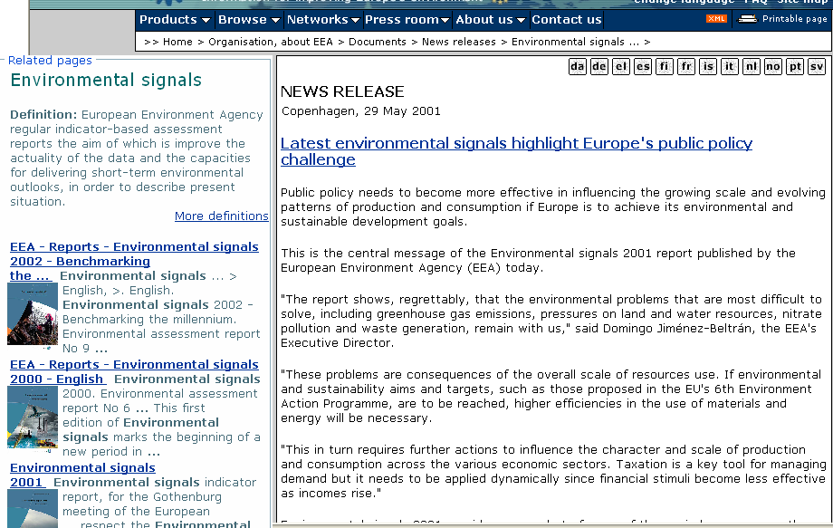
Related Pages
Show related pages organized in content groups or by subjects/terms.
Tool-tip within text
Side by side

Slide 9
Auto Site Index / Site Map
A-Z index
TermA
Webpage 1
Webpage 2
TermB
Webpage 3
TermC
Webpage 4
TermD
Webpage 3
Webpage 5
Webpage 1
Hierarchical (site map)
TermA
Webpage 1
Webpage 2
TermB
Webpage 3 TermC
Webpage 4
TermD
Webpage 3
Webpage 5
Webpage 1
Thesauri-driven hierarchical website index

Slide 10
Auto Site Index / Site Map
Combined
TermA
Webpage 1
Webpage 2
See also TermC
TermB
Webpage 4
TermC
Webpage 3
Webpage 5
Webpage 1
See also TermA
Examples:
BBC A-Z index
EEA site map
Content group
“Reports”
TermA
Webpage 1
Webpage 2
TermB
Webpage 3
TermC
Webpage 4
TermD
Webpage 3
Webpage 5
Webpage 1
…
Content group
“Data”
TermE
Webpage 6
Webpage 7
TermF
Webpage 8
TermG
Webpage 9
Webpage 10
Webpage 11
…

Slide 11
Web Virtual Assistant/Agent
Live example (Ikea)

Slide 12
External sites monitoring / competitors monitoring
We could monitor environmental news portal to get the ”hot topics of the day”
Adapt the website to what happens in the news: ”Actuality agent”
  “Semioticians* see actuality as a key device for anchoring the preferred reading on the supposed 'facts' presented 'as they happened'.”
  (www.cultsock.ndirect.co.uk/MUHome/cshtml/media/efterms.html)
  * Semiotician or semanticist: a specialist in the study of meaning

Slide 13
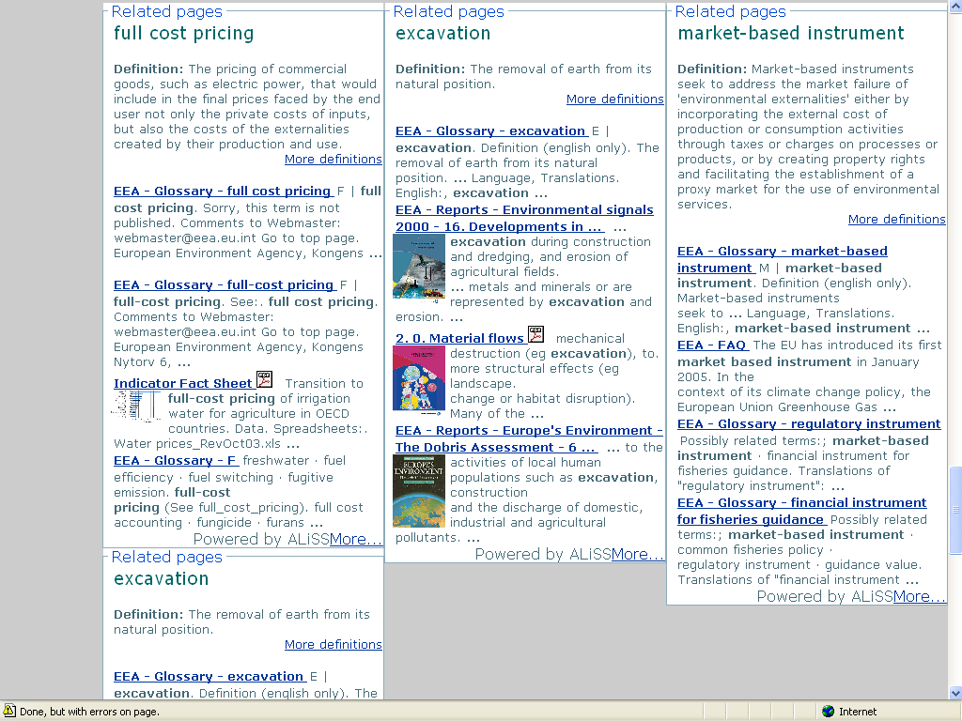
Personalisation - My web alerts portal

Slide 14
ALiSS Live Demo
http://webservices.eea.eu.int/alissBIG
http://glossary.eea.eu.int/EEAGlossary

Slide 15
Architecture overview
Agent servers handles the requests from Agent clients. There can be many Agent servers which each of them have a specific set of rules on how to aggregate content groups and how to delivery the search results to the agent clients. Several agents can build a multi-agent server.
ALiSS
Web services
XML-RPC API
Agent (Server)
Internet
Client web browser
Webpage HTML
It contains indexed content groups search results
Content groups definitions and settings
Catalog
Agent (client)
Java script (Ajax) / Flash
It contains ontologies’ descriptions (thesauri, taxonomies, glossaries) and logic for inference and deductions about the relationships among them. The format for import is RDF / SKOS.
An “agent client” handles the requests to one and only one “Agent server” via XML-RPC and creates an “attractive layout” of the results into the client webpage (HTML and CSS).
Ontologies KB
Internet
Google Box
Google
Google API

Slide 16
Main technolgies and standards
Programming/Logic language: Python
Presentation/Template language: HTML, DTML, Page templates and CSS
Knowledge representation language: RDF/SKOS (XML) and OO database objects
Information protocols / web service API: XML-RPC, SOAP
CMS/Application server: Zope and/or Plone
Modelling: UML
Testing: Unit Testing
Perfomance / stability: Load balancing on ZEO, advanced cache mechanisms and indexing

Slide 17
ALiSS Web Service API
getTermsForPage(PageURL)
getTopPagesForTerms(Terms)
getRelatedTermsForTerm(Term,RelationType)
getRelatedPagesForPage(PageURL,RelationType)
getTermSuggestions(PartOfTerm)

Slide 18
Further work and resources
Content groups setup, real world tests and fine-tuning
Relations from thesauri and taxonomies (ex from Gemet)
Deduction logic of relations among pages based on relation among terms
Investigate the use of inference engine (OpenCyc) and KB for ”reasoning about pages”
We need continuos update of EEA glossary, Gemet and other ontology systems. They constitute”brain” of ALiSS.

Slide 19
Thanks for your attention !

