Slide 1

16/01/2023 – Reportnet 3 Architecture
Pekka Niikkonen - Christian-Xavier Prosperini
Reportnet 3 – 2023 Architectural changes
Notes:
This presentation needs to be viewed in slideshow mode

Slide 2
Current situation
Many dataflow deliveries failing
Data processing of deliveries fail due to:
High volumes of data
Complex QC rules
Bottlenecks in database design and structure
Failures because of long run times
Can lead to cancellations or timeouts and failures
Networking issues
Often temporary
Can lead to timeouts and failures
Data export does not match the import (data consistency)
Reportnet

Slide 3


Workflow today
Human intervention required
Process can fail at any step due to
High data volumes & complex QC rules
Time it takes to identify and resolve issues
Provider-Helpdesk-Dev-and back and forth, Time: 9-17 vs 17-9
Human intervention is prone to errors
Takes long time due to high volume of incoming issues
VOLUME
VOLUME
VOLUME
VOLUME
START
IMPORT
VALIDATE
RELEASE
STOP
TIME
TIME
TIME
TIME

Slide 4

First architectural change - Orchestrator
Orchestrator works in the background
Manages and monitors workflows
Steps in to resolve when problems occur
Reduces need for human intervention
Faster identification of issues
Addresses failures before reported by users
Not 100% coverage yet but monitoring tools and dashboard help v-team to react faster
Orchestrator
VOLUME
VOLUME
VOLUME
VOLUME
START
IMPORT
VALIDATE
RELEASE
STOP
TIME
TIME
TIME
TIME

Slide 5
Test setup with orchestrator in place
Two E2E test runs in parallel on each with real data
200K records imported
400K records imported
Testing with up to 2M records this week
Repeated test runs to ensure consistency of results

Slide 6
Test results with orchestrator on steps involved
Step | 200k records | 400k records
Import | 10 min | 1 hour
Validate | 4 hours | 2 hours
Release | 5 min | 12 min

Slide 7
Observations and results before orchestrator
Happy path
~14 hours for big datasets
START
IMPORT
1 hour
VALIDATE
8 hours
RELEASE
5 hours
STOP
Idle Time (1h)
17-9 time

Slide 8
Observations and results before orchestrator
Validation stuck
~18-22 hours for big datasets
START
IMPORT
1 hour
VALIDATE
Stuck
RELEASE
5 hours
STOP
Idle Time (1h)
17-9 Time
Recovery Time
(9am to 1pm)

Slide 9

Observations and results with orchestrator
Validation stuck with orchestrator addressing issue
~14 hours for big datasets
START
IMPORT
1 hour
VALIDATE
Stuck
RELEASE
5 hours
STOP
Idle Time (1h)
17-9 Time
Recovery Time
(9am to 1pm)

Slide 10
Second wave of architectural changes
What’s the path to address these issues?
Priority | Description | Severity
1 | Ensure stability with automation (orchestrator) | Critical
2 | Investigate alternative database systems | High
2 | Increase scalability (data storage system) | High
2 | Improve performance and stability (ongoing) | Medium

Slide 11
Draft initial timeline
Orchestrator deployed in production
27-01-2023
Initiation & Planning
Execution
Mar
April
Jan
Feb
Scope for next steps
Charter
Plan for next steps

Slide 12
End

Slide 13
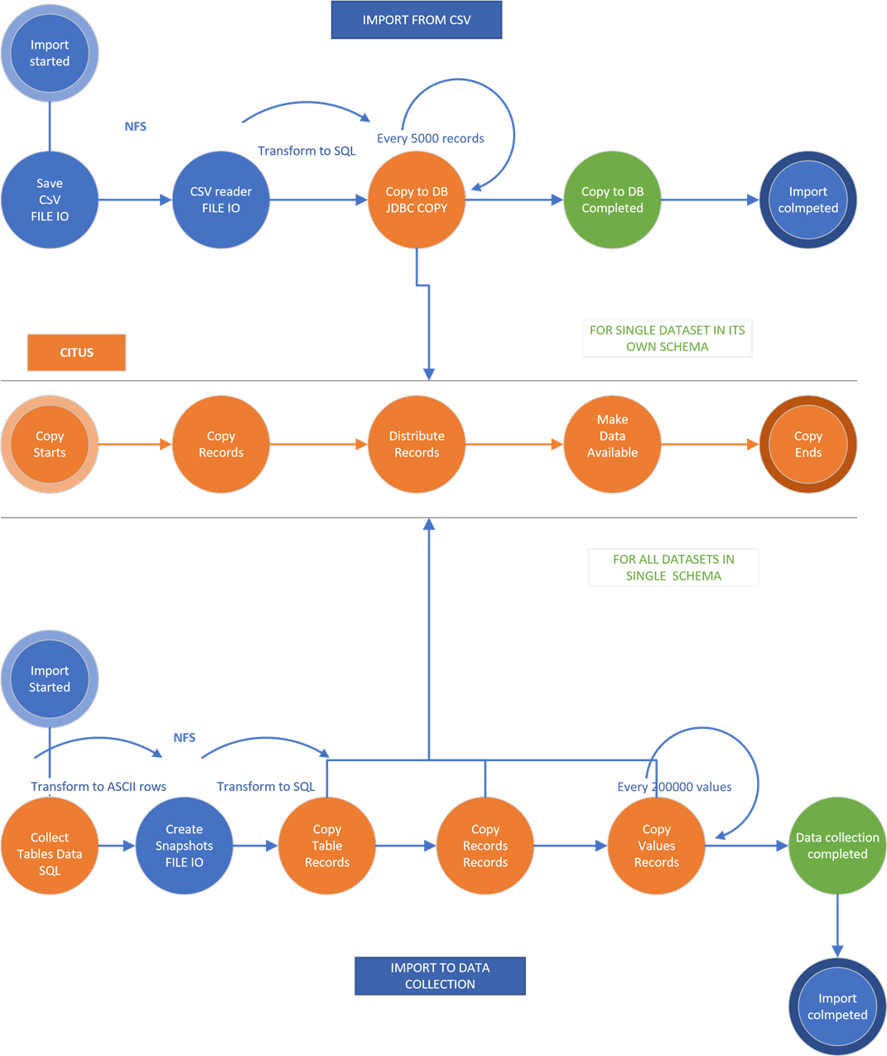
Import to dataset and Import to data collection paths (in relation to citus)
DB process
Java process
Java
Cleanup
process

Slide 14
Orchestrator Queues and step recovery (Architecture modifications)

Slide 15
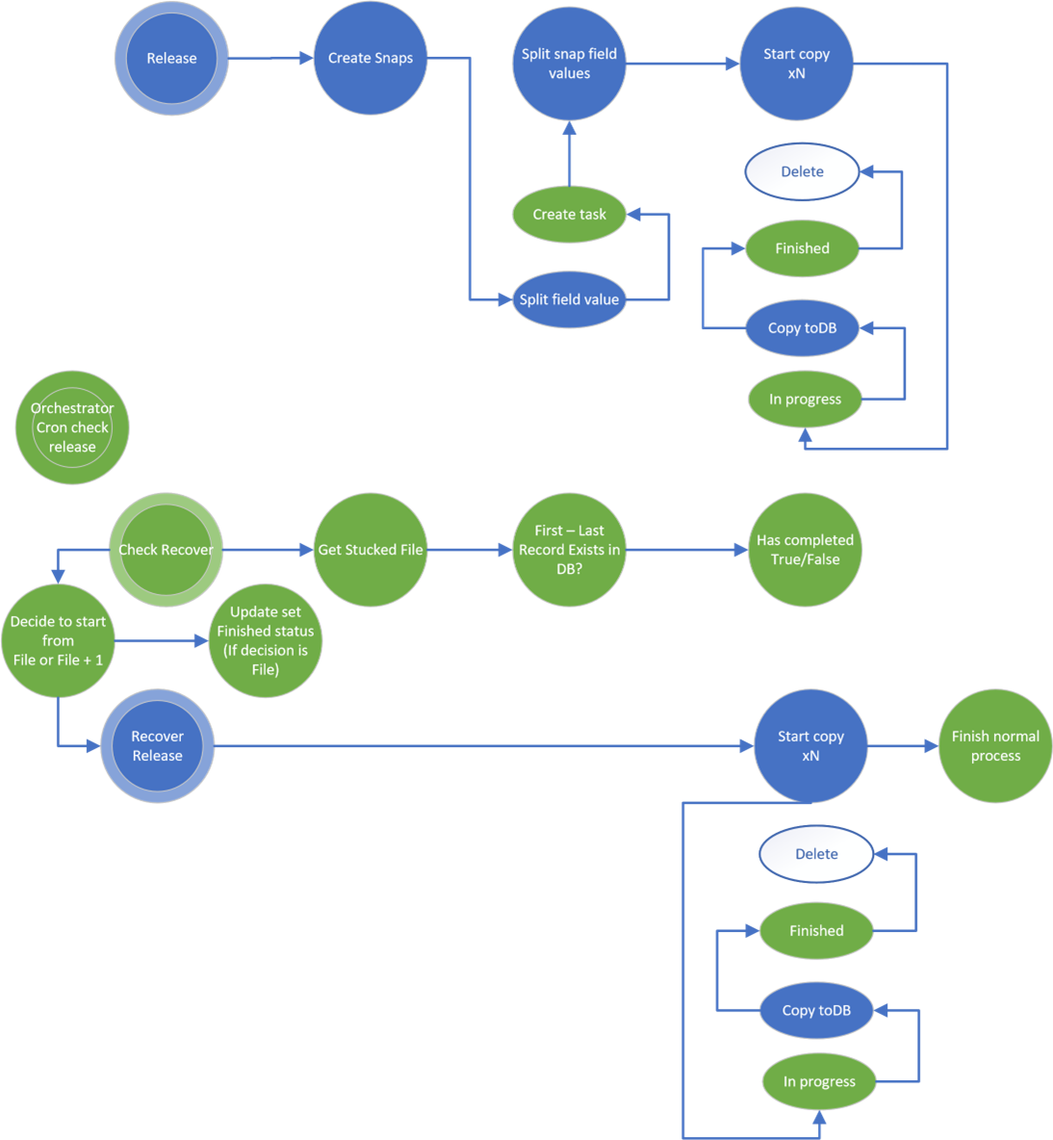

Release step
Microservice API calls
Recover
Status
(
Delete
Notification
cleanup
)

Slide 16
Time needed to address incoming issues now
Issues piling up with high volume providers
Most get escalated to development team
We have limited number of resources (people)
Ticket for issues for cars/vans opened on Sep 29, 2022
Multiple issues handled in same ticket
The ticket was closed on Nov 8, 2022
2 months to resolve all issues
Another ticket opened on Oct 13, 2022
Closed on Jan 3, 2023 – same story here, 2+ months to resolve

Slide 17
Observations and results so far before orchestrator
~14 hours for big datasets (happy path)
Import (1h)
Validation (8h)
Release (5h)
Idle Time (1h)
5pm to 9am Time
~18 – 22 hours for big datasets (without orchestrator)
Import (1)
Validation (stuck)
Release (5)
Idle Time (1)
5pm to 9am Time
Recover Time
(9am to 1pm)

Slide 18
Observations and result so far with orchestrator
~14 hours for big datasets (with orchestrator fixing error)
Import (1)
Validation (stuck)
Release (5)
Idle Time (1)
5pm to 9am Time
5pm to 9pm Orchestrator recover

Slide 19
Test cases
TO COMPLETE ON MON AM
Scenario | Result
Happy path (delivery not getting stuck)
Failure in import w/ automatic recovery | X minutes delay
Failure in validation w/ automatic recovery | Y minutes delay
Failure in release w/ automatic recovery | ...
Front-end database crash (Citus) | Z seconds delay...

