Slide 1
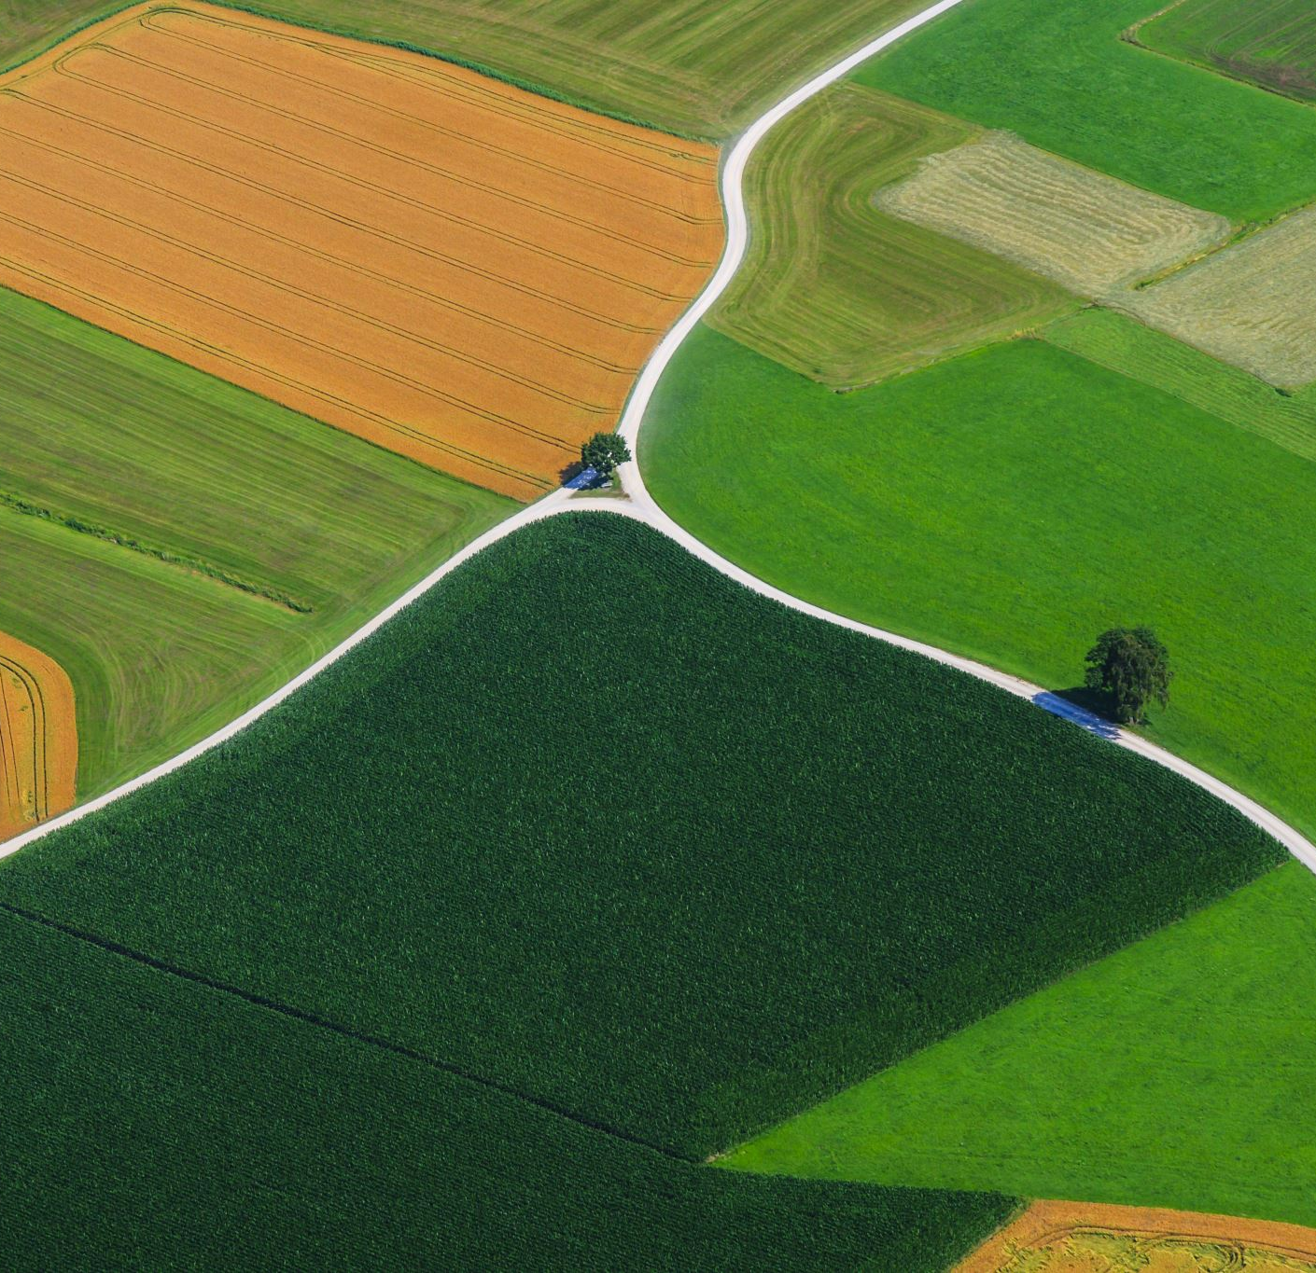
Data filtering, imputation, phasing, formating and exporting
Ricardo H. Ramirez Gonzalez
19 December 2025
International Masters in Plant Breeding
Ricardo.Ramirez@genomicsengland.co.uk

Slide 2
Data formats and filtering
VCF, CSV, myOwnFormat, xlsx

Slide 3
What are people using SNPs and genetic markers for?
For identifying SNPs associated with inherited disease
For studying associations between genetic variants and traits in samples from populations:
Genome-wide association studies (GWAS)
Genotyping by sequencing , association mapping
Population evolution and variation Genetics
Bulk segregant analysis (BSA) – used to identify SNPs or genetic markers associated with a mutant phenotype
Candidates for gene editing
Notes:
BSA - pooled individuals with extremes in the phenotype, then call SNPs on each pool

Slide 4
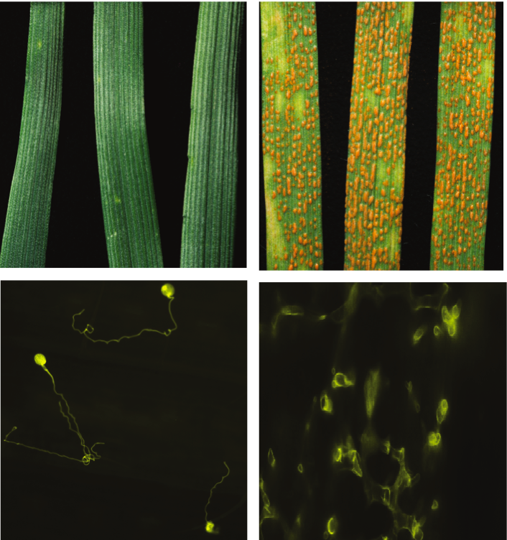
A practical example
Avocet+Yr15
Avocet
Segovia V
Segovia V
Segovia V
Lines developed by the University of Sydney

Slide 5
F₂ population
Expected segregation: 3:1
Notes:
----- Meeting Notes (21/10/2013 09:06) -----
Regresar a la imagen de los parentales.
Poner quien lo hizo, en australia.
----- Meeting Notes (03/06/2014 14:37) -----
Add p values

Slide 6
Most of the time spent on bioinformatics is on data formatting

Slide 7
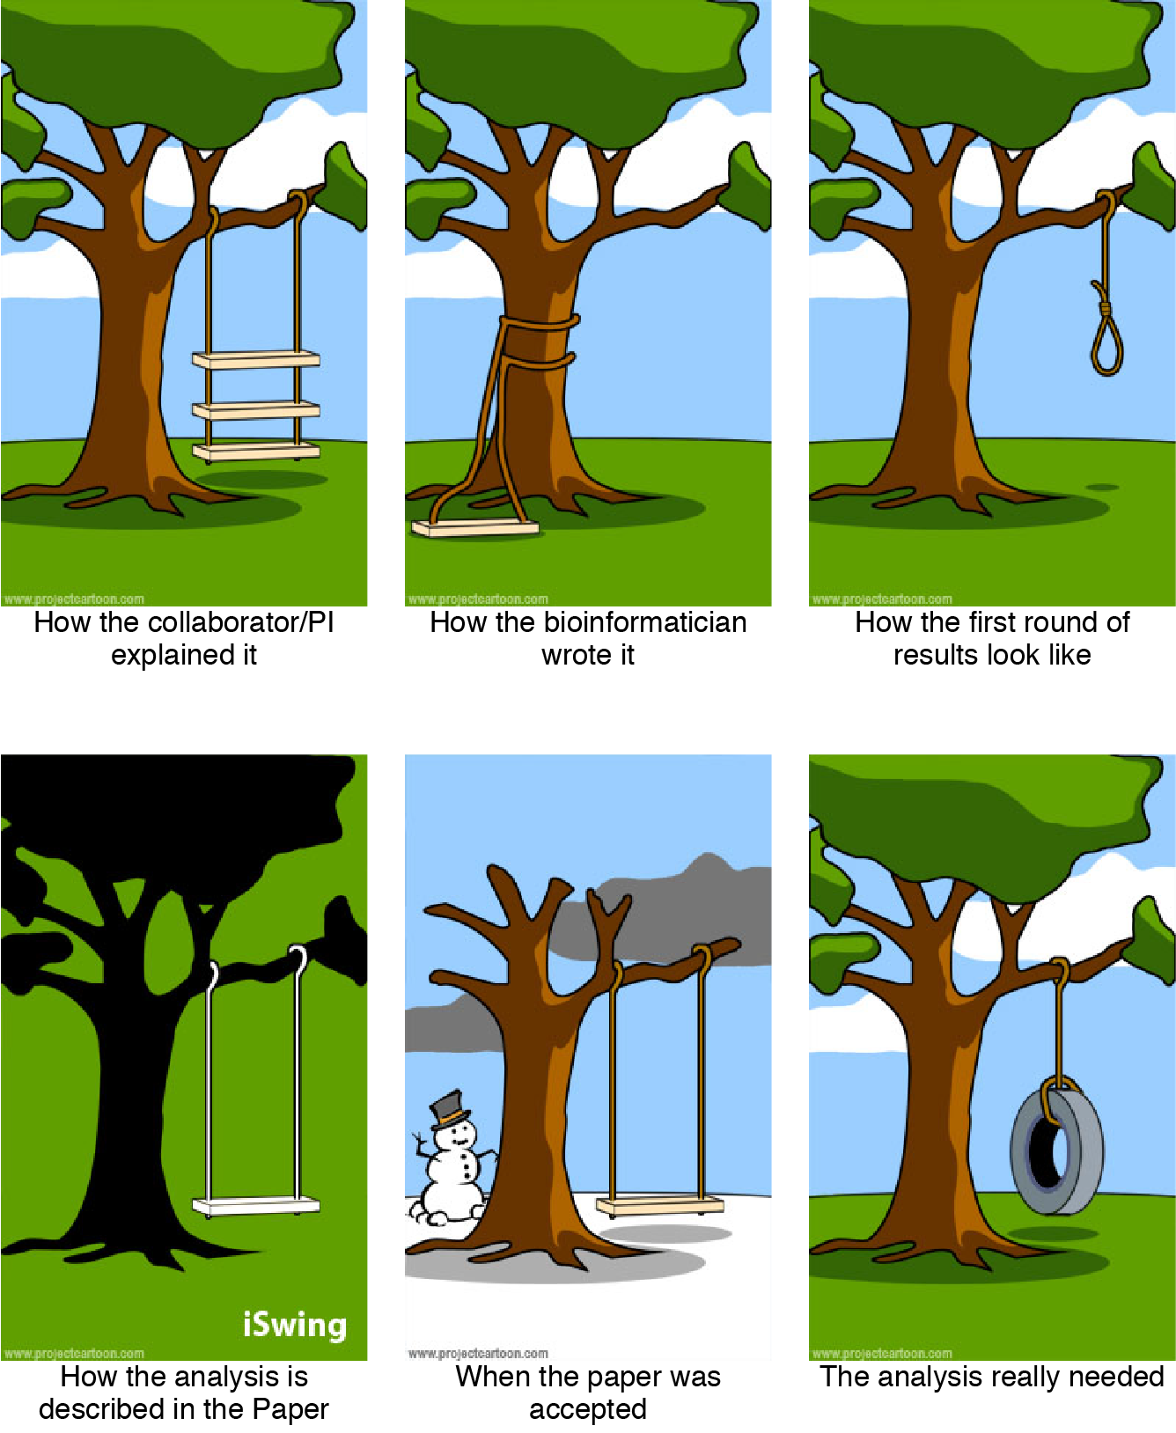

Slide 13
Genotyping data
What data do you capture?
How do you decide what data is important to capture?
Do you use previously known markers, or do you develop your own?
How do you get the data?
Do you know any genotyping file format?
Would you make your own format? What would you include?

Slide 14
Discussion on data to capture on genotyping
Breakout rooms (15 minutes)

Slide 15
Genotyping data (return from breakout)
What data do you capture?
How do you decide what data is important to capture?
Do you use previously known markers, or do you develop your own?
How do you get the data?
Do you know any genotyping file format?
Would you make your own format? What would you include?

Slide 16
Team X
What data do you capture?
How do you decide what data is important to capture?
Do you use previously known markers, or do you develop your own?
How do you get the data? Genotyping data - from the provider
Do you know any genotyping file format?
Would you make your own format? What would you include?

Slide 17
Data manipulation
Formatting and exporting

Slide 18
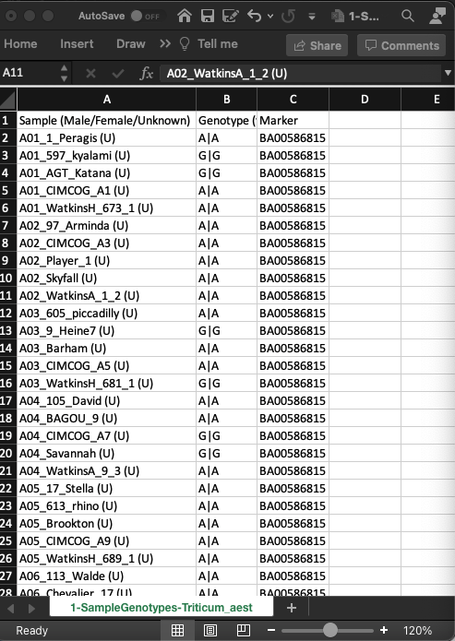
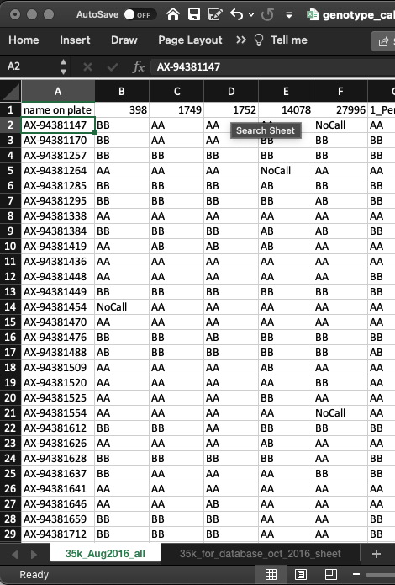
Excel files with genotypes
Advantages
Easy to produce manually
Accessible, anyone can get and use a spreadsheet
Disadvantages
Nonstandard format
Large datasets may crash excel
Hard to replicate analysis done in excel

Slide 19
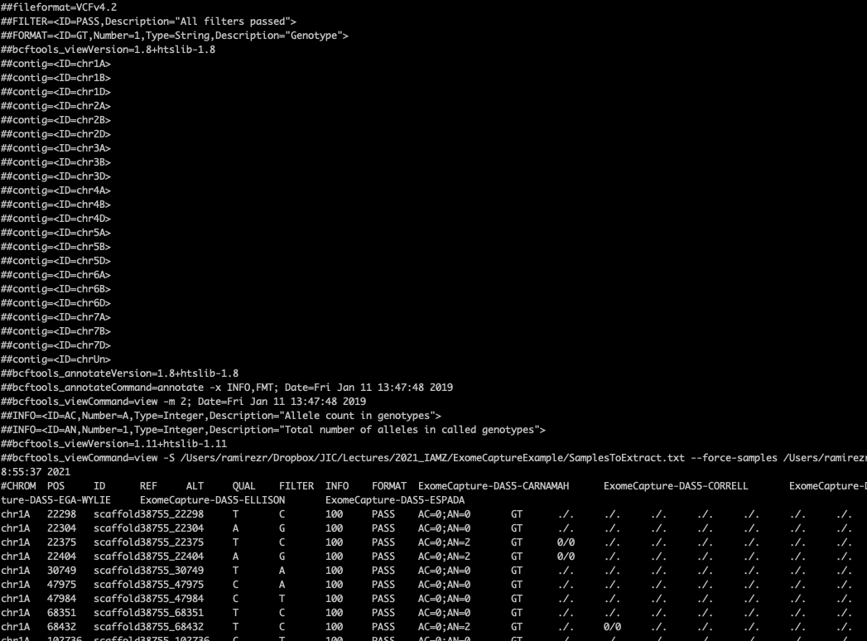
Variant Call Format (VCF)
Advantages
Standard format
Several tools to manipulate filter
Several bioinformatic tools produce them
Flexible
Disadvantages
Difficult to interpret without specialized tools
Different tools produce slightly different annotationx
Notes:
He, F., Pasam, R., Shi, F. et al. Exome sequencing highlights the role of wild-relative introgression in shaping the adaptive landscape of the wheat genome. Nat Genet 51, 896–904 (2019). https://doi.org/10.1038/s41588-019-0382-2

Slide 20
Building a SNP calling Pipeline
Altmann et al (2012) Beginners Guide to SNP calling...
Notes:
First part of the pipeline is very similar to what you have already done.
For use with RNA-Seq, you need a splice aware algorithm like you’ve been using

Slide 22
Bulk Frequency Ratios
✗
✓
Notes:
----- Meeting Notes (21/10/2013 09:16) -----
Poner que porcentaje de los candidatos se van cuando usas los bulks.
----- Meeting Notes (03/06/2014 14:37) -----
Get the figure from the paper. Where it is rotated.
Make something more schematic for the presentaiton (Maybe animate it).
Use colours and boxes for different colors for each calculation.

Slide 23
Bulk Frequency Ratios
✗
✓
Notes:
----- Meeting Notes (21/10/2013 09:16) -----
Poner que porcentaje de los candidatos se van cuando usas los bulks.
----- Meeting Notes (03/06/2014 14:37) -----
Get the figure from the paper. Where it is rotated.
Make something more schematic for the presentaiton (Maybe animate it).
Use colours and boxes for different colors for each calculation.

Slide 24
Bulk Frequency Ratios
✗
✓
SNP Index 184A:
Bulk Frequency Ratio: ﻿﻿

Slide 25
All SNPs
SNPs BFR>6
S. Wang, et al (2014). Characterization of polyploid wheat genomic diversity using a high-density 90,000 SNP array. Plant Biotechnology Journal.

Slide 26
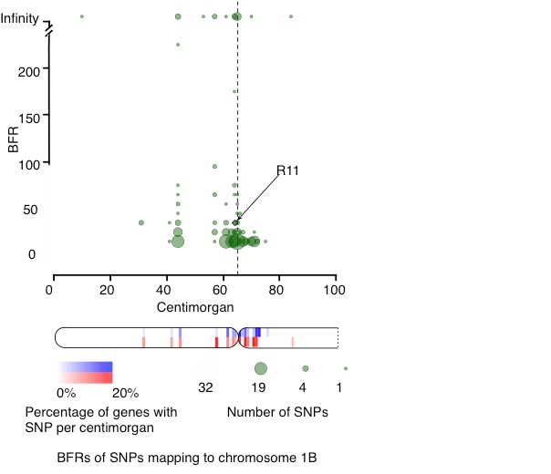
BFRs near the 1B centromere

Slide 27
Selection criteria
Origin (Yr15)
Short arm Chromosome group 1
BFR > 6

Slide 28
Candidate selection
Putative genes with SNP: 16,022 (17.01%)

Slide 29
Candidate selection
Putative genes with SNP: 16,022 (17.01%)

Slide 30
Candidate selection
Putative genes with SNP: 16,022 (17.01%)

Slide 31
Variant calling methods
Allele counting
Probabilistic methods, e.g. Bayesian model to quantify statistical uncertainty
Assign priors based on observed allele frequency of multiple samples
Heuristic approach
Based on thresholds for read depth, base quality, variant allele frequency, statistical significance
SNP
variant
Ref
A
Ind1
G/G
Ind2
A/G
Nielsen R, Paul JS, Albrechtsen A, Song YS. Genotype and SNP calling from next-generation sequencing data. Nat Rev Genet. 2011 Jun;12(6):443-51. PMID: 21587300.
http://seqanswers.com/wiki/Software/list

Slide 32
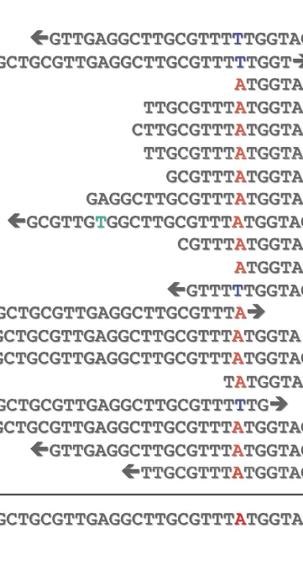
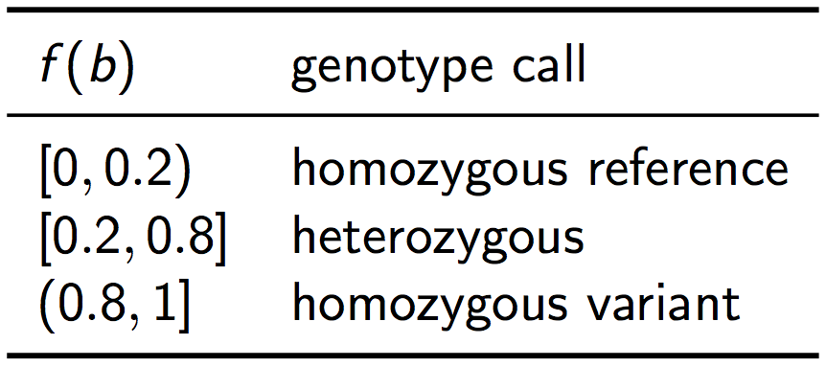
Varian calling principles (Naïve approach)
Filter base calls according to quality
Filter by frequency
Typically, a quality Filter of PHRED Q 20 was used (i.e., probability of error 1% ).
Then, the following frequency thresholds were used according to the frequency of the non-ref base, f(b):

Slide 33
Varian calling principles (Naïve approach)
The frequency heuristic works well if the sequencing depth is high, so that the probability of a heterozygous nucleotide falling outside of the 20% - 80% region is low.
Problems with frequency heuristic:
For low sequencing depth, leads to undercalling of heterozygous genotypes
Use of quality threshold leads to loss of information on individual read/base qualities
Does not provide a measure of confidence in the call

Slide 34
Variant Calling - Popular Tools
GATK
a haplotype caller
can use pooled samples
FreeBayes
a haplotype caller
can use pooled samples
can use polyploid samples
SAMtools (Mpileup and Bcftools)
Single or multiple samples
Common start point as the samtools family of tools is very common for general bioinformatc analsis
Notes:
GATK and FreeBayes are haplotype-based variant detectors – they both try to realign seqs around a variant region
Haplotype calling means that the surrounding regions can used for calling a SNP rather than simply relieing on the strict alignment
And they can look around the SNPs in multiple samples to see how many other SNPs there are in that region.
Mention how they work in general terms
Try to go through their advantages and disadvantages
GATK has rounds of calling, 2nd round is the population mode looking at all samples, first round just calls SNPs on each sample
Freebayes just has the 2nd round
GATK needs more coverage than Freebayes
GATK and Freebyases only callers designed for polyploids
GATK needs lots of memory!
We will use FreeBayes for the practicals
Mention that we are combining 4 samples together and why: program takes into consideration the observed alleles freq of multiple samples
In contrast, Samtools (and varScan) which don’t have the haplotyping feature
However SNP calls could be OK with high coverage (What level is classed as high coverage?) – so Samtools could also be option if you already have it installed
Look at how much coverage is required to call its gettign lower an lower.

Slide 35
Discussion (15 min)
Different variant callers store different attributes, depending on the method used to produce them.
Which are the minimum information you would expect to use to filter?
What is your expectation for breeding lines?
Would you trust a heterozygous call in an isogenic line?
If you have an F2 population, and you get an SNP unique to a single plant in the population, would you trust it? Why?

Slide 36
Team X (To copy and fill)
Different variant callers store different attributes, depending on the method used to produce them.
Which are the minimum information you would expect to use to filter?
What is your expectation for breeding lines?
Would you trust a heterozygous call in an isogenic line
If you have an F2 population, and you get an SNP unique to a single plant in the population, would you trust it? Why?

Slide 37
The best tool to process your data is the tool you know!

Slide 38
Filtering tools
Programming languages:
Python, R, Python
Specialized tools
bcftools to filter and format VCF files
Visual tools
Your favorite spreadsheet! There is no shame

Slide 39
Programming languages
Advantages
Fine control of what you do.
Analysis easy to reproduce and share
Disadvantages
Learning curve if the first time you use a language
Complex to setup a development environment
Python (Biopython, Pandas), R (Tidyverse [ggplot, dplyr], Bioconductor), Perl (Bioperl)
If you can format your data as a table, learn SQL!

Slide 40
Specialized standard tools
Designed for a family of file formats
Advantages
Useful for common tasks, don’t reinvent the wheel!
Standardized pipelines and algorithms
Tested by a large community
Disadvantages
Need to convert format when changing tools
Each tool requires its own mindset
A successful tool may hide a newer more refined tool (For example, bowtie vs hisat from the same lab)
Samtools, bcftools, plink, beagle

Slide 41
Visual tools and online tools
Advantages
Easy to use
Intuitive
Disadvantages
Difficult to document which steps you followed
Slow with large datasets
Not easy to automate for repetitive tasks
Excel, IGV, ensembl, niche databases

Slide 42
Discussion (10 minutes)
Your opinion will be considered for the practical session.
Which tools do you prefer?
Are you comfortable with programming?
Which R/python packages are you familiar with?

Slide 43
For the practical
Make sure you have installed R with the following packages:
R/QTL
The tidivyerse package (ggplot/dplyr)
rtracklayer
Ggbio
GenomicRanges
Beagle (requires java) https://faculty.washington.edu/browning/beagle/beagle.html

Slide 44
Imputation and phasing
Sources of noise
What the data can tell you
What you know about your data

Slide 45
Why do we need to impute?
Data sources are noisy.
Sequencing errors
Missing genotyping values
Low quality data (cheaper to sequence with less coverage)
On large experiments, few datapoints may be missing
Leads to artificial variation that makes the downstream analysis more complicate

Slide 46
Use the data for your advantage: F₂ population
Expected segregation: 3:1
Notes:
----- Meeting Notes (21/10/2013 09:06) -----
Regresar a la imagen de los parentales.
Poner quien lo hizo, en australia.
----- Meeting Notes (03/06/2014 14:37) -----
Add p values

Slide 47
Use the data for your advantage

Slide 48
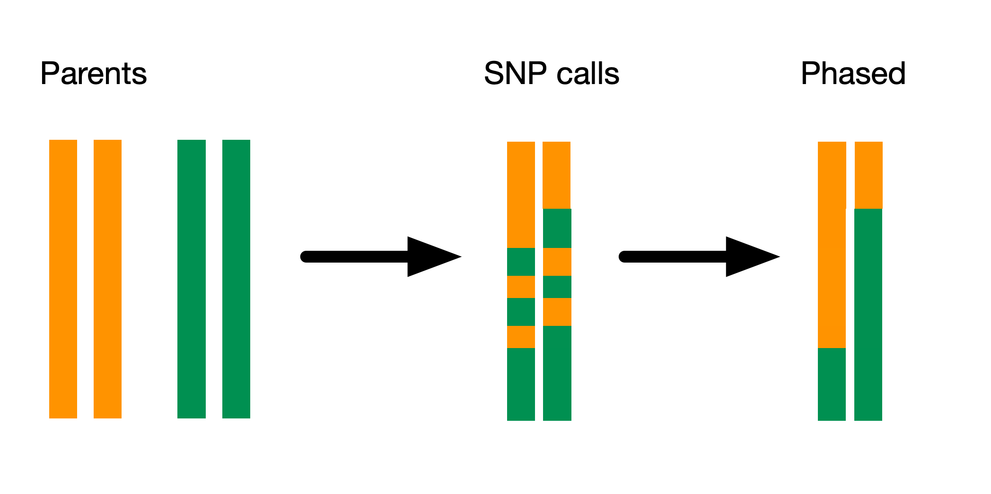
Phasing

Slide 49
Phasing

Slide 50
Phasing

Slide 51
TOOLS TO IMPUTE
QTL Package
Has a function to fill missing values
Plink
Command line to analyze genotype data
Beagle
Tool specifically designed for imputing and phasing

Slide 52
Discuss (15 minutes)
How would you work with samples where you don’t know the pedigree?
Would you prefer to sample several progenitor samples and compare them or make a selection of crosses?
Can you think on cases where you would prefer NOT to impute?
When you know the parents, phasing is trivial. Can you imagine other complexities that may come from a diversity panel?

