Slide 1
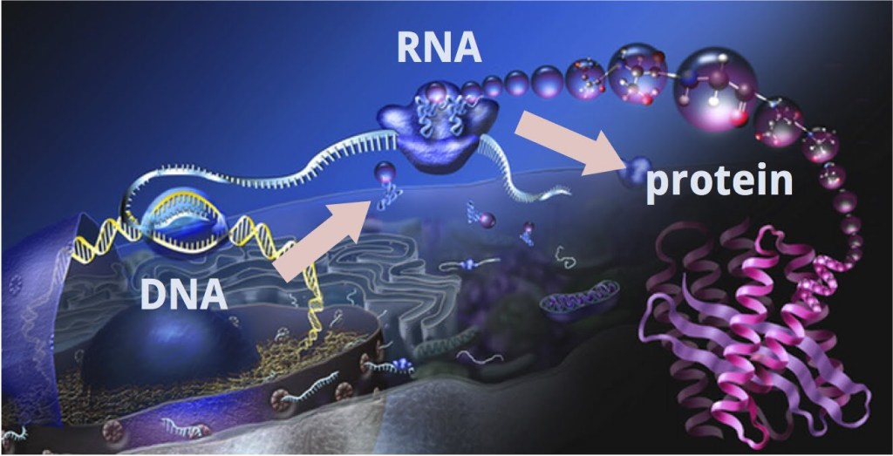


ANALYSIS OF TRANSCRIPTOMES
Rubén Sancho; Bruno Contreras-Moreira
16 December 2025 (6 hours)
9:00-10:00
10:00-11:00
11:30-13:30
15:00-17:00
Notes:
central dogma of molecular biology
<número>

Slide 2
Session Objectives
Gain an overview of the complete RNA-seq analysis workflow.
Understand differential gene expression (DEG) and co-expression network analyses.
Understand the key concepts underlying these analyses.
Become familiar with the bioinformatics tools and processes used in RNA-seq analysis.

Slide 3
How to analyze RNA-seq data?
From raw data to interpreting differential expression results, co-expression networks, and biological implications.
Hypothesis
Experimental Design
Objectives
RNA-seq
(raw data)
Library prep. protocol
Sequencing platform
Quality Check (QC)
QC reports
Filtering
Reference genome/transcriptome
Mapping
Counting/ Normalization
Differentially Expressed Genes-DEGs
(individual genes)
Co-expressed genes
(Groups/modules of genes)
Notes:
https://bio-protocol.org/en/bpdetail?id=5295&type=0
<número>

Slide 4
Experimental Design & RNA-seq
Experimental design: ✓ Tissues ✓ Samples ✓ Reps ✓ Treatments ✓ Sampling time
Library type: ✓ mRNA-seq (PolyA+) ✓ Total RNA-seq (no rRNA) ✓ Strand-specific RNA-seq ✓ Small RNA-seq ✓ scRNA-seq ✓ 3’-end RNA-seq
The most widely used protocol involves the TruSeq (Illumina) kit, which assumes abundant starting material (0.1–1 μg total RNA) and maintains strand specificity
Sequencing (read) type: ✓ Single-End ✓ Paired-end ✓ Short ✓ Long
Goals: ✓ Differentially Expressed Genes ✓ Co-expressed genes ✓ Isoform/Gene level …
The choice of bioinformatics tools and commands depends on this information!!!

Slide 5
RNA-seq Library Types
Type | Preparation | Captured RNA | Advantages | Disadvantages | Applications
mRNA-seq (PolyA+) | Selection of polyadenylated RNA using oligo(dT) beads | Mature mRNA (polyA+) | High specificity for coding genes; reproducible; high proportion of informative reads | Does not detect noncoding or non-polyA RNAs; unsuitable for degraded RNA | Differential gene expression; standard transcriptome profiling
Total RNA-seq | Ribosomal RNA removal (Ribo-Zero, NEBNext, etc.) | All RNAs except rRNA | Captures coding and noncoding RNAs; works with degraded RNA | Higher background noise; more expensive | Whole transcriptome profiling; lncRNA studies; FFPE* samples
Strand-specific RNA-seq | Incorporation of strand-specific markers during cDNA synthesis | Same as mRNA-seq or Total RNA-seq, but retains strand orientation | Distinguishes sense/antisense transcripts; improves isoform annotation | Slightly higher cost and complexity | Antisense RNA, isoform detection, transcriptional regulation
Small RNA-seq | Size selection (18–30 nt fragments) | miRNA, siRNA, piRNA, small snRNA** | Enables post-transcriptional regulation studies | Does not detect mRNA or long transcripts | miRNA profiling, piRNA discovery, small RNA pathways
3’-end RNA-seq (TagSeq, QuantSeq) | Captures only the 3’ ends of transcripts using short oligo(dT) priming | 3’ end of mRNA | Cost-effective; simple; correlates well with gene expression | No isoform or splicing information | Rapid expression quantification; high-throughput screening
Single-cell RNA-seq (scRNA-seq) | Cell barcoding using droplets or nanowells | Total RNA from individual cells | Single-cell resolution; reveals cellular heterogeneity | Expensive; lower coverage per cell; complex analysis | Developmental biology; cancer heterogeneity; immune profiling
Exome-capture RNA-seq | Hybridization with probes targeting known exons | Exonic coding regions | Focused on genes of interest; reduces background | Misses noncoding RNAs and unannotated isoforms | Targeted studies; validation of candidate genes
Notes:
*
FFPE samples = tissue samples preserved in formalin and paraffin for long-term storage and histological analysis.
**
miRNA (microRNA): Small non-coding RNA (~22 nt) that regulates gene expression by binding to target mRNAs and inhibiting their translation.
siRNA (small interfering RNA): Short double-stranded RNA that triggers degradation of complementary mRNA through RNA interference (RNAi).
piRNA (PIWI-interacting RNA): Small RNA found mainly in germ cells that silences transposons and protects genome integrity.
snRNA (small nuclear RNA): Small RNA involved in the splicing of pre-mRNA within the spliceosome.
<número>

Slide 6
Quality Check (QC)
In the Lab: concentrations, absorbances and integrity (RIN- RNA Integrity Number 1-10)
 | Optimal Value | Minimum | Comments
A260/A280 | 1.8–2.1 | ≥ 1.7 | Low values indicate protein or phenol contamination.
A260/A230 | >2.0 | ≥ 1.8 | Low values suggest salt or reagent contamination.
Concentration | 100 ng – 2 µg total RNA | ≥ 50 ng | Depends on protocol; higher input improves library complexity.
RIN (RNA Integrity Number) | ≥ 8 | ≥ 6 (for rRNA-depleted RNA-seq) | Below 6, use specialized protocols (e.g., 3’-end RNA-seq).
In silico (check QC reports): Per base sequence quality; Per tile sequence quality; Per sequence quality scores; Per base sequence content; Per sequence GC content; Per base N content; Sequence Length Distribution; Sequence Duplication Levels; Overrepresented sequences; Adapter Content
Notes:
QC explanation: https://www.bioinformatics.babraham.ac.uk/projects/fastqc/Help/3%20Analysis%20Modules/
<número>

Slide 7
Filtering
Remove adapters and low-quality sequences and/or nucleotides
Trimmomatic software
ILLUMINACLIP: Cut adapter and other Illumina-specific sequences from the read.
SLIDINGWINDOW: Perform a sliding window trimming, cutting once the average quality within the window falls below a threshold.
LEADING: Cut bases off the start of a read, if below a threshold quality
TRAILING: Cut bases off the end of a read, if below a threshold quality
CROP: Cut the read to a specified length
HEADCROP: Cut the specified number of bases from the start of the read
MINLEN: Drop the read if it is below a specified length
TOPHRED33: Convert quality scores to Phred-33
TOPHRED64: Convert quality scores to Phred-64
Notes:
ILLUMINACLIP:TruSeq3-SE:2:30:10 → Remove Illumina adapters provided in the TruSeq3-PE.fa file (provided). Initially Trimmomatic will look for seed matches (16 bases) allowing maximally 2 mismatches. These seeds will be extended and clipped if in the case of paired end reads a score of 30 is reached (about 50 bases), or in the case of single ended reads a score of 10, (about 17 bases).
<número>

Slide 8

Mapping and Counting
Mapping or aligning the sequences against a reference genome/transcriptome is a key step in identifying which genes the sequenced RNA fragments originate from and thus quantifying their expression.
To select the alignment/mapping software we must take into account:
What reference is available, genome or transcriptome?
What downstream analyses will be performed: differential expression, co-expression networks, …?
Software | Alignment type | Reference | Speed | Accuracy | Splicing detection | Direct quantification | Output | Key notes
STAR | Full alignment (sequence-based) | Genome | Very high | Very high | Yes | No (use featureCounts or RSEM) | SAM/BAM files | Gold standard in large projects (e.g., ENCODE, GTEx); excellent for novel genes or isoforms
HISAT2 | Full alignment (hierarchical indexing) | Genome | High | High | Yes | No (use StringTie or featureCounts) | SAM/BAM files | Fast and memory-efficient; successor to TopHat2
Salmon | Quasi-mapping | Transcriptome | Very high | High | Not directly (depends on annotation) | Yes | Expression tables (TPM, FPKM, counts) | Very fast; ideal for direct quantification without BAM files
Kallisto | Pseudoalignment | Transcriptome | Extremely high | High | No | Yes | Expression tables (TPM, counts) | Ultra-fast; great for exploratory or large-cohort analyses
Notes:
STAR: Spliced Transcripts Alignment to a Reference
HISAT2: hierarchical indexing for spliced alignment of transcripts. Mainly used in humans.
STAR – Full sequence alignment (splicing-aware)
What it does: Aligns each RNA-Seq read base by base to the genome, allowing for splice junctions (exon–exon boundaries).
How: Uses a fast seed-and-extend strategy to handle long reads and detect introns.
Result: Very accurate mapping; produces detailed alignment files (SAM/BAM).
Use case: Ideal for detecting new transcripts, splicing events, and variants.
HISAT2 – Full alignment with hierarchical indexing
What it does: Similar to STAR, but uses a graph-based FM index to align reads efficiently to the genome.
How: Combines the Burrows–Wheeler transform and graph FM index to model exons, introns, and known variants.
Result: Accurate, memory-efficient, and splice-aware alignments.
Use case: Great for genome-level analysis with limited computational resources.
Salmon – Quasi-mapping
What it does: Maps reads approximately (not base by base) to known transcripts.
How: Uses lightweight algorithms to determine the most likely transcript of origin without full alignment.
Result: Very fast estimation of transcript abundances (TPM, counts).
Use case: Expression quantification when splicing discovery is not needed.
Kallisto – Pseudoalignment
What it does: Assigns reads to transcripts without aligning individual bases at all.
How: Uses k-mer matching to find which transcripts could have generated each read.
Result: Extremely fast transcript quantification, with small memory footprint.
Use case: Large-scale or exploratory RNA-Seq projects focused on quantification only.
<número>

Slide 9

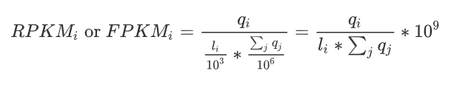

Counting, Normalization and Differential Expression analysis
Gene Expression Measurement
Raw counts: Number of sequencing reads mapped to each gene.
Cannot be directly compared between genes or samples:
Longer genes = more sequenced reads
Samples with deeper sequencing = more total sequenced reads
RPKM: Reads Per Kilobase of exon per Million reads mapped. Single-end (SE) RNA-seq.
FPKM: Analogous to RPKM and is used specifically in paired-end (PE) RNA-seq experiments.
→ raw read or fragment counts (per feature and sample)
→ feature (i.e., gene or transcript) length (per feature, bp)
Normalize for sequencing depth and gene length
→ total number of mapped reads or fragments (per sample)
TPM: Transcript Per Million.
The sum of all TPM values is the same in all samples. A TPM value represents a relative expression level that should be comparable between samples.
→ reads mapped to transcript (per transcript and sample)
→ transcript length (per transcript bp)
→ the sum of mapped reads to transcript normalized by transcript length

Slide 10
Tools for Counting/Normalization and Differential Expression analysis
Tool | Type | Input | Output | Level | Use | Advantages | Disadvantages
featureCounts | Counting | Aligned reads (BAM/SAM) | Raw counts | Gene | Read summarization | Fast, memory-efficient | No isoform quantification
RSEM | Quantification | Aligned reads (or raw FASTQ) | TPM, FPKM, counts | Gene & transcript | Quantifying expression | Handles multi-mapping reads, isoform-aware | Slow, computationally demanding
StringTie | Assembly + Quantification | Aligned reads | Assembled transcripts + FPKM | Transcript | Transcript reconstruction | Detect novel isoforms | Less accurate with low coverage
DESeq2 | Differential expression | Raw counts | Fold change, p-values | Gene | Expression comparison | Statistically robust, well-documented | Requires raw counts, not TPM
Sleuth | Differential expression | TPMs (from Kallisto) | Fold change, q-values | Transcript | Fast DE analysis | Very fast, interactive, works with Kallisto | Kallisto input

Slide 11
Differentially Expressed Genes (DEGs) using Sleuth
Genes whose expression levels significantly increase or decrease between different conditions or groups
Different tissues (leaves, seeds, flower parts, roots, ...), different growth stages, treatments/doses (e.g. nitrogen, ...), abiotic stresses (heat, cold, drought, waterlogging, nutrient deficiency, ...), or biotic stresses (diseases, ...).
Sleuth is used to explore gene expression results from Kallisto and to perform differential expression analysis.
Sleuth is implemented in an interactive shiny app that utilizes Kallisto quantifications and bootstraps for fast and accurate analysis of data from RNA-seq experiments.
Sleuth uses the bootstraps to ascertain and correct for technical variation in experiments.
Notes:
Kallisto is a pseudoalignment-based RNA-seq quantification tool.
Because many reads cannot be uniquely assigned to a transcript, there is uncertainty in transcript abundance estimates.
To capture this uncertainty, kallisto performs bootstrap sampling:
It resamples the reads from the library multiple times (commonly 100 replicates).
Each replicate produces an estimate of transcript abundance.
The collection of replicates represents the probability distribution of transcript abundances, showing the expected range of variation.
Sleuth applies a linear modeling framework that incorporates bootstrap-derived uncertainty, making differential expression testing more reliable and reducing false positives.
Kallisto’s bootstraps are resampled quantifications that reflect technical uncertainty. Sleuth leverages them to distinguish inferential noise from biological variation, enabling more robust and interpretable differential expression analysis.
<número>

Slide 12
Gene Co-expression Networks
Graphical representations that show how genes are related based on the similarity of their expression patterns.
● Node = Gene Edge = Connection (correlated expression levels)
Premise: Genes with similar expression patterns (co-expressed) are functionally associated
Weighted
Unweighted
Connection strength varies (from 0 to 1)
Soft-threshold
Connected (1) or not connected (0)
Hard-threshold
Hub Gene/Isoform
(potential driver genes)
Gene/Isoform
Weak connections
Strong connections
Very Strong connections
Notes:
The main difference between a Weighted Gene Co-expression Network (WGCN) and an unweighted co-expression network lies in how the relationships (edges) between genes are represented:
Unweighted network:
Connections between genes are binary — a gene pair is either connected or not connected.
This is determined by applying a correlation threshold: if the correlation between two genes’ expression levels exceeds the threshold, an edge is assigned (value = 1); otherwise, no edge (value = 0).
This approach is simple but loses information about the actual strength of the relationship.
Weighted network:
Each edge has a continuous weight (e.g., between 0 and 1) representing the strength of the correlation between genes.
Instead of a hard cutoff, a soft-thresholding function (often raising the correlation to a power) is used to retain more information.
This allows for detecting gradual relationships and produces networks that are more robust and biologically meaningful.
👉 In summary:
Unweighted: connection = yes/no (discrete information).
Weighted: connection strength varies (continuous information about co-expression).
<número>

Slide 13
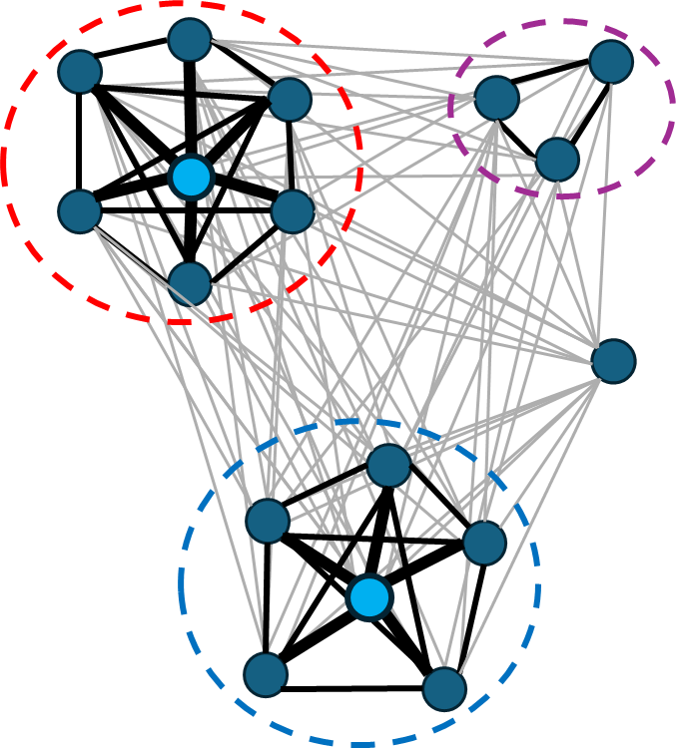

WGCNA
Weighted Gene Co-expression Network Analysis
Glossary of WGCNA Terminology
Data set
Expression matrix (normalized expression values) with rows as genes/isoforms and columns as samples.
Not filtering genes by differential expression.
It is recommended that the analysis be performed with a larger number of samples, at least 20.
Clean the data by removing obvious outlier samples as well as genes and samples with excessive numbers of missing entries.
Notes:
A node represents a gene and an edge joining two nodes represents their relationship. Among the measures of relationship, weighted co-expression is one of the most widely used thanks to the popularity of the WGCNA R package where the relationships are quantified (weight) instead of only a presence/absence information.
Several information and tutorial
https://bigomics.ch/blog/introduction-to-wgcna-and-its-applications-in-gene-correlation-network-analysis/
https://cran.r-project.org/web/packages/WGCNA/index.html
https://bioinformaticsworkbook.org/tutorials/wgcna.html#gsc.tab=0
https://github.com/evanpeikon/co_expression_network
https://ngs101.com/how-to-build-gene-co-expression-networks-from-rna-seq-data-using-wgcna-complete-step-by-step-guide-for-absolute-beginners/
<número>

Slide 14


WGCNA
Weighted Gene Co-expression Network Analysis
2. Weighted Network construction
Adjacency: matrix n x n which encodes the network connection strength between nodes i and j.
An intermediate quantity called the co-expression similarity s _{ij} is first defined to calculate the adjacency matrix.
The default method defines the co-expression similarity s _{ij} as the absolute value of the correlation coefficient (Pearson, biweight or the Spearman correlation) between the profiles of nodes i and j:s _{ij} = |cor(x _{i} , x _{j} )|.
The co-expression similarity is transformed into the adjacency using a thresholding procedure.
Unweighted networks: adjacency a _{ij} between gene expression profiles x _{i} and x _{j} can be defined by hard thresholding the co-expression similarity s _{ij} as
where τ is the "hard" threshold parameter. Thus, two genes are linked (a _{ij} = 1) if the absolute
correlation between their expression profiles exceeds the (hard) threshold τ.
Weighted networks: the adjacency takes on continuous values between 0 and 1 and can be defined by raising the co-expression similarity to a power: with β ≥ 1. The weighted adjacency a _{ij} between two genes is proportional to their similarity.
How to choose the threshold parameters? Scale-free topology criterion.
Notes:
<número>

Slide 15
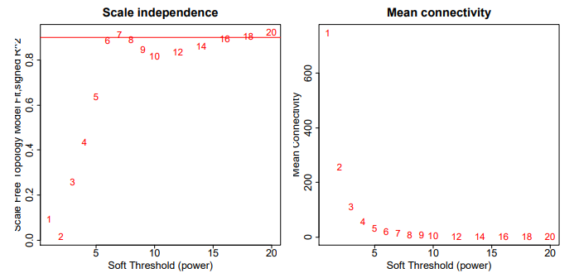
WGCNA
Weighted Gene Co-expression Network Analysis
How to choose the threshold parameters? Scale-free topology criterion.
A scale-free network is one where most nodes have few connections, and a few nodes (hubs) have many connections. Many real biological systems show this property.
WGCNA package tests a range of β values (e.g. 1 to 20), and calculates:
The R² of the fit between node connectivity and the power-law distribution (how “scale-free” the network is)
The mean connectivity (so the network isn’t too sparse or too dense).
Then WGCNA plots these results:
R² vs. β (to see where the scale-free fit becomes strong)
Mean connectivity vs. β (to check network density).
The best β is usually the smallest value where:
the scale-free fit R² is high (≥ 0.8–0.9), and
the mean connectivity is still reasonable.
Notes:
<número>

Slide 16
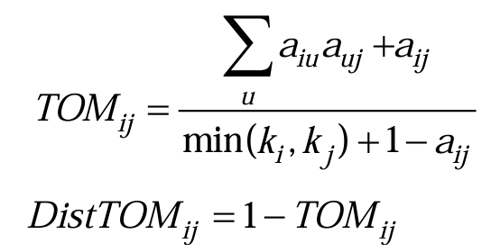
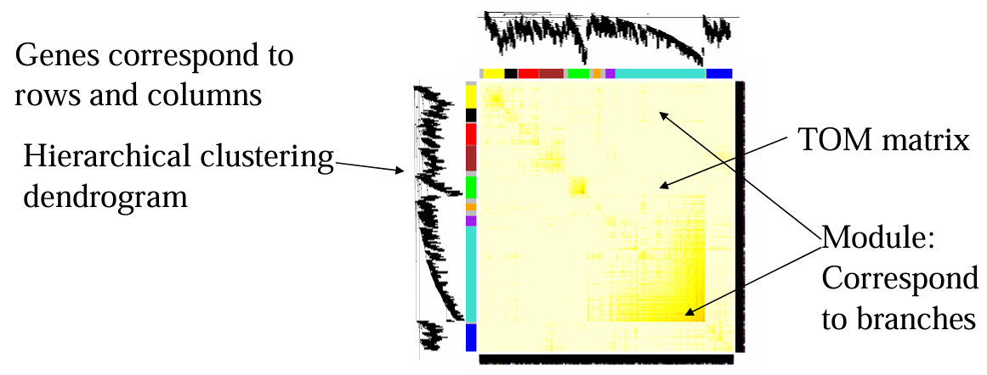
WGCNA
Weighted Gene Co-expression Network Analysis
3. Module detection
Modules are clusters of highly interconnected genes and are defined by average linkage hierarchical clustering using as input the topological overlap dissimilarity (distance) measure (the higher the value, the more different the connection patterns of two genes).
Topological Overlap Matrix (TOM) is a measure of how similar two genes are in terms of their network connections, considering not only the direct correlation between two genes but also how many neighbors they share (e.g. If gene A and gene B are both connected to many of the same genes, their TOM will be high).
A network heatmap plot (interconnectivity plot) of a gene network together with the corresponding hierarchical clustering dendrograms and the resulting modules
Source: An Overview of Weighted Gene Co-Expression Network Analysis by Steve Horvath
Notes:
<número>

Slide 17
WGCNA
Weighted Gene Co-expression Network Analysis
4.1. Gene significance (GS)
It used to incorporate external information into the co-expression network.
The higher the absolute value of GS_{i} , the more biologically significant is the i-th gene.
A gene significance measure could also be defined by minus log of a p-value.
4.2. Module significance
The average absolute gene significance measure for all genes in a given module.
5. Other key parameters
Connectivity: it measures how correlated a gene is with all other network genes.
Intramodular connectivity (k_{IM}): it measures how connected, or co-expressed, a given gene is with respect to the genes of a particular module.
Module eigengene E: The first principal component of a given module (such as a representative of the gene expression profiles in a module).
Eigengene significance: The correlation coefficient between the module eigengene and a trait.
Module Membership (MM) (also known as eigengene-based connectivity k_{ME}): For each gene, a measure of module membership by correlating its gene expression profile with the module eigengene of a given module.
Notes:
Equivalent definitions
•GS.ClinicalTrait(i) = |cor(x(i),ClinicalTrait)| where x(i) is the gene expression profile of the i-thgene
•GS(i)=|T-test(i)| of differential expression between groups defined by the trait
•GS(i)=-log(p-value)
<número>

Slide 18
Practical Exercise
Notes:
Website for RNAseq analysis: https://ranaseq.eu/index.php
<número>

Slide 19


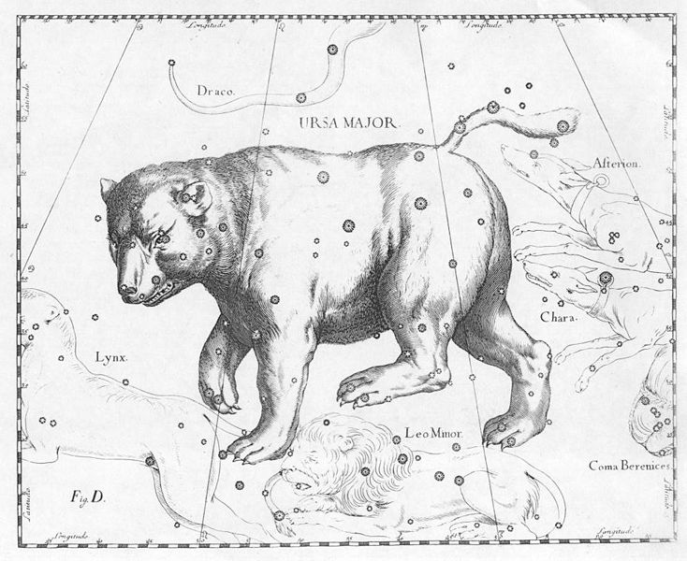




Experimental Design
RNA-seq
(raw data)
Quality Check (QC)
FastQC
Trimmomatic
Filtering
Mapping
kallisto
sleuth
Counting/Normalization
Differentially Expressed Genes-DEGs
(individual genes)
Co-expressed genes
(Groups/modules of genes)
Notes:
MultiWGCNA: https://www.bioconductor.org/packages/release/bioc/vignettes/multiWGCNA/inst/doc/autism_full_workflow.html
MultiWGCNA: https://github.com/fogellab/multiWGCNA
<número>

Slide 20
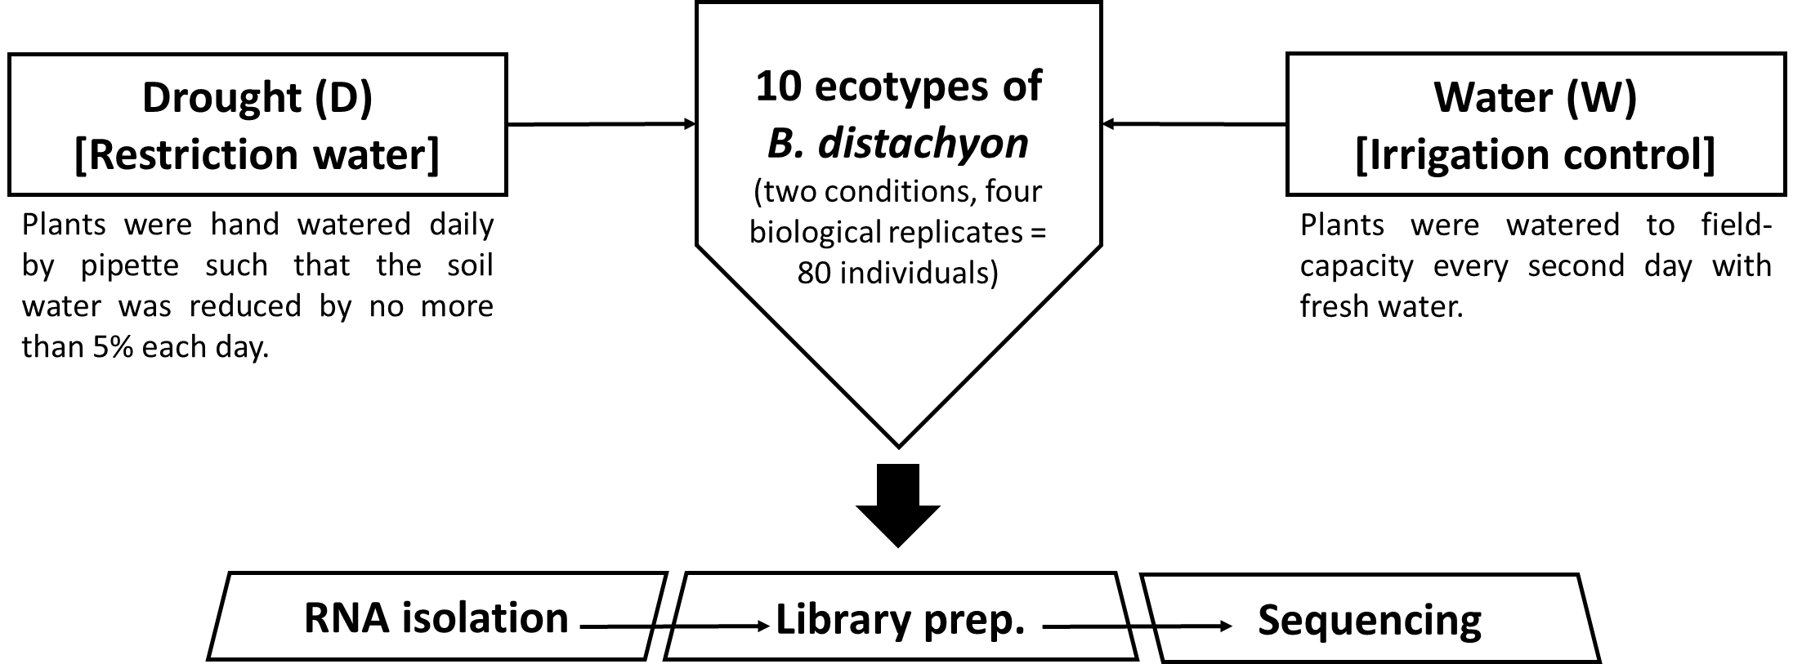
Experimental Design
Hypothesis: There are genes with similar expression profiles involved in the response to water stress.
Objective: To detect a set of co-expressed genes involved in the response to water stress and the hub genes with a key role in the regulation of the module.
Two youngest fully-expanded leaves of the tallest tiller0
3’ cDNA tag
Illumina HiSeq system
Des Marais et al (2017)
Sancho et al. (2022)
Notes:
This Tag-Seq method yields only one sequence per expressed transcript in the RNA pool,
<número>

Slide 21
Readme (Step-by-step)
OPEN the “Readme_Docker_Transcriptomic_class.txt” file
OPEN Ubuntu (WSL)
In your home, create the folder "transcriptome_class" and extend permissions
mkdir transcriptome_class
chmod 777 transcriptome_class
Docker environment: https://github.com/eead-csic-compbio/bioinformatics/tree/main/docker
Run (in Ubuntu): docker pull csicunam/bioinformatics_iamz:latest
Bind local "transcriptome_class" folder to container folder "/data":
docker run -it -v $HOME/transcriptome_class:/data -v /tmp/.X11-unix:/tmp/.X11-unix -e DISPLAY=$DISPLAY csicunam/bioinformatics_iamz:latest
From Windows, the "transcriptome_class" folder is located in:
\\wsl.localhost\Ubuntu-22.04\home\iamz\transcriptome_class
\\wsl.localhost\Ubuntu-22.04\home\rsancho\transcriptome_class (Rubén Sancho laptop)
Notes:
<número>

Slide 22
Readme (Step-by-step)
Move into /data: cd /data
Create symbolic link:
ln -s /home/vep/test_data/transcripts/brachy/ brachy
Create report folders:
mkdir report report_filtered
Notes:
<número>

Slide 23
Folders structure
/home/vep/test_data/transcripts/brachy/
00_Reference_transcriptome
01_RNAseq_raw
(QC report)
FastQC
QC report
Trimmomatic
Run in WSL terminal (Ubuntu)
Transcriptome Class
02_RNAseq_filtered
(QC report)
FastQC
QC report
Kallisto
03_quant
Run in Rstudio (Windows/Ubuntu)
Sleuth
04_sleuth
05_WGCNA
WGCNA
Notes:
<número>

Slide 24
RNA-seq
RNA-Seq library protocol is the 3′ cDNA tag library prep for sequencing on the Illumina HiSeq platform adapted from Meyer et al. (2011).
Sequencing was carried out using an Illumina HiSeq2500 platform (100 bp Single-End, SE, sequencing).
Notes:
This Tag-Seq method yields only one sequence per expressed transcript in the RNA pool,
<número>

Slide 25
Quality Check (QC)
Task 01: Generate QC report of ABR3_W_03 sample.
Review and interpret the results obtained
Software: FastQC v0.12.1.
Command: fastqc input_fastqc -o output_folder
Tips:
Remember to create the output folder.
Check that the paths of the software, input files, and output folder are correct.

Slide 26
Answer
Quality Check (QC)
fastqc 01_RNAseq_raw/ABR3_W_03.fastq.gz \
-o 01_RNAseq_raw/reports/
Open the report: \\wsl.localhost\Ubuntu-22.04\home\iamz\transcriptome_class\report\ABR3_D_03_fastqc.html

Slide 27
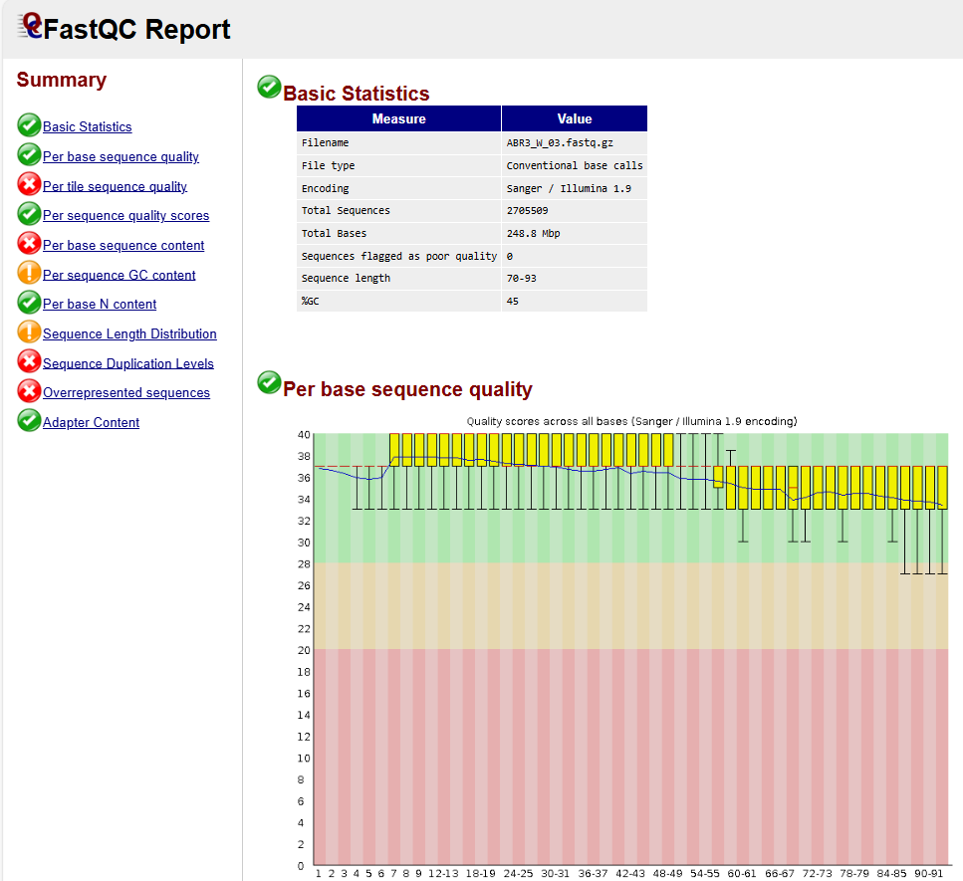
Answer
Quality Check (QC) with FastQC
quality scores
Position in the read (bp)
The range of quality scores across all bases at each position in the Fastq file
Notes:
Per base sequence quality: https://www.bioinformatics.babraham.ac.uk/projects/fastqc/Help/3%20Analysis%20Modules/2%20Per%20Base%20Sequence%20Quality.html
For each position a BoxWhisker type plot is drawn. The elements of the plot are as follows:
The central red line is the median value
The yellow box represents the inter-quartile range (25-75%)
The upper and lower whiskers represent the 10% and 90% points
The blue line represents the mean quality
The y-axis on the graph shows the quality scores. The higher the score the better the base call. The background of the graph divides the y axis into very good quality calls (green), calls of reasonable quality (orange), and calls of poor quality (red). The quality of calls on most platforms will degrade as the run progresses, so it is common to see base calls falling into the orange area towards the end of a read.
https://hbctraining.github.io/Intro-to-rnaseq-hpc-salmon/lessons/qc_fastqc_assessment.html
<número>

Slide 28
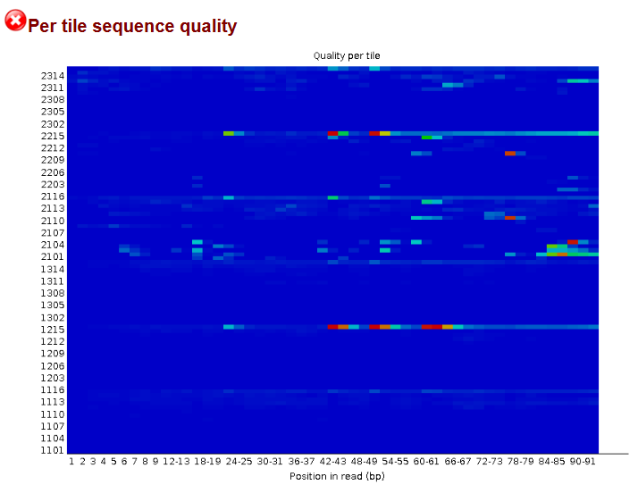
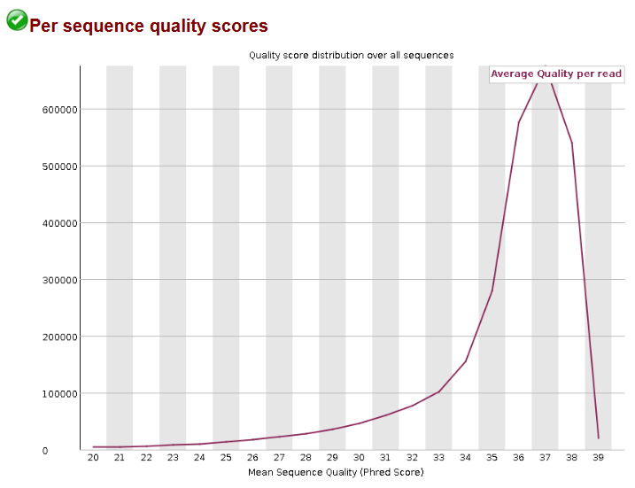
Answer
Quality Check (QC) with FastQC
flowcell tile
Number of sequences
The plot shows the deviation from the average quality for each flowcell tile. Hotter colours indicate that a tile had worse qualities than other tiles for that base. Bubbles, smudges or debris in the flowcell lane.
It allows you to see if a subset of your sequences have universally low-quality values.
Notes:
Per tile sequence quality: https://www.bioinformatics.babraham.ac.uk/projects/fastqc/Help/3%20Analysis%20Modules/12%20Per%20Tile%20Sequence%20Quality.html
Per sequence quality scores: https://www.bioinformatics.babraham.ac.uk/projects/fastqc/Help/3%20Analysis%20Modules/3%20Per%20Sequence%20Quality%20Scores.html
<número>

Slide 29
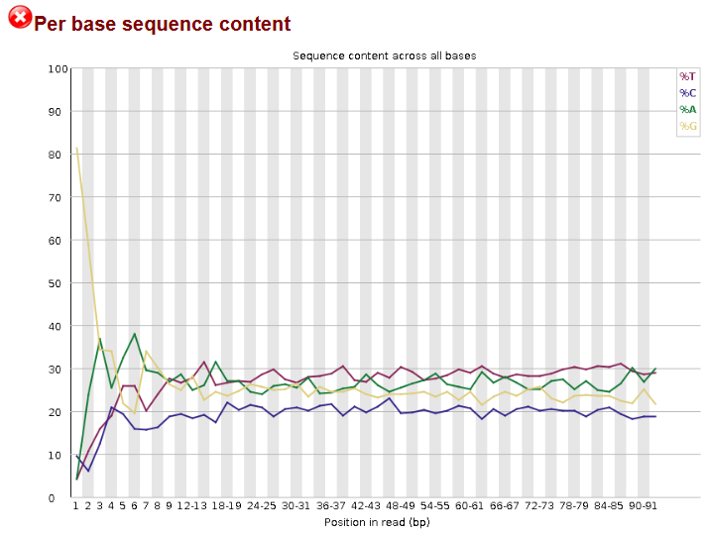
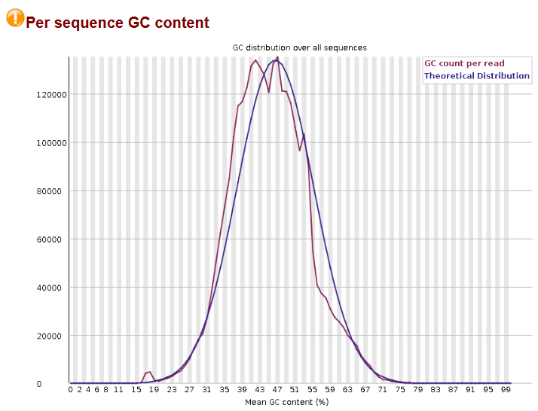
Answer
Quality Check (QC) with FastQC
%
Number of sequences
The proportion of each base position in a file for which each of the four normal DNA bases has been called. In a random library you would expect that there would be little to no difference between the different bases (A-T and C-G) of a sequence run. IMPORTANT: Some types of library will always produce biased sequence composition, normally at the start of the read. Libraries produced by priming using random hexamers (including nearly all RNA-Seq libraries) inherits an intrinsic bias in the positions at which reads start. This is not a problem which can be fixed by processing, and it doesn't seem to adversely affect the ability to measure expression.
The GC content across the whole length of each sequence in a file and compares it to a modelled normal distribution of GC content. In a normal random library, you would expect to see a roughly normal distribution of GC content where the central peak corresponds to the overall GC content of the underlying genome.
Notes:
Per base sequence content: https://www.bioinformatics.babraham.ac.uk/projects/fastqc/Help/3%20Analysis%20Modules/4%20Per%20Base%20Sequence%20Content.html
Per sequence GC content: https://www.bioinformatics.babraham.ac.uk/projects/fastqc/Help/3%20Analysis%20Modules/5%20Per%20Sequence%20GC%20Content.html
<número>

Slide 30
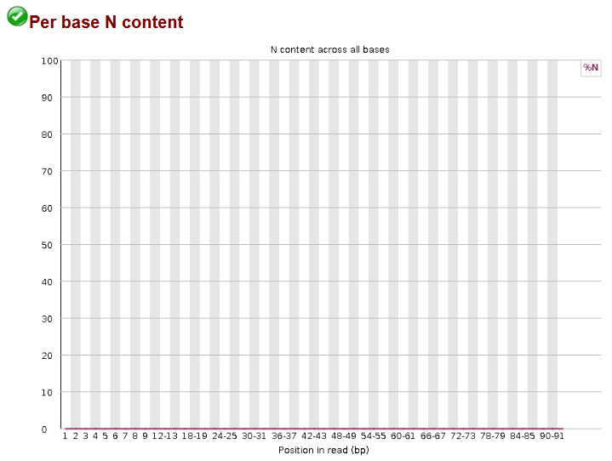
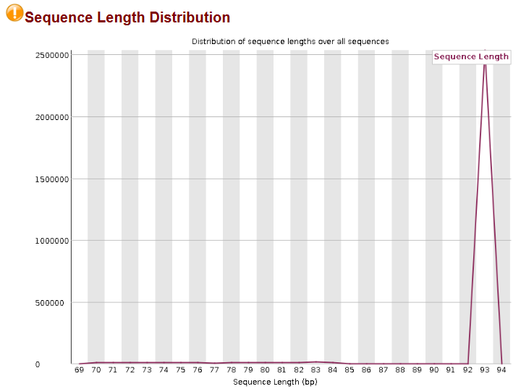
Answer
Quality Check (QC) with FastQC
Number of sequences
%
This module plots out the percentage of base calls at each position for which an N was called.
This module generates a graph showing the distribution of fragment sizes in the file which was analysed.
Notes:
Per base N content: https://www.bioinformatics.babraham.ac.uk/projects/fastqc/Help/3%20Analysis%20Modules/6%20Per%20Base%20N%20Content.html
Sequence Length Distribution: https://www.bioinformatics.babraham.ac.uk/projects/fastqc/Help/3%20Analysis%20Modules/7%20Sequence%20Length%20Distribution.html
<número>

Slide 31
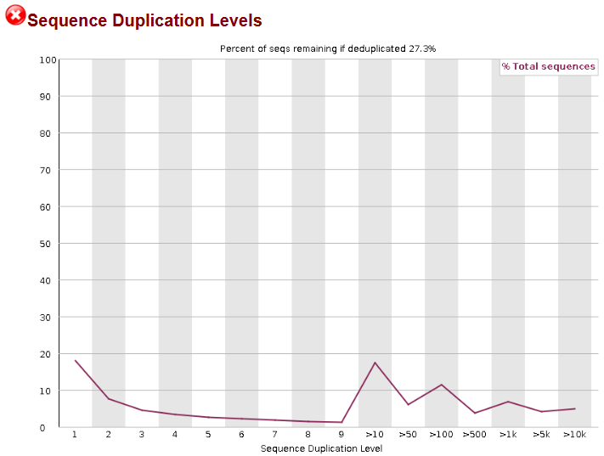
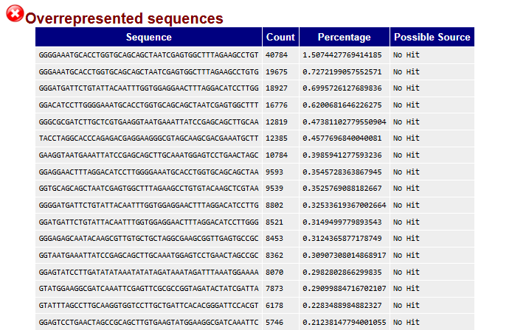
Answer
Quality Check (QC) with FastQC
% of sequences
This module lists all of the sequence which make up more than 0.1% of the total. For each overrepresented sequence the program will look for matches in a database of common contaminants and will report the best hit it finds. This module will often be triggered when used to analyse small RNA libraries where sequences are not subjected to random fragmentation, and the same sequence may naturally be present in a significant proportion of the library.
This module counts the degree of duplication for every sequence in a library and creates a plot showing the relative number of sequences with different degrees of duplication. A high level of duplication is more likely to indicate some kind of enrichment bias. IMPORTANT: In RNA-Seq libraries, sequences from different transcripts will be present at wildly different levels in the starting population. In order to be able to observe lowly expressed transcripts it is therefore common to greatly over-sequence high expressed transcripts, and this will potentially create large set of duplicates.
Notes:
Sequence Duplication Levels: https://www.bioinformatics.babraham.ac.uk/projects/fastqc/Help/3%20Analysis%20Modules/8%20Duplicate%20Sequences.html
Overrepresented sequences: https://www.bioinformatics.babraham.ac.uk/projects/fastqc/Help/3%20Analysis%20Modules/9%20Overrepresented%20Sequences.html
<número>

Slide 32
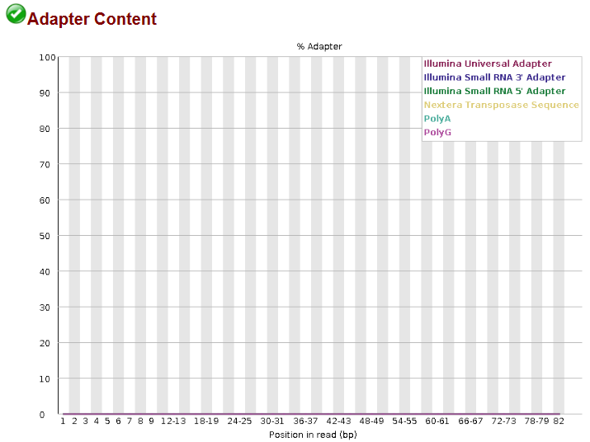
Answer
Quality Check (QC) with FastQC
It checks if your library contains a significant amount of adapters in order to be able to assess whether you need to adapter trim or not. The plot itself shows a cumulative percentage count of the proportion of your library which has seen each of the adapter sequences at each position
Notes:
Adapter Content: https://www.bioinformatics.babraham.ac.uk/projects/fastqc/Help/3%20Analysis%20Modules/10%20Adapter%20Content.html
<número>

Slide 33
Filtering with Trimmomatic
Task 02: Filter the sequences of ABR3_W_03 sample. Select the most appropriate parameters based on the QC report to improve their quality.
Software: Trimmomatic v.0.39
Command: java -jar trimmomatic-0.39.jar SE -threads 4 -phred33 \
Input_file Output_file\
ILLUMINACLIP:path/adapter_file:x:xx:xx \
LEADING:xx TRAILING:xx \
SLIDINGWINDOW:xx:xx \
MINLEN:xx
Tips:
Check that the paths of the software, input files, and output folder are correct.
Phred+33 is listed as Illumina 1.9/Sanger (see QC report)
Adapter file TruSeq3-SE.fa for Illumina HiSeq2500
Check Trimmomatic website: http://www.usadellab.org/cms/?page=trimmomatic
Notes:
<número>

Slide 34
Answer
Filtering with Trimmomatic
java -jar trimmomatic-0.39.jar \
SE \
-threads 4 \
-phred33 \
01_RNAseq_raw/ABR3_W_03.fastq.gz \
02_RNAseq_filtered/ABR3_W_03_trimmed.fastq.gz \
ILLUMINACLIP:software/Trimmomatic-0.39/adapters/TruSeq3-SE.fa:2:30:10 \
LEADING:3 \
TRAILING:3 \
SLIDINGWINDOW:4:15 \
MINLEN:36
Notes:
Remove Illumina adapters provided in the TruSeq3-PE.fa file (provided). Initially Trimmomatic will look for seed matches (16 bases) allowing maximally 2 mismatches. These seeds will be extended and clipped if in the case of paired end reads a score of 30 is reached (about 50 bases), or in the case of single ended reads a score of 10, (about 17 bases). Remove leading low quality or N bases (below quality 3) Remove trailing low quality or N bases (below quality 3) Scan the read with a 4-base wide sliding window, cutting when the average quality per base drops below 15 Drop reads which are less than 36 bases long after these steps
Of course the :30: parameter has no effect, but a value has to be specified nevertheless)
http://www.usadellab.org/cms/uploads/supplementary/Trimmomatic/TrimmomaticManual_V0.32.pdf
<número>

Slide 35
Quality Check (QC) after filtering step
Task 03: Generate a new QC report of the filtered sequences and compare the reports before and after filtering. What parameters have changed?
Software: FastQC v.0.12.1

Slide 36
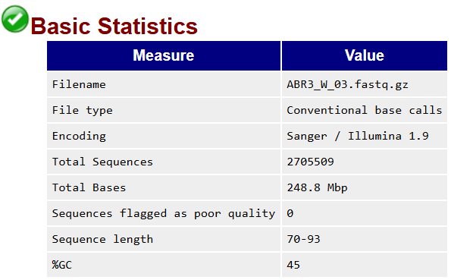
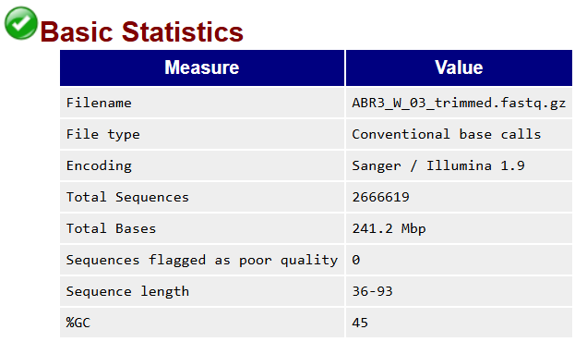
Answer
Comparing QC reports before and after filtering step
fastqc 02_RNAseq_filtered/ABR3_W_03_trimmed.fastq.gz -o 02_RNAseq_filtered/reports/
Before …
After …

Slide 37
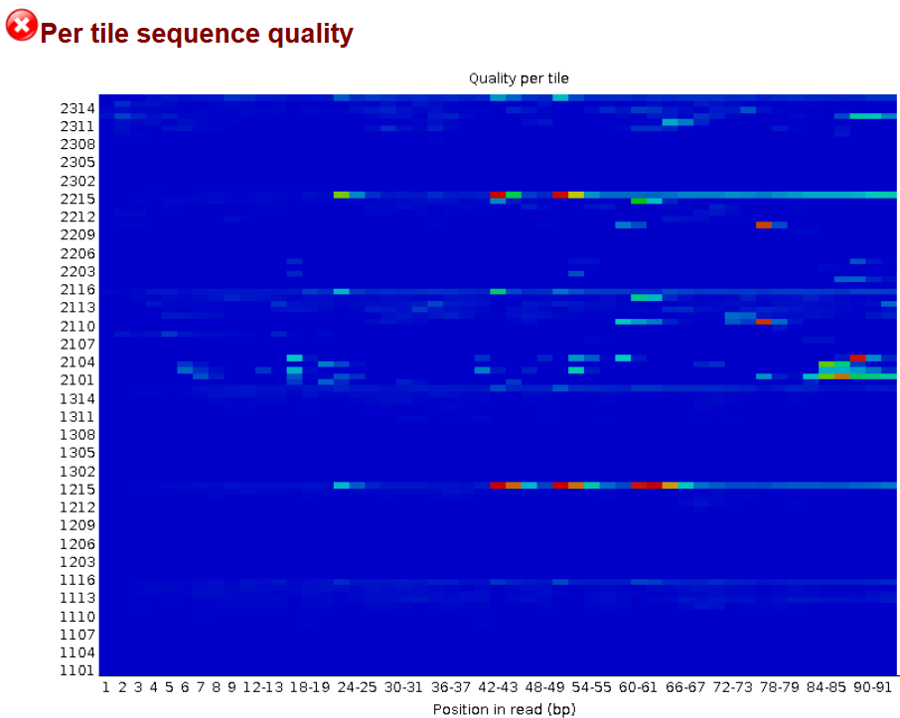

Answer
Comparing QC reports before and after filtering step
Before …
After …

Slide 38
Mapping with kallisto
Task 04: Perform pseudo-alignments of the reads from sample ABR3_W_03 against the reference transcriptome (Bdistachyon_314_v3.1.transcript.TagSeq500b.fa.gz) and indicate the expression of the Bradi3g51200 gene in est_counts and TPM.
Software: kallisto 0.48
# Index reference
kallisto index \
-i ref.output.idx ref.input.fa.gz
# Quantification
kallisto quant \
-i ref.output.idx \
-o output_folder/output_subfolder_sample \
-b 100 \ # Number of bootstrap samples*
--single \ # Quantify single-end reads
-l 100 \ # Estimated average fragment length**
-s 20 \ # Estimated standard deviation of fragment length***
<(zcat input_compressed.fastq.gz)

Slide 39
Mapping with kallisto
* Number of bootstrap samples
** Estimated average fragment length
*** Estimated standard deviation of fragment length
Number of bootstrap samples (-b): Because many reads can map to multiple transcripts, kallisto uses a probabilistic model to assign them. To measure how uncertain these assignments are, kallisto performs bootstrap resampling — it repeatedly resamples reads (with replacement) and re-estimates transcript abundances. Typical bootstrapping value: 100
Estimated average fragment length (-l): In the case of single-end reads, the -l option must be used to specify the average fragment length. Typical Illumina libraries produce fragment lengths ranging from 180–200 bp but it’s best to determine this from a library quantification with an instrument such as an Agilent Bioanalyzer.
For paired-end reads, the average fragment length can be directly estimated from the reads, and the program will do so if -l is not used (this is the preferred run mode).
Estimated standard deviation of fragment length (-s): This value describes how much variation there is in the length of the sequenced cDNA fragments. Library kits or sequencing facilities often report the average fragment size and its variation, e.g. “200 ± 20 bp” → -l 200 -s 20. Typical ‘s’ value: 20
Notes:
https://pachterlab.github.io/kallisto/manual
<número>

Slide 40
Answer
Mapping with kallisto
Pseudoalignments of RNA-Seq data were carried out using as references 500 bp from the 3′ tails of the B. distachyon_314_version 3.1 transcriptome (IBI, 2010; https://phytozome.jgi.doe.gov/).
We applied estimated average fragment lengths of 100 bp and standard deviations of fragment length of 20.
# Index reference
kallisto index \
-i 00_Reference_transcriptome/Bdistachyon_314_v3.1.transcript.TagSeq500b.idx \
00_Reference_transcriptome/Bdistachyon_314_v3.1.transcript.TagSeq500b.fa.gz
# Quantification
kallisto quant \
-i 00_Reference_transcriptome/Bdistachyon_314_v3.1.transcript.TagSeq500b.idx \
-o 03_quant/ABR3_W_03 \
-b 100 \ # Number of bootstrap samples
--single \ # Quantify single-end reads
-l 100 \ # Estimated average fragment length
-s 20 \ # Estimated standard deviation of fragment length
<(zcat 02_RNAseq_filtered/ABR3_W_03_trimmed.fastq.gz)
Notes:
default: -l, -s values are estimated from paired end data, but are required when using –single.
<número>

Slide 41
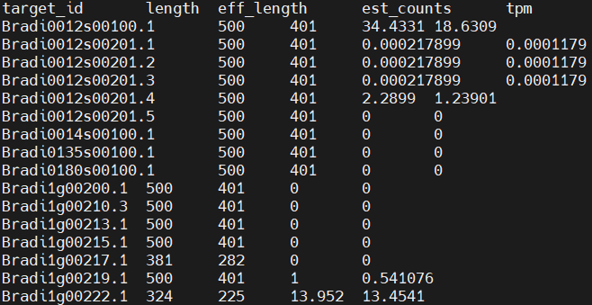
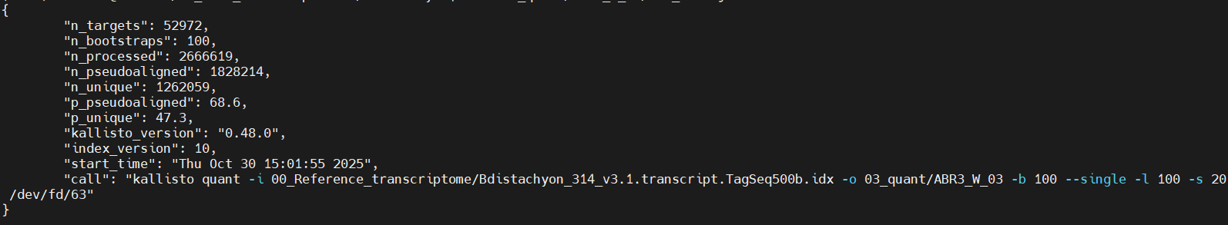
Mapping with kallisto
abundance.tsv
Output files:
abundance.h5: a HDF5 binary file containing run info, abundance estimates, bootstrap estimates, and transcript length information length. This file can be read in by sleuth.
abundance.tsv: a plaintext file of the abundance estimates. It does not contain bootstrap estimates. The first line contains a header for each column, including estimated counts, TPM, effective length.
run_info.json: a json file containing information about the run.
run_info.json
Notes:
https://pachterlab.github.io/kallisto/manual
What are estimate_counts?
estimate_counts are the estimated number of reads assigned to each transcript.
They are not raw counts, because many reads can map to multiple isoforms.
Instead, kallisto uses a probabilistic model to distribute reads among transcripts.
In kallisto, estimate_counts are the expected number of reads per transcript, calculated via pseudoalignment and a maximum likelihood model that distributes ambiguous reads probabilistically.
<número>

Slide 42
Answer
Mapping with kallisto
Gene expression fo Bradi3g51200 (sample ABR3_W_03):
est_counts = 60
TPM = 32.4646
Notes:
What are estimate_counts?
estimate_counts are the estimated number of reads assigned to each transcript.
They are not raw counts, because many reads can map to multiple isoforms.
Instead, kallisto uses a probabilistic model to distribute reads among transcripts.
In kallisto, estimate_counts are the expected number of reads per transcript, calculated via pseudoalignment and a maximum likelihood model that distributes ambiguous reads probabilistically.
<número>

Slide 43
Readme (Sleuth and WGCNA)
Into /data (Ubuntu WSL)
cp -r /home/vep/test_data/transcripts/brachy/05_WGCNA/ .
cp -r /home/vep/test_data/transcripts/brachy/04_Sleuth/ .
Extent permissions: chmod -R 777 04_Sleuth 05_WGCNA
Copy Rstudio scripts:
Copy Rstudio script "Practical_Sleuth.rmd" in
\\wsl.localhost\Ubuntu-22.04\home\iamz\transcriptome_class\04_Sleuth
Copy Rstudio script "Practical_WGCNA_W_dataset.rmd" in
\\wsl.localhost\Ubuntu-22.04\home\iamz\transcriptome_class\05_WGCNA
Copy Rstudio script "Practical_WGCNA_D_dataset.rmd" in
\\wsl.localhost\Ubuntu-22.04\home\iamz\transcriptome_class\05_WGCNA
Notes:
<número>

Slide 44
Data exploration and DEGs with Sleuth
Task 05: Run the Sleuth pipeline to explore your data and DEGs.
Software: sleuth v.0.30.2
Pipeline in Rstudio: Practical_Sleuth.Rmd
In \\wsl.localhost\Ubuntu-22.04\home\iamz\transcriptome_class\04_Sleuth
Notes:
https://cyverse-kallisto-tutorial.readthedocs-hosted.com/en/latest/step3.html
https://rpubs.com/kapeelc12/Sleuth
<número>

Slide 45
Data exploration and DEGs with Sleuth
Task 05.1: Use sleuth_live(so) to explore the boxplots of the Bradi1g06560.1 isoform/transcript expression (in TPMs) with respect to the experimental conditions (drought and irrigation).
Notes:
https://cyverse-kallisto-tutorial.readthedocs-hosted.com/en/latest/step3.html
https://rpubs.com/kapeelc12/Sleuth
<número>

Slide 46
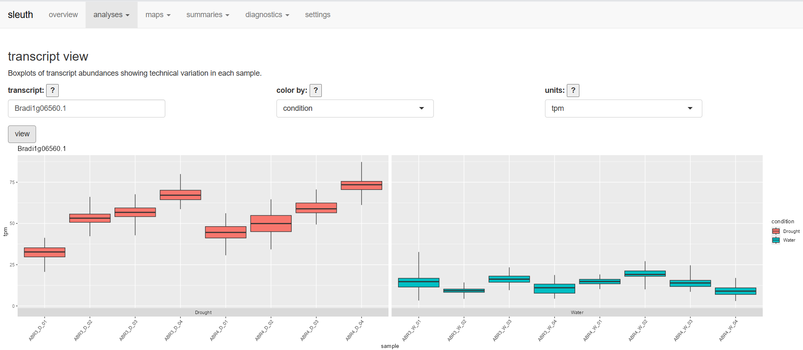
Answer 05.1
Data exploration and DEGs with Sleuth
Sleuth_live(so): analyses → transcript view
Notes:
<número>

Slide 47
Data exploration and DEGs with Sleuth
Task 05.2: Use sleuth_live(so) to explore the heatmap of the following isoforms: Bradi1g06560.1 Bradi2g54810.2 Bradi4g08240.1 Bradi4g31150.1.
Use as covariate “condition” and as units TPMs.
Notes:
<número>

Slide 48
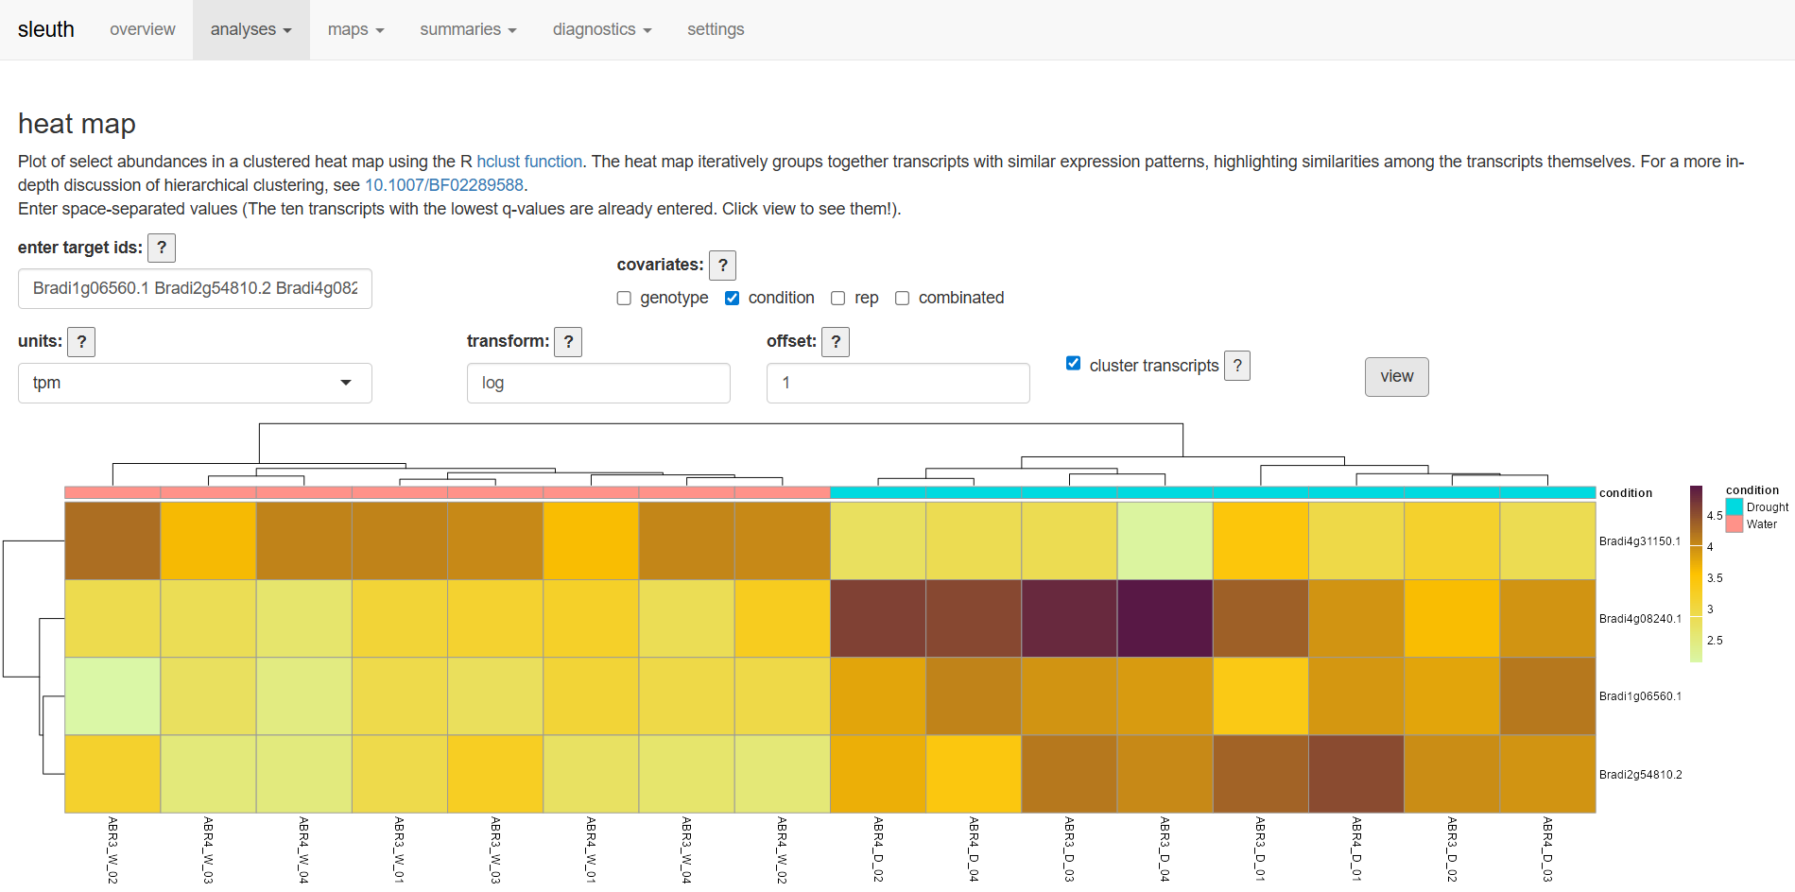
Answer 05.2
Data exploration and DEGs with Sleuth
Sleuth_live(so): analyses → heatmap
Notes:
<número>

Slide 49
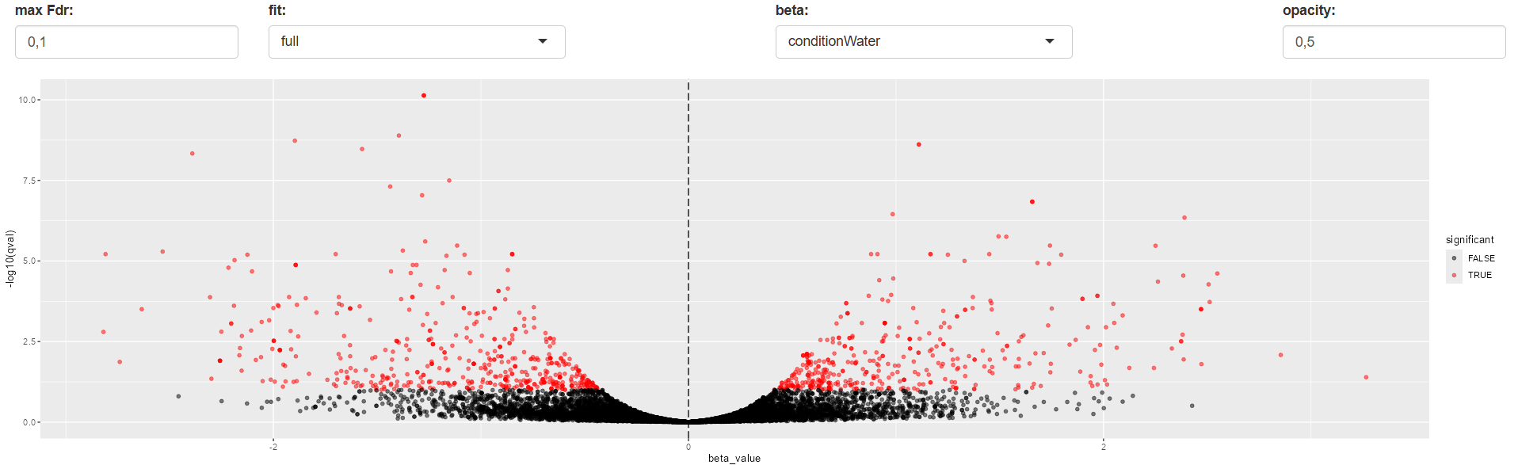
Data exploration and DEGs with Sleuth
Sleuth_live(so): analyses → volcano plot
Down-regulated (-)
Up-regulated (+)
Statistical significance of the change
X-axis (log2 fold change) This represents the magnitude of change in gene expression between two conditions.
Notes:
X-axis (log2 fold change) This represents the magnitude of change in gene expression between two conditions.
Positive values → genes are upregulated in the condition of interest.
Negative values → genes are downregulated (lower expression).
Y-axis (–log10 p-value or q-value) This represents the statistical significance of the change.
The higher the point, the more statistically significant the result (smaller p-value or q-value).
Sleuth often uses the adjusted p-value (q-value) to account for multiple testing.
Each point Corresponds to a gene or transcript. Its position reflects both:
The biological effect size (fold change).
The confidence in that effect (significance).
-------------------------------------------------------------
-------------------------------------------------------------
target_id: The identifier of the transcript or gene (usually the kallisto transcript ID).
pval: The raw p-value from the statistical test of differential expression. It indicates the probability of observing such an effect if there were no real difference.
qval: The p-value adjusted for multiple testing using False Discovery Rate (FDR). This is more reliable for identifying truly significant genes when thousands of tests are performed.
b: The estimated coefficient from the linear model. In practice, this represents the log2 fold change between conditions.
se_b: The standard error of the coefficient b. It measures the uncertainty of the fold change estimate.
mean: The average abundance (TPM or normalized counts) of the transcript across samples.
var: The total observed variance in transcript abundance across samples.
tech_var: The technical variance estimated from kallisto bootstraps. This reflects uncertainty due to the quantification process rather than biological differences.
sigma_sq: The initial estimate of biological variance (after separating out technical variance).
smooth_sigma_sq: A smoothed version of sigma_sq, obtained using shrinkage or regularization to stabilize estimates for transcripts with limited data.
final_sigma_sq: The final biological variance estimate used in the model. It combines information from sigma_sq and smooth_sigma_sq to provide a robust variance value.
<número>

Slide 50
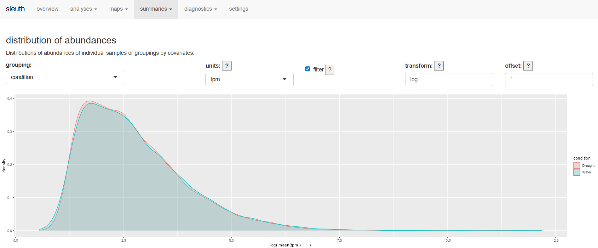
Data exploration and DEGs with Sleuth
Sleuth_live(so): summaries → densities
Notes:
What you see in practice
The curve typically has a peak at low expression values, because most transcripts are expressed at low levels.
There’s often a long tail toward higher values, representing fewer transcripts with very high expression.
By comparing density plots across conditions or replicates, you can check whether the overall distribution of expression is similar (important for normalization and quality control).
Why Sleuth shows this
It’s a QC visualization: helps you see the global distribution of transcript abundances.
It highlights whether one sample has a very different distribution (which could indicate technical issues).
It also illustrates the typical “many low, few high” pattern of transcript expression in RNA-seq data.
<número>

Slide 51
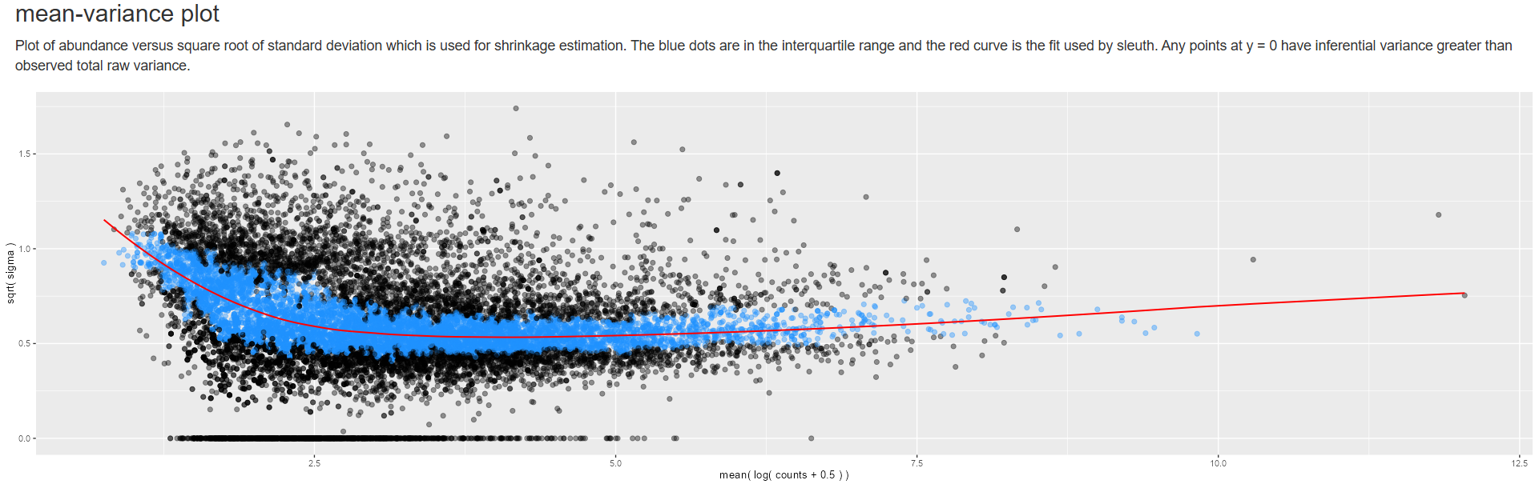
Data exploration and DEGs with Sleuth
Sleuth_live(so): diagnostics → mean-variance plot
Y ()
(variability in expression)
X (Abundance)
Notes:
Blue dots: Transcripts within the interquartile range, used as stable reference points.
Red curve: Fitted line showing the relationship between abundance and variance, used for shrinkage (stabilizing variance estimates).
Points at y = 0: Cases where inferential variance (from kallisto bootstraps) is greater than the observed raw variance, so Sleuth sets biological variance to zero.
In summary: The plot visualizes how transcript variability relates to abundance and shows how Sleuth applies shrinkage to produce robust variance estimates for differential expression analysis.
Shrinkage in Sleuth’s mean–variance plot is a way of regularizing variance estimates: noisy points are adjusted toward a smooth trend so that the analysis is more robust and less sensitive to random fluctuations.
Why it’s useful
Stabilizes variance estimates across transcripts.
Prevents low-abundance genes from appearing artificially variable.
Improves the reliability of downstream statistical tests (like differential expression), because variance is modeled consistently.
<número>

Slide 52
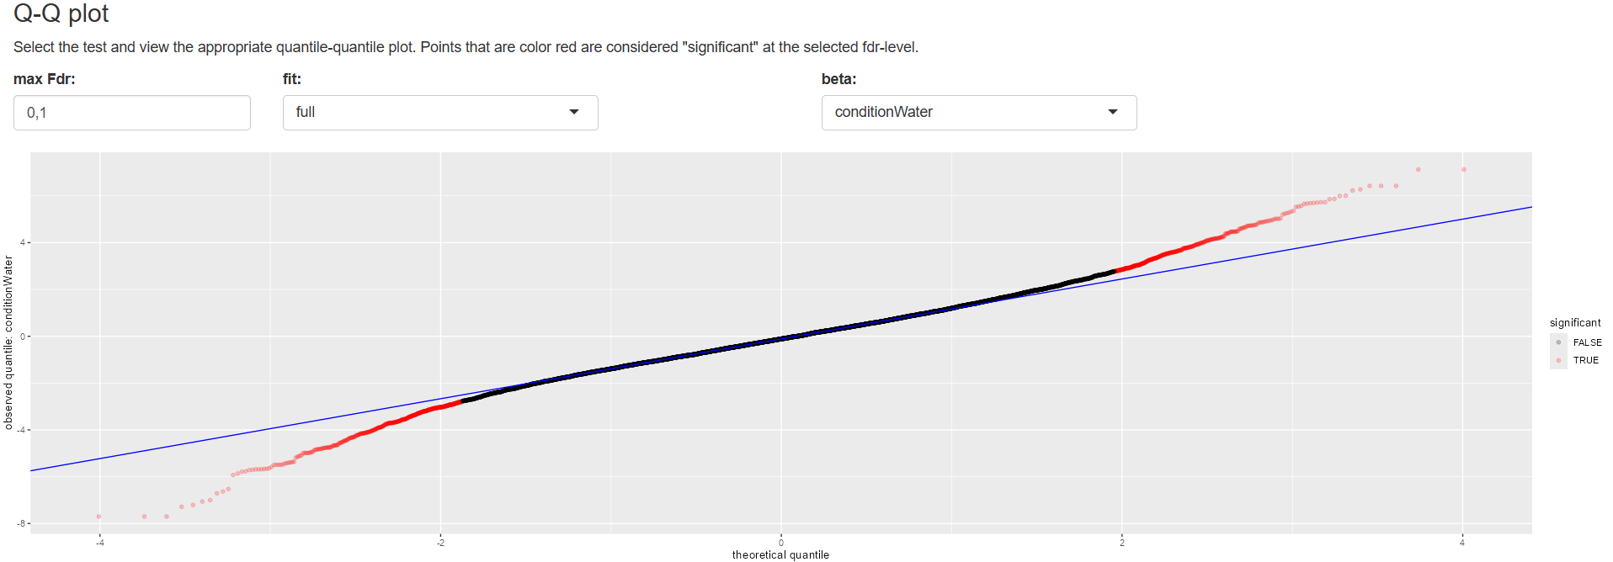
Data exploration and DEGs with Sleuth
Sleuth_live(so): diagnostics → Q-Q plot
Notes:
Q–Q (Quantile–Quantile) plots compare the distribution of observed test statistics (from your RNA-seq analysis) against the distribution expected under the null hypothesis (no differential expression).
The x-axis represents the theoretical quantiles (expected values if there were no true differences).
The y-axis represents the observed quantiles (your actual test results; Likelihood Ratio Test y el Wald Test).
How to interpret it
Points along the diagonal line: Observed values match the expected distribution → no evidence of differential expression.
Points deviating upward from the line: More extreme test statistics than expected → potential true differential expression.
Red points: Genes/transcripts considered significant at the chosen FDR threshold (q-value cutoff). These are the candidates Sleuth highlights as differentially expressed.
Sleuth’s Q–Q plot compares observed vs. expected test statistics. Red points mark significant genes at the chosen FDR level, and deviations from the diagonal line reveal evidence of differential expression beyond random noise.
<número>

Slide 53
Data exploration and DEGs with Sleuth
Sleuth is a powerful R package designed to analyze gene expression values ​​calculated by the Kallisto software (pseudo-aligner).
Sleuth allows for exploring and visualizing the data, which is essential for this type of analysis.
Sleuth also allows for the identification of differentially expressed genes (DEGs).
Notes:
<número>

Slide 54
Co-expression Network with WGCNA
Task 05: Run the WGCNA pipeline to construct and explore the co-expression network.
Software: WGCNA v.1.73
Pipeline in Rstudio: Practical_WGCNA.Rmd
In \\wsl.localhost\Ubuntu-22.04\home\iamz\transcriptome_class\05_WGCNA
Notes:
https://fuzzyatelin.github.io/bioanth-stats/module-F21-Group1/module-F21-Group1.html
<número>

Slide 55
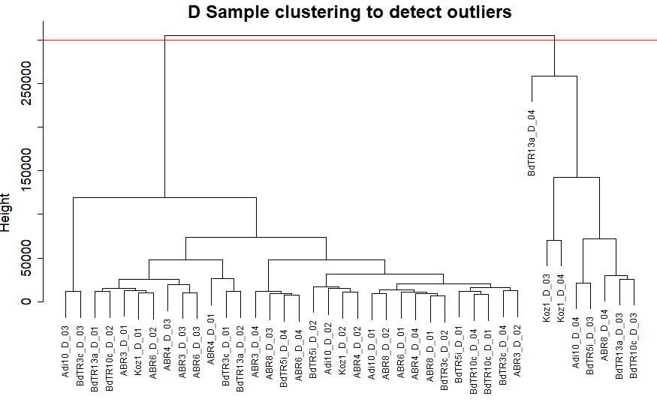
Co-expression Network with WGCNA
Outliers Detection
Notes:
<número>

Slide 56
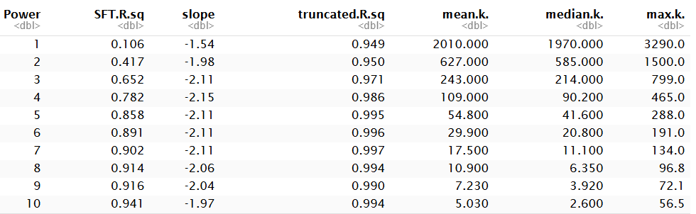
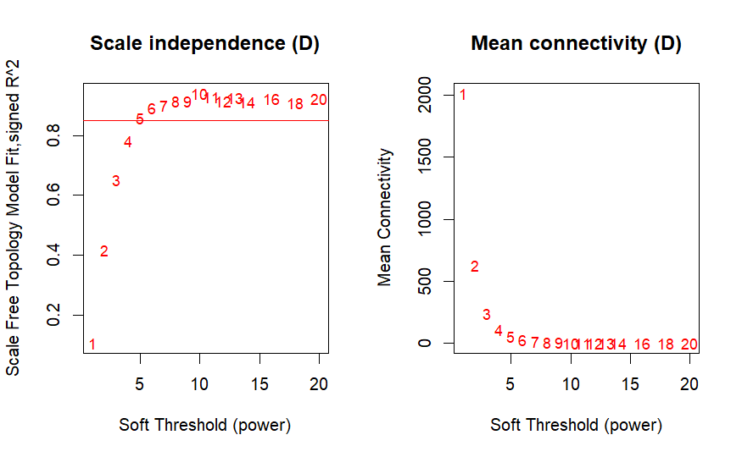
Co-expression Network with WGCNA
Soft-thresholding powers selection for network construction
Notes:
<número>

Slide 57
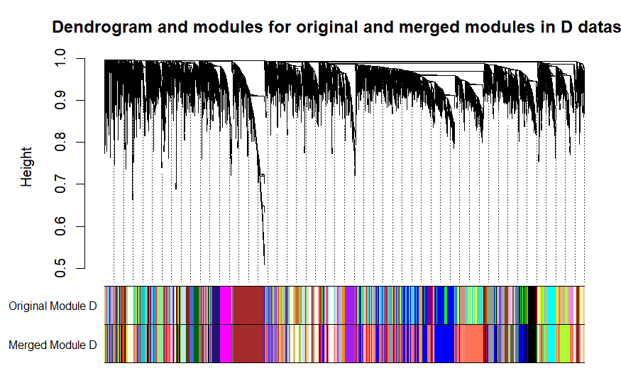
Co-expression Network with WGCNA
Network construction and Module detection
The gray module represents unclustered genes (without an assigned module).
Note: In this exercise, very few genes appear in "gray" because I filtered them beforehand to reduce the database size and speed up computation.
Notes:
<número>

Slide 58
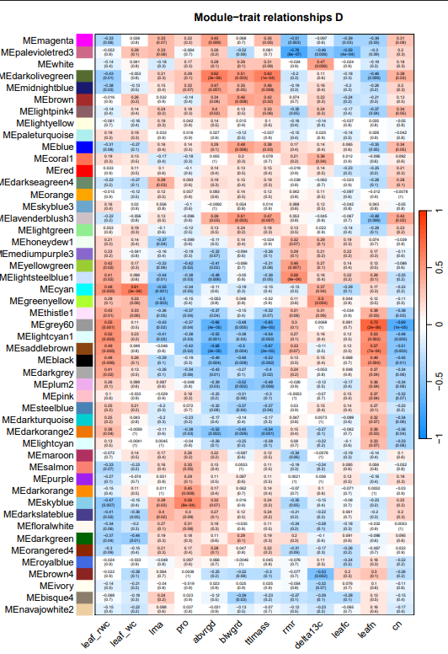
Co-expression Network with WGCNA
Module-trait associations
Modules
Traits
Notes:
[leaf_rwc (relative water content in leaf); leaf_wc (water content in leaf); lma (leaf mass per area); pro (leaf proline content); abvrgd (above ground biomass); blwgrd (below ground biomass); ttlmass (total mass); rmr (root mass ratio); delta13c (carbon isotope, a proxy for lifetime integrated WUE); leafc (leaf carbon content); leafn (leaf nitrogen content); cn (leaf carbon/nitrogen ratio)]
<número>

Slide 59
Co-expression Network with WGCNA
Task 06. Perform a Statistical overrepresentation test (https://pantherdb.org/) to determine if the genes of the magenta module of the drought network are significantly involved in any biological process according to the "GO“
(The format of the ID gene must be converted: sed 's/Bradi/BRADI_/g’ ID.txt | sed -E 's/\.[0-9]/v3/g' | sort | uniq | tr '\n' ' ')
BRADI_1g01507v3 BRADI_1g03590v3 BRADI_1g03610v3 BRADI_1g04440v3 BRADI_1g07237v3 BRADI_1g08410v3 BRADI_1g08870v3 BRADI_1g09950v3 BRADI_1g11630v3 BRADI_1g11960v3 BRADI_1g13232v3 BRADI_1g14940v3 BRADI_1g15030v3 BRADI_1g16190v3 BRADI_1g16620v3 BRADI_1g20360v3 BRADI_1g20620v3 BRADI_1g20930v3 BRADI_1g26260v3 BRADI_1g27490v3 BRADI_1g29040v3 BRADI_1g30247v3 BRADI_1g32330v3 BRADI_1g32660v3 BRADI_1g32990v3 BRADI_1g33300v3 BRADI_1g35742v3 BRADI_1g36290v3 BRADI_1g37080v3 BRADI_1g37175v3 BRADI_1g37750v3 BRADI_1g38760v3 BRADI_1g42730v3 BRADI_1g44047v3 BRADI_1g44230v3 BRADI_1g45080v3 BRADI_1g45160v3 BRADI_1g45200v3 BRADI_1g46530v3 BRADI_1g47767v3 BRADI_1g48010v3 BRADI_1g50370v3 BRADI_1g51610v3 BRADI_1g53320v3 BRADI_1g53850v3 BRADI_1g55500v3 BRADI_1g55620v3 BRADI_1g61040v3 BRADI_1g61170v3 BRADI_1g64850v3 BRADI_1g65480v3 BRADI_1g66800v3 BRADI_1g67040v3 BRADI_1g67290v3 BRADI_1g68720v3 BRADI_1g69400v3 BRADI_1g70700v3 BRADI_1g72740v3 BRADI_1g72950v3 BRADI_1g73120v3 BRADI_1g74300v3 BRADI_1g76950v3 BRADI_1g77637v3 BRADI_2g00831v3 BRADI_2g02110v3 BRADI_2g02400v3 BRADI_2g05640v3 BRADI_2g07040v3 BRADI_2g12830v3 BRADI_2g13110v3 BRADI_2g13870v3 BRADI_2g13870v30 BRADI_2g13870v33 BRADI_2g14411v3 BRADI_2g15950v3 BRADI_2g16660v3 BRADI_2g17200v3 BRADI_2g19540v3 BRADI_2g22140v3 BRADI_2g23040v3 BRADI_2g23250v3 BRADI_2g24230v3 BRADI_2g25613v3 BRADI_2g27900v3 BRADI_2g31576v3 BRADI_2g33360v3 BRADI_2g33682v3 BRADI_2g36000v3 BRADI_2g39890v3 BRADI_2g40942v3 BRADI_2g41117v3 BRADI_2g42227v3 BRADI_2g45460v3 BRADI_2g45840v3 BRADI_2g47530v3 BRADI_2g49280v3 BRADI_2g49660v3 BRADI_2g50300v3 BRADI_2g51240v3 BRADI_2g52470v3 BRADI_2g53020v3 BRADI_2g54570v3 BRADI_2g55490v3 BRADI_2g55960v3 BRADI_2g56190v3 BRADI_2g56490v3 BRADI_2g56500v3 BRADI_2g56710v3 BRADI_2g57220v3 BRADI_2g57230v3 BRADI_2g58835v3 BRADI_2g61767v3 BRADI_3g02640v3 BRADI_3g03532v3 BRADI_3g05530v3 BRADI_3g06107v3 BRADI_3g15890v3 BRADI_3g19893v3 BRADI_3g22980v3 BRADI_3g26930v3 BRADI_3g26967v3 BRADI_3g27800v3 BRADI_3g28450v3 BRADI_3g28700v3 BRADI_3g29700v3 BRADI_3g29797v3 BRADI_3g30380v3 BRADI_3g33544v3 BRADI_3g33850v3 BRADI_3g35000v3 BRADI_3g36370v3 BRADI_3g37047v3 BRADI_3g37260v3 BRADI_3g37790v3 BRADI_3g37820v3 BRADI_3g38220v3 BRADI_3g38670v3 BRADI_3g39440v3 BRADI_3g41490v3 BRADI_3g43890v3 BRADI_3g44947v3 BRADI_3g44950v3 BRADI_3g45030v3 BRADI_3g45206v3 BRADI_3g45940v3 BRADI_3g48240v3 BRADI_3g48590v3 BRADI_3g49400v3 BRADI_3g50110v3 BRADI_3g50420v3 BRADI_3g51600v3 BRADI_3g54200v3 BRADI_3g54267v3 BRADI_3g56610v3 BRADI_3g57525v3 BRADI_3g58980v3 BRADI_4g01710v3 BRADI_4g02925v3 BRADI_4g05450v3 BRADI_4g06370v3 BRADI_4g07390v3 BRADI_4g07911v3 BRADI_4g08420v3 BRADI_4g08550v3 BRADI_4g09120v3 BRADI_4g10998v3 BRADI_4g17336v3 BRADI_4g20537v3 BRADI_4g23800v3 BRADI_4g24320v3 BRADI_4g25430v3 BRADI_4g27376v3 BRADI_4g29506v3 BRADI_4g29540v3 BRADI_4g31070v3 BRADI_4g32941v3 BRADI_4g33899v3 BRADI_4g34056v3 BRADI_4g34980v3 BRADI_4g35170v3 BRADI_4g35301v3 BRADI_4g36690v3 BRADI_4g37460v3 BRADI_4g37770v3 BRADI_4g40310v3 BRADI_4g42710v3 BRADI_4g42890v3 BRADI_4g43220v3 BRADI_4g44530v3 BRADI_4g44760v3 BRADI_4g45410v3 BRADI_5g00590v3 BRADI_5g02037v3 BRADI_5g06390v3 BRADI_5g06628v3 BRADI_5g10090v3 BRADI_5g10140v3 BRADI_5g12452v3 BRADI_5g13610v3 BRADI_5g13930v3 BRADI_5g14550v3 BRADI_5g15300v3 BRADI_5g15396v3 BRADI_5g15835v3 BRADI_5g15970v3 BRADI_5g16100v3 BRADI_5g18290v3 BRADI_5g20410v3 BRADI_5g20890v3 BRADI_5g21757v3 BRADI_5g23150v3 BRADI_5g23158v3 BRADI_5g24850v3 BRADI_5g25450v3 BRADI_5g25547v3 BRADI_5g26907v3
Notes:
The Gene Ontology (GO) provides a structured, controlled vocabulary to describe gene functions across species, covering biological processes, molecular functions, and cellular components."
<número>

Slide 60
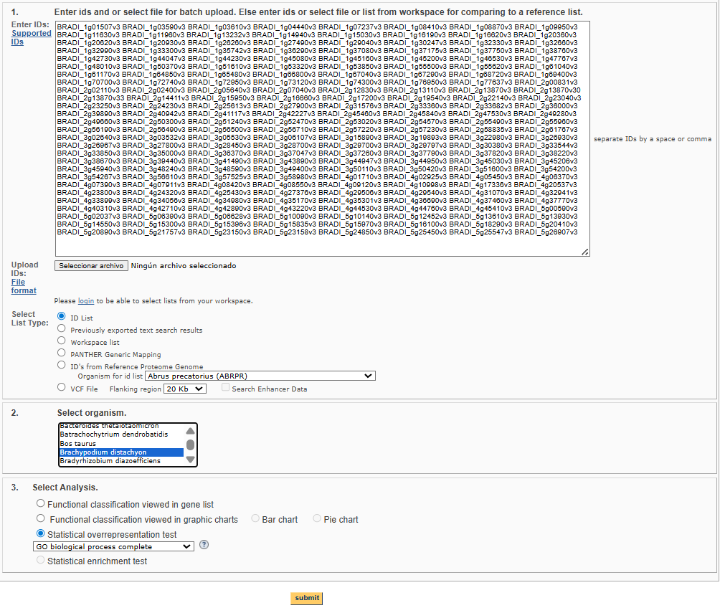
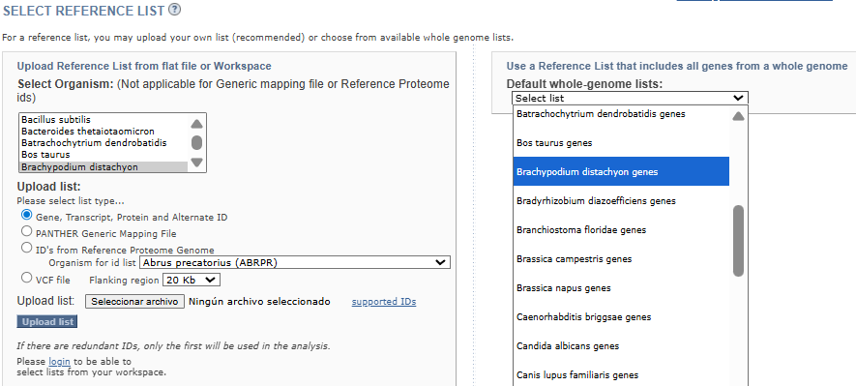
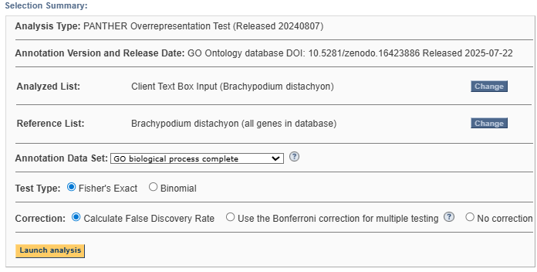
Co-expression Network with WGCNA
1
6
2
3
4
7
5
Notes:
<número>

Slide 61

EXTRA EXERCISES

Slide 62
EXTRA EXCERCISES
Task 07. Normalize the raw gene expression counts obtained from single-end read mappings to a reference genome, converting them into RPKM and TPM values. There are four genes (A, B, C and D) and three samples (1, 2 and 3).
Gene | Sample 1 |  |  | Sample 2 |  |  | Sample 3
 | Raw | RPKM | TPM | Raw | RPKM | TPM | Raw | RPKM | TPM
A (2,000 bp) | 15 | 0.15*10⁶ | 0.32*10⁶ | 18 |  |  | 35
B (4,000 bp) | 25 |  |  | 30 |  |  | 70
C (1,000 bp) | 10 |  |  | 12 |  |  | 20
D (10,000 bp) | 0 |  |  | 1 |  |  | 1
Total reads | 50 |  |  | 61 |  |  | 126
e.g. GeneA.Sample1 =
e.g. GeneA.Sample1 =
Notes:
<número>

Slide 63
EXTRA EXCERCISES
Task 08. Using the compressed Fastqc file ABR3_D_03.fastq.gz (folder 01_RNAseq_raw), perform the steps of generating the QC report (FastQC software), filtering (Trimmomatic software) the sequences to remove adapters and low quality (and QC report after filtering) and aligning (Kallisto software) the filtered sequences against the reference transcriptome.
Task 09. Using Sleuth and the same input as in the previous example, visualize and compare the expression of the Bradi3g51200.1, Bradi1g37410.1, Bradi3g43870.1 transcripts using a heatmap.
What differences do you observe when comparing their expression in the control group versus under drought conditions?
Task 10. Construct a co-expression network (WGCNA R package) of the samples and genes analyzed under the control condition (W). Compare the results of the modules obtained in both co-expression networks, drought (D) and control (W).

Slide 64

Deliverable Task
Please, make a folder named ‘transcripts/’ in the same GitHub repo of session 1, and write a report that includes:
How you solved the exercises.
The results obtained.
The main specific inputs and outputs used at each step.
The problems you encountered.
Briefly propose an experiment in which these analyses could be applied.

Slide 65

Thank you!
If you have any questions, please feel free to email me at rsancho@eead.csic.es

