Slide 1
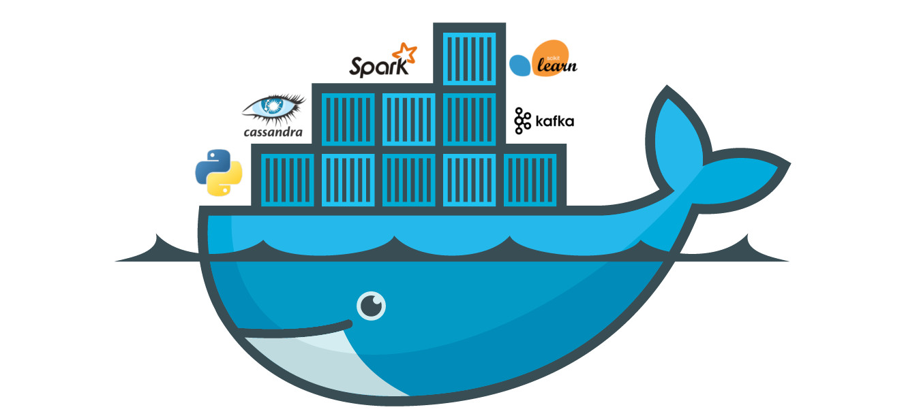
Docker Session 2

Slide 2
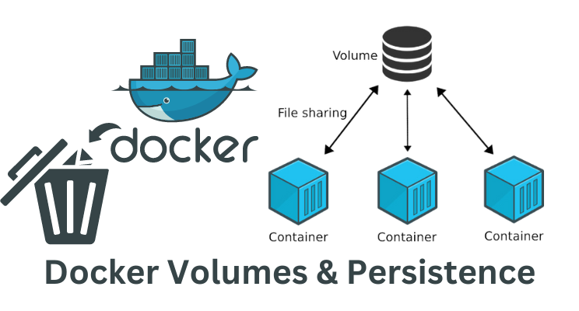

Slide 3
Volumes and persistent data
There are two main categories of data. Persistent and non-persistent.
Persistent is the stuff you need to keep. Things like; customer records, financials, bookings, audit logs, and even some types of application log data. Non-persistent is the stuff you don’t need to keep.
Both are important, and Docker has options for both.

Slide 4
Docker volumes are a feature of Docker that provide a way to persistently store and manage data in containers. A volume is a directory or a named storage location outside the container’s file system that is accessible to one or more containers. It allows data to be shared and retained even when containers are stopped, started, or removed.

Slide 5
Containers are excellent for microservices design patters. And we often associate microservices with words like ephemeral and stateless. So…. microservices are all about stateless and ephemeral workloads, and containers are great microservices. Therefore, we often jump to the conclusion that containers must be just for ephemeral stuff.
Bu that’s wrong. Just wrong, wrong, wrong!

Slide 6
It’s true that containers are great at stateless and non-persistent stuff.
Every container automatically gets a bunch of local storage. By default, this is where all of the container’s files and filesystem go. You’ll hear this referred to by names like; local storage, graphdriver storage, and snapshotter storage. Either way, it’s an integral part of the container, and is tied to the container’s lifecycle — it gets created when the container gets created, and it gets deleted when the container gets deleted. Simple.
On Linux systems, it exists somewhere under /var/lib/docker/<storage-driver>/
as part of the container.

Slide 7
• Red Hat Enterprise Linux: Use the overlay2 driver with modern versions of
RHEL running Docker 17.06 or higher. Use the devicemapper driver with older
versions. This applies to Oracle Linux and other Red Hat related upstream and
downstream distros.
• Ubuntu: Use the overlay2 or aufs drivers. If you’re using a Linux 4.x kernel
or higher you should go with overlay2.
• SUSE Linux Enterprise Server: Use the btrfs storage driver.
• Windows Windows only has one driver and it is configured by default.

Slide 8
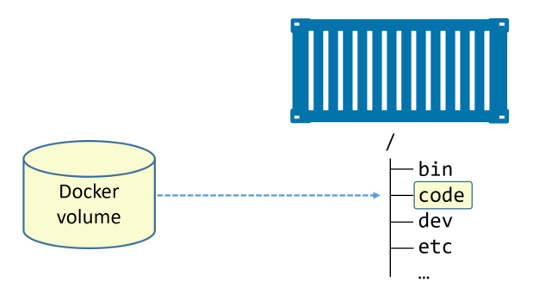
The arrow from the volume to the /code directory is a dashed line to represent the decoupled relationship between volumes and containers.

Slide 9
Volumes are first-class citizens in Docker. Among other things, this means they are
their own object in the API, and they have their own docker volume sub-command. Use the following command to create a new volume called myvol.
$ docker volume create myvol

Slide 10
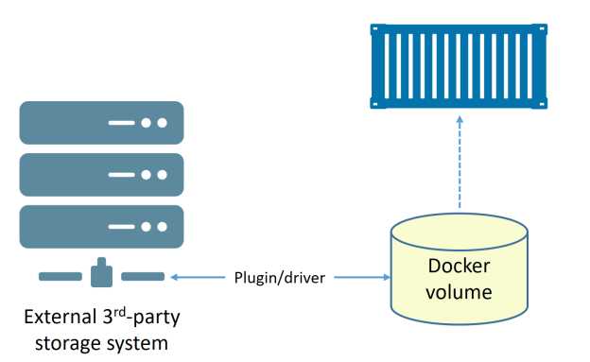
Docker volumes…
Third-party drivers are available as plugins. These can provide advanced storage features and integrate external storage systems with Docker. an external storage system (e.g. SAN or NAS) being used to provide the backend storage for the volume. The driver integrates the external storage system, with its advanced features, into the Docker environment.

Slide 11
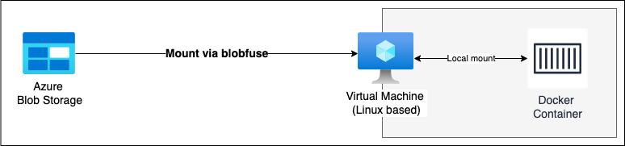

Slide 12
docker volume prune will delete all volumes that are not mounted into a container or service replica, so use with caution! docker volume rm lets you specify exactly which volumes you want to delete. Neither command will delete a volume that is in use by a container or service replica.
$ docker volume prune

Slide 13
it’s also possible to deploy volumes via Dockerfiles using the VOLUME instruction. The format is VOLUME <container-mount-point. However, it’s not possible to specify the host directory portion in a Dockerfile. This is because host directories are, by nature, host-dependent, meaning they can change between hosts and potentially break builds. If specifying via a Dockerfile, you have to specify host directories at deploy-time.

Slide 14
Docker Volumes vs. Bind Mounts
Docker Volumes | Bind Mounts
Docker volumes are managed by Docker and are typically stored in a specific directory on the host machine. | Bind mounts reference a directory on the host machine. The directory is directly mounted into the container at a specified path.
Volumes are independent of the container’s lifecycle and can be created, managed, and shared across multiple containers. | Bind mounts are tightly coupled to the host file system and do not have the same features and flexibility as Docker volumes.
Volumes offer more features, such as data management commands and integration with Docker ecosystem tools. | Bind mounts are useful when you need to directly access files or directories from the host in the container.

Slide 15
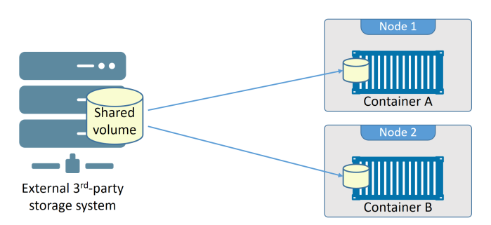
$ docker container run -dit --name voltainer \ --mount source=bizvol,target=/vol \ alpine
Integrating Docker with external storage systems makes it easy to share the external storage between cluster nodes. For example, a single storage LUN or NFS share can be presented to multiple Docker hosts, and therefore made available to containers and service replicas no-matter which host they’re running on.

Slide 16
Types of Docker Volumes
There are two main types of Docker volumes:
Anonymous Volumes: Anonymous volumes are created with no specific source or name. They are typically used to store temporary or transient data generated by a container during its lifecycle.
Named Volumes: Named volumes are created and managed with a user-defined name and specific source, allowing containers to independently share data across. Named volumes are generally recommended for the production environment.
Remote Volumes: Created and managed on a remote host. This enables sharing of data between different Docker hosts.
Host Volumes: Created and managed on the host machine.
Third-Party Volume Plugins: Enables the use of external storage systems like cloud storage or distributed file systems as backing storage for Docker volumes.

Slide 17
You can create an anonymous volume by using the -v option without specifying a source.
docker run -v /mydata -it busybox
You can use volume as read only volume by adding ro docker run -v data:/mydata:ro -it busybox

Slide 18
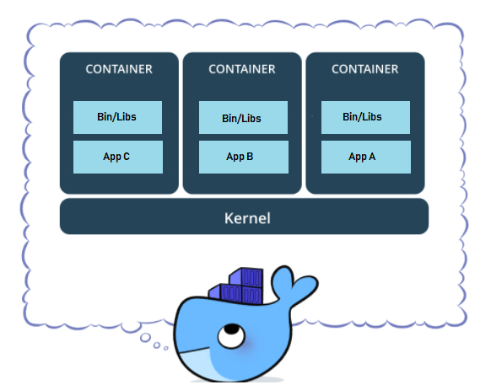
Docker Networking

Slide 19
Docker Networking..
It’s always the network!
Any time there’s a an infrastructure problem, we always blame the network. Part of the reason is that networks are at the center of everything — no network, no app!
In the early days of Docker, networking was hard — really hard! These days it’s almost a pleasure
Docker networking is based on an open-source pluggable architecture called the Container Network Model (CNM). libnetwork is Docker’s real-world implementation of the CNM, and it provides all of Docker’s core networking capabilities. Drivers plug in to libnetwork to provide specific network topologies.
https://github.com/moby/libnetwork/blob/master/docs/design.md
https://github.com/containernetworking/cni

Slide 20
Docker Networking..
For those coming from traditional networking backgrounds, the new way of doing things can be confusing. There are several different options available for networking containers and standardization efforts have started to happen on the various approaches. Before we look at the different standards out there, let’s look at network interfaces for containers versus virtual machines.
Virtual machines simulate hardware and include virtual network interface cards (NIC) that are used to connect to the physical NIC. On the other hand, containers are just processes, managed by a container runtime, that share the same host kernel. So containers can be connected to the same network interface and network namespace as the host (e.g., eth0), or they can be connected to an internal virtual network interface and their own network namespace and then connected to the external world in various ways.

Slide 21
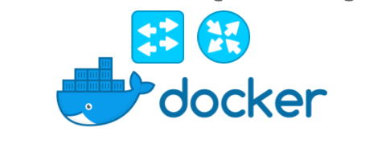
To create a smooth out-of-the-box experience, Docker ships with a set of native drivers that deal with the most common networking requirements. These include single-host bridge networks, multi-host overlays, and options for plugging into existing VLANs. Ecosystem partners extend things even further by providing their own drivers.
Last but not least, libnetwork provides a native service discovery and basic container load balancing solution.

Slide 22
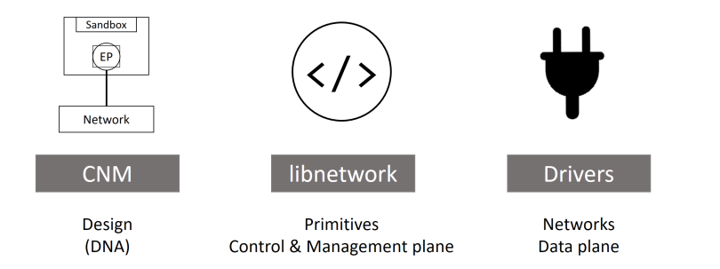
Hello Docker network!
At the highest level, Docker networking comprises three major components:
• The Container Network Model (CNM)
• libnetwork
• Drivers

Slide 23
at a high level, it defines three building blocks:
• Sandboxes
• Endpoints
• Networks

Slide 24
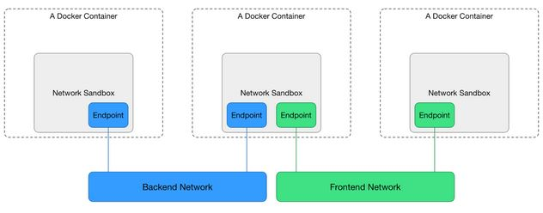

Slide 25
A sandbox is an isolated network stack. It includes; Ethernet interfaces, ports, routing tables, and DNS config.

Slide 26
Endpoints are virtual network interfaces (E.g. veth). Like normal network interfaces, they’re responsible for making connections. In the case of the CNM, it’s the job of the endpoint to connect a sandbox to a network.

Slide 27
Networks are a software implementation of an 802.1d bridge (more commonly known as a switch). As such, they group together, and isolate, a collection of endpoints that need to communicate.

Slide 28
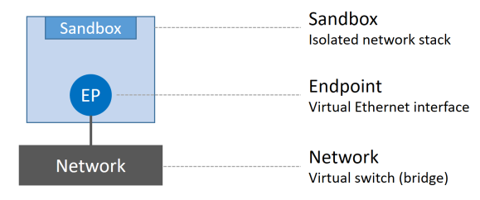

Slide 29
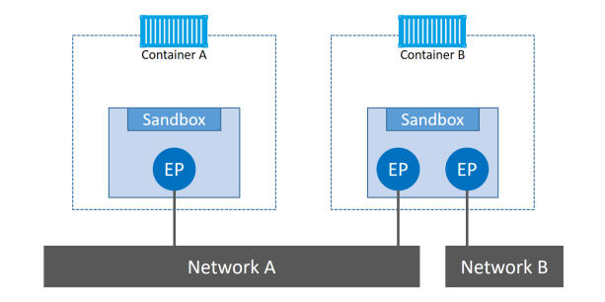
The atomic unit of scheduling in a Docker environment is the container, and as the name suggests, the Container Network Model is all about providing networking to containers.

Slide 30
n the early days of Docker, all the networking code existed inside the daemon. This was a nightmare — the daemon became bloated, and it didn’t follow the Unix principle of building modular tools that can work on their own, but also be easily composed into other projects. As a result, it all got ripped out and refactored into an external library called libnetwork. Nowadays, all of the core Docker networking code lives in libnetwork.

Slide 31
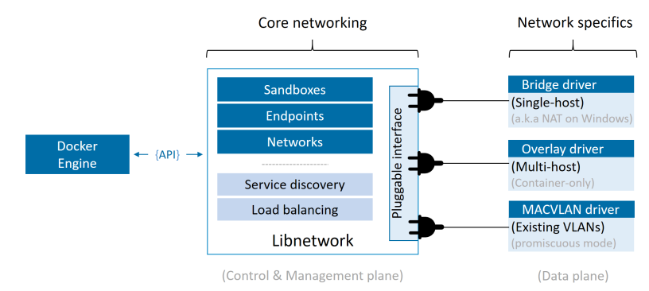
Drivers
If libnetwork implements the control plane and management plane functions, then drivers implement the data plane. For example, connectivity and isolation is all handled by drivers. So is the actual creation of network objects.

Slide 32
Docker Networking..
Docker ships with several built-in drivers, known as native drivers or local drivers. On Linux they include; bridge, overlay, and macvlan.
3rd-parties can also write Docker network drivers. These are known as remote drivers, and examples include calico, contiv, kuryr, and weave.
Each driver is in charge of the actual creation and management of all resources on the networks it is responsible for. For example, an overlay network called “prod-fecuda” will be owned and managed by the overlay driver. This means the overlay driver will be invoked for the creation, management, and deletion of all resources on that network.

Slide 33
Docker Networking..
Docker ships with several built-in drivers, known as native drivers or local drivers. On Linux they include; bridge, overlay, and macvlan.
3rd-parties can also write Docker network drivers. These are known as remote drivers, and examples include calico, contiv, kuryr, and weave.
Each driver is in charge of the actual creation and management of all resources on the networks it is responsible for. For example, an overlay network called “prod-fecuda” will be owned and managed by the overlay driver. This means the overlay driver will be invoked for the creation, management, and deletion of all resources on that network.

Slide 34
Docker Networking..
Docker network types:
Single-host bridge networks
Host Network
Multi-host overlay networks
Connecting to existing networks
IPvLAN Network
Macvlan Network

Slide 35
Docker Networking..
Docker network types:
Single-host bridge networks
Host Network
Multi-host overlay networks
Connecting to existing networks
IPvLAN Network
Macvlan Network

Slide 36
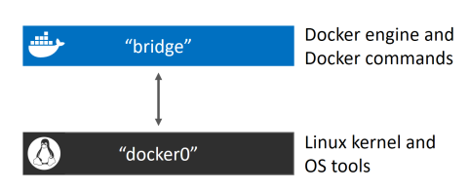
Docker Networking..
Docker networks built with the bridge driver on Linux hosts are based on the battlehardened linux bridge technology that has existed in the Linux kernel for over 15 years. This means they’re high performance and extremely stable! It also means you can inspect them using standard Linux utilities. For example.

Slide 37
Docker Networking..
ip a
ip address show dev docker0
brctl show
apt install bridge-utils -y
docker network ls
docker network inspect bridge
docker network create -d bridge nhdockerbrdg
brctl show

Slide 38
Docker Networking..
docker container run -d --name c1 \
--network nhdockerbrdg \
alpine sleep 1d
Beware: The default bridge network on Linux does not support name resolution via the Docker DNS service. All other user-defined bridge networks do!

Slide 39
Docker Networking..
MACVLAN: docker network create -d macvlan \
--subnet=10.0.0.0/24 \ --ip-range=10.0.00/25 \ --gateway=10.0.0.1 \ -o parent=eth0.100 \ macvlan100
docker container run -d --name mactainer1 \ --network macvlan100 \
alpine sleep 1d
It’s vital that this range of addresses be reserved for Docker and not in use by other nodes or DHCP servers, as there is no management plane feature to check for overlapping IP ranges.

Slide 40
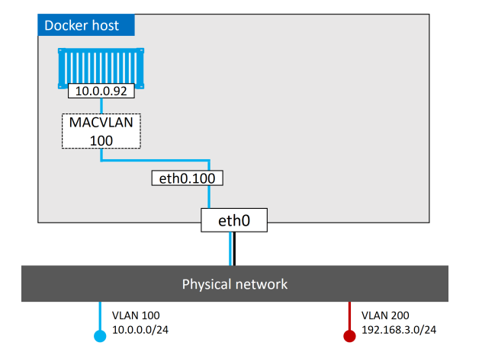
Docker Networking..
MACVLAN..

Slide 41
Docker Networking..
MACVLAN..
Note: If you can’t get MACVLAN to work, it might be because the host NIC is not in promiscuous mode. Remember that public cloud platforms do not allow promiscuous mode.
As we’ve got a MACVLAN network and used it to connect a new container to an existing VLAN. However, it doesn’t stop there. The Docker MACVLAN driver is built on top of the tried-and-tested Linux kernel driver with the same name. As such, it supports VLAN trunking. This means we can create multiple MACVLAN networks and connect containers on the same Docker host to them

Slide 42
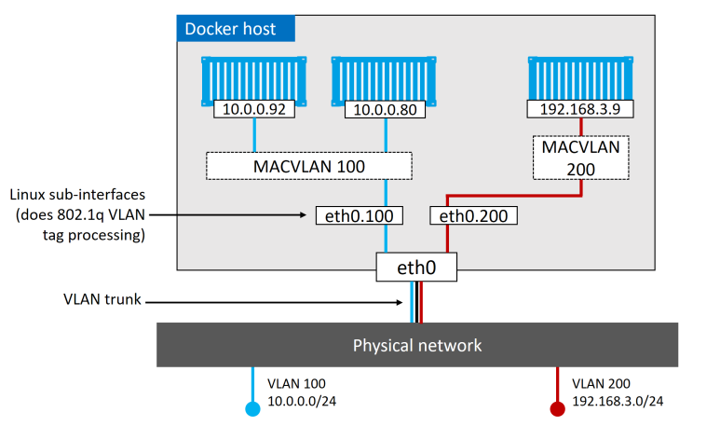
Docker Networking..
MACVLAN..

Slide 43
Docker Networking..
Sidenote: You can use journalctl to get docker Dameon logs
journalctl -u docker.service

Slide 44
Docker Networking..
Service discovery libnetwork also provides some important network services.
Service discovery allows all containers and Swarm services to locate each other by name. The only requirement is that they be on the same network.
Under the hood, this leverages Docker’s embedded DNS server, as well as a DNS resolver in each container.

Slide 45
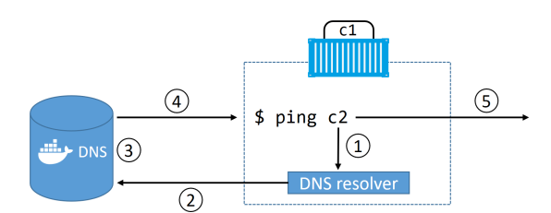
Docker Networking..
Service discovery • step 1: The ping c2 command invokes the local DNS resolver to resolve the
name “c2” to an IP address. All Docker containers have a local DNS resolver.
• Step 2: If the local resolver does not have an IP address for “c2” in its local
cache, it initiates a recursive query to the Docker DNS server. The local resolver
is pre-configured to know the details of the embedded Docker DNS server.
• Step 3: The Docker DNS server holds name-to-IP mappings for all containers
created with the --name or --net-alias flags. This means it knows the IP
address of container “c2”.
• Step 4: The DNS server returns the IP address of “c2” to the local resolver in
“c1”. It does this because the two containers are on the same network — if they
were on different networks this would not work.
• Step 5: The ping command is sent to the IP address of “c2”.

Slide 46
Docker Networking..
docker container run -it --name c1 \ --dns=8.8.8.8 \
alpine sh

