Slide 1
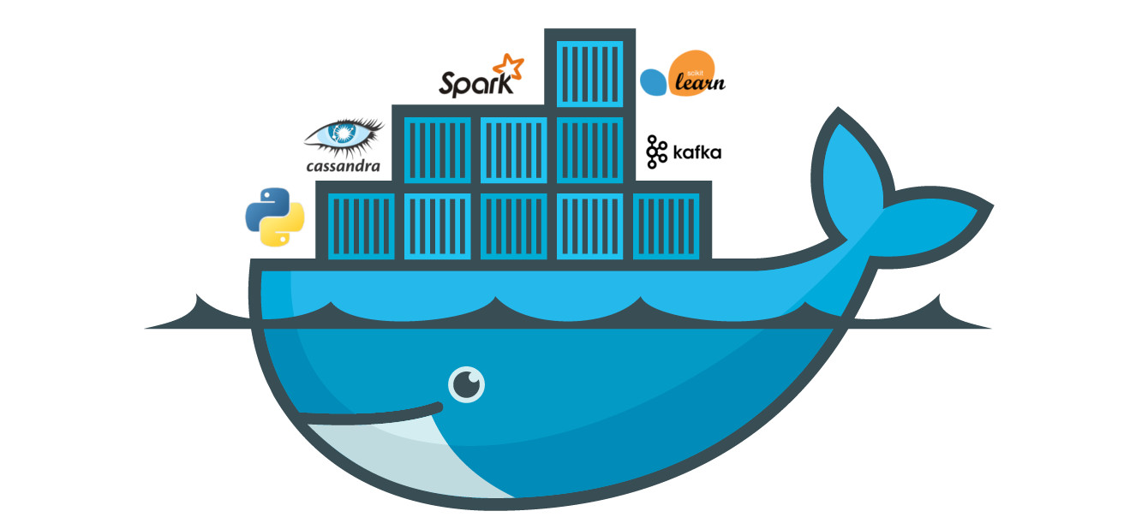
Docker Session 3

Slide 2
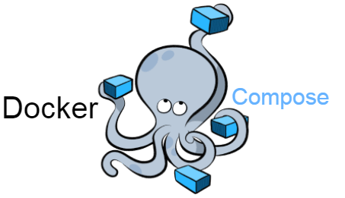

Slide 3
Docker Compose
deploys and manages multi-container applications on Docker nodes operating in single-engine mode.

Slide 4
Docker compose..
Most modern apps are made of multiple smaller services that interact to form a useful app. We call this microservices. A simple example might be an app with the following four services:
• web front-end
• ordering
• catalog
• back-end database

Slide 5
In the beginning was Fig. Fig was a powerful tool, created by a company called Orchard, and it was the best way to manage multi-container Docker apps. It was a Python tool that sat on top of Docker, and allowed you to define entire multicontainer apps in a single YAML file. You could then deploy the app with the fig command-line tool. Fig could even manage the entire life-cycle of the app.
Behind the scenes, Fig would read the YAML file and deploy and manage the app via the Docker API. It was a good thing!

Slide 6
In fact, it was so good, that in 2014, Docker, Inc. acquired Orchard and re-branded Fig as Docker Compose. The command-line tool was renamed from fig to dockercompose, and ever since the acquisition, it’s been an external tool that gets bolted on top of the Docker Engine. Even though it’s never been fully integrated into the Docker Engine, it’s always been immensely popular and very widely used.
As things stand today, Compose is still an external Python binary that you have to install on a host running the Docker Engine. You define multi-container (multiservice) apps in a YAML file, pass the YAML file to the docker-compose binary, and
Compose deploys it via the Docker Engine API.

Slide 7
sudo apt-get update sudo apt install docker-compose

Slide 8
Compose files
Compose uses YAML files to define multi-service applications. YAML is a subset of JSON, so you can also use JSON. However, all of the examples in this chapter will be YAML.
The default name for the Compose YAML file is docker-compose.yml. However, you can use the -f flag to specify custom filenames.

Slide 9
Composefile example
version: "3.5"
services:
web-fe: build: .
command: python app.py
ports: - target: 5000 published: 5000
networks: - counter-net

Slide 10
Docker-compose…
docker-compose -f nh-compse.yml up –d
docker-compose ps
docker-compose top docker-compose stop docker-compose restart
docker-compose rm

Slide 11
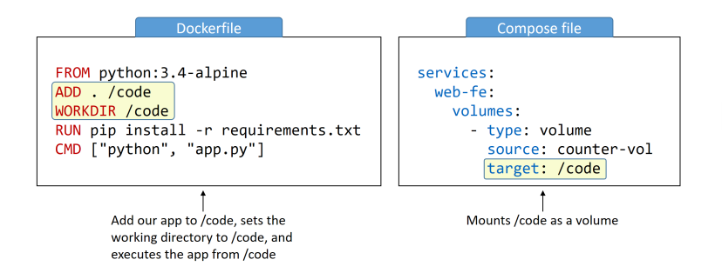

Slide 12
The following code can be used in your Compose file to create a new overlay network
called over-net that allows standalone containers to connect to it (attachable).
networks:
over-net:
driver: overlay
attachable: true

