Slide 1
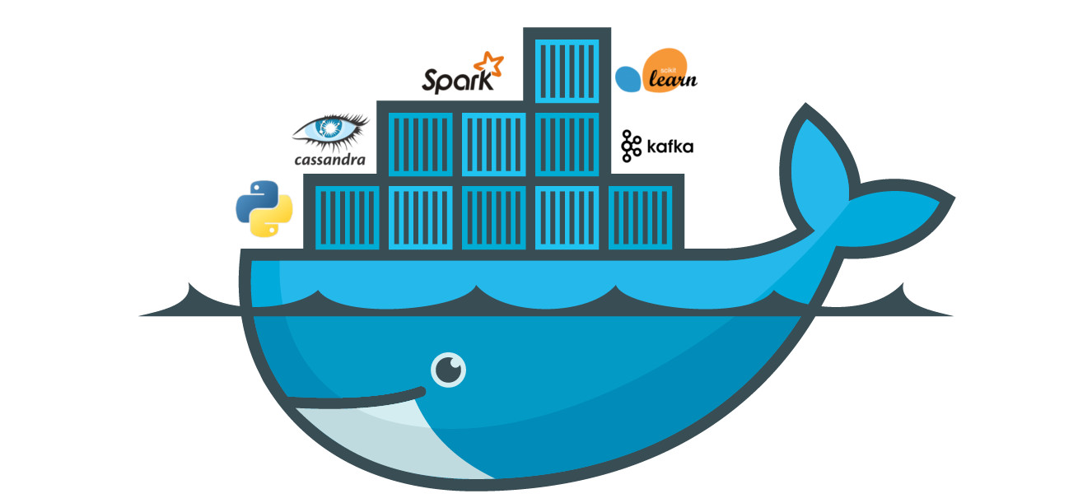
Docker Session 4

Slide 2
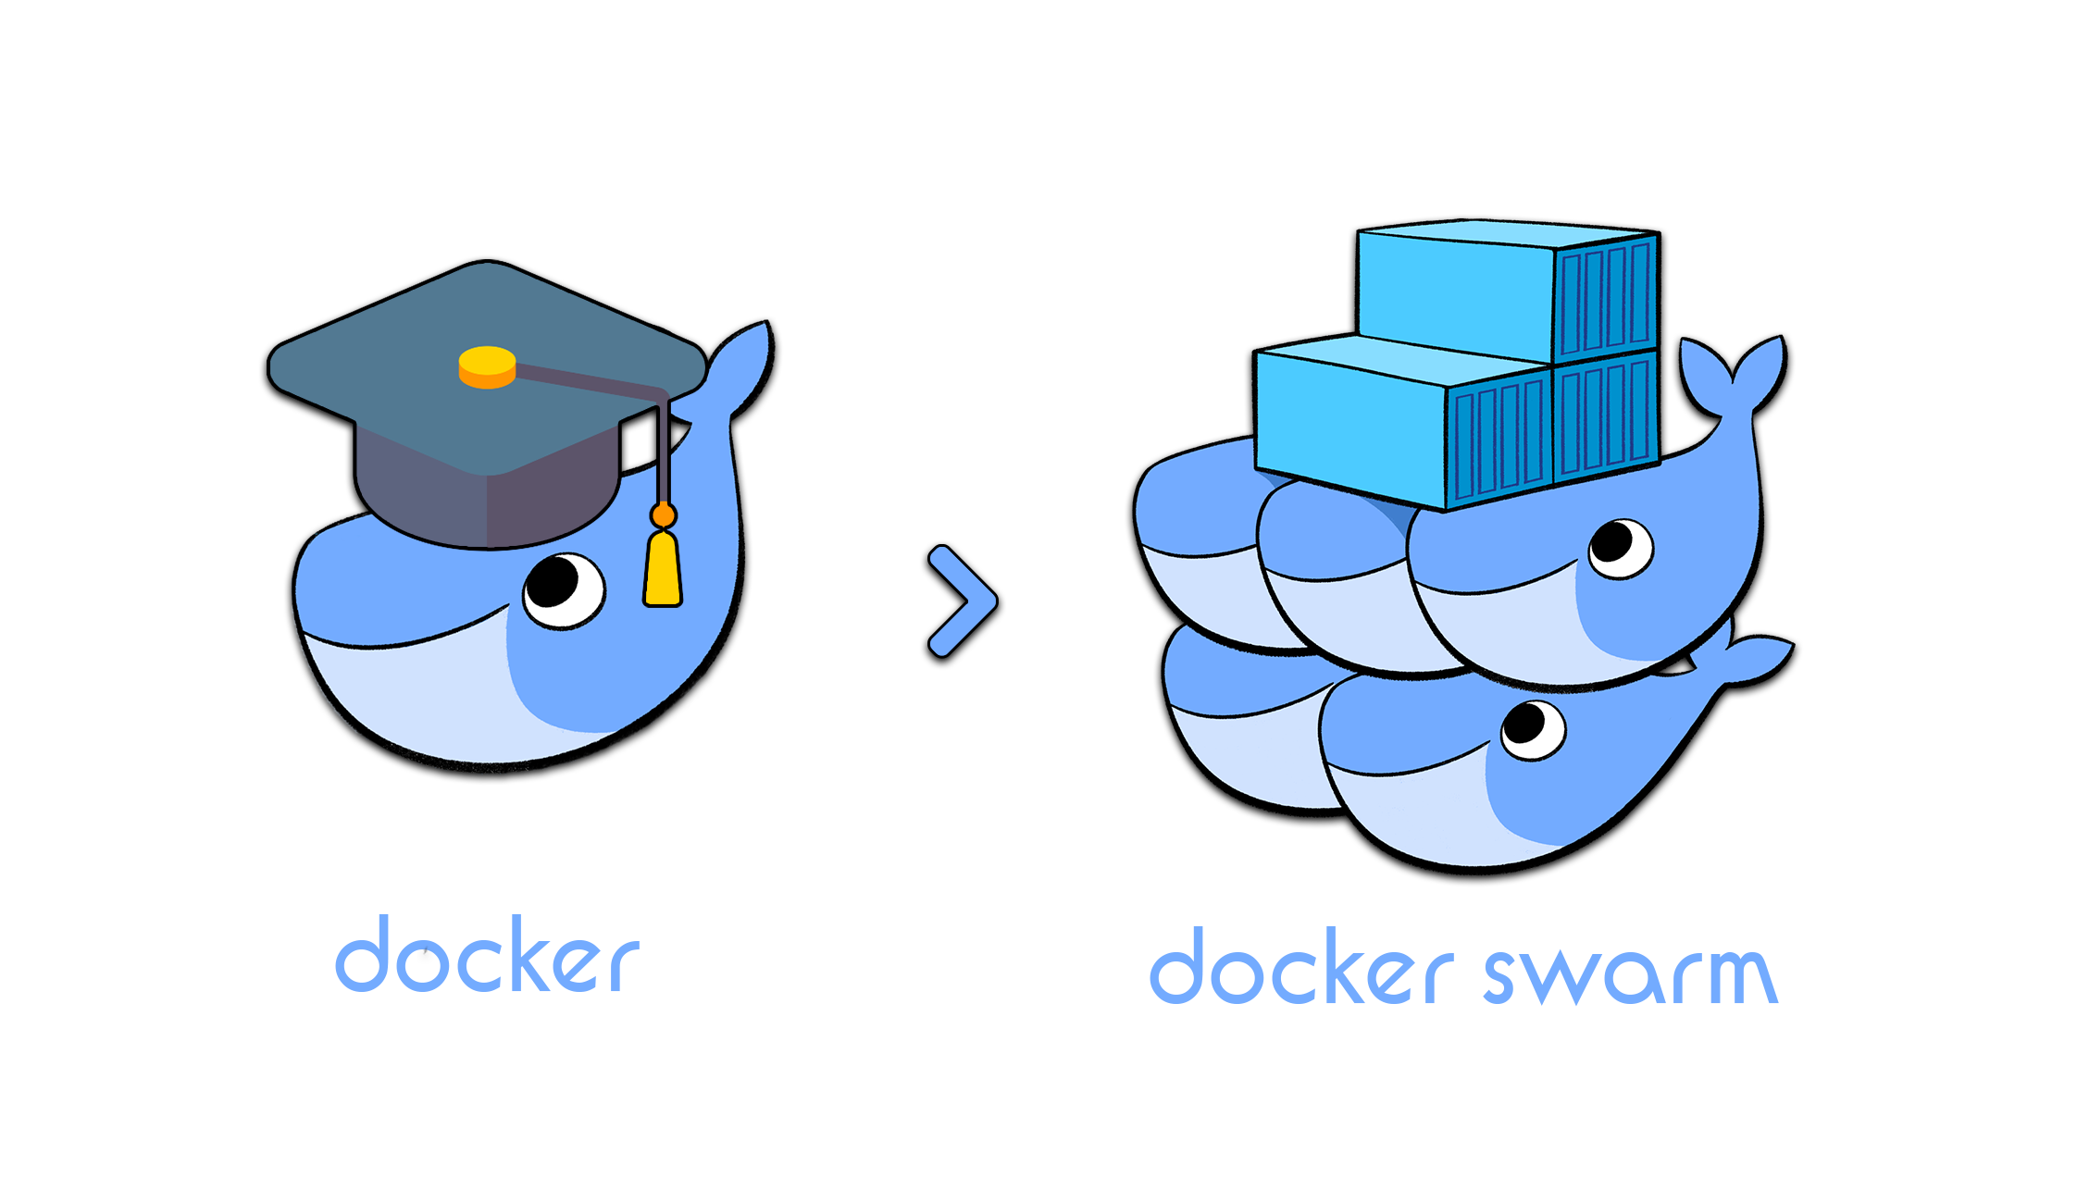
Docker Swarm

Slide 3
Docker Swarm is two things: an enterprise-grade secure cluster of Docker hosts, and an engine for orchestrating microservices apps.
On the clustering front, it groups one or more Docker nodes and lets you manage them as a cluster. Out-of-the-box you get an encrypted distributed cluster store, encrypted networks, mutual TLS, secure cluster join tokens, and a PKI that makes managing and rotating certificates a breeze! And you can non-disruptively add and remove nodes. It’s a beautiful thing!

Slide 4
On the orchestration front, swarm exposes a rich API that allows you to deploy and manage complicated microservices apps with ease. You can define your apps in declarative manifest files, and deploy them with native Docker commands. You can even perform rolling updates, rollbacks, and scaling operations. Again, all with simple commands.
In the past, Docker Swarm was a separate product that you layered on top of the Docker engine. Since Docker 1.12 it’s fully integrated into the Docker engine and can be enabled with a single command, it has the ability to deploy and manage native swarm apps as well as Kubernetes apps. Though at the time of writing, support for Kubernetes apps is relatively new.

Slide 5
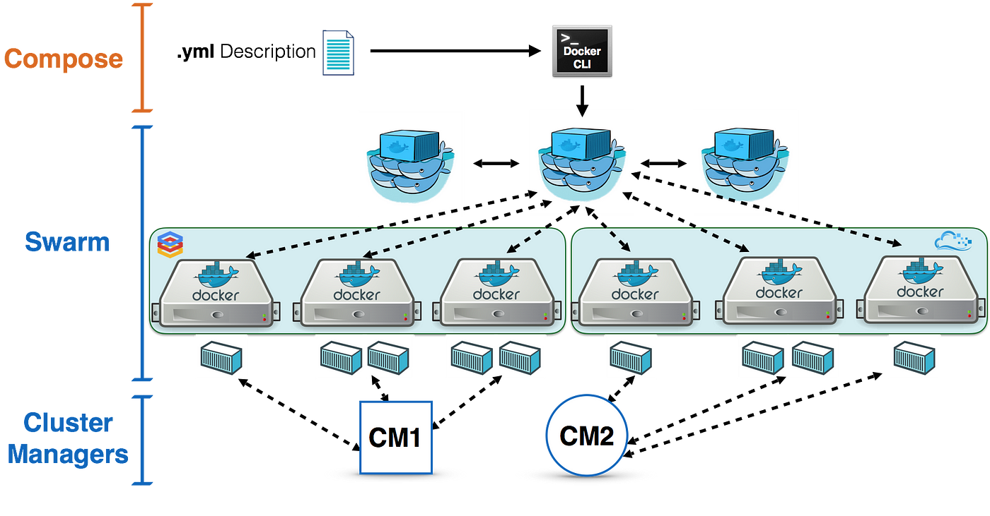

Slide 6
Nodes are configured as managers or workers. Managers look after the control plane of the cluster, meaning things like the state of the cluster and dispatching tasks to workers. Workers accept tasks from managers and execute them.
The configuration and state of the swarm is held in a distributed etcd database located on all managers. It’s kept in memory and is extremely up-to-date.

Slide 7
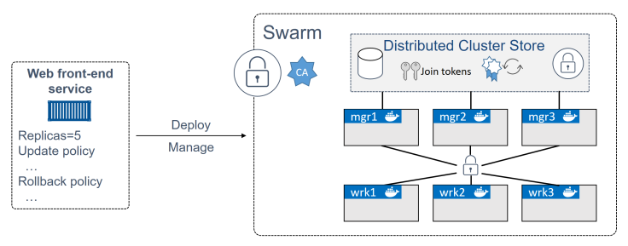

Slide 8
Each of the nodes needs Docker installed and needs to be able to communicate with the rest of the swarm. It’ also beneficial if name resolution is configured — it makes it easier to identify nodes in command outputs and helps when troubleshooting.
On the networking front, you should have the following ports open on routers and firewalls:
• 2377/tcp: for secure client-to-swarm communication
• 7946/tcp and 7946/udp: for control plane gossip
• 4789/udp: for VXLAN-based overlay networks

Slide 9
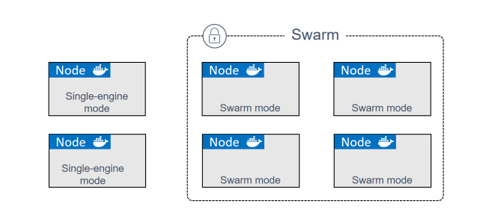
Initializing a brand new swarm
Docker nodes that are not part of a swarm are said to be in single-engine mode. Once they’re added to a swarm they’re switched into swarm mode.

Slide 10
docker swarm init
docker swarm init \ --advertise-addr 10.0.0.1:2377 \ --listen-addr 10.0.0.1:2377
docker node ls docker swarm join-token worker docker swarm join-token manager

Slide 11
The --advertise-addr, and --listen-addr flags optional. They have been added considering the best practice to be as specific as possible when it comes to network configuration.

