Slide 1
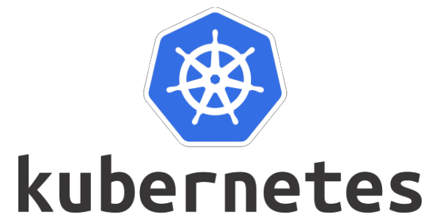
Session 1

Slide 2
Kubernetes is an application orchestrator. For the most part, it orchestrates containerized cloud-native microservices apps.

Slide 3
What is an orchestrator An orchestrator is a system that deploys and manages applications. It can deploy your applications and dynamically respond to changes. For example, Kubernetes can:
Deploy your application
Scale it up and down dynamically based on demand
Self-heal it when things break
Perform zero-downtime rolling updates and rollbacks
• Lots more…

Slide 4
What is a cloud-native app A cloud-native application is one that’s designed to meet cloud-like demands of autoscaling, self-healing, rolling updates, rollbacks and more.
It’s important to be clear that cloud-native apps are not applications that will only run in the public cloud. Yes, they absolutely can run on public clouds, but they can also run anywhere that you have Kubernetes, even your on-premises datacenters.
So, cloud-native is about the way applications behave and react to events

Slide 5
What is a microservices app
A microservices app is built from lots of small, specialised, independent parts that work together to form a meaningful application. For example, you might have an e-commerce app comprising all of the following small, specialised, independent components:
• Web front-end
• Catalog service
• Shopping cart
• Authentication service
• Logging service
• Persistent store

Slide 6
As each of these features is developed and deployed as its own small app, or small service, we call each one a microservice. Typically, each is coded and owned by a different development team. Each can have its own release cycle and can be scaled independently. For example, you can patch and scale the shopping cart microservice without affecting any of the others.
Building applications this way is vital for cloud-native features.

Slide 7
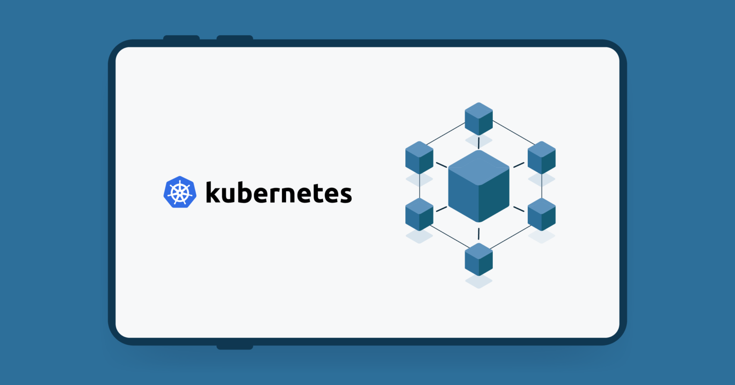
For the most part, each microservice runs as a container. Assuming this e-commerce app with the 6 microservices, there’d be one or more web front-end containers, one or more catalog containers, one or more shopping cart containers etc.
With all of this in mind, let’s re-phrase that definition that was full of buzzwords…
Kubernetes deploys and manages (orchestrates) applications that are packaged and run as containers (containerized) and that are built in ways (cloud-native microservices) that allow them to scale, self-heal, and be updated in-line with modern cloud-like requirements.

Slide 8
Where did Kubernetes come from
Amazon Web Services (AWS) changed the world when it brought us modern cloud computing. Since then, everyone else has been playing catch-up.
One of the companies trying to catch-up was Google. Google had its own very good cloud and needed a way to abstract the value of AWS, and make it easier for potential customers to get off AWS and onto their cloud.
Google also had a lot of experience working with containers at scale. For example, huge Google applications, such as Search and Gmail, have been running at extreme scale on containers for a lot of years – since way before Docker brought us easy-to-use containers. To orchestrate and manage these containerised apps, Google had a couple of in-house proprietary technologies called Borg and Omega.
Well, Google took the lessons learned from these in-house systems, and created a new platform called Kubernetes that it donated to the newly formed Cloud Native Computing Foundation (CNCF) in 2014 as an open-source project

Slide 9
Kubernetes enables two things Google and the rest of the industry needed:
1. It abstracts underlying infrastructure such as AWS
2. It simplifies moving applications on and off clouds
Since its introduction in 2014, Kubernetes has become the most important cloud-native technology on the planet.

Slide 10
Kubernetes enables two things Google and the rest of the industry needed:
1. It abstracts underlying infrastructure such as AWS
2. It simplifies moving applications on and off clouds
Since its introduction in 2014, Kubernetes has become the most important cloud-native technology on the planet.

Slide 11
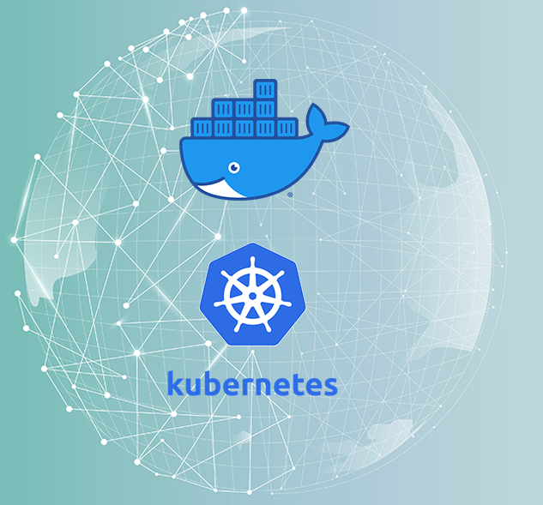
Kubernetes and Docker
Docker and Kubernetes have worked well together since the beginning of Kubernetes. Docker builds applications into container images and can run them as containers. Kubernetes can’t do either of those. Instead, it sits at a higher level and orchestrates things.
Consider the following quick example. You have a Kubernetes cluster with 10 nodes for running your production applications. The first step is for your development teams to use Docker to package their applications as containers. Once this is done you give those containerised apps to Kubernetes to run. Kubernetes makes high-level orchestration decisions such as which nodes should run the containers, but Kubernetes itself cannot start and stop containers.

Slide 12
Kubernetes and Docker
Docker and Kubernetes have worked well together since the beginning of Kubernetes. Docker builds applications into container images and can run them as containers. Kubernetes can’t do either of those. Instead, it sits at a higher level and orchestrates things.
Consider the following quick example. You have a Kubernetes cluster with 10 nodes for running your production applications. The first step is for your development teams to use Docker to package their applications as containers. Once this is done you give those containerised apps to Kubernetes to run. Kubernetes makes high-level orchestration decisions such as which nodes should run the containers, but Kubernetes itself cannot start and stop containers.

Slide 13
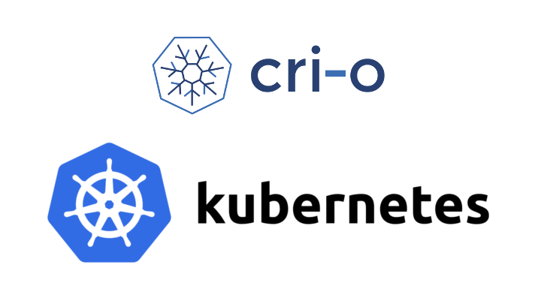
Docker runtime was bloated and overkill for what Kubernetes needed. As a result, the Kubernetes project began work to make the container runtime layer pluggable so that users could choose the best runtime for their needs,in 2016 Kubernetes introduced the container runtime interface (CRI) that made this container runtime layer pluggable. Since then, lots of different container runtimes have been developed for Kubernetes.
At the time of writing, containerd (pronounced “container dee”) has replaced Docker as the default container runtime in most Kubernetes clusters. However, containerd is a stripped-down version of Docker that’s optimized for Kubernetes. As such, all container images created by Docker will continue to work on Kubernetes. In fact, both Docker and Kubernetes work with containers that support the Open Containers Initiative (OCI) specification.

Slide 14
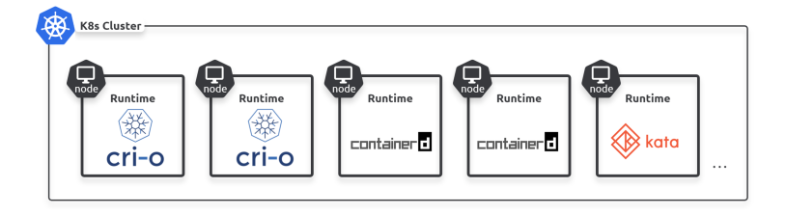
Kubernetes cluster with worker nodes using different container runtimes.

Slide 15
Kubernetes and Borg: Resistance is futile!
There’s a good chance you’ll hear people talk about how Kubernetes relates to Google’s Borg and Omega systems.
As previously mentioned, Google has been running containers at scale for a long time – crunching through billions of containers a week. Orchestrating these containerised apps was the job of a couple of in-house technologies called Borg and Omega. So, it’s not a huge stretch to make the connection with Kubernetes – all three are in the game of orchestrating containers at scale, and they’re all related to Google.
However, it’s important to understand that Kubernetes is not an open-source version of Borg or Omega. It’s more like Kubernetes shares its DNA and family history with them

Slide 16
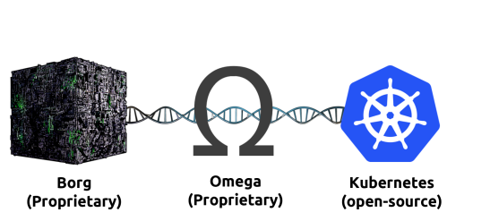

Slide 17
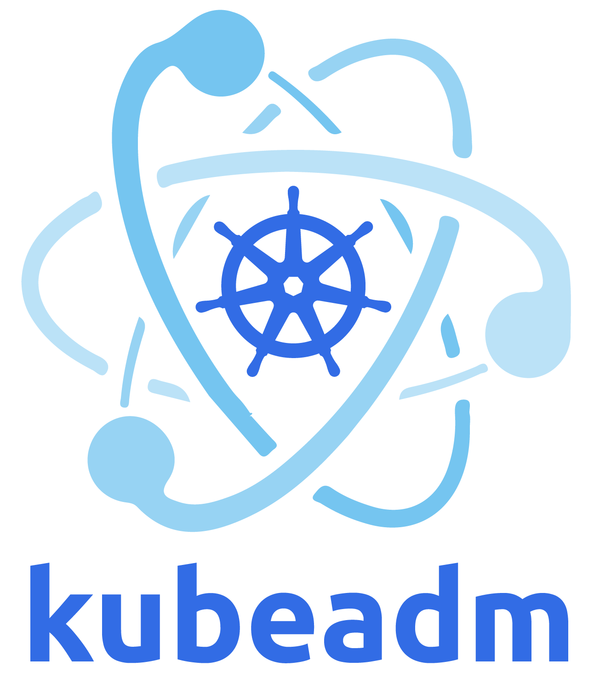
Kubeadm
.
Kubeadm is a tool built to provide kubeadm init and kubeadm join as best-practice "fast paths" for creating Kubernetes clusters.
kubeadm performs the actions necessary to get a minimum viable cluster up and running. By design, it cares only about bootstrapping, not about provisioning machines. Likewise, installing various nice-to-have addons, like the Kubernetes Dashboard, monitoring solutions, and cloud-specific addons, is not in scope.

Slide 18
kubelet
The kubelet is the primary "node agent" that runs on each node. It can register the node with the apiserver using one of: the hostname; a flag to override the hostname; or specific logic for a cloud provider.
The kubelet works in terms of a PodSpec. A PodSpec is a YAML or JSON object that describes a pod. The kubelet takes a set of PodSpecs that are provided through various mechanisms (primarily through the apiserver) and ensures that the containers described in those PodSpecs are running and healthy. The kubelet doesn't manage containers which were not created by Kubernetes.
Other than from a PodSpec from the apiserver, there are two ways that a container manifest can be provided to the kubelet.
File: Path passed as a flag on the command line. Files under this path will be monitored periodically for updates. The monitoring period is 20s by default and is configurable via a flag.
HTTP endpoint: HTTP endpoint passed as a parameter on the command line. This endpoint is checked every 20 seconds (also configurable with a flag).
.

Slide 19
Command line tool (kubectl)
Kubernetes provides a command line tool for communicating with a Kubernetes cluster's control plane, using the Kubernetes API.
This tool is named kubectl.
For configuration, kubectl looks for a file named config in the $HOME/.kube directory. You can specify other kubeconfig files by setting the KUBECONFIG environment variable or by setting the --kubeconfig flag.
.

Slide 20
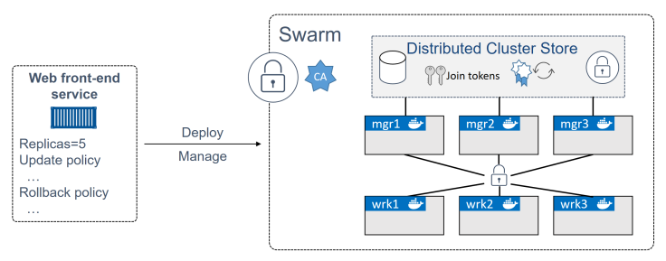

Slide 21
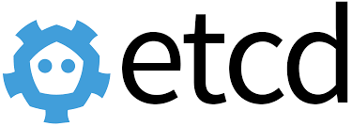
etcd is a distributed reliable key-value store for the most critical data of a distributed system, with a focus on being:
Simple: well-defined, user-facing API (gRPC)
Secure: automatic TLS with optional client cert authentication
Fast: benchmarked 10,000 writes/sec
Reliable: properly distributed using Raft

