Slide 1
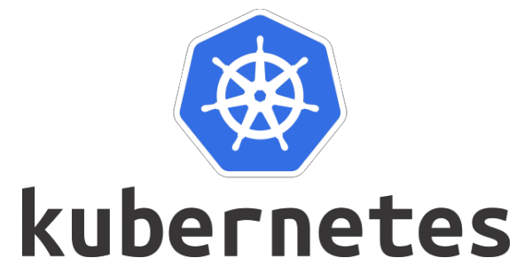
Session 2

Slide 2
Kubernetes Components
When you deploy Kubernetes, you get a cluster.
A Kubernetes cluster consists of a set of worker machines, called nodes, that run containerized applications. Every cluster has at least one worker node.
The worker node(s) host the Pods that are the components of the application workload. The control plane manages the worker nodes and the Pods in the cluster. In production environments, the control plane usually runs across multiple computers and a cluster usually runs multiple nodes, providing fault-tolerance and high availability.
kubectl label node kslave01 node-role.kubernetes.io/worker=worker

Slide 3
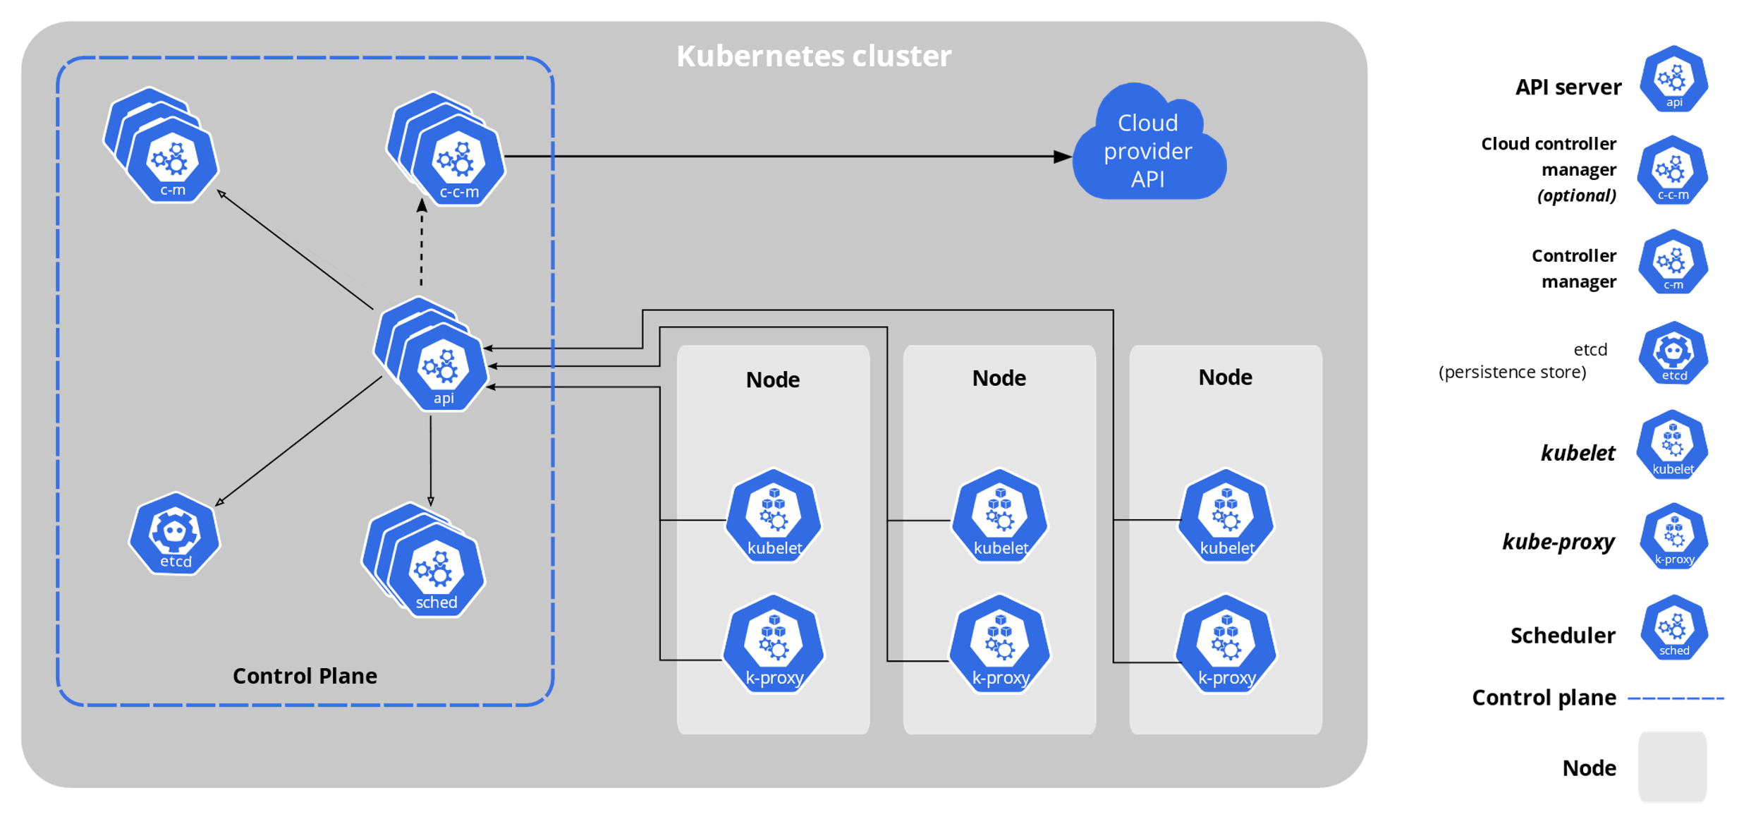

Slide 4
Control Plane Components
The control plane's components make global decisions about the cluster (for example, scheduling), as well as detecting and responding to cluster events (for example, starting up a new pod when a Deployment's replicas field is unsatisfied).
Control plane components can be run on any machine in the cluster. However, for simplicity, setup scripts typically start all control plane components on the same machine, and do not run user containers on this machine.

Slide 5
https://kubernetes.io/docs/setup/production-environment/tools/kubeadm/high-availability/

Slide 6
kube-apiserver
The API server is a component of the Kubernetes control plane that exposes the Kubernetes API. The API server is the front end for the Kubernetes control plane.
kube-apiserver is designed to scale horizontally—that is, it scales by deploying more instances. You can run several instances of kube-apiserver and balance traffic between those instances.

Slide 7
cat > nginx-pod.json <<EOF
{
"apiVersion": "v1",
"kind": "Pod",
"metadata": {
"name": "nginx-pod"
},
"spec": {
"containers": [
{
"name": "nginx",
"image": "nginx:1.7.9",
"ports": [
{
"containerPort": 80
}
]
}
]
}
}
EOF

Slide 8
curl -k -v -X POST -H "Authorization: foo <FOO_TOKEN>“ -H "Content-Type: application/json" https://127.0.0.1:6443/api/v1/namespaces/default/pods -d@nginx-pod.json

Slide 9
https://kubernetes.io/docs/reference/generated/kubernetes-api/v1.30/

Slide 10
API groups
API groups make it easier to extend the Kubernetes API. The API group is specified in a REST path and in the apiVersion field of a serialized object.
There are several API groups in Kubernetes:
The core (also called legacy) group is found at REST path /api/v1. The core group is not specified as part of the apiVersion field, for example, apiVersion: v1.
The named groups are at REST path /apis/$GROUP_NAME/$VERSION and use apiVersion: $GROUP_NAME/$VERSION (for example, apiVersion: batch/v1). You can find the full list of supported API groups in Kubernetes API reference.

Slide 11
Alpha:
The version names contain alpha (for example, v1alpha1).
Built-in alpha API versions are disabled by default and must be explicitly enabled in the kube-apiserver configuration to be used.
The software may contain bugs. Enabling a feature may expose bugs.
Support for an alpha API may be dropped at any time without notice.
The API may change in incompatible ways in a later software release without notice.
The software is recommended for use only in short-lived testing clusters, due to increased risk of bugs and lack of long-term support.

Slide 12
Beta:
The version names contain beta (for example, v2beta3).
Built-in beta API versions are disabled by default and must be explicitly enabled in the kube-apiserver configuration to be used (except for beta versions of APIs introduced prior to Kubernetes 1.22, which were enabled by default).
Built-in beta API versions have a maximum lifetime of 9 months or 3 minor releases (whichever is longer) from introduction to deprecation, and 9 months or 3 minor releases (whichever is longer) from deprecation to removal.
The software is well tested. Enabling a feature is considered safe.
The support for a feature will not be dropped, though the details may change.
The schema and/or semantics of objects may change in incompatible ways in a subsequent beta or stable API version. When this happens, migration instructions are provided. Adapting to a subsequent beta or stable API version may require editing or re-creating API objects and may not be straightforward. The migration may require downtime for applications that rely on the feature.
The software is not recommended for production uses. Subsequent releases may introduce incompatible changes. Use of beta API versions is required to transition to subsequent beta or stable API versions once the beta API version is deprecated and no longer served.

Slide 13
Stable:
The version name is vX where X is an integer.
Stable API versions remain available for all future releases within a Kubernetes major version, and there are no current plans for a major version revision of Kubernetes that removes stable APIs.

Slide 14
API groups
API groups make it easier to extend the Kubernetes API. The API group is specified in a REST path and in the apiVersion field of a serialized object.
There are several API groups in Kubernetes:
The core (also called legacy) group is found at REST path /api/v1. The core group is not specified as part of the apiVersion field, for example, apiVersion: v1.
The named groups are at REST path /apis/$GROUP_NAME/$VERSION and use apiVersion: $GROUP_NAME/$VERSION (for example, apiVersion: batch/v1). You can find the full list of supported API groups in Kubernetes API reference.
Certain resources and API groups are enabled by default. You can enable or disable them by setting --runtime-config on the API server. The --runtime-config flag accepts comma separated <key>[=<value>] pairs describing the runtime configuration of the API server. If the =<value> part is omitted, it is treated as if =true

Slide 15
kube-apiserver.service
to disable batch/v1, set --runtime-config=batch/v1=false to enable batch/v2alpha1, set –runtime-config=batch/v2alpha1
to enable a specific version of an API, such as storage.k8s.io/v1beta1/csistoragecapacities,
set --runtime-config=storage.k8s.io/v1beta1/csistoragecapacities
Kubernetes stores its serialized state in terms of the API resources by writing them into etcd

Slide 16
etcd
Consistent and highly-available key value store used as Kubernetes' backing store for all cluster data.
If your Kubernetes cluster uses etcd as its backing store, make sure you have a back up plan for the data.
ETCDCTL_API=3 etcdctl --endpoints=https://127.0.0.1:2379 \
--cacert=/etc/kubernetes/pki/etcd/ca.crt \
--cert=/etc/kubernetes/pki/etcd/server.crt \
--key=/etc/kubernetes/pki/etcd/server.key \
snapshot /foo/etcdbackup
stop all API server instances
restore state in all etcd instances
restart all API server instances
Do not configure any auto scaling groups for etcd clusters. It is strongly recommended to always run a static five-member etcd cluster for production Kubernetes clusters at any officially supported scale.

Slide 17
kube-scheduler
Control plane component that watches for newly created Pods with no assigned node, and selects a node for them to run on.
Factors taken into account for scheduling decisions include: individual and collective resource requirements, hardware/software/policy constraints, affinity and anti-affinity specifications, data locality, inter-workload interference, and deadlines.

Slide 18
kube-controller-manager
Control plane component that runs controller processes.
Logically, each controller is a separate process, but to reduce complexity, they are all compiled into a single binary and run in a single process.
There are many different types of controllers. Some examples of them are:
Node controller: Responsible for noticing and responding when nodes go down.
Job controller: Watches for Job objects that represent one-off tasks, then creates Pods to run those tasks to completion.
EndpointSlice controller: Populates EndpointSlice objects (to provide a link between Services and Pods).
ServiceAccount controller: Create default ServiceAccounts for new namespaces.

Slide 19
cloud-controller-manager
A Kubernetes control plane component that embeds cloud-specific control logic. The cloud controller manager lets you link your cluster into your cloud provider's API, and separates out the components that interact with that cloud platform from components that only interact with your cluster.
The cloud-controller-manager only runs controllers that are specific to your cloud provider. If you are running Kubernetes on your own premises, or in a learning environment inside your own PC, the cluster does not have a cloud controller manager.
As with the kube-controller-manager, the cloud-controller-manager combines several logically independent control loops into a single binary that you run as a single process. You can scale horizontally (run more than one copy) to improve performance or to help tolerate failures.
The following controllers can have cloud provider dependencies:
Node controller: For checking the cloud provider to determine if a node has been deleted in the cloud after it stops responding
Route controller: For setting up routes in the underlying cloud infrastructure
Service controller: For creating, updating and deleting cloud provider load balancers

Slide 20
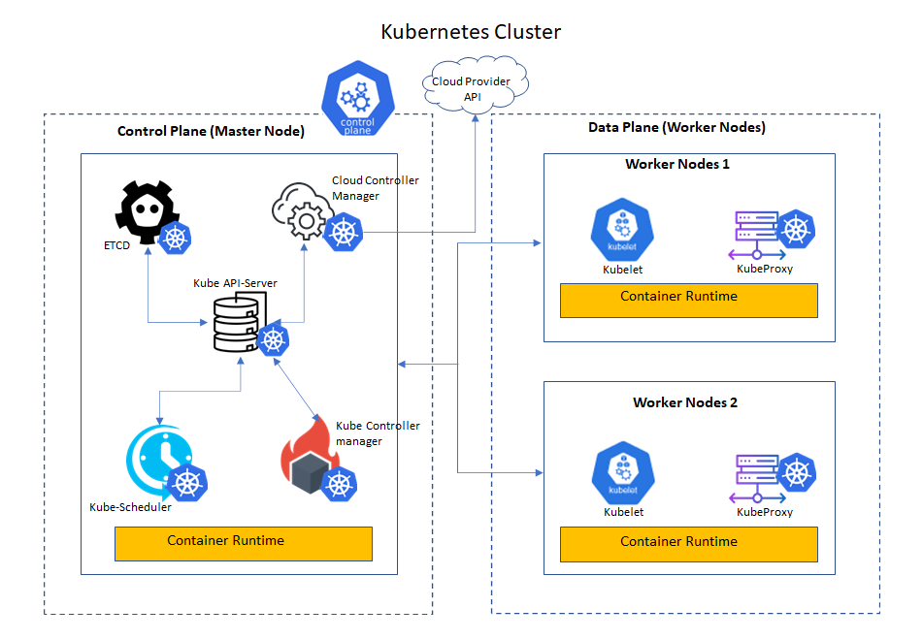

Slide 21
Node Components (Worker)
Node components run on every node, maintaining running pods and providing the Kubernetes runtime environment.
Kubelet:
An agent that runs on each node in the cluster. It makes sure that containers are running in a Pod.
The kubelet takes a set of PodSpecs that are provided through various mechanisms and ensures that the containers described in those PodSpecs are running and healthy. The kubelet doesn't manage containers which were not created by Kubernetes.
A PodSpec defines the characteristics of a pod, including the containers it contains, the volumes it uses, the networking settings, resource requests and limits, environment variables, and more.

Slide 22
apiVersion: v1
kind: Pod
metadata:
name: command-demo
labels:
purpose: demonstrate-command
spec:
containers:
- name: command-demo-container
image: debian
command: ["printenv"]
args: ["HOSTNAME", "KUBERNETES_PORT"]
restartPolicy: OnFailure
ENTRYPOINT (in Dockerfile) is equal to command: (in PodSpec)
CMD (in Dockerfile) equals args: (in PodSpec)

Slide 23
kube-proxy
kube-proxy is a network proxy that runs on each node in your cluster, implementing part of the Kubernetes Service concept.
kube-proxy maintains network rules on nodes. These network rules allow network communication to your Pods from network sessions inside or outside of your cluster.
kube-proxy uses the operating system packet filtering layer if there is one and it's available. Otherwise, kube-proxy forwards the traffic itself.

Slide 24
Container runtime
A fundamental component that empowers Kubernetes to run containers effectively. It is responsible for managing the execution and lifecycle of containers within the Kubernetes environment.
Kubernetes supports container runtimes such as containerd, CRI-O, and any other implementation of the Kubernetes CRI (Container Runtime Interface).

Slide 25
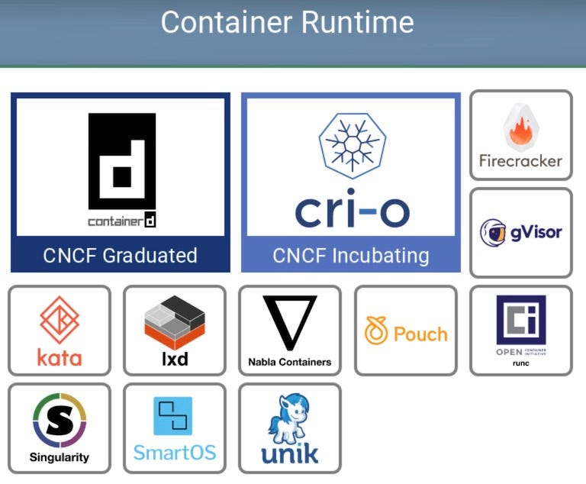

Slide 26
Addons
Addons use Kubernetes resources (DaemonSet, Deployment, etc) to implement cluster features. Because these are providing cluster-level features, namespaced resources for addons belong within the kube-system namespace.

Slide 27
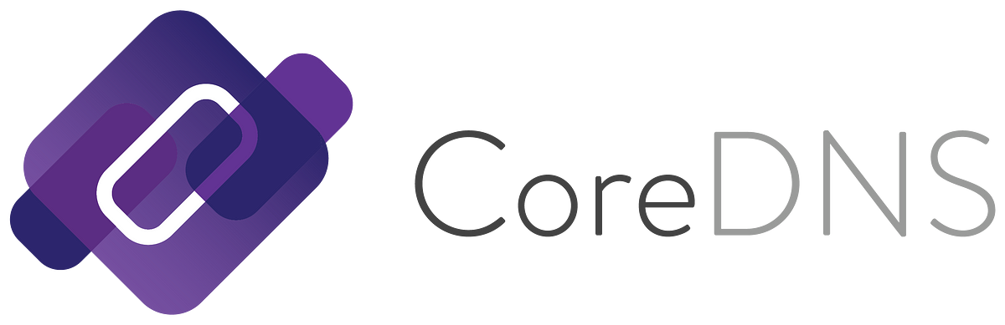
Addons..
DNS
While the other addons are not strictly required, all Kubernetes clusters should have cluster DNS, as many examples rely on it.
Cluster DNS is a DNS server, in addition to the other DNS server(s) in your environment, which serves DNS records for Kubernetes services.
Containers started by Kubernetes automatically include this DNS server in their DNS searches.

Slide 28
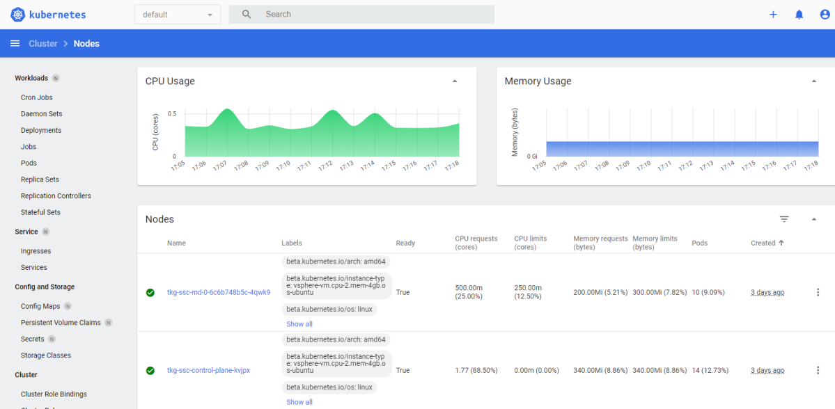
Addons..
Web UI (Dashboard)
Dashboard is a general purpose, web-based UI for Kubernetes clusters. It allows users to manage and troubleshoot applications running in the cluster, as well as the cluster itself.

Slide 29
Addons..
Container Resource Monitoring
Container Resource Monitoring records generic time-series metrics about containers in a central database, and provides a UI for browsing that data.
kubectl apply -f https://raw.githubusercontent.com/techiescamp/kubeadm-scripts/main/manifests/metrics-server.yaml
kubectl top nodes

Slide 30
Addons..
Cluster-level Logging
A cluster-level logging mechanism is responsible for saving container logs to a central log store with search/browsing interface.

Slide 31
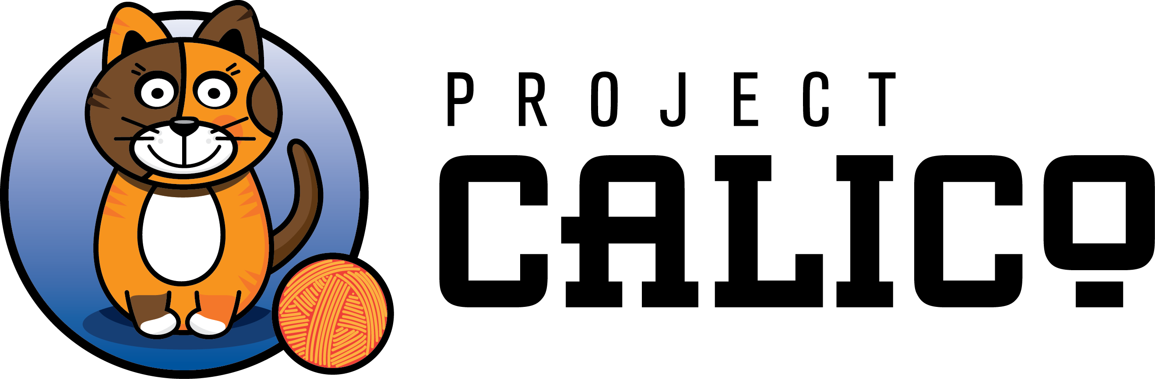



Addons..
Network Plugins
Network plugins are software components that implement the container network interface (CNI) specification. They are responsible for allocating IP addresses to pods and enabling them to communicate with each other within the cluster..
kubectl apply -f https://docs.projectcalico.org/manifests/calico.yaml

Slide 32
The declarative model and desired state
The declarative model and the concept of desired state are at the very heart of Kubernetes. So, it’s vital you understand them.
In Kubernetes, the declarative model works like this:
1. Declare the desired state of an application microservice in a manifest file
2. Post it to the API server
3. Kubernetes stores it in the cluster store as the application’s desired state
4. Kubernetes implements the desired state on the cluster
5. A controller makes sure the observed state of the application doesn’t vary from the
desired state
Terminology: observed state, actual state and current state all mean the same thing.

Slide 33
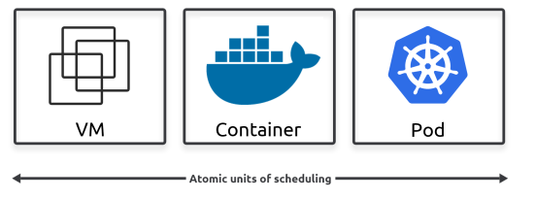
Pods
In the VMware world, the atomic unit of scheduling is the virtual machine (VM). In the Docker world, it’s the container. Well… in the Kubernetes world, it’s the Pod.

Slide 34
Pods
In the VMware world, the atomic unit of scheduling is the virtual machine (VM). In the Docker world, it’s the container. Well… in the Kubernetes world, it’s the Pod.

Slide 35
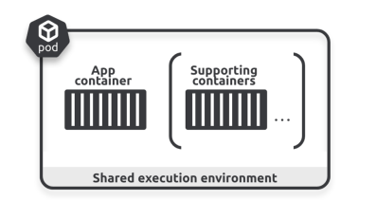
Pods
The simplest model is to run a single container in every Pod. This is why we often use the terms “Pod” and “container” interchangeably. However, there are advanced use-cases that run multiple containers in a single Pod. Powerful examples of multi-container Pods include:
• Service meshes
• Web containers supported by a helper container pulling updated content
• Containers with a tightly coupled log scraper

Slide 36
Pods
Pods themselves don’t actually run applications – applications always run in containers. The Pod is just an execution environment to run one or more containers. Keeping it high level, Pods ring-fence an area of the host OS and run one or more containers.
If you’re running multiple containers in a Pod, they all share the same Pod environment. This includes the network stack, volumes, IPC namespace, shared memory, and more. As an example, all containers in the same Pod will share the same IP address (the Pod’s IP).

Slide 37
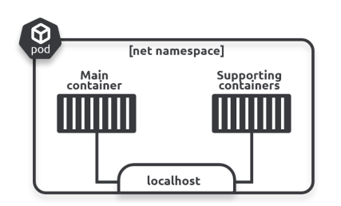
Pods
If two containers in the same Pod need to talk to each other (container-to-container within the Pod) they can use the Pod’s localhost interface

Slide 38
Pods
Multi-container Pods are ideal when you have requirements for tightly coupled containers that may need to share memory and storage. However, if you don’t need to tightly couple containers, you should put them in their own Pods and loosely couple them over the network. This keeps things clean by having every Pod dedicated to a single task. However, it creates a lot of potentially un-encrypted east-west network traffic. You should seriously consider using a service mesh to secure traffic between Pods and provide better network observability.

Slide 39
Pods
Multi-container Pods are ideal when you have requirements for tightly coupled containers that may need to share memory and storage. However, if you don’t need to tightly couple containers, you should put them in their own Pods and loosely couple them over the network. This keeps things clean by having every Pod dedicated to a single task. However, it creates a lot of potentially un-encrypted east-west network traffic. You should seriously consider using a service mesh to secure traffic between Pods and provide better network observability.
A single Pod can only be scheduled to a single node - Kubernetes cannot schedule a single Pod across multiple nodes. This is also true of multi-container Pods – all containers in the same Pod run on the same node.

Slide 40
Pods
Pod lifecycle
Pods are mortal – they’re created, they live, and they die. If they die unexpectedly, you don’t bring them back to life. Instead, Kubernetes starts a new one in its place. This new one looks, smells, and feels like the old one. However, it’s a shiny new Pod with a shiny new ID and IP address.
This has implications on how you design your applications. Don’t design them to be tightly coupled to a particular instance of a Pod. Instead, design them so that when Pods fail, a totally new one (with a new ID and IP address) can pop up somewhere else in the cluster and seamlessly take its place.

Slide 41
Pods
Pod immutability
Pods are immutable. This means you don’t change them once they’re running.
For example, once a Pod is running, you never log on to it and change or update its configuration. If you need to change or update it, you replace it with a new one running the new configuration. Whenever we talk about updating Pods, we really mean delete the old one and replace it with a new one.

Slide 42
Pods
Pods augment containers
Pods augment containers in all the following ways:
• Labels and annotations
• Restart policies
• Probes (startup probes, readiness probes, liveness probes, and potentially more)
• Affinity and anti-affinity rules
• Termination control
• Security policies
• Resource requests and limits kubectl explain pods

Slide 43
Pods
Labels let you group Pods and associate them with other objects in powerful ways. Annotations let you add experimental features and integrations with 3rd-party tools and services. Probes let you test the health and status of Pods and the apps they run. This enables advanced scheduling, updates, and more. Affinity and anti-affinity rules give you control over where in a cluster Pods are allowed to run. Termination control lets you gracefully terminate Pods and the applications they run. Security policies let you enforce security features. Resource requests and limits let you specify minimum and maximum values for things like CPU, memory, and disk IO.

Slide 44
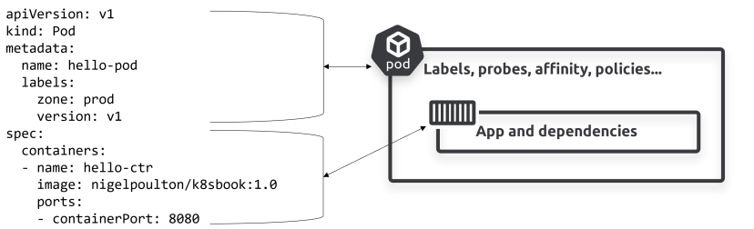
Pods

Slide 45
Pods
kubectl label nodes <your-node-name> disktype=ssd
pec:
affinity:
nodeAffinity:
requiredDuringSchedulingIgnoredDuringExecution:
nodeSelectorTerms:
spec:
affinity:
nodeAffinity:
preferredDuringSchedulingIgnoredDuringExecution:

Slide 46
Pods
Node affinity weight
You can specify a weight between 1 and 100 for each instance of the preferredDuringSchedulingIgnoredDuringExecution affinity type. When the scheduler finds nodes that meet all the other scheduling requirements of the Pod, the scheduler iterates through every preferred rule that the node satisfies and adds the value of the weight for that expression to a sum.
The final sum is added to the score of other priority functions for the node. Nodes with the highest total score are prioritized when the scheduler makes a scheduling decision for the Pod.

Slide 47
Deployments
Most of the time you’ll deploy Pods indirectly via higher-level controllers. Examples of higher-level controllers include Deployments, DaemonSets, and StatefulSets.
As an example, a Deployment is a higher-level Kubernetes object that wraps around a Pod and adds features such as self-healing, scaling, zero-downtime rollouts, and versioned rollbacks.
Behind the scenes, Deployments, DaemonSets and StatefulSets are implemented as controllers that run as watch loops constantly observing the cluster making sure observed state matches desired state.

Slide 48
Service objects and stable networking
Pods are mortal and can die. However, if they’re managed via higher level controllers, when they fail they get replaced with new ones with totally different IP addresses. This also happens with rollouts and scaling operations. Rollouts replace old Pods with new ones with new IPs. Scaling up adds new Pods with new IP addresses, whereas scaling down deletes existing Pods. Events like these cause a lot of IP churn.
The point is, Pods are unreliable, and this poses challenges.
Assume you’ve got a microservices app with a bunch of Pods performing video rendering. How can this work if clients of the rendering service can’t rely on rendering Pods being there when needed?
This is where Services come in to play. They provide reliable networking for a set of Pods.

Slide 49
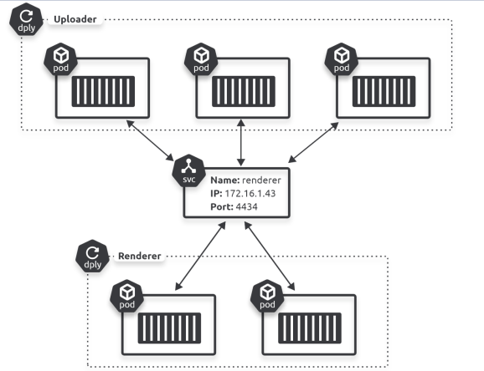
Service objects and stable networking

Slide 50
Service objects and stable networking

Slide 51
Service objects and stable networking...
Services have a front-end consisting of a stable DNS name, IP address, and port. On the back-end, they load-balance traffic across a dynamic set of Pods. As Pods come and go, the Service observes this, automatically updates itself, and continues to provide that stable networking endpoint.
The same applies if you scale the number of Pods up or down. New Pods are seamlessly added to the Service and will receive traffic. Terminated Pods are seamlessly removed and will not receive traffic.
That’s the job of a Service – it’s a stable network abstraction point that provides TCP and UDP load-balancing across a dynamic set of Pods.
However, Services don’t possess application intelligence. This means they cannot provide application-layer host and path routing. For that, you need an Ingress, which understands HTTP and provides host and path-based routing. A later chapter is dedicated to Ingress.
In summary, Services bring stable IP addresses and DNS names to the unstable world of Pods.

