Slide 1
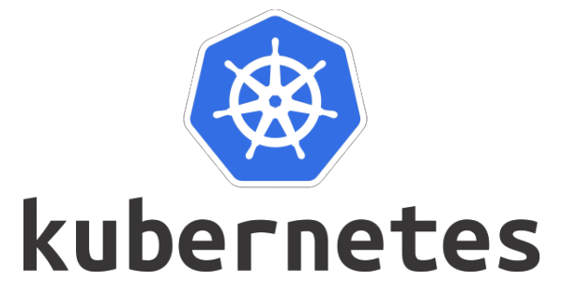
Session 3

Slide 2
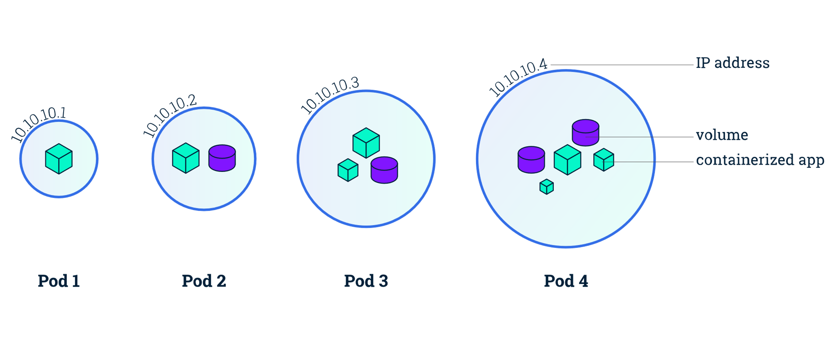
Working with Pods

Slide 3
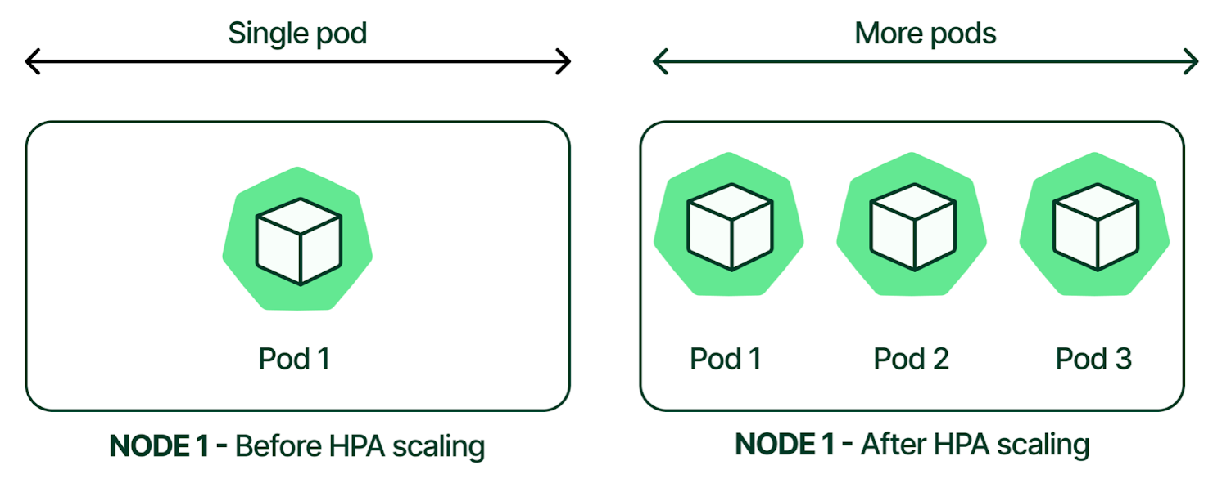
If you scale an app, you add or remove Pods.
Horizontal scaling means that the response to increased load is to deploy more Pods. This is different from vertical scaling, which for Kubernetes would mean assigning more resources (for example: memory or CPU) to the Pods that are already running for the workload.

Slide 4
There are three main reasons for Pods:
1. Pods augment containers
2. Pods assist in scheduling
3. Pods enable resource sharing

Slide 5
Pods augment containers
• Labels and annotations
• Restart policies
• Probes (startup probes, readiness probes, liveness probes, and potentially more)
• Affinity and anti-affinity rules
• Termination control
• Security policies
• Resource requests and limits

Slide 6
kubectl explain pods

Slide 7
Pod Labels and Annotations
You can use either labels or annotations to attach metadata to Kubernetes objects. Labels can be used to select objects and to find collections of objects that satisfy certain conditions. In contrast, annotations are not used to identify and select objects. The metadata in an annotation can be small or large, structured or unstructured, and can include characters not permitted by labels. It is possible to use labels as well as annotations in the metadata of the same object.
apiVersion: v1
kind: Pod
metadata:
name: annotations-demo
annotations:
imageregistry: "https://hub.docker.com/"
spec:
containers:
- name: nginx
image: nginx:1.14.2
ports:
- containerPort: 80

Slide 8
Real life scenario:
A developer has done some work to make a functional change to a particular pod, and when that work is done, they want to automatically run tests and deployments through a CI/CD pipeline.
At this time, the developer can deliver the changes to the external CI/CD system by updating the annotation of the corresponding Pod. CI/CD systems can check the annotations and start automated testing and deployment processes accordingly.

Slide 9
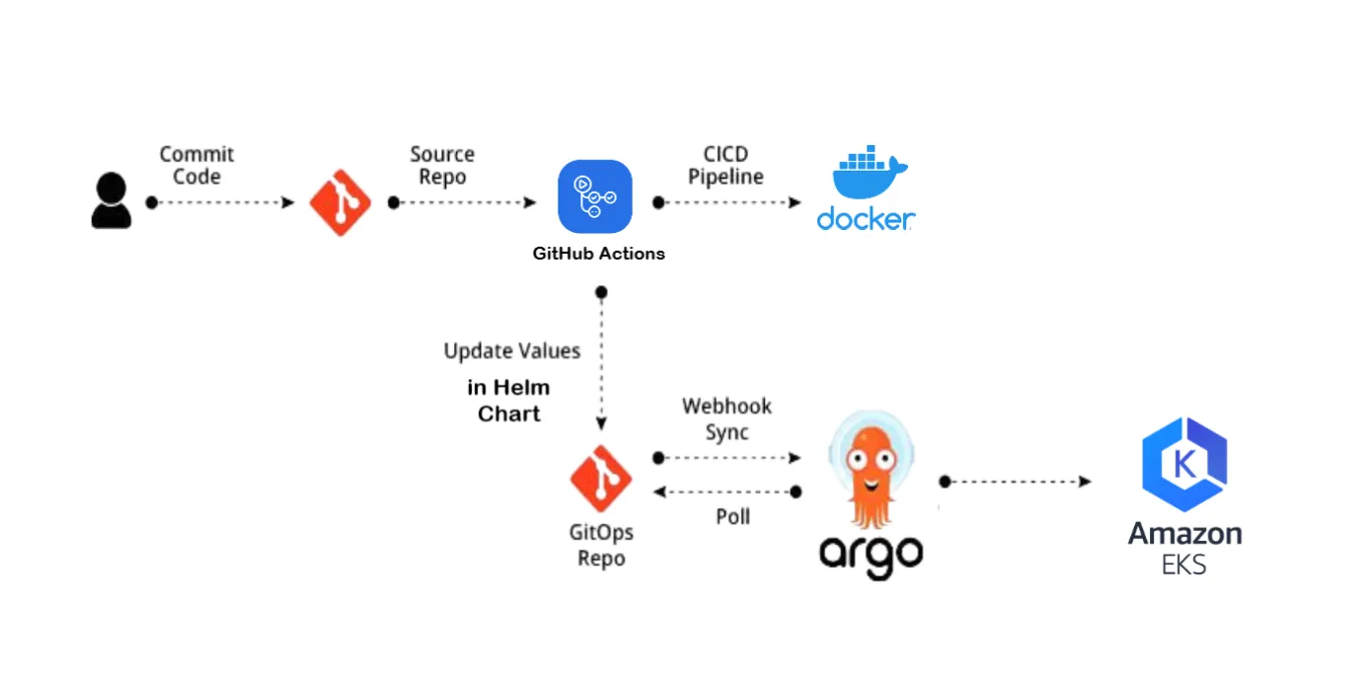

Slide 10
apiVersion: argoproj.io/v1alpha1
kind: Application
metadata:
name: aws-ec2-instance-checker
namespace: argocd
annotations:
argocd-image-updater.argoproj.io/image-list: fdervisi/aws-ec2-instance-checker:*
argocd-image-updater.argoproj.io/write-back-method: git:secret:argocd/git-creds
argocd-image-updater.argoproj.io/git-branch: master
spec:
project: default
source:
repoURL: https://github.com/fdervisi/k8s_cicd_overview
targetRevision: HEAD
path: helm/aws-ec2-instance-checker
destination:
server: https://kubernetes.default.svc
namespace: aws-ec2-instance-checker
syncPolicy:
automated:
prune: true
selfHeal: true
allowEmpty: true

Slide 11
Pods enable resource sharing
On the sharing of resources front, Pods provide a shared execution environment for one or more containers. This shared execution environment includes things such as:
• Shared filesystem
• Shared network stack (IP address, routing table, ports…)
• Shared memory
• Shared volumes

Slide 12
Static Pods vs controllers
There are two ways to deploy Pods:
1. Directly via a Pod manifest
2. Indirectly via a controller
Pods deployed directly from a Pod manifest are called static Pods and have no superpowers such as self-healing, scaling, or rolling updates. This is because they’re only monitored and managed by the worker node’s kubelet process which is limited to attempting restarts on the local worker node. If the worker node they’re running on fails, there’s no control-plane process watching and capable of starting a new one on a different node.

Slide 13
Pods deployed via controllers have all the benefits of being monitored and managed by a highly-available controller running on the control-plane. The local kubelet can still attempt local restarts, but if restart attempts fail, or the node itself fails, the observing controller can start a replacement Pod on a different worker node.

Slide 14
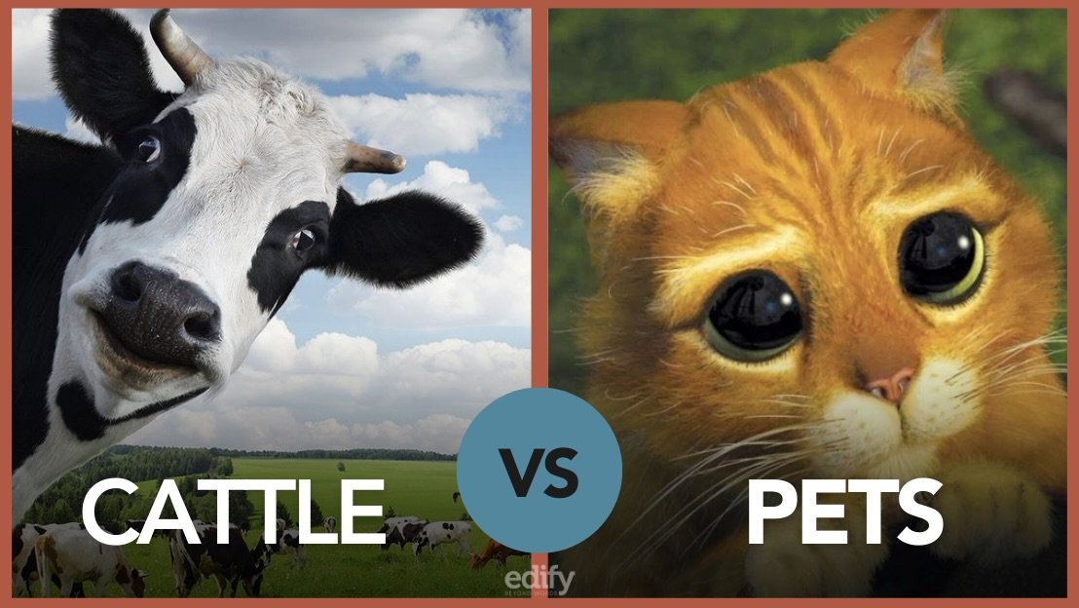
Just to be clear, it’s vital to understand that Pods are mortal. When they die, they’re gone. There’s no fixing them and bringing them back from the dead. This firmly places them in the cattle category of the pets vs cattle paradigm. Pods are cattle, and when they die, they get replaced by another.

Slide 15
This is why applications should always store state and data outside the Pod. It’s also why you shouldn’t rely on individual Pods – they’re ephemeral, here today, gone tomorrow…
In the real world, you’ll almost always deploy and manage Pods via controllers.
Single-container and multi-container Pods
Pods can run one or more containers. The single-container model is the simplest, but multi-container Pods are important in real-world production environments and vital for service meshes. You’ll learn more about multi-container Pods later in the chapter

Slide 16
On Linux, the container runtime typically configures kernel cgroups that apply and enforce the limits you defined. The CPU limit defines a hard ceiling on how much CPU time that the container can use. During each scheduling interval (time slice), the Linux kernel checks to see if this limit is exceeded; if so, the kernel waits before allowing that cgroup to resume execution. The CPU request typically defines a weighting. If several different containers (cgroups) want to run on a contended system, workloads with larger CPU requests are allocated more CPU time than workloads with small requests. The memory request is mainly used during (Kubernetes) Pod scheduling. On a node that uses cgroups v2, the container runtime might use the memory request as a hint to set memory.min and memory.low. The memory limit defines a memory limit for that cgroup. If the container tries to allocate more memory than this limit, the Linux kernel out-of-memory subsystem activates and, typically, intervenes by stopping one of the processes in the container that tried to allocate memory. If that process is the container's PID 1, and the container is marked as restartable, Kubernetes restarts the container. The memory limit for the Pod or container can also apply to pages in memory backed volumes, such as an emptyDir. The kubelet tracks tmpfs emptyDir volumes as container memory use, rather than as local ephemeral storage. When using memory backed emptyDir

Slide 17
Deploying Pods
The process of deploying a Pod to Kubernetes is as follows:
1. Define it in a YAML manifest file
2. Post the YAML to the API server 3. The API server authenticates and authorizes the request
4. The configuration (YAML) is validated
5. The scheduler deploys the Pod to a healthy worker node with enough available
resources
6. The local kubelet monitors it
If the Pod is deployed via a controller, the configuration will be added to the cluster
store as part of overall desired state and a controller will monitor it.

Slide 18
The anatomy of a Pod
At the highest level, a Pod is an execution environment shared by one or more containers:
• net namespace: IP address, port range, routing table…
• pid namespace: isolated process tree
• mnt namespace: filesystems and volumes…
• UTS namespace: Hostname
• IPC namespace: Unix domain sockets and shared memory

Slide 19
Atomic deployment of Pods
Pod deployment is an atomic operation. This means it’s all-or-nothing – deployment either succeeds or it fails. You’ll never have a scenario where a partially deployed Pod is servicing requests. Only after all a Pod’s containers and resources are running and ready will it start servicing requests.

Slide 20
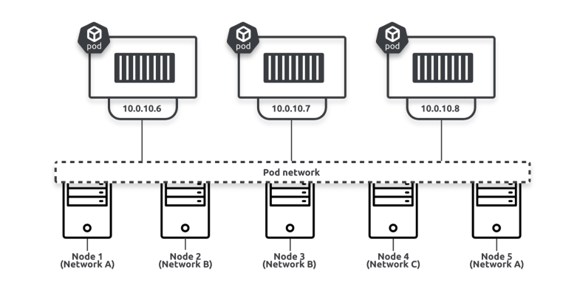
Inter-pod communication

Slide 21
Pod lifecycle
The lifecycle of a typical Pod is something like this…
You define it in a declarative YAML object. This gets posted to the API server and the Pod enters the pending phase. It’s then scheduled to a healthy worker node with enough resources and the local kubelet instructs the container runtime to pull all required images and start all containers. Once all containers are pulled and running, the Pod enters the running phase. If it’s a short-lived Pod, as soon as all containers terminate successfully the Pod enters the succeeded state. If it’s a long-lived Pod, it remains indefinitely in the running phase.

Slide 22
Shorted-lived and long-lived Pods
Pods can run all different types of applications. Some, such as web servers, are intended to be long-lived and should remain in the running phase indefinitely. If any containers
in a long-lived Pod fail, the local kubelet may attempt to restart them.
We say the kubelet “may” attempt to restart them. This is based on the container’s restart policy which is defined in the Pod config. Options include Always, OnFailure, and Never. Always is the default restart policy and appropriate for most long-lived Pods.
Other workload types, such as batch jobs, are designed to be short-lived and only run until a task completes. Once all containers in a short-lived Pod successfully terminate, the Pod terminates and its status is set to successful. Appropriate container restart policies for short-lived Pods will usually be Never or OnFailure.
Kubernetes has several controllers for different types of long-lived and short-lived workloads. Deployments, StatefulSets, and DaemonSets are examples of controllers designed for long-lived Pods. Jobs and CronJobs are examples designed for short-lived Pods.

Slide 23
Kubernetes offers several well-defined multi-container Pod patterns:
• Sidecar pattern
• Adapter pattern
• Ambassador pattern
• Init pattern

Slide 24
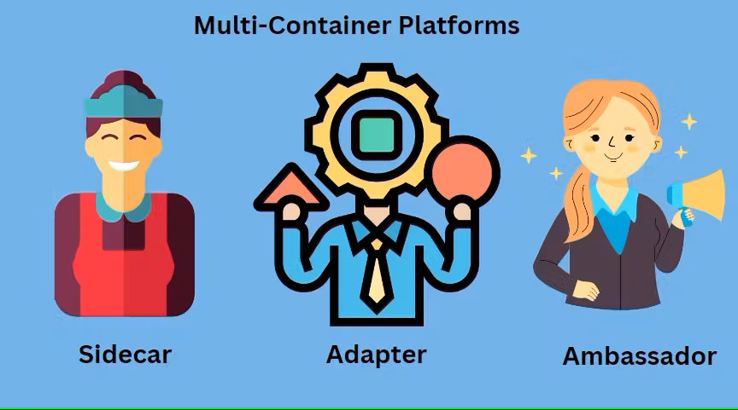

Slide 25
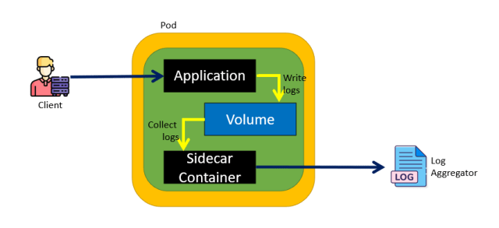
Sidecar multi-container Pods
The sidecar pattern is probably the most popular and most generic multi-container pattern. It has a main application container and a sidecar container. It’s the job of the sidecar to perform a secondary task for the main application container. The previous

Slide 26
example of a main application web container, plus a helper pulling up-to-date content is a classic example of the sidecar pattern – the “sync” container pulling the content from the external repo is the sidecar.
An increasingly important user of the sidecar model is the service mesh. At a high level, service meshes inject sidecar containers into application Pods. The sidecars then do things like encrypt traffic and expose telemetry and metrics.

Slide 27
Adapter multi-container Pods
The adapter pattern is a specific variation of the sidecar pattern where the helper container takes non-standardized output from the main container and rejigs it into a format required by an external system.
A simple example is NGINX logs being sent to Prometheus. Out-of-the-box, Prometheus doesn’t understand NGINX logs, so a common approach is to put an adapter container into the NGINX Pod that converts NGINX logs into a format accepted by Prometheus.

Slide 28
Ambassador multi-container Pods
The ambassador pattern is another variation of the sidecar pattern. This time, the helper container brokers connectivity to an external system. For example, the main application container can just dump its output to a port the ambassador container is listening on and sit back while the ambassador container does the hard work of getting it to the external system.
It acts a lot like political ambassadors that interface with foreign nations on behalf of a government. In Kubernetes, ambassador containers interface with external systems on behalf of the main app container.

Slide 29
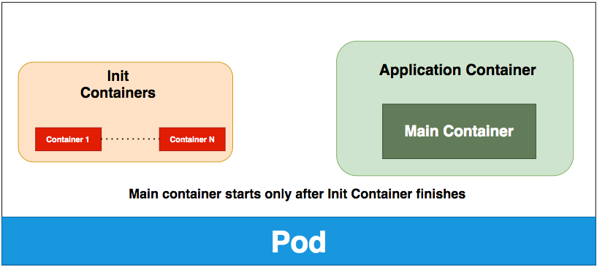
Init multi-container Pods
The init pattern is not a form of sidecar. It runs a special init container that’s guaranteed to start and complete before the main app container. It’s also guaranteed to only run once.
As the name suggests, its job is to run tasks that initialise the environment for the main application container. For example, a main app container may need permissions setting, an external API to be up and accepting connections, or a remote repository cloning to a local volume. In these cases, an init container can do that prep work and will only exit when the environment is ready for the main app container. The main app container will not start until the init container completes.

