Slide 1
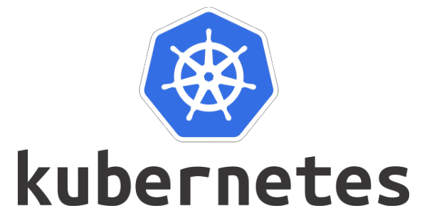
Session 4

Slide 2
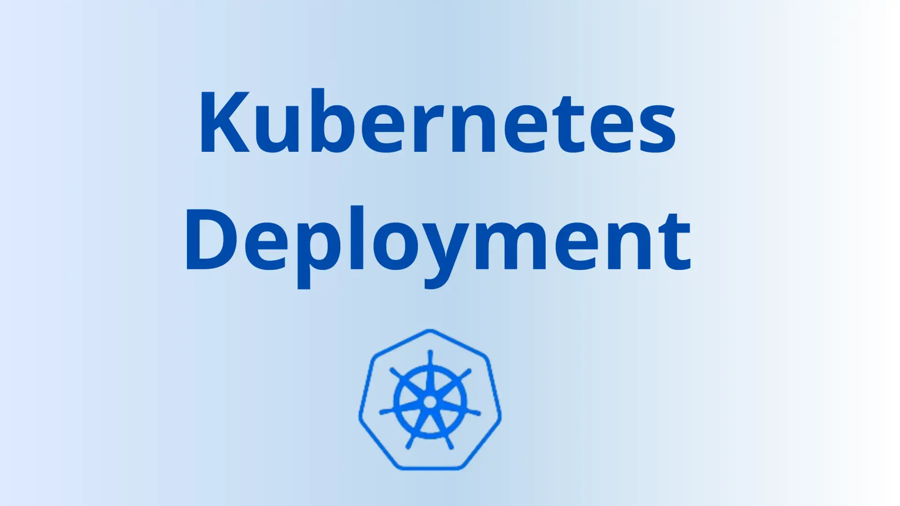
Kubernetes Deployments

Slide 3
kubectl explain deployments

Slide 4
The Deployment spec is a declarative YAML object where you describe the desired state of a stateless app. You give it to Kubernetes where the Deployment controller implements and manages it. The controller element is highly-available and operates as a background loop on the control plane reconciling observed state with desired state.
The latest version of the Deployment object, including all features and attributes, is defined in the apps/v1 workloads API sub-group.

Slide 5
Note: The Kubernetes API is architecturally divided into smaller sub-groups to make it easier to manage and navigate. The apps sub-group is where Deployments, DaemonSets, StatefulSets, and other workload-related objects are defined. We sometimes call it the workloads API. If you’re new to APIs, it’s normal for the Kubernetes API to be confusing.

Slide 6
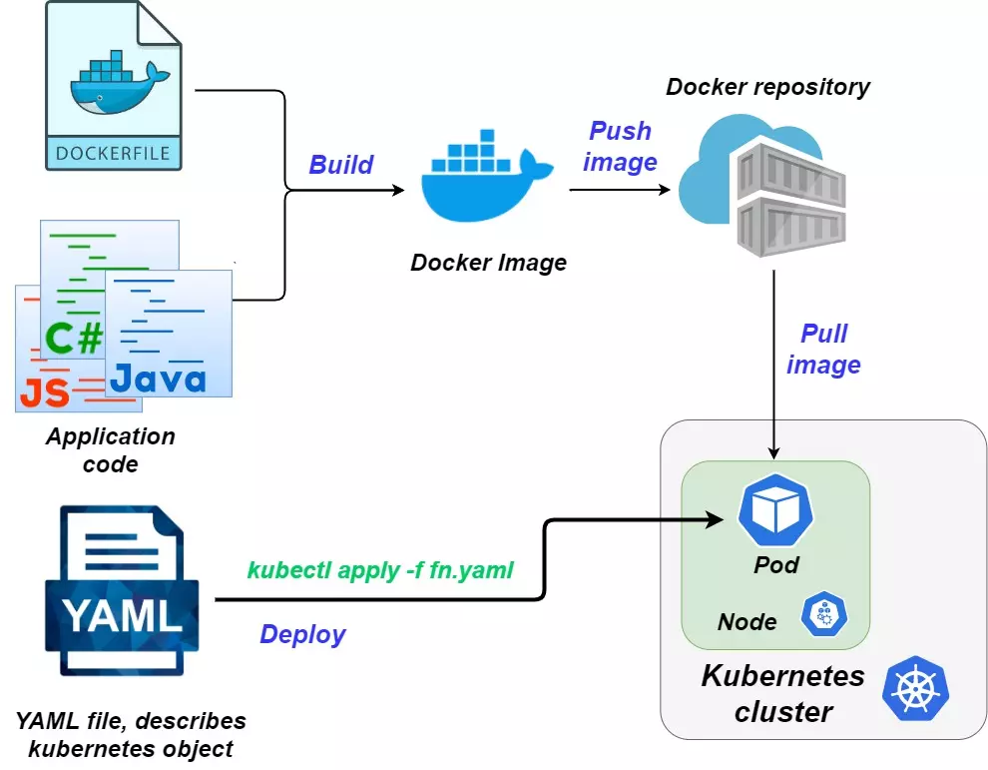
You start with a stateless application, package it as a container, then define it in a Pod template. At this point you could run it on Kubernetes. However, static Pods like this don’t self-heal, they don’t scale, and they don’t allow for easy updates and rollbacks. For these reasons, you’ll almost always wrap them in a Deployment object.

Slide 7
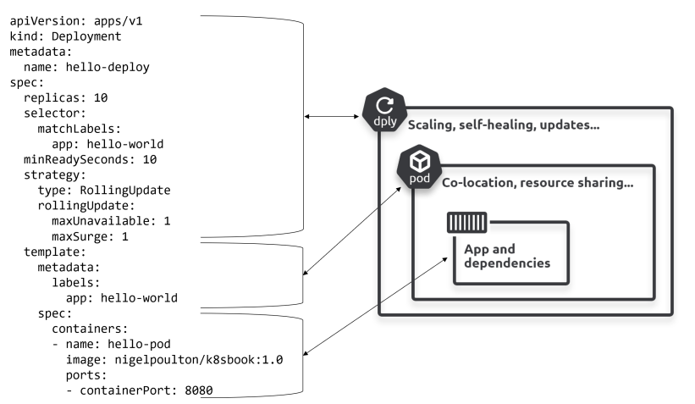

Slide 8
A Deployment object only manages a single Pod template. For example, an application with a front-end web service and a shopping basket service will have a different Pod template for each. As a result, it’ll need two Deployment objects – one managing frontend web Pods, the other managing any shopping basket Pods. However, a Deployment can manage multiple replicas of the same Pod. For example, the front-end web Deployment might be managing 5 identical replicas of the front-end web Pod.

Slide 9
Deployments and ReplicaSets
Behind-the-scenes, Deployments rely heavily on another object called a ReplicaSet. While it’s recommended not to manage ReplicaSets directly (let the Deployment controller manage them), it’s important to understand the role they play.
At a high-level, containers are a great way to package applications and dependencies. Pods allow containers to run on Kubernetes and enable co-scheduling and a bunch of other good stuff. ReplicaSets manage Pods and bring self-healing and scaling. Deployments manage ReplicaSets and add rollouts and rollbacks. As a result, working with Deployments brings the benefits of everything else – the container, the Pod, the ReplicaSet.

Slide 10
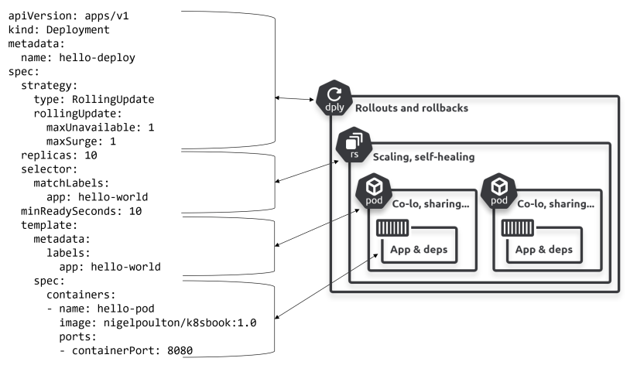

Slide 11
If Pods managed by a Deployment fail, they will be replaced – self-healing
If Pods managed by a Deployment see increased or decreased load, they can be
scaled
Remember though, hidden away behind-the-scenes, it’s actually the ReplicaSets doing the self-healing and scalability.

Slide 12
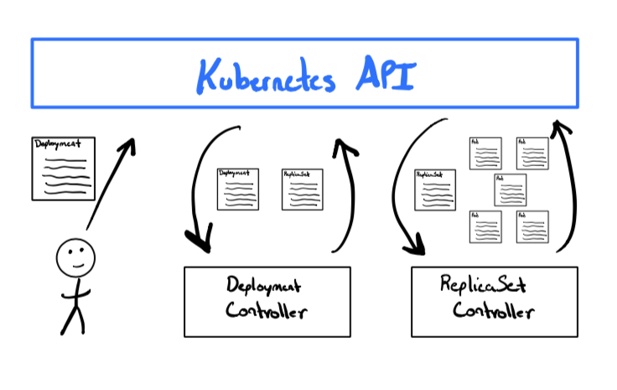
• Desired state
• Observed state (sometimes called actual state or current state)
• Reconciliation

Slide 13
Controllers and reconciliation
Fundamental to desired state is the process of reconciliation.
For example, ReplicaSets are implemented as a controller running as a background reconciliation loop checking the right number of Pod replicas are present on the cluster. If there aren’t enough, it adds more. If there are too many, it terminates some.
Assume a scenario where desired state is 10 replicas, but only 8 are present. It makes no difference if this is due to a failure, or if it’s because an autoscaler has requested an increase in desired state from 8 to 10. Either way, this is a red-alert condition for Kubernetes and the ReplicaSet controller brings up two more replicas. And the best part… it does all this without calling you at 4:20 am!

Slide 14
Rolling updates with Deployments
Zero-downtime rolling-updates (rollouts) of stateless apps are what Deployments are all about. However, they require a couple of things from your microservices applications in order to work properly:
1. Loose coupling via APIs
2. Backwards and forwards compatibility

Slide 15
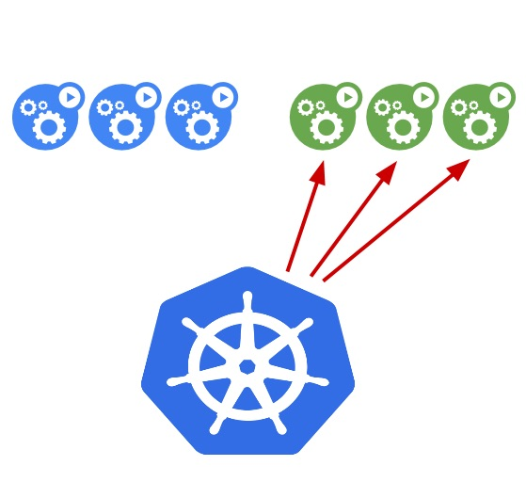
Assume you’re running 5 replicas of a stateless web front-end. As long as all clients communicate via APIs and are backwards and forwards compatible, it doesn’t matter which of the 5 replicas a client connects to. To perform a rollout, Kubernetes creates a new replica running the new version and terminates an existing one running the old version. At this point, you’ve got 4 replicas on the old version and 1 on the new. This process repeats until all 5 replicas are on the new version. As the app is stateless, and there are always multiple replicas up and running, clients experience no downtime or interruption of service.

Slide 16
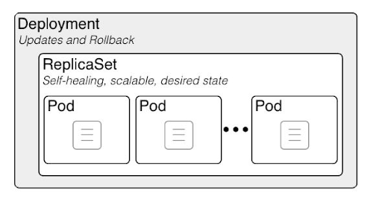

Slide 17
At a high-level, containers are a great way to package applications and dependencies. Pods allow containers to run on Kubernetes and enable co-scheduling and a bunch of other good stuff. ReplicaSets manage Pods and bring self-healing and scaling. Deployments manage ReplicaSets and add rollouts and rollbacks. As a result, working with Deployments brings the benefits of everything else – the container, the Pod, the ReplicaSet.

Slide 18
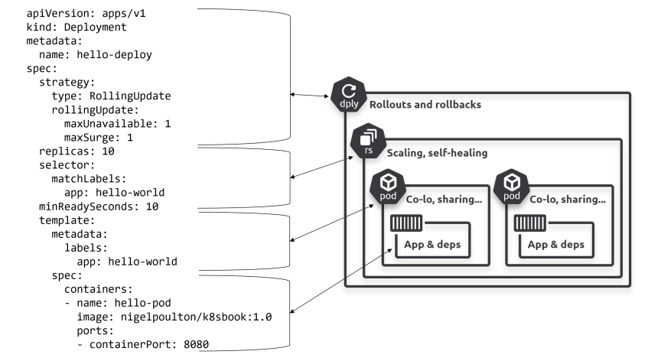

Slide 19
Self-healing and scalability
Pods are great. They let you co-locate containers, share volumes, share memory, simplify networking, and a lot more. But they offer nothing in the way of self-healing and scalability – if the node a Pod is running on fails, the Pod is lost.
Enter Deployments…
• If Pods managed by a Deployment fail, they will be replaced – self-healing
• If Pods managed by a Deployment see increased or decreased load, they can be
scaled
Remember though, hidden away behind-the-scenes, it’s actually the ReplicaSets doing the self-healing and scalability. You’ll see them in action soon.

Slide 20
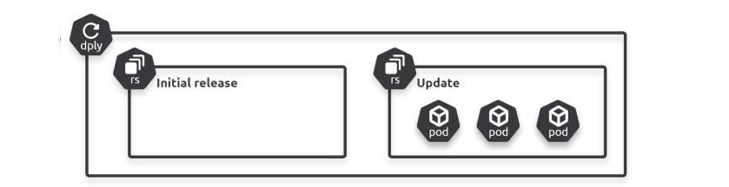

Slide 21
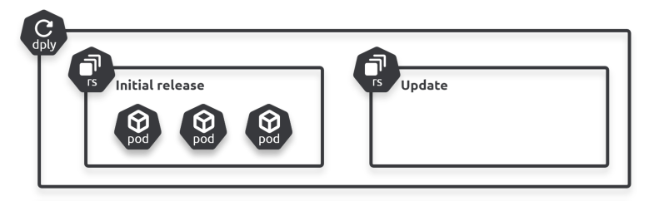
older ReplicaSets are wound down and no longer manage any Pods. However, their configurations still exist on the cluster, making them a great option for reverting to previous versions.
The process of a rollback is the opposite of a rollout – you wind one of the old ReplicaSets up while you wind the current one down. Simple.

Slide 22
That’s not the end though. Kubernetes gives you fine-grained control over how rollouts and rollbacks proceed. For example, you can insert delays, control the pace and cadence
of releases, and you can even probe the health and status of updated replicas.

Slide 23
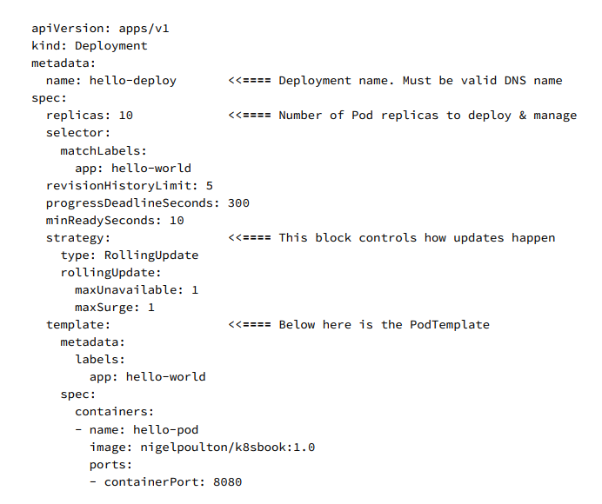

Slide 24
you can see the name of the ReplicaSet matches the name of the Deployment with a hash added to the end. This is a crypto-hash of the Pod template section of the Deployment manifest (everything below .spec.template)
kubectl scale deploy nh-deploy --replicas 5

Slide 25
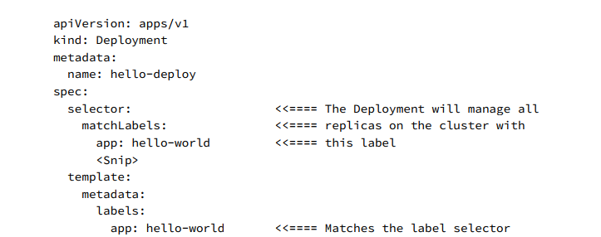
Deployment’s label selector

Slide 26
In earlier versions of Kubernetes, it was possible for Deployments to take over management of existing static Pods if they had the same labels. However, recent versions use the
system-generated pod-template-hash label so only Pods that were originally created by the Deployment/ReplicaSet will be managed.

Slide 27
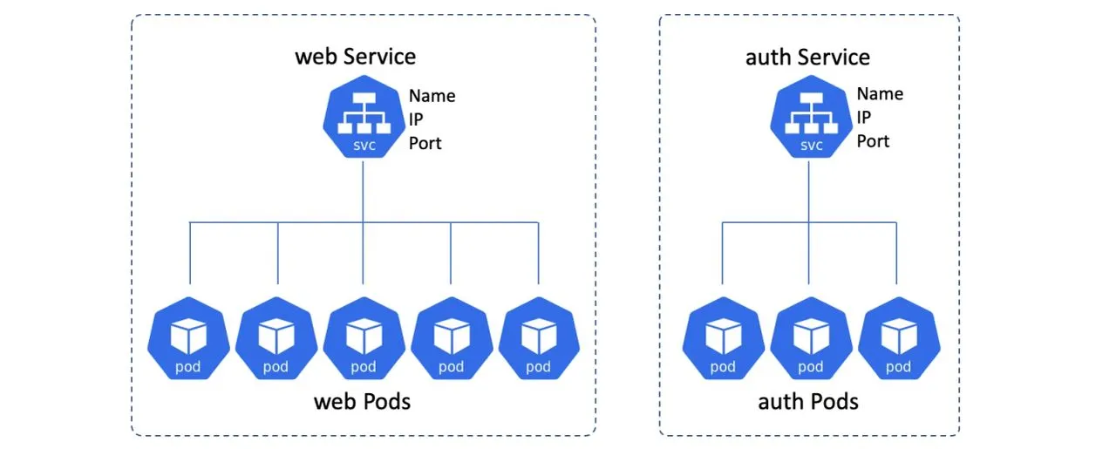
Kubernetes Services

Slide 28
kubectl explain service

Slide 29
When Pods fail, they get replaced by new ones with new IPs. Scaling-up introduces new Pods with new IP addresses. Scaling down removes Pods. Rolling updates delete existing Pods and replace them with new ones with new IPs. All of this creates massive IP churn and demonstrates why you should never connect directly to any Pod. This is where Services come to the rescue by providing a stable and reliable network endpoint for groups of unreliable Pods.

Slide 30
When Pods fail, they get replaced by new ones with new IPs. Scaling-up introduces new Pods with new IP addresses. Scaling down removes Pods. Rolling updates delete existing Pods and replace them with new ones with new IPs. All of this creates massive IP churn and demonstrates why you should never connect directly to any Pod. This is where Services come to the rescue by providing a stable and reliable network endpoint for groups of unreliable Pods.

Slide 31
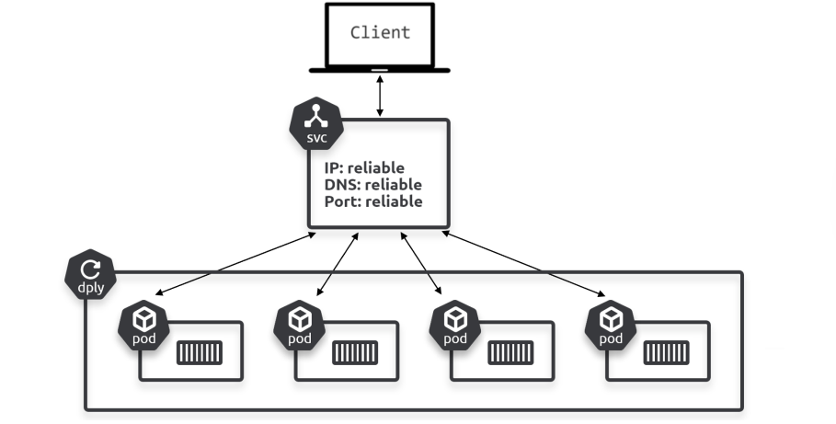

Slide 32
With a Service in place, the Pods can scale up and down, they can fail, and they can be updated and rolled back. Despite all of this, client access is still possible via the Service. This is because the Service observes changes and maintains an up-to-date list of healthy Pods and sends traffic to them. But it never changes its stable IP, DNS, and port.
Think of Services as having a static front-end and a dynamic back-end. The front-end consists of the IP, DNS name, and port that never changes. The back-end comprises the list of healthy Pods and can be constantly changing.

Slide 33
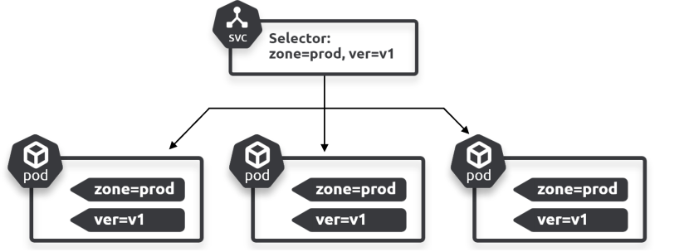
Labels and loose coupling
Services are loosely coupled with Pods via labels and selectors. This is the same technology that loosely couples Deployments to Pods and is key to the flexibility of Kubernetes. 3 Pods are labelled as zone=prod and ver=v1, and the Service has a selector that matches.

Slide 34
the Service is providing stable networking to all three Pods – you send requests to the Service and it forwards them to the Pods. In doing this, it also provides basic load-balancing across the three Pods.

Slide 35
the Service is providing stable networking to all three Pods – you send requests to the Service and it forwards them to the Pods. In doing this, it also provides basic load-balancing across the three Pods.
For a Service to send traffic to a Pod, the Pod needs every label the Service is selecting on. It can also have additional labels the Service isn’t looking for.

Slide 36
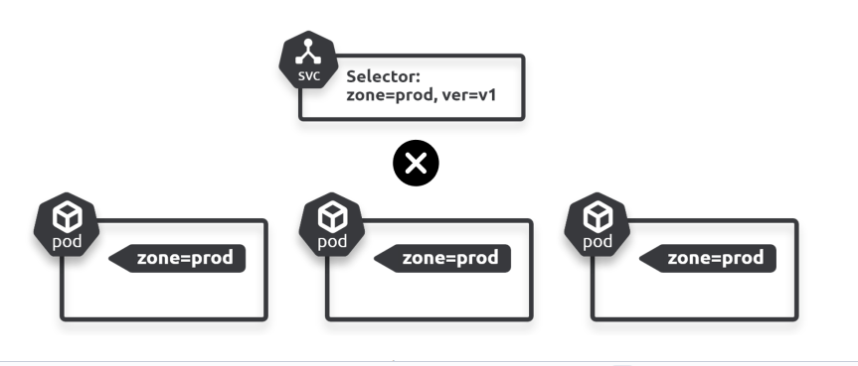

Slide 37
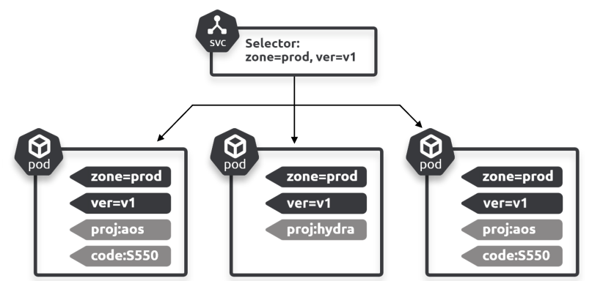

Slide 38
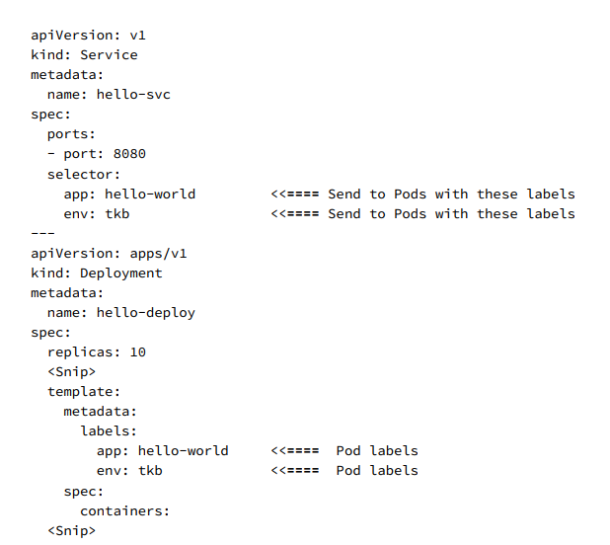

Slide 39
Services and EndpointSlices
As Pods come-and-go, Services maintain an up-to-date list in one or more EndpointSlice objects that are created automatically for every Service with a label selector.
Every time you create a Service, Kubernetes automatically creates an associated Endpoints object. This Endpoints object is used to store a dynamic list of healthy Pods matching the Service’s label selector.
Kubernetes is constantly evaluating the Service’s label selector against all healthy Pods on the cluster. Any new Pods that match the selector get added to one of the Service’s EndpointSlice objects, whereas any Pods that disappear get removed. This means the Services EndpointSlice objects are always up to date.

Slide 40
When sending traffic to Pods via a Service, the cluster’s internal DNS resolves the Service name to an IP address. It then sends the traffic to this stable IP address and the traffic gets routed to one of the Pods. However, a Kubernetes-native application (that’s a fancy way of saying an application that understands Kubernetes and can query the Kubernetes API) can query EndpointSlices directly, bypassing the DNS lookup and use of the Service’s IP.
Note: Recent versions of Kubernetes are replacing older monolithic Endpoints objects with more efficient EndpointSlices. The functionality is identical, but EndpointSlices achieve better performance and are more efficient on large busy clusters.

Slide 41
Dual stack networking (IPv4 and IPv6)
Kubernetes 1.23 promoted IPv4/IPv6 dual-stack networking to stable. This means Pods and Services can have IPv4 and IPv6 addresses. It’s a major step forward in general Kubernetes networking and may be a game-changer for Kubernetes on IoT where there are potentially thousands of devices needing their own IP addresses.
For this to work, you need all cluster nodes to have routable IPv4 and IPv6 addresses and your CNI plugin needs to support dual stack networking.

Slide 42
Accessing Services from inside the cluster
Kubernetes supports several types of Service. The default type is ClusterIP.
A ClusterIP Service has a stable virtual IP address that is only accessible from inside the cluster. It’s programmed into the internal network fabric and guaranteed to be stable for the life of the Service. Programmed into the network fabric is a fancy way of saying the network just knows about it and you don’t need to bother with the details.
Anyway, every Service you create gets a ClusterIP that’s registered, along with the name of the Service, in the cluster’s internal DNS service. All Pods in the cluster are preprogrammed to use the cluster’s DNS service, meaning all Pods can convert Service names to ClusterIPs.

Slide 43
Accessing Services from outside the cluster
Kubernetes has two types of Service for requests originating from outside the cluster:
• NodePort
• LoadBalancer
NodePort Services build on top of the ClusterIP type and allow external clients to hit a dedicated port on every cluster node and reach the Service. We call this dedicated port the “NodePort”.
You already know the default Service type is ClusterIP and it registers a DNS name, virtual IP, and port with the cluster’s DNS. NodePort Services build on this by adding
an additional NodePort that can be used to reach the Service from outside the cluster.

Slide 44
apiVersion: v1
kind: Service
metadata:
name: skippy
spec:
type: NodePort
ports:
- port: 8080
nodePort: 30050
selector:
app: hello-world
Pods inside the cluster can access this Service by its name (skippy) on port 8080. Clients connecting from outside the cluster can send traffic to any cluster node on port 30050.

Slide 45
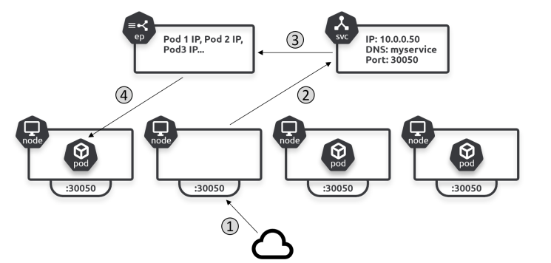

Slide 46
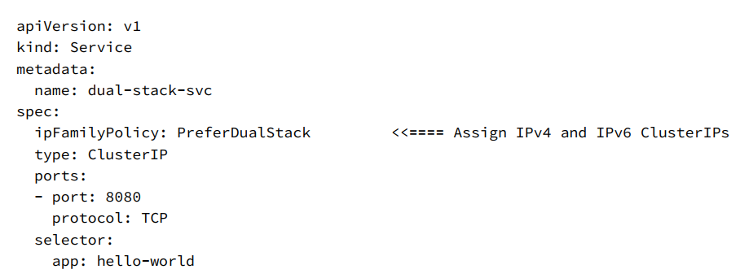

Slide 47
The field of interest is .spec.ipFamilyPolicy which can be set to any of the following three values:
• SingleStack
• PreferDualStack
• RequireDualStack

Slide 48
kubectl expose deployment svc-test --type=NodePort kubectl describe svc svc-test

Slide 49
