Slide 1
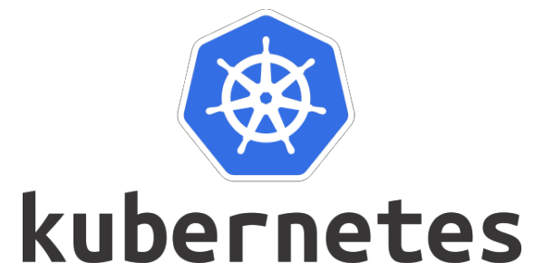
Session 5

Slide 2
Kubernetes service types summary

Slide 3
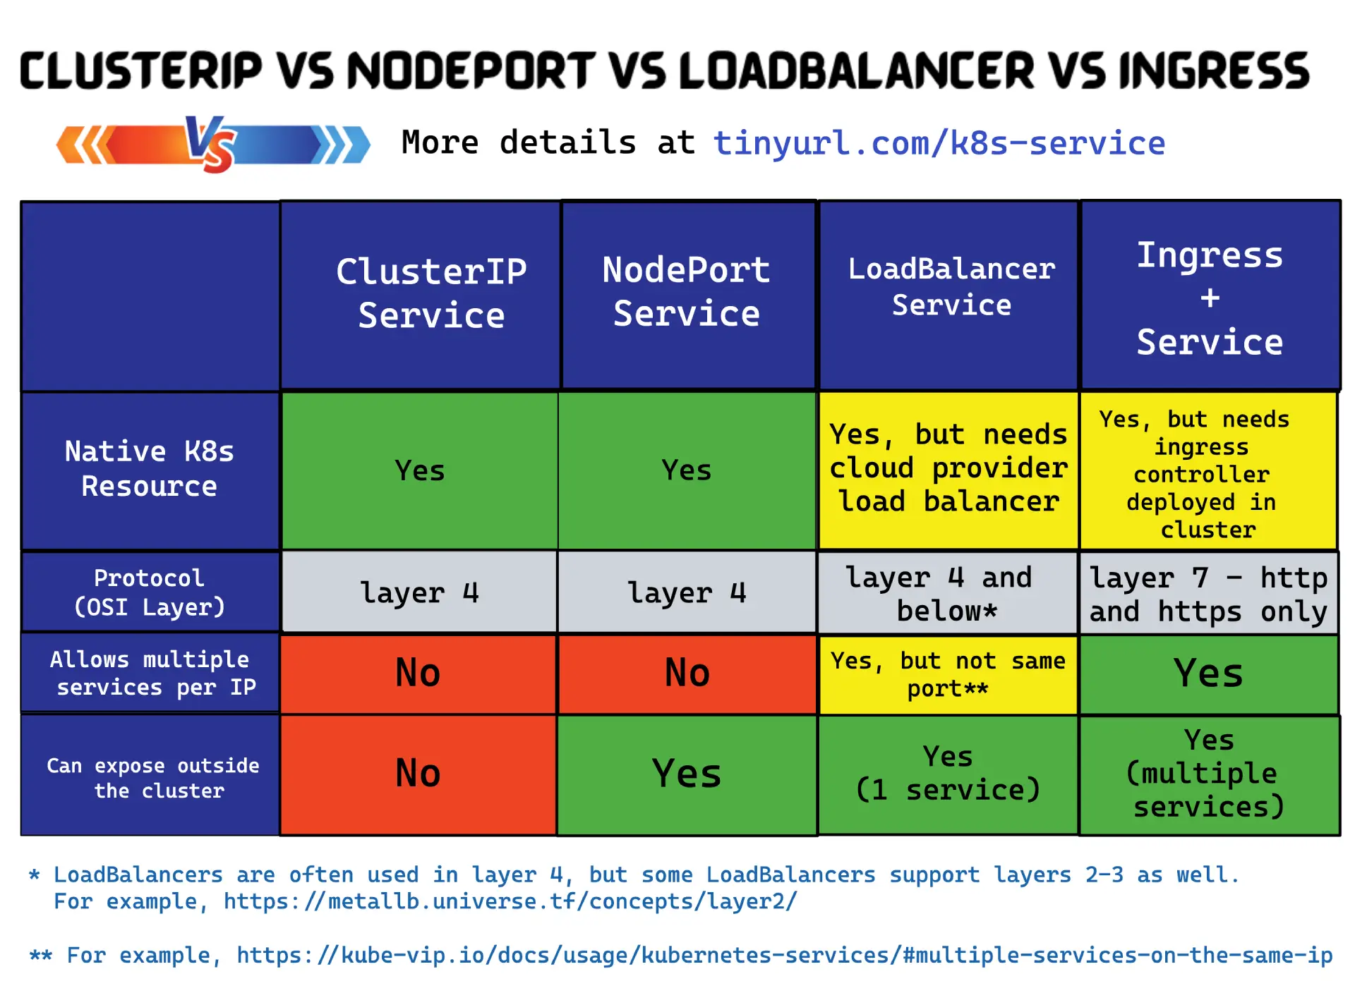

Slide 4
type: ClusterIP
This default Service type assigns an IP address from a pool of IP addresses that your cluster has reserved for that purpose.
Several of the other types for Service build on the ClusterIP type as a foundation.
If you define a Service that has the .spec.clusterIP set to "None" then Kubernetes does not assign an IP address.

Slide 5
type: NodePort
If you set the type field to NodePort, the Kubernetes control plane allocates a port from a range specified by --service-node-port-range flag (default: 30000-32767).
apiVersion: v1
kind: Service
metadata:
name: my-service
spec:
type: NodePort
selector:
app.kubernetes.io/name: MyApp
ports:
- port: 80
# By default and for convenience, the `targetPort` is set to
# the same value as the `port` field.
targetPort: 80
# Optional field
# By default and for convenience, the Kubernetes control plane
# will allocate a port from a range (default: 30000-32767)
nodePort: 30007

Slide 6
apiVersion: v1
kind: Service
metadata:
name: my-service
spec:
selector:
app.kubernetes.io/name: MyApp
ports:
- protocol: TCP
port: 80
targetPort: 9376
clusterIP: 10.0.171.239
type: LoadBalancer
status:
loadBalancer:
ingress:
- ip: 192.0.2.127

Slide 7
apiVersion: v1
kind: Service
metadata:
name: cloud-lb
spec:
type: LoadBalancer
ports:
- port: 9000
targetPort: 8080
selector:
chapter: services

Slide 8

MetalLB
https://metallb.universe.tf/

Slide 9
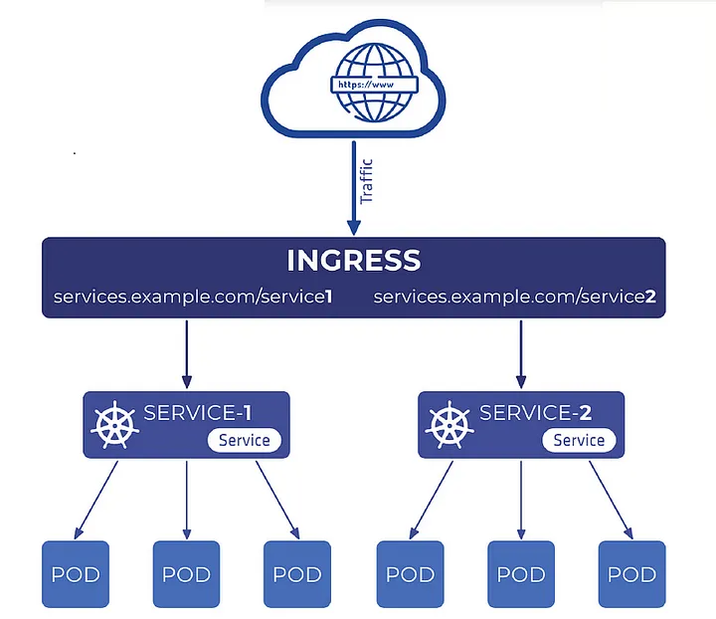
Ingress

Slide 10
you saw how Service objects provide stable networking for Pods. You also saw how to expose applications to external consumers via NodePort Services and LoadBalancer Services. However, both of these have limitations.
NodePorts only work on high port numbers (30000-32767) and require knowledge of node names or IPs. LoadBalancer Services fix this but require a 1-to-1 mapping between an internal Service and a cloud load-balancer. This means a cluster with 25 internetfacing apps will need 25 cloud load-balancers, and cloud load-balancers aren’t cheap. Your cloud may also place a limit on how many load-balancers you can provision in a region.

Slide 11
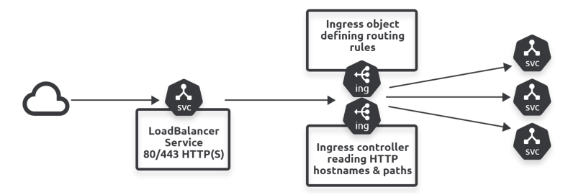
To do this, Ingress creates a single LoadBalancer Service, on port 80 or 443, and uses host-based and path-based routing to send traffic to the correct backend Service.

Slide 12
Ingress architecture
Ingress is a stable resource in the Kubernetes API. It went GA in Kubernetes 1.19 after being in beta for over 15 releases. During the 3+ years it was in alpha and beta, service meshes increased in popularity and there’s some overlap in functionality. As a result, if you plan to run a service mesh, you may not need Ingress.
Ingress is defined in the networking.k8s.io API sub-group as a v1 object and is based on the usual two constructs:
1. A controller
2. An object spec

Slide 13
The object spec defines rules to govern traffic routing, whereas the controller implements the rules.
However, a lot of Kubernetes clusters don’t ship with a built-in Ingress controller – you have to install your own. This is the opposite of other API resources, such as Deployments and ReplicaSets, which have a built-in pre-configured controller. However, some hosted Kubernetes clusters give you the option to pre-install one.
Once you have an Ingress controller, you deploy Ingress objects with rules that tell the controller how to route requests.

Slide 14
The object spec defines rules to govern traffic routing, whereas the controller implements the rules.
However, a lot of Kubernetes clusters don’t ship with a built-in Ingress controller – you have to install your own. This is the opposite of other API resources, such as Deployments and ReplicaSets, which have a built-in pre-configured controller. However, some hosted Kubernetes clusters give you the option to pre-install one.
Once you have an Ingress controller, you deploy Ingress objects with rules that tell the controller how to route requests.

Slide 15
On the topic of routing, Ingress operates at layer 7 of the OSI model, also known as the “application layer”. This means it can inspect HTTP headers and forward traffic based on hostnames and paths.
Note: A quick side-step. The “OSI model” is the reference model for TCP/IP networking. It comprises seven layers numbered 1-7, with the lowest
layers concerned with things like signalling and electronics, the middle layers dealing with reliability through things like acks and retries, and the higher layers adding awareness of user apps such as HTTP services. Ingress operates at layer 7, also known as the application layer, and implements HTTP intelligence.

Slide 16
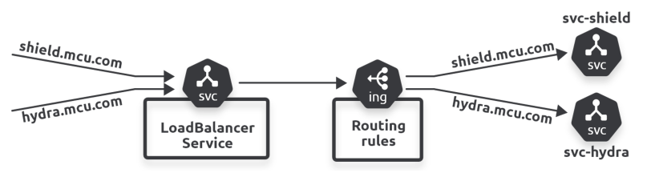

Slide 17
For this to work, name resolution needs to point the appropriate DNS names to the public endpoint of the Ingress load-balancer. you’ll need shield.mcu.com and hydra.mcu.com to resolve to the public IP of the Ingress loadbalancer.
In summary, Ingress exposes multiple ClusterIP Services through a single cloud loadbalancer. You create and deploy Ingress objects that are rules governing how traffic reaching the load-balancer is routed to backend Services. The Ingress controller, which you usually have to install yourself, inspects hostnames and paths to make intelligent
In summary, Ingress exposes multiple ClusterIP Services through a single cloud loadbalancer. You create and deploy Ingress objects that are rules governing how traffic reaching the load-balancer is routed to backend Services. The Ingress controller, which you usually have to install yourself, inspects hostnames and paths to make intelligent routing decisions.

Slide 18
kubectl apply -f https://raw.githubusercontent.com/kubernetes/ingress-nginx/ controller-v1.5.1/deploy/static/provider/cloud/deploy.yaml namespace/ingress-nginx created serviceaccount/ingress-nginx created ingressclass.networking.k8s.io/nginx created<Snip> job.batch/ingress-nginx-admission-patch created
kubectl get pods -n ingress-nginx -l app.kubernetes.io/name=ingress-nginx

Slide 19
NAME READY STATUS RESTARTS AGE
ingress-nginx-admission-create--1-4w5ps 0/1 Completed 0 87s
ingress-nginx-admission-patch--1-9hg7t 0/1 Completed 1 87s
ingress-nginx-controller-54bfb9bb-cbgh6 1/1 Running 0 88s

Slide 20
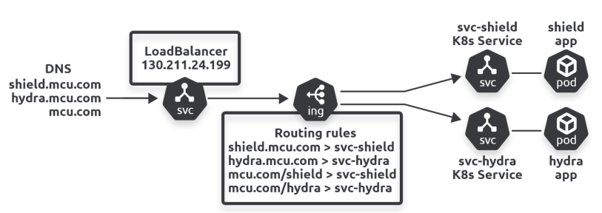
kubectl get ingressclass

Slide 21
Traffic flow to the shield app using host-based routing will be as follows:
1. A client will send traffic to shield.mcu.com
2. DNS name resolution will send the traffic to the load-balancer’s public endpoint
3. Ingress will read the HTTP headers for the hostname (shield.mcu.com)
4. An Ingress rule will trigger, and the traffic will be routed to the svc-shield
ClusterIP backend
5. The ClusterIP Service will ensure the traffic reaches the shield Pod

Slide 22
Service discovery

Slide 23
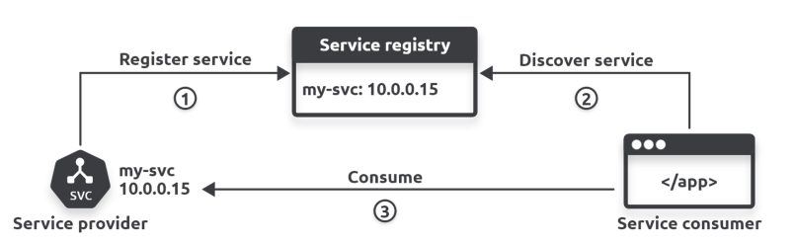
Service registration
Two important things to note about service discovery in Kubernetes:
1. Kubernetes operates its internal DNS as a service registry
2. All Kubernetes Services are automatically registered with DNS

Slide 24
Kubernetes provides a well-known internal DNS service that we usually call the “cluster DNS”. It’s well known because every Pod in the cluster is automatically configured to know where to find it. It’s implemented in the kube-system Namespace as a set of Pods managed by a Deployment called coredns and fronted by a Service called kubedns. Behind the scenes, it’s based on a DNS technology called CoreDNS and runs as a
Kubernetes-native application.

Slide 25
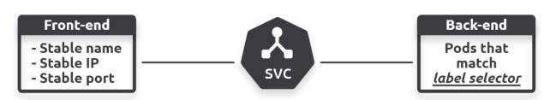
kubectl get endpointslice

Slide 26
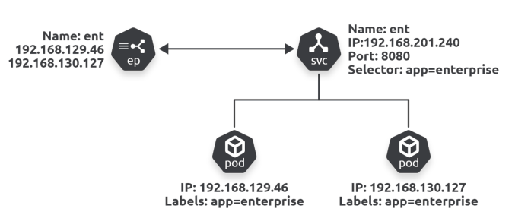
The kube-proxy agent on every node is also watching the API server for new EndpointSlice objects. When it sees one, it creates local networking rules on all worker nodes to redirect ClusterIP traffic to Pod IPs. In modern Linux-based Kubernetes clusters, the technology used to create these rules is the Linux IP Virtual Server (IPVS). Older versions used iptables.
At this point the Service is fully registered and ready to be used:
• Its front-end configuration is registered with DNS
• Its back-end label selector is created
• Its EndpointSlice objects are created
• kube-proxies have created the necessary local routing rules on worker nodes

Slide 27
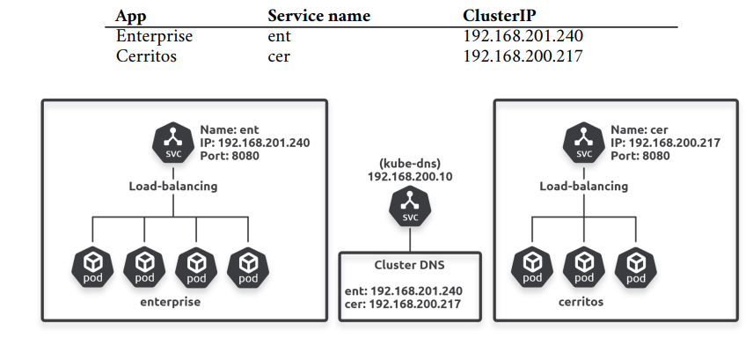
Service discovery

Slide 28
For service discovery to work, apps need to know both of the following:
1. The name of the Service fronting the apps they want to connect to
2. How to convert the name to an IP address
Application developers are responsible for point 1. They need to code apps to know the names of other apps they want to consume. Actually, they need to code the names of Services fronting the remote apps. For example, if the cerritos app wants to connect to enterprise, it needs to send requests to the ent Service.
Kubernetes takes care of point 2, converting the name to an IP.

Slide 29
Converting names to IP addresses using the cluster DNS
Kubernetes automatically populates every container’s /etc/resolv.conf file with the
IP address of the cluster DNS Service. It also adds any search domains that should be
appended to unqualified names.
An “unqualified name” is a short name such as ent. Appending a search domain converts
it to a fully qualified domain name (FQDN) such as ent.default.svc.cluster.local.
The following snippet shows a container that is configured to send DNS queries to
the cluster DNS at 192.168.200.10. It also lists three search domains to append to
unqualified names.
$ cat /etc/resolv.conf
search svc.cluster.local cluster.local default.svc.cluster.local
nameserver 192.168.200.10 <<==== matches ClusterIP of internal cluster DNS service
options ndots:5

Slide 30
Some network magic
ClusterIPs are on a “special” network called the service network, and there are no routes to it! This means containers send all ClusterIP traffic to their default gateway.
Terminology: A default gateway is where systems send traffic when there’s no known route. Normally, the default gateway forwards traffic to another device with a larger routing table in the hope it will have a route to the destination. A simple analogy might be driving from City A to City Z. The local roads in City A probably don’t have signs to City Z, so you follow signs to the major highway/motorway. Once on the highway/motorway there’s more chance you’ll find directions to City Z. If the first signpost doesn’t have a route, you keep driving until you see one that does. Occasionally you don’t find a sign and you get lost or run out of battery/fuel. Routing is similar, if a system doesn’t have a route for the destination network, it sends it from one default gateway to the next until hopefully a system has a route. As with driving, it’s also possible you never find a route and the request times out.

Slide 31
The container’s default gateway sends the traffic to the node it’s running on.
The node doesn’t have a route to the service network either, so it sends it to its own default gateway. Doing this causes the traffic to be processed by the node’s kernel, which is where the magic happens…
Every Kubernetes node runs a system service called kube-proxy that implements a controller watching the API server for new Services and EndpointSlice objects. When it sees them, it creates local IPVS rules telling the node to intercept traffic destined for the Service’s ClusterIP and forward it to individual Pod IPs.
This means that every time a node’s kernel processes traffic headed for an address on the service network, a trap occurs and the traffic is redirected to the IP of a healthy Pod matching the Service’s label selector.

Slide 33
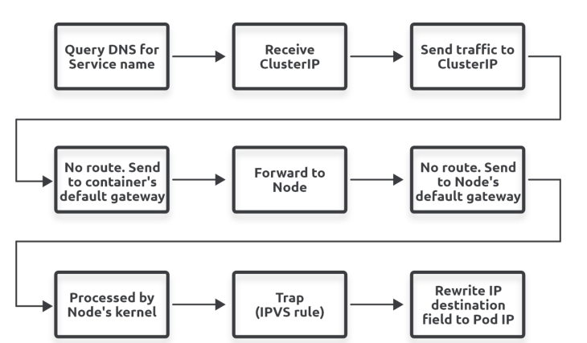
Summarising service discovery

Slide 34
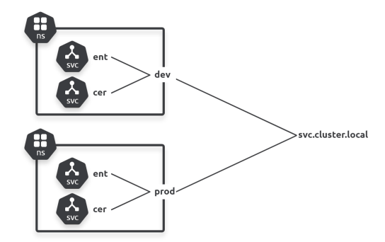
Service discovery and Namespaces
It’s important to understand that every cluster has an address space, and we can use Namespaces to partition it.
Cluster address spaces are based on a DNS domain that we call the cluster domain. The domain name is usually cluster.local and objects have unique names within it.
Objects can connect to Services in the local Namespace using short names such as ent and cer. But connecting to objects in a remote Namespace requires FQDNs such as ent.dev.svc.cluster.local and cer.dev.svc.cluster.local.

Slide 35
Kubernetes storage

Slide 36
Storing and retrieving important data is critical to most real-world business applications. Fortunately, Kubernetes has a mature and feature-rich storage subsystem called
the persistent volume subsystem. The 3rd-party ecosystem also extends this with products
that provide data management services such as backup and recovery, remote replication,
snapshots and more.

Slide 37
Kubernetes supports a variety of storage back-ends. These include enterprise-class storage systems from providers such as EMC and NetApp, as well as cloud storage back-ends. Each of these requires slightly different configuration.

Slide 38
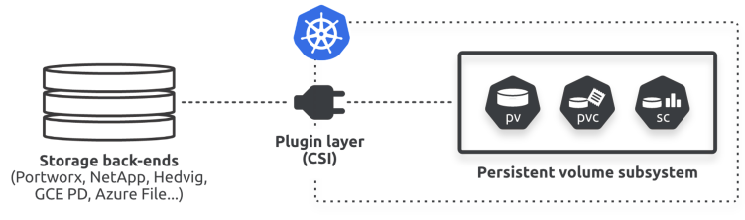
Kubernetes supports lots of types of storage from lots of different places. For example, block, file, and object storage from a variety of external systems that can be in the cloud or your on-premises datacenters. However, no matter what type of storage, or where it comes from, when it’s exposed to Kubernetes it’s called a volume. For example, Azure File resources surfaced in Kubernetes are called volumes, as are block devices from an HPE 3PAR array, or object storage from Alicloud.

Slide 39
Note: Prior to the CSI, all storage plugins were implemented as part of the main Kubernetes code tree (in-tree). This meant they had to be open-source, and all updates and bug-fixes were tied to the main Kubernetes releasecycle. This was a problem for storage providers as well as the Kubernetes maintainers. However, now that we have the CSI, storage vendors no longer need to open-source their code, and they can release updates and bug-fixes against their own timeframes.

Slide 40
Kubernetes persistent volume subsystem. This is a set of API objects that make it easy for applications to consume storage. There are a growing number of storage-related API objects, but the core ones are:
• Persistent Volumes (PV)
• Persistent Volume Claims (PVC)
• Storage Classes (SC)

Slide 41
PVs map to external storage assets, PVCs are like tickets that authorize applications (Pods) to use them, and SCs make it all automatic and dynamic.

Slide 42
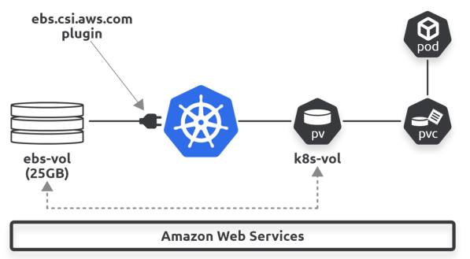
A Kubernetes cluster is running on AWS and the AWS administrator has created a 25GB EBS volume called “ebs-vol”. She creates a PV called “k8s-vol” that maps back to the “ebs-vol” via the ebs.csi.aws.com CSI plugin. While that might sound complicated, it’s not. The PV is simply a way of representing the external storage asset on the Kubernetes cluster. Finally, the Pod uses a PVC to claim access to the PV and start using it.

Slide 43
Storage Providers
As previously mentioned, Kubernetes uses storage from a wide range of 3rd-party systems including cloud storage and dedicated storage hardware devices.
Some obvious restrictions apply. For example, you can’t use AWS storage services if your Kubernetes cluster is running in Microsoft Azure. However, each provider (a.k.a provisioner) needs a CSI plugin to expose their storage assets to Kubernetes. The plugin usually runs as a set of Pods in the kube-system Namespace.

Slide 44
The CSI is a vital piece of the Kubernetes storage jigsaw and has been instrumental in bringing enterprise-grade storage from traditional vendors to Kubernetes. However, unless you’re a developer writing storage plugins, you’re unlikely to interact with it very often.
It’s an open-source project that defines a standards-based interface so that storage can be leveraged in a uniform way across multiple container orchestrators. For example, a storage vendor should be able to write a single CSI plugin that works across multiple orchestrators such as Kubernetes and Docker Swarm. In practice, Kubernetes is the focus, but Docker is implementing support for the CSI.
From a day-to-day perspective, your main interaction with the CSI will be referencing the appropriate CSI plugin in your YAML manifest files and reading its documentation to find supported features and attributes.
Sometimes we call plugins “provisioners”, especially when we talk about Storage Classes later in the chapter.

Slide 45
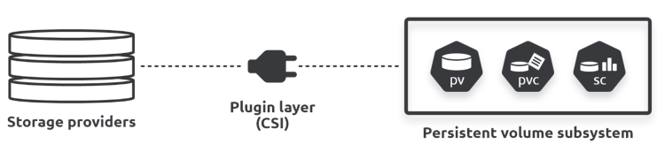
The Kubernetes persistent volume subsystem
The three core API resources in the persistent volume subsystem are:
• Persistent Volumes (PV)
• Persistent Volume Claims (PVC)
• Storage Classes (SC)

Slide 46

At a high level, PVs are how external storage assets are represented in Kubernetes. PVCs are like tickets that grant a Pod access to a PV. SCs make it all dynamic.
Assume you have an external storage system with two tiers of storage:
• Flash/SSD fast storage
• Mechanical slow archive storage
You expect apps on your Kubernetes cluster to use both, so you create the following two Storage Classes.

Slide 47
With the StorageClass objects in place, applications can create volumes on-the-fly by creating Persistent Volume Claims (PVC) that reference either of the storage classes. Each time this happens, the CSI plugin instructs the external storage system to create an appropriate storage asset. This is automatically mapped to a PV on Kubernetes and the app uses the PVC to claim it and mount it for use.

Slide 48
Dynamic provisioning with Storage Classes
As the name suggests, storage classes allow you to define different classes/tiers of storage. How you define them is up to you and will depend on the types of storage you have available. For example, if your external storage systems support fast and slow storage, as well as remote replication, you might define these three classes: • fast-local
• fast-replicated
• slow-archive-local
As far as Kubernetes goes, storage classes are resources in the storage.k8s.io/v1 API group. The resource type is StorageClass, and you define them in regular YAML files that you post to the API server for deployment. You can use the sc shortname to refer to them when using kubectl.

Slide 49
kubectl api-resources
kubectl explain csidriver
kubectl explain storageclasses.provisioner

Slide 50
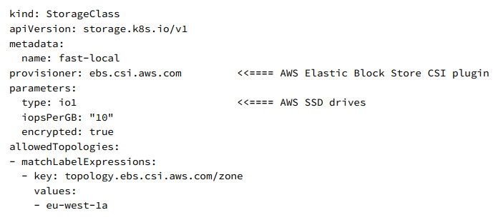
The following SC defines a class of storage called “fast-local”, based on AWS solid state drives (io1) in the Ireland Region (eu-west-1a). It also requests a performance level of 10 IOPs per gigabyte and encrypted volumes. Writing this file requires knowledge of AWS storage and reading the plugin documentation.

Slide 51
Notes:
1. StorageClass objects are immutable – you can’t modify them after they’re deployed
2. metadata.name should be meaningful as it’s how you and other objects refer to the
class
3. The terms provisioner and plugin are used interchangeably
4. The parameters block is for plugin-specific values

Slide 52
You can configure as many StorageClasses as you need. However, each one relates to a single type of storage on a single back-end. For example, if you have a Kubernetes cluster with OpenEBS and Portworx storage back-ends, you’ll need at least one StorageClasses for each.
On the flip-side, each back-end storage system can offer multiple classes/tiers of storage, each of which needs its own StorageClass. A simple example we’ll see later is the slower standard persistent disk and the faster SSD persistent disk tiers offered by the Google Cloud back-end. These are typically implemented with the following SCs on a GKE cluster:
1. standard-rwo for the slower standard disk
2. premium-rwo for the faster SSD

Slide 53
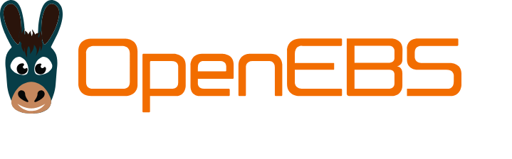
https://openebs.io/

Slide 54
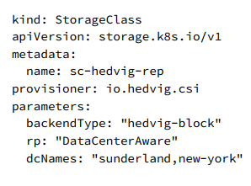

Slide 55
Working with StorageClasses
The basic workflow for deploying and using a StorageClass is as follows:
1. Have a storage back-end (can be cloud or on premises)
2. Have a Kubernetes cluster connected to the back-end storage
3. Install and configure the CSI storage plugin
4. Create one or more StorageClasses on Kubernetes
5. Deploy Pods with PVCs that reference those StorageClasses

Slide 56
Working with StorageClasses
The basic workflow for deploying and using a StorageClass is as follows:
1. Have a storage back-end (can be cloud or on premises)
2. Have a Kubernetes cluster connected to the back-end storage
3. Install and configure the CSI storage plugin
4. Create one or more StorageClasses on Kubernetes
5. Deploy Pods with PVCs that reference those StorageClasses

Slide 57
apiVersion: v1
kind: PersistentVolumeClaim
metadata:
name: foo-pvc
namespace: foo
spec:
storageClassName: "" # Empty string must be explicitly set otherwise default StorageClass will be set
volumeName: foo-pv
...
apiVersion: v1
kind: PersistentVolume
metadata:
name: foo-pv
spec:
storageClassName: ""
claimRef:
name: foo-pvc
namespace: foo
...

Slide 58
Access mode
Kubernetes supports three volume access modes:
• ReadWriteOnce (RWO)
• ReadWriteMany (RWM)
• ReadOnlyMany (ROM)
Reclaim policy
A volume’s ReclaimPolicy tells Kubernetes how to deal with a PV when its PVC is released. Two policies currently exist:
• Delete
• Retain

Slide 59
Access mode
Kubernetes supports three volume access modes:
• ReadWriteOnce (RWO)
• ReadWriteMany (RWM)
• ReadOnlyMany (ROM)
Reclaim policy
A volume’s ReclaimPolicy tells Kubernetes how to deal with a PV when its PVC is released. Two policies currently exist:
• Delete
• Retain

Slide 60
Delete is the most dangerous and is the default for PVs created dynamically via storage classes. It deletes the PV and associated storage resource on the external storage system when the PVC is released. This means all data will be lost! Use with caution.
Retain will keep the associated PV object on the cluster as well as any data stored on the external system. However, other PVCs are prevented from using it in future. The obvious disadvantage is it requires manual clean-up.

Slide 61
StorageClasses (SC) let you dynamically create physical back-end storage resources that get automatically mapped to Persistent Volumes (PV) on Kubernetes. You define SCs in YAML files that reference a plugin and tie them to a particular tier of storage on a particular storage back-end. For example, high-performance AWS SSD storage in the AWS Mumbai Region. The SC needs a name, and you deploy it using kubectl apply. Once deployed, the SC watches the API server for new PVCs that reference it. When matching PVCs appear, the SC dynamically creates the required asset on the back-end storage system and maps it to a PV on Kubernetes. Apps can then claim it by referencing the PVC name.

Slide 62
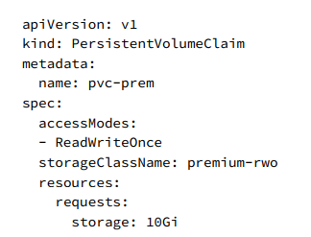
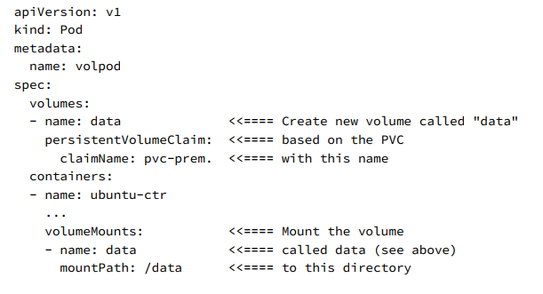
kubectl get sc

Slide 63
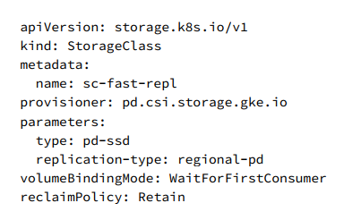
Creating and using a new storage class

