Slide 1
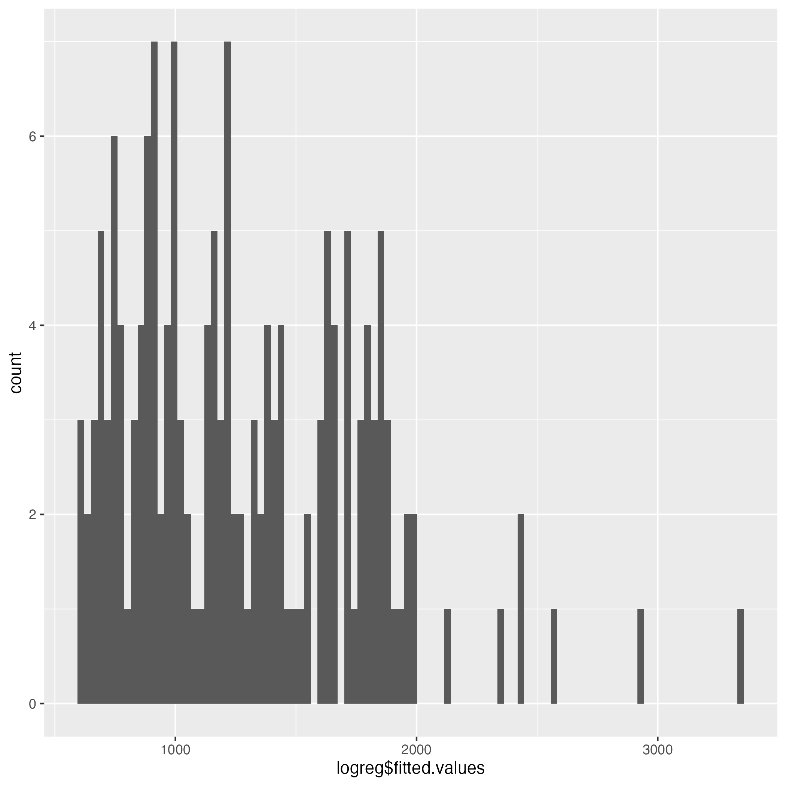
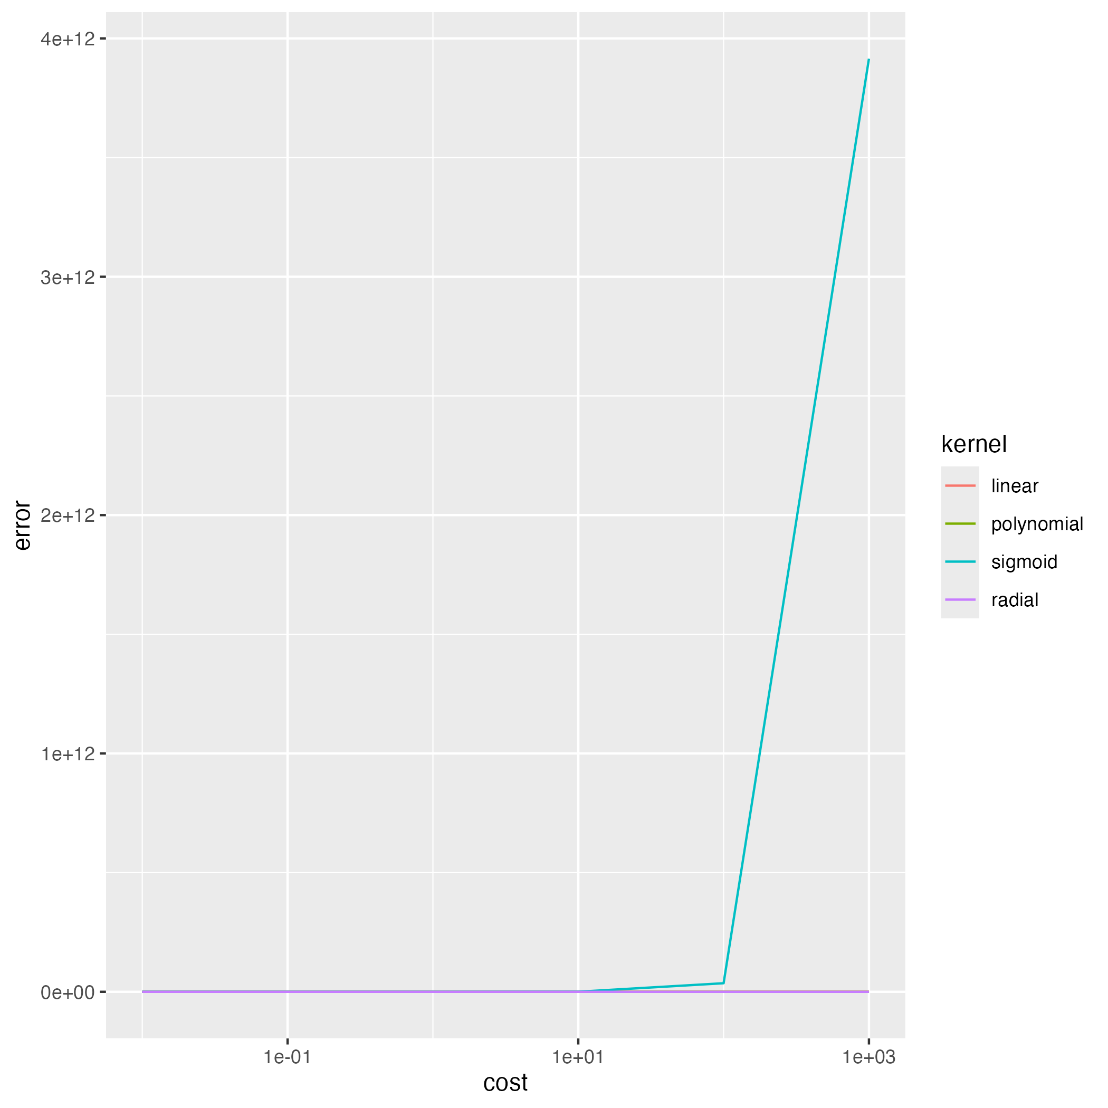

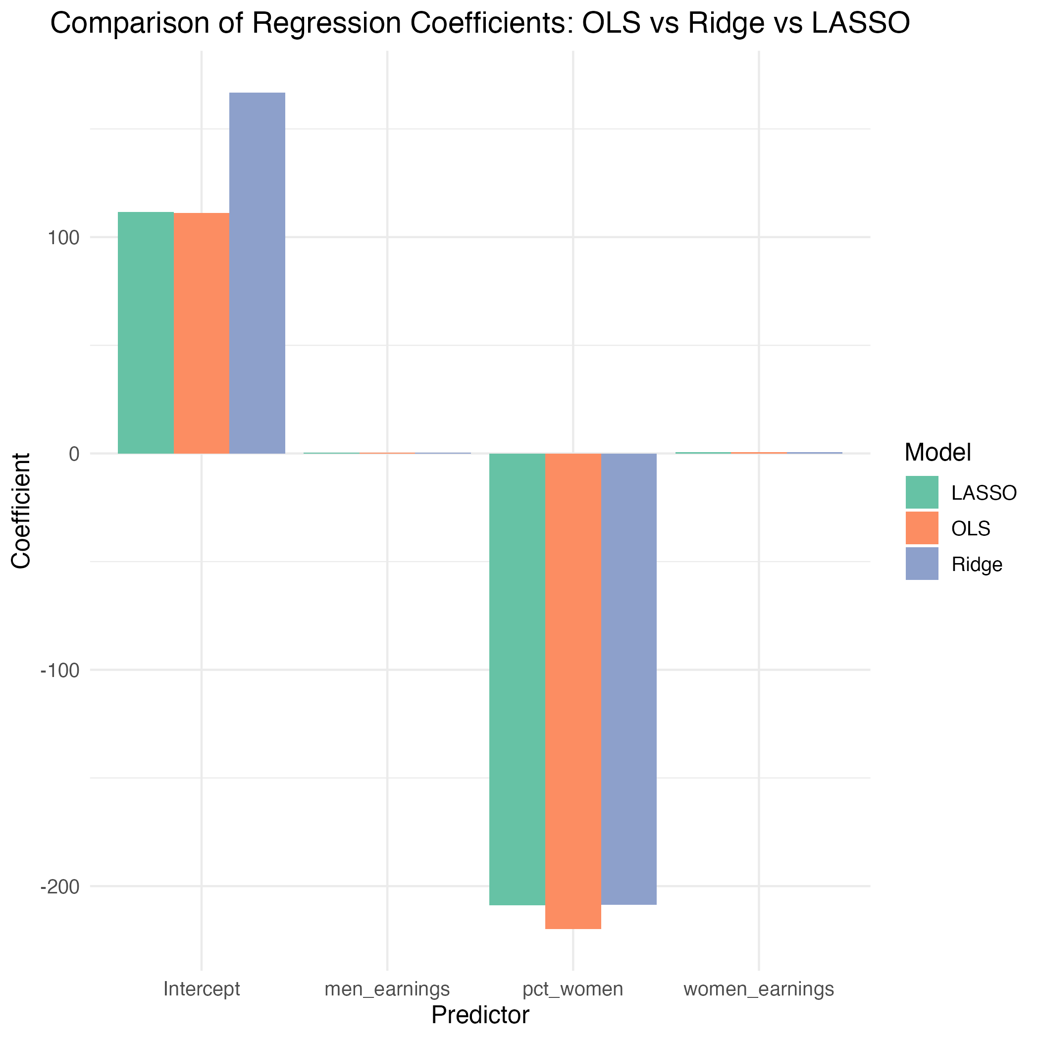
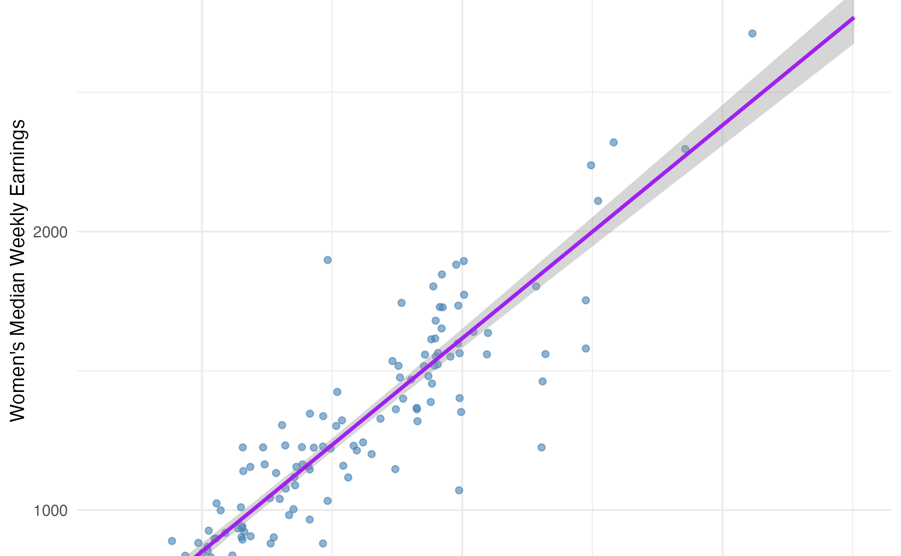
Wage Inequality in the U.S. Labor Market
Emily Eames and Layne DiBuono
American University
Topic
This project investigates the determinants of wage inequality in the U.S. labor market using advanced regression (Ridge or Lasso) and classification methods (Random Forest, SVMs) to compare predictive accuracy along with interpretability.
Data
Our data is from the BLS and the St. Louis Federal Reserve. These datasets provide various wage and demographic related data with options for historical data and recent data (2024)
Classification
Can we predict whether an individual earns above or below the median national wage based on their demographic and employment characteristics?
Introduction
Introduction to our project
Fig. 3. Fitted value plot
Literature Review
Insert lit review here.
Model | Feature extraction | Reprocessing | Classification
Log Reg | >200,000 flops | ~10 flops | ~200 flops
Class Tree |  |  | ~10,000 flops
SVM
Regression
Results and Analyses
There are many hotels surrounding the Tianjin University
What are the main factors (education, experience, occupation, gender, region) that explain variation in individual wages, and how do regularization methods like Ridge and LASSO improve model performance and interpretability?
Fig. 4. Title of the Figure. (16 point font)
Ethical Concerns
Bias in data - gender/race wage gaps reflecting systemic inequality
Interpretation risk – Avoid implying causation from correlation
Responsible reporting – Frame results within socioeconomic context
Conclusion
1. Technical Tours
2. Post Conference Tours
(Detailed information will be updated later)
Fig. 1. Comparison plot
Fig. 2. Correlation plot
Table I. Model results*
Model | Feature extraction | Reprocessing | Classification
OLS | >200,000 flops | ~10 flops | ~200 flops
Ridge Regression |  |  | ~10,000 flops
Lasso
References:
[1] Gould, E., Mishel, L., & Bivens, J. (2015, January 6). Wage stagnation in nine charts. Economic Policy Institute . https://www.epi.org/publication/charting-wage-stagnation/
[2] Sherman, A., Trisi, D., & Cureton, J. (2024, December 11). A guide to statistics on historical trends in income inequality. Center on Budget & Policy Priorities. https://www.cbpp.org/research/poverty-and-inequality/a-guide-to-statistics-on-historical-trends-in-income-inequality
Authors emails: ld9100a@american.edu

