Slide 1
HackerWar 3.0

Slide 2
Table of contents
Our Team
Understanding Problem Statement
Our Solution
Execution Plan
Credits

Slide 3
HackBots
Eebad Reza
Sneha Rani
Aakriti Kumari
Raj Aryan

Slide 4
Problem Statement
For Indian handicraft and handloom industry make a cross-border e-commerce marketplace will bring customers and sellers together on a single business platform.
To provide a unique e-commerce platform for craftsmen to sell various crafts and accessories.
To globalise the Indian handicraft industry.
Providing a shared platform for the creation, marketing, and sale of high-quality handicrafts and items.

Slide 5
Solution
Sentiment analysis
Worldwide Shipping
Demand forecasting
Automatic quality checks

Slide 6
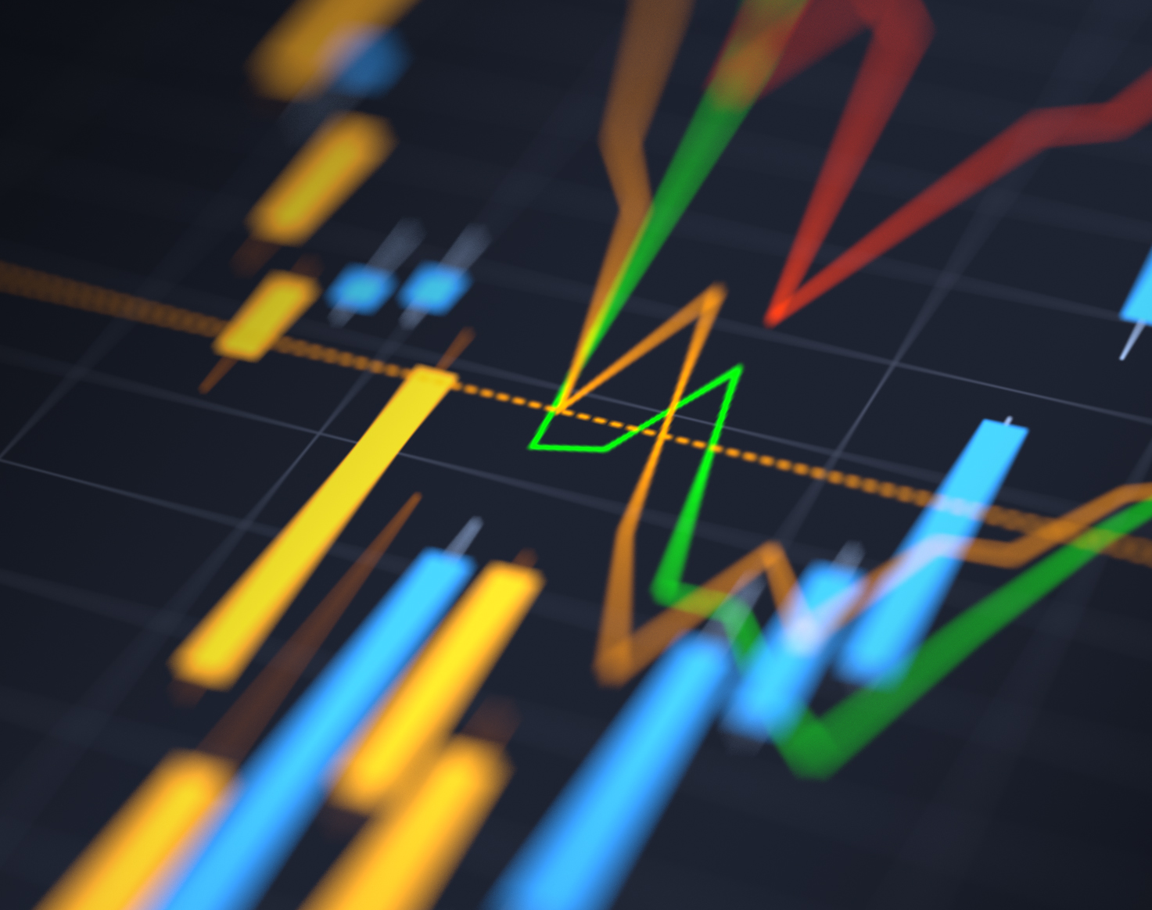
Feature for Making Website Efficient in Sales
This Photo by Unknown author is licensed under CC BY-ND.

Slide 7
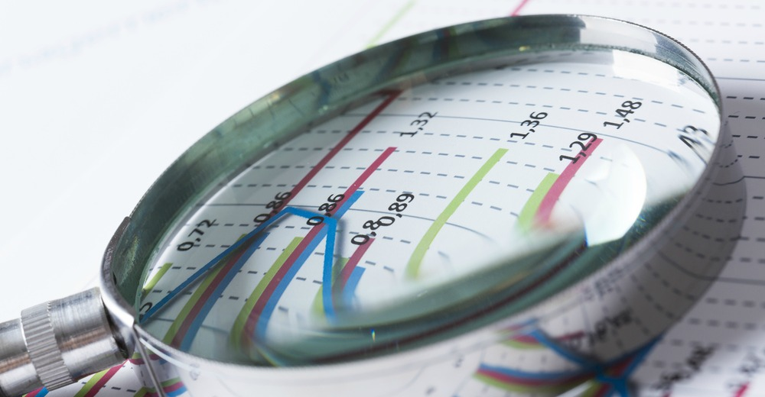
Demand Forecasting
Demand forecasting is the process of using predictive analysis of historical data to estimate and predict customers' future demand for a product or service. .
Demand forecasting is helpful in supply chain management.
Deploying a demand forecasting in website in not feasible.
But, with the use of cookies and API', we will be able collect user information regarding like which product they are browsing or buying, which will help in demand forecasting in supply chain management.
This Photo by Unknown author is licensed under CC BY-ND.

Slide 8

Sentiment Analysis
Sentiment analysis (or opinion mining) is a natural language processing (NLP) technique used to determine whether data is positive, negative or neutral.
Sentiment analysis is often performed on textual data to help businesses monitor brand and product sentiment in customer feedback, and understand customer needs.
We will be using Sentiment Analysis (API) in the review section of the handcraft and handloom product , this can used for recommendation process.
This Photo by Unknown author is licensed under CC BY-SA-NC.

Slide 9
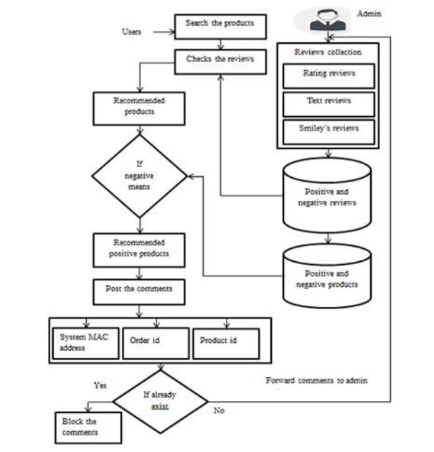
Continue
If the user write negative review,
the system will recommend
the product with positive review.
We will implement this function
by calling various API's.

Slide 10

Automatic Quality Check
Giving an accurate quality check of the product is not feasible with only website . One would require many other tools like AI/ML model and Physical warehouse for automation checking.
But we can evaluate the quality of the product through the users itself, we can use review and rating of the product to determine its quality.
We will mark the product with special label which have passed the quality check. This will benefit both buyer and seller .
This Photo by Unknown author is licensed under CC BY-NC.

Slide 11
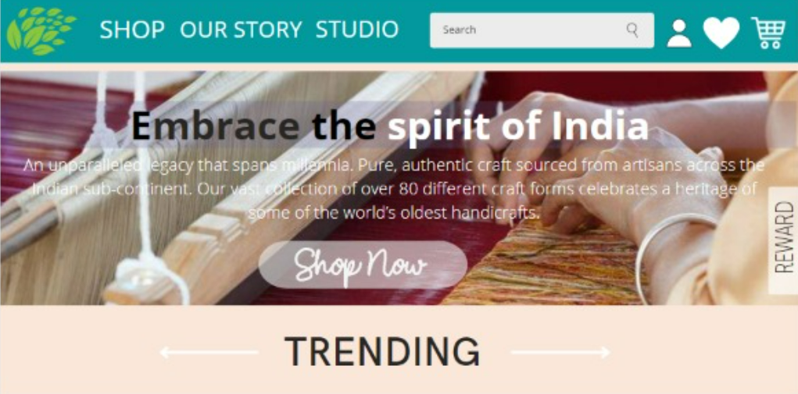
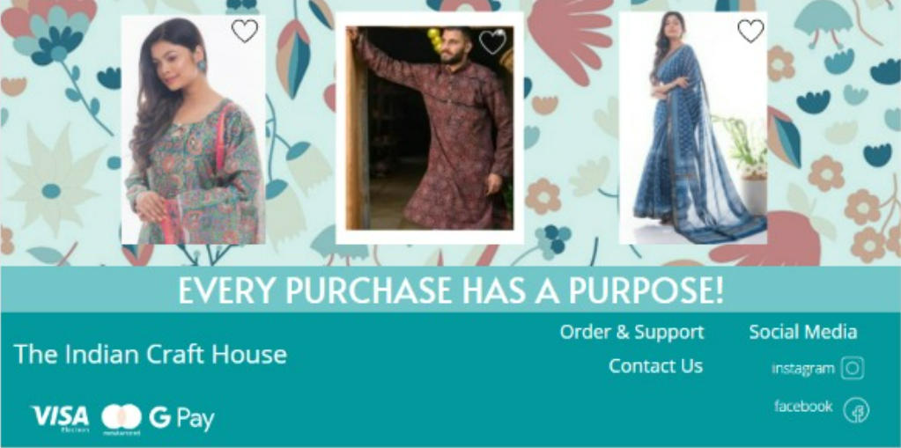
HOME PAGE : FIRST LOOK
Include variety of clothes of different materials.
Display the trending product of the website.
Show various offers and reward available for users.

Slide 12
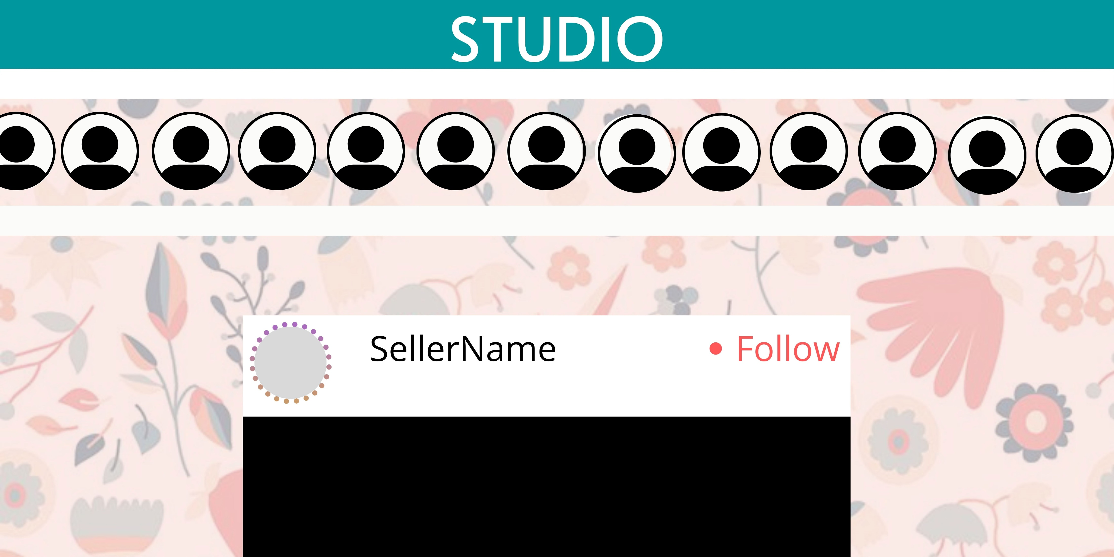
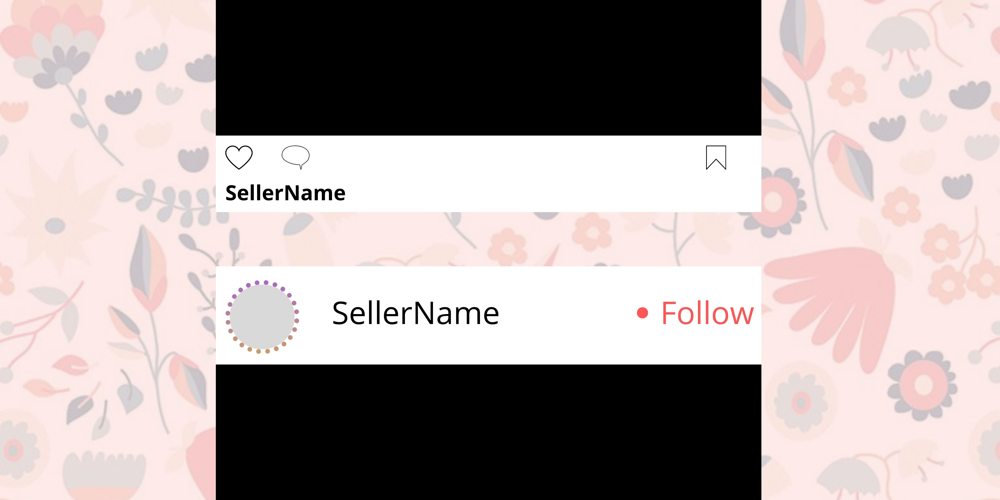
STUDIO
This Section of Website will help us to bridge the gap between the artisan and buyers.
With the help of content creator and influencers, we will spread awareness about the rich culture of craft and handloom of India throughout the globe.

Slide 13
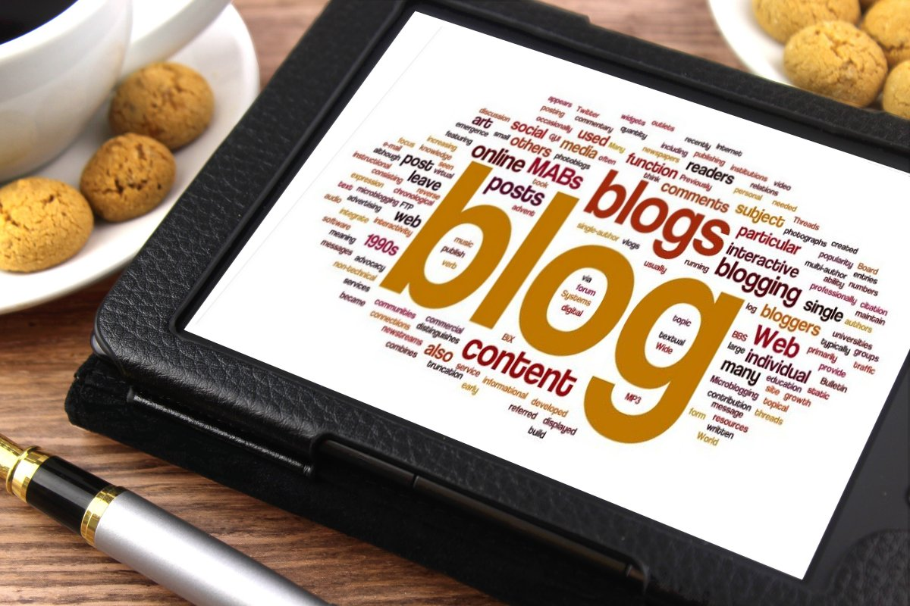
Blog & Reviews
There will be an short blog section , where users can read about other's person experience about shopping in website, with various products.
Blog will also include artisan story , there lifestyle, how generation-to-generation these skill are been passed out .
This Photo by Unknown author is licensed under CC BY-SA.

Slide 14

OUR STORY
Spreads awareness about Indian goods .
Connects people with products.
Encourages other sellers to become a part of this marvelous community.

Slide 15
Credits
Eebad Reza : : FrontEnd
Raj Aryan : : BackEnd
Aakriti Kumari : : FrontEnd
Sneha Rani. : : FrontEnd + Assets

Slide 16

Thank you

